Slide 1
Ernst Ising - Lars Onsager Distinguished Lecturer
Fall 2023
J. Michael Kosterlitz

Slide 2
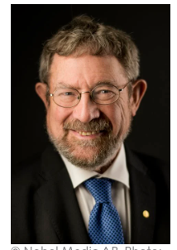
Professor J. Michael Kosterlitz Harrison E. Farnsworth Professor of Physics, Brown University
Lars Onsager Prize – American Physical Society
Maxwell Medal – British Institute of Physics
Fellow – American Academy of Arts and Sciences
Elected to the U. S. National Academy of Sciences
Recipient – 2016 Nobel Prize in Physics

Slide 3
Why are there different phases of matter?

Slide 4
Order and disorder
favorable
unfavorable
Ordered
phase
Disordered
phase

Slide 5
But, with different local rules …
UNfavorable
favorable
Frustration!
Ordered
phase
?
Glassy
phase

Slide 6
What if spins can point at any angle?
all possible
Topological Defects
Order disorder means dis-association
of these defects
In 2-d, stable order can happen because of topology

