Slide 1
Colleagues, students in Iaşi University, are happy to celebrate
Sorin’s Jubilee of his twenties
It IS now 50 years since his (chronological) twenties.
and here, in Iasi, we have a fresh memory of Sorin’s twenties

Slide 2
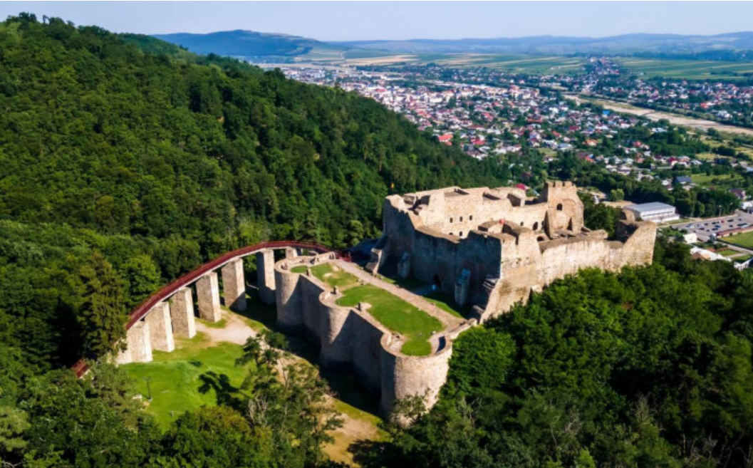
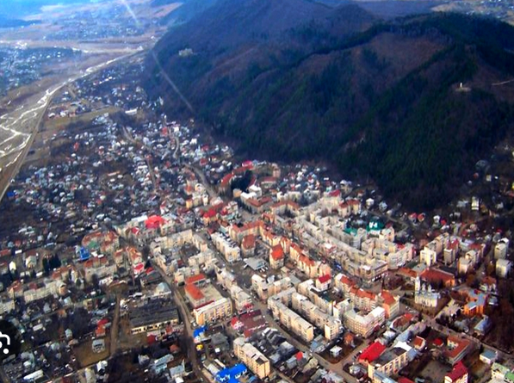
Two Moments ≈50 Years Apart
From: leaving Targu Neamt for … Computer Science
https://www.digi24.ro/stiri/externe/ue/sobieski-si-romanii-in-varianta-cu-fonduri-ue-ce-se-poate-vedea-la-cetatea-neamt-dupa-reabilitare-1602351
https://www.ziartarguneamt.ro/poate-fi-targu-neamt-un-oras-turistic

Slide 3
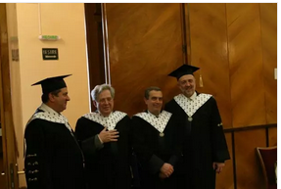
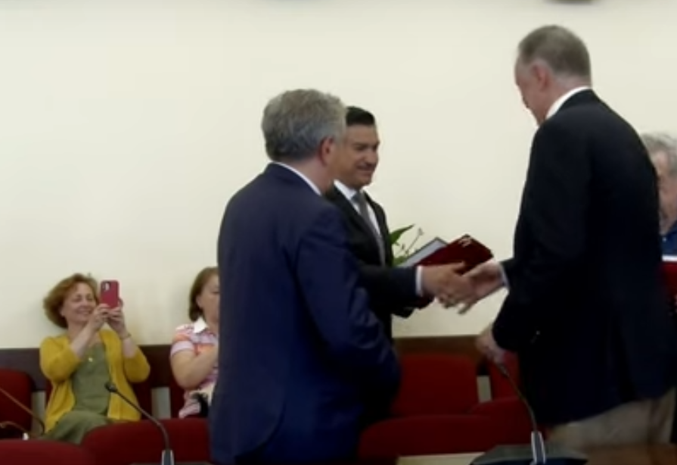
To: the Iasi University and the City of Iasi awarding Sorin their respective highest honours, thus expressing the pride of the community where Sorin spent his student and young researcher years.
As acknowledged in the Laudatiae, we honoured a most influential scientist whose results – individual scientific endeavour, master-student magic interaction or the huge, brilliantly co-coordinated by him team work – are milestones in Computer Science and in BioInformatics.
Alexandru Ioan Cuza University of Iaşi, June 24th, 2010
Iaşi City Hall, June 6th, 2023
https://www.uaic.ro/galerie-foto-uaic/prof-univ-dr-sorin-istrail-si-prof-univ-dr-dan-simovici-profesori-de-onoare-ai-universitatii-alexandru-ioan-cuza/
https://www.youtube.com/watch?v=hdDNVvHoU98

Slide 4
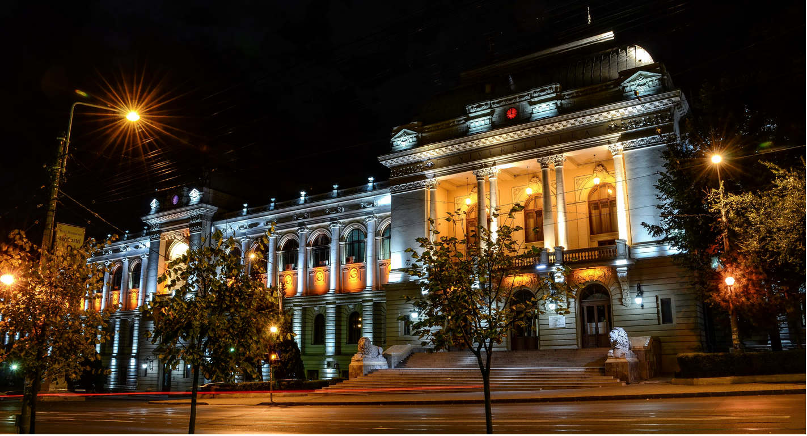
May I share with you a few words and images on what Sorin did in-between these two moments, for and with the academic community where his career started.

Slide 5
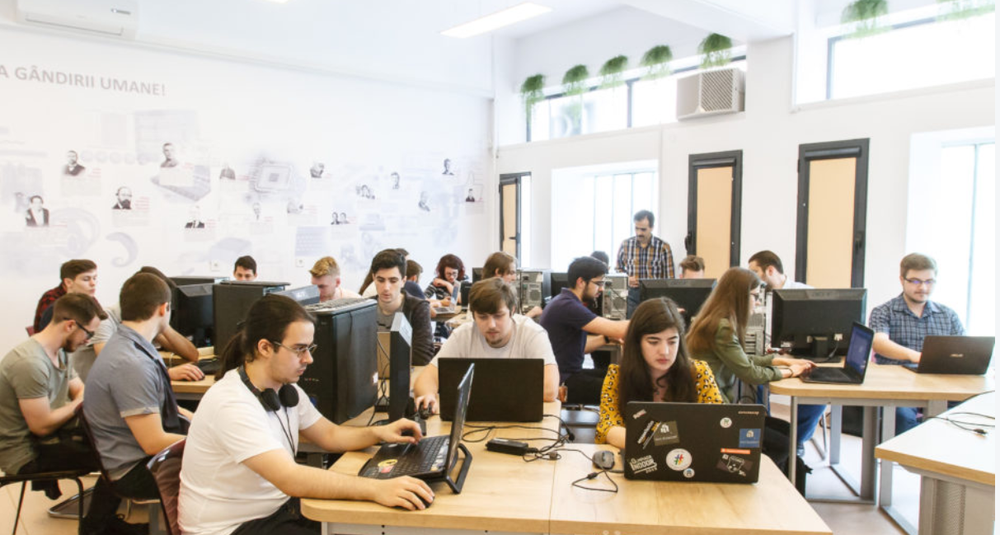
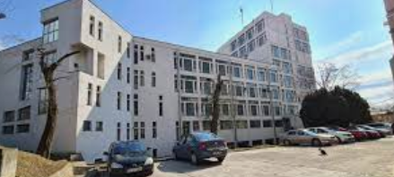
Sorin graduated high-school as valedictorian. Then, he enrolled in the first ever Computer Science class in Iaşi – and subsequently promoted enthusiastically this choice among younger pupils in his high-school. Sorin graduated in Matematica/Informatica in 1975 as valedictorian, Summa cum laude, of that first Computer Science class.
The Computer Science Faculty building was inaugurated when Sorin was still a student (1974).
Computer Science Faculty of Iasi, today.
“Towards the next milestones in the fascinating journey of human thinking”
https://www.facebook.com/FacultateaDeInformaticaUAICIasi/
https://www.info.uaic.ro/studii-de-master/

Slide 6
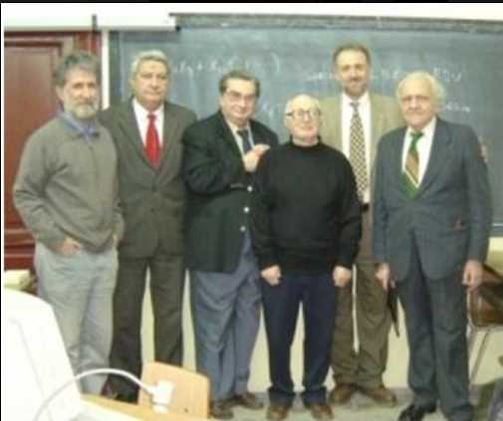
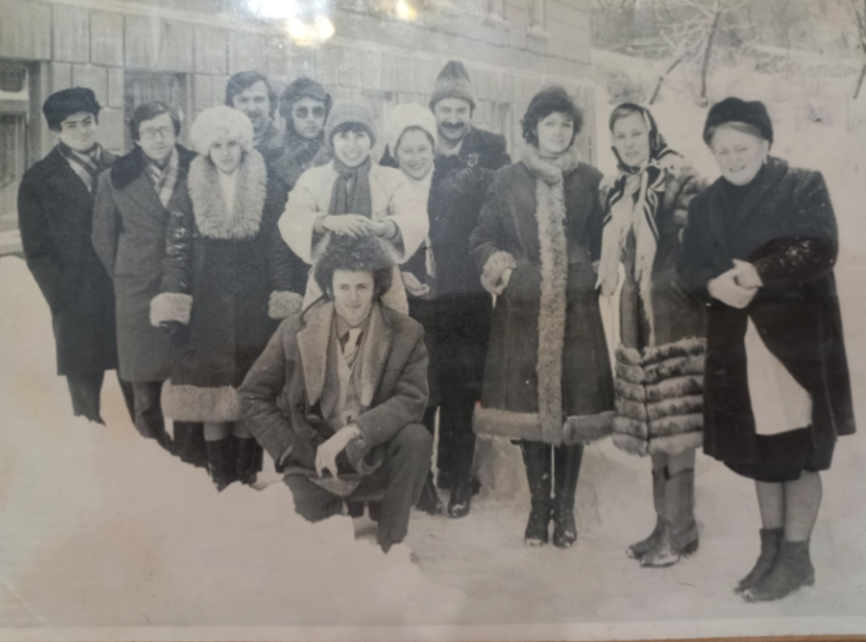
Sorin defended his PhD thesis in 1979, his advisors being professors Solomon Marcus and Sergiu Rudeanu: Context-Sensitive Languages with Applications in the Semantics of Programming Languages and in Number Theory.
1977-1983: he joined Alexandru Ioan Cuza University of Iasi - its Computer Center and its Faculty of Mathematics -, undertaking research and teaching Algorithmics and Programming.
On the occasion of Sorin’s lecture "Comparative genomics algorithms: from genomics to protein folding and to systems", 16 December 2005, Faculty of Mathematics and Computer Science, University of Bucharest. In front of Sorin, his lifelong cherished PhD advisors, professors Solomon Marcus and Sergiu Rudeanu
Early 1980’s, winter. Sorin and most of his colleagues at the Computer Center of the Iasi University. (courtesy of Niculina)
http://mvlada.blogspot.com/2019/01/info-iasi-si-rosycs-iasi.html

Slide 7
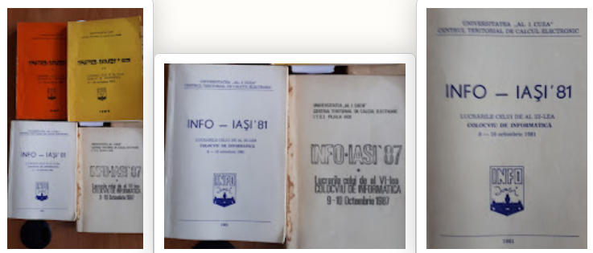
Besides his publications, he, as ever, enthusiastically
organised lecture groups and research teams in the Computer Center,
shaped the first four editions of the only, by then, scientific conference in CS in Romania, INFOIASI,
gave talks in high-schools attracting bright pupils to the newly established CS section of the Faculty of Mathematics
one can still find, on one of Sorin’s webpages, a High-school students entry.
University Library, Iasi.

Slide 8
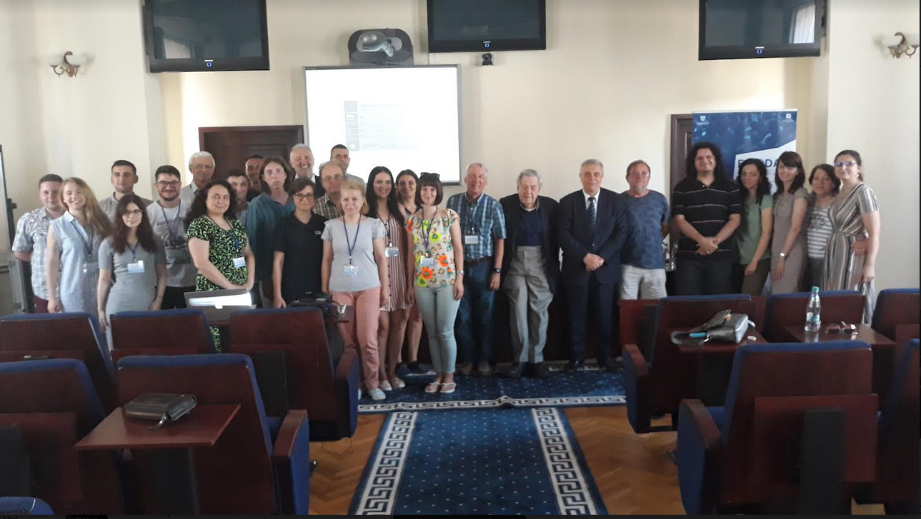
Thereafter Sorin has been continuously contributing to the academic life in Iaşi. Since 2006, Sorin gives lectures at ECODAM – the Summer Doctoral School of The Computer Science Faculty in Iași. Each of the 13 editions of this event joined together PhD students from three countries – Romania, Republic of Moldavia and Ukraine – and invited speakers from three continents – most frequently, Europe, North America and Australia.
2019
Sorin among the Ukrainean and Moldavian PhD students – always happy among happy students.
https://profs.info.uaic.ro/~summerschool/summerschool/public/

Slide 9
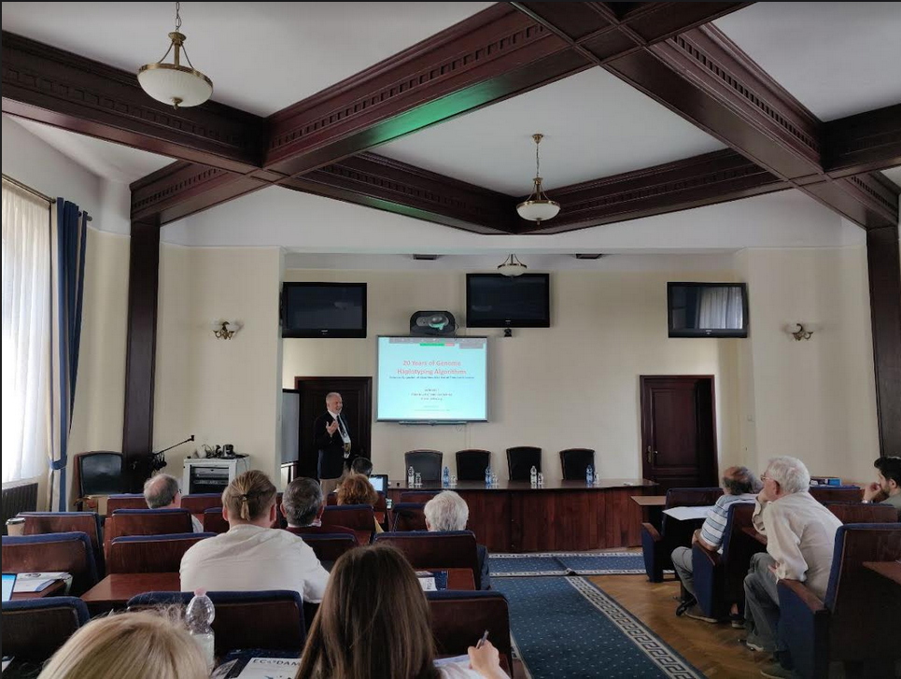
Sorin Lectures at ECODAM
Concepts of Mathematical Rigor for Algorithms in De-randomization, Statistical Physics, and Molecular Biology (2010);
Human Genome and Medicine (2011);
Genome Assembly Algorithms (2011);
The Missing Heritability Problem: Disease Models, Algorithms and the Genome (2013);
Computer Science through Urn Games: An Unified Framework for a Hierarchy of Solvable and Unsolvable Problems (2014);
The Book of Why – A Formalisation of Causality (2019);
20 years of Genome Happlotyping Algorithms (2023).

Slide 10
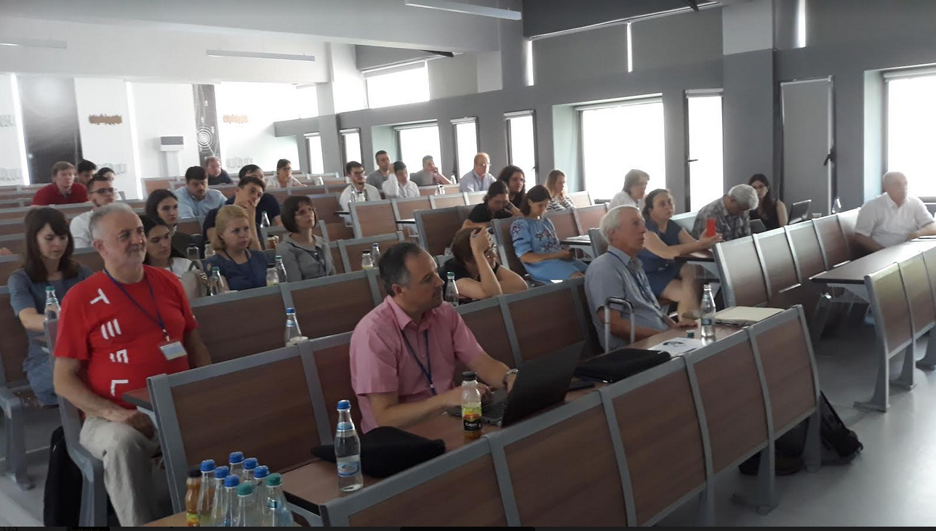
Sorin during an ECODAM session, with Kenneth DeJong and Oscar Cordon.
https://profs.info.uaic.ro/~summerschool/summerschool/public/

Slide 11
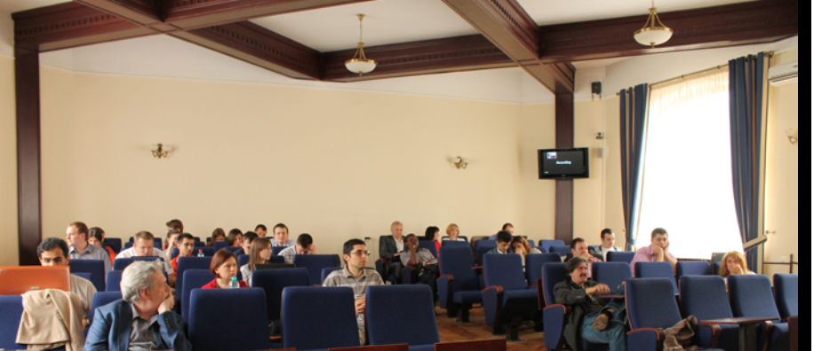
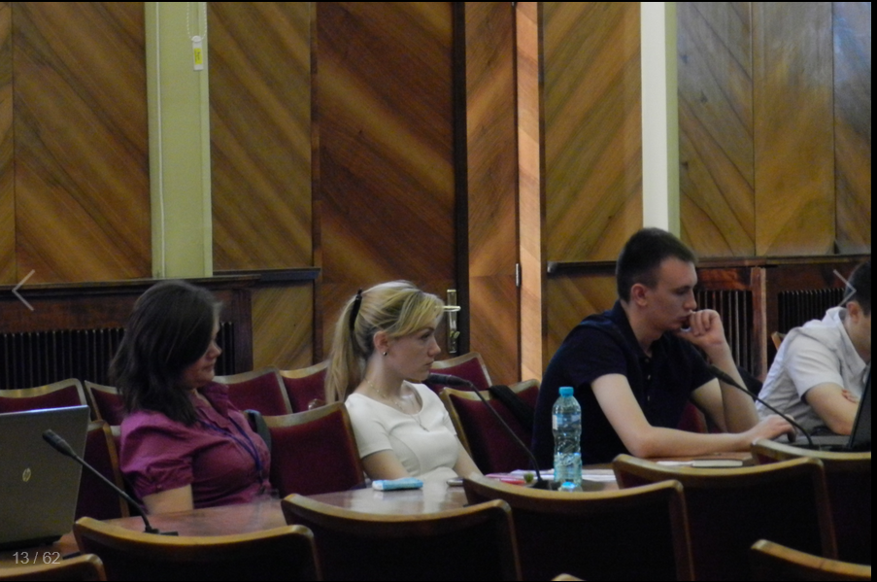
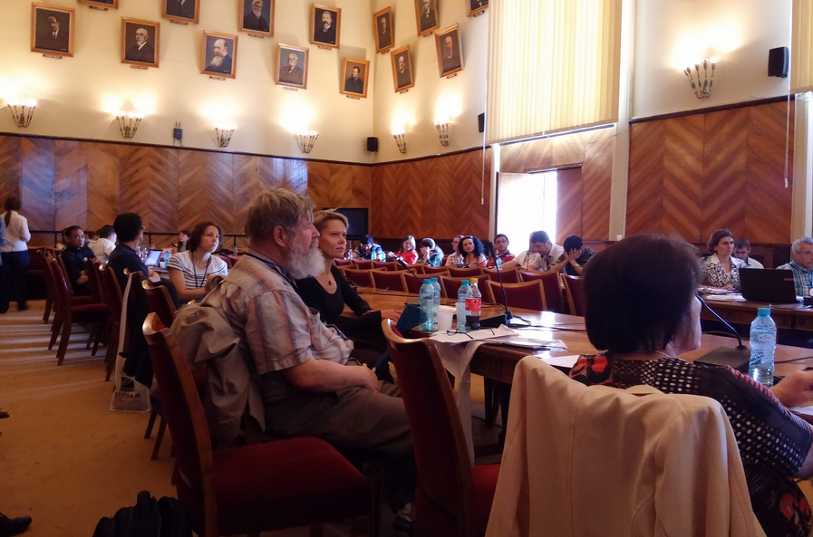
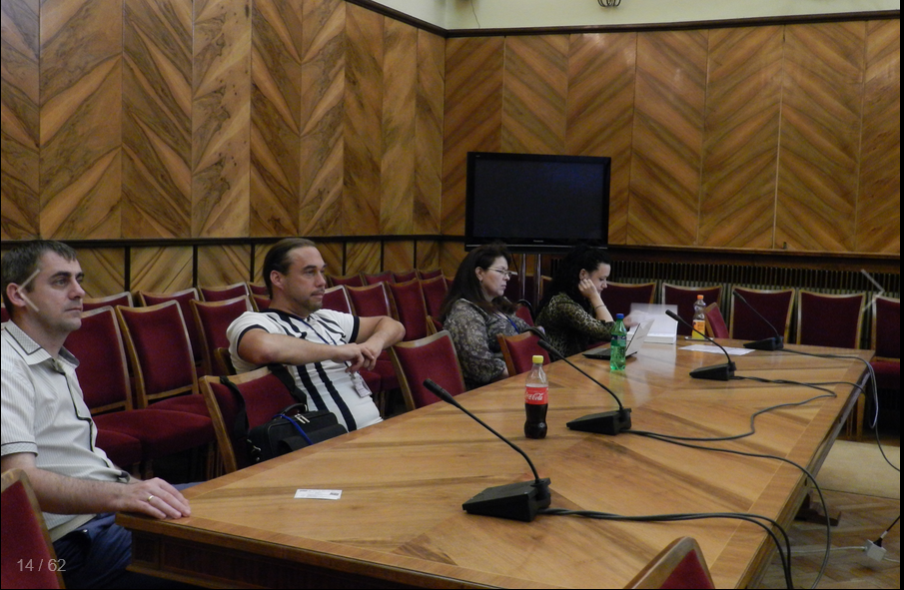
https://profs.info.uaic.ro/~summerschool/summerschool/public/

Slide 12
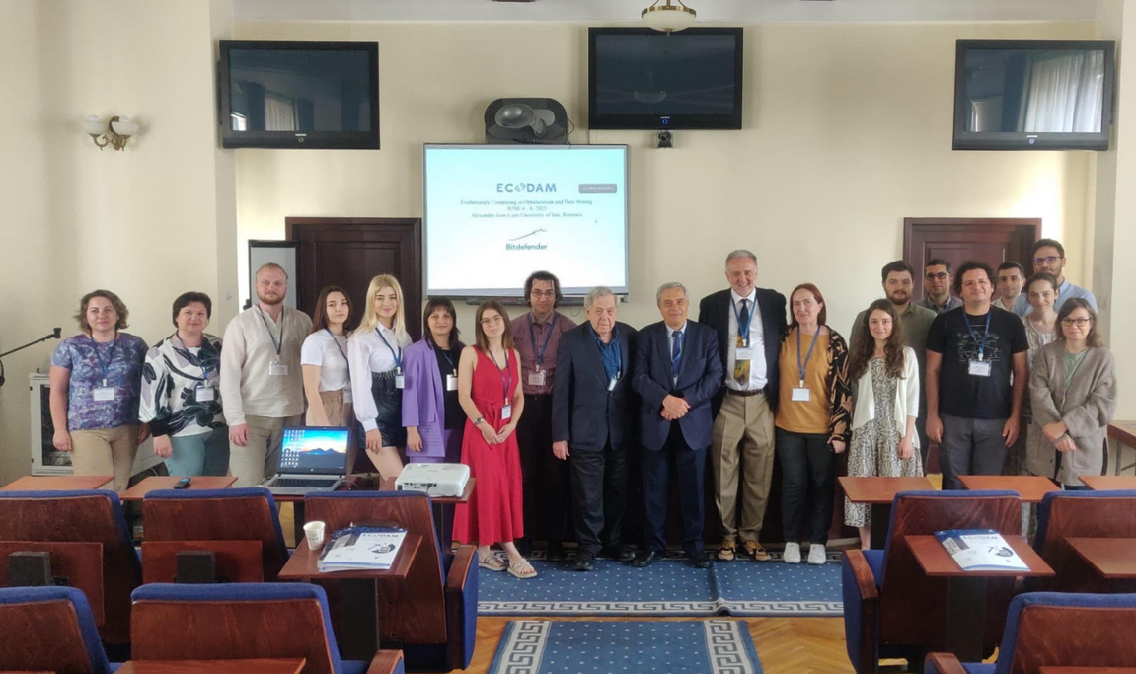
2023
https://profs.info.uaic.ro/~summerschool/summerschool/public/

Slide 13
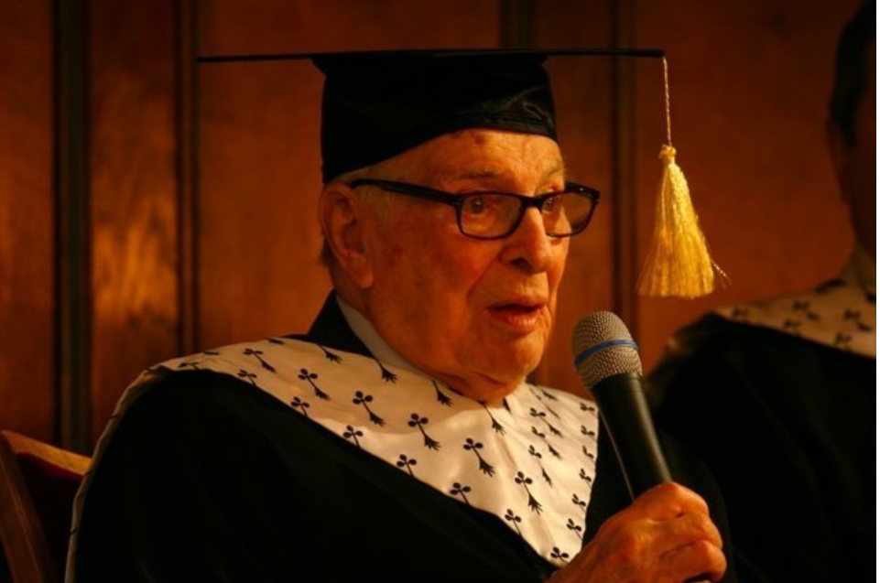
Arrow Days in Iaşi – October 2013
Sorin was a member of the committee which awarded in October 2013 the title of Doctor Honoris Causa of the Iasi University to Professor Kenneth Arrow.
The whole event would have not been possible, were it not for Sorin’s enthusiasm and perseverance.
Professor Arrow's parents were born in Iasi.
Sorin dedicated 4 years to organising Kenneth Arrow’s visit to Iasi,
eventually bringing enormous joy to both the outstanding scientist, who came for the first time to his parents’ native place, and to the Romanian community of Mathematicians and Economists, who simply crowded to Iasi University on October 29th 2013 to attend Kenneth Arrow’s acceptance lecture.
All pictures from Arrow Day in Iasi - courtesy of Diana Chihaia

Slide 14
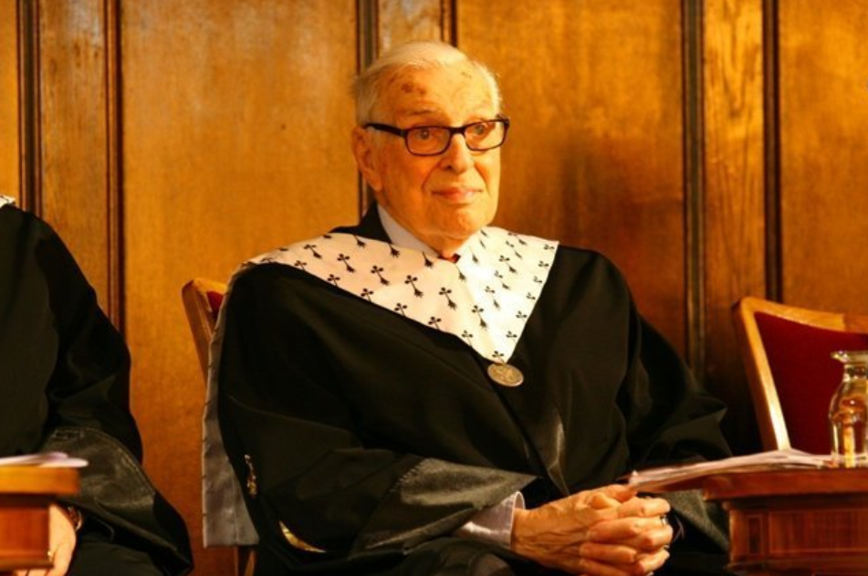
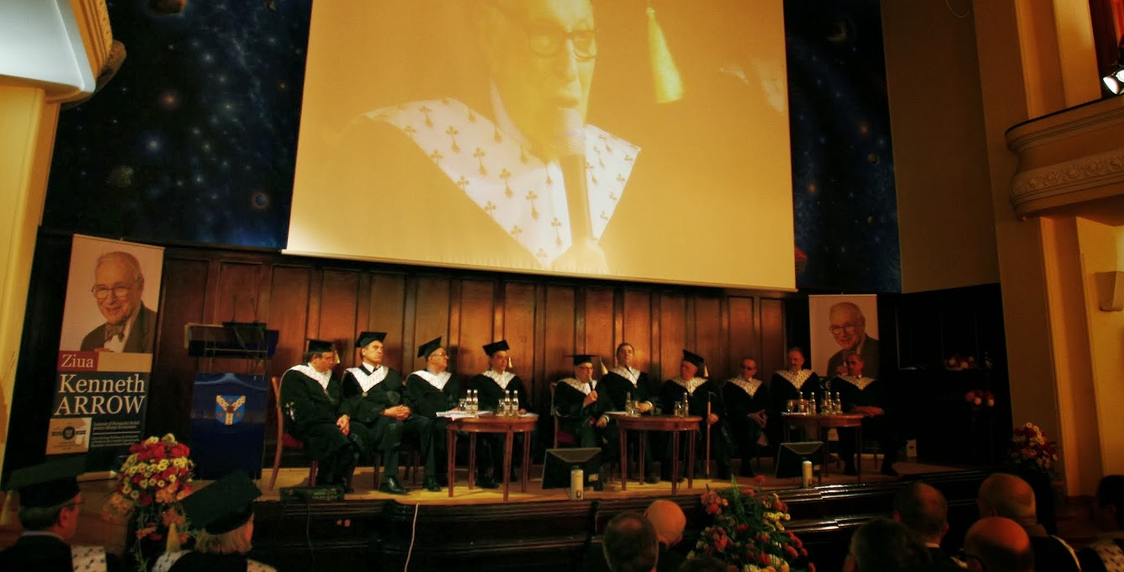

Slide 15
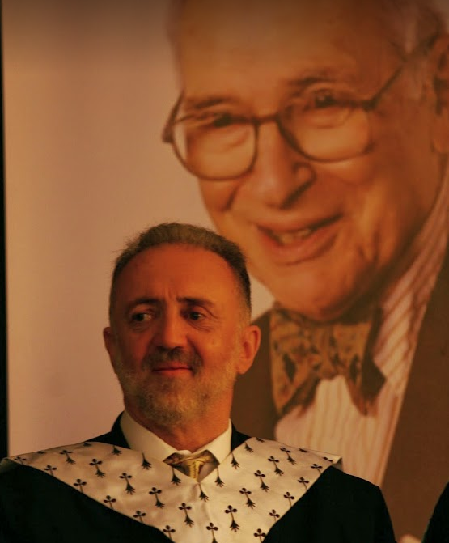
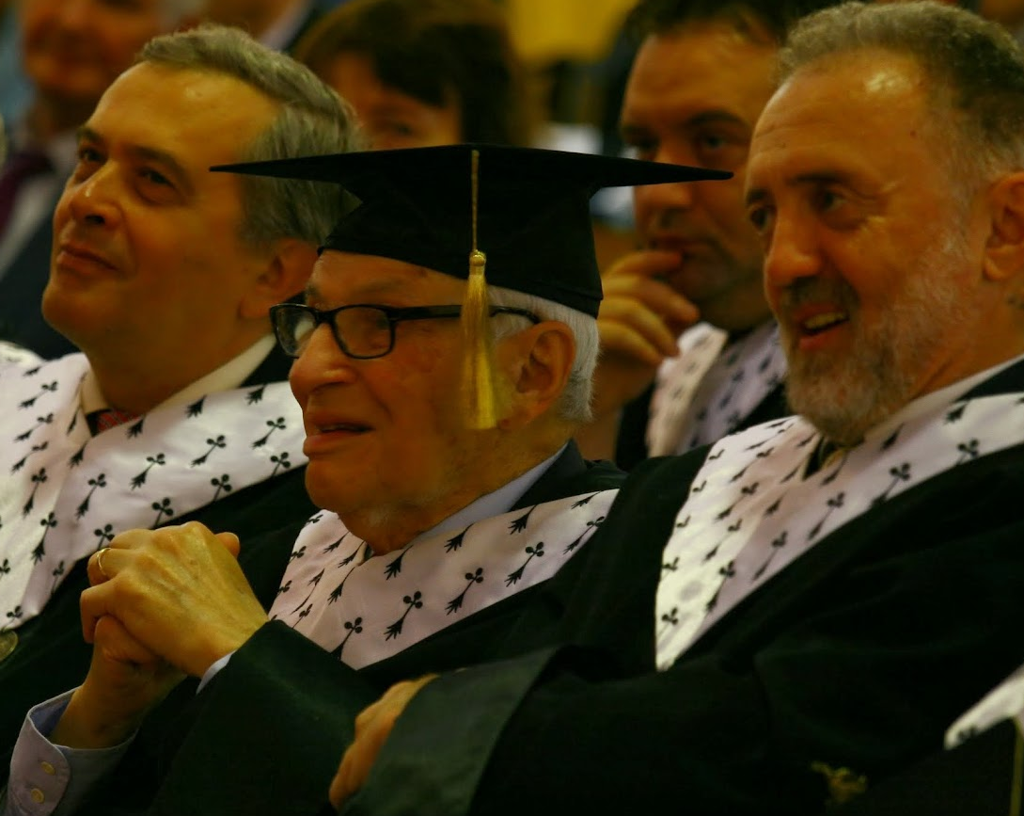
Courtesy of Diana Chihaia

Slide 16
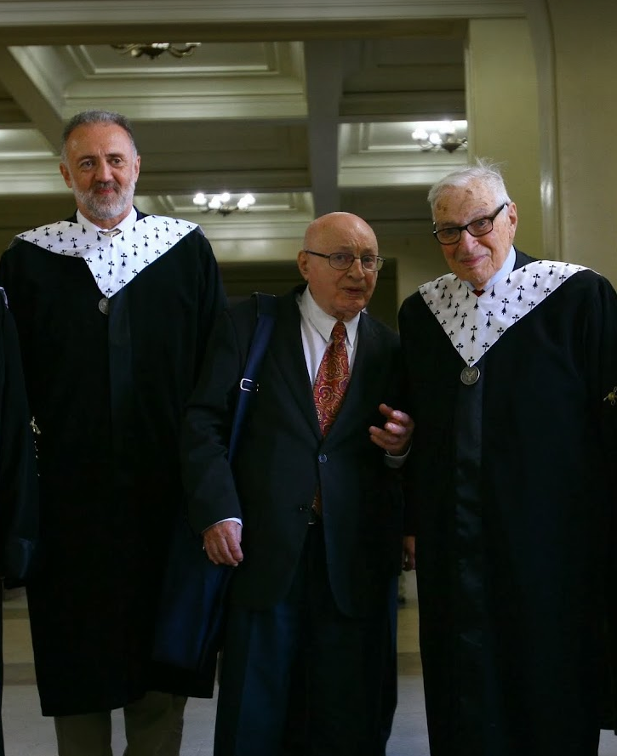
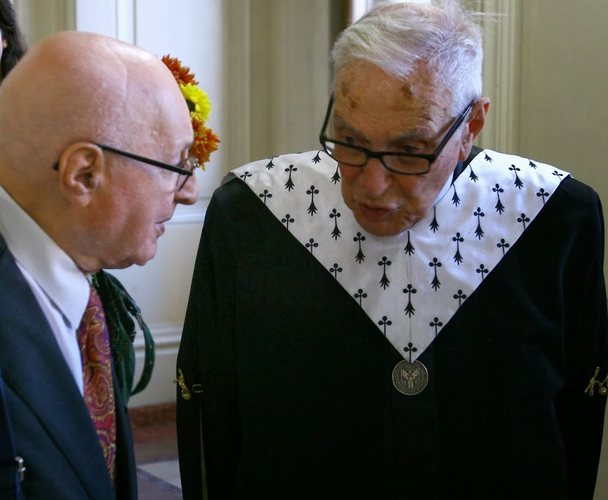
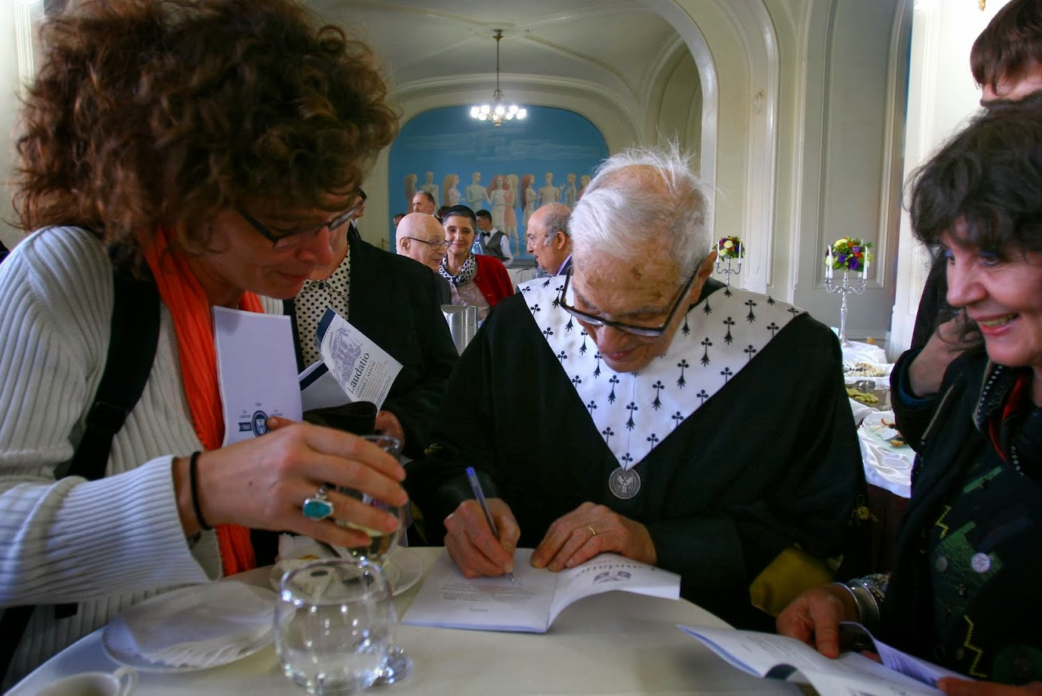

Slide 17
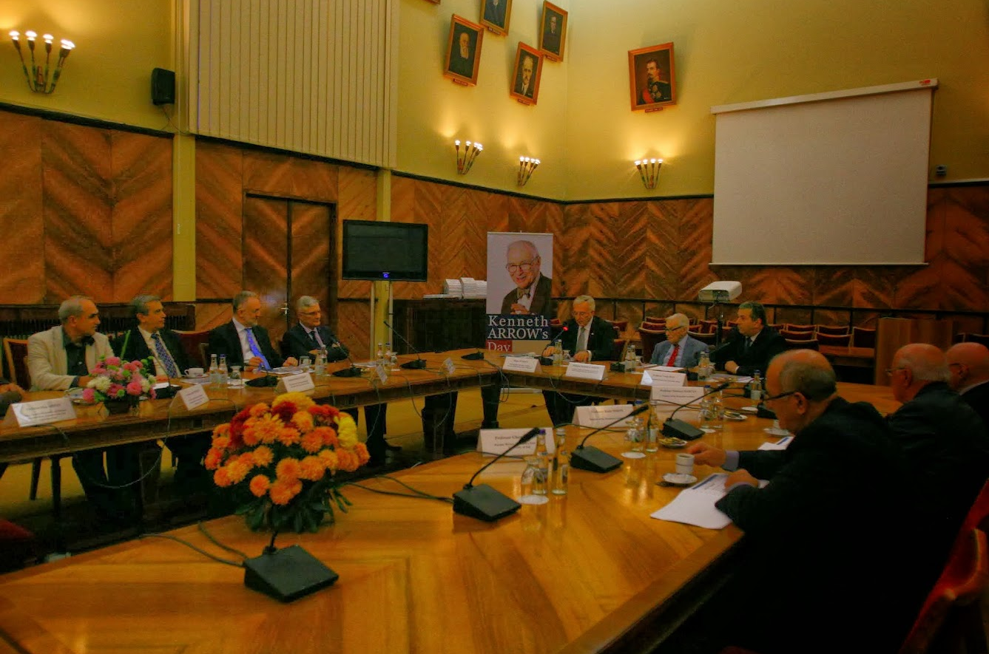
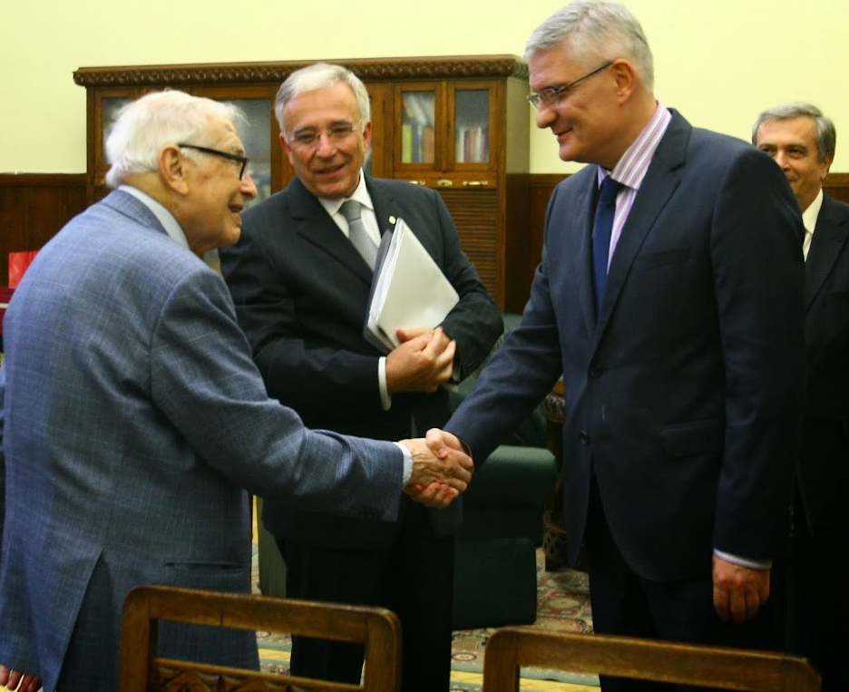

Slide 18
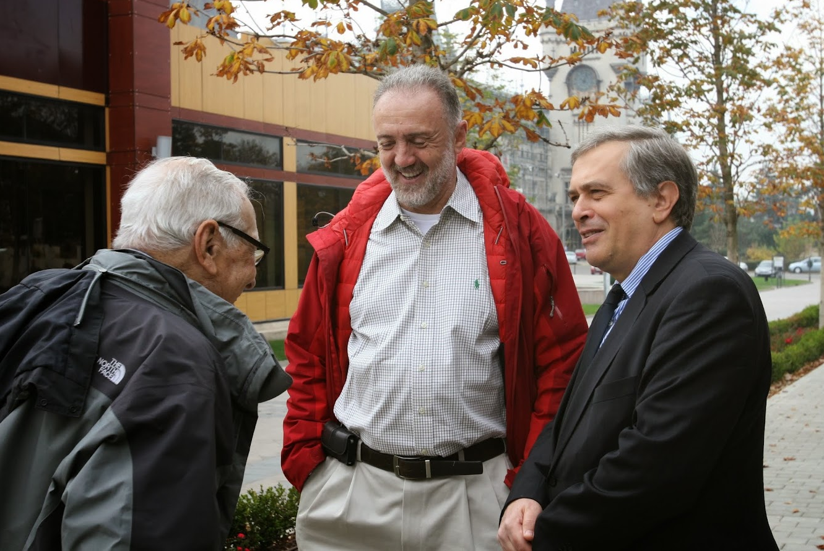
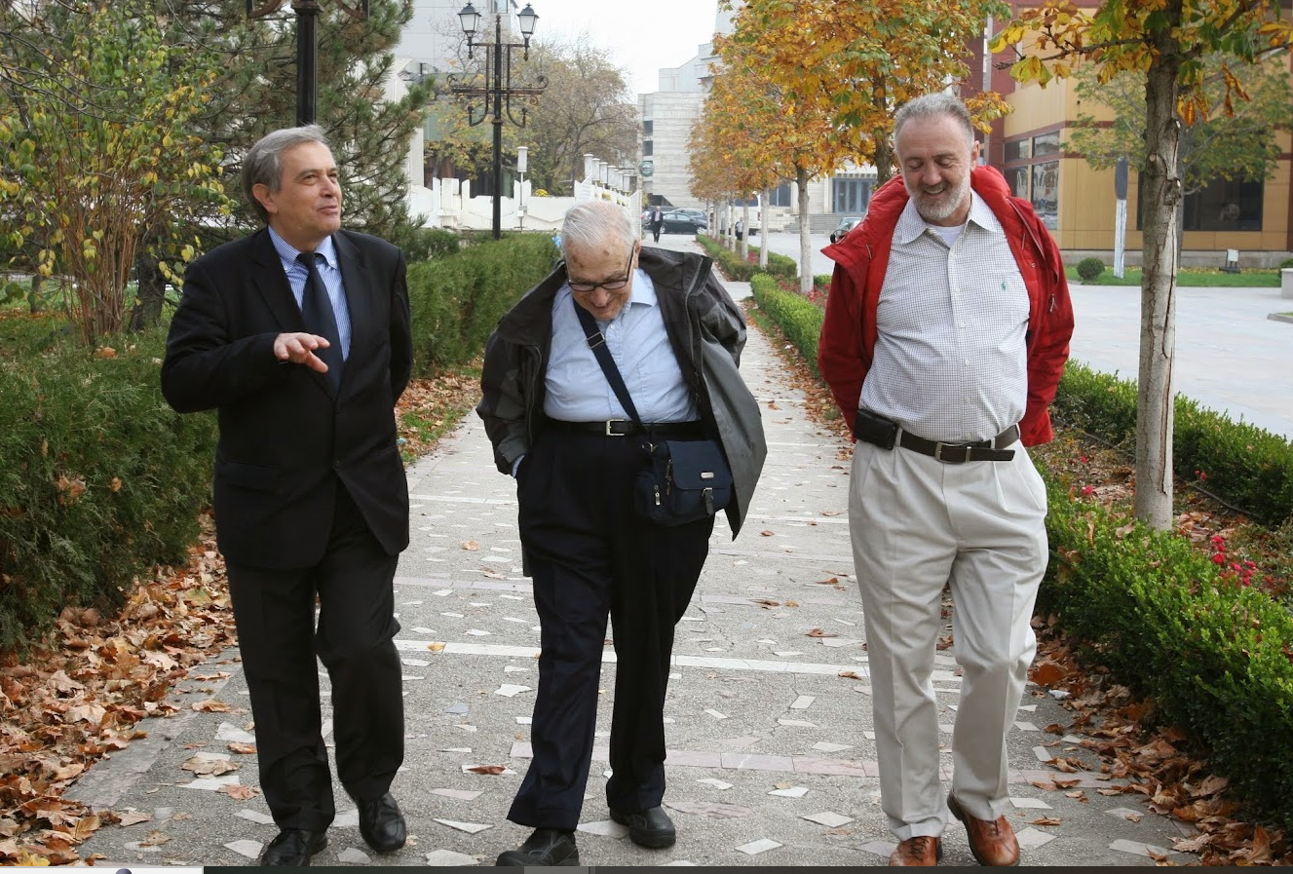
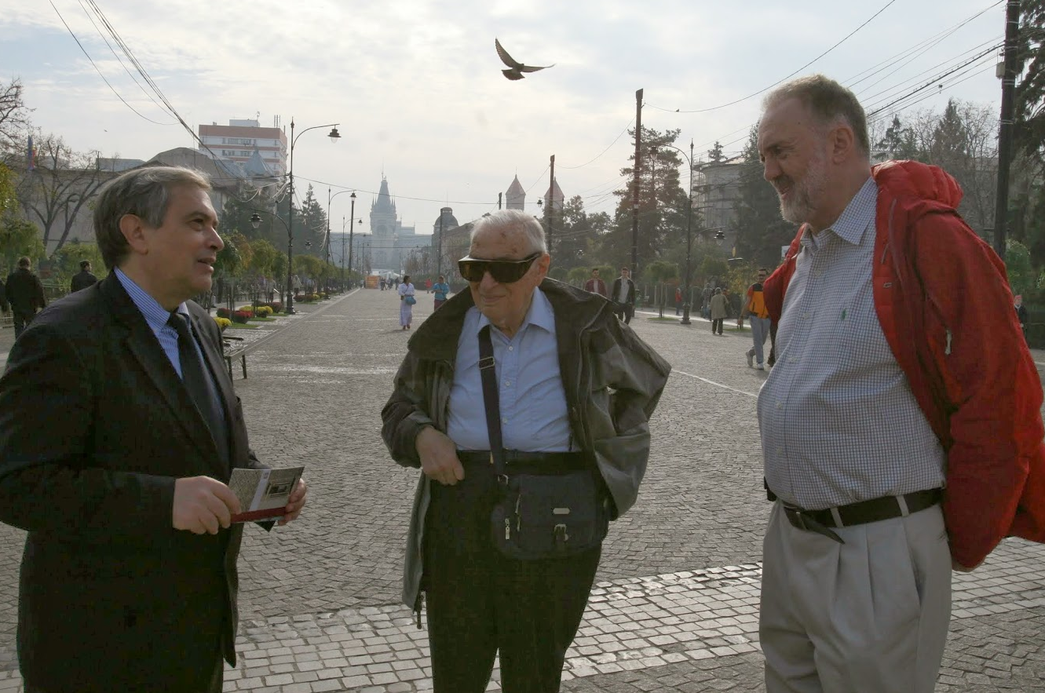

Slide 19
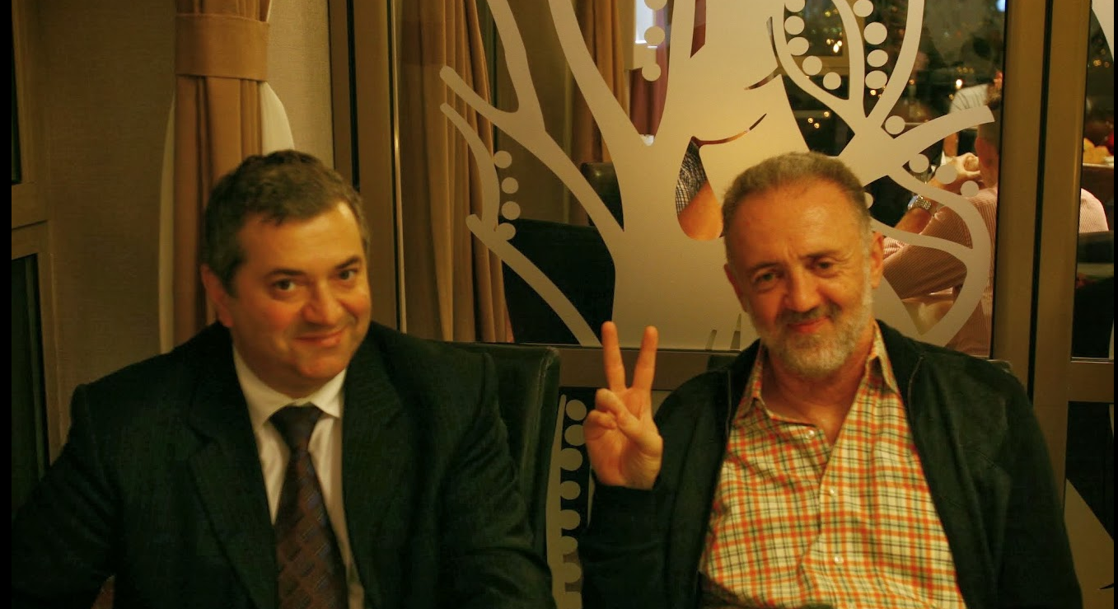

Slide 20
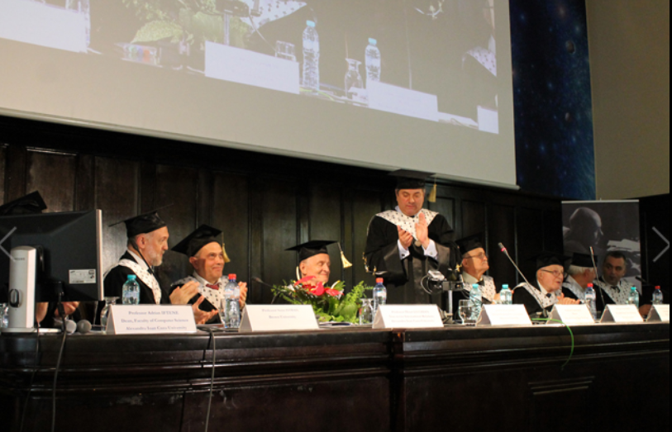
Conway Days in Iasi – June 2014 ECODAM Doctoral Summer School
Sorin was a member of the University "Al. I. Cuza", Iasi, Romania committee awarding in June 2014 the title of Doctor Honoris Causa to John Horton Conway, the then John von Neumann Professor, Emeritus, at Princeton.
It would have never happened were not for Sorin’s enthusiasm and dedication - and for the deeply touching care he took during the whole trip to Iasi of John Conway.
John Conway gave lectures at ECODAM, undertook game sessions with students and high-school pupils, participated in panel discussions with leading Mathematicians in Romania.
Iasi was welcoming an outstanding scientist of the world, and the Mathematics community in Romania – members and prospective future members of the community – came to Iasi for the Conway Days.
The sense of a community flooding to the same place at the same time brought to me memories of Spielberg’s movie “Close Encounter of the Third Kind”.

Slide 21
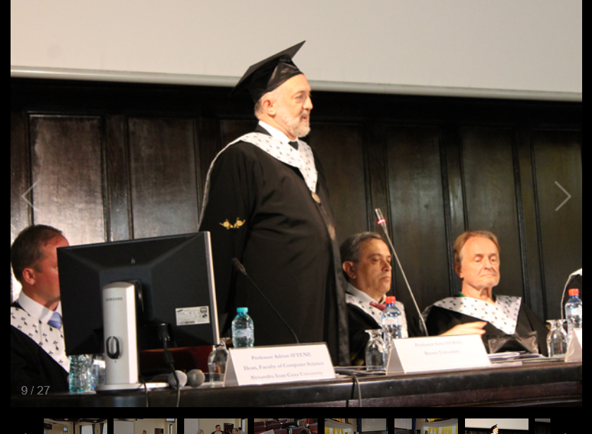
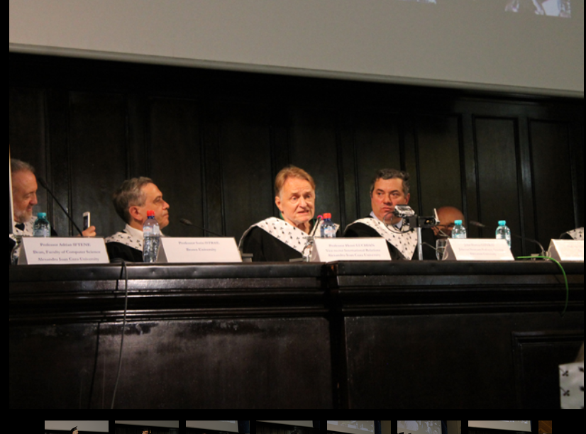
https://profs.info.uaic.ro/~summerschool/summerschool/public/

Slide 22
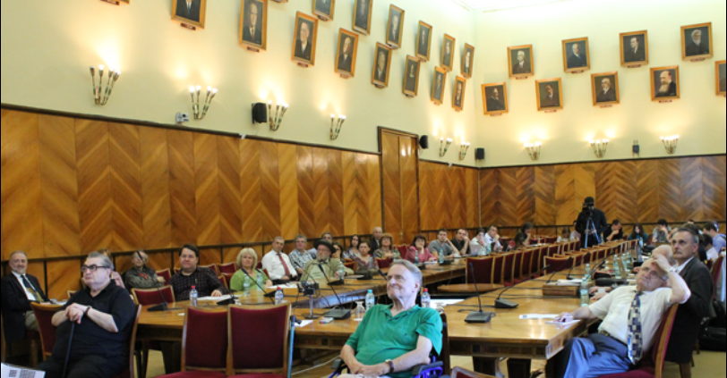
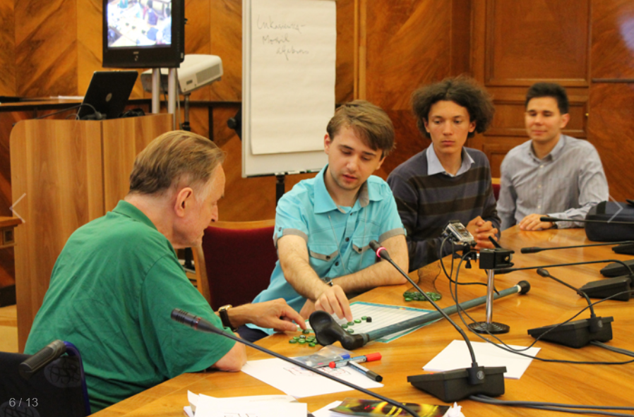
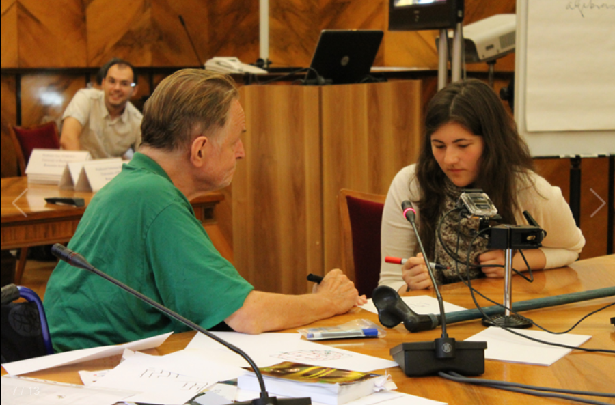
https://profs.info.uaic.ro/~summerschool/summerschool/public/

Slide 23
A Romanian fairy tale, Agingless Youth, has it that visiting your birthplace many years after you left, you find yourself young while everybody around there is old.
This amazing touch of the general theory of relativity (perhaps also of the “ageless quest” of Leonard Guarente - the SIR2 gene) in an ancient story, turns out however to work both ways:
Indeed, Sorin comes yearly to visit Iasi, always being an inspiration and a catalyst. Each time he acts and feels as young as he was here dozens of years ago.
The magic beyond the ancient fairy tale is that, as opposed to the old story, we, his friends and colleagues, also feel as young as we were when Sorin lived here, fifty years ago.
Which makes a good reason to always look forward to welcoming Sorin next time in Iasi, hopefully on the occasion of his graduation jubilee (& again ECODAM).
Many further jubilees celebrated together!
Honouring a dear friend, we wish “La mulţi şi frumoşi ani, Sorin, de la toţi colegii şi prietenii din Iaşi!”

Slide 24
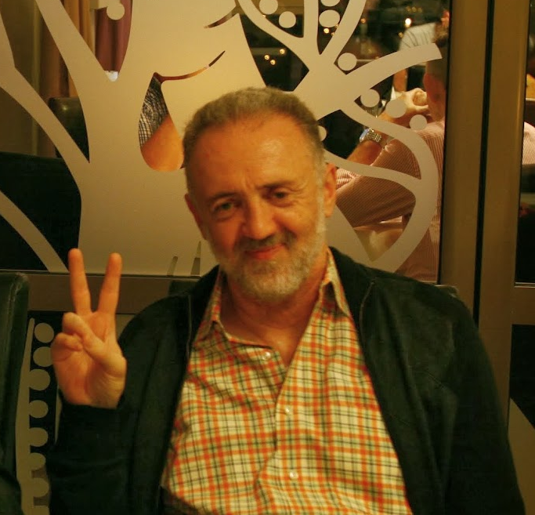
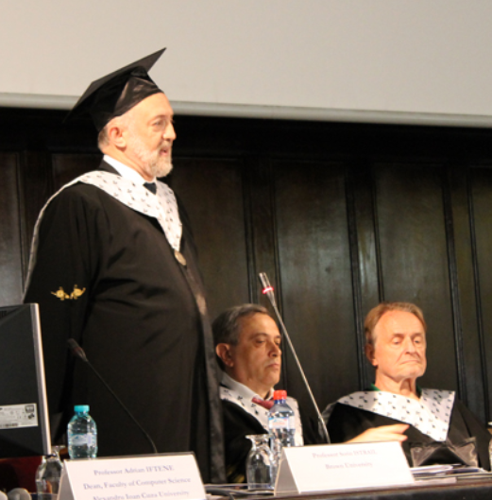
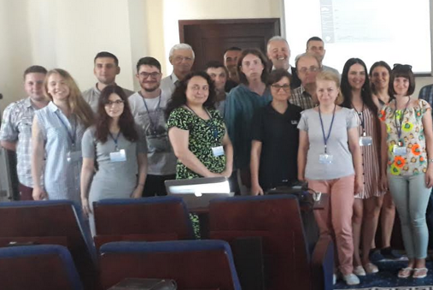
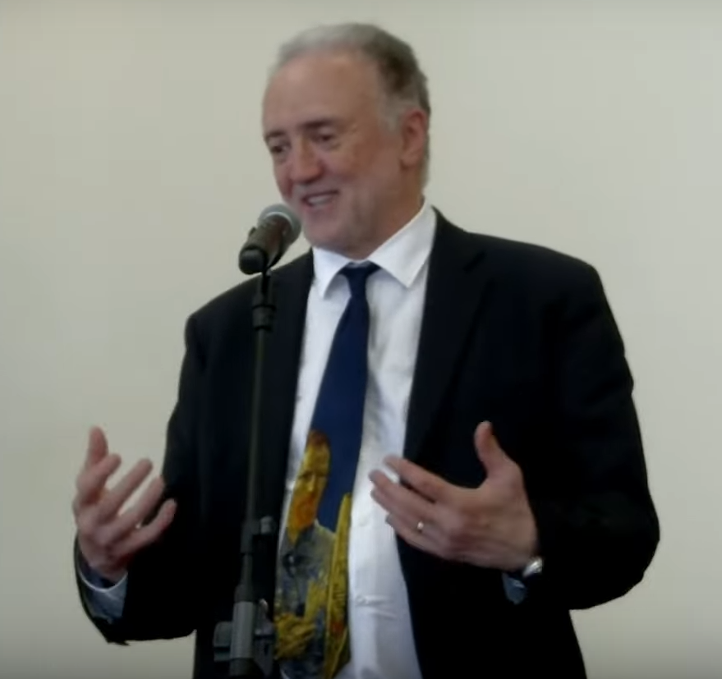
A happy Sorin surrounded by happy students is an ubiquitous picture that tells 1,000 words.
About sharing the joy of science.
We wish to Sorin and to us many new
“Happy Sorin multiplying the joy of Science” snapshots!

