Slide 1
Exact Results from an Approximate Theory:
Topological Defects and Phase Transitions
in two dimensions
(A random walk through physics to a Nobel prize)
Sorin Fest, October, 2023
John Michael Kosterlitz
Department of Physics
Brown University
Providence, RI, USA

Slide 2
Situation of 2D systems in 1970’s
2D magnetic models:
H/kT=K(1-s(i).s(j)) s=(s₁…s_{n}), |s|=1
Numerical simulations and high temperature series expansions indicated:
n=1: (Ising model): yes, transition (exact solution, L. Onsager, 1944)
n=2: 2D planar rotor model (superfluid He films): maybe
n>2 : probably not
n= infinity: NO phase transition (exact solution, H.E. Stanley, 1968)
This situation needed further study, especially for n=2 (Superfluid He⁴ film, etc.)

Slide 4
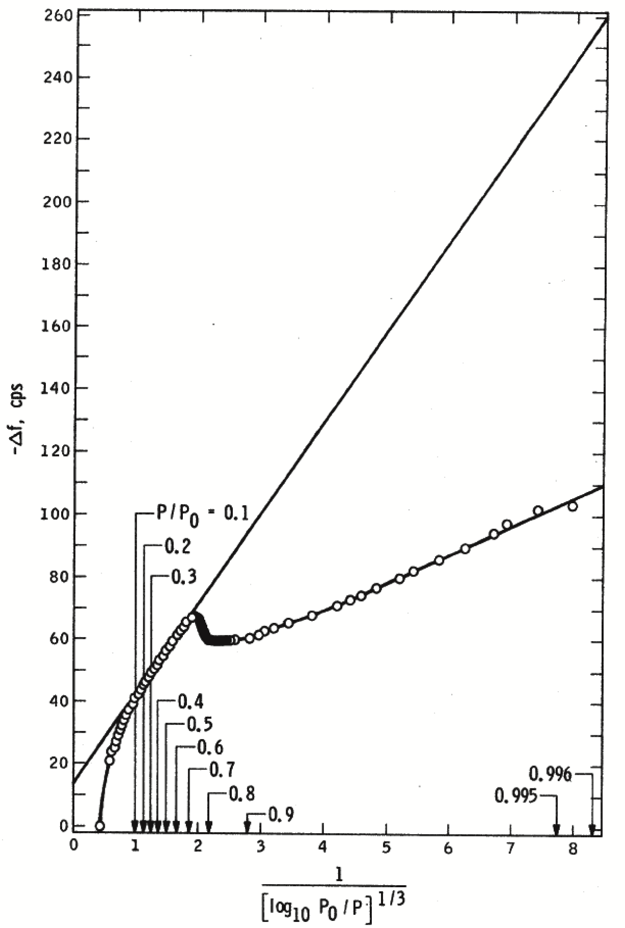
Figure 1, M Chester, L C Yang and J B Stephens, Phys Rev Lett 29, 211 (1972) – resonant frequency of crystal with layer of adsorbed ⁴He.
(Copyright: APS)

Slide 5
Problem: Theory said that, for a 2D (very thin) film of ⁴He there was no long-range order at any finite T>0 (rigorously true) which implied no phase transition to an ordered (superfluid) state (based on knowledge due to Onsager, Landau etc).
But, experiment showed the opposite – there is a transition to a low temperature superfluid state! Thouless set me the problem of resolving this conflict between theory – no state with long-range order – and observation – clear low T state undergoing superfluid flow (which required long-range order according to Onsager, Landau et al).
Fortunately, I was too young and ignorant to realize that this was an impossible task so he and I went ahead and solved the problem – which led to part of the 2016 Nobel prize!

Slide 6
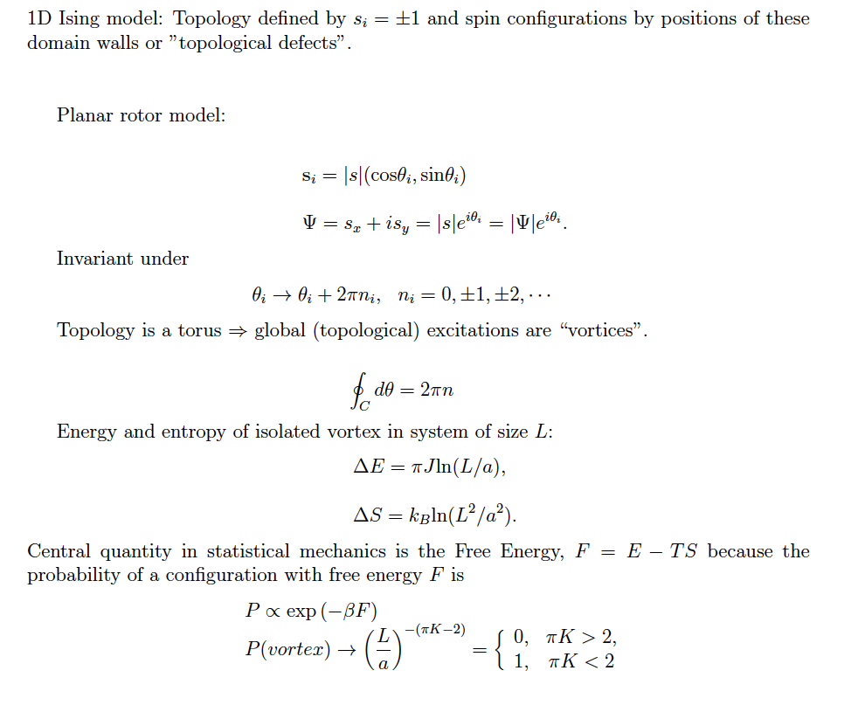
H/kT=(J/4kT)Σ(s_{i}-s_{j})²=(K(T)/2)Σ(σ_{i}−σ_{j})²
When K(T) large, topological sector is stable and when K(T) small, have transitions between topological sectors!

Slide 7
Also N.D. Mermin, H. Wagner, 1966

Slide 8
Vortex with n=+1.
( n=-1 vortex, fluid flow is in opposite direction.)
+
+

Slide 9
Uniform superfluid velocity u_{s} reduced by h/mL when vortex goes across system. The only excitations which can dissipate the superfluid flow and make the fluid normal are the topological defects (vortices) – must study system of vortices and antivortices in 2D. Or neutral plasma in 2D.
u_{s}

Slide 10
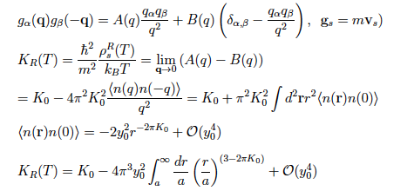
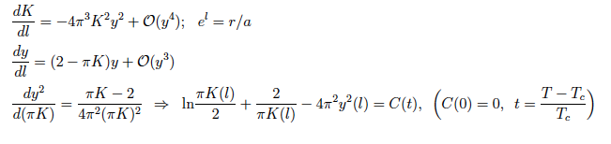
⟨
⟩
a➝ae^{l}
C(t)=-t(8𝝅y²-t)

Slide 11
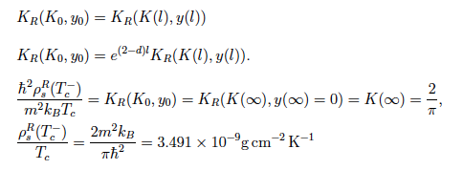
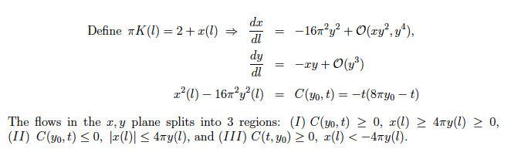
Josephson relation in d dimensions

Slide 12
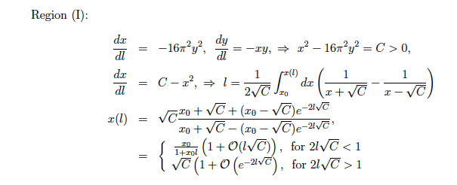

Slide 13
a➛a(l)=ae^{l}

Slide 14
RG flows in the (K,y) plane. The transition temperature T_{c}(y) is the straight line on the right ending at K=2/π.
y=exp(-E_{c}/k_{B}T)
K=ρ_{S}⁰/k_{B}T

Slide 15
Crucial predictions of our theory
Measured stiffness:
Correlation lengths:
Superfluid density:
t<0

Slide 16
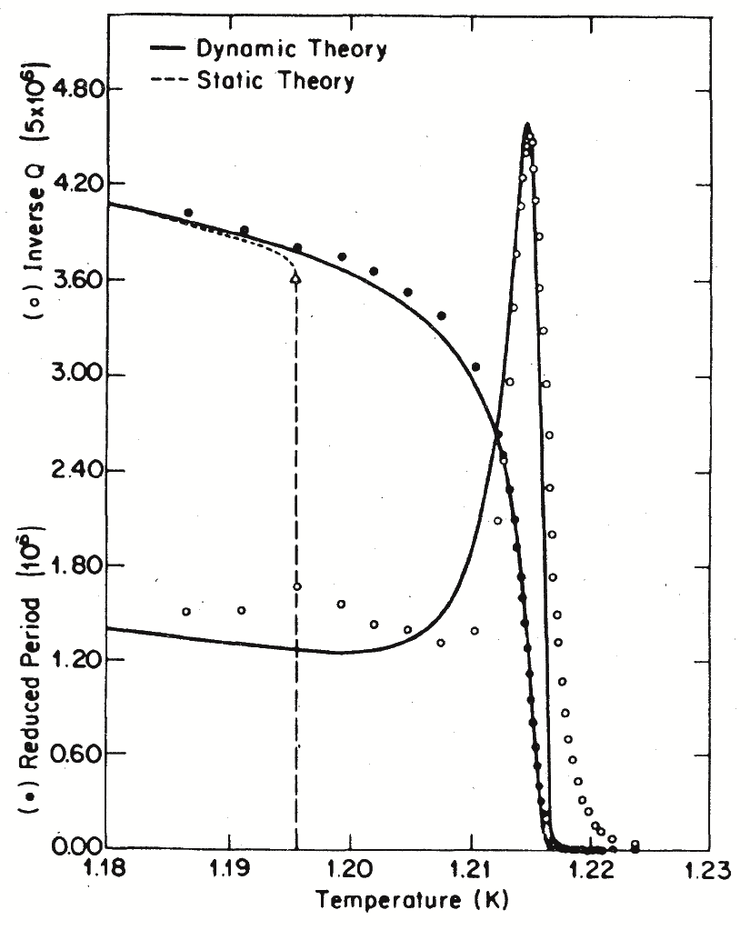
Figure 2: DJ Bishop and JD Reppy, Phys Rev Lett 40, 1727 (1978)
Frequency very low 𝝎=10Hz
(Copyright: APS)

Slide 17
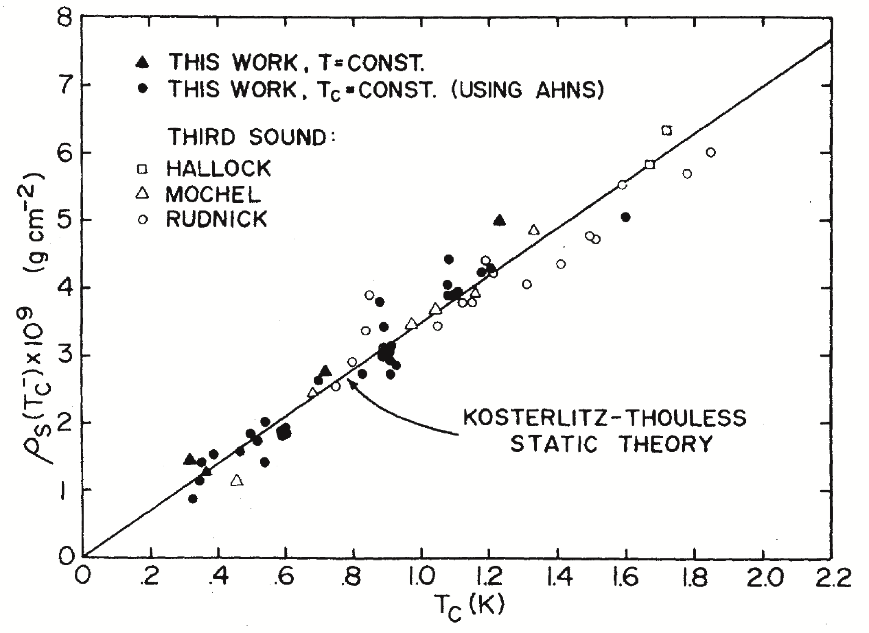
Figure 3: DJ Bishop and JD Reppy, Phys Rev Lett 40, 1727 (1978).
(Copyright: APS)

Slide 18

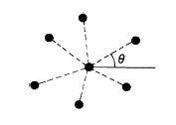

Two possible orders in 2D crystal:
Translational order: Particle positions at R=r+u(r)
r=ne₁+me₂ define ideal periodic lattice.
u(r) is displacement from ideal lattice position.
Order Parameters:
Orientational order: Triangular lattice has 6 crystal axes π/3=60⁰ apart.
Orientational order parameter:

Slide 19






Bond Angle (or crystal axes) Order in Harmonic Crystal
Gaussian theory says: (i) algebraic decay of translational order (Mermin-Wagner theorem)
(ii) long range orientational order
(iii) elastic moduli finite
Need to identify excitations which will lead to isotropic liquid – dislocations & disclinations
Dislocation:
Disclination

Slide 20
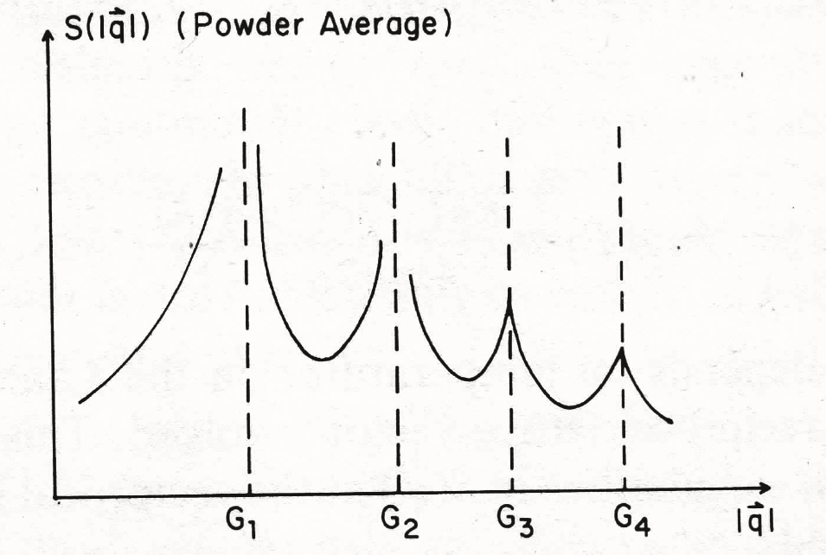
Figure 2.19: D.R. Nelson ``Defects and Geometry in Condensed Matter Physics” (Cambridge University Press) 2002
Reprinted with permission. Copyright 2002 Cambridge University Press.

Slide 21
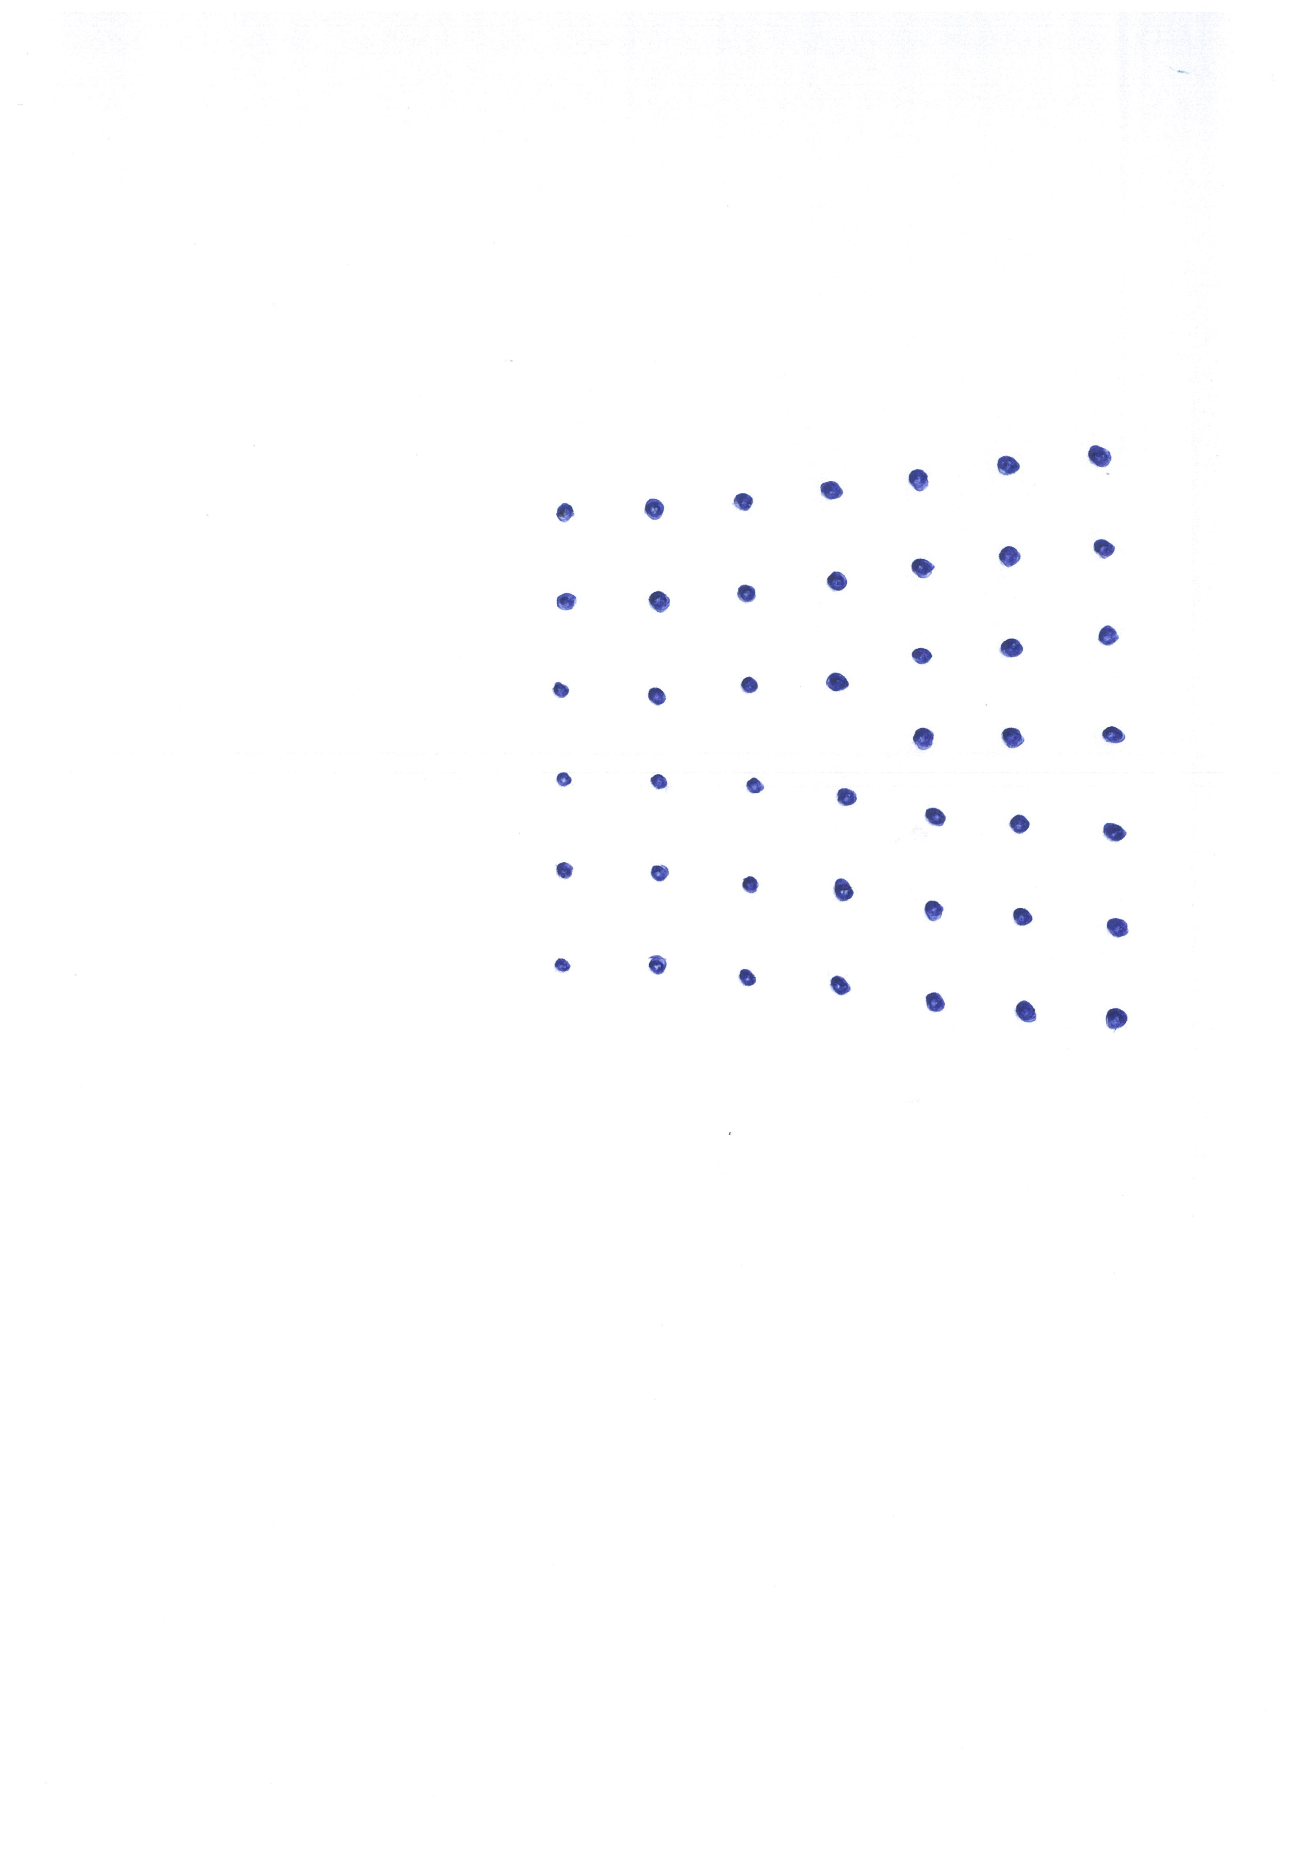
Dislocation in square lattice. Burger’s vector b amount 3x5 contour fails to close.
b

Slide 22
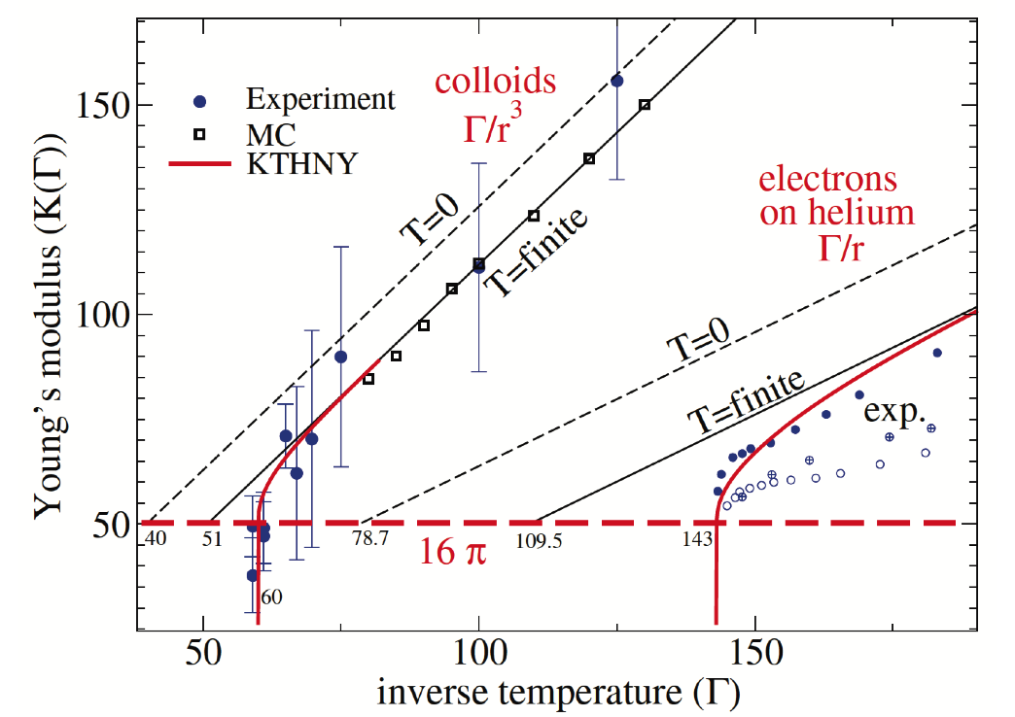
Figure 2 (J Zanghellini et al 2005 J. Phys: Condens. Matter 17 S3579)
Copyright IOP Publishing. Reproduced with permission. All rights reserved.

Slide 23
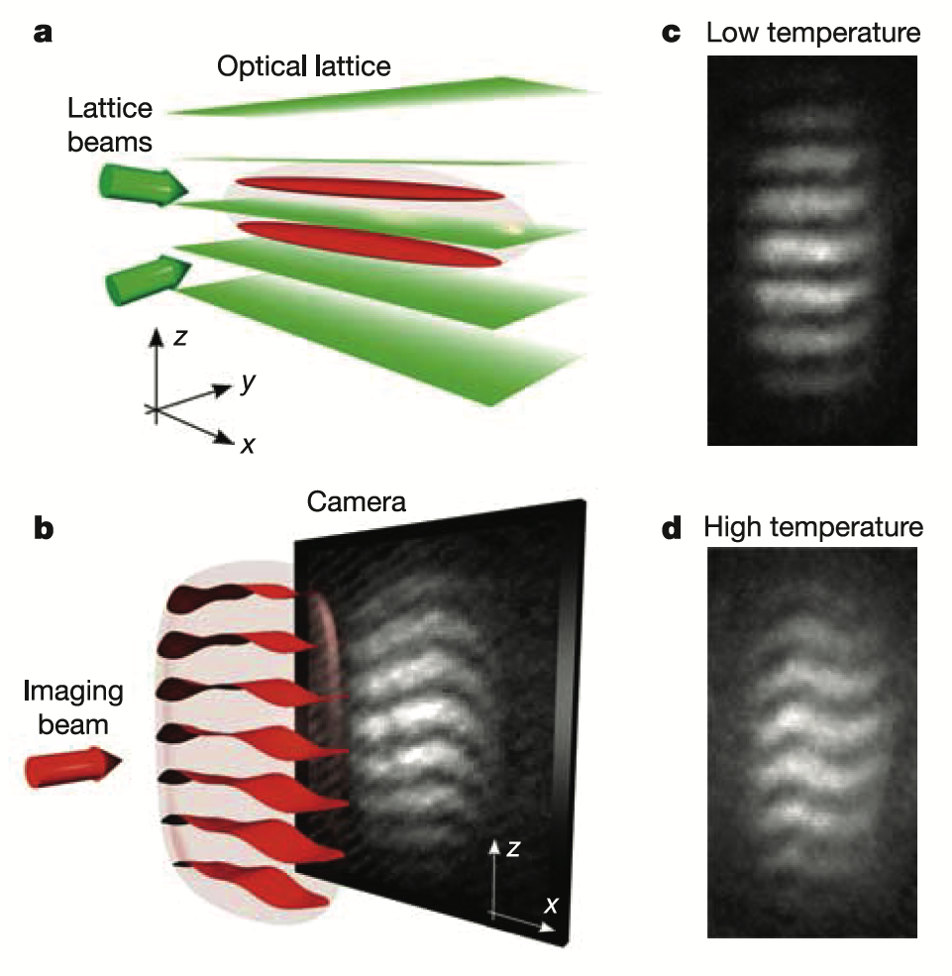
Figure 1 reprinted with permission from Z Hadzibabic, P Kruger, M Cheneau, B Battelier and J Dalibard, Nature 441, 1118 (2006). Copyright 2006 Nature Publishing Group

Slide 24
Concluding Remarks
I would like to thank David Thouless for introducing me to this beautiful problem, David Nelson for collaboration and discussions, John Reppy for many useful discussions and the Nobel Committee for the recognition.
I wish to thank my wife Berit for an incredible life journey taking us from Cambridge to Oxford to Torino to Birmingham to Providence; finally, but not least, my children Karin, Jonathan and Elisabeth for putting up with me.

