Slide 1
User-Centered Design
Getting User Feedback

Slide 2
Agenda
Focus groups
In-lab studies
A/B testing
Card sorting
Traffic analysis

Slide 3
Focus Groups

Slide 4

What are focus groups?
A “somewhat informal” method of gathering qualitative data
Usually consists of 6-9 representative target users and a moderator

Slide 5
Focus Groups: The Pros
Focus groups are great a great way to find out what your users want and need from your product
This is your chance to get a feel for how your ideas will be received by the public before investing much time and money on them

Slide 6
Focus Groups: The cons
Focus groups don’t show you what users do; they show you want users say they do
Information from focus groups can be inaccurate
Focus groups cannot be used to evaluate the usability or efficiency of a user interface

Slide 7
In-lab studies

Slide 8

What are In-Lab Studies?
In-lab studies are a method of usability testing which involves observing users complete a set of predetermined tasks in a controlled environment

Slide 9
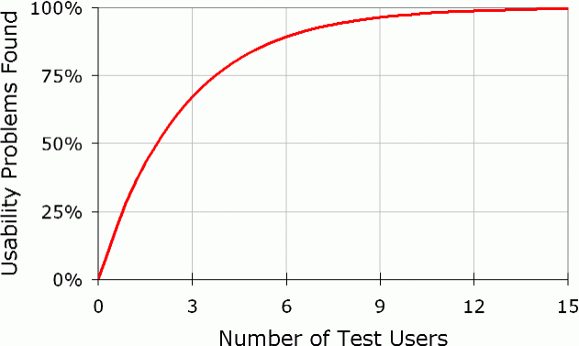
How Many Participants?
Jakob Nielsen has found a law of diminishing returns associated with additional study participants
He claims only five participants are needed for a study to be effective
The diminishing returns found by Nielsen. Note that this graph does not account for how important the problems found were.

Slide 10
Responses to Nielsen’s Magic Number 5
Nielsen’s advice is somewhat controversial, but it is important to consider some qualifications:
  The number 5 only applies to identifying usability problems; for gathering quantitative data, Nielsen recommends 20 participants
  Nielsen advocates running multiple lab sessions and designing iteratively
    So if you can afford 20 participants, it’s better to have 4 rounds of 5 users than 1 round of 20.
  Nielsen advises including more participants if your system will be used by two or more distinct groups of users (e.g. buyers and sellers)

Slide 11
Recruiting Participants
Participants in your usability study should be representative of your user base
Consider your target demographic
  Age
  Level of comfort with technology
  Level of experience with previous versions of your system (if applicable)
  Level of experience with similar and/or competing systems

Slide 12
Comparing Designs: Between-Subjects vs. Within-Subjects
Let’s say you have 2+ potential designs and you would like to find out which one users prefer
You can show each individual participant only one design (between-subjects testing) or multiple designs (within-subjects testing)
Between-subjects testing avoids biasing users by exposing them to multiple options
Within-subjects testing requires fewer participants

Slide 13
Comparing Designs: Counterbalancing
The sequence in which a user is introduced to different designs can affect their opinion of the designs
  Biasing – if a participant sees super-difficult-to-use Version A before less-difficult-to-use Version B, they are more likely to view Version B as very easy to use
  Priming – if the participant uses Version A to complete a task, that knowledge can sometimes help in using Version B to complete the same task
These effects can be mitigated using counterbalancing. The easiest way to counterbalance a within-subjects study is to randomize the order in which designs are presented

Slide 14
Selecting Test Tasks
Focus on tasks which represent core functionality or which, if done wrong, could lead to dire consequences
Build scenarios around tasks in order to motivate participants
Check task descriptions for hidden clues about how to complete the task

Slide 15
Outline of an In-lab Test
The facilitator greets the participant. The participant fills out and signs a consent form and any other required paperwork.
The facilitator asks the participant about their expectations for the interface.
The facilitator goes through task descriptions one by one with the participant, interacting with the participant as necessary (e.g. reminding the participant to think aloud, helping a confused participant, etc.)
Short debriefing

Slide 16
A/B Testing
Aka “bucket testing”

Slide 17
What is A/B Testing?
In A/B testing, visitors to a live website are presented with one of two or more options
  These may be a control or proven design and an experimental or new design
Their actions are then tracked to see which option performed better
  For example, a website might test two different layouts for their product details pages and compare how many sales were made to users of each layout

Slide 18
A/B Testing: The Upside
A/B testing measures the actual behavior of users in real-world conditions
  Compare with focus groups, which reveal what users say they do, and in-lab tests, which measure behavior of users in artificial conditions
A/B testing can measure very small performance differences with high statistical significance (assuming enough site traffic)
A/B testing can resolve tradeoffs between conflicting findings from focus groups or other general guidelines
A/B testing is very inexpensive (especially compared to in-lab testing)

Slide 19
A/B Testing: The Downside
A/B testing has a short-term focus
A/B testing does not reveal any psychological insight
A/B testing can only be done in cases where design decisions have a specific, measurable impact
  This might be sales or advertising clicks
  Goals are often much harder to measure: increasing user satisfaction, rehabilitating a brand, etc.

Slide 20
When Does A/B Testing make sense?
A/B testing is a good solution when…
  You have clear goals and an easy way to measure success
  It’s easy to swap out the different options
    E.g. graphics, captions, titles, etc.
    Note that this is mostly fairly trivial stuff which does not touch the architecture or fundamental interaction model for your UI
    The more your 2+ versions of your system diverge, the harder they will be for you to maintain and eventually reconcile

Slide 21
Card Sorting

Slide 22
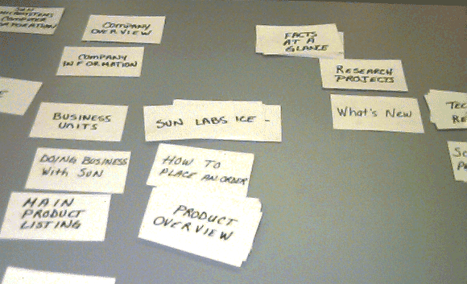
What is Card Sorting?
Card sorting is a method in which users are guided through the process of creating a tree of categories out of a set of concepts
Doing so reveals their underlying ideas about how the concepts are related
Card sorting can be used to reveal intuitive information architectures, menu structures, or web site navigation paths

Slide 23
The process of Card Sorting
The concepts you wish to have sorted are written on a set of index cards
The user is presented with the index cards and asked to place similar concepts in groups
The user is asked to then asked to cluster these groups according to similarity
For each possible relationship between concepts, the relationship is given 1 point if the concepts appear in the same cluster and 2 points if the concepts appear in the same group
  This similarity matrix can then be analyzed using statistical software to calculate a representative hierarchy

Slide 24
Traffic Analysis

Slide 25
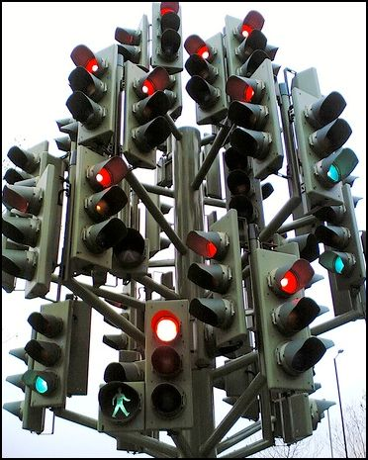
What is traffic analysis?
Traffic analysis is the practice of observing patterns of software use from “behind the scenes”
  We will focus on web traffic analysis, but these techniques can be generalized to other forms of software

Slide 26
Looking at server logs
Server logs contain a history of page requests
A “hit” is generated whenever a file is served
  This can be any type of file, so when an HTML file with five images on it is requested, that counts as six hits
A “page view” is generated when a specific page (HTML file) is requested

Slide 27
Interesting Server log averages
Average page views per visitor
  How much do visitors explore your site?
Average page duration
  How long do visitors spend on any given page?
  Which pages are most interesting to visitors once they find them?
Average visit duration
  How much time are visitors investing in your site?
  How can you analyze a page’s average duration in light of the average visit duration?

Slide 28
Popularity
Most requested pages
  Which pages seem the most interesting or relevant to visitors?
  Compare with page duration: were visitors misled? Are there interesting/relevant pages which are too hard to find?
Most popular entry pages
  What pages are usually “landing pages” for your site? Do they provide adequate navigation affordances?
Most popular exit pages
  What pages drive visitors away?
  What steps in a process (e.g. checkout, registration) are most difficult?

Slide 29
Other server log insights
Popular paths
  How do users move through your site?
Referrers
  Where are your users coming from?
  How effective are your advertising campaigns (if applicable)?

Slide 30
Thinking outside the server log
Server logs can provide a lot of useful data, but ultimately they only keep track of page requests
What happens after the page is loaded?

Slide 31
Tracking User Interaction
Client-side scripting (e.g. JavaScript) makes it possible to track how users interact with a page after it loads
Mouse-tracking
  Provides an approximation of where the user’s attention is focused
Interaction with DOM elements
Tracking DOM events

Slide 32
Narrowing Focus
So far, we have covered how aggregate data can be used to draw conclusions about the “average user”
However, there is no average user
It can be helpful to look at a single visit in detail rather than large data sets
  Especially illuminating: looking at anomalous or unwanted behavior
    Why would a user abandon a full shopping cart midway through checkout?

Slide 33
Where it gets complicated
As with A/B testing, web traffic analysis is easiest when you have a specific, measurable goal in mind
  Selling a product, generating advertising revenue, etc.
It becomes more difficult when your goals are more abstract

Slide 34
Example
How would you use web traffic analysis to measure search quality for a major search engine?

