Slide 1
Prototyping

Slide 2
Agenda
Why bother with prototypes?
Approaches to prototyping
Dimensions of fidelity
Prototyping in practice

Slide 3
Introduction

Slide 4
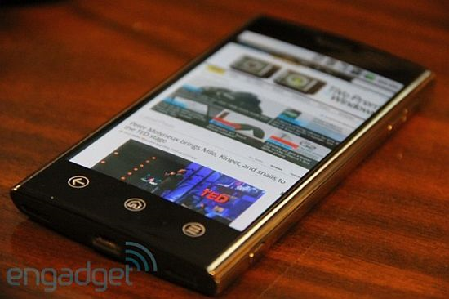
What is a prototype?
A prototype is an incomplete, early version of a product
There are many approaches to building prototypes for software user interfaces
UI prototypes can be as simple as a drawing on a piece of paper or as complex as web application
  Or anywhere in between those extremes!
A cellphone prototype.

Slide 5
Why bother with prototypes?
Prototyping is an integral part of the UI design process
You wouldn’t just sit down and start churning out Java without designing your class structure
  …we hope
Similarly, you should not try to write code for a frontend without mocking it up beforehand

Slide 6
Benefits of Prototyping
Low cost: requires little time, technical expertise
High return on investment:
  Getting user feedback early in the design process
  Uncovers problematic design choices before they are committed to code
  Minimizes miscommunication between designers
Generally results in a better UI

Slide 7
Types of Prototypes

Slide 8
Language Caveat
There is no universal vocabulary for prototyping
When you’re out in the “real world”, you will probably find that any one of these words can refer to many things
  And that one sort of prototype can have many names even within the same team
It’s a good idea to double-check that you and your coworkers are on the same page

Slide 9
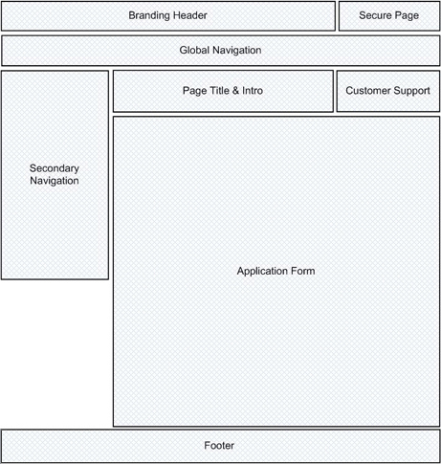
Wireframes
Visual representations of an interface’s intended layout, typically without its actual content
Good for evaluating content placement
http://uxmatters.com/mt/archives/2007/03/wireframing-with-patterns.php

Slide 10
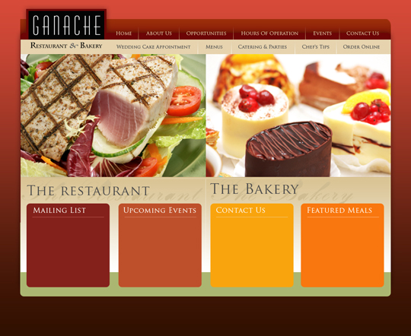
Compositions (“Comps”)
Static prototypes which focus on graphic design decisions, including colors, fonts, layouts, logos, media, etc.
Good for evaluating aesthetic choices
http://anthonysanders.us/blog/2009/05/comp-designs-for-ganache-restaurant-and-bakery/

Slide 11
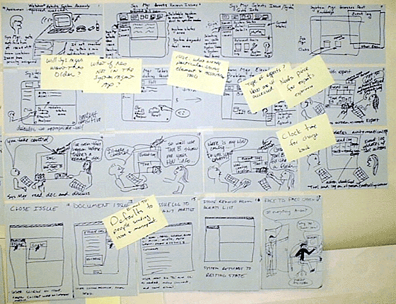
Storyboards
Inspired by storyboards used by animators
Series of images which represent how an interface would be used to accomplish a task
  Could be a FSM or a narrative
Good for evaluating workflow
http://net.typepad.com/net/2007/07/storyboards-as-.html

Slide 12
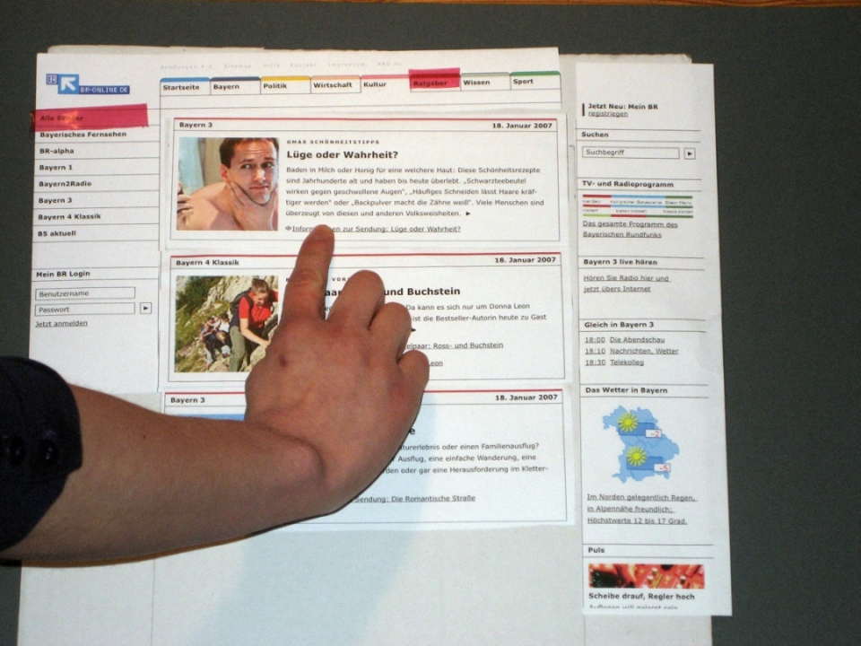
Paper Prototypes
Paper representations of an interface used to simulate interaction
Good for evaluating general concept, specific workflows, and usability
http://felixberger.info/wp-content/uploads/2008/09/br_online_-_prototype.jpg

Slide 13
Digital Prototypes
Interactive—but not necessarily functional—user interfaces created with any of a number of platforms
  E.g. Adobe Flash, HTML/CSS, etc.
Good for evaluating a working design which has been derived from a few rounds of less costly prototypes

Slide 14
Prototype Fidelity

Slide 15
Lo-Fi vs. Hi-Fi
Traditionally, prototypes are categorized as either lo-fi (low fidelity) or hi-fi (high fidelity)
Fidelity can be thought of as how close of an approximation of the final product is being attempted
In this class, we will be using lo-fi as a synonym for paper prototyping and hi-fi as a synonym for digital prototyping
  But as you are about to see, it’s actually more complicated than that!

Slide 16
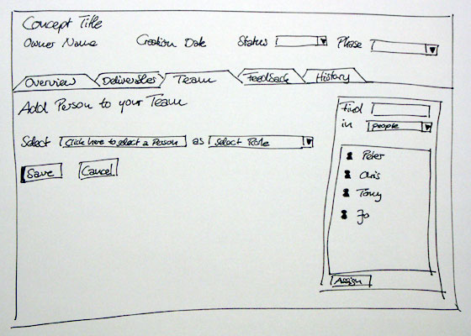
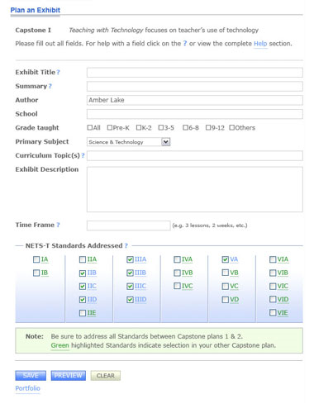
Dimensions of Fidelity
Fidelity can be broken down into four basic dimensions:
  Breadth
  Depth
  Look
  Interaction
http://www.sapdesignguild.org/editions/edition7/proto_design.asp
http://six-16.com/ux/index.html

Slide 17
Breadth
The “breadth” of a prototype refers to how much of the product’s functionality is represented in the prototype
  A very narrow prototype only represents a single feature
  A broad prototype represents all intended functionality
  Prototypes should generally be as broad as needed to cover basic tasks, but not much more

Slide 18
Depth
The “depth” of a prototype refers to how much of the prototype’s backend is functional, and how robust it is
  A very shallow prototype has no backend at all and is hard-coded to respond as though the user had provided ideal input
  A deep prototype has some logic and error-handling capabilities
  At first glance, depth may seem unimportant, but it affects the amount of exploration a user can do
  Thus depth can actually have a profound influence on user testing!

Slide 19
Look
“Look” is probably what most people think of when they think of prototype fidelity
It refers to how accurately a prototype represents the product’s intended appearance, including fonts, colors, and graphics
It’s generally a good idea to hold off on something which has a high fidelity look until later in the design process

Slide 20
Interaction
“Interaction” refers to how the prototype handles input and output
For example, you might create a digital prototype for an iPad application which runs on your desktop and responds to traditional a traditional mouse and keyboard
Do not confuse interaction with depth!

Slide 21
In Practice

Slide 22
Gathering Data
Who are your users? What tasks are they trying to accomplish?
Don’t guess—do your research!
  Observe users in their natural habitats
  Check out solutions that already exist (even hacky ones)
Make sure you are focusing on a problem at the right level of detail
  At this stage, don’t think “bicycle cup holders”
  Think “helping cyclists stay hydrated without getting hit by a car”

Slide 23
Brainstorming Warm-Up
It can be helpful to do some sort of warm-up before you start brainstorming
You could allot ~5 minutes to free-form chatter about related products or tasks
Or you could encourage your team to start thinking creatively and feeling comfortable sharing their thoughts with an associations game
  Examples: “Songs David Hasselhoff should cover”, “Mythological animal which would be most lucrative to own”

Slide 24
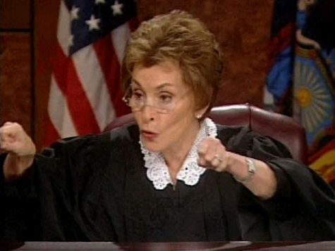
Brainstorming: IDEO Rules
One conversation at a time
Stay focused
Encourage wild ideas
Defer judgment
Build on ideas from other brainstormers
None of this.

Slide 25
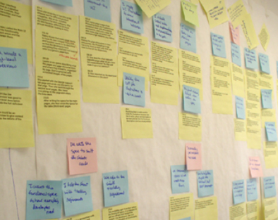
Sorting ideas
Affinity diagramming is one way to sort ideas
It can be used to identify and group desired functionality
The steps:
  Solicit ideas; write each of them on a Post-It note
  Stick Post-It notes on a wall
  Have participants get up and rearrange notes into relational clusters without speaking to one another
  As a group, discuss what the clusters represent (you might want to give them catchy names)
Affinity diagramming is like card sorting, but will produce nonhierarchical results.

Slide 26
Valuing Ideas
Define the importance of each idea:
  Does it address the problem?
  Will target users like it?
  Are the technical requirements available?
  Is it affordable to implement?
Rank ideas by importance
Pick the top N ideas

Slide 27
Lo-Fi
Now that you’ve got some ideas, you can start making a paper prototype
It may seem difficult to represent something as complicated as a modern software interface with something as old school as paper
But the good news is, a lot of metaphors common to UI design were inspired by paper!

Slide 28
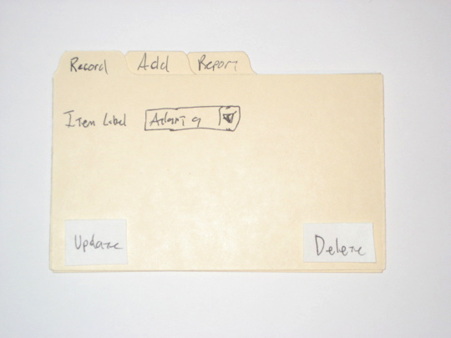
Example: Tabbed Panel
Images from: http://www.alistapart.com/articles/paperprototyping/

Slide 29
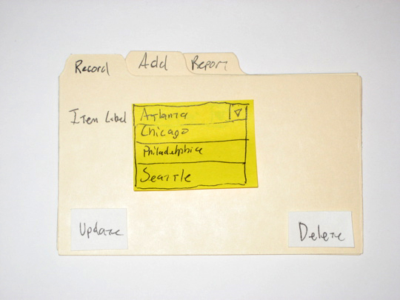
Example: Drop-down Menu

Slide 30
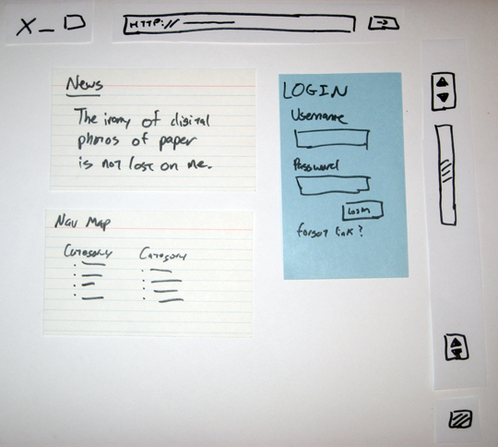
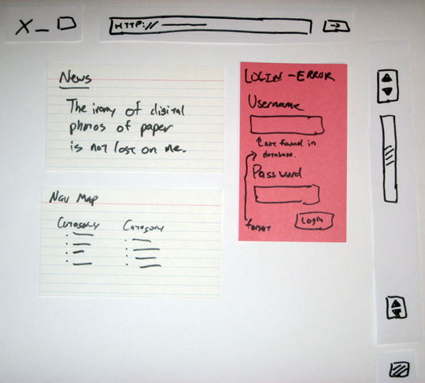
Example: Dynamic Web Content

Slide 31
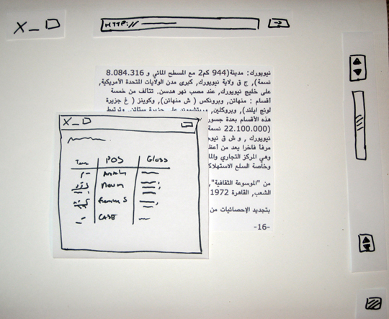
Example: Pop-Up Windows

Slide 32
Why Go lo-fi?
Lo-fi prototypes don’t require any technical skill, so anyone can participate in creating them
You can get user feedback early on in the design process
Paper prototypes can seem less intimidating than digital prototypes
They can also result in more creative feedback
  …and less nitpicky feedback

Slide 33
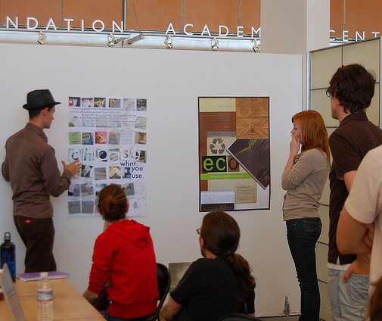
Critique
Critique is a method of soliciting feedback which was developed by studio art educators
You display whatever lo-fi prototype(s) you have developed for your product to a small group of peers
They share their immediate reactions to your ideas and weigh in on whatever open questions you have identified
http://www.flickr.com/photos/pjchmiel/2972140234

Slide 34
How to Get the Most from a Critique
Be clear about what sort of feedback you’re looking for
  Overall idea?
  Specific workflows or interactions?
  Usability?
  Technical feasibility?
  Graphic design?
Answer questions and correct misconceptions, but do not argue in favor of your design
Show alternative designs if possible

Slide 35
How to Give a Good Critique
Talk about the design, not the designer
  NO: “You are really bad at handling accessibility.”
  YES: “If you implement this as is, a visually impaired user will not be able to use the secondary navigation.”
Point out positive aspects and be specific
  NO: “It looks good.”
  YES: “The layout makes finding information on the page very easy.”
Ask for alternatives rather than offering solutions
  NO: “You should do this instead of that.”
  YES: “Have you considered any other input methods?”

Slide 36
Hi-Fi
Once you have developed a lo-fi prototype and solicited feedback on it through peer critique and user testing:
  You may wish to create another lo-fi prototype (isn’t iterative design fun?)
  Or you may be ready to move on to a hi-fi prototype
Which choice you make will be a function of how much of your original design you feel needs to change
Remember, a high fidelity prototype is a non-trivial time investment
Depending on how you build it, it may end up being the first code your write for your final product

