Slide 1
Cognitive Science for Software Engineers
Requisite background on perception, memory, and learning

Slide 2
Introduction
What we are covering and why

Slide 3
Why is cognitive science important to us?
By now, chances are you know pretty well how a computer works
But computers only account for 1/3 of the letters in “HCI”
In order to design effective interfaces, you will need to learn a bit about how humans work

Slide 4
What topics will be covered today?
Perception
User output
Memory
Learning
We will go over the basic concepts relevant to each of these topics, and then relate them back to interface design.

Slide 5
Perception
How we experience the world

Slide 6
What is perception?
Perception is the process by which we recognize and give meaning to sensory input
We will focus on visual input because it is the most readily applicable to modern user interfaces
Visual perception involves recognizing shapes, interpreting depth, sensing motion, and maintaining constancies

Slide 7
Gestalt principles
Visual perception isn’t just about what you see; your mind often times fills in the blanks for you
For example, your mind determines a “figure-ground” relationship between visual items
It determines what the figures are in a given scene and interprets them as resting in the “foreground”
The rest of the image is conceived of as the “background”

Slide 8

Sound familiar?
The figure-ground principle at work
background
foreground
foreground

Slide 9

But wait, there’s more
An example from Netflix
background
foreground

Slide 10
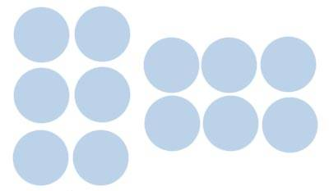
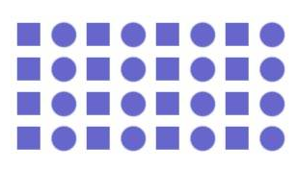
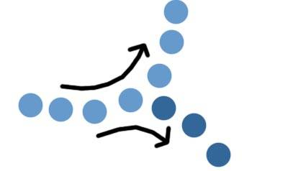

Other Gestalt principles
Proximity
Similarity
Continuity
Closure

Slide 11
Making sense of clutter
The principles of proximity and similarity help us make sense of cluttered and complicated environments
They are particularly important to consider when designing GUIs

Slide 12
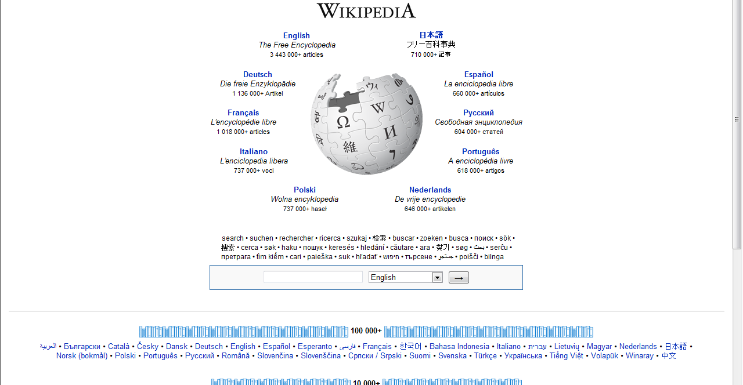
Proximity in action
Wikipedia uses proximity to show language options

Slide 13
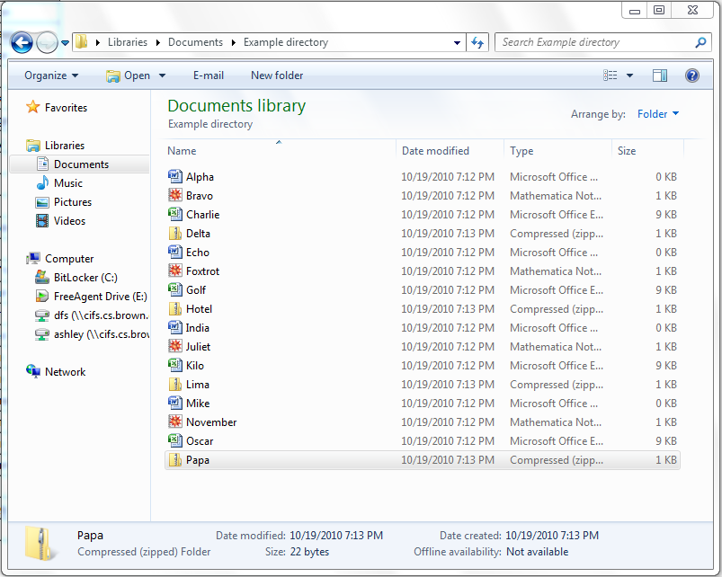
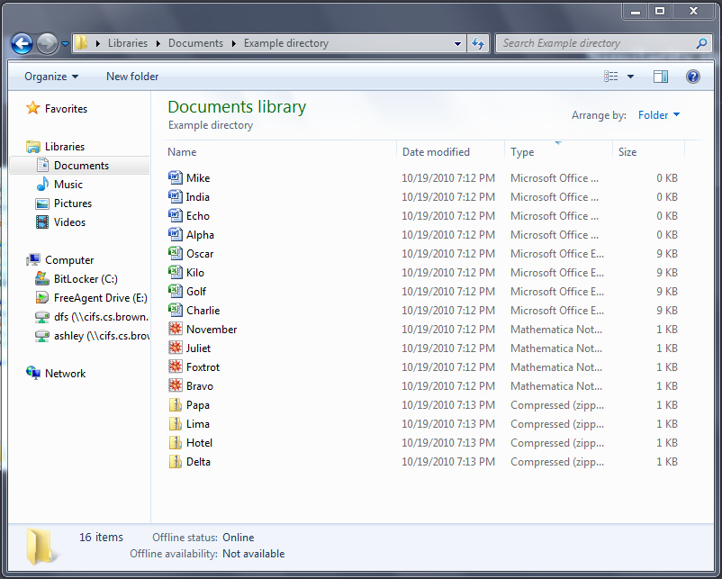
Similarity in action
Elements are seen as groups according to icon style in Windows Explorer

Slide 14
Gestalt principles are a double-edged sword
In the previous example, there might not have been any reason to see groups of files based on their type
  Maybe the files were all completely unrelated
  Maybe the most logical groups each consisted of one .xls, one .doc, one zipped folder, etc.
Gestalt principles might cause users to perceive visual groups where no logical grouping exists, or where the logical grouping is different from the visual groups

Slide 15
Attention
A crude model of attention is a spotlight. Like a spotlight, attention…
  Is selective
  Is finite
  Can only cover one continuous area
Also, attention tends to decline over time

Slide 16

Selectivity
Since attention is selective, UIs should be designed to draw in the user’s attention to the right place.
Example: Tag clouds give weight to the topics which appear the most (and therefore are the most important/relevant to the site)

Slide 17
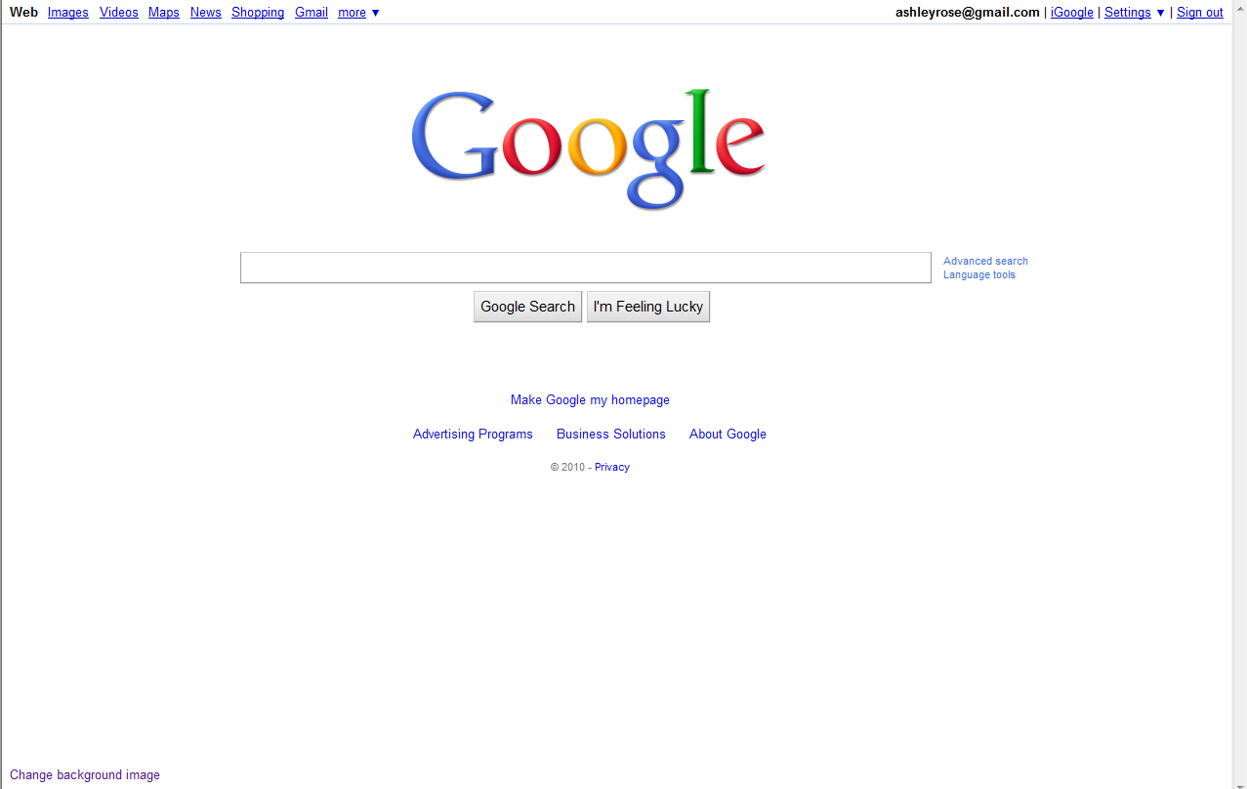
Limitation
Since attention is limited, UIs should not bombard users with too much information at once.
Google’s homepage is a classic example of minimalism.

Slide 18
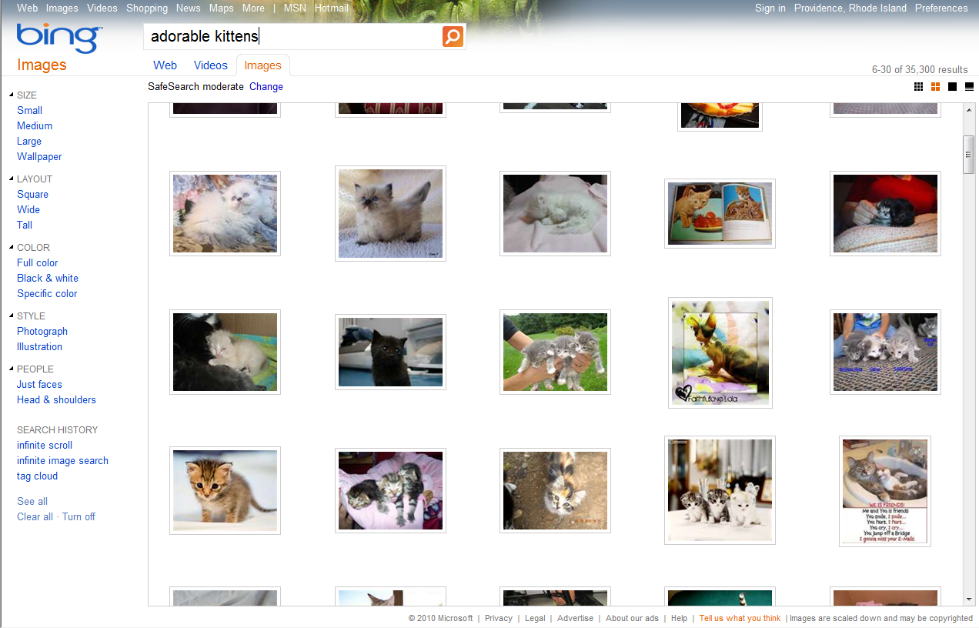
Monotony
Since attention tends to decline over time, long and monotonous tasks should be avoided.
Bing eliminated pagination by implementing an “infinite scroll” on its image search results

Slide 19
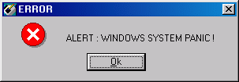
The consequences of monotony
Abusing a user’s attention span can lead to some dangerous mistakes
Take alert boxes for example
When a pop-up windows appear, the user’s first priority is to get through them
This can mean unfortunate consequences, depending on what the pop-up was for
So never use a warning when you mean undo

Slide 20
Output

Slide 21
User output
The user is able to communicate with the computer through a number of means
  Traditional: keyboard and mouse (gesture, click, double-click, click-and-drag, etc.)
  Modern: touch, multi-touch, pen and tablet, speech
Motor movements, such as pointing or typing, take time and are subjects to various types of errors
There is a trade-off between speed and accuracy

Slide 22
Fitts’ Law
Fitts’ Law describes the time required to complete a task as a function of how complicated it is
T = a + b log₂ (D/W + 1)
Where T is the time it takes for a person to point to an object based on the distance to the object (D) and the size of the object (W)

Slide 23
Application: Fitts’ Law
Because the mouse is typically “bound” to the screen, items which appear on the edge of the screen can be considered to have infinite width and/or height and are thus especially easy to target

Slide 24
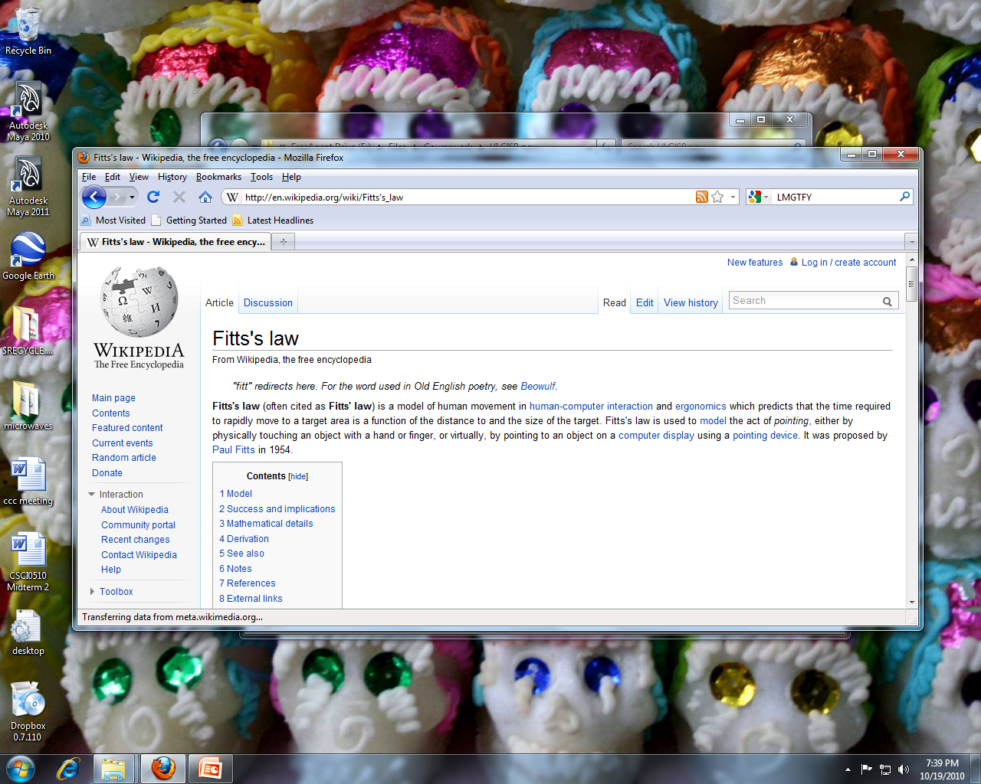
Fitts’ Law: Windows
Windows makes the Start menu and dock easy to target

Slide 25
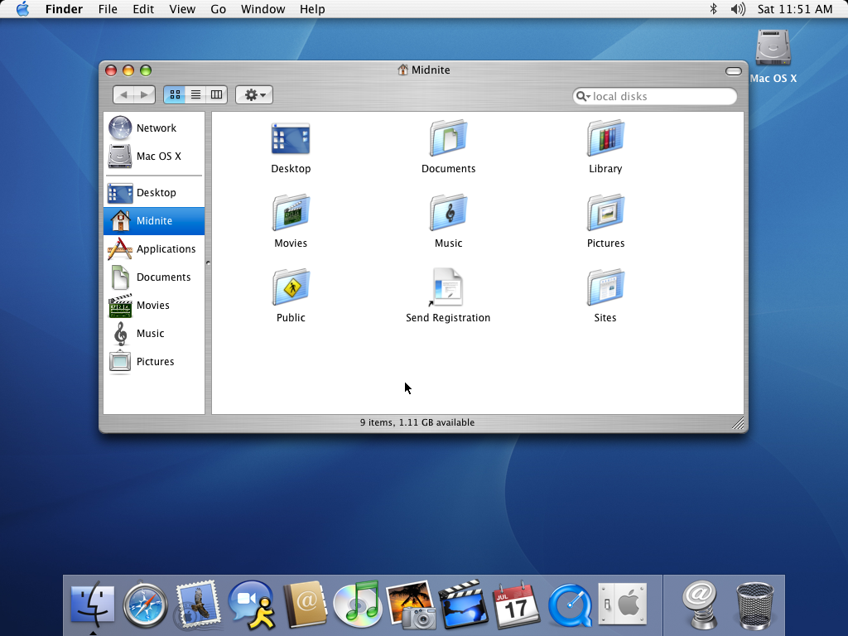
Fitts’ Law: Mac
Mac OS makes the dock and window menu easy to target

Slide 26
Memory and Learning
The impressions made by perception

Slide 27
Memory stores
It has long been recognized that memory is not a single unit or system
Cognitive scientists today generally recognize three memory stores: sensory register, short-term memory, and long-term memory

Slide 28
Sensory register
Briefly stores information with sense-specific details
Iconic memory – visual sensory register; generally a complete snapshot which decays within ¼ of a second
Echoic memory – auditory sensory register; retained for several seconds
Iconic memory does not last long enough for users to extract useful information from it, so we cannot rely on it

Slide 29
Short term memory
Buffer which can hold up to 7 ± 2 units of information
  A “unit” can be a number, a letter, a name, a word, etc.
Information can be lost due to decay over time, interference among times, and being displaced by incoming information
When designing interactions, you must respect these limits

Slide 30

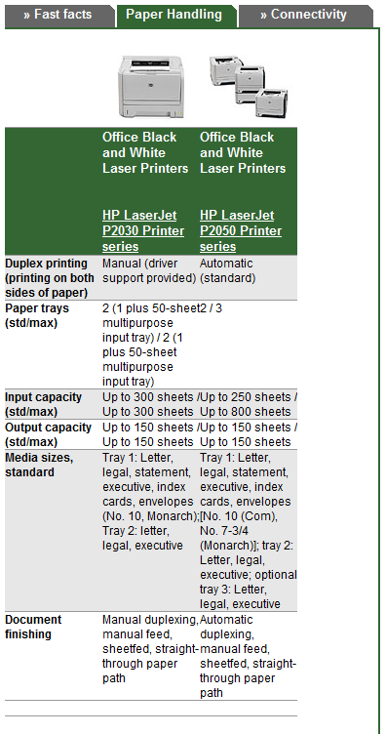
Application: Comparison shopping

Slide 31
Long-term memory
Long-term memory can be divided into two major categories: explicit and implicit memory
  Explicit memory includes recall of events and knowledge about the world
  Implicit memory includes recall of procedures
Learning—that is, moving knowledge from short-term memory to long-term memory—can be accomplished through rehearsal (repetition) and/or meaningful association (mnemonic devices, etc.)
Obviously, no one is born knowing how to use a computer. Everything must be learned at some point.

Slide 32
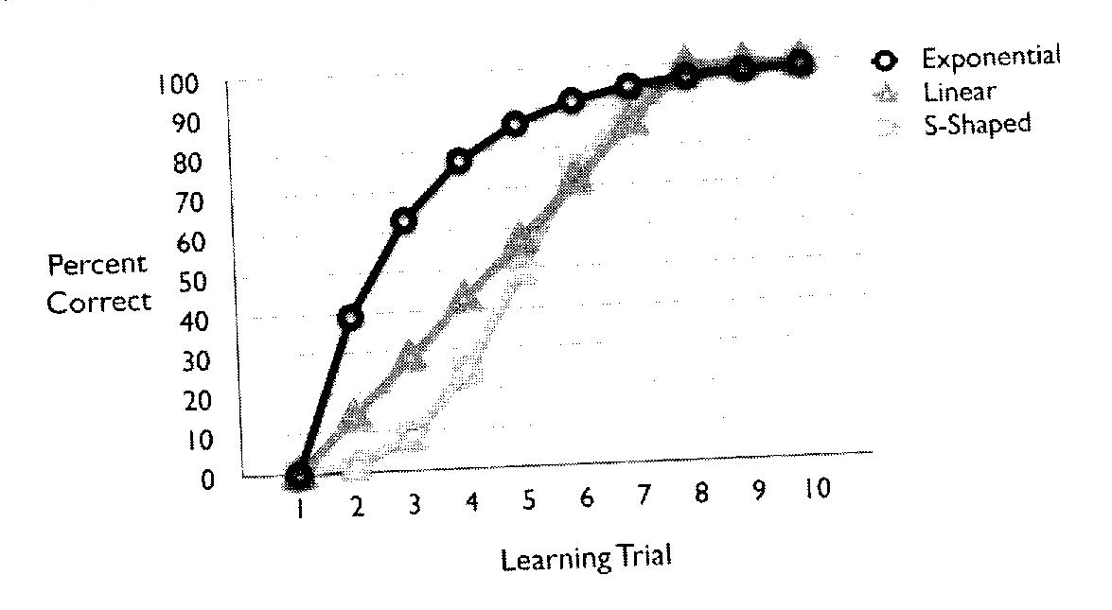
Learning and forgetting
The relationship between number of learning trials or previous study time and recall ability is modeled by the “learning curve”
  Don’t be led astray by the misuse of the phrase “steep learning curve”! If a task is associated with a “steep learning curve”, it is probably very easy to learn!

Slide 33
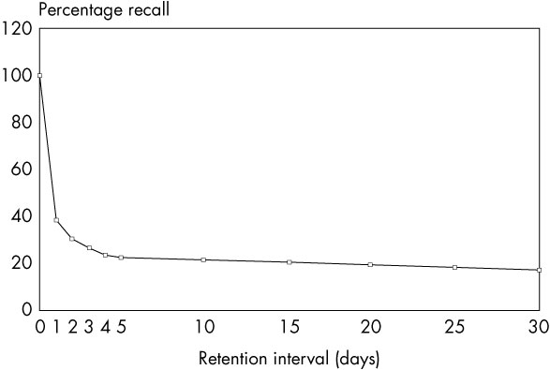
Learning and forgetting, continued
Similarly, there is a “forgetting curve” which models the probability of recall in cases where an individual has no further study

Slide 34
Transfer and interference
Learning new things can sometimes clash with the knowledge you have already attained
This is called interference
  Proactive interference occurs when something you learned previously interferes with something you learned later
    This can make it difficult to learn how to use new versions of familiar software
  Retroactive interference occurs when something you learned later interferes with something you had learned previously
    This can make it difficult to use an older version of a program after learning how to use the new version

Slide 35
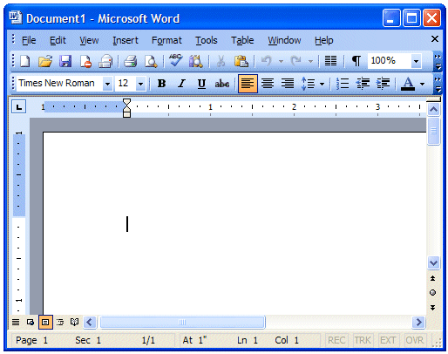
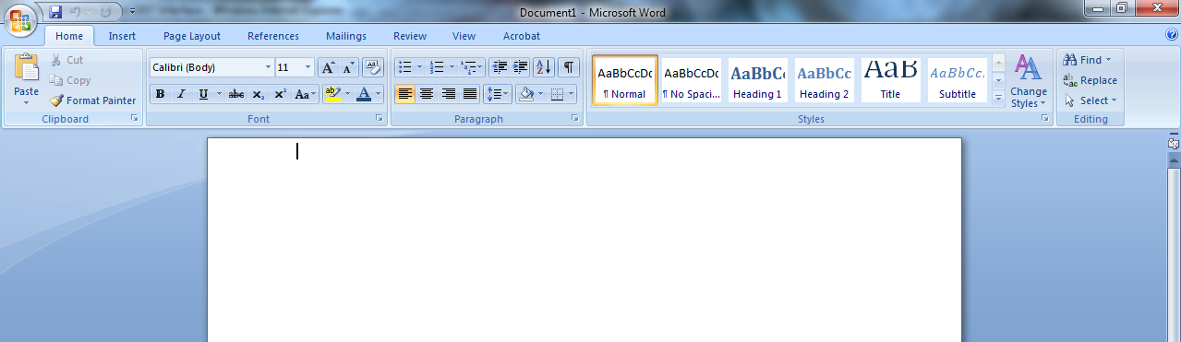
Example: Proactive interference
The addition of the ribbon to Word 2007

