Slide 1
Bridging Discrete and Continuous Protein Folding through Hydrophobicity and Molecular Dynamics
Colin Baker, Pranav Mahableshwarkar, Ritambhara Singh, and Sorin Istrail

Slide 2
Protein Structure Prediction
To carry out structure-based drug design, computational chemists need accurate protein structures.
But, determining structures experimentally can be costly
How can we predict protein structures without carrying out new experiments?

Slide 3
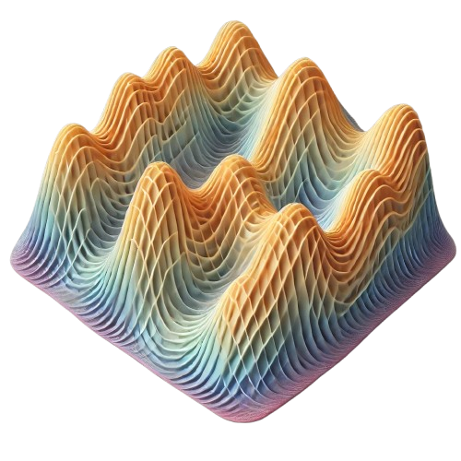
Protein Structure Prediction
Two possible computational objectives:
  Globally minimize some high dimensional energy function
  Combinatorial models
Image credit: DALL-E

Slide 4
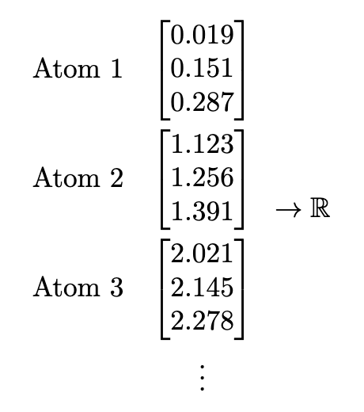
Protein Structure Prediction
Two possible computational objectives:
  Globally minimize some high dimensional energy function
  Combinatorial models

Slide 5
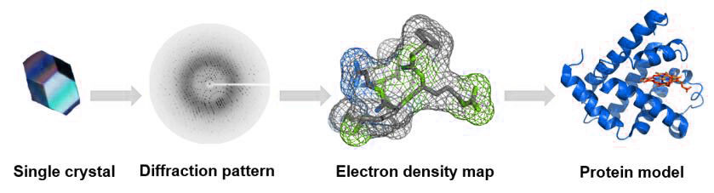
Protein Structure Prediction
  Or, fit to existing experimental data
  Deep learning models
Image credit: https://www.creative-biostructure.com/comparison-of-crystallography-nmr-and-em_6.htm

Slide 6
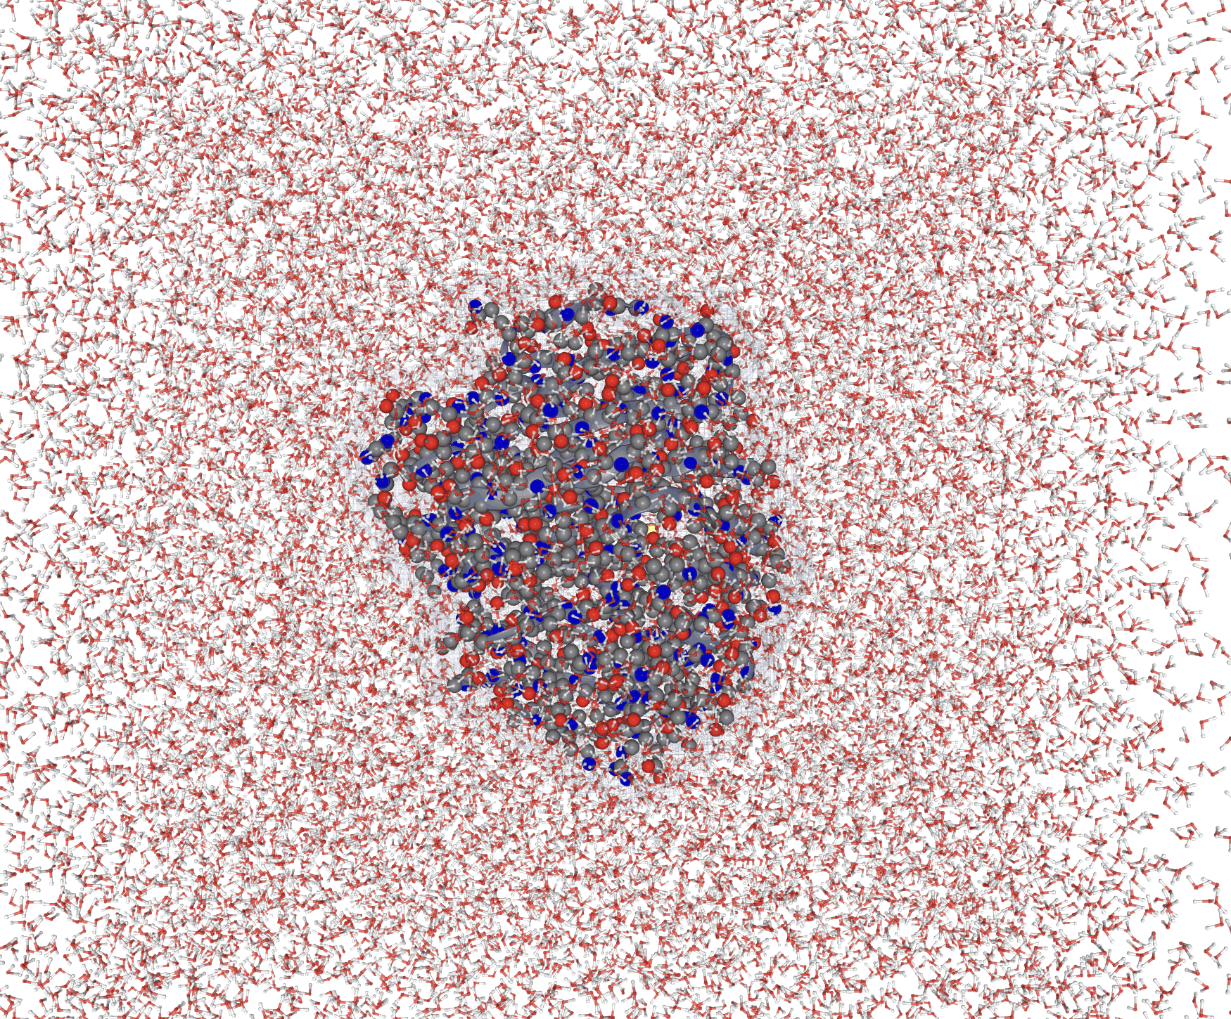


Molecular Dynamics
  Leverages the fundamental observation that
  Then integrates the second order differential equation

Slide 7
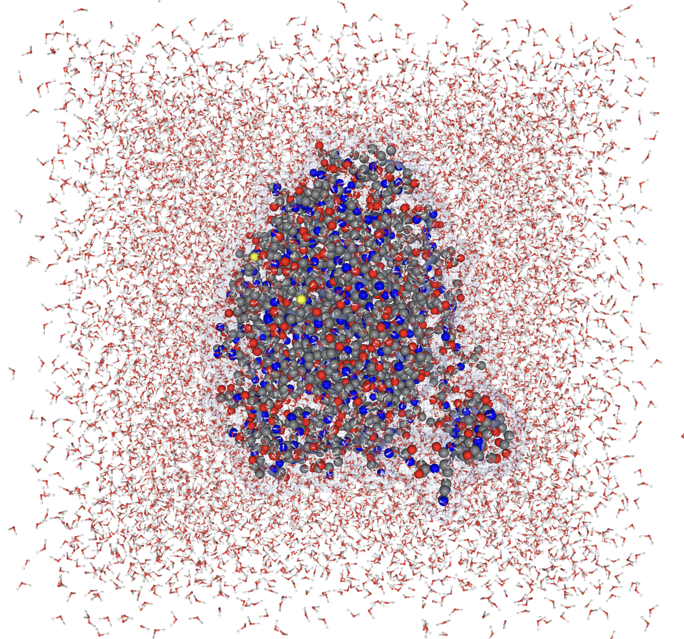
Overview
Energy functions and molecular dynamics
Characterizing hydrophobicity scales
WaterFire
NP-completeness of reducing contact potentials to the HP model
Tractable reductions to leverage WaterFire
AlphaFold model and pitfalls
Updating the AlphaFold embedding space

Slide 8
Overview
Energy functions and molecular dynamics
Characterizing hydrophobicity scales
WaterFire
NP-completeness of reducing contact potentials to the HP model
Tractable reductions to leverage WaterFire
AlphaFold model and pitfalls
Updating the AlphaFold embedding space

Slide 9
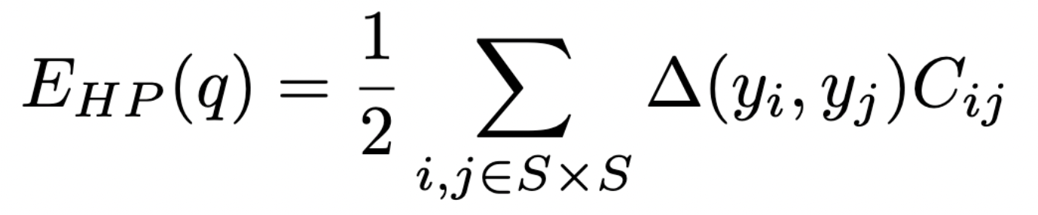
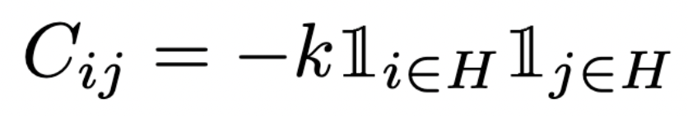
HP Model
The HP model is an energy function

Slide 10
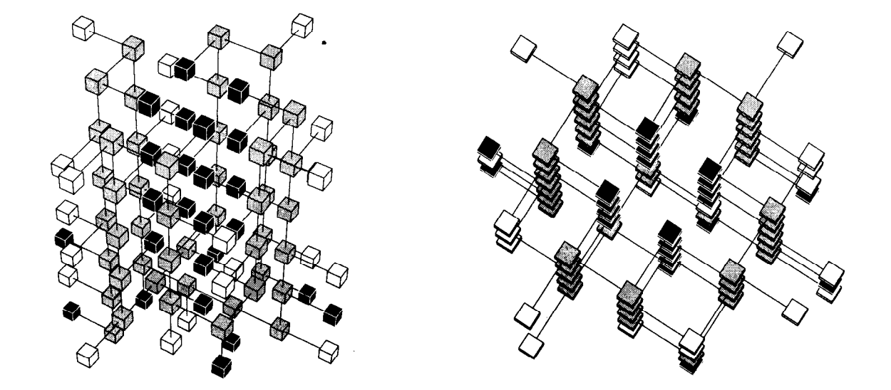
HP Model
The HP model is an energy function

Slide 11
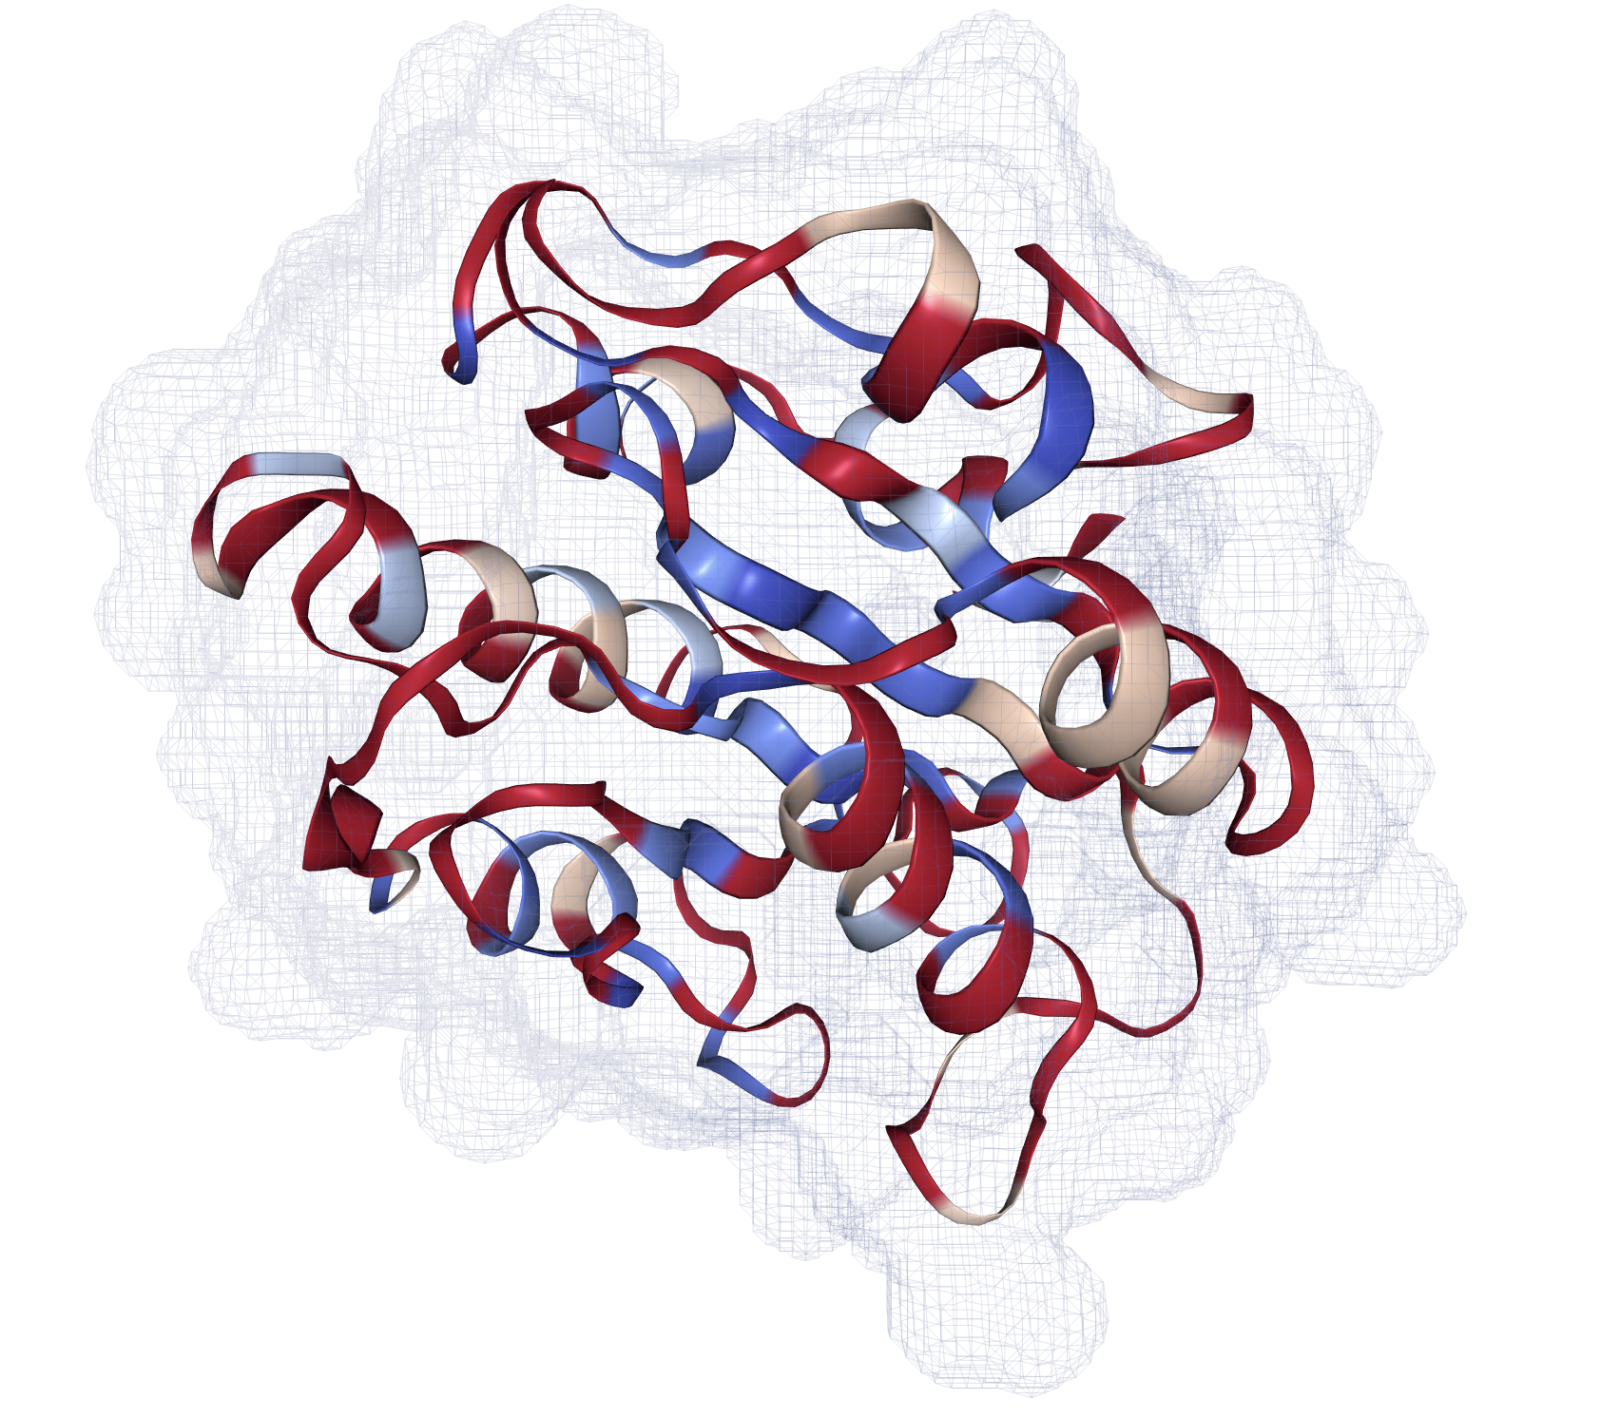
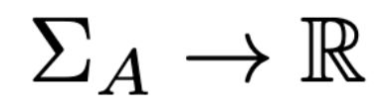
HP Model
Usually, we determine the set H by a hydrophobicity scale

Slide 12
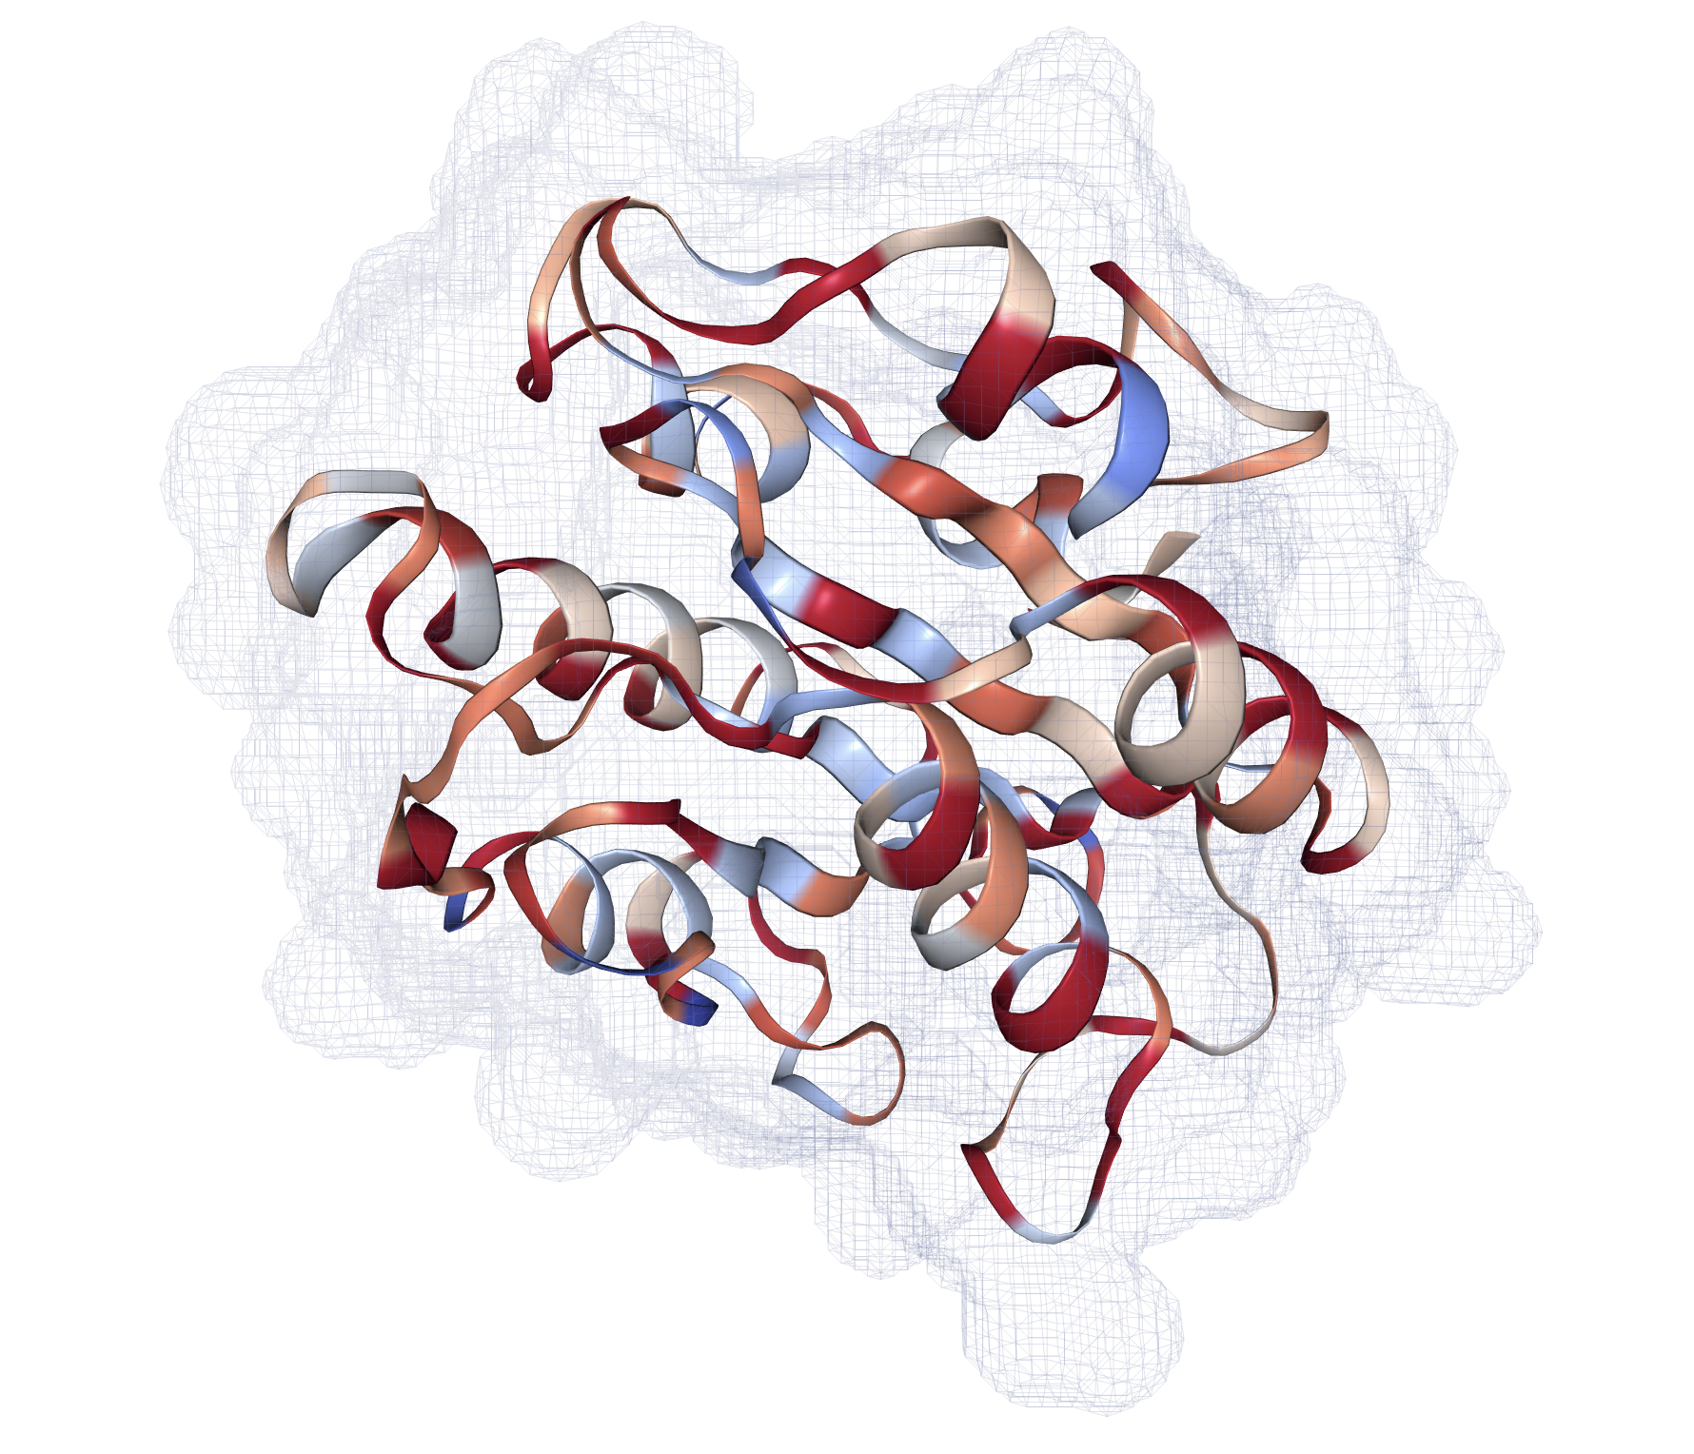
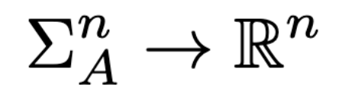
WaterFire
WaterFire corrects existing hydrophobicity scales by water density fluctuation in molecular dynamics trajectories

Slide 13
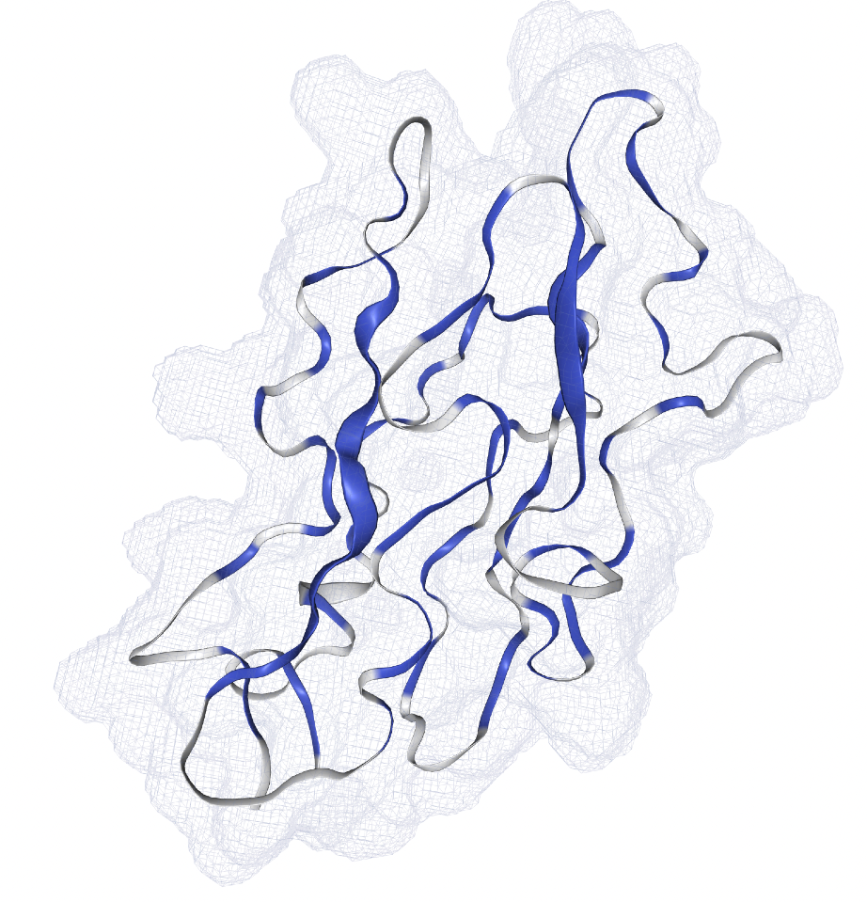
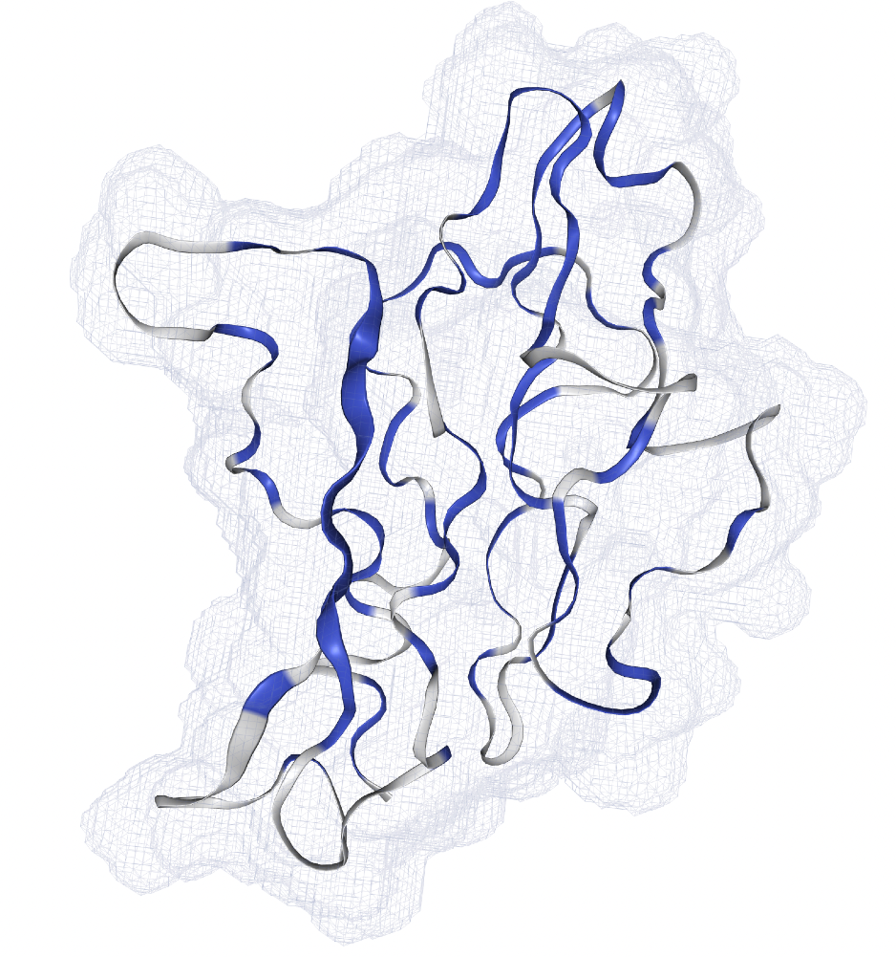
WaterFire
When applied iteratively in an HP approximation algorithm, WaterFire can yield an energy decrease, but secondary structure is still missing
-4.97•10⁵ kJ/mol
-5.37•10⁵ kJ/mol

Slide 14
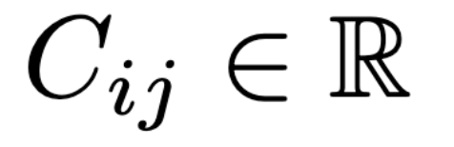
Generalizing WaterFire
What if instead of choosing H, we choose C directly?

Slide 15
Feasibility of Generalizing WaterFire
Reducing to any HP model approximation is NP-complete for an arbitrary C, by reduction from k-clique
We cannot choose the correct set H to minimize guaranteed energy according to the elements of C
Reducing WaterFire to an approximation algorithm is tractable, given C is monotonic in some ordering of the input amino acids

Slide 16
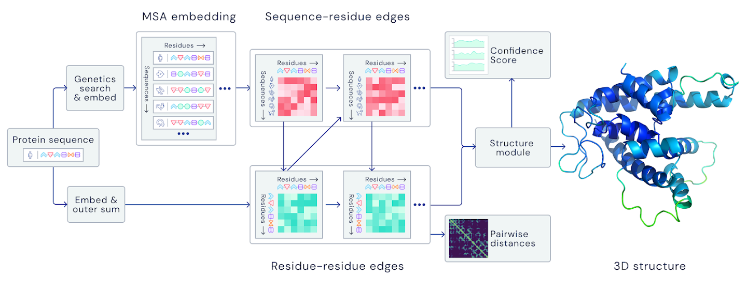
AlphAFold
Image credit: Rubiera, Oxford Protein Informatics Group

Slide 17
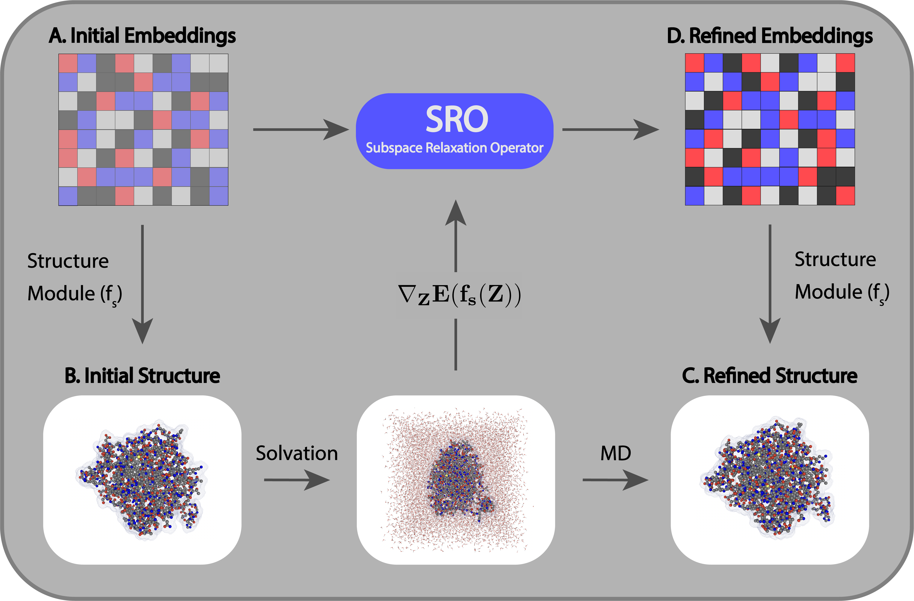
SubSpace Relaxation Operator (SRO)

Slide 18
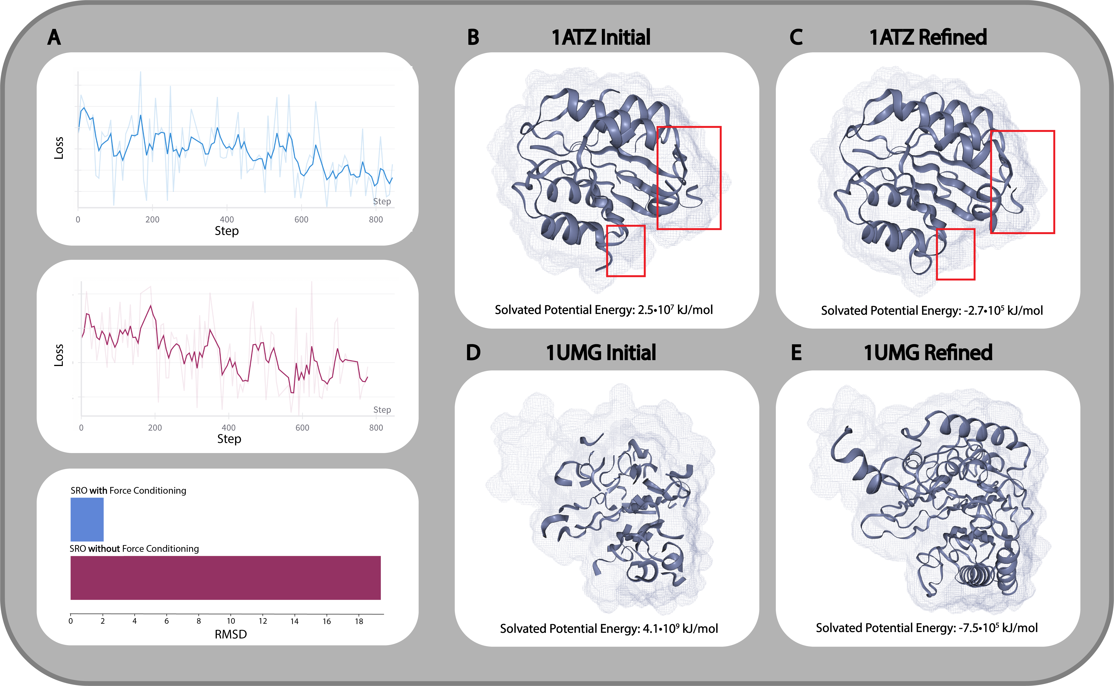
SRO Results

Slide 19
Thank you!

Slide 20
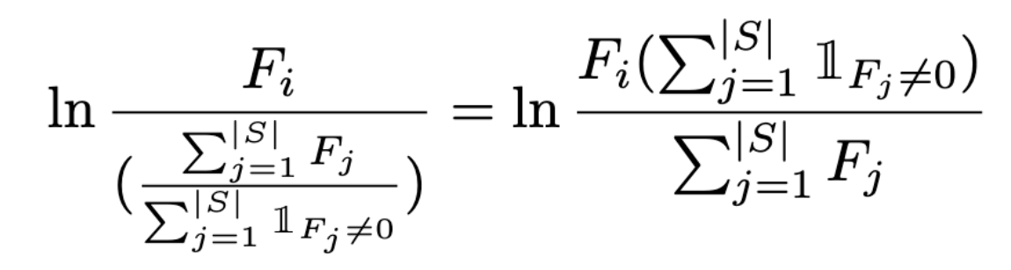
WaterFire Correction
WaterFire corrects existing hydrophobicity scales by water density fluctuation in molecular dynamics trajectories

