Slide 1
Causality Theory –an introduction
Sorin Istrail
Brown University
Lecture given at ECODAM 2019
University “Alexandru Ioan Cuza” Iasi
Amfiteatrul “Calin Ignat”
June 2019
In Memoriam of Professors Calin Ignat and Sergiu Rudeanu

Slide 2
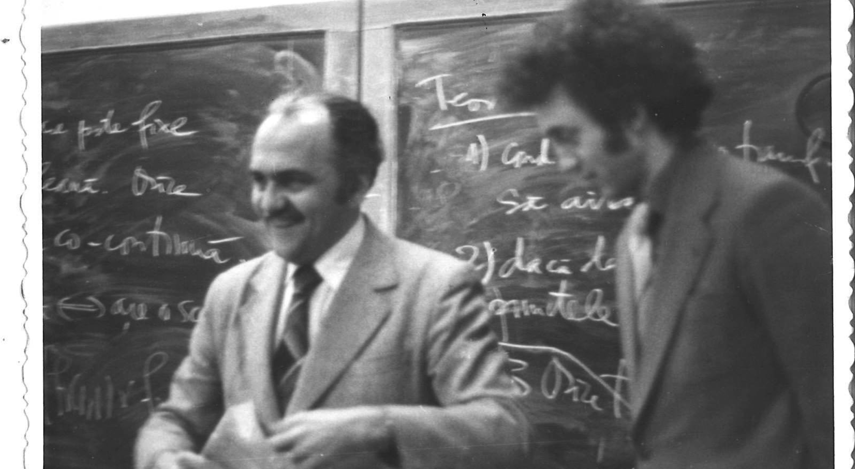
Sorin with his professor Sergiu Rudeanu

Slide 3
Causation is the most fundamental connection in the universe.
Without it, there would be no moral responsibility: none of our thoughts would be connected with our actions and none of our actions with any consequences.
Nor would we have a system of law because blame resides only in someone having caused injury or damage.
There would be no science and technology.
Any intervention we make in the world around us is premised on there being causal connections that are to at least a degree predictable.
It is causation that is the basis of this prediction and of explanation.

Slide 4
David Hume 1739
What is for one thing to cause another?
What is causation?
Philosophers have struggled with this question for millennia, at least since Aristotle (384-322 BC)
David Hume in 1739 “A treatise on Human Understanding”
argues that all we can observe in nature is a series of events. One thing happens and then another, and so on.
The problem is that when we start wondering about whether any of those events are causally connected is that the supposed causal connection is not itself part of our experience.

Slide 5
Causality Theory
Judea Pearl “Causation” 2000, Cambridge University Press
P. Sprites, C. Glymour, R. Scheines “Causation, Prediction and Search” MIT Press 2000
Judea Pearl “The Book of Why”, Penguin Random House, 2018.

Slide 6
Causation
The mantra learned in elementary statistics courses:
“Correlation does not imply causation”
If we observe a systematic relationship between two variables, and we have ruled out the likelihood that this is simply due to random coincidence, then something must be causing this relationship

Slide 7
A simple correlation implies an unresolved causal structure, since we cannot know which is the cause and which is the effect, or if both are common effects of other unmeasured variables.

Slide 8
Although correlation implies an unresolved causal structure, the reverse is not true:
Causation implies a completely resolved correlation structure
The causal relationship between objects or variables determine the correlational relationships between them

Slide 9
The causal process generating our observed data imposes constraints on the patterns of correlation that such data displays
The term “correlation” evokes the notion of probabilistic association between random variables.

Slide 10
One reason why some prefer to speak of “association” rather than “causes” is perhaps that causation is seen as a metaphysical notion that is best left to philosophers.
The philosophers of science cannot agree what constitues a “cause”
So we will see that we can study “causes” without defining them

Slide 11
Can we study “causes” without defining them?
Yes: The methods developed are general to any definition of “cause”
Yes: Scientists deal with concepts that have ambiguous meaning, e.g., Probability
Rather than defining causality, the approach is to axiomatize causality

Slide 12
Can we study “causes” without defining them?
Rather than defining causality, the approach is to axiomatize causality
i.e., determine attributes that scientists view as necessary for a relation to be “causal” and then develop a mathematical theory language based on these attributes

Slide 13
Axioms for Causality
Axiom 1: Relation must be Transitive
If A causes B and B causes C then it must also be true that A causes C
Axiom 2: Relation must be Local
The technical term is “Markov condition”
“events are caused by their proximal causes”

Slide 14
Axioms for Causality
Axiom 2: Relation must be Local
The technical term is “Markov condition”
“events are caused by their proximal causes”
If event A causes event C only through its effect on an intermediate event B
(i.e., A -> B -> C)
then the causal influence of A on C is blocked if
event B is prevented from responding to A

Slide 15
Axioms for Causality
Axiom 3: Relation must be Irreflexive
i.e., an event cannot cause itself
This is not to say that every event must be causally explained. To argue this way would lead us directly into the paradox of infinite regression
Every explanation in science includes events that are accepted (measured, observed) without being derived from previous events

Slide 16
Axioms for Causality
Axiom 4: Relation must be Asymmetric
If A is a cause of B then B cannot simultaneously be a cause of A.
This does not exclude feedback loops so long as we understand these to be dynamic in nature:
A causes B at time t, B causes A at time t+dt, and so on

Slide 17
Translating from Causal to Statistical Models
“It is no wonder that statisticians have virtually banished the word “cause” from statistics”
Pearl 1997: A century of confusion between correlation and causation can be traced to …

Slide 18
A
E
C
F
B
D
Variables A and B are causally independent meaning that changes in either
will not affect the value of the other
Each of the four variables C, D, E, F are causally dependent on A and B
either directly C or indirectly E and F

Slide 19
A
E
C
F
B
D
By “causally dependent” we mean changes on either A or B will
provoke changes in each of C, D, E, and F, but changes in any of
these will not provoke changes in either A or B
A and B are “direct causes” of C because A or B will provoke
changes in C irrespective of the behavior of either D, E and F

Slide 20
A
E
C
F
B
D
A and B are “indirect causes” of D, E, F because changes in A or B will
provoke changes in these only by changing C.
If C is prevented from changing then A and B will no longer cause changes
in these variables
C is a direct “common cause” of D and E and an “indirect cause” of F
through its effects on D and E
Finally, both D and E are direct causes of F, though they are not themselves
causally independent

Slide 21
A
E
C
F
B
D

Slide 22
Causal graph
Vertex = variable
Edge = effect
X-->Y means X is a direct cause of Y
X<-->Y means neither X nor Y is a cause of the other but both share common unknown causes represented by some unknown vertex not included in the causal graph (incomplete causal graphs with unspecified latent vertices)

Slide 23
Direct cause
A direct cause is a causal relationship between two vertices that exists independently of any other vertex in the causal explanation (→) whose tail is at the cause and whose head is pointing to its direct effect: e.g. A and B are direct causes for C.
Furthermore, A and B are causal parents of C, and C is their causal child.

Slide 24
Direct and indirect cause
A cause is “direct” only in relation to other vertices in the causal graph. This is important because a common error is to incorrectly equate a “direct” cause relative to others in the causal graph with more fundamental claim that the cause is “direct” with respect to other variable that might exist.
An indirect cause is a causal relationship between two vertices that is conditional on the behavior of other vertices in the causal explanation. Again, a cause is ‘indirect’ only in relation to other vertices in the causal graph. A is an indirect cause of the vertex D (A→C→) because its causal effect is conditional on the behavior of vertex C.

Slide 25
Directed path
A and B are causal ancestors of D and
D is causal descendent of both A and B
A directed path bewteen two vertices in the causal graph exists if it is possible to trace an ordered sequence of vertices that must be traversed when following the direction of the edges (head to tail) in order to travel from the first to the second
If no such paths exist then the two vertices are
causally independent (causal conditional independence is defined
next).
There are two directed paths between A and F:
A→C→D→F and A→C→E→F

Slide 26
Undirected path
An undirected path between two vertices in the causal graph exists if it is possible to trace an ordered sequence of vertices that must be traversed, ignoring the direction of the edges (head to tail) in order to travel from the first to the second.
An example of undirected path from A to B
A→C←B

Slide 27
Collider
A collider vertex on an undirected graph is a vertex with arrows pointing into it from both directions
The vertex F in the undirected graph
D→F←E is a collider along this indirected
path
It is possible for the vertex to be a collider on along one path and a non-collider along another

Slide 28
Non-collider
The contrary to a collider is a non-collider
The vertex C in the path A→C→D is a
non-collider

Slide 29
Causal conditioning
The vertices in the causal graph can be conceived to be in one of two states along a given path: active (ON) and inactive (OFF)
The natural state of a non-collider is active (ON) and the natural state of a collider is inactive (OFF).
Intuitively, one can think of the arrows pointing out the direction of causal influence.

Slide 30
Conditioning
Conditioning on a vertex in a causal graph means to change its state:
if it was active (ON) then conditioning inactivates it (OFF)
but if it was inactive (OFF) then conditioning activates it (ON)

Slide 31
d-separation (the concept of Independence,
Judea Pearl’s seminal concept)
We are still discussing only directed acyclic graphs concepts – no probability distributions or statistical models yet
We define now what is meant for “independence” for a vertex or a group of vertices in a causal graph upon conditioning on some other set of vertices =
the notion of d-separation

Slide 32
d-separation (cont)
Definition (d-separation)
Given a causal graph G, if X and Y are two different vertices in G, and W is a set of of vertices in G that does not contain X or Y, then
X and Y are d-separated given W if and only if
there exists no undirected path U between X and Y such that:
Every collider of U is either in W or else has a descendant in W, and
No other vertex of U is in W

Slide 33
d-separation (cont)
Informally, d-separation gives the necessary and sufficient conditions for two vertices in a directed acyclic causal graph to be observationally (probabilistically) independent upon conditioning on some other set of vertices.
d-separation is the translation device between the language of causality and the language of probability distributions.

Slide 34
Probability distributions
The vertices of the casual graph represent attributes in a causal system
When we randomly sample observational units possessing these attributes from some statistical population that is governed by this causal system, the vertices of the causal graph are also random variables that obey a probability distribution.
Since causal relationships involve at least two such random variables, we must deal with joint probability distributions.

Slide 35
Probabilistic (conditional) independence
By definition, two random variables (X,Y) that are (unconditionally) independent if their joint probability density of X and Y is the product of the probability density of X and the probability density of Y.
P(X,Y)=P(X)*P(Y)
Conditional on a set of variables Z,
P(X, Y|Z)=P(X|Z)*P(Y|Z)

Slide 36
The Markov condition
For causal models, the Markov condition is a property both of a directed acyclic causal graph and the joint probability distribution that is generated by the graph.
The Markov condition is satisfied if, given a vertex v in the graph, or a random variable v in the probability distribution, v is independent of all ancestral causes given its causal parents.
I.e., once we know the direct causes of an event,
knowledge of more distant (indirect) causes provides
no new information.

Slide 37
The Markov condition (cont)
An important property of probability distributions that obey the Markov condition is that they can be decomposed into conditional probabilities involving only variables and their causal parents.

Slide 38
Causality=Complete Correlation Structure
A
Only for DAGs
C
B
D
A causal graph and the joint probability distribution generated by it.
This decomposition states that, to know the probability distribution of D,
we need to know the value of C, i.e., P(D|C). To know the probability
distribution of C we only need to know the values of A and B, i.e., P(C|{A,B}).
A and B are independent (d-separated), and so to know the joint distribution
of A and B we only need to know the marginal distributions of A and B,
i.e., P(A)*P(B).
P(A, B, C, D)=P(A)*P(B)*P(C|{A,B})*P(D|C)

Slide 39
The translation from causal models to observational models
Although causal models and observational models are not the same thing there is a remarkable relationship between the two.
Theorem (Judea Pearl, 1988)
For any directed acyclic causal graph, every d-separation statement obtained from the graph implies an independence relation in the joint probability distribution of the random variables represented by its vertices.

Slide 40
Judea Pearl’s Theorem
The theorem is very general. It does not depend on any distributional assumptions of the random variables or on the functional form of the causal relationships.
This is the translational device that we needed in order to properly translate the causal claims represented by the directed graph into the “official” language of probability theory used by statisticians to express observational models.

Slide 41
Judea Pearl: The Ladder of Causation
Level 1: ASSOCIATION
Activity: Seeing, Observing
Questions: What if I see …?
(How are variables related?
How would seeing X change my belief in Y?)
Level 2: INTERVENTION
Activity: Doing, Intervening
Questions: What if I do …? How?
(What would Y be if I do X? How can I make Y happen?)
Level 3: COUNTERFACTUALS
Activity: Imagining, Retrospection, Understanding
Questions: What if I had done …? Why?
(Was it X that caused Y? What if X had not occurred? What if I had acted differently?)

