Slide 1
Theodosius Dobzhansky
Sir Francis Galton
Sir Ronald Fisher
Prof. Sorin Istrail

Slide 2
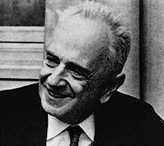
Theodosius Dobzhansky (1900-1975)
Nothing in Biology Makes Sense
Except in the Light of Evolution

Slide 3
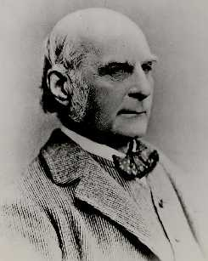
The Supreme Law of Unreason
Sir Francis Galton
A quotation (Galton 1889) relevant to the central limit theorem and about the normal or "Gaussian" distribution:
I know of scarcely anything so apt to impress the imagination as the wonderful form of cosmic order expressed by the "Law of Frequency of Error." The law would have been personified by the Greeks and deified, if they had known of it. It reigns with serenity and in complete self-effacement, amidst the wildest confusion. The huger the mob, and the greater the apparent anarchy, the more perfect is its sway. It is the supreme law of Unreason. Whenever a large sample of chaotic elements are taken in hand and marshaled in the order of their magnitude, an unsuspected and most beautiful form of regularity proves to have been latent all along.

Slide 4
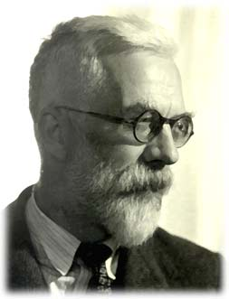
In Fisher We Trust
Sir Ronald Aylmer Fisher

