Slide 1
Data and Haplotype Phasing
Derek Aguiar
CSCI2820 – Medical Bioinformatics
9/19/13

Slide 2
Summary of last class
Basics of biology + genetic variation

Slide 3
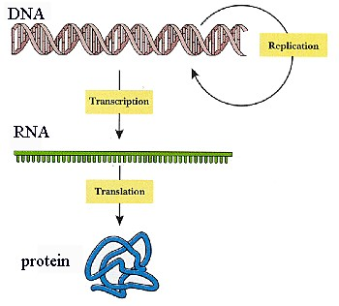
Central Dogma
gene
  Unit of inheritance
  Transcribed into mRNA
mRNA
  messenger RNA
  blueprint for protein
proteins
  Essential molecules that are active in
  practically all cellular processes
Genes – RNA – Proteins
  http://www.dnalc.org/resources/3d/central-dogma.html

Slide 4
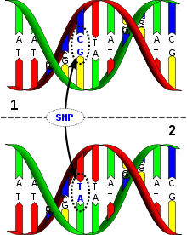
Variation
Single nucleotide variant (polymorphism)
http://en.wikipedia.org/wiki/Single-nucleotide_polymorphism
https://sites.google.com/site/lifesciencesinmaine/5-cell-division-reproduction-and-dna

Slide 5
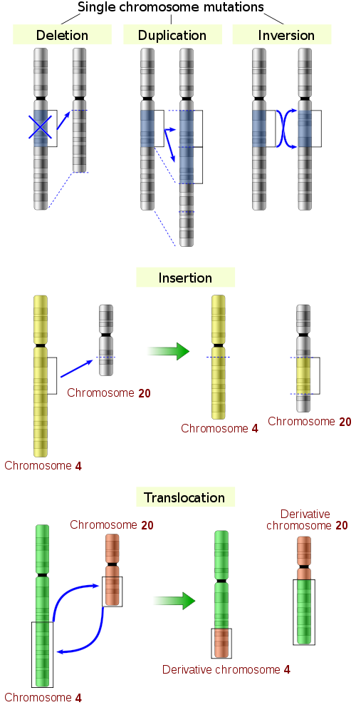
Variation
Structural Variation
  Deletion
  Duplication
  Translocation
  Inversion
http://en.wikipedia.org/wiki/Single-nucleotide_polymorphism
https://sites.google.com/site/lifesciencesinmaine/5-cell-division-reproduction-and-dna

Slide 6
Summary of last class
Basics of biology + genetic variation
Recombination

Slide 7
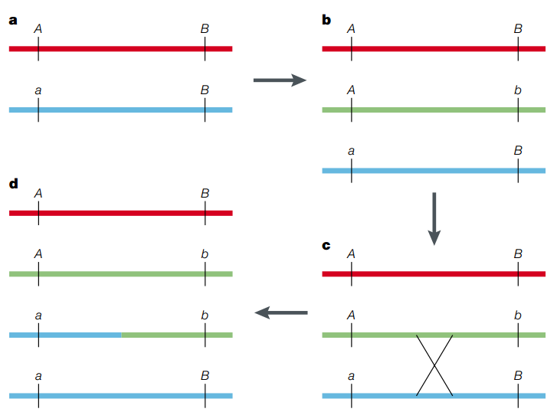
Recombination

Slide 8
Summary of last class
Basics of biology + genetic variation
Recombination
Linkage Disequilibrium
  Deviation from random association among alleles
  Computing D, D’, r²
    R² is the correlation coefficient of the frequencies
    Relationship between r² and X²

Slide 9
Importance of seeing from both angles
Understanding the biology helps computational researchers create more accurate models, more accurate solutions, help identify biases, etc…
Understanding the computation may help biologists compute better results, create a better study design, develop fine-tuned solutions to unresolved problems, etc…

Slide 10
data used so far in 2820
Genes
Variants
Genotypes
Haplotypes
Genotype
{A,C}
C
{G,T}
{C,T}
{C,A}
{T,A}
ACGCCT
TGCGGA
Haplotype
ACGCCT
CCTTAA
CCTTAA
GGAATT

Slide 11
Linkage Disequilibrium
D’ in real data
  HLA-DRA: Chromosome 6 bases 32515-32520kb
  Surrounding area: 32400-32600kb
LD in different populations

Slide 12
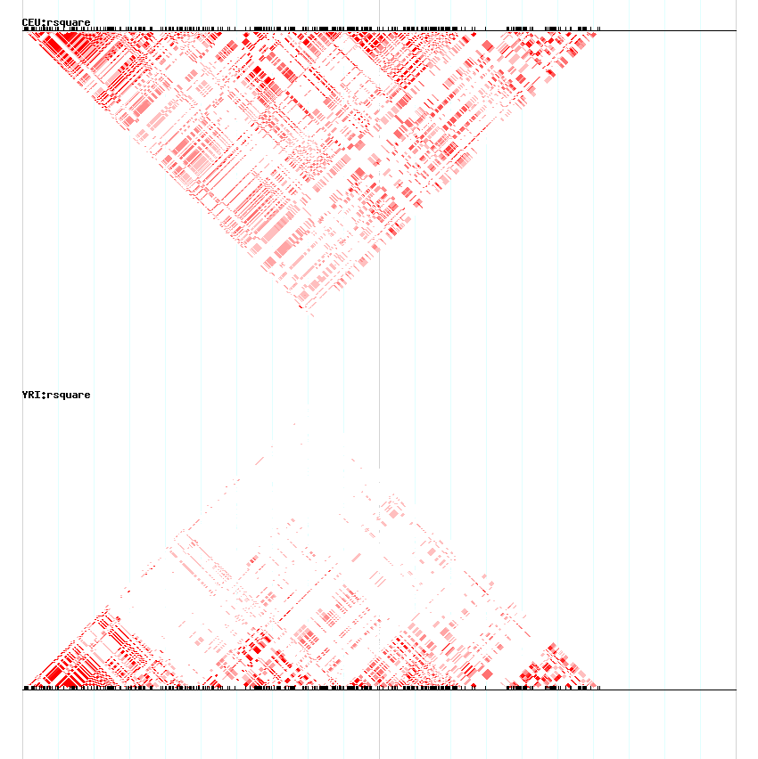
Linkage Disequilibrium heat maps.
The markers are distributed along the x-axis.
Each cell represents two SNPs, the darker the red color the higher the LD between the markers.
CEU = Utah residents of northern and western European ancestry
YRI = 30 trios from Ibadan, Nigeria

Slide 13
Computing LD
We’ve been hiding something from you…
  Haplotypes are not easily obtainable
Where does the data come from?
  DNA microarrays
    SNP “chips”
  Sequencing

Slide 14
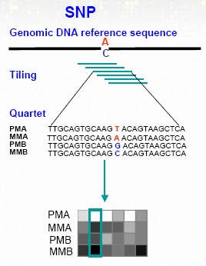
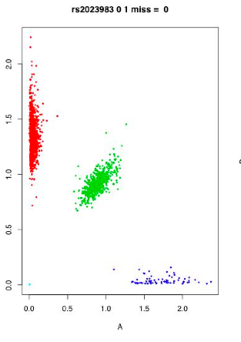
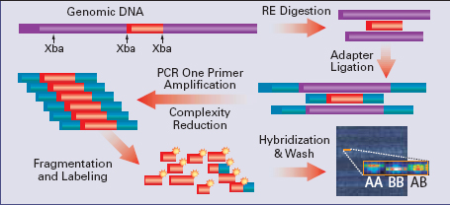
SNP Arrays
SNP array intensity allele calls
Probe intensities
Allele 0
Allele 1
http://www.sanger.ac.uk/resources/software/illuminus/
http://www-microarrays.u-strasbg.fr/base.php?page=affySNPsE.php

Slide 15
High-throughput Sequencing
Also termed next-generation sequencing
  Illumina
  454
  SOLiD
DNA is fractured, amplified, fixated onto an array, bases are added
Single molecule or 3rd generation technologies
Source of bias
Error signature
Short reads: ~50-200bp (454 can get up to 1kb)
Generally more error prone than Sanger
Extremely fast and parallel

Slide 16
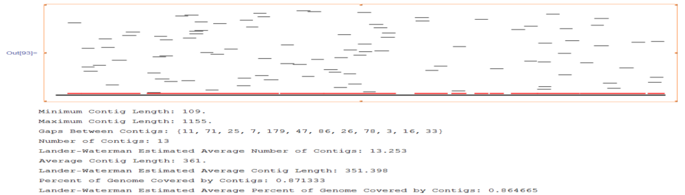
Genome Assembly
Sequence genome
Extend overlapping reads
Produce consensus sequence, variation usually not called

Slide 17
Haplotype reconstruction
Compute haplotypes from either microarray or sequence data
  From sequence data: haplotype assembly
  From microarray: haplotype phasing

Slide 18
Notation and assumptions
Infinite sites
  Every variant has two alleles
  So, variant alleles can be encoded with a bit
    0 major allele, 1 minor allele
Haplotypes are strings of variants
Genotypes are strings of variants representing the allelic combinations for two homologous chromosomes
  0 and 1 the homozygotes, 2 denotes the heterozygote

Slide 19

Haplotype Phasing
Given a sample of genotypes from a population, separate each individual’s paired chromosomes (genotypes) into the maternal and paternal chromosomes (haplotypes)
explanation 1
explanation 2
genotype
hap 1
hap 1
100111100
100101000
100111000
100101100
100121200
hap 2
hap 2
Notes:
ANIMATION AND LABELS
2^{(k-1)} where k is the number of 2’s possible combinations of haplotypes

Slide 20
Space of solutions
Given a genotype with k ambiguous sites (2’s), how many explanations are there?

Slide 21
Space of solutions
Given a genotype with k ambiguous sites (2’s), how many explanations are there?
1 ambiguous site can be resolved easily, adding another generates two possible combinations
So……. 2^{k-1}

Slide 22
Haplotype phasing
Input: n genotypes covering m variants
Output: 2n haplotype covering m variants
What should we optimize for?

Slide 23
Optimization
Parsimony
Maximum Likelihood
Bayesian
Perfect phylogeny
  Assuming no recombination

Slide 24
Optimization
Parsimony
Maximum Likelihood
Bayesian
Perfect phylogeny
  Assuming no recombination

Slide 25
Algorithm
We have input, output, and optimization.
How about an algorithm?
What properties of the data can we use?

Slide 26
Algorithm
We have input, output, and optimization.
How about an algorithm?
What properties of the data can we use?
  Haplotype sharing
  LD and blocks

Slide 27
The Clark method
Developed in 1990 by Andy Clark
Easy cases for phasing?
  E.g. how do you phase 11200?

Slide 28
The Clark method
Developed in 1990 by Andy Clark
Easy cases for phasing?
  Genotype is composed of homozygous sites
  Genotype has a single heterozygous site
Harder cases
  Genotypes with more than a single ambiguous site

Slide 29
The Clark method
Suppose n=5 and m=5
Variants
A | 0 | 1 | 2 | 0 | 2
B | 2 | 0 | 0 | 0 | 0
C | 1 | 2 | 1 | 2 | 1
D | 0 | 0 | 1 | 0 | 0
E | 0 | 1 | 0 | 0 | 0
Genotypes

Slide 30
The Clark method
Resolved Set
Suppose n=5 and m=5
Variants
A
A
B | 0 | 0 | 0 | 0 | 0
B | 1 | 0 | 0 | 0 | 0
C
C
D | 0 | 0 | 1 | 0 | 0
D | 0 | 0 | 1 | 0 | 0
E | 0 | 1 | 0 | 0 | 0
E | 0 | 1 | 0 | 0 | 0
Variants
A | 0 | 1 | 2 | 0 | 2
B | 2 | 0 | 0 | 0 | 0
C | 1 | 2 | 1 | 2 | 1
D | 0 | 0 | 1 | 0 | 0
E | 0 | 1 | 0 | 0 | 0
Haplotypes
Genotypes

Slide 31
Consistent haplotypes
Let g be some genotype
If, for some haplotype h, there exists a haplotype explanation for g including h then h is said to be consistent with g
Then, h and its compliment w.r.t. g can be used as a phasing explanation for g

Slide 32
The Clark method
Resolved Set
Suppose n=5 and m=5
Variants
A
A
B | 0 | 0 | 0 | 0 | 0
B | 1 | 0 | 0 | 0 | 0
C
C
D | 0 | 0 | 1 | 0 | 0
D | 0 | 0 | 1 | 0 | 0
E | 0 | 1 | 0 | 0 | 0
E | 0 | 1 | 0 | 0 | 0
Variants
A | 0 | 1 | 2 | 0 | 2
B | 2 | 0 | 0 | 0 | 0
C | 1 | 2 | 1 | 2 | 1
D | 0 | 0 | 1 | 0 | 0
E | 0 | 1 | 0 | 0 | 0
Haplotypes
Genotypes

Slide 33
The Clark method
Resolved Set
Suppose n=5 and m=5
Variants
A | 0 | 1 | 0 | 0 | 0
A | 0 | 1 | 1 | 0 | 1
B | 0 | 0 | 0 | 0 | 0
B | 1 | 0 | 0 | 0 | 0
C
C
D | 0 | 0 | 1 | 0 | 0
D | 0 | 0 | 1 | 0 | 0
E | 0 | 1 | 0 | 0 | 0
E | 0 | 1 | 0 | 0 | 0
Variants
A | 0 | 1 | 2 | 0 | 2
B | 2 | 0 | 0 | 0 | 0
C | 1 | 2 | 1 | 2 | 1
D | 0 | 0 | 1 | 0 | 0
E | 0 | 1 | 0 | 0 | 0
Haplotypes
Genotypes

Slide 34
The Clark method
Resolved Set
Suppose n=5 and m=5
Variants
A | 0 | 1 | 0 | 0 | 0
A | 0 | 1 | 1 | 0 | 1
B | 0 | 0 | 0 | 0 | 0
B | 1 | 0 | 0 | 0 | 0
C | ? | ? | ? | ? | ?
C | ? | ? | ? | ? | ?
D | 0 | 0 | 1 | 0 | 0
D | 0 | 0 | 1 | 0 | 0
E | 0 | 1 | 0 | 0 | 0
E | 0 | 1 | 0 | 0 | 0
Variants
A | 0 | 1 | 2 | 0 | 2
B | 2 | 0 | 0 | 0 | 0
C | 1 | 2 | 1 | 2 | 1
D | 0 | 0 | 1 | 0 | 0
E | 0 | 1 | 0 | 0 | 0
Haplotypes
Genotypes

Slide 35
Clark algorithm
Resolve all homozygotes and single heterozygotes, add to resolved set
While there are unresolved genotypes
  Find a haplotype from the resolved set that is consistent with an unresolved genotype
  Add it, and its compliment to the resolved set
  Mark genotype as resolved
  If no haplotype in the resolved list is consistent with an unresolved genotype, terminate

Slide 36
Drawbacks?

Slide 37
Drawbacks?
It’s possible that a genotype can be resolved in multiple ways

Slide 38
Drawbacks?
It’s possible that a genotype can be resolved in multiple ways
Unresolved genotypes

Slide 39
Drawbacks?
It’s possible that a genotype can be resolved in multiple ways
Unresolved genotypes
Starting condition may not be met

Slide 40
Drawbacks?
It’s possible that a genotype can be resolved in multiple ways
Unresolved genotypes
Starting condition may not be met
Order of resolution

Slide 41
Order of resolution
The number of orphaned genotypes depends on the order of resolution.
Maximum Resolution Problem
  Input: A set of unresolved genotypes and resolved haplotypes
  Output: Maximum number of ambiguous vectors that can be resolved by successive applications of Clark’s algorithmic genotype resolution step
Equivalent to minimizing the number of orphan genotypes

Slide 42
Max resolution
Theorem
  The maximum resolution problem is NP-complete
  Reduction from satisfiability

Slide 43
Where to find the data
Almost everything
  NCBI http://www.ncbi.nlm.nih.gov/
  EBI http://www.ebi.ac.uk/
Variation
  HapMap http://hapmap.ncbi.nlm.nih.gov/
Sequence Data
  1000 genomes http://www.1000genomes.org/
  Assemblathon 1&2 http://assemblathon.org/

Slide 44
Lecture summary
LD in real data is messy
Experimental techniques produce genotypes
Genotype -> haplotype is a difficult computational problem
We formalized haplotype phasing, constructed an optimization, and analyzed the Clark algorithm
Mathematica and data sources

