Slide 1
Visualization of high-dimensional scientific images for annotation tools
Peter Bajcsy and Pushkar Sathe
National Institute of Standards and Technology

Slide 2
Introduction
Motivation/Challenges:
  Multi-dimensional imaging captures complex data beyond human perception.
  Task-specific approaches ensure relevant information is emphasized.
Common Requirement:
  Annotate multi-dimensional data based on human perception
  Computer Vision Annotation Tool (CVAT) compatible.
Problem Statements:
  Create multiple visual representations of multi-dimensional images for human visual consumption.
  Design evaluation metrics for selecting the optimal representation given a task.

Slide 3
Annotations to Create Ground Truth Image Segments

Slide 4
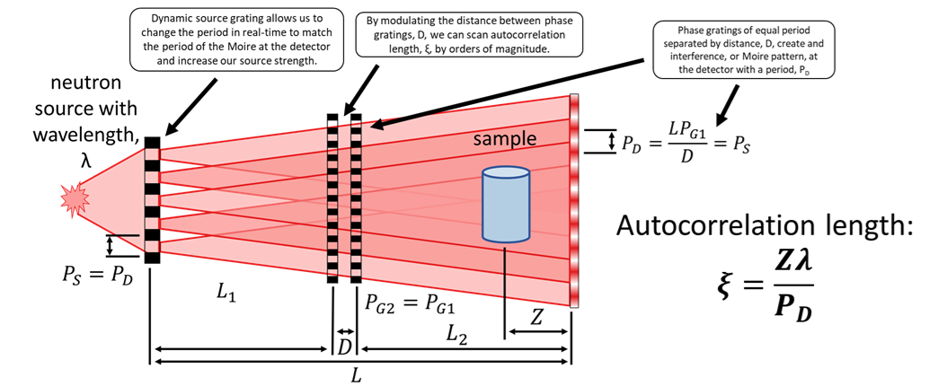
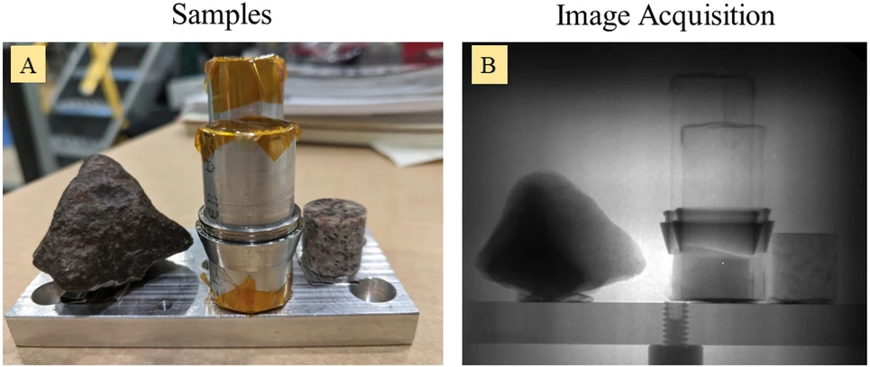
Interferometry: INFER - Neutron Interferometric Microscopy of Small Forces and Hierarchical Structures
Project webpage
One image for each configuration of Z, λ. and P_{D}

Slide 5
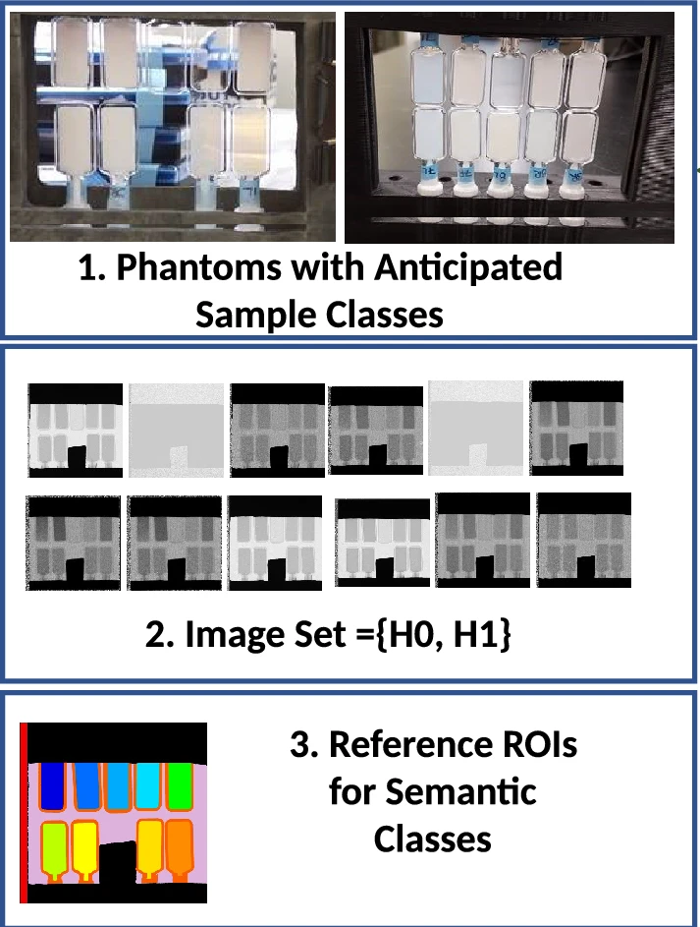
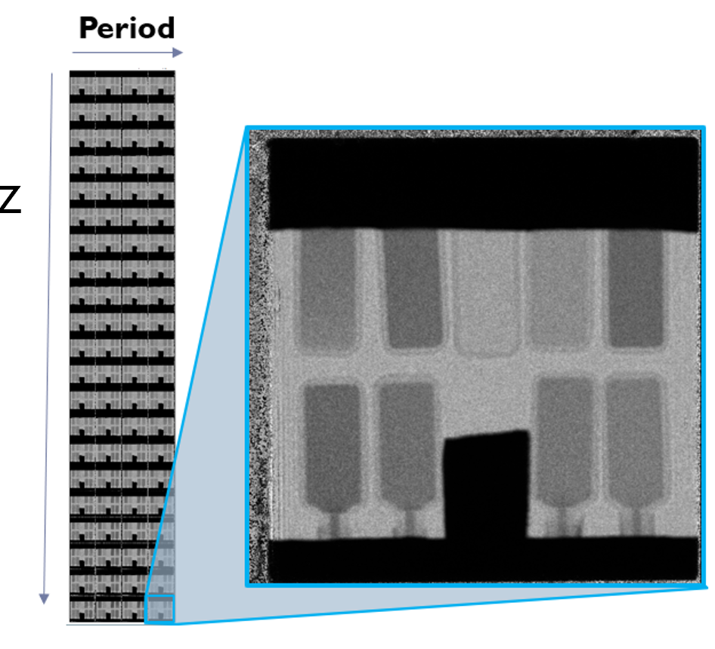
Specific Dataset: Overview
INFER Neutron Imaging
Data Dimensions:
Spatial (x, y), Z, Period P_{D} = (1942, 1942, 21, 4)

Slide 6
Specific Dataset: Access
General Task: Visualize high-dimensional images for manual segmentation tasks where the segments are defined by the homogeneity of high-dimensional attributes.
Access to data downloads:
(1) Measured Intensities for 84 autocorrelation values: A sample with polystyrene (PS) beads with varying radii in Deuterium Oxide suspensions acquired at ORNL HFIR)
tar.gz file download (1.5 GB)
(2) Manual Mask: 1 manually annotated mask with pixel-level annotations of 13 classes for the PS dataset (1)
tar.gz file download (52 KB)
Data dissemination webpage

Slide 7
Projections to Lower-Dimensions
METHOD | DESCRIPTION
PCA (Principal Component Analysis) | Decomposes the images into orthogonal components, each representing a direction of maximum variance.
ICA (Independent Component Analysis) | Extracts statistically independent components from the images.
NMF (Non-negative Matrix Factorization) | Factorizes the images into parts-based components.
MSVD (Multiscale Singular Value Decomposition) | Decomposes the images into singular vectors across multiple scales.
LP (Laplacian Pyramid) | Decomposes images into multi-level pyramids, separating high-frequency (details) and low-frequency (structures) components.
DWT (Discrete Wavelet Transform) | Decomposes images into wavelet sub-bands, representing different frequency components.

Slide 8
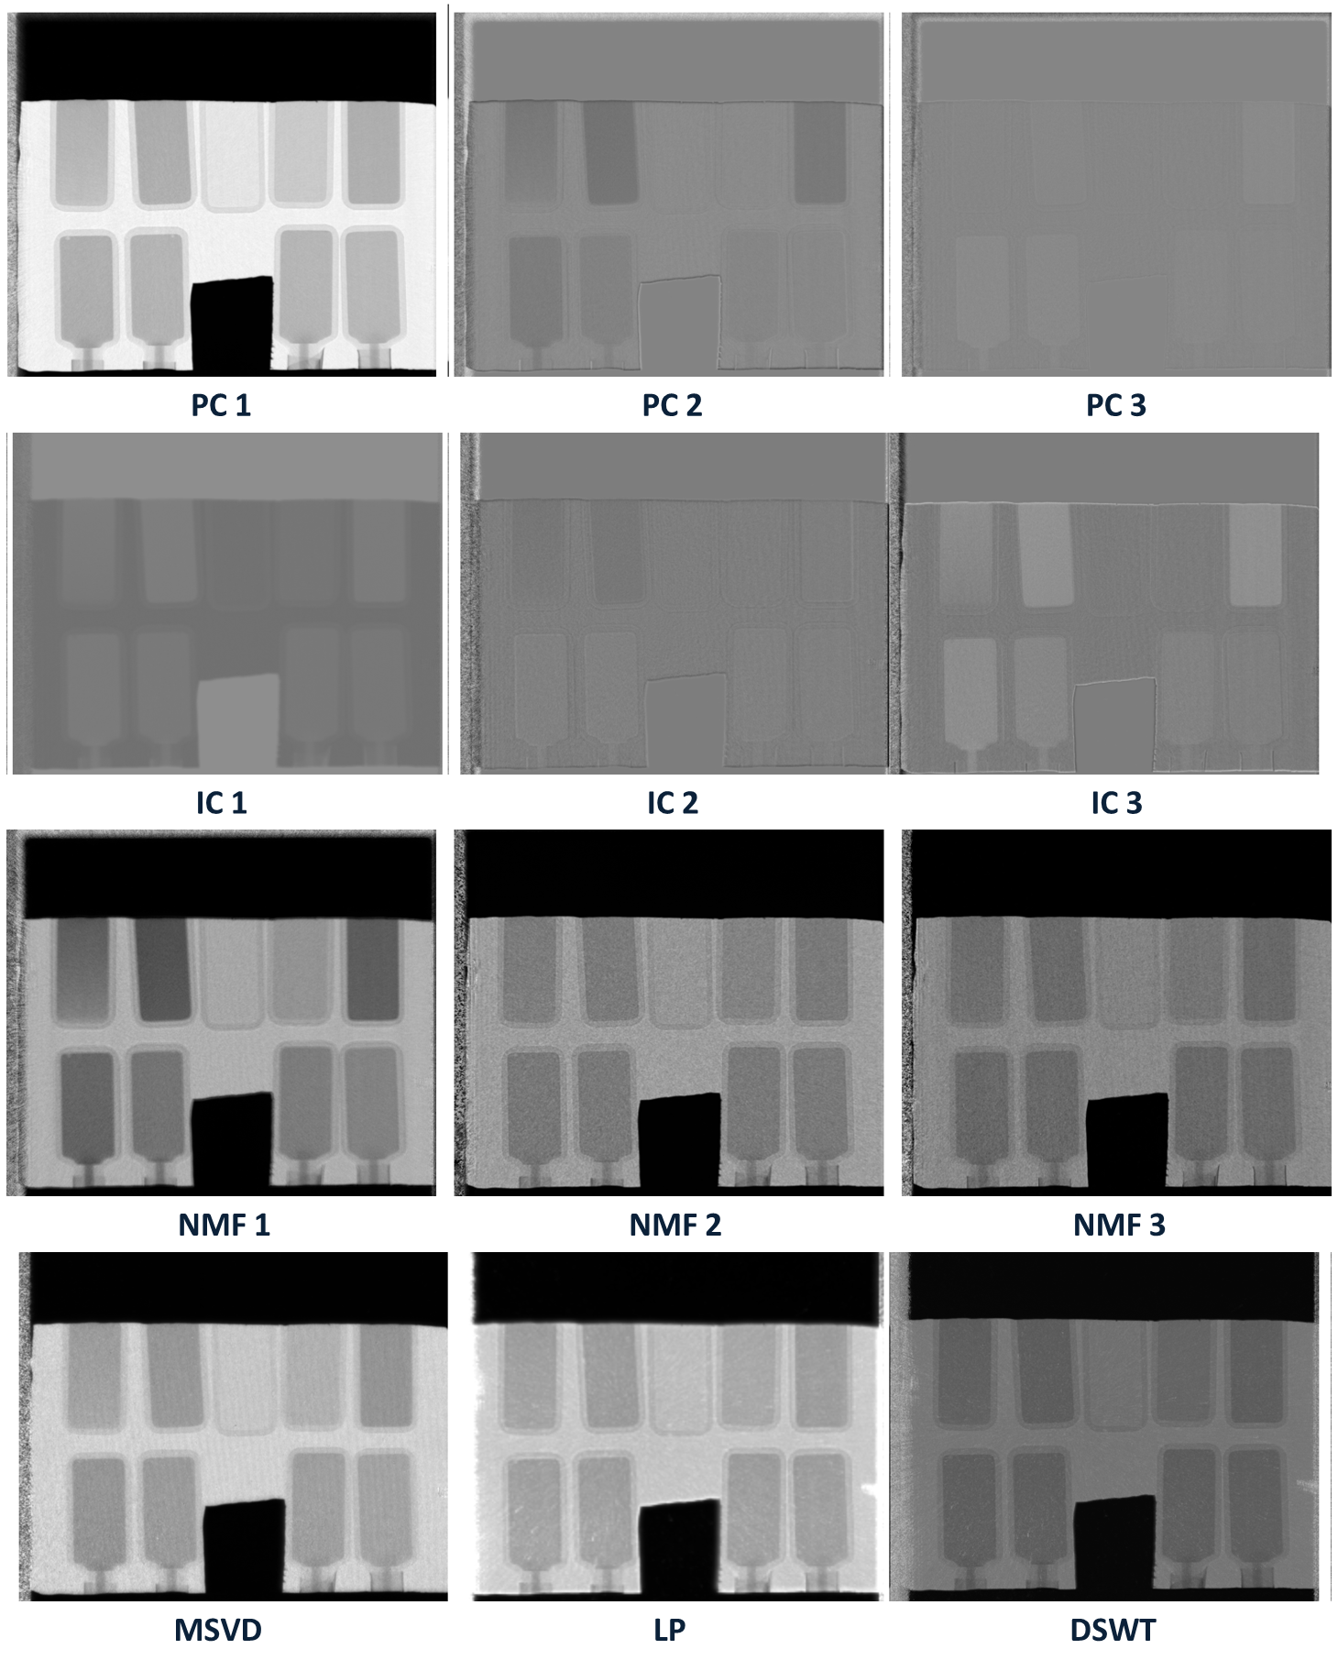
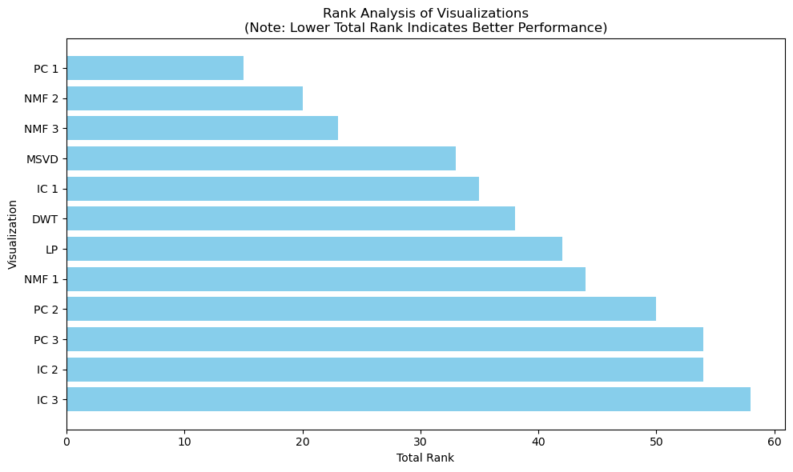
Examples of Projections
Rank Analysis of Visualizations
(Lower is Better)

Slide 9
Annotations to Create Ground Truth Clusters

Slide 10
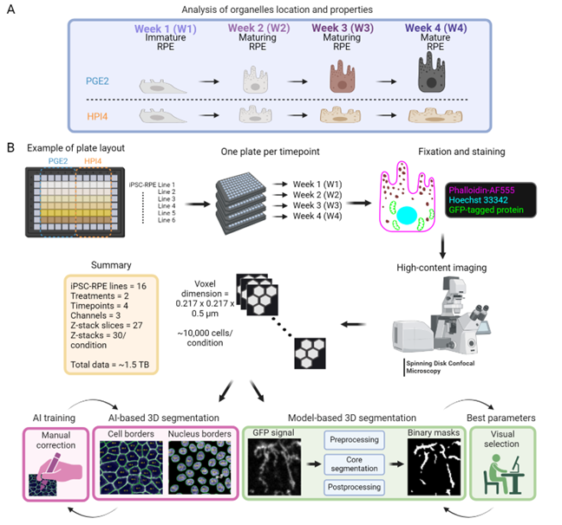

Quantify 3D Characteristics of Human Retinal Pigment Epithelium
A 3D Subcellular Map of Human Retinal Pigment Epithelium Using Quantitative Confocal Fluorescent Microscopy
ACTB (actin filaments)
CETN2 (centrioles)
CTNNB1 (adherens junctions)
DSP (desmosomes)
FBL (nucleolus)
GJA1 (gap junctions)
LAMP1 (lysosomes)
LC3B (autophagosomes)
LMNB1 (nuclear envelope)
MYH10 (actomyosin bundles)
RAB5 (endosomes)
SEC61B (ER)
SLC25A17 (peroxisomes)
ST6GAL1 (Golgi apparatus)
TOM20 (mitochondria)
Z01 (TJP1 tight junction protein)

Slide 11
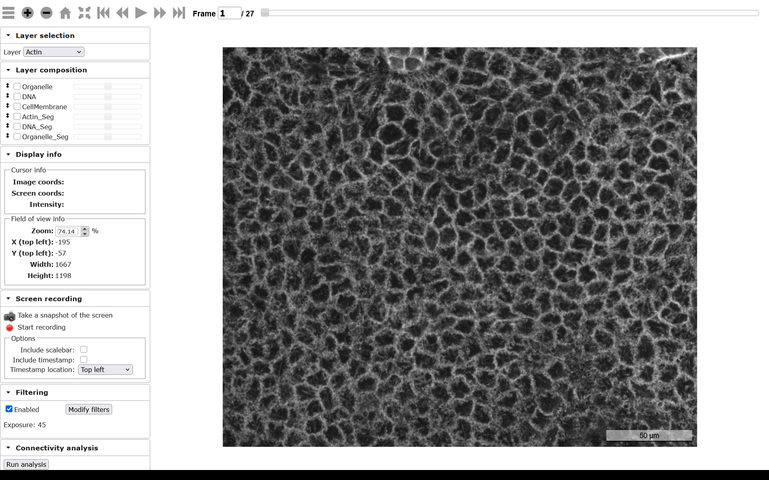
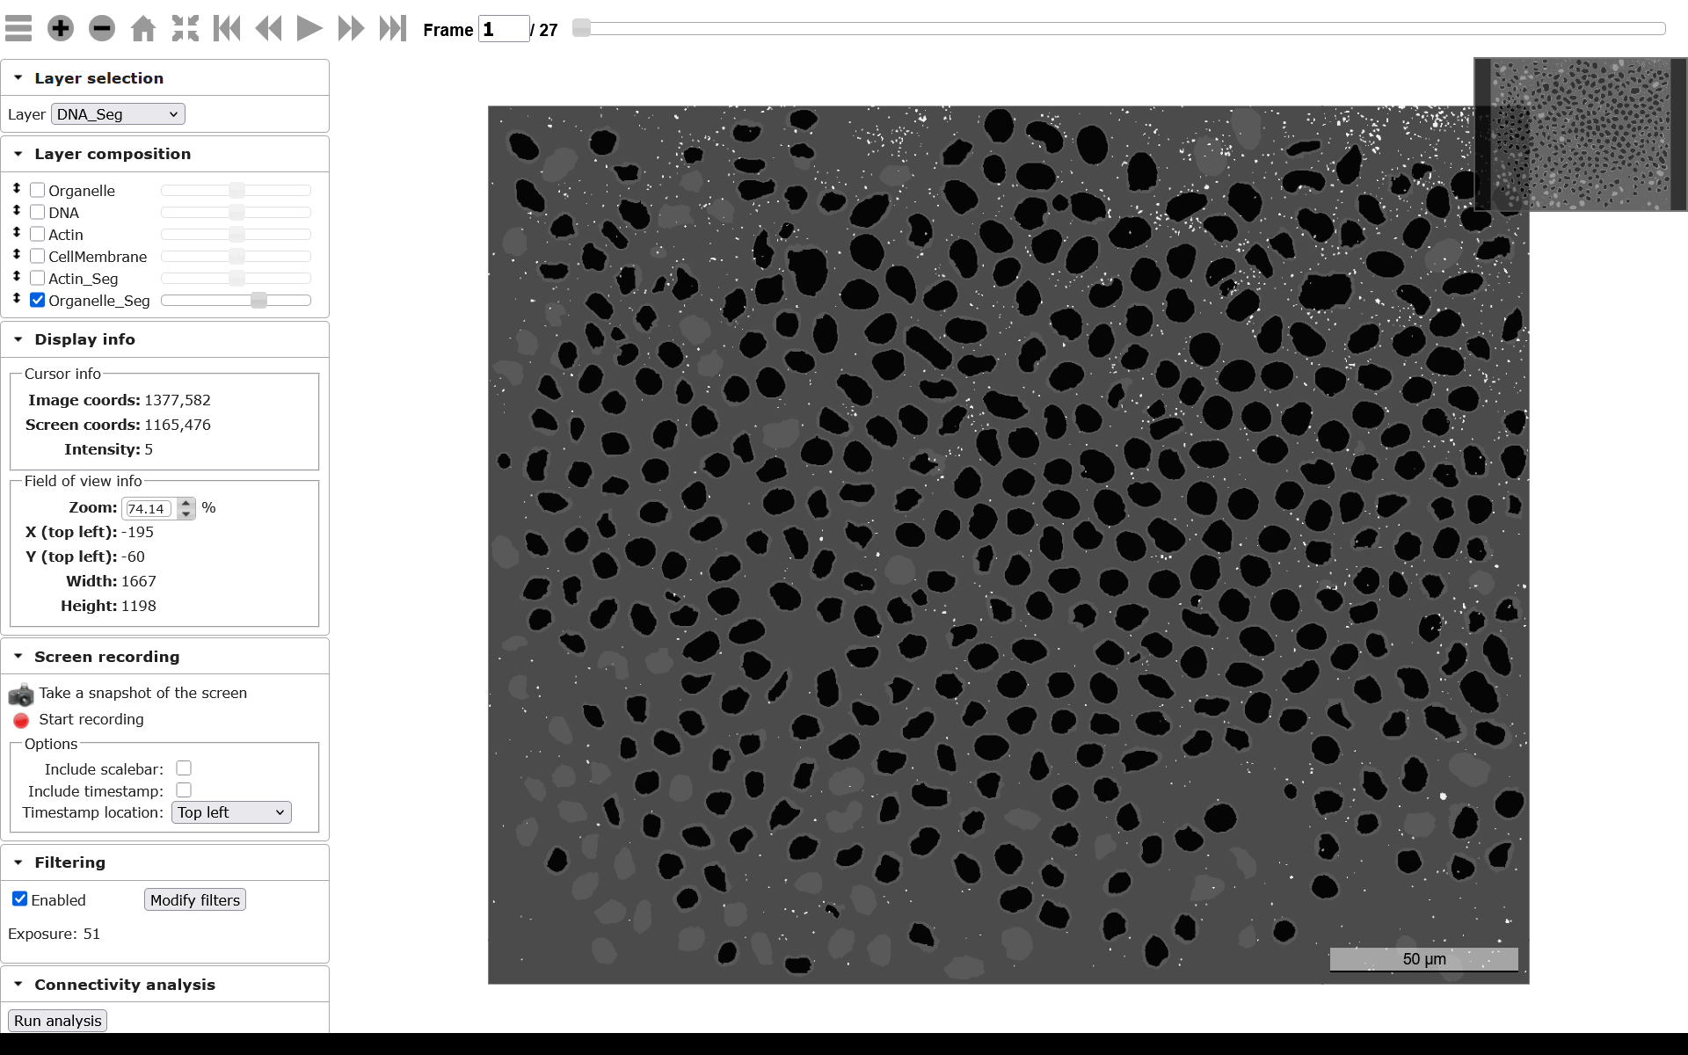
Specific Dataset: Access
Download webpage
Interactive viewing of 2TB of images
Measured Images
Segmented Images

Slide 12
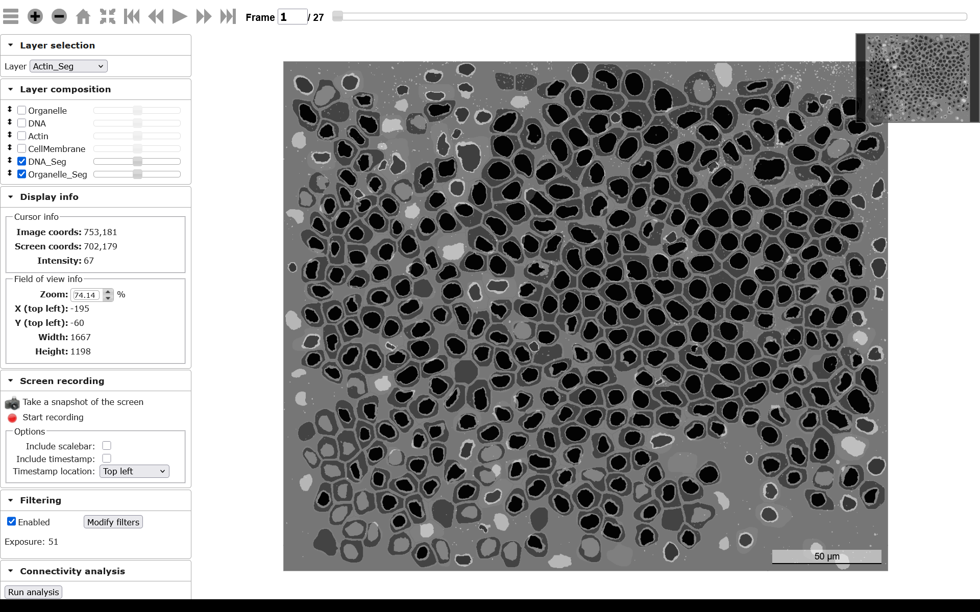
Specific Dataset: Task
The task for annotators is to cluster cells for which organelles around each nucleus have similar distributions.
Display: Cell Boundary with DNA and Organelle
Task: Inspection of distributions of organelles around DNA in each cell

