Slide 1
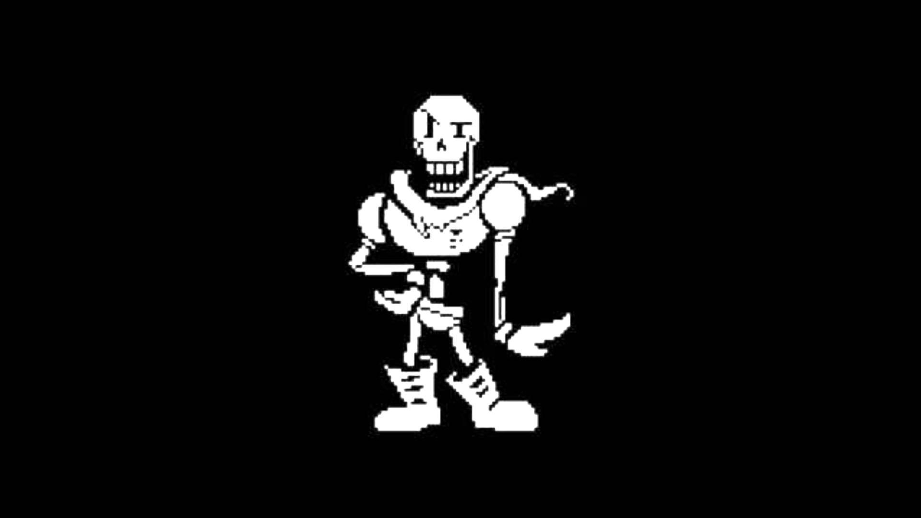
Lecture 4
Announcements

Slide 2
Wiz 1 Feedback
Multi-directional movement
  Probably using an if-or block for each key input
  Use one if-or for vertical, one if-or for horizontal
Different animations with different directions looks nicer too
Movement should happen onTick rather than onKeyPressed/Typed
  Set the keys that are down when they're pressed
  onTick, look at your boolean array and see which are true

Slide 3
Clipping
At this point, all of you have commented on FPS issues resulting from g.clip()
We will have a solution for you later this week
Once the solution is released, you are REQUIRED to clip

Slide 4
Course Administration
Things sometimes go wrong
  Our email script is particularly temperamental
Grades are released by Thursday
  Email us if you don’t get a grade report by then

Slide 5

Get Ready for Wiz 2!
We’re adding smart enemies!
Actually challenging to play
Even more fun than Wiz 1!

Slide 6
QUESTIONS?
Announcements

Slide 7
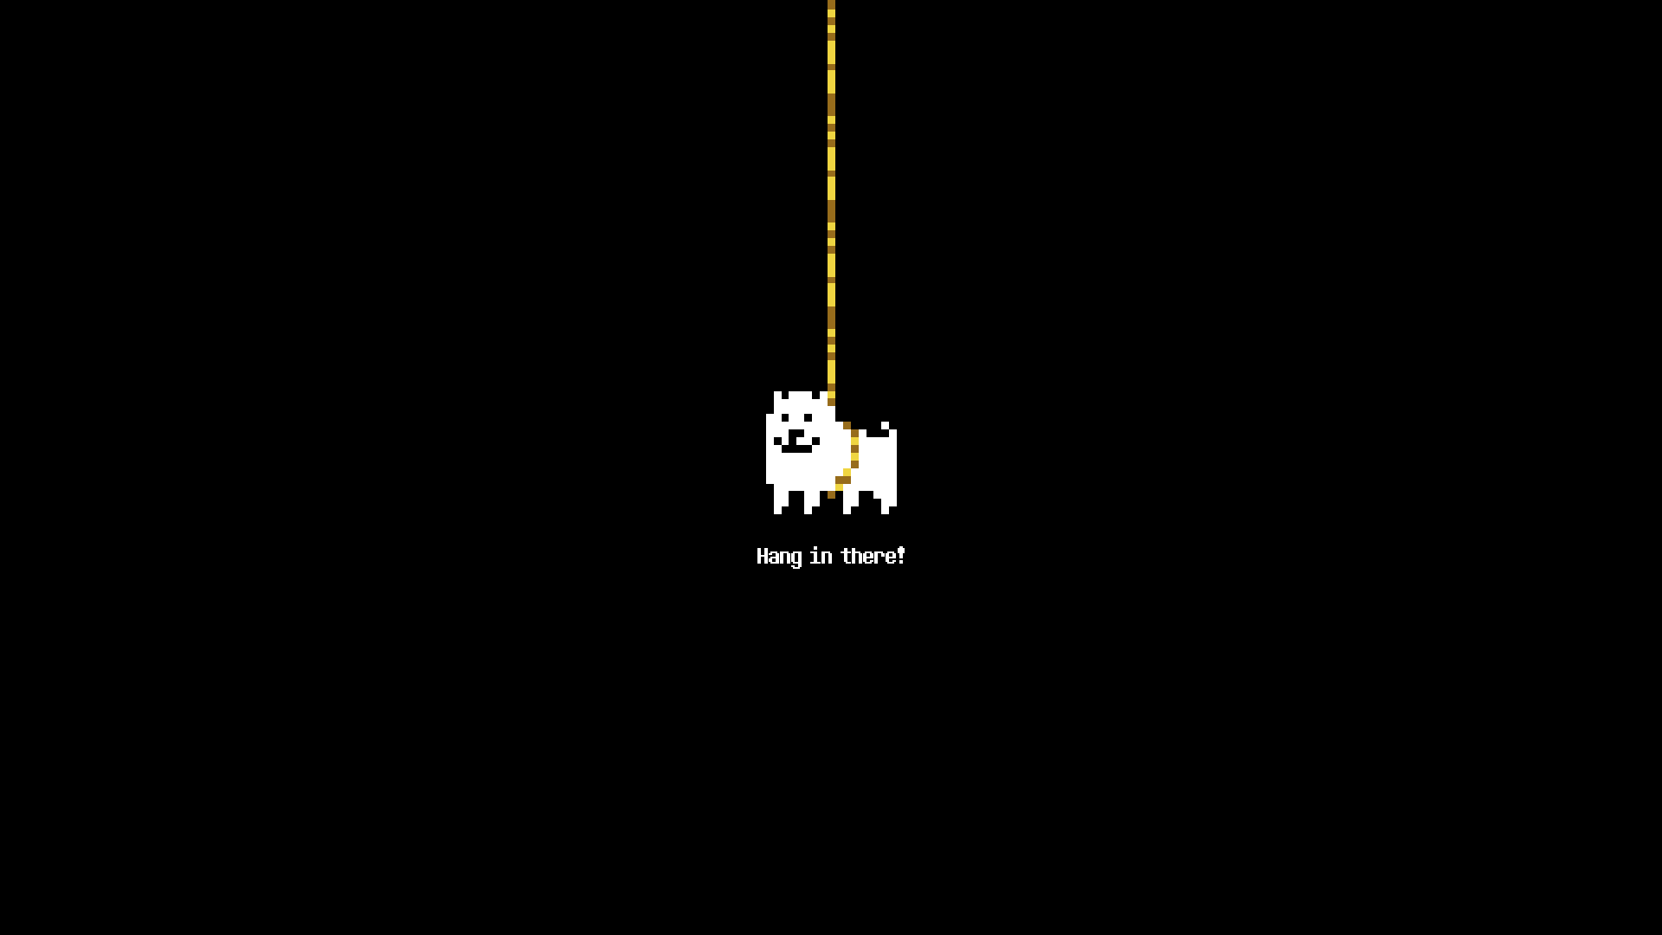
Lecture 4
Pathfinding

Slide 8
MOTIVATION
Pathfinding

Slide 9
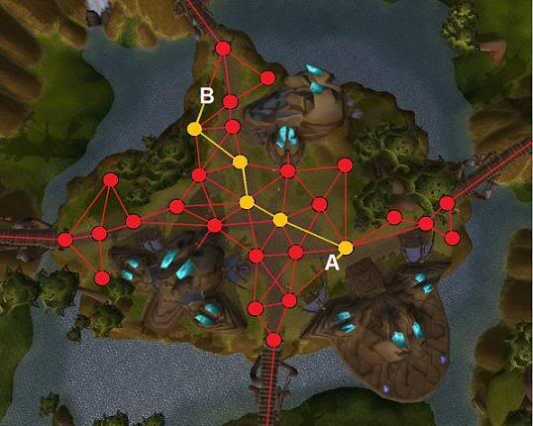
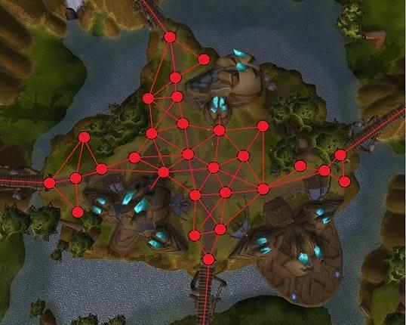
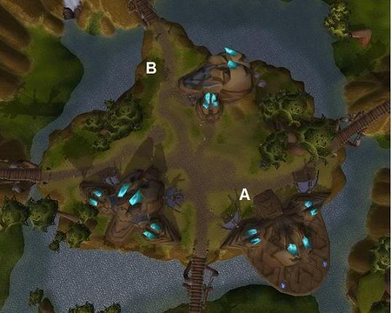
Why is pathfinding important?
NPCs need to navigate an environment that has obstructions
Goal: find minimum cost path from A to B
  Cost includes factors such as distance, terrain, position of enemies.
Typically uses a graph to represent navigable states.

Slide 10
DIJKSTRA’S ALGORITHM
Pathfinding

Slide 11
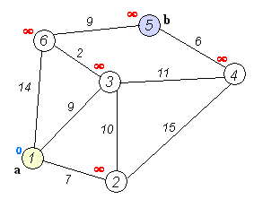
Dijkstra’s
Basic idea:
  Process nodes in order of shortest distance from start
  To process a node, update cost to each of its neighbor and add them to a PriorityQueue, then never process this node again
  Each node in PriorityQueue keeps track of shortest distance to it and pointer to previous node
  When you process the end node, you’re done!

Slide 12
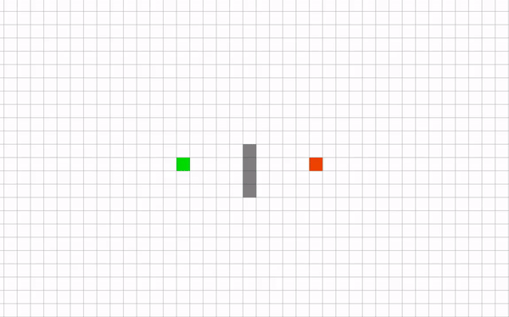
Why Dijkstra’s can be gross

Slide 13
A*
Pathfinding

Slide 14
General idea
Dijkstra’s assumes it’s impossible to predict cost
  This is overly pessimistic
In pathfinding, we at least know the general direction we want to go
A* is a graph traversal algorithm that takes advantage of this

Slide 15
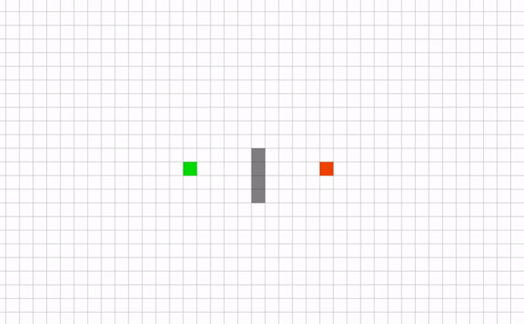
Why A* is better

Slide 16
How does it work?
Uses a “heuristic” to guess the cost from any given node to the destination node
  Heuristic passed by the caller
In addition to tracking distance from start, track heuristic value for each node
  Prioritize in PriorityQueue based on
    f(node) = distance_to(node) + heuristic(node)
Heuristic can be as simple as the Euclidean distance between the given and destination node, but also try to take other factors
  Get creative – better heuristics help A* run faster!

Slide 17
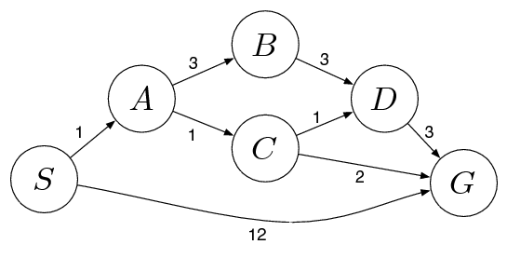
Things to keep in mind
You could have a bad heuristic that points you in the wrong direction.
Experiment!
You may use A* several times-- make it generalizable!!!

Slide 18
A* Pseudocode
http://mat.uab.cat/~alseda/MasterOpt/AStar-Algorithm.pdf
Come into hours if you need help understanding the algorithm
Please come to hours… we are so lonely…

Slide 19
PATHFINDING IN WIZ
Pathfinding

Slide 20
What do you need?
Graph of accessible space
A-star implementation
That’s pretty much it
Notes:
TODO: add image of path visualization in tac

Slide 21

The Graph
Can’t include every point in the world
  There are infinitely many
Need discrete “waypoints” that units can move between
Notes:
TODO: add image of path visualization in tac

Slide 22
The Graph contd.
One option:
  Build a graph of accessible waypoints, each with a position
  Pathfind between waypoints by running A* on the graph
Notes:
TODO: add image of path visualization in tac

Slide 23
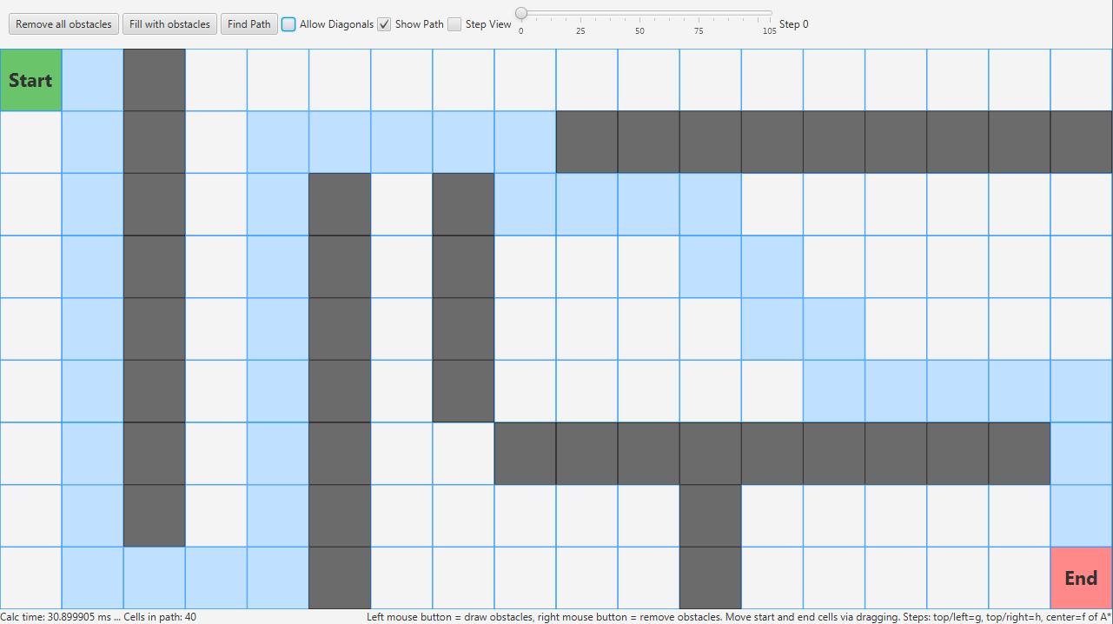
The Grid
Another option (recommended):
  Represent the graph as a 2D array
  Each entry represents a position in the world
  Each entry specifies whether or not that position is accessible
  getNeighbors(Vec2i pos) function that returns accessible neighbors of a grid position
  Can run A* in the same way
    Add neighbors to queue
    Pop lowest cost neighbor from queue
    Continue
Notes:
TODO: add image of path visualization in tac

Slide 24
The Grid contd.
Don’t have to manually specify all accessible positions, just inaccessible ones
Easier to update than waypoint graph
Notes:
TODO: add image of path visualization in tac

Slide 25
PathfindingBehavior
Hold onto a waypoint graph / grid of some sort
  The graph / grid should be able to provide a path from point A to point B
Hold onto a path
Update position based on next location in path and current location
Notes:
TODO: add image of path visualization in tac

Slide 26
PathfindingSystem
If you want a dynamic graph / grid
Have a PathfindingSystem that
  Updates the waypoint graph / grid each tick based on game object positions and bounding boxes
Notes:
TODO: add image of path visualization in tac

Slide 27
QUESTIONS?
Pathfinding

Slide 28
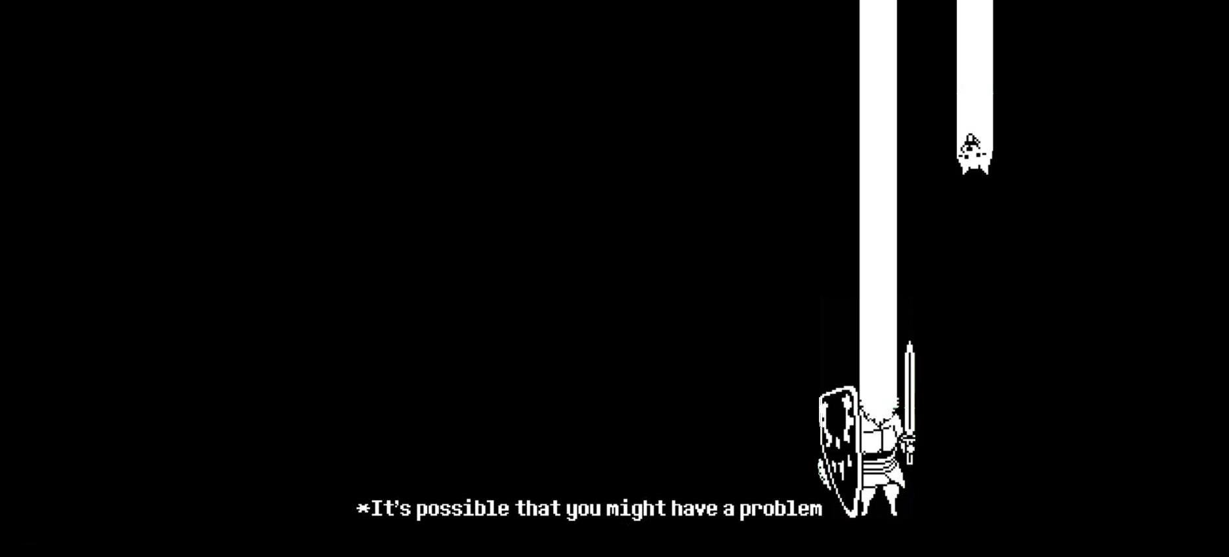
Lecture 4
Decision Making

Slide 29
MOTIVATION
Decision Making

Slide 30
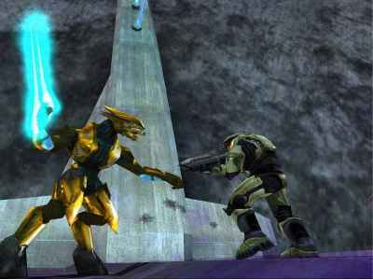
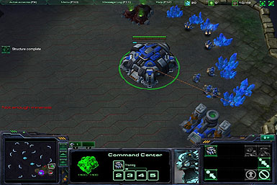
Game A.I.
Usually used to make computer controlled units behave reasonably
Can also be used to support the human player
Essential for a good gameplay experience

Slide 31
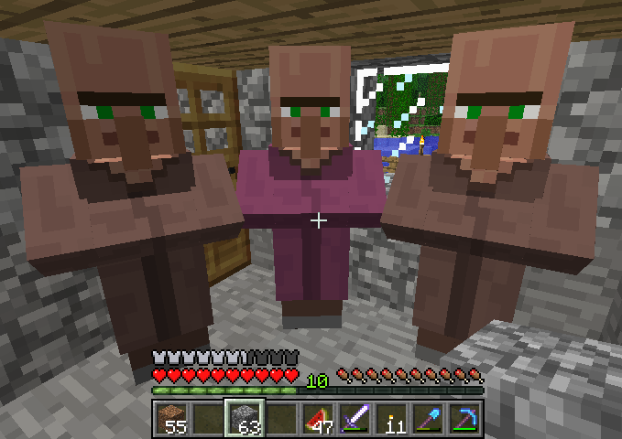
Decision Making
NPC’s should do something, but what?
Could hardcode the logic
  Game-specific
  Likely involves copied code
We want a structured way for NPC’s to make decisions
  Based on game state, unit state, random values, etc…

Slide 32

Lecture 4
Behavior Trees

Slide 33
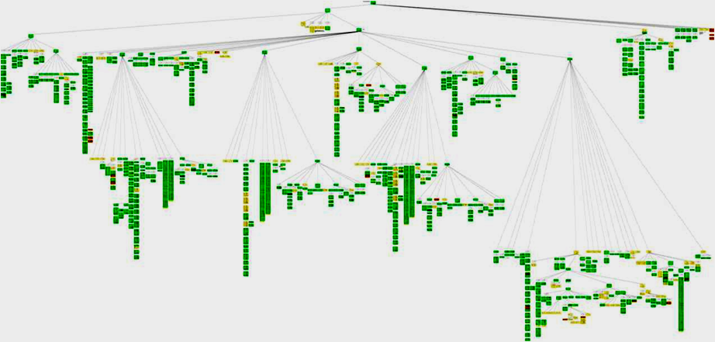
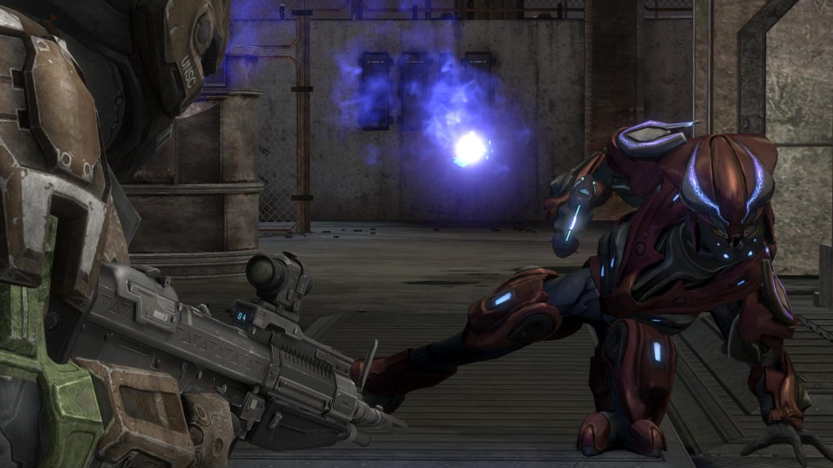
Behavior Trees
“Recently” popularized by Halo 2
Core functionality is engine-general!

Slide 34
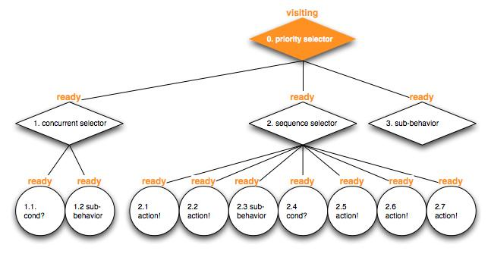
Structure
It’s a tree!
Every tick, the root node is updated
Each node returns a status when it’s updated
  SUCCESS, FAIL, RUNNING
Nodes will update their children and return a status based on responses

Slide 35
The Leaves
Leaf nodes of the tree are Actions and Conditions
Actions do things
  Make a unit move or attack
  Return SUCCESS or FAIL based on result of Action
  Return RUNNING if Action is still if progress
Conditions check some game state
  Returns SUCCESS if the condition is true, or FAIL if the condition is false
Eat
Action
Sleep
Action
Party!
Action
Enemy near?
Condition
Is it daytime?
Condition

Slide 36
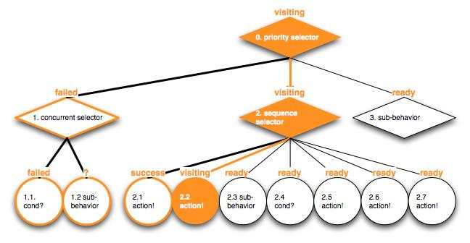
The Internal Nodes
Internal nodes are Composites and Wrappers/Decorators
Composites have multiple children nodes
Wrappers wrap a single child node
These dictate the traversal of the tree on an update
Composite
Wrapper
Condition
Node
Composite
Action

Slide 37
The Composites
Maintain a list of children nodes
Update by updating the children nodes (usually in a particular order)
Return RUNNING if a child returns RUNNING
Return SUCCESS/FAIL under other circumstances depending on the type of composite

Slide 38
The Selector
On update, updates each of its children in order until one of them *doesn’t* fail
  Hence “select”, as this child has been “selected”
Returns FAIL only if all children fail
Kind of like an if else statement or block of or’s
  If child 1 succeeds, else if child 2 succeeds, etc…
Friday night
Do 1971
Sleep
Party!
Notes:
Priority

Slide 39
The Sequence
On update, updates each of its children in order until one *does* fail
Returns SUCCESS if the entire sequence completes, else FAIL
If one behavior fails then the whole sequence fails, hence “sequence”
Similar to a bunch of and’s
Implement Wiz
Implement viewports
Implement the rest
Implement better viewports

Slide 40
Other Nodes
Wrappers contain a single child and modify its behavior. Examples include:
  Invert child
  Repeatedly update child X times until FAIL or SUCCESS
Random Selectors update its children in random order
  For unpredictable behavior
  Harder to debug though
Not required for Wiz, but feel free to play around!

Slide 41
Behavior Tree Node
Just needs to be updated and reset
Sample contract:
interface BTNode{
Status update(float seconds);
void reset();
}

Slide 42
Composites
Needs a list of children
Also should keep track of what child was running
Sample contract:
class Composite implements BTNode {
List<BTNode> children;
BTNode lastRunning;
}

Slide 43
Note about Composites
Sequences start updating from the previously RUNNING child
  Previously running child should be left intact after returning, unless the entire sequence was completed
  Goal is to complete the entire sequence – “I was in the middle of something and should continue where I left off”
Selectors should always update from the first child
  Should reset the previously running child if a child before it starts RUNNING
  Children have priority – “I should always go back to defend my base, even if I’m in the middle of an offensive sequence”

Slide 44
QUESTIONS?
Behavior Trees

Slide 45
Example
Root
Selector
Defend
Sequence
Offense
Sequence
Enemy Near?
Condition
Setup Defense
Action
Army Large Enough?
Condition
Go to enemy base
Action
Siege Base
Action

Slide 46
Example
Root
Selector
update
Defend
Sequence
Offense
Sequence
Enemy Near?
Condition
Setup Defense
Action
Army Large Enough?
Condition
Go to enemy base
Action
Siege Base
Action

Slide 47
Example
Root
Selector
update
Defend
Sequence
Offense
Sequence
update
Enemy Near?
Condition
Setup Defense
Action
Army Large Enough?
Condition
Go to enemy base
Action
Siege Base
Action

Slide 48
Example
Root
Selector
update
Defend
Sequence
Offense
Sequence
update
Enemy Near?
Condition
Setup Defense
Action
Army Large Enough?
Condition
Go to enemy base
Action
Siege Base
Action

Slide 49
Example
Root
Selector
update
Defend
Sequence
Offense
Sequence
update
Enemy Near?
Condition
Setup Defense
Action
Army Large Enough?
Condition
Go to enemy base
Action
Siege Base
Action

Slide 50
Example
Root
Selector
update
Defend
Sequence
Offense
Sequence
Enemy Near?
Condition
Setup Defense
Action
Army Large Enough?
Condition
Go to enemy base
Action
Siege Base
Action

Slide 51
Example
Root
Selector
update
Defend
Sequence
Offense
Sequence
update
Enemy Near?
Condition
Setup Defense
Action
Army Large Enough?
Condition
Go to enemy base
Action
Siege Base
Action

Slide 52
Example
Root
Selector
update
Defend
Sequence
Offense
Sequence
update
Enemy Near?
Condition
Setup Defense
Action
Army Large Enough?
Condition
Go to enemy base
Action
Siege Base
Action

Slide 53
Example
Root
Selector
update
Defend
Sequence
Offense
Sequence
update
Enemy Near?
Condition
Setup Defense
Action
Army Large Enough?
Condition
Go to enemy base
Action
Siege Base
Action

Slide 54
Example
Root
Selector
update
Defend
Sequence
Offense
Sequence
update
Enemy Near?
Condition
Setup Defense
Action
Army Large Enough?
Condition
Go to enemy base
Action
Siege Base
Action

Slide 55
Example
Root
Selector
update
Defend
Sequence
Offense
Sequence
update
Enemy Near?
Condition
Setup Defense
Action
Army Large Enough?
Condition
Go to enemy base
Action
Siege Base
Action

Slide 56
Example
Root
Selector
update
Defend
Sequence
Offense
Sequence
Enemy Near?
Condition
Setup Defense
Action
Army Large Enough?
Condition
Go to enemy base
Action
Siege Base
Action

Slide 57
Example
Root
Selector
Defend
Sequence
Offense
Sequence
Enemy Near?
Condition
Setup Defense
Action
Army Large Enough?
Condition
Go to enemy base
Action
Siege Base
Action

Slide 58
Example
Root
Selector
update
Defend
Sequence
Offense
Sequence
Enemy Near?
Condition
Setup Defense
Action
Army Large Enough?
Condition
Go to enemy base
Action
Siege Base
Action

Slide 59
Example
Root
Selector
update
Defend
Sequence
Offense
Sequence
update
Enemy Near?
Condition
Setup Defense
Action
Army Large Enough?
Condition
Go to enemy base
Action
Siege Base
Action

Slide 60
Example
Root
Selector
update
Defend
Sequence
Offense
Sequence
update
Enemy Near?
Condition
Setup Defense
Action
Army Large Enough?
Condition
Go to enemy base
Action
Siege Base
Action

Slide 61
Example
Root
Selector
update
Defend
Sequence
Offense
Sequence
update
Enemy Near?
Condition
Setup Defense
Action
Army Large Enough?
Condition
Go to enemy base
Action
Siege Base
Action

Slide 62
Example
Root
Selector
update
Defend
Sequence
Offense
Sequence
update
Enemy Near?
Condition
Setup Defense
Action
Army Large Enough?
Condition
Go to enemy base
Action
Siege Base
Action

Slide 63
Example
Root
Selector
update
Defend
Sequence
Offense
Sequence
update
Enemy Near?
Condition
Setup Defense
Action
Army Large Enough?
Condition
Go to enemy base
Action
Siege Base
Action

Slide 64
Example
Root
Selector
update
Defend
Sequence
Offense
Sequence
Enemy Near?
Condition
Setup Defense
Action
Army Large Enough?
Condition
Go to enemy base
Action
Siege Base
Action

Slide 65
Example
Root
Selector
update
Defend
Sequence
Offense
Sequence
Enemy Near?
Condition
Setup Defense
Action
Army Large Enough?
Condition
Go to enemy base
Action
Siege Base
Action

Slide 66
Example
Root
Selector
Defend
Sequence
Offense
Sequence
Enemy Near?
Condition
Setup Defense
Action
Army Large Enough?
Condition
Go to enemy base
Action
Siege Base
Action

Slide 67
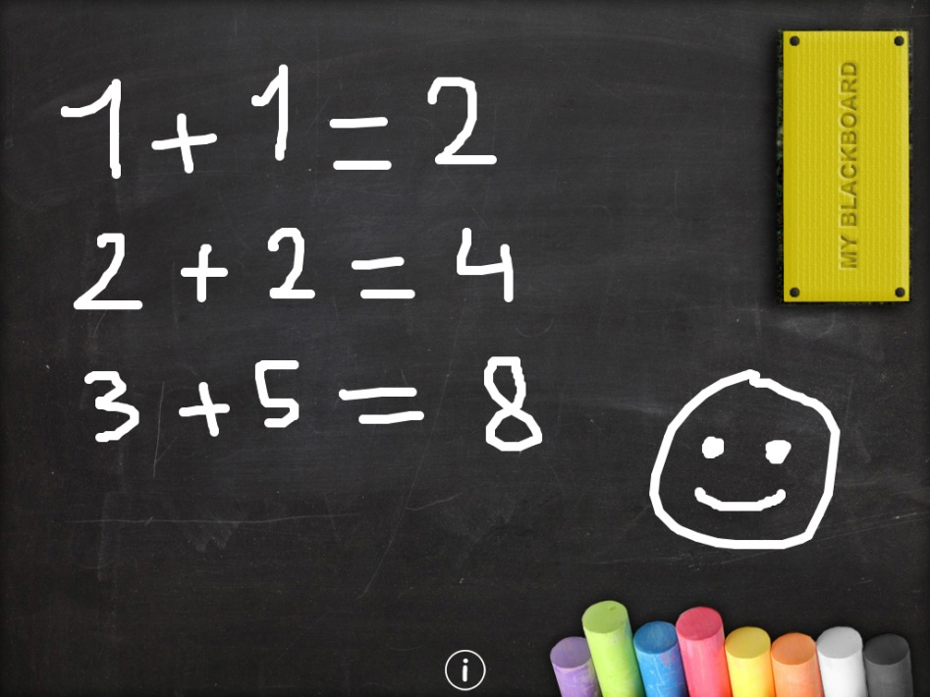
Data Persistence
Your behavior tree nodes might need to communicate somehow
  Finding a target, going to the target are separate nodes
How to share data?
Blackboard: shared object that holds information, that nodes can write and read from
  Minimally, a Map<String, ???>
Certain groups of nodes can share different blackboards

Slide 68
In Summary
Interfaces/abstract classes for:
  BTNode
  Composite
  Condition/Action
Full classes for:
  Sequence
  Selector
  Other wrappers
Game-specific classes extending Condition/Action

Slide 69
QUESTIONS?
Behavior Trees

Slide 70
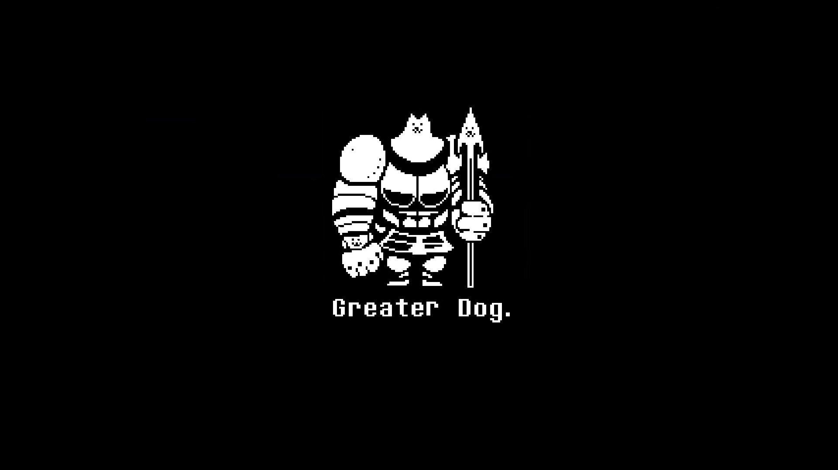
Lecture 4
Goal Oriented
Action Planning

Slide 71

Issues with BTs
Behavior trees aren’t perfect
Lots of enemies
  Too much work to code each
  Minor tweaks change a lot of code
Procedurally generated enemies
  Behavior trees usually aren’t expressive enough

Slide 72

What is GOAP?
Goal oriented action planning
What’s the fastest way to kill the player?

Slide 73
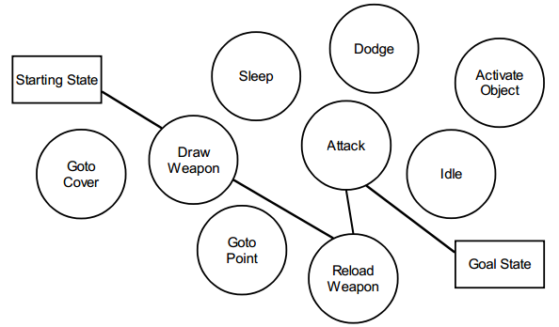
What is GOAP?
GOAP is a graph of game states
We can search over it
  A*

Slide 74
The Nodes
Each node is a GameState
GameStates are probably a map of string tags to booleans or integers
The tags and their meaning are determined game-side
class GameState {
Map<String, Integer> _props;
}

Slide 75
The Edges
Each edge is an Action the AI can take
Each Action has a cost and a Condition
Actions also change the GameState
public abstract class Action {
private List<Condition> _conditions;
private float _cost;
public abstract void changeState(GameState s);
}

Slide 76
Planning
Goal
  Generate a plan or “path” of actions
  This plan should take you from start state to end state
Just use A* !

Slide 77
Planning contd.
Start at a state
Add neighboring states to priority queue
  Go through all actions
  All actions whose conditions are true from the current state are allowed
  Generate a neighbor for each by applying the corresponding action to a copy of the game state
Pop lowest cost state from priority queue
Continue
Return “path” or list of actions that took you from start to end state

Slide 78
Actions
Just like behavior trees, GOAP has actions
Actions are much simpler in GOAP
  Change one or more of the tags in the game state

Slide 79
Conditions
Just like behavior trees, GOAP has conditions
Conditions are also much simpler
  Return true or false
  Determined entirely by GameState

Slide 80
Conditions
public abstract class Condition {
public abstract boolean isMet(GameState s);
}

Slide 81
GOAP
The game defines a start state based on the current game world
The game also defines a goal (Condition)
Once the search is done, you need to map the list of actions to some real game effect
Usually only the first action is executed before GOAP is run again
  The action might not be completed before a new plan is generated
  E.g., following the player

Slide 82
QUESTIONS?
Goal Oriented Action Planning

Slide 83
Problems
Depending on the Actions available, GOAP can generate an infinite graph without any goal states
This can be handled by any of the following:
  Allow each action to be used once/max # of times
  Specify a maximum cost

Slide 84
Problems
With lots of actions and a distant goal, GOAP can be really slow
GOAP is best used to solve small problems

Slide 85
Problems
GOAP optimizes over a single parameter (time, cost, etc.)
GOAP is good for short, discrete problems:
  Which combo should I use?
  Which route should I take?
GOAP is bad for long-term, strategic problems:
  How do I optimize my economy?
  Which item will maximize my options next level?

Slide 86
Mix and Match
Behavior trees and GOAP don’t have to be mutually exclusive
Behavior tree can determine the strategy (setting up which actions are available, how much each is weighted, what the goal is, etc.)
GOAP can determine the plan to execute that strategy
Behavior tree turns that plan into concrete actions
  e.g., sequence

Slide 87
QUESTIONS?
Goal Oriented Action Planning

Slide 88

Lecture 4
Tips for Wiz 2

Slide 89
FOG OF WAR
Tips for Wiz II

Slide 90
Circle Fog of War
Draw the map
  Only draw enemies/drops in range of player
Afterwards, in one of the drawable behaviors:
  Generate a rectangle across the GameWorld
  Generate a circle around the player
  Subtract the circle from the rectangle
  Draw the resulting shape black without full opacity
  Can instead use image/texture map for smoother transition

Slide 91
Room by Room
Similar to last slide
Illuminate the entire room that the player is in
Need to dynamically generate the rectangle

Slide 92
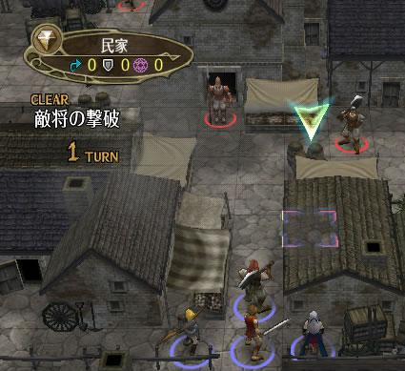
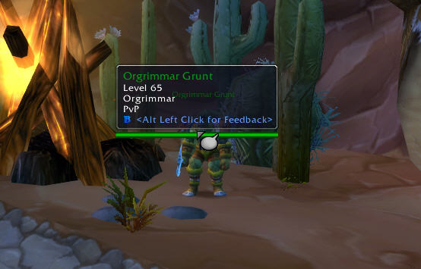
Floating Elements
“Floating” elements are common
Make sure your viewport supports these!
  Determine where on the screen a point in the game is
  Draw element at screen scale
  Consider a second onDraw() call (maybe “onUI”) responsible for floating elements
  How can you “unproject” a unit’s location?

Slide 93
lateTick
Expanded contract
  Systems, objects, behaviors!
Used for actions that need to be executed once all game objects have been ticked and collided
Example: updating the position of the viewport
  Avoids viewport center lagging behind player
public void lateTick(float seconds);

Slide 94
QUESTIONS?
Tips for Wiz

Slide 95
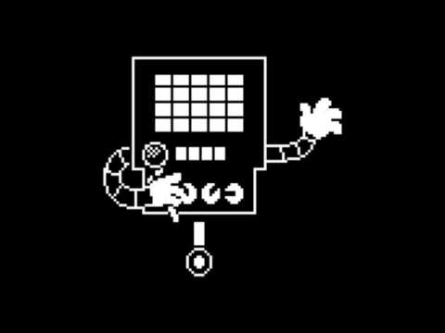
Game Design 2
Controls

Slide 96
Why are controls important?
In games, the player interacts with some game world
Controls are the player’s interface for interaction with the game world
Can make or break your game!
Player
Controls
Game World

Slide 97
Good Controls: 3 Core Principles
Good controls must be:
Intuitive
Ergonomic
Agentive

Slide 98
Principle 1: Intuitive
Intuitive controls:
  Are easy to pick up and learn
  Make sense for the game being played
  Require little cognitive effort from the player
  Follow pre-existing conventions when possible

Slide 99
Principle 1: Intuitive
General conventions:
Button | RTS | MMO | Shooter
Left Click | Select units | Select target | Fire
Right Click | Move to/attack units | Attack target | Secondary fire/hold aim
WASD | Pan camera | Movement | Movement
Space | Focus on event | Jump | Jump
Mouse Wheel | Zoom camera | Zoom camera | Cycle weapons
Number keys | Hotkeyed units | Special skills | Select weapon
Shift (held) | Modify click actions | Use second skill set | Sprint

Slide 100
Principle 2: Ergonomic
Ergonomic controls:
  Have a consistent “home-base” position
    e.g. one hand on mouse, one hand on WASD
  Place most used buttons at or around home-base
  Demand as little movement as possible from the player

Slide 101
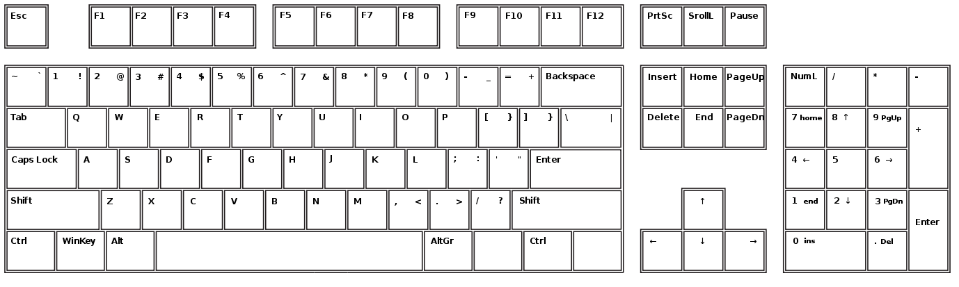

Principle 2: Ergonomic

Slide 102
Principle 2: Ergonomic
Blue: Home Base
(No Movement Necessary)
Notes:
A note on accessibility: what counts as 'home base' may change based on physical ability; letting players map their own key inputs helps get around this.

Slide 103
Principle 2: Ergonomic
Cyan: Most Common Actions
(Minimal Finger Movement)

Slide 104
Principle 2: Ergonomic
Green: Common Actions
(Some Finger Movement)

Slide 105
Principle 2: Ergonomic
Purple: Held Actions
(Pinky movement for Shift and Ctrl, Thumb for Alt)

Slide 106
Principle 2: Ergonomic
Yellow: Infrequent Actions
(Some Hand Movement)
*Most players will already have learned muscle memory for ESC

Slide 107
Principle 2: Ergonomic
Red: Use With Caution
(Full Hand Movement Required)

Slide 108
Principle 3: Agentive
Agentive controls:
  Give the player as much control as possible
  Produce consistently predictable results
  Respond as quickly as possible to player input

Slide 109

Principle 3: Agentive
Common player complaints about controls that are not agentive:
  “It feels laggy.”
  “I can’t get it to do what I want.”
  “Why doesn’t anything happen when I press the button?”

Slide 110
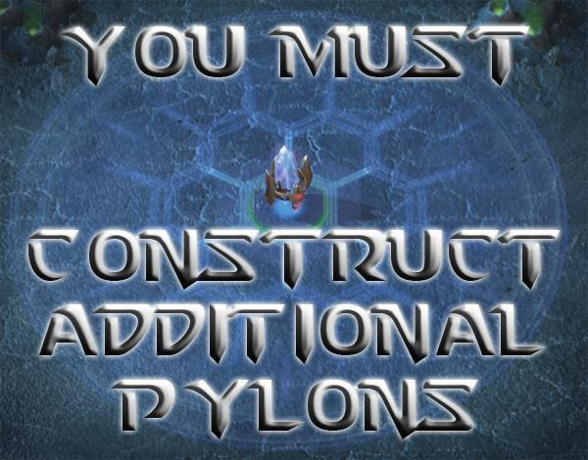
Principle 3: Agentive
Solutions:
  Make response time on every button press as quick as possible
  Provide feedback when a particular action is not available

Slide 111
3 Principles: Recap
Good controls are:
  Intuitive (the player can pick them up quickly)
  Ergonomic (the player can perform them easily)
  Agentive (the player feels in control)
These need to be kept in balance!
  Ergonomic controls may not be intuitive and vice versa

Slide 112
Common CS1971 Control Pitfalls
Not following conventions for no discernible reason
  Movement on IJKL
Assigning actions to the keys of the first letter they start with
  J for jump, L for laser, F for fire
Using modifier keys unnecessarily
  Left click to select unit, Shift + left click to move, Ctrl + left click to attack

Slide 113
Game Design Tips for Tac 2
Follow the conventions of the genre!
  WASD to move
  Left click / arrow keys to shoot
  If you’re not sure, steal from well known games
Think from the player’s perspective!

Slide 114
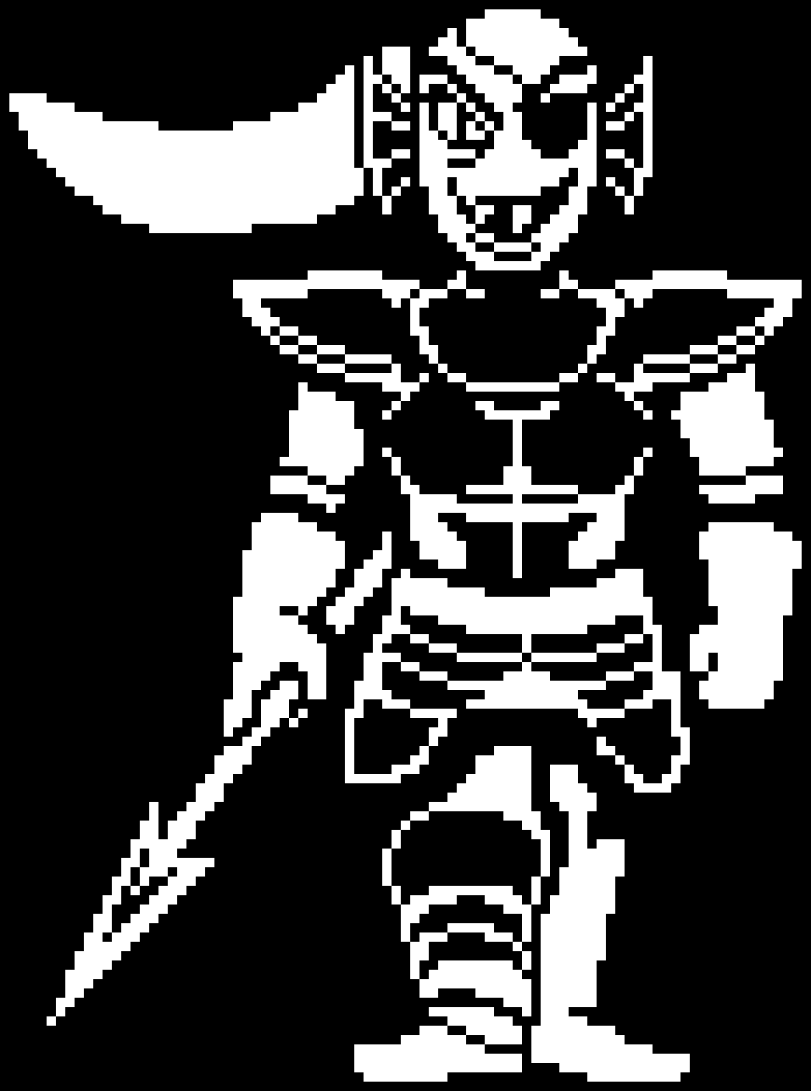
Lecture 4
Final Project Overview

Slide 115
Overview
Can be any 2D game
You should work in groups!
Each person is responsible for 10 “points” worth of new engine features
  More members in a group means more engine features
  More details in the final project handout

Slide 116
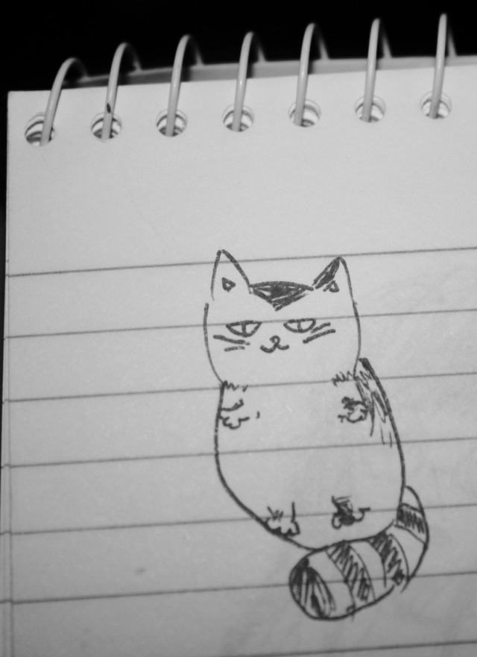



Timeline
4 main parts:
  Week 1: Idea
  Week 2: Form groups and get approved
  Week 3: Design
  Weeks 4-8: Code, playtest, polish, present

Slide 117
Week 1: Idea (this week!)
A ½ page document
Describe basic gameplay idea
  How is your game fun?
  Why should someone want to help make it?
Describe engine feature(s) you plan on implementing
Give a 60-second “elevator pitch” of your game in class next week
Everyone must give a pitch, even if you already know your group and which project you’re working on

Slide 118
Week 2 Groups
Form a group (or decide to work alone)
Finalize game and engine features
Each group must meet with the TA’s to present their ideas
Meetings will be next week
If this time doesn’t work, please email us

Slide 119
Week 3: Design
Research new engine features
Design the engine and game
Exact breakdown of member responsibilities
Choose someone’s engine to use or integrate engines
Explain how you will use version control

Slide 120
Weeks 4-8
Week 4:
  Engine should be mostly done
Week 5:
  Engine should be done
  Game is playable
  3 playtests per member from people not in CS1971

Slide 121
Weeks 4-8
Week 6:
  Game should be more done
  3 more playtests per member from outsiders
Week 7:
  Game should be done
  3 playtests per member
  Powerpoint slideshow for postmortem presentation

Slide 122
Weeks 4-8
Week 8:
  Finish/polish up your game, bug fixes, etc
  Create a jar and script, and put it in /contrib
  Make a video demo of your game from gameplay footage
And then you’re done!

Slide 123
QUESTIONS?
Final Project Overview

Slide 124

Wiz 1 Playtesting
The most exciting part of the day!

