Slide 1
CSCI-1680
DNS II + WWW
Nick DeMarinis
Based partly on lecture notes by Rodrigo Fonseca, Scott Shenker and John Jannotti

Slide 2
Administrivia
TCP milestone II: Schedule meeting by Friday, April 22 (tomorrow)
  If you have trouble finding a slot, let us know
  Questions?
HW3: Due Tuesday, April 26
  Problem 1 should help with Milestone II
Office hours today
  Remote: 3-5pm
  Also, whenever my door is open, or if the sign says so

Slide 3
More on DNS

Slide 4
DNS Example
$ dig cs.brown.edu @10.1.1.10
; <<>> DiG 9.10.6 <<>> cs.brown.edu @10.1.1.10
;; global options: +cmd
;; Got answer:
;; ->>HEADER<<- opcode: QUERY, status: NOERROR, id: 8536
;; flags: qr aa rd ra; QUERY: 1, ANSWER: 1, AUTHORITY: 0, ADDITIONAL: 1
;; OPT PSEUDOSECTION:
; EDNS: version: 0, flags:; udp: 1220
;; QUESTION SECTION:
;cs.brown.edu. IN A
;; ANSWER SECTION:
cs.brown.edu. 1800 IN A 128.148.32.12
;; Query time: 69 msec
;; SERVER: 10.1.1.10#53(10.1.1.10)
;; WHEN: Tue Apr 19 09:03:39 EDT 2022
;; MSG SIZE rcvd: 57
Notes:
Responses called Resource Records (RRs)

Slide 5
DNS record types
RR Type | Purpose | Example
A | IPv4 Address | 128.148.56.2
AAAA | IPv6 Address | 2001:470:8956:20::1
CNAME | Specifies an alias (“Canonical name”) | systems.cs.brown.edu. 86400 IN CNAME systems-v3.cs.brown.edu. systems-v3.cs.brown.edu. 86400 IN A 128.148.36.51
MX | Mail servers | MX <priority> <ip> eg. MX 10 1.2.3.4
SOA | Start of authority | Information about who owns a zone
PTR | Reverse IP lookup | 7.34.148.128.in-addr.arpa. 86400 IN PTR quanto.cs.brown.edu.
SRV | How to reach specific services (eg. host, port) | _minecraft._tcp.example.net 3600 SRV <priority> <weight> <port> <server IP>
More: https://en.wikipedia.org/wiki/List_of_DNS_record_types

Slide 6
Great Firewall of CIT
If attacker is on the path (say, it is the ISP, or a malicious version of TStaff), what could they do?
  Can sniff all DNS queries
  Send fake responses back first
  Could do this selectively, to direct facebook.com to cs.brown.edu, for example…

Slide 7
https://blog.thousandeyes.com/monitoring-dns-in-china/

Slide 8
“Helpful” ISPs
Many ISPs hijack NXDOMAIN responses to “help” by offering search and advertisement related to the domain
E.g., www.bicycleisntadomain.com doesn’t (currently) exist
  Could return a page with search and ads on bicycles (or domain registrations?)

Slide 9
HTTP: Hypertext Transfer Protocol

Slide 10
Precursors
1945, Vannevar Bush, Memex:
  “a device in which an individual stores all his books, records, and communications, and which is mechanized so that it may be consulted with exceeding speed and flexibility”
Precursors to hypertext
  “The human mind [...] operates by association. With one item in its grasp, it snaps instantly to the next that is suggested by the association of thoughts, in accordance with some intricate web of trails carried by the cells of the brain”
His essay, “As we may think”, is worth reading!

Slide 11
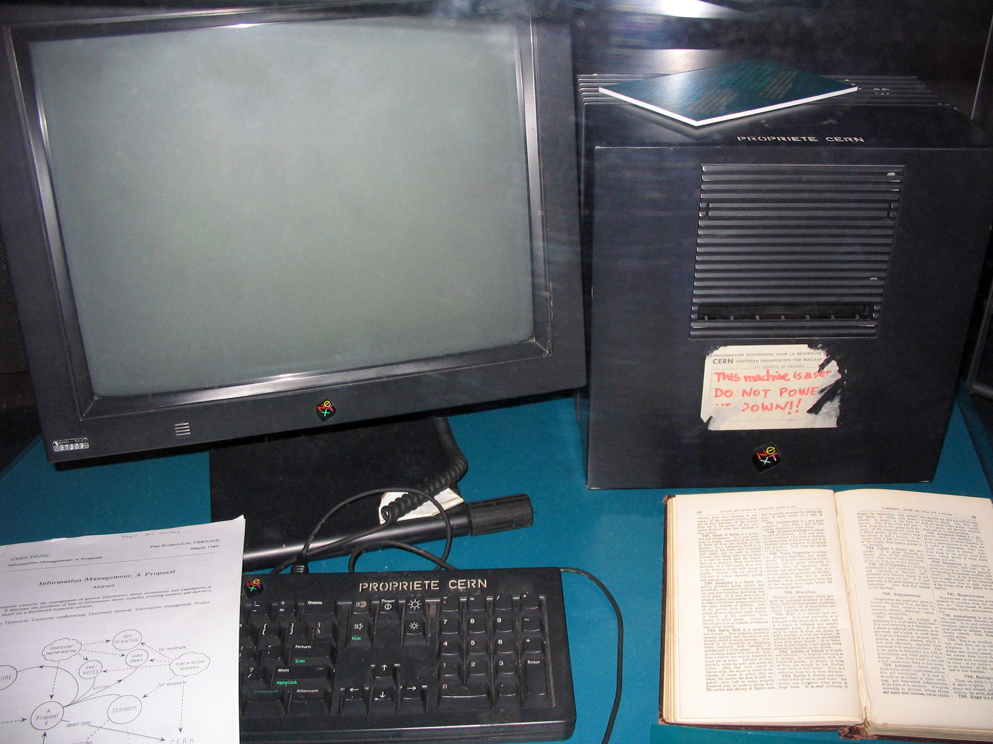
Tim Berners-Lee
Physicist at CERN, trying to solve real problem
  Distributed access to data
WWW: distributed database of pages linked through the Hypertext Transfer Protocol
  First HTTP implementation: 1990
  HTTP/0.9 – 1991
    Simple GET command
  HTTP/1.0 – 1992
    Client/server information, simple caching
  HTTP/1.1 – 1996
    Extensive caching support
    Host identification
    Pipelined, persistent connections, …
The first webserver

Slide 12
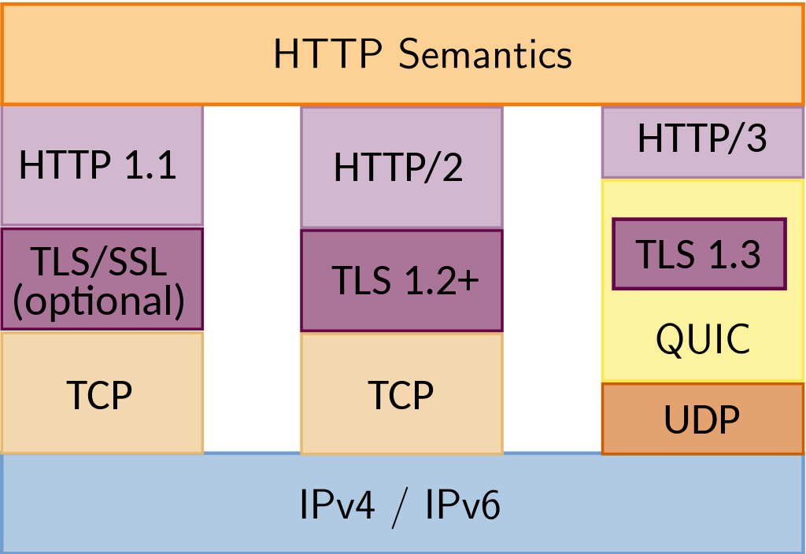
HTTP/2 – 2015
  Main goal: reduce latency
  True multiplexing of messages
  Binary encoding, compression
HTTP/3 – Draft as of 2022
  Same goals as HTTP/2
  Integrates security via TLS (next class…)
  Replace transport layer with QUIC
  Already supported in >70% of browsers
http://httpwg.org/specs/rfc7540.html

Slide 13
Why so successful?
Ability to self publish
  Like youtube for video
But…
  Mechanism is easy
  Independent, open
  Free
Current debate
  Is it easy enough? Why is facebook so popular, even though it is not open?

Slide 14
Components
Content
  Objects (may be static or dynamically generated)
Clients
  Send requests / Receive responses
Servers
  Receive requests / Send responses
  Store or generate content
Proxies/Middleboxes
  Placed between clients and servers
  Provide extra functions
    Caching, anonymization, logging, transcoding, filtering access
  Explicit or transparent

Slide 15
Ingredients
HTTP
  Hypertext Transfer Protocol
HTML
  Language for description of content
Names (mostly URLs)
  Won’t talk about URIs, URNs

Slide 16
How to find stuff?
DNS: names for one or more hosts
  eg. cs.brown.edu
How do we ask for a specific resource from this host?
URL: Uniform Resource Locator

Slide 17
How to find stuff: URLs
protocol://[name@]hostname[:port]/directory/resource?k1=v1&k2=v2#tag
Name: can identify a client
Hostname: FQDN or IP address
Port number: defaults to common protocol port (eg. 80, 22)
Directory: path to the resource
Resource: name of the object
After that, various delimiters to specify further, common examples:
  ?parameters are passed to the server for execution
  #tag allows jumps to named tags within document

Slide 18
HTTP
Client-server protocol
Protocol (but not data) in ASCII (before HTTP/2)
Stateless
Extensible (header fields)
Server typically listens on port 80 (or 443, with TLS)
Server sends response, may close connection (client may ask it to say open)

Slide 19
Steps in HTTP^{(1.0)} Request
Open TCP connection to server
Send request
Receive response
TCP connection terminates
  How many RTTs for a single request?
You may also need to do a DNS lookup first!

Slide 20
> telnet www.cs.brown.edu 80
Trying 128.148.32.110...
Connected to www.cs.brown.edu.
Escape character is '^]'.
GET / HTTP/1.0
HTTP/1.1 200 OK
Date: Thu, 24 Mar 2011 12:58:46 GMT
Server: Apache/2.2.9 (Debian) mod_ssl/2.2.9 OpenSSL/0.9.8g
Last-Modified: Thu, 24 Mar 2011 12:25:27 GMT
ETag: "840a88b-236c-49f3992853bc0"
Accept-Ranges: bytes
Content-Length: 9068
Vary: Accept-Encoding
Connection: close
Content-Type: text/html
<!DOCTYPE html PUBLIC "-//W3C//DTD XHTML 1.0 Strict//EN"
"http://www.w3.org/TR/xhtml1/DTD/xhtml1-strict.dtd">
<html xmlns="http://www.w3.org/1999/xhtml" xml:lang="en" lang="en”>
...

Slide 21
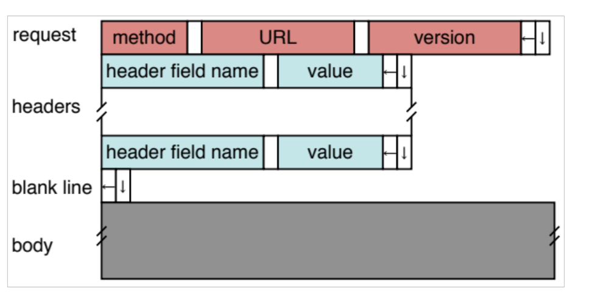
HTTP Request
Method:
  GET: current value of resource, run program
  HEAD: return metadata associated with a resource
  POST: update a resource, provide input for a program
Headers: useful info for proxies or the server
  E.g., desired language

Slide 22
Sample Browser Request
GET / HTTP/1.1
Host: localhost:8000
User-Agent: Mozilla/5.0 (Macinto ...
Accept: text/xml,application/xm ...
Accept-Language: en-us,en;q=0.5
Accept-Encoding: gzip,deflate
Accept-Charset: ISO-8859-1,utf-8;q=0.7,*;q=0.7
(empty line)
In your browser: Inspect element -> Network view

Slide 23
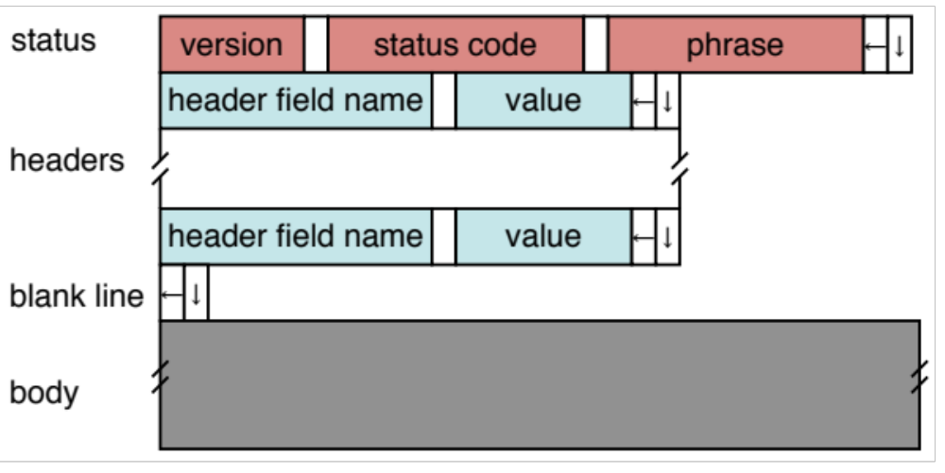
HTTP Response
Status Codes:
  1xx: Information e.g, 100 Continue
  2xx: Success e.g., 200 OK
  3xx: Redirection e.g., 302 Found (elsewhere)
  4xx: Client Error e.g., 404 Not Found
  5xx: Server Error e.g, 503 Service Unavailable

Slide 24
HTTP is Stateless
Each request/response treated independently
Servers not required to maintain state
This is good!
  Improves server scalability
This is also bad…
  Some applications need persistent state
  Need to uniquely identify user to customize content
  E.g., shopping cart, web-mail, usage tracking, (most sites today!)

Slide 25
HTTP Cookies
Client-side state maintenance
  Client stores small state on behalf of server
  Sends request in future requests to the server
  Cookie value is meaningful to the server (e.g., session id)
Can provide authentication
1. Request
Client
2. Response
Set-Cookie: XYZ
Server
3. Request
Cookie: XYZ

Slide 26
Anatomy of a Web Page
HTML content
A number of additional resources
  Images
  Scripts
  Frames
Browser makes one HTTP request for each object
  Course web page: 14 objects
  Modern web pages: hundreds of objects

Slide 27
Modern web pages and HTTP
Web APIs: HTTP response/requests are a standard way to ask for anything
Modern web pages: use Javascript to make lots of requests without reloading page
  And can use APIs for all kinds of other stuff

Slide 28
Example: Github public API
$ curl https://api.github.com/users/ndemarinis
{
"login": "ndemarinis",
"id": 1191319,
"node_id": "MDQ6VXNlcjExOTEzMTk=",
"avatar_url": "https://avatars.githubusercontent.com/u/1191319?v=4",
"gravatar_id": "",
"url": "https://api.github.com/users/ndemarinis",
"type": "User",
"site_admin": false,
"name": "Nick DeMarinis",
"blog": "https://vty.sh",
"twitter_username": null,
"public_repos": 10,
. . .
}

Slide 29
HTTP Performance
What matters for performance?
Depends on type of request
  Lots of small requests (objects in a page)
  Some big requests (large download or video)

Slide 30
Small Requests
Latency matters
RTT dominates
Two major causes:
  Opening a TCP connection
  Actually sending the request and receiving response
  And a third one: DNS lookup!

Slide 31
How can we reduce the number of connection setups?
Keep the connection open and request all objects serially
  Works for all objects coming from the same server
  Which also means you don’t have to “open” the window each time
Persistent connections (HTTP/1.1)

Slide 32
Browser Request
GET / HTTP/1.1
Host: localhost:8000
User-Agent: Mozilla/5.0 (Macinto ...
Accept: text/xml,application/xm ...
Accept-Language: en-us,en;q=0.5
Accept-Encoding: gzip,deflate
Accept-Charset: ISO-8859-1,utf-8;q=0.7,*;q=0.7
Keep-Alive: 300
Connection: keep-alive

Slide 33
Small Requests (cont)
Second problem is that requests are serialized
  Similar to stop-and-wait protocols!
Two solutions
  Pipelined requests (similar to sliding windows)
  Parallel Connections
    Browsers implement this differently—see “Inspect element”
  How are these two approaches different?
Notes:
Transport layer is different

Slide 34
HTTP/2
Adds more options to trade off:
Multiplexed streams on same connection
  Plus stream weights, dependencies
No head of line blocking!
  But what happens if there is packet loss?
https://www.twilio.com/blog/2017/10/http2-issues.html
Notes:
Head of line blocking!

Slide 35
HTTP/3
Mapping of HTTP semantics onto QUIC
  E.g., QUIC already implements multiple streams, and HTTP doesn’t need to do it
QUIC: Another transport-layer protocol, intended to replace TCP
  RFC9000
  Same goals as TCP, but…
  Integrates security by default (TLS, next class)
  Supports multiple streams at once
  Various tricks to reduce message size and latency
By moving multiplexing into the transport layer, can do so in a way that benefits HTTP (no head of line blocking!)
Notes:
Removing abstractions is good sometimes

Slide 36
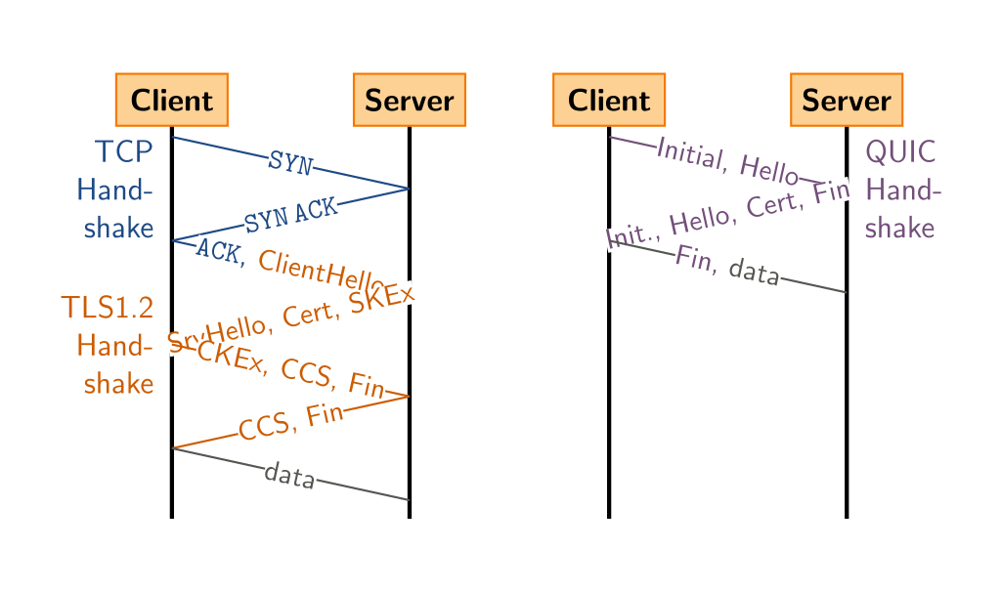
Comparison: QUIC’s handshake

Slide 37
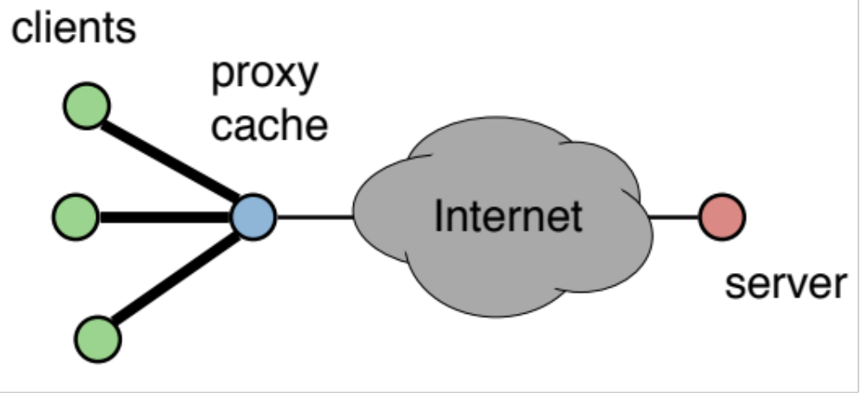
Larger Objects
Problem is throughput in bottleneck link
Solution: HTTP Proxy Caching
  Also improves latency, and reduces server load

Slide 38
How to Control Caching?
Server sets options
  Expires header
  No-Cache header
Client can do a conditional request:
  Header option: if-modified-since
  Server can reply with 304 NOT MODIFIED

Slide 39

Caching
Where to cache content?
  Client (browser): avoid extra network transfers
  Server: reduce load on the server
  Service Provider: reduce external traffic
Server
Backbone ISP
ISP-1
ISP-2
Clients

Slide 40
Caching
Why caching works?
  Locality of reference:
    Users tend to request the same object in succession
    Some objects are popular: requested by many users
Server
Backbone ISP
ISP-1
ISP-2
Clients

Slide 41
How well does caching work?
Very well, up to a point
  Large overlap in requested objects
  Objects with one access place upper bound on hit ratio
  Dynamic objects not cacheable*
Example: Wikipedia
  About 400 servers, 100 are HTTP Caches (Squid)
  85% Hit ratio for text, 98% for media
* But can cache portions and run special code on edges to reconstruct

Slide 42
HTTP Cache Control
Cache-Control = "Cache-Control" ":" 1#cache-directive
cache-directive = cache-request-directive
| cache-response-directive
cache-request-directive =
"no-cache" ; Section 14.9.1
| "no-store" ; Section 14.9.2
| "max-age" "=" delta-seconds ; Section 14.9.3, 14.9.4
| "max-stale" [ "=" delta-seconds ] ; Section 14.9.3
| "min-fresh" "=" delta-seconds ; Section 14.9.3
| "no-transform" ; Section 14.9.5
| "only-if-cached" ; Section 14.9.4
| cache-extension ; Section 14.9.6
cache-response-directive =
"public" ; Section 14.9.1
| "private" [ "=" <"> 1#field-name <"> ] ; Section 14.9.1
| "no-cache" [ "=" <"> 1#field-name <"> ]; Section 14.9.1
| "no-store" ; Section 14.9.2
| "no-transform" ; Section 14.9.5
| "must-revalidate" ; Section 14.9.4
| "proxy-revalidate" ; Section 14.9.4
| "max-age" "=" delta-seconds ; Section 14.9.3
| "s-maxage" "=" delta-seconds ; Section 14.9.3
| cache-extension ; Section 14.9.6
cache-extension = token [ "=" ( token | quoted-string ) ]

Slide 43
Reverse Proxies
Close to the server
  Also called Accelerators
  Only work for static content
Server
Reverse proxies
Backbone ISP
ISP-1
ISP-2
Clients

Slide 44
Forward Proxies
Typically done by ISPs or Enterprises
  Reduce network traffic and decrease latency
  May be transparent or configured
Server
Reverse proxies
Backbone ISP
ISP-1
ISP-2
Forward proxies
Clients

Slide 45
Content Distribution Networks
Integrate forward and reverse caching
  One network generally administered by one entity
  E.g. Akamai
Provide document caching
  Pull: result from client requests
  Push: expectation of high access rates to some objects
Can also do some processing
  Deploy code to handle some dynamic requests
  Can do other things, such as transcoding

Slide 46
Example CDN
Server
CDN
Backbone ISP
ISP-1
ISP-2
Forward proxies
Clients

Slide 47
How Akamai works
Akamai has cache servers deployed close to clients
  Co-located with many ISPs
Challenge: make same domain name resolve to a proxy close to the client
Lots of DNS tricks. BestBuy is a customer
  Delegate name resolution to Akamai (via a CNAME)
From Brown:
dig www.bestbuy.com
;; ANSWER SECTION:
www.bestbuy.com. 3600 IN CNAME www.bestbuy.com.edgesuite.net.
www.bestbuy.com.edgesuite.net. 21600 IN CNAME a1105.b.akamai.net.
a1105.b.akamai.net. 20 IN A 198.7.236.235
a1105.b.akamai.net. 20 IN A 198.7.236.240
  Ping time: 2.53ms
From Berkeley, CA:
a1105.b.akamai.net. 20 IN A 198.189.255.200
a1105.b.akamai.net. 20 IN A 198.189.255.207
  Ping time: 3.20ms

Slide 48
DNS Resolution
dig www.bestbuy.com
;; ANSWER SECTION:
www.bestbuy.com. 3600 IN CNAME www.bestbuy.com.edgesuite.net.
www.bestbuy.com.edgesuite.net. 21600 IN CNAME a1105.b.akamai.net.
a1105.b.akamai.net. 20 IN A 198.7.236.235
a1105.b.akamai.net. 20 IN A 198.7.236.240
;; AUTHORITY SECTION:
b.akamai.net. 1101 IN NS n1b.akamai.net.
b.akamai.net. 1101 IN NS n0b.akamai.net.
;; ADDITIONAL SECTION:
n0b.akamai.net. 1267 IN A 24.143.194.45
n1b.akamai.net. 2196 IN A 198.7.236.236
n1b.akamai.net finds an edge server close to the client’s local resolver
  Uses knowledge of network: BGP feeds, traceroutes. Their secret sauce…

Slide 49
Example
dig www.bestbuy.com
;; QUESTION SECTION:
;www.bestbuy.com. IN A
;; ANSWER SECTION:
www.bestbuy.com. 2530 IN CNAME www.bestbuy.com.edgekey.net.
www.bestbuy.com.edgekey.net. 85 IN CNAME e1382.x.akamaiedge.net.
e1382.x.akamaiedge.net. 16 IN A 104.88.86.223
;; Query time: 6 msec
;; SERVER: 192.168.1.1#53(192.168.1.1)
;; WHEN: Thu Nov 16 09:43:11 2017
;; MSG SIZE rcvd: 123
traceroute to 104.88.86.223 (104.88.86.223), 64 hops max, 52 byte packets
1 router (192.168.1.1) 2.461 ms 1.647 ms 1.178 ms
2 138.16.160.253 (138.16.160.253) 1.854 ms 1.509 ms 1.462 ms
3 10.1.18.5 (10.1.18.5) 1.886 ms 1.705 ms 1.707 ms
4 10.1.80.5 (10.1.80.5) 4.276 ms 6.444 ms 2.307 ms
5 lsb-inet-r-230.net.brown.edu (128.148.230.6) 1.804 ms 1.870 ms 1.727 ms
6 131.109.200.1 (131.109.200.1) 2.841 ms 2.587 ms 2.530 ms
7 host-198-7-224-105.oshean.org (198.7.224.105) 4.421 ms 4.523 ms 4.496 ms
8 5-1-4.bear1.boston1.level3.net (4.53.54.21) 4.099 ms 3.974 ms 4.290 ms
9 * ae-4.r00.bstnma07.us.bb.gin.ntt.net (129.250.66.93) 4.689 ms 4.109 ms
10 ae-6.r24.nycmny01.us.bb.gin.ntt.net (129.250.4.114) 8.863 ms 10.205 ms 10.477 ms
11 ae-1.r08.nycmny01.us.bb.gin.ntt.net (129.250.5.62) 9.298 ms
ae-1.r07.nycmny01.us.bb.gin.ntt.net (129.250.3.181) 10.008 ms 8.677 ms
12 ae-0.a00.nycmny01.us.bb.gin.ntt.net (129.250.3.94) 8.543 ms 7.935 ms
ae-1.a00.nycmny01.us.bb.gin.ntt.net (129.250.6.55) 9.836 ms
13 a104-88-86-223.deploy.static.akamaitechnologies.com (104.88.86.223) 9.470 ms 8.483 ms 8.738 ms
dig www.bestbuy.com @109.69.8.51
e1382.x.akamaiedge.net. 12 IN A 23.60.221.144
traceroute to 23.60.221.144 (23.60.221.144), 64 hops max, 52 byte packets
1 router (192.168.1.1) 44.072 ms 1.572 ms 1.154 ms
2 138.16.160.253 (138.16.160.253) 2.460 ms 1.736 ms 2.722 ms
3 10.1.18.5 (10.1.18.5) 1.841 ms 1.649 ms 3.348 ms
4 10.1.80.5 (10.1.80.5) 2.304 ms 15.208 ms 2.895 ms
5 lsb-inet-r-230.net.brown.edu (128.148.230.6) 1.784 ms 4.744 ms 1.566 ms
6 131.109.200.1 (131.109.200.1) 3.581 ms 5.866 ms 3.238 ms
7 host-198-7-224-105.oshean.org (198.7.224.105) 4.288 ms 6.218 ms 8.332 ms
8 5-1-4.bear1.boston1.level3.net (4.53.54.21) 4.209 ms 6.103 ms 5.031 ms
9 ae-4.r00.bstnma07.us.bb.gin.ntt.net (129.250.66.93) 3.982 ms 5.824 ms 4.514 ms
10 ae-6.r24.nycmny01.us.bb.gin.ntt.net (129.250.4.114) 9.735 ms 12.442 ms 8.689 ms
11 ae-9.r24.londen12.uk.bb.gin.ntt.net (129.250.2.19) 81.098 ms 81.343 ms 81.120 ms
12 ae-6.r01.mdrdsp03.es.bb.gin.ntt.net (129.250.4.138) 102.009 ms 110.595 ms 103.010 ms
13 81.19.109.166 (81.19.109.166) 99.426 ms 93.236 ms 101.168 ms
14 a23-60-221-144.deploy.static.akamaitechnologies.com (23.60.221.144) 94.884 ms 92.779 ms 93.281 ms
Other DNS servers to try:
77.88.8.8 (St Petersburg),
89.233.43.71 (Copenhagen),
202.46.32.22(Beijing)

Slide 50
Other CDNs
Akamai, Limelight, Cloudflare
Amazon, Facebook, Google, Microsoft
Netflix
Where to place content?
Which content to place? Pre-fetch or cache?

Slide 51
How to Control Caching?
Server sets options
  Expires header
  No-Cache header
Client can do a conditional request:
  Header option: if-modified-since
  Server can reply with 304 NOT MODIFIED
More when we talk about Content Distribution

