Slide 1
CSCI-1680
Transport Layer II
Data over TCP: Flow Control
Nick DeMarinis
Based partly on lecture notes by Rodrigo Fonseca, David Mazières, Phil Levis, John Jannotti

Slide 2
Administrivia
Make sure you have signed up for IP grading
TCP milestone I: Thurs, Apr 14
TCP gear-up early next week, look for details

Slide 3
Topics for today
Flow control: Sliding window
Computing RTO
Connection termination

Slide 4
Sliding window: in abstract terms
Window of size w
Can send at most w packets before waiting for an ACK
Goal
  Network “pipe” always filled with data
  ACKs come back at rate data is delivered => “self-clocking”

Slide 5
Sender example

Slide 6
Receiver example

Slide 7
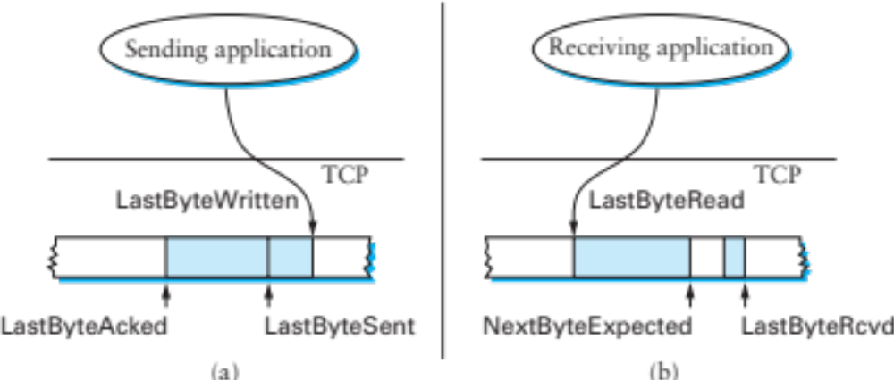
Flow Control: Sender
Invariants
LastByteSent – LastByteAcked <= AdvertisedWindow
EffectiveWindow = AdvertisedWindow – (BytesInFlight)
LastByteWritten – LastByteAcked <= MaxSendBuffer
Useful Sliding Window Terminology:
RFC 793, Sec 3.3

Slide 8
Flow control: receiver
Useful Sliding Window Terminology:
RFC 793, Sec 3.3
Can accept data if space in window
Available window =
BufferSize– ((NextByteExpected-1) - LastByteRead
On receiving segment for byte S
  if s is outside window, ignore packet
  if s == NextByteExpected:
    Deliver to application (Update LastByteReceived)
    If next segment was early arrival, deliver it too
  If s > NextByteExpected, but within window
    Queue as early arrival
Send ACK for highest contiguous byte received, available window

Slide 9
Flow Control
Advertised window can fall to 0
  How?
  Sender eventually stops sending, blocks application
Resolution: zero window probing: sender sends 1-byte segments until window comes back > 0

Slide 10
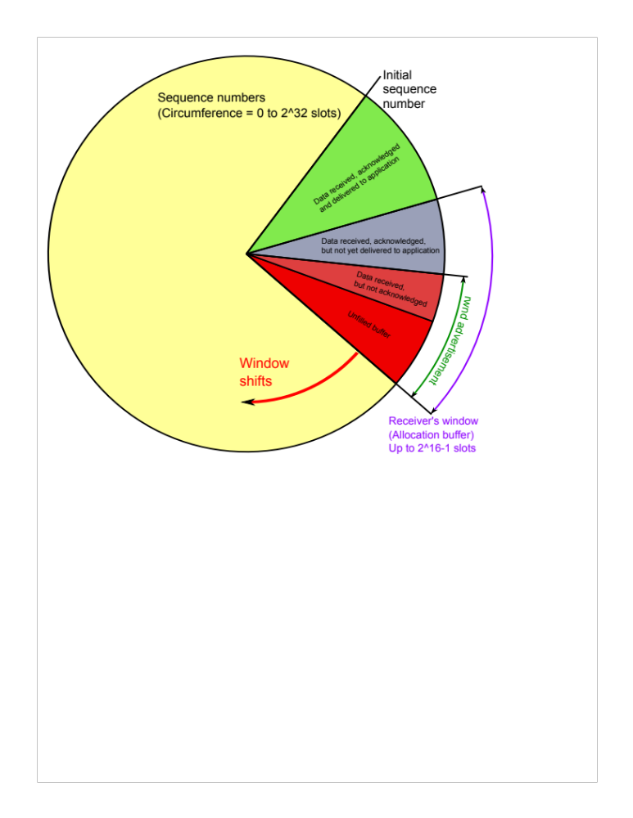

Slide 11
Some Visualizations
Normal conditions: https://www.youtube.com/watch?v=zY3Sxvj8kZA
With packet loss: https://www.youtube.com/watch?v=lk27yiITOvU

Slide 12
How do ACKs work?
ACK contains next expected sequence number
If one segment is missed but new ones received, send duplicate ACK
Retransmit when:
  Receive timeout (RTO) expires
  Receive 3 Duplicate ACKs
How to set RTO?

Slide 13
When to time out?
RFC793, Sec 3.7
Should expect an ACK within one Round Trip Time (RTT)
Problem: RTT can be highly variable
Strategy: expected RTT based on ACKs received
  Use exponentially weighted moving average (EWMA)
  RFC793 version (“smoothed RTT”):
  SRTT = (⍺ * SRTT) + (1 - ⍺)* RTT_{Measured}
  RTO = max(RTO_{Min}, min(β * SRTT, RTO_{Max}))
  ⍺ = “Smoothing factor”: .8-.9
  β = “Delay variance factor”: 1.3—2.0
Notes:
Congestion control is all about modeling the network

Slide 14
This is only the beginning…
Problem 1: what if segment is a retransmission?
  Solution: don’t update RTT if segment was retransmitted
Problem 2: RTT can have high variance
  Initial implementation doesn’t account for this
  Congestion control: modeling network load

Slide 15
When to Transmit?
Nagle’s algorithm
Goal: reduce the overhead of small packets
  if (there is data to send) and (window >= MSS)
  Send a MSS segment
  else
  if there is unAcked data in flight
  buffer the new data until ACK arrives
  else
  send all the new data now
Receiver should avoid advertising a window <= MSS after advertising a window of 0
Notes:
Problem: too many small packets

Slide 16
Delayed Acknowledgments
Goal: Piggy-back ACKs on data
  Delay ACK for 200ms in case application sends data
  If more data received, immediately ACK second segment
  Note: never delay duplicate ACKs (if missing a segment)
Warning: can interact badly with Nagle for some applications
  Nagle waits for ACK until send => Temporary deadlock
  App can disable Nagle with TCP_NODELAY
  App should also avoid many small writes
Notes:
Why does it

Slide 17
Summary: flow control
Flow control provides correctness: reliable, in order delivery
Need more for performance
  What if the network is the bottleneck?
Sending too fast will cause queue overflows, heavy packet loss
Need more for performance: congestion control

Slide 18
Connection Termination
When you have no more data to send, send a FIN
  Sent by close() or shutdown()
Both sides close connection separately!
TIME_WAIT: initiating side should wait for 2*MSL before deleting TCB
  MSL = Longest time a segment might be delayed (configurable, ~1min)
Close
FIN_WAIT_1
FIN
ACK
CLOSE_WAIT
FIN_WAIT_2
…
Close
FIN
LAST_ACK
TIME_WAIT
2MSL
ACK
CLOSED
CLOSED

Slide 19
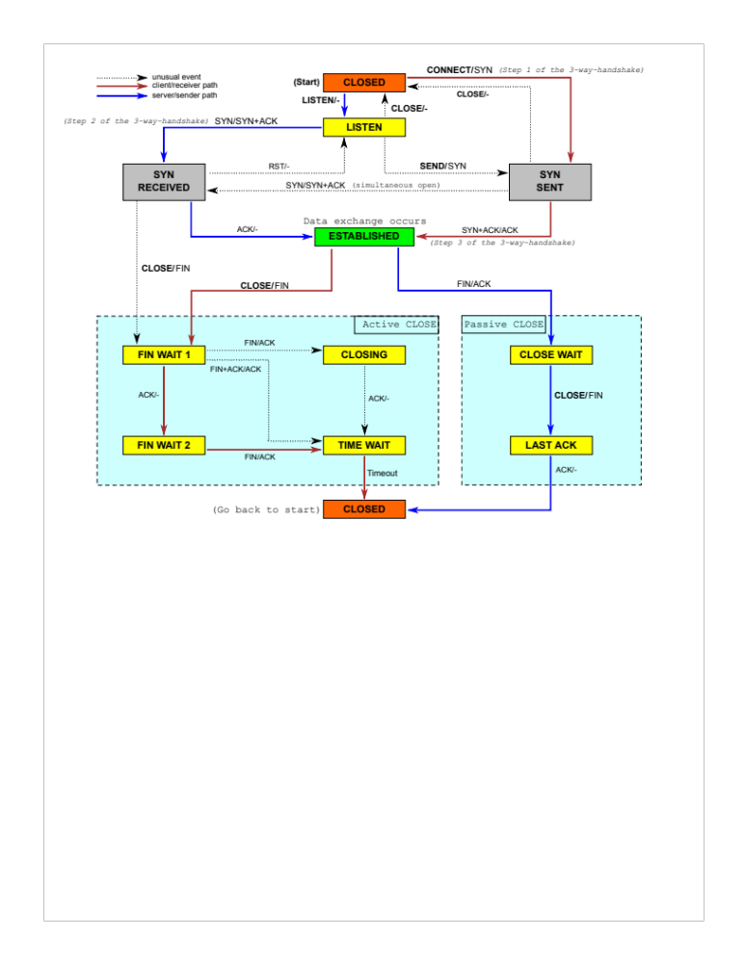
TCP State Diagram

