Slide 1
CSCI-1680
Transport Layer I
Nick DeMarinis
Based partly on lecture notes by Rodrigo Fonseca, David Mazières, Phil Levis, John Jannotti

Slide 2
Administrivia
Later today: Look for message about IP grading
  Meeting slots first week after break (and during break)
TCP: Draft of assignment out today
  Read it over before break, start when we get back
Summer/UTA hiring: Expect a message from me today/tomorrow

Slide 3
Today
Light overview of the transport layer and TCP
  Why we need TCP
  What components are involved
  What you will do in the project

Slide 4
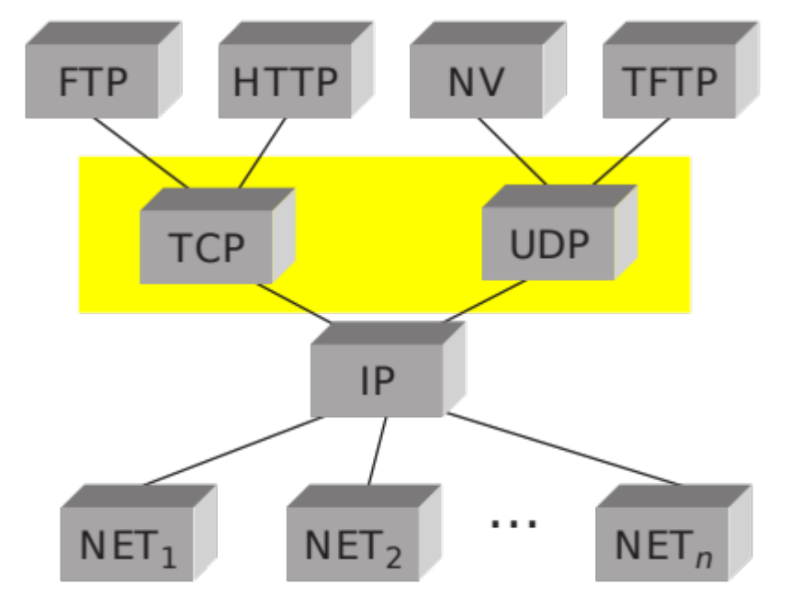
Transport Layer
Transport protocols sit on top of network layer
Problem solved: communication among processes
  Application-level multiplexing (“ports”)
  Error detection, reliability, etc.

Slide 5

From Lec 2: OSI Reference Model
Application Protocol
Transport Protocol
Network Protocol
Link-Layer Protocol
Notes:
Open Systems Interconnect, ISO
We no longer care about paths

Slide 6
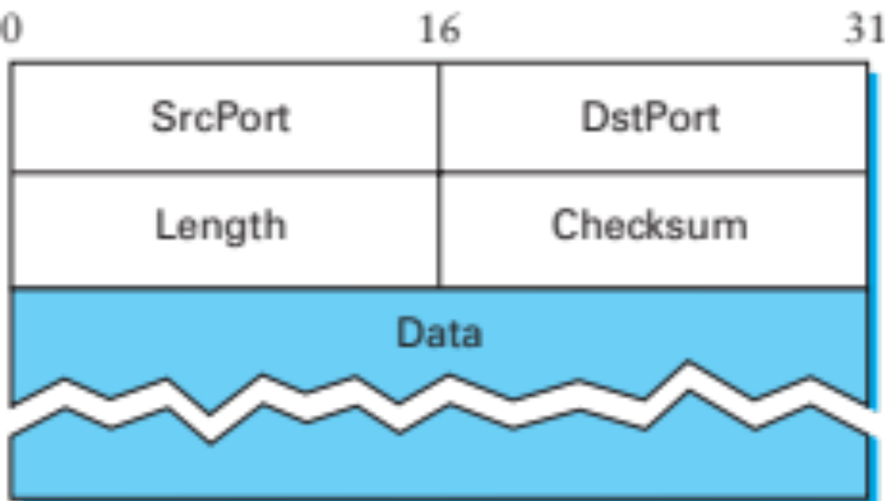
Basic transport: UDP
User Datagram Protocol
Unreliable datagram service
Adds multiplexing (via ports) and nothing else
Checksum is pretty useless

Slide 7
UDP Checksum
Uses the same algorithm as the IP checksum
  Set Checksum field to 0
  Sum all 16-bit words, adding any carry bits to the LSB
  Flip bits to get checksum (except 0xffff->0xffff)
  To check: sum whole packet, including sum, should get 0xffff
How many errors?
  Catches any 1-bit error
  Not all 2-bit errors
Optional in IPv4: not checked if value is 0
Notes:
2-bit error not caught: E.g., increment word ending in 0, decrement one ending in 1

Slide 8
Pseudo Header
0 7 8 15 16 23 24 31
+--------+--------+--------+--------+
| source address |
+--------+--------+--------+--------+
| destination address |
+--------+--------+--------+--------+
| zero |protocol| UDP length |
+--------+--------+--------+--------+
Checksum is computer over pseudo-header prepended to the UDP header
  For IPv4: IP Source, IP Dest, Protocol (=17), plus UDP length
What does this give us?
What is a problem with this?
  Is UDP a layer on top of IP?
Notes:
Check that the destination is correct. It’s kind of useless, actually.

Slide 9
Next Problem: Reliability
We talked briefly about link-layer reliability:
Problem | Mechanism
Dropped Packets
Acknowledgments + Timeout
Duplicate Packets
Sequence Numbers
Packets out of order
Receiver Window
Maximizing throughput
Sliding Window (Pipelining)
Single link: things were easy… ☺

Slide 10
Transport Layer Reliability
Extra difficulties
  Multiple hosts
  Multiple hops
  Multiple potential paths
What does this mean?
  Multiple opportunities for failure
  Hosts have different resources
  Varying RTTs
Notes:
Both across connections and during a connection
Why do they vary? What do they influence?
RTT influences the potential window size (delay X bandwidth), the values for timeouts.

Slide 11
Extra Difficulties (cont.)
Out of order packets
  Not only because of drops/retransmissions
  Can get very old packets (up to 120s), must not get confused
Unknown resources at other end
  Must be able to discover receiver buffer: flow control
Unknown resources in the network
  Should not overload the network
  But should use as much as safely possible to maximize throughput
Notes:
We call this congestion control

Slide 12
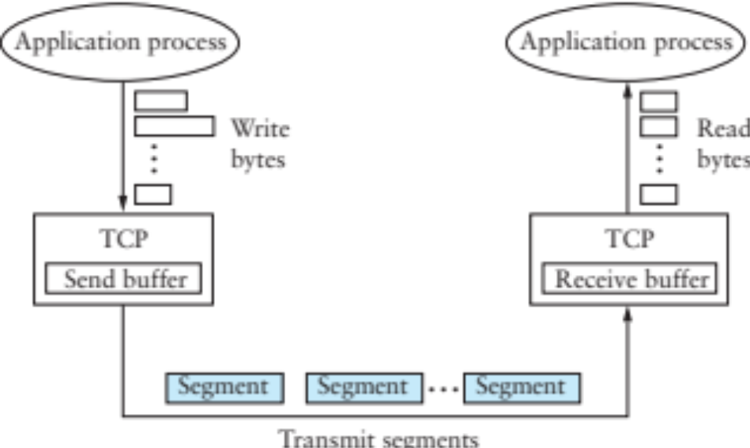
TCP – Transmission Control Protocol
Service model: “reliable, connection oriented, full duplex ordered byte stream”
Flow control: If one end stops reading, writes at other eventually stop/fail
Congestion control: Keeps sender from overloading the network

Slide 13
TCP
Specification
  RFC 793 (1981), RFC 1222 (1989, some corrections), RFC 5681 (2009, congestion control), …
Was born coupled with IP, later factored out
End-to-end protocol
  Minimal assumptions on the network
  All mechanisms run on the end points
What if you had link-layer reliability instead?
Notes:
Don’t always need reliability!

Slide 14
Not the only options…
 | UDP | TCP | SCTP | DCCP
Multiplexing | ✔ | ✔ | ✔ | ✔
Connection |  | ✔ | ✔ | ✔
Reliablity |  | ✔ | ✔
In-order |  | ✔ | optional
Message | ✔ |  | ✔ | ✔
Stream |  | ✔
Flow Control |  | ✔ | ✔
Congestion Control |  | ✔ | ✔ | ✔
Multiple Streams |  | * | ✔
Multiple Paths |  | * | ✔
*MPTCP adds multiple streams and multiple paths
This table is not exhaustive!

Slide 15
Why not provide X on the network layer?
X = Reliability, security, message ordering…
Cost
  These functionalities are not free: don’t burden those who don’t need them
Conflicting
  Timeliness and in-order delivery, for example
Insufficient
  Example: reliability
Notes:
Insufficient: need an end-to-end picture to get reliable delivery

Slide 16
End-to-end argument
Functions placed at lower levels of a system may be redundant or of little value
  They may need to be performed at a higher layer anyway
But they may be justified for performance reasons
  Or just because they provide most of what is needed
  Example: retransmissions
Takeaway: weigh the costs and benefits at each layer
Notes:
Example: Bit-torrent file transfer
Example performance enhancement
o-----o-----o----o 0.1 chance of drop
End-to-end ack: (0.9^4)^2 = 0.43 (~2.3X)
2 Retransmissions per hop:
Failure: fails three retransmissions = ((1-(0.1)^3)^4)^8 = 0.99

Slide 17
TCP Header
0 1 2 3
0 1 2 3 4 5 6 7 8 9 0 1 2 3 4 5 6 7 8 9 0 1 2 3 4 5 6 7 8 9 0 1
+-+-+-+-+-+-+-+-+-+-+-+-+-+-+-+-+-+-+-+-+-+-+-+-+-+-+-+-+-+-+-+-+
| Source Port | Destination Port |
+-+-+-+-+-+-+-+-+-+-+-+-+-+-+-+-+-+-+-+-+-+-+-+-+-+-+-+-+-+-+-+-+
| Sequence Number |
+-+-+-+-+-+-+-+-+-+-+-+-+-+-+-+-+-+-+-+-+-+-+-+-+-+-+-+-+-+-+-+-+
| Acknowledgment Number |
+-+-+-+-+-+-+-+-+-+-+-+-+-+-+-+-+-+-+-+-+-+-+-+-+-+-+-+-+-+-+-+-+
| Data | |U|A|P|R|S|F| |
| Offset| Reserved |R|C|S|S|Y|I| Window |
| | |G|K|H|T|N|N| |
+-+-+-+-+-+-+-+-+-+-+-+-+-+-+-+-+-+-+-+-+-+-+-+-+-+-+-+-+-+-+-+-+
| Checksum | Urgent Pointer |
+-+-+-+-+-+-+-+-+-+-+-+-+-+-+-+-+-+-+-+-+-+-+-+-+-+-+-+-+-+-+-+-+
| Options | Padding |
+-+-+-+-+-+-+-+-+-+-+-+-+-+-+-+-+-+-+-+-+-+-+-+-+-+-+-+-+-+-+-+-+
| data |
+-+-+-+-+-+-+-+-+-+-+-+-+-+-+-+-+-+-+-+-+-+-+-+-+-+-+-+-+-+-+-+-+

Slide 18
Header Fields
Ports: multiplexing
Sequence number
  Correspond to bytes, not packets!
Acknowledgment Number
  Next expected sequence number
Window: willing to receive
  Lets receiver limit SWS (even to 0) for flow control
Data Offset: # of 4 byte (header + option bytes)
Flags, Checksum, Urgent Pointer

Slide 19
Header Flags
URG: whether there is urgent data
ACK: ack no. valid (all but first segment)
PSH: push data to the application immediately
RST: reset connection
SYN: synchronize, establishes connection
FIN: close connection

Slide 20
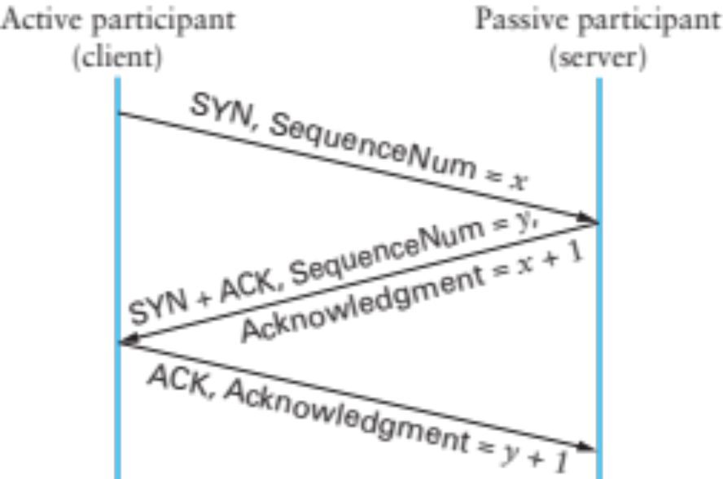
Establishing a Connection
connect()
listen(),
accept()
accept()
returns
Three-way handshake
  Two sides agree on respective initial sequence nums
If no one is listening on port: server sends RST
If server is overloaded: ignore SYN
If no SYN-ACK: retry, timeout

Slide 21
Connection Termination
FIN bit says no more data to send
  Caused by close or shutdown
  Both sides must send FIN to close a connection
Typical close
Close
FIN_WAIT_1
FIN
ACK
CLOSE_WAIT
FIN_WAIT_2
…
Close
FIN
LAST_ACK
TIME_WAIT
2MSL
ACK
CLOSED
CLOSED

Slide 22

Summary of TCP States
Connection Establishment
Passive close:
Can still send!
Active close:
Can still receive

Slide 23
Next class
Sending data over TCP

