Slide 1
CSCI-1680
APIs
Nick DeMarinis
Based partly on lecture notes by Rodrigo Fonseca, Scott Shenker and John Jannotti

Slide 2
Administrivia
TCP officially due tonight (Tuesday, Nov 21)
  Office hours 2-5pm (Me); 5-7pm (Alex); 7-9pm (Rhea)
  Like with IP: you can continue to make small bugfixes after the deadline
    OK: Fixing small bugs, README, capture files, code cleanup
    Not OK: eg. implementing sendfile/recvfile, teardown, submitting untested code
  Grading meetings: after break

Slide 3
Administrivia
Final project is online
Group registration form: due tomorrow (11/29) by 5pm EST
Brief proposal: due Friday 12/1, no late days permitted!!
  We will review all of these over the weekend
HW4 (probably last HW): out this week, due next week
TCP grading: end of this week, early next week
  Look for email today/tomorrow

Slide 4
Project examples
Make your own iterative DNS resolver
Build a simple HTTP server
Make your own web API for something
Implement Snowcast, etc. using RPCs (more next week)
Extend your IP/TCP in some way…
These are only a few ideas!

Slide 5
Client
HTTP server
Request: GET /thing
Response: 200 OK + thing
HTTP request: a way to fetch (GET) or send (POST) some object
Doesn’t need to be a web page
Doesn’t need to be from a browser
Generic way to ask the server to do something => an API over the network!

Slide 6
How do programs communicate?
Need a protocol! We’ve seen lots of examples….
IP, TCP, ICMP, RIP, OSPF, BGP, DNS, HTTP, Snowcast ...

Slide 7
How do programs communicate?
Need a protocol! We’ve seen lots of examples….
IP, TCP, ICMP, RIP, OSPF, BGP, DNS, HTTP, Snowcast ...
What do protocols require?

Slide 8
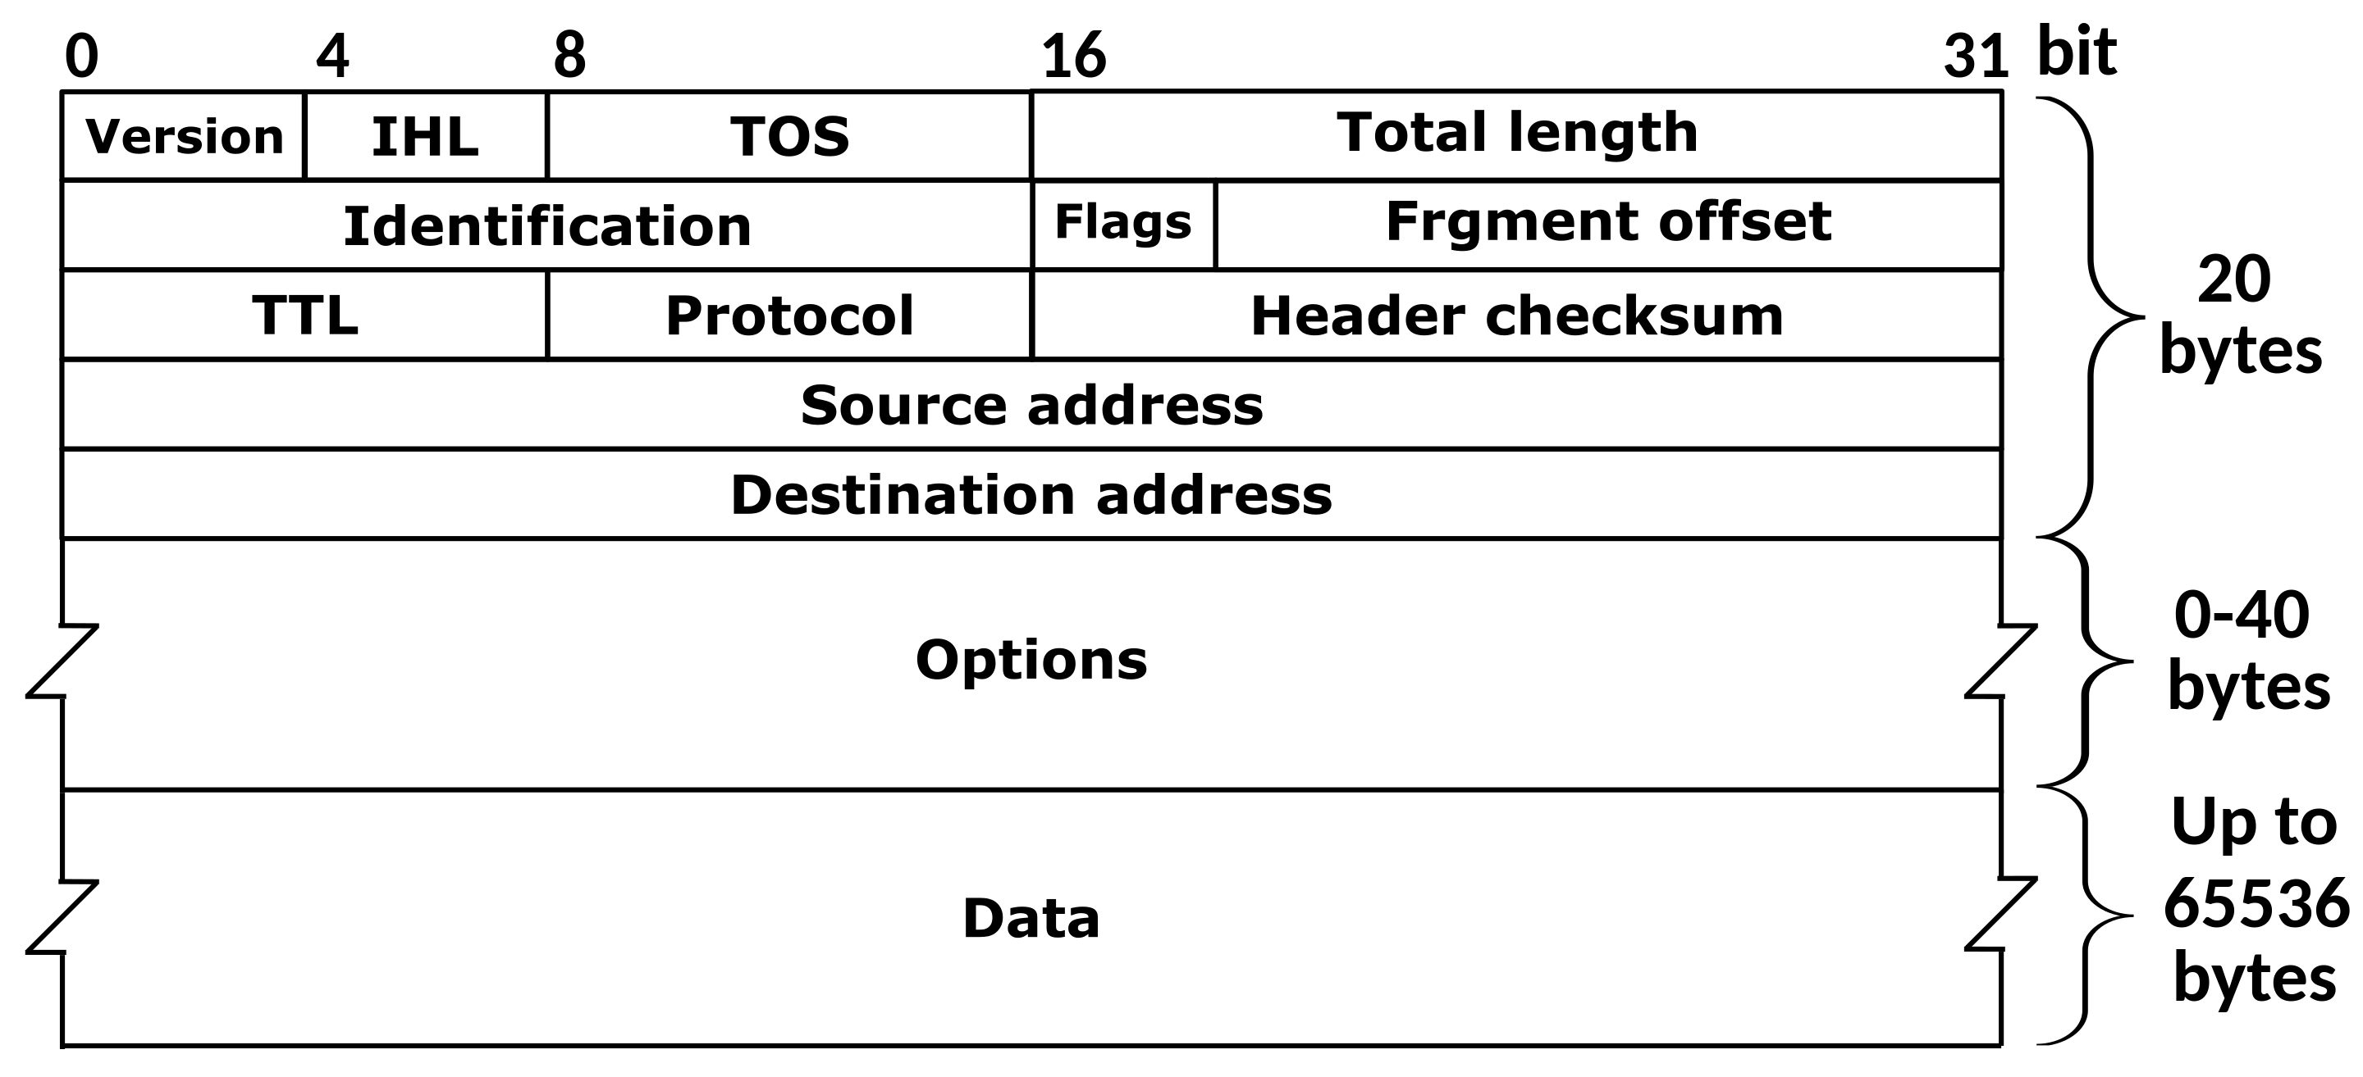
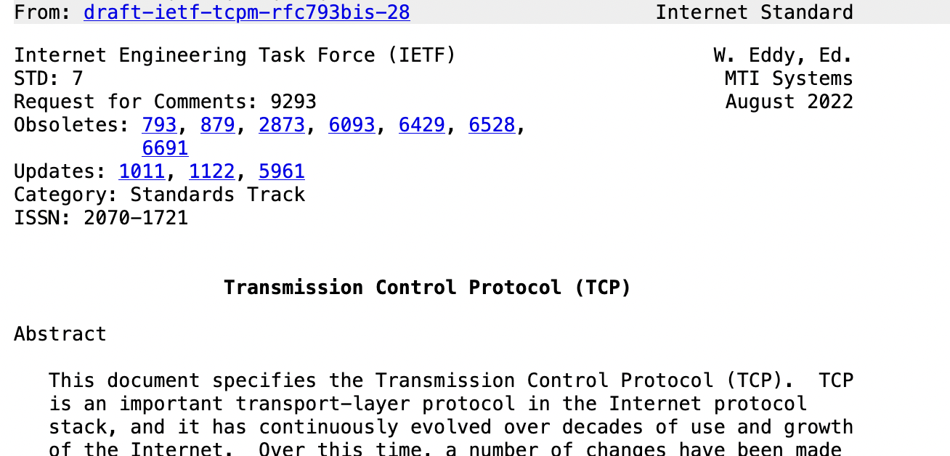
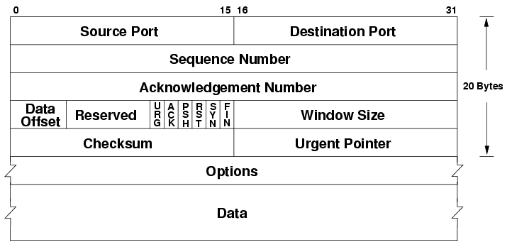
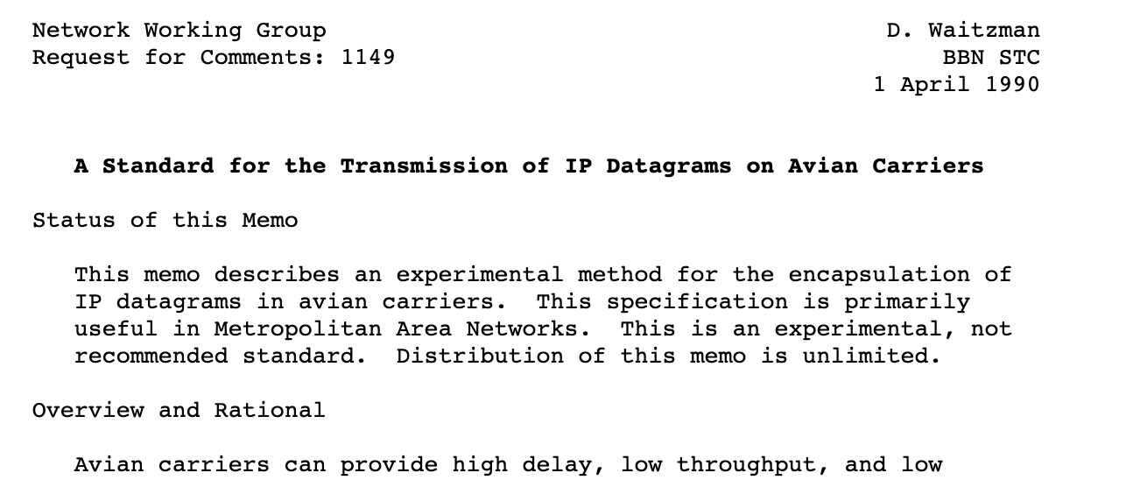
Requirements for protocols
Data representation (headers, packet formats)
Semantics (when to send each message,
how to handle errors)

Slide 9
Requirements for protocols
Data representation (headers, packet formats)

Slide 10
Requirements for protocols
Data representation (headers, packet formats)
Semantics (when to send each message,
how to handle errors)
Must be specific enough to interoperate
(support multiple architectures, byte orders, languages, locales …)

Slide 11
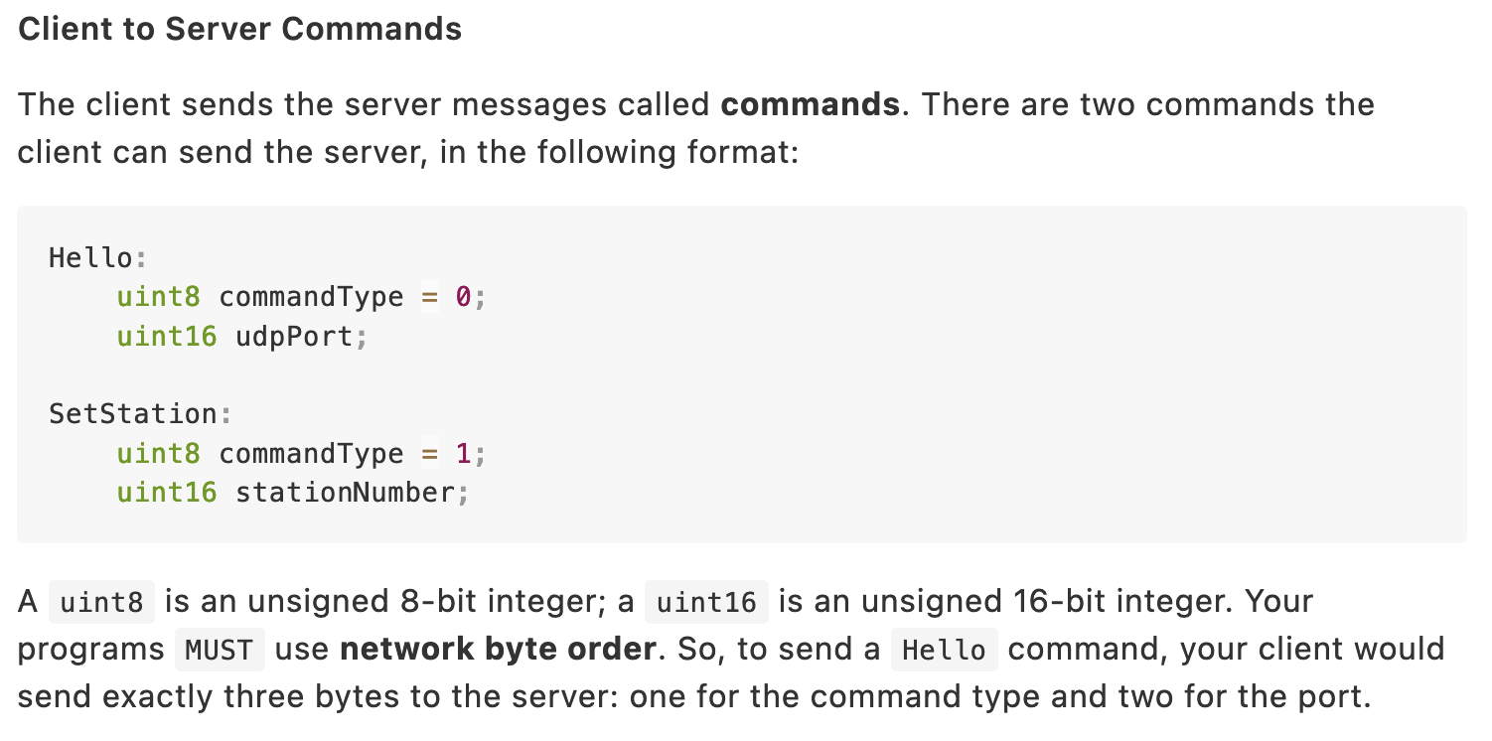
When you made a custom protocol…

Slide 12
When you made a custom protocol…
// Guessing game example (lecture 3!!)
type struct GuessMessage {
MessageType uint8
Number uint16
}
func (m *GuessMessage) Marshal() []byte {
buf := new(bytes.Buffer)
err := binary.Write(buf, binary.BigEndian, m.MessageType)
if err != nil {
. . .
}
err = binary.Write(buf, binary.BigEndian, m.Number)
if err != nil {
. . .
}
return buf.Bytes()
}

Slide 13
When you made a custom protocol…
// Guessing game example (lecture 3!!)
type struct GuessMessage {
MessageType uint8
Number uint16
}
func (m *GuessMessage) Marshal() []byte {
buf := new(bytes.Buffer)
err := binary.Write(buf, binary.BigEndian, m.MessageType)
if err != nil {
. . .
}
err = binary.Write(buf, binary.BigEndian, m.Number)
if err != nil {
. . .
}
return buf.Bytes()
}
All the protocols you’ve made so far (+IP, TCP, RIP, …):
manually packing bytes into buffers

Slide 14
All the protocols you’ve been writing so far: manually loading bytes into buffers
This is useful for learning:
How protocols work under the hood
How fundamental Internet protocols actually work
But if your job is to build applications, is this what you should be doing?
Almost certainly not.

Slide 15
How SHOULD you write a protocol outside this class?
And why?

Slide 16
How SHOULD you write a protocol outside this class?
And why?
* At least, how to start thinking about it

Slide 17
Typical application goal: make an API for something
What you have: some servers/services that live somewhere in the cloud
Your App

Slide 18
Typical application goal: make an API for something
What you have: some servers/services that live somewhere in the cloud
=> Might be distributed, might not
Want: end-user to be able to use your app
Read data
Write/upload data
Client
do_thing()
Your App
Response/error

Slide 19
Client
do_thing()
Your App
Response/error
Challenges/Requirements
Heterogeneous devices (desktop/mobile, different OSes)
Application will change
Number of user devices will scale
Number of services/services will scale too!

Slide 20
Client
do_thing()
API
Your App
Response/error
Would like to have a generic API for interacting with application services
=> Flexible to changes
=> Easy to scale
=>

Slide 21
Why doesn’t this work?
// Guessing game example (lecture 3!!)
type struct GuessMessage {
MessageType uint8
Number uint16
}
func (m *GuessMessage) Marshal() []byte {
buf := new(bytes.Buffer)
err := binary.Write(buf, binary.BigEndian, m.MessageType)
if err != nil {
. . .
}
err = binary.Write(buf, binary.BigEndian, m.Number)
if err != nil {
. . .
}
return buf.Bytes()
}

Slide 23
Your App
Client
do_thing()
API
Response/error
Usually, build on existing tools that can define the API for you

Slide 24
Your App
Client
do_thing()
API
Response/error
Usually, build on existing tools that can define the API for you
=> Creates endpoints where you write code to perform actions
=> Don’t need to worry about serializing/deserializing messages
=> Build on existing protocols to handle scaling
(eg. HTTP proxies, load balancing, caching, etc.)

Slide 25
Concepts: endpoints

Slide 26
HTTP APIs
App
Client
HTTP API
GET /component/do_some_action
200 OK + (Data)
Endpoints at various URLs
Usually: Request data with GET, upload with POST
Client authenticates/passes inputs data with headers, cookies
Response normally JSON, XML, or other self-describing format

Slide 27
An example

Slide 28
curl -X GET 'https://www.gradescope.com/courses/567871/memberships.csv’
-H 'User-Agent: Mozilla/5.0 (Macintosh; Intel Mac OS X 10.15; rv:109.0) Gecko/20100101 Firefox/118.0’
-H 'Accept: text/html,application/xhtml+xml,application/xml;q=0.9,image/avif,image/webp,*/*;q=0.8' -H 'Accept-Language: en-US,en;q=0.5’
-H 'Accept-Encoding: gzip, deflate, br’
-H 'Referer: https://www.gradescope.com/courses/567871/memberships’
-H 'DNT: 1’
-H 'Connection: keep-alive’
-H 'Cookie: remember_me=XXXXXXXXXXXXXXXX; __stripe_mid=XXXXXXXXXXXXX; signed_token=XXXXXXXXXXXXXXX; _gradescope_session=XXXXXX[. . .]XXXXXXXX; __stripe_sid=XXXXXXXXXXX’
-H 'Upgrade-Insecure-Requests: 1’
-H 'Sec-Fetch-Dest: document’
-H 'Sec-Fetch-Mode: navigate’
-H 'Sec-Fetch-Site: same-origin’
-H 'Sec-Fetch-User: ?1'

Slide 29
Example: Github public API
$ curl https://api.github.com/users/ndemarinis
{
"login": "ndemarinis",
"id": 1191319,
"node_id": "MDQ6VXNlcjExOTEzMTk=",
"avatar_url": "https://avatars.githubusercontent.com/u/1191319?v=4",
"gravatar_id": "",
"url": "https://api.github.com/users/ndemarinis",
"type": "User",
"site_admin": false,
"name": "Nick DeMarinis",
"blog": "https://vty.sh",
"twitter_username": null,
"public_repos": 10,
. . .
}

Slide 30
Why is this useful?
HTTP is ubiquitous
Lots of existing tools to scale HTTP
  Cookies etc. for user authentication
  Proxies/load balancers
Why use JSON/etc vs. a binary encoding?

Slide 31
HTTP Example
> telnet www.cs.brown.edu 80
Trying 128.148.32.110...
Connected to www.cs.brown.edu.
Escape character is '^]'.
GET / HTTP/1.0
HTTP/1.1 200 OK
Date: Thu, 24 Mar 2011 12:58:46 GMT
Server: Apache/2.2.9 (Debian) mod_ssl/2.2.9 OpenSSL/0.9.8g
Last-Modified: Thu, 24 Mar 2011 12:25:27 GMT
ETag: "840a88b-236c-49f3992853bc0"
Accept-Ranges: bytes
Content-Length: 9068
Vary: Accept-Encoding
Connection: close
Content-Type: text/html
<!DOCTYPE html PUBLIC "-//W3C//DTD XHTML 1.0 Strict//EN"
"http://www.w3.org/TR/xhtml1/DTD/xhtml1-strict.dtd">
<html xmlns="http://www.w3.org/1999/xhtml" xml:lang="en" lang="en”>
...

Slide 32
What if you need more flexibility?

Slide 33
Generic view: Remote Procedure Call (RPC)
Procedure calls are a well understood mechanism
  Transfer control and data on a single computer
Idea: make distributed programming look the same
  Have servers export interfaces that are accessible through local APIs
  Perform the illusion behind the scenes
2 Major Components
  Protocol to manage messages sent between client and server
  Language and compiler support
    Packing, unpacking, calling function, returning value

Slide 34
Stub Functions
Local stub functions at client and server give appearance of a local function call
client stub
  marshalls parameters -> sends to server -> waits
  unmarshalls results -> returns to client
server stub
  creates socket/ports and accepts connections
  receives message from client stub -> unmarshalls parameters -> calls server function
  marshalls results -> sends results to client stub

Slide 35
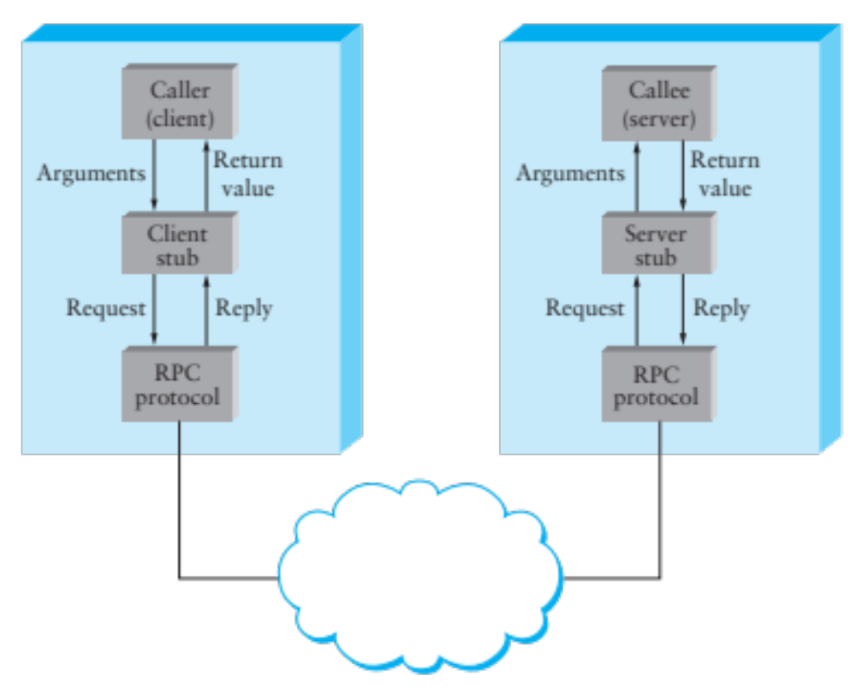

Slide 36
Some examples
gRPC
Apache Thrift
JSON-RPC
XML-RPC, SOAP
. . .

Slide 37
Design questions

Slide 38
Describing data

Slide 39
Example: gRPC
IDL-based, defined by Google
  Protocol Buffers as IDL
User specifies services, calls
  Single and streaming calls
  Support for timeouts, cancellations, etc
Transport: based on HTTP/2
service HelloService {
rpc SayHello (HelloRequest)
returns (HelloResponse);
}
message HelloRequest {
string greeting = 1;
}
message HelloResponse {
string reply = 1;
}

Slide 40
gRPC
Generates stubs in many languages
  C/C++, C#, Node.js, PHP, Ruby, Python, Go, Java
  These are interoperable
Transport is http/2

Slide 41
Protocol Buffers
Defined by Google, released to the public
  Widely used internally and externally
  Supports common types, service definitions
  Natively generates C++/Java/Python/Go code
    Over 20 other supported by third parties
  Efficient binary encoding, readable text encoding
Performance
  3 to 10 times smaller than XML
  20 to 100 times faster to process

Slide 42
Protocol Buffers Example (for a file)
  message Student {
  required String name = 1;
  required int32 credits = 2;
  }
  Student s;
  s.set_name(“Jane”);
  s.set_credits(20);
  fstream output(“students.txt” , ios:out | ios:binary );
  s.SerializeToOstream(&output);
Writer
students.txt
  Student s;
  fstream input(“students.txt” , ios:in | ios:binary );
  s.ParseFromIstream();
Reader

Slide 43
protobuf: Binary Encoding
Variable-length integers
  7 bits out of 8 to encode integers
  Msb: more bits to come
  Multi-byte integers: least significant group first
Signed integers: zig-zag encoding, then varint
  0:0, -1:1, 1:2, -2:3, 2:4, …
  Advantage: smaller when encoded with varint
General:
  Field number, field type (tag), value
Strings:
  Varint length, unicode representation

Slide 44
Apache Thrift
Originally developed by Facebook
Used heavily internally
Supports (at least): C++, Java, Python, PHP, Ruby, Erlang, Perl, Haskell, C#, Cocoa, Smalltalk, and Ocaml
Types: basic types, list, set, map, exceptions
Versioning support
Many encodings (protocols) supported
  Efficient binary, json encodings

Slide 45
Conclusions
Unless you really want to optimize your protocol for performance, use an IDL
Parsing code is easy to get (slightly) wrong, hard to make fast—only want to do this once!
Which one should you use?

Slide 46
Which data types?
Basic types
  Integers, floating point, characters
  Some issues: endianness (ntohs, htons), character encoding, IEEE 754
Flat types
  Strings, structures, arrays
  Some issues: packing of structures, order, variable length
Complex types
  Pointers! Must flatten, or serialize data structures

Slide 47
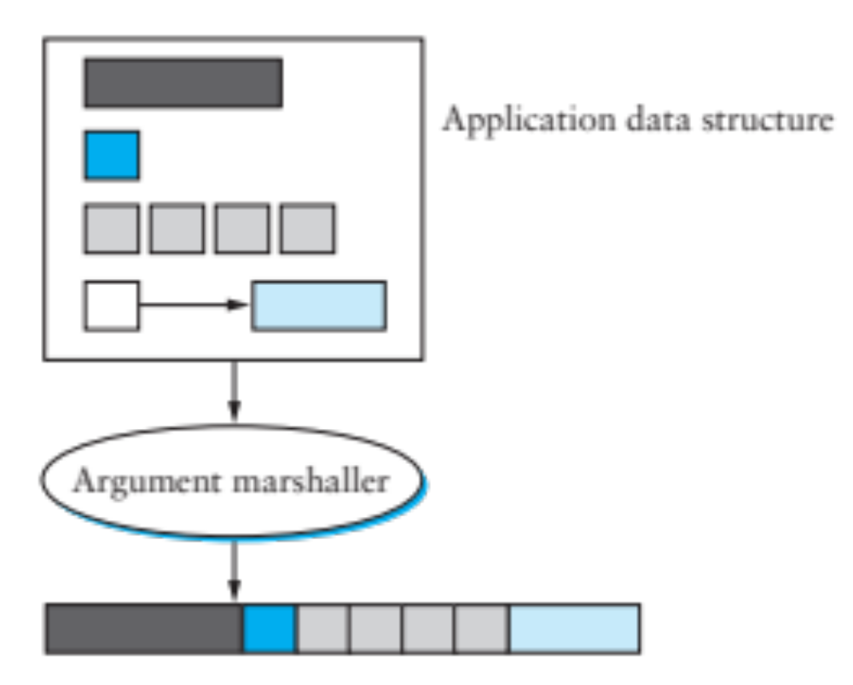

Slide 48
Problem
Two programs want to communicate: must define the protocol
  We have seen many of these, across all layers
  E.g., Snowcast packet formats, protocol headers
Key Problems
  Semantics of the communication
    APIs, how to cope with failure
  Data Representation
  Scope: should the scheme work across
    Architectures
    Languages
    Compilers…?

Slide 49
Data Schema
How to parse the encoded data?
Two Extremes:
  Self-describing data: tags
    Additional information added to message to help in decoding
    Examples: field name, type, length
  Implicit: the code at both ends “knows” how to decode the message
    E.g., your Snowcast implementation
    Interoperability depends on well defined protocol specification!
    very difficult to change

Slide 50
Presentation Formatting
How to represent data?
Several questions:
  Which data types do you want to support?
    Base types, Flat types, Complex types
  How to encode data into the wire
  How to decode the data?
    Self-describing (tags, type-length-value)
    Implicit description (the ends know)
Several answers:
  Many frameworks do these things automatically

Slide 51
Stub Generation
2 Main ideas:
Introspection-based
  E.g., Java RMI
Independent specification: IDL
  IDL – Interface Description Language
    describes an interface in a language neutral way
  Separates logical description of data from
    Dispatching code
    Marshalling/unmarshalling code
    Data wire format

Slide 52
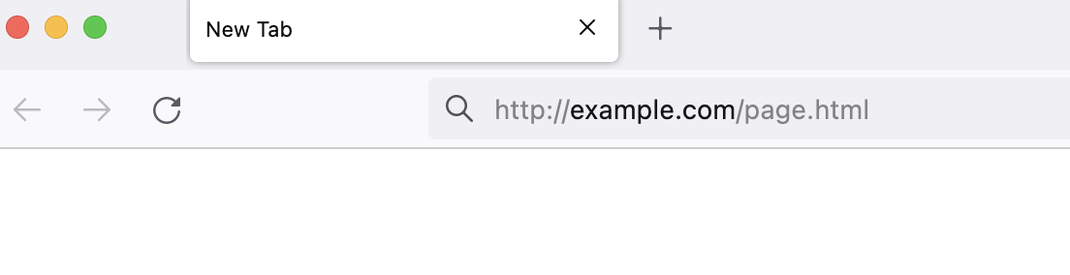
Web browser
DNS
Webserver
example.com
example.com?
page.html
<html>
<title>hi</title>
<h1>Welcome!</h1>
</html>
GET /page.html
200 OK + (Content of page.html)
Welcome!
Server returns response (in this case, with HTML)

Slide 53


