Slide 1
CSCI-1680
DNS
Nick DeMarinis
Based partly on lecture notes by Rodrigo Fonseca, Scott Shenker and John Jannotti

Slide 2
Administrivia
TCP milestone II: sign up for a meeting soon (by Monday at latest—don’t stress about having it all done)
TCP gearup III: tonight (11/9), 5-7pm
HW4: TBA, but due after TCP

Slide 3
The story so far
POV: You want to connect to some website
You
example.com
5.6.7.8
connect(example.com,
80)

Slide 4
The story so far
POV: You want to connect to some website
You
DNS resolver
example.com
5.6.7.8
connect(example.com,
80)
A example.com?
5.6.7.8

Slide 5
The story so far
POV: You want to connect to some website
You
DNS resolver
example.com
5.6.7.8
connect(example.com,
80)
A example.com?
…
5.6.7.8

Slide 6
The story so far
POV: You want to connect to some website
You
DNS resolver
example.com DNS server
example.com
5.6.7.8
connect(example.com,
80)
A example.com?
…
5.6.7.8
5.6.7.8

Slide 7
The story so far
POV: You want to connect to some website
You
DNS resolver
example.com DNS server
example.com
5.6.7.8
connect(example.com,
80)
A example.com?
…
5.6.7.8
5.6.7.8

Slide 8
Warmup
Q: If the randomsite.com’s DNS server goes down,
can another DNS server still resolve randomsite.com?
You
DNS resolver
example.com DNS server
example.com
5.6.7.8
connect(example.com,
80)
A example.com?
…
5.6.7.8
5.6.7.8

Slide 10
How it scales: caching
DNS Resolvers cache responses to avoid doing recursive/iterative queries
Many messages => extra computation, extra latency
$ dig cs.brown.edu @10.1.1.10
;; ANSWER SECTION:
cs.brown.edu. 1800 IN A 128.148.32.12

Slide 11
How it scales: caching
DNS Resolvers cache responses to avoid doing recursive/iterative queries
Many messages => extra computation, extra latency
How long to cache?
=> Every record has a TTL (in seconds), delete when it expires
$ dig cs.brown.edu @10.1.1.10
;; ANSWER SECTION:
cs.brown.edu. 1800 IN A 128.148.32.12

Slide 12
$ dig cs.brown.edu @10.1.1.10
; <<>> DiG 9.10.6 <<>> cs.brown.edu @10.1.1.10
;; global options: +cmd
;; Got answer:
;; ->>HEADER<<- opcode: QUERY, status: NOERROR, id: 8536
;; flags: qr aa rd ra; QUERY: 1, ANSWER: 1, AUTHORITY: 0, ADDITIONAL: 1
;; OPT PSEUDOSECTION:
; EDNS: version: 0, flags:; udp: 1220
;; QUESTION SECTION:
;cs.brown.edu. IN A
;; ANSWER SECTION:
cs.brown.edu. 1800 IN A 128.148.32.12
;; Query time: 69 msec
;; SERVER: 10.1.1.10#53(10.1.1.10)
;; WHEN: Tue Apr 19 09:03:39 EDT 2022
;; MSG SIZE rcvd: 57
Notes:
Responses called Resource Records (RRs)

Slide 13
Today
You
DNS resolver
example.com
5.6.7.8
connect(example.com,
80)
A example.com?
5.6.7.8
How does this work in practice? What can go wrong?

Slide 14
How it scales: caching
DNS Resolvers cache responses to avoid doing recursive/iterative queries
Many messages => extra computation, extra latency
How long to cache?
=> Every record has a TTL (in seconds), delete when it expires
$ dig cs.brown.edu @10.1.1.10
;; ANSWER SECTION:
cs.brown.edu. 1800 IN A 128.148.32.12

Slide 15
Related: redundant services via DNS
Can return multiple answers for one record
=> If a client can’t connect to first result, can try next one
$ dig nytimes.com
;; ANSWER SECTION:
nytimes.com. 111 IN A 151.101.65.164
nytimes.com. 111 IN A 151.101.1.164
nytimes.com. 111 IN A 151.101.129.164
nytimes.com. 111 IN A 151.101.193.164
;; Query time: 40 msec
;; SERVER: 10.1.1.10#53(10.1.1.10)
;; WHEN: Thu Nov 09 08:42:41 EST 2023
;; MSG SIZE rcvd: 104
DNS server usually shuffles answers on each response—why?
Notes:
Responses called Resource Records (RRs)

Slide 16
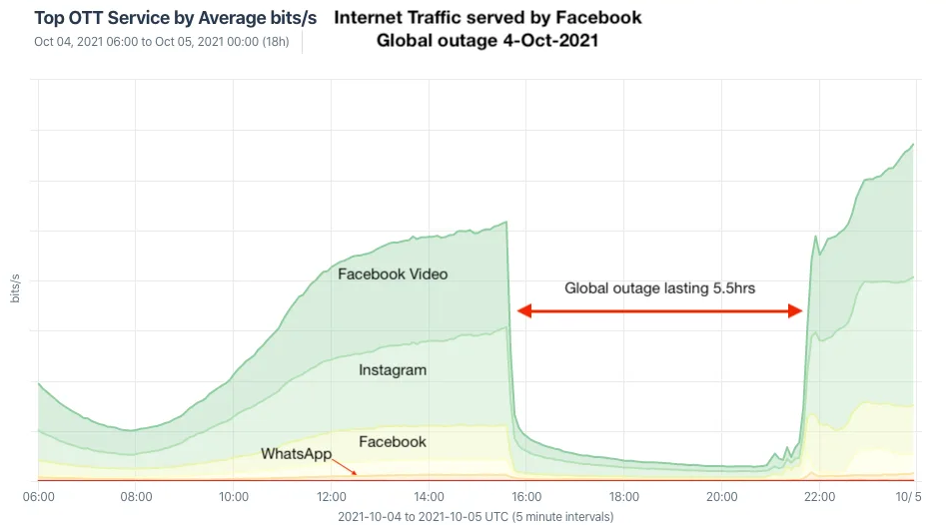
Facebook DNS outage (2021)
BGP configuration bug: Facebook withdraws all routes for its DNS servers to the Internet
=> Facebook DNS unreachable—not even Facebook could access their systems!
Traffic graph
Many writeups here

Slide 17
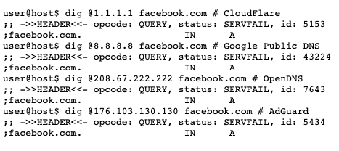
Source

Slide 18
DNS record types
RR Type | Purpose | Example
A | IPv4 Address | 128.148.56.2
AAAA | IPv6 Address | 2001:470:8956:20::1
CNAME | Specifies an alias (“Canonical name”) | systems.cs.brown.edu. 86400 IN CNAME systems-v3.cs.brown.edu. systems-v3.cs.brown.edu. 86400 IN A 128.148.36.51
NS | DNS servers for a domain | cs.brown.edu. 86400 IN NS br1.brown.edu
MX | Mail servers | MX <priority> <ip> eg. MX 10 1.2.3.4
SOA | Start of authority | Information about who owns a zone
PTR | Reverse IP lookup | 7.34.148.128.in-addr.arpa. 86400 IN PTR quanto.cs.brown.edu.
SRV | How to reach specific services (eg. host, port) | _minecraft._tcp.example.net 3600 SRV <priority> <weight> <port> <server IP>
More: https://en.wikipedia.org/wiki/List_of_DNS_record_types

Slide 19
DNS record types
RR Type | Purpose | Example
A | IPv4 Address | 128.148.56.2
AAAA | IPv6 Address | 2001:470:8956:20::1
CNAME | Specifies an alias (“Canonical name”) | systems.cs.brown.edu. 86400 IN CNAME systems-v3.cs.brown.edu. systems-v3.cs.brown.edu. 86400 IN A 128.148.36.51
NS | DNS servers for a domain | cs.brown.edu. 86400 IN NS br1.brown.edu
MX | Mail servers | MX <priority> <ip> eg. MX 10 1.2.3.4
SOA | Start of authority | Information about who owns a zone
PTR | Reverse IP lookup | 7.34.148.128.in-addr.arpa. 86400 IN PTR quanto.cs.brown.edu.
SRV | How to reach specific services (eg. host, port) | _minecraft._tcp.example.net 3600 SRV <priority> <weight> <port> <server IP>
More: https://en.wikipedia.org/wiki/List_of_DNS_record_types

Slide 20
Reverse DNS
What if we want to map IP address => domain name?
Notes:
dig -tPTR 12.32.148.128.in-addr.arpa

Slide 21
Reverse DNS
What if we want to map IP address => domain name?
Leverages hierarchy in IP addresses, but in reverse
=> How? reverse the numbers: 12.32.148.128, then look that up
Notes:
dig -tPTR 12.32.148.128.in-addr.arpa

Slide 22
What happens when you register a new domain?

Slide 23
Registering a new domain
Your new startup helpme.com
Get a block of addresses from ISP
  Say 212.44.9.0/24
Register helpme.com at namecheap.com (for ex.)
  Provide name and address of your authoritative name server (primary and secondary)
  Registrar inserts RR pair into the .com TLD server:
    helpme.com NS dns1.helpme.com
    dns1.helpme.com A 212.44.9.120
Configure your authoritative server (dns1.helpme.com)
  Type A record for www.helpme.com
  Type MX record for helpme.com

Slide 24
Registering a new domain
Your new startup helpme.com
Get a block of addresses from ISP
  Say 212.44.9.0/24
Register helpme.com at namecheap.com (for ex.)
  Provide name and address of your authoritative name server (primary and secondary)
  Registrar inserts RR pair into the .com TLD server:
    helpme.com NS dns1.helpme.com
    dns1.helpme.com A 212.44.9.120
Configure your authoritative server (dns1.helpme.com)
  Type A record for www.helpme.com
  Type MX record for helpme.com

Slide 25
Inserting a Record in DNS, cont
Need to provide reverse PTR bindings
  E.g., 212.44.9.120 -> dns1.helpme.com
Configure your dns server to serve the 9.44.212.in-addr.arpa zone
  Need to add a record of this NS into the parent zone (44.212.in-addr.arpa)
Insert the bindings into the 9.44.212.in-addr.arpa zone

Slide 26
What can go wrong?

Slide 27
You
DNS resolver
example.com
5.6.7.8
connect(example.com,
80)
A example.com?
5.6.7.8

Slide 28
DNS Protocol
TCP/UDP port 53
Most traffic uses UDP
  Lightweight protocol has 512 byte message limit
  Can run over TCP (more on this later)
A few options to request recursive queries, …

Slide 29
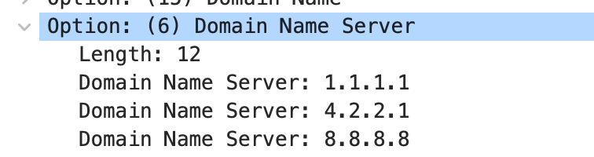
DNS Security
You go to starbucks, how does your browser find www.google.com?
  Ask local name server, obtained from DHCP
Can you trust this DNS server?

Slide 30
You
Local DNS
example.com
5.6.7.8

Slide 31
Great Firewall of CIT
If attacker is on the path (say, it is the ISP, or a malicious version of TStaff), what could they do?

Slide 32
You
Local DNS
Public DNS
example.com
5.6.7.8

Slide 33
Great Firewall of CIT
If attacker is on the path (say, it is the ISP, or a malicious version of TStaff), what could they do?
  Can sniff all DNS queries
  Send fake responses back first
  Could do this selectively, to direct facebook.com to cs.brown.edu, for example…

Slide 34
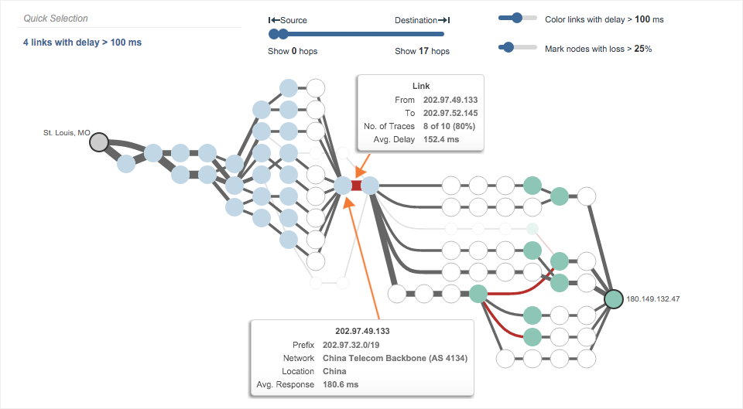
https://www.thousandeyes.com/blog/internet-censorship-around-the-world

Slide 35
https://blog.thousandeyes.com/monitoring-dns-in-china/

Slide 36
Public DNS
Public DNS resolvers provided by cloud companies and ISPs
8.8.8.8 (Google)
1.1.1.1 (Cloudflare)
… and others
Why do this?

Slide 37
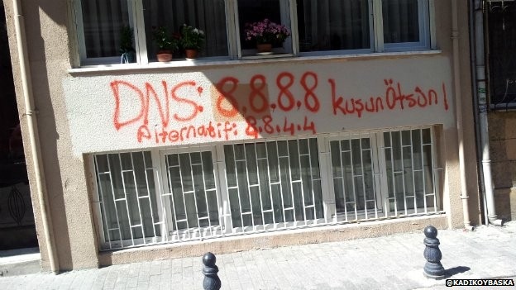
Changing DNS servers in response to blocking of Twitter in Turkey (2014)
Writeup, with more links: https://www.thousandeyes.com/blog/internet-censorship-around-the-world

Slide 38
“Helpful” ISPs
Many ISPs hijack NXDOMAIN responses to “help” by offering search and advertisement related to the domain
E.g., www.bicycleisntadomain.com doesn’t (currently) exist
  Could return a page with search and ads on bicycles (or domain registrations?)

Slide 39
What can be done?
Some defenses against DNS spoofing/hijacking

Slide 40
What can be done?
Some defenses against DNS spoofing/hijacking
DNSSEC: protocol to sign/verify hierarchy of DNS lookups
  Expensive to deploy, hierarchy must support at all levels
  APNIC DNSSEC monitor: https://stats.labs.apnic.net/dnssec
  https://www.internetsociety.org/resources/deploy360/2012/nist-ipv6-and-dnssec-statistics-6/
Tunneling DNS: client uses DNS via more secure protocol
  DNS over HTTPS
  DNS over TLS

Slide 41
More on DNS

Slide 42
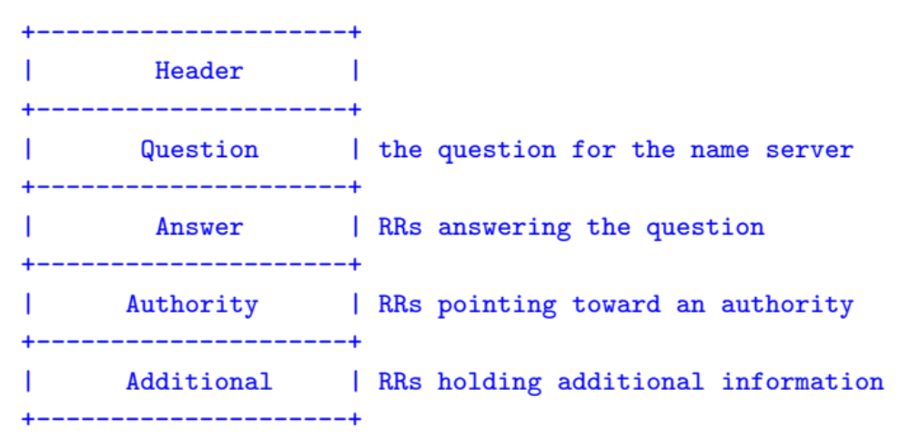
Structure of a DNS Message
Same format for queries and replies
  Query has 0 RRs in Answer/Authority/Additional
  Reply includes question, plus has RRs
Authority allows for delegation
Additional for glue, other RRs client might need

Slide 43
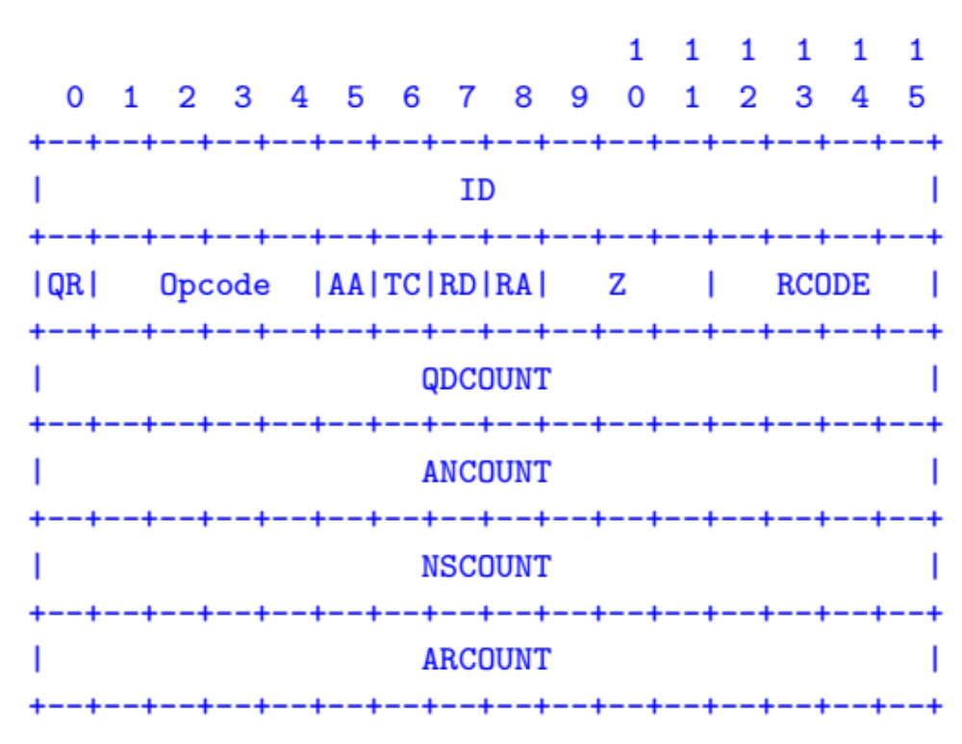
Header format
Id: match response to query; QR: 0 query/1 response
RCODE: error code.
AA: authoritative answer, TC: truncated,
RD: recursion desired, RA: recursion available

Slide 44
Other RR Types
CNAME (canonical name): specifies an alias
www.google.com. 446199 IN CNAME www.l.google.com.
www.l.google.com. 300 IN A 72.14.204.147
MX record: specifies servers to handle mail for a domain (the part after the @ in email addr)
  Different for historical reasons
SOA (start of authority)
  Information about a DNS zone and the server responsible for the zone
PTR (reverse lookup)
7.34.148.128.in-addr.arpa. 86400 IN PTR quanto.cs.brown.edu.

Slide 45
Example
dig . ns
dig +norec www.cs.brown.edu @a.root-servers.net
dig +norec www.cs.brown.edu @a.edu-servers.net
dig +norec www.cs.brown.edu @bru-ns1.brown.edu
www.cs.brown.edu. 86400 IN A 128.148.32.110

Slide 46
Resource Records
All DNS info represented as resource records (RR)
name [ttl] [class] type rdata
  name: domain name
  TTL: time to live in seconds
  class: for extensibility, normally IN (1) “Internet”
  type: type of the record
  rdata: resource data dependent on the type
Example RRs
  www.cs.brown.edu. 86400 IN A 128.148.32.110
  cs.brown.edu. 86400 IN NS dns.cs.brown.edu.
  cs.brown.edu. 86400 IN NS ns1.ucsb.edu.

Slide 47
DNS Example
$ dig cs.brown.edu @10.1.1.10
; <<>> DiG 9.10.6 <<>> cs.brown.edu @10.1.1.10
;; global options: +cmd
;; Got answer:
;; ->>HEADER<<- opcode: QUERY, status: NOERROR, id: 8536
;; flags: qr aa rd ra; QUERY: 1, ANSWER: 1, AUTHORITY: 0, ADDITIONAL: 1
;; OPT PSEUDOSECTION:
; EDNS: version: 0, flags:; udp: 1220
;; QUESTION SECTION:
;cs.brown.edu. IN A
;; ANSWER SECTION:
cs.brown.edu. 1800 IN A 128.148.32.12
;; Query time: 69 msec
;; SERVER: 10.1.1.10#53(10.1.1.10)
;; WHEN: Tue Apr 19 09:03:39 EDT 2022
;; MSG SIZE rcvd: 57
Notes:
Responses called Resource Records (RRs)

Slide 48
DNS Example
When server doesn’t know all info…
% dig +norec cs.brown.edu @j.root-servers.net
; <<>> DiG 9.10.6 <<>> +norec cs.brown.edu @j.root-servers.net
;; global options: +cmd
;; Got answer:
;; ->>HEADER<<- opcode: QUERY, status: NOERROR, id: 61618
;; flags: qr; QUERY: 1, ANSWER: 0, AUTHORITY: 13, ADDITIONAL: 27
;; OPT PSEUDOSECTION:
; EDNS: version: 0, flags:; udp: 1232
;; QUESTION SECTION:
;cs.brown.edu. IN A
;; AUTHORITY SECTION:
edu. 172800 IN NS a.edu-servers.net.
edu. 172800 IN NS b.edu-servers.net.
edu. 172800 IN NS l.edu-servers.net.
edu. 172800 IN NS m.edu-servers.net.
;; ADDITIONAL SECTION:
a.edu-servers.net. 172800 IN A 192.5.6.30
b.edu-servers.net. 172800 IN A 192.33.14.30
c.edu-servers.net. 172800 IN A 192.26.92.30
d.edu-servers.net. 172800 IN A 192.31.80.30
e.edu-servers.net. 172800 IN A 192.12.94.30
Notes:
Responses called Resource Records (RRs)

Slide 49
What we have
IP addresses
Used by routers to forward packets
Fixed length, binary numbers
Assigned based on where host is on the network
Usually refers to one host
Examples
5.6.7.8
212.58.224.138
2620:6e:6000:900:c1d:c9f7:8a1c:2f48
Efficient forwarding: ✅
Human readable: ❌
Scalable for distributed services: ❌

Slide 50
What we have
IP addresses
Used by routers to forward packets
Fixed length, binary numbers
Assigned based on where host is on the network
Usually refers to one host
Examples
5.6.7.8
212.58.224.138
2620:6e:6000:900:c1d:c9f7:8a1c:2f48
Efficient forwarding: ✅
Human readable: ❌
Scalable for distributed services: ❌
=> Need a new abstraction for “stuff” we are trying to access

Slide 51
What we want: a new abstraction for names
Server for website.com
5.6.7.8
You
connect(“website.com”, 80)
connect(5.6.7.8, 80)

Slide 52
What we want: a new abstraction for names
Server for website.com
5.6.7.8
You
connect(“website.com”, 80)
connect(5.6.7.8, 80)
Want: names
- Human-readable
- Variable length
- Don’t need to care about where destination is/what server it is
=> Can refer to a service, not just a host

Slide 53
Some important details
How do local servers find root servers?
  DNS lookup on a.root-servers.net ?
  Servers configured with root cache file
  Contains root name servers and their addresses
  . 3600000 IN NS A.ROOT-SERVERS.NET.
  A.ROOT-SERVERS.NET. 3600000 A 198.41.0.4
  ...
How do you get addresses of other name servers?
  To obtain the address of www.cs.brown.edu, ask a.edu-servers.net, says a.root-servers.net
  How do you find a.edu-servers.net?
  Glue records: A records in parent zone

Slide 54
Other uses of DNS
Local multicast DNS
  Used for service discovery
  Made popular by Apple
  This is how you learn of different Apple TVs in the building
Load balancing
CDNs (more on this later)

Slide 55
Reliability
Answers may contain several alternate servers
Try alternate servers on timeout
  Exponential backoff when retrying same server
Use same identifier for all queries
  Don’t care which server responds, take first answer

Slide 56
Negative Caching
Remember things that don’t work
  Misspellings like www.cnn.comm, ww.cnn.com
  Is the cost of these two queries the same?
These can take a long time to fail the first time
  Good to cache negative results so it will fail faster next time
But negative caching is optional, and not widely implemented

