Slide 1
CSCI-1680
Network Layer:
Inter-domain Routing
Nick DeMarinis
Based partly on lecture notes by Rachit Agarwal, Rodrigo Fonseca, Jennifer Rexford,
Rob Sherwood, David Mazières, Phil Levis, John Jannotti

Slide 2
Administrivia
IP: Due next Thursday (10/19)
HW2: As soon as I can get there

Slide 3
Recall: BGP
Exterior routing: between Autonomous Systems (ASes)
=> How networks with different goals/policies/incentives connect to each other (or don’t)
=> A ”path vector” protocol
  A BGP update
  “I can reach prefix 128.148.0.0/16
  through ASes 44444 3356 14325 11078”

Slide 4
  A BGP update
  “I can reach prefix 128.148.0.0/16
  through ASes 44444 3356 14325 11078”
Key policy questions
“How to use route info to update forwarding tables?”
“What routing info to send to neighbors?”

Slide 5
  A BGP update
  “I can reach prefix 128.148.0.0/16
  through ASes 44444 3356 14325 11078”
Key policy questions
“How to use route info to update forwarding tables?”
“What routing info to send to neighbors?”
=> Local routing policy
=> Export policy
=> Policy Implications? What can go wrong?

Slide 6
B
X
A
Z
C
Y
Relationships between AS drive policy:
Customer->Provider:
Peers:
Example from Kurose and Ross, 5th Ed
Notes:
Size represents connectedness
Customer, peer
X sends to Y over C, sends to Z over BA. What happens if B sends a packet to X with destination at Y?
X should never advertise any paths to B that include C.
B advertises BAZ to X
B should not advertise BAZ to C

Slide 7
B
X
A
Z
C
Y
Relationships between AS drive policy:
Customer->Provider: Customer pays provider to advertise its routes, send it traffic
Example from Kurose and Ross, 5th Ed
Notes:
Size represents connectedness
Customer, peer
X sends to Y over C, sends to Z over BA. What happens if B sends a packet to X with destination at Y?
X should never advertise any paths to B that include C.
B advertises BAZ to X
B should not advertise BAZ to C

Slide 8
B
X
A
Z
C
Y
Relationships between AS drive policy:
Customer->Provider: Customer pays provider to advertise its routes, send it traffic
Y pays C
X pays B, C (multihomed)
B is transit [provider] for X: Traffic destined for X goes through B
X is not transit for B, C: Traffic from B->C must not go through X!
Example from Kurose and Ross, 5th Ed
Notes:
Size represents connectedness
Customer, peer
X sends to Y over C, sends to Z over BA. What happens if B sends a packet to X with destination at Y?
X should never advertise any paths to B that include C.
B advertises BAZ to X
B should not advertise BAZ to C

Slide 9
B
X
A
Z
C
Y
Relationships between AS drive policy:
Customer->Provider: Customer pays provider to advertise its routes, send it traffic
Y pays C
X pays B, C (multihomed)
B is transit [provider] for X: Traffic destined for X goes through B
X is not transit for B, C: Traffic from B->C must not go through X!
  => Why not? X gains nothing!
Example from Kurose and Ross, 5th Ed
Notes:
Size represents connectedness
Customer, peer
X sends to Y over C, sends to Z over BA. What happens if B sends a packet to X with destination at Y?
X should never advertise any paths to B that include C.
B advertises BAZ to X
B should not advertise BAZ to C

Slide 10
B
X
A
Z
C
Y
Relationships between AS drive policy:
Customer->Provider: Customer pays provider to advertise its routes, send it traffic
Peers: Providers may share routes at no cost for mutual benefit
Example from Kurose and Ross, 5th Ed
Notes:
Size represents connectedness
Customer, peer
X sends to Y over C, sends to Z over BA. What happens if B sends a packet to X with destination at Y?
X should never advertise any paths to B that include C.
B advertises BAZ to X
B should not advertise BAZ to C

Slide 11
B
X
A
Z
C
Y
Relationships between AS drive policy:
Customer->Provider: Customer pays provider to advertise its routes, send it traffic
Peers: Providers may share routes at no cost for mutual benefit
Y pays C
X pays B, C (multihomed)
Example from Kurose and Ross, 5th Ed
Notes:
Size represents connectedness
Customer, peer
X sends to Y over C, sends to Z over BA. What happens if B sends a packet to X with destination at Y?
X should never advertise any paths to B that include C.
B advertises BAZ to X
B should not advertise BAZ to C

Slide 12
B
X
A
Z
C
Y
Providers: highly connected ISPs
  Most connected (“Tier 1”) have no default route!
  Tier 2 is customer of Tier 1, …
Peers: Providers may share routes at no cost for mutual benefit
=> A peers with B
=> A peers with C
. . .
Example from Kurose and Ross, 5th Ed
Notes:
Size represents connectedness
Customer, peer
X sends to Y over C, sends to Z over BA. What happens if B sends a packet to X with destination at Y?
X should never advertise any paths to B that include C.
B advertises BAZ to X
B should not advertise BAZ to C

Slide 13
How to turn this into a policy?
Selection Policy: which path to use in your network
Export Policy: which path to advertise

Slide 14
How to think about policies

Slide 15
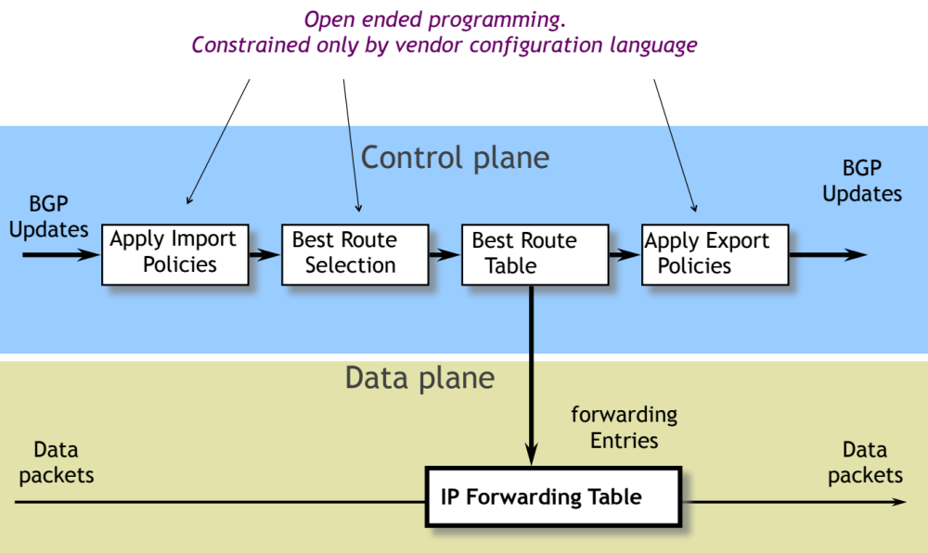
Update processing
Image credit Rachit Agarwal

Slide 16
AS relationships
Customer pays provider for connectivity
  E.g. Brown contracts with OSHEAN
  Customer is stub, provider is a transit
Many customers are multi-homed
  E.g., OSHEAN connects to Level3, Cogent
Typical policies:
  Provider tells all neighbors how to reach customer
  Provider wants to send traffic to customers ($$$)
  Customer does not provide transit service

Slide 17
Peer Relationships
Peer ASs agree to exchange traffic for free
  Penalties/Renegotiate if imbalance
Tier 1 ISPs have no default route: all peer with each other
You are Tier i + 1 if you have a default route to a Tier i
Typical policies
  AS only exports customer routes to peer
  AS exports a peer’s routes only to its customers
  Goal: avoid being transit when no gain

Slide 18
Typical route selection policy
In decreasing priority order:
Make or save money (send to customer > peer > provider)
Try to maximize performance (smallest AS path length)
Minimize use of my network bandwidth (“hot potato routing”
…
Notes:
Lots of other BGP attributes
Smallest AS path might not be shortest path (networks may have different sizes)

Slide 19
Gao-Rexford Model
(simplified) Two types of relationships: peers and customer/provider
Export rules:
  Customer route may be exported to all neighbors
  Peer or provider route is only exported to customers
Preference rules:
  Prefer routes through customer ($$)
If all ASes follow this, shown to lead to stable network

Slide 20
An example

Slide 21
Typical Export Policy
Destination prefix advertised by… | Export route to…
Customer | Everyone (providers, peers, other customers…)
Peer | Customers only
Provider | Customers only
Known as Gao-Rexford principles: define common practices for AS relationships

Slide 22
B
X
A
Z
C
Y
How to prevent X from forwarding transit between B and C?
How to avoid transit between CBA ?
Example from Kurose and Ross, 5th Ed
Notes:
Another way to look at it is like this…
Customer, peer
X sends to Y over C, sends to Z over BA. What happens if B sends a packet to X with destination at Y?
X should never advertise any paths to B that include C.
B advertises BAZ to X
B should not advertise BAZ to C

Slide 23
What can go wrong?

Slide 24
How to advertise your prefixes?
Try to aggregate (summarize) prefixes for networks you own, but not always possible
More specific prefix => More preferred
=> Can have policy, security implications…

Slide 25
How to advertise your prefixes?
Try to aggregate (summarize) prefixes for networks you own, but not always possible
Problem: smaller allocations => more prefixes in table
=> Forwarding table size limited by fast memory (TCAM) inside routers

Slide 26
What can lead to table growth?
More addresses being allocated
Fragmentation
  Multihoming
  Change of ISPs
  Address re-selling

Slide 27
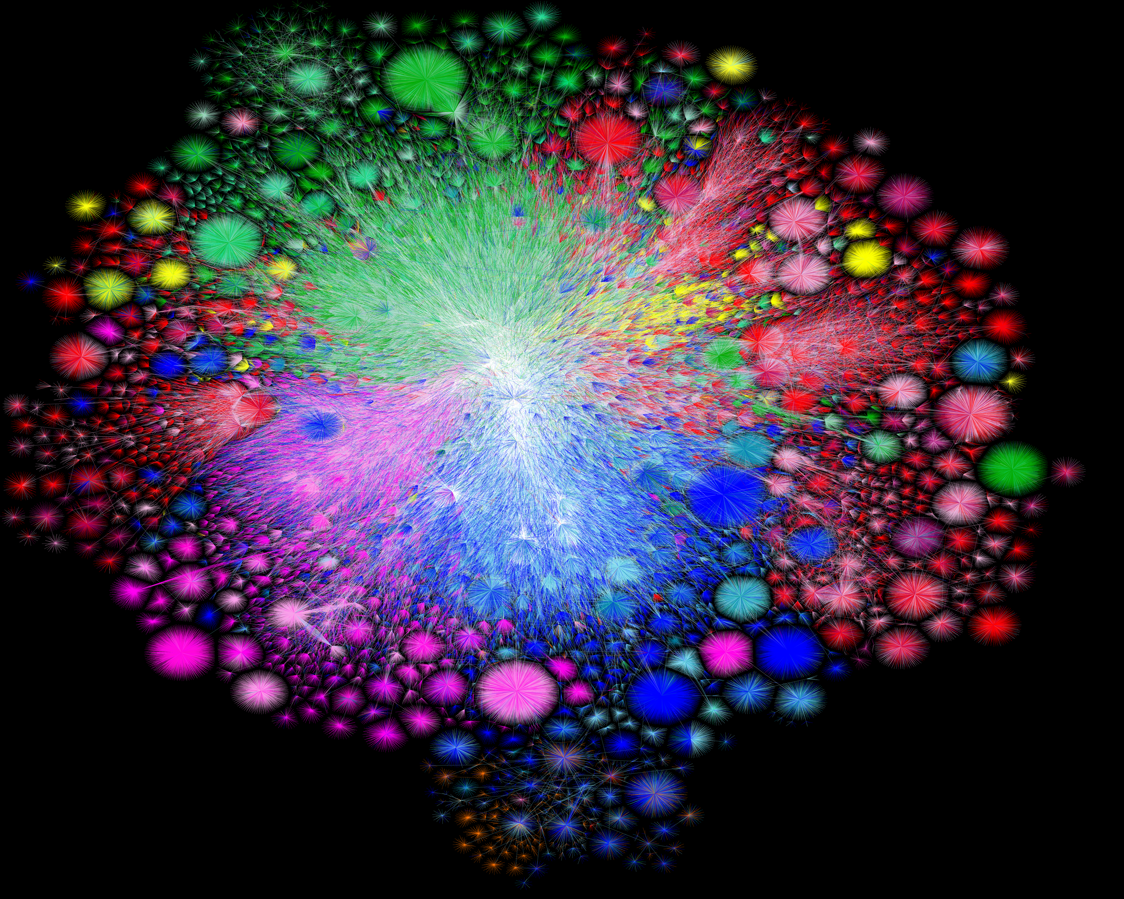
Map of the Internet, 2021 (via BGP)
OPTE project

Slide 28
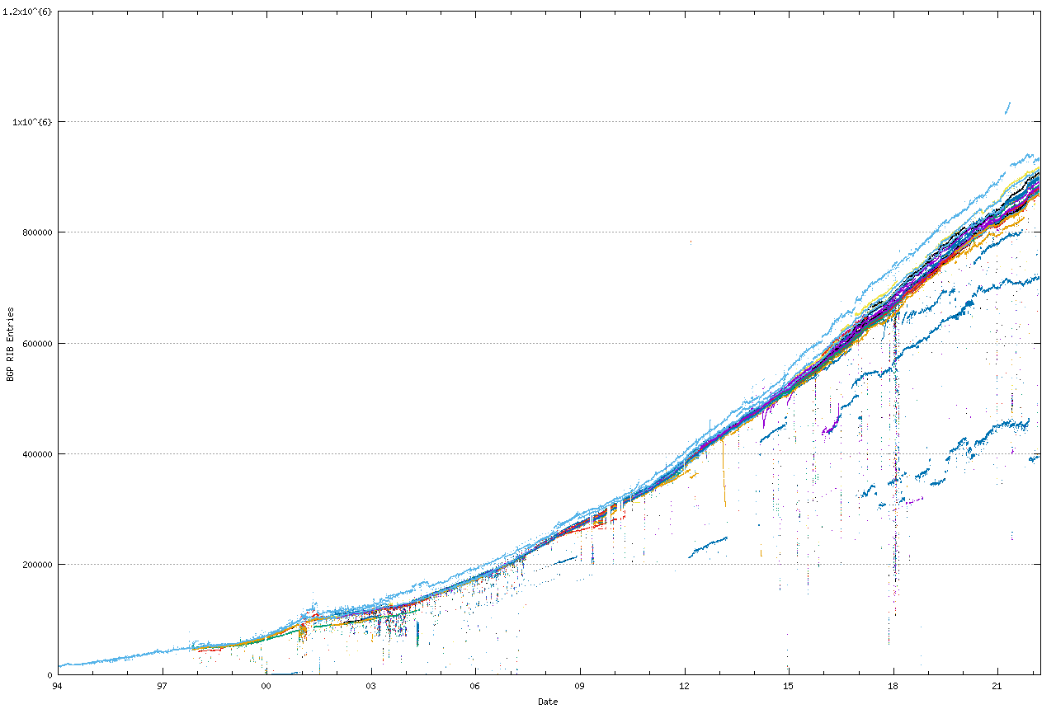
BGP Table Growth
Source: bgp.potaroo.net

Slide 29
BGP Table Growth for v6
Source: bgp.potaroo.net

Slide 30
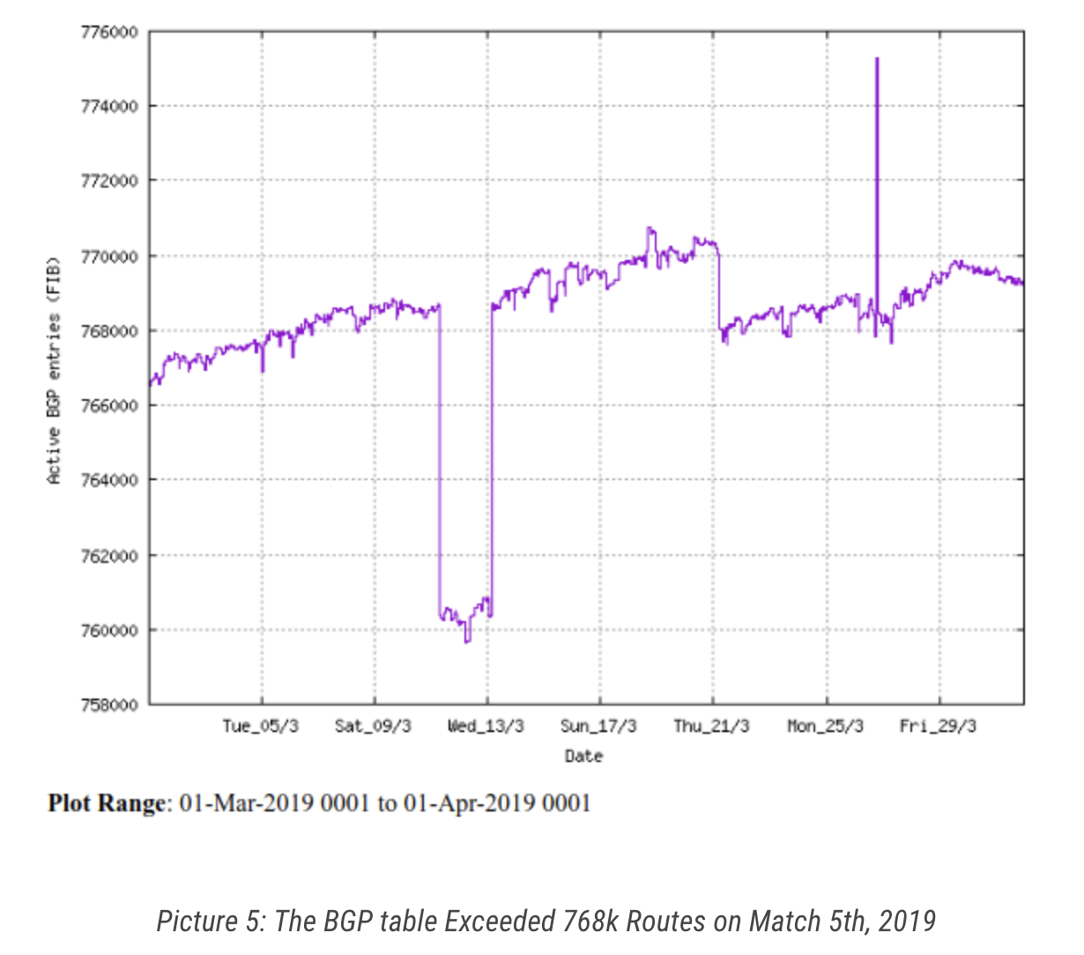
How big can the table get?
August 12, 2014: the full IPv4 BGP table reached 512k prefixes
March 5, 2019: 768k prefixes
Older routers run out of space => Outages

Slide 31
Peering Drama
Cogent vs. Level3 were peers
In 2003, Level3 decided to start charging Cogent
Cogent said no
Internet partition: Cogent’s customers couldn’t get to Level3’s customers and vice-versa
  Other ISPs were affected as well
Took 3 weeks to reach an undisclosed agreement

Slide 32
BGP can be fragile!
Individual router configurations and policy can affect whole network
Consequences sometimes disastrous…

Slide 33
Some BGP Challenges
Convergence
Traffic engineering
  How to assure certain routes are selected
Misconfiguration
Security
BGP can be fragile! One router configuration can affect a large portion of the network

Slide 34
BGP Problems and Security Issues

Slide 35
BGP Recap
Key protocol that holds Internet routing together
Path Vector Protocol among Autonomous Systems (ASes)
Route selection based on policy, rather than “optimal” routes
What can go wrong?
Notes:
We already learned about misconfiguration, now for security

Slide 36
Who owns a prefix?
Allocated by Internet authorities
  Regional Internet Registries (ARIN, RIPE, APNIC)
  Internet Service Providers
Ideally, AS who owns prefix (or its providers) should advertise it
However: BGP does not verify this

Slide 37
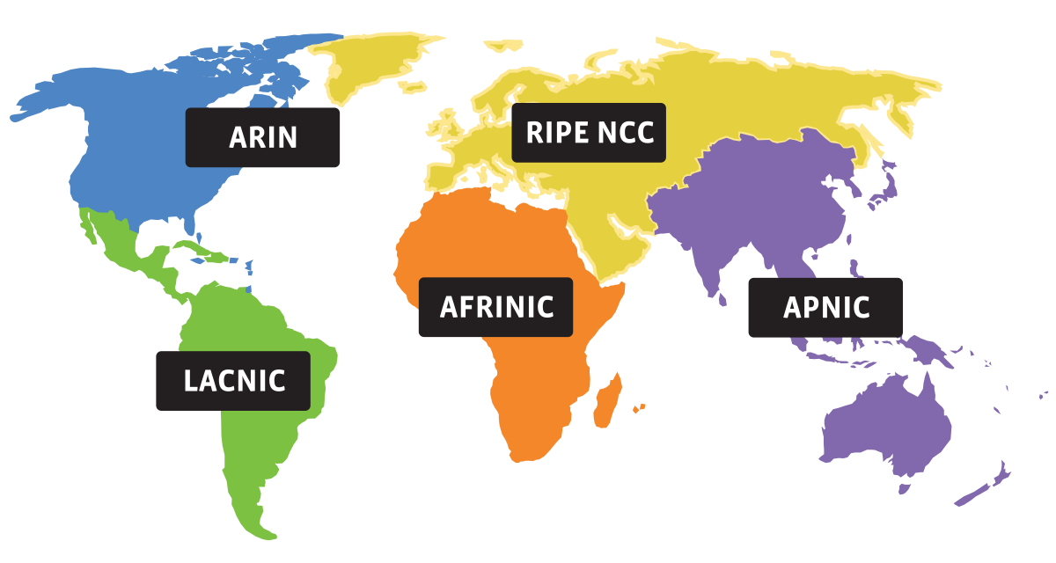
The Five RIRs

Slide 38
What can go wrong?

Slide 39

Prefix Hijacking
4
3
5
2
7
6
1
12.34.0.0/16
12.34.0.0/16
Consequences for the affected ASes
  Sinkhole: data traffic is discarded
  Snooping: data traffic is inspected, and then redirected
  Impersonation: data traffic is sent to bogus destinations

Slide 40
Hijacking is Hard to Debug
Real origin AS doesn’t see the problem
  Picks its own route
  Might not even learn the bogus route
May not cause loss of connectivity
  E.g., if the bogus AS snoops and redirects
  … may only cause performance degradation
Or, loss of connectivity is isolated
  E.g., only for sources in parts of the Internet
Diagnosing prefix hijacking
  Analyzing updates from many vantage points
  Launching traceroute from many vantage points

Slide 41
Sub-Prefix Hijacking
4
3
5
2
7
6
1
12.34.0.0/16
12.34.158.0/24
Originating a more-specific prefix
  Every AS picks the bogus route for that prefix
  Traffic follows the longest matching prefix

Slide 42
How to Hijack a Prefix
The hijacking AS has
  Router with eBGP session(s)
  Configured to originate the prefix
Getting access to the router
  Network operator makes configuration mistake
  Disgruntled operator launches an attack
  Outsider breaks into the router and reconfigures
Getting other ASes to believe bogus route
  Neighbor ASes not filtering the routes
  … e.g., by allowing only expected prefixes
  But, specifying filters on peering links is hard

Slide 43
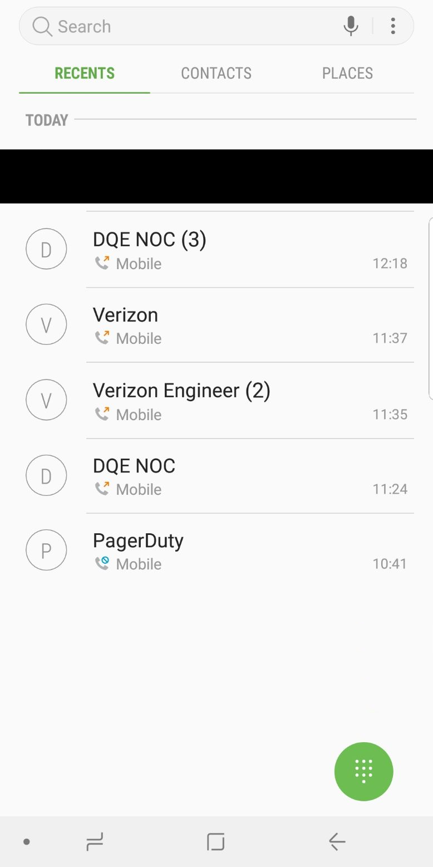
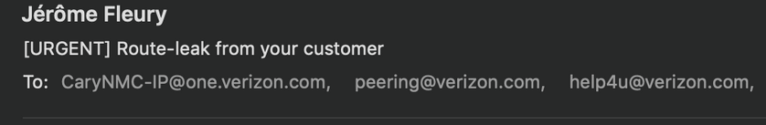
Some Notable incidents
June 24, 2019: Misconfigured small customer router accepted lots of transit traffic
At this level, solving problems involves a lot of human expertise!

Slide 44


Slide 45
Pakistan Youtube incident
Youtube’s has prefix 208.65.152.0/22
Pakistan’s government order Youtube blocked
Pakistan Telecom (AS 17557) announces 208.65.153.0/24 in the wrong direction (outwards!)
Longest prefix match caused worldwide outage
http://www.youtube.com/watch?v=IzLPKuAOe50

Slide 46
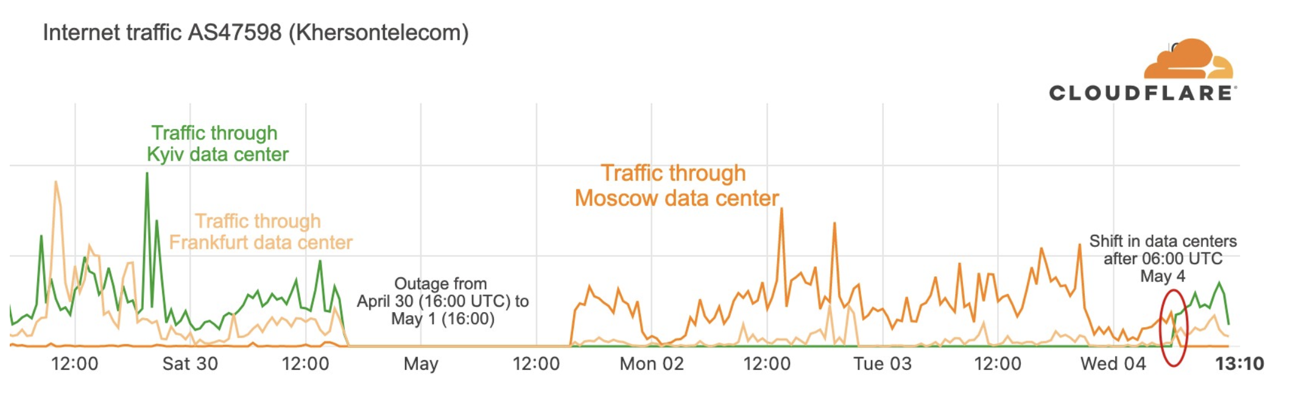
ISP outage in Russian-occupied city of Kherson, Ukraine
Comes back several days later… with traffic routed through a Russian ISP
https://blog.cloudflare.com/tracking-shifts-in-internet-connectivity-in-kherson-ukraine/

Slide 47
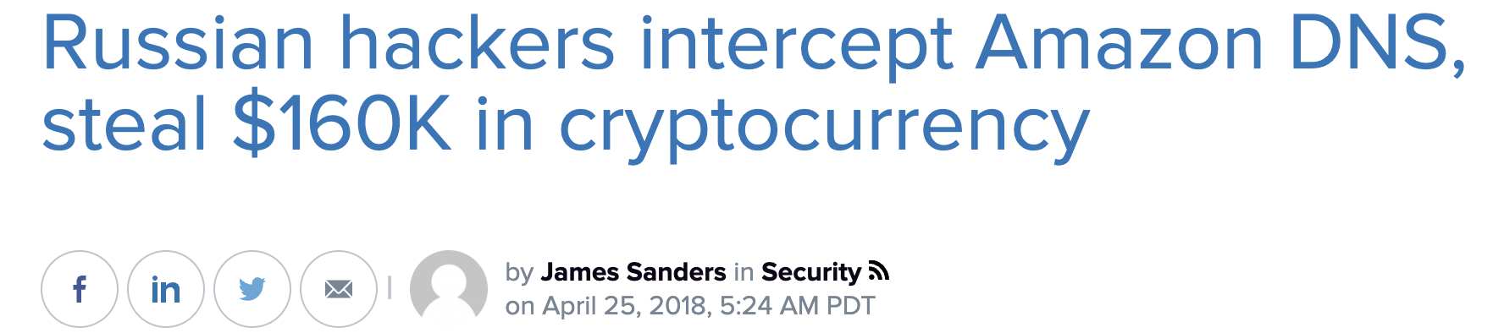
Many other incidents
China incident, April 8th 2010
  China Telecom’s AS23724 generally announces 40 prefixes
  On April 8th, announced ~37,000 prefixes
  About 10% leaked outside of China
  Suddenly, going to www.dell.com might have you routing through AS23724!

Slide 48
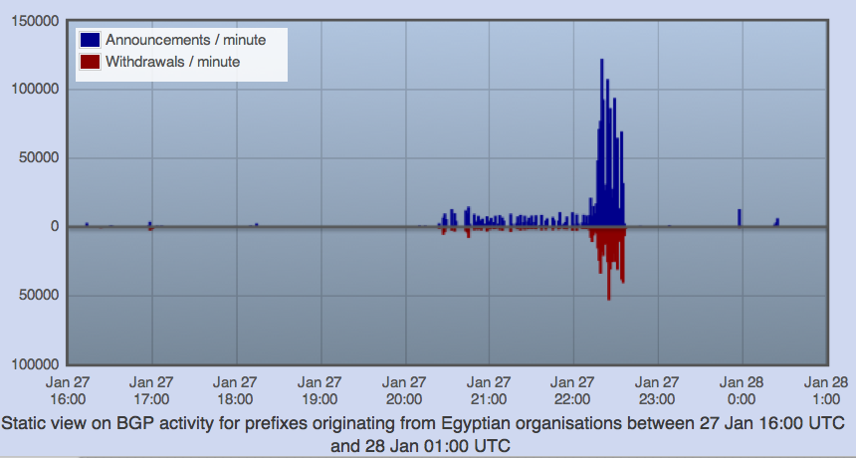
“Shutting off” the Internet
Starting from Jan 27th, 2011, Egypt was disconnected from the Internet
  2769/2903 networks withdrawn from BGP (95%)!
Source: RIPEStat - http://stat.ripe.net/egypt/

Slide 49
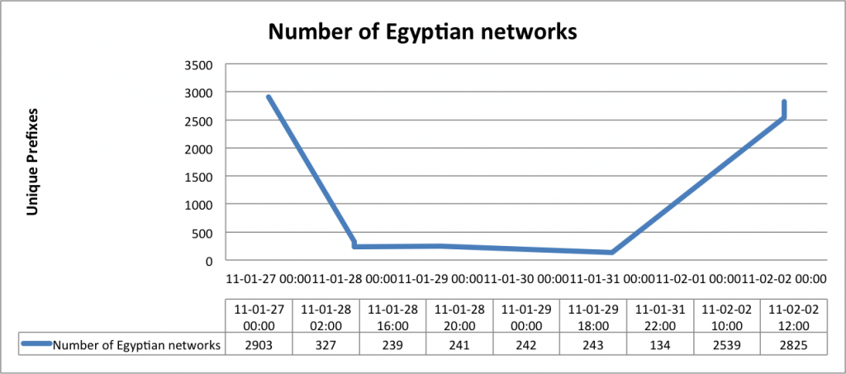
Egypt Incident
Source: BGPMon (http://bgpmon.net/blog/?p=480)

Slide 50
What can be done?
Originally: Internet Routing Registries (IRRs): public database listing IP allocations
But, database not verified and often incomplete/wrong
route: 10.0.0.0/8
descr: University of Blogging
descr: Anytown, USA
origin: AS65099
mnt-by: MNT-UNIVERSITY
notify: person@example.com
changed: person@example.com 20180101
source: RADB

Slide 51
What can be done?
$whois -h whois.radb.net AS14325
aut-num: AS14325
as-name: ASN-OSHEAN
descr: OSHEAN, Inc.
import: from AS14325:AS-MBRS accept PeerAS
mp-import: from AS14325:AS-MBRS accept PeerAS
export: to AS-ANY announce AS14325:AS-MBRS
mp-export: to AS-ANY announce AS14325:AS-MBRS
admin-c: Tim Rue
tech-c: Ventsislav Gotov
notify: vgotov@oshean.org
mnt-by: MAINT-AS14325
changed: vgotov@oshean.org 20210512
source: RADB

Slide 52
Proposed Solution: RPKI
Based on a public key infrastructure
Address attestations
  Claims the right to originate a prefix
  Signed and distributed out of band, checked on BGP updates
  Checked through delegation chain from ICANN
Can avoid
  Prefix hijacking
  Addition, removal, or reordering of intermediate ASes

Slide 53
Proposed Solution: RPKI
Every AS adds signature of its route info in database
  Max prefix size, etc.
Other ASes using routes can cryptographically verify advertised routes against signature
Can avoid
  Prefix hijacking
  Addition, removal, or reordering of intermediate ASes

Slide 54
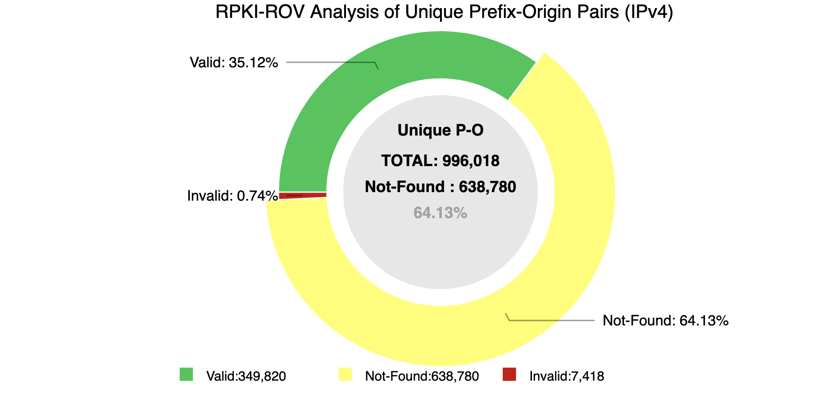
RPKI deployment

Slide 55
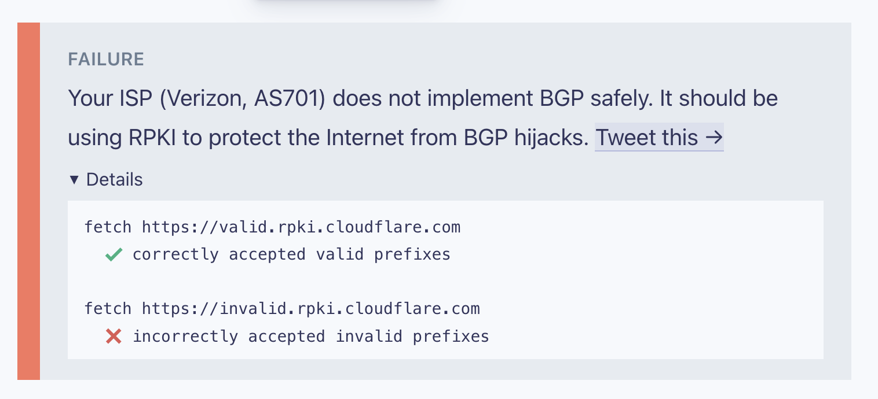
RPKI at Brown?

Slide 56
Following slides not covered, but interesting

Slide 57
BGP Protocol Details
BGP speakers: nodes that communicates with other ASes over BGP
Speakers connect over TCP on port 179
Exact protocol details are out of scope for this class; most important messages have type UPDATE

Slide 58
Prefixes
Nodes in local network share prefix
  Key to decide whether to send message locally
Prefixes can also aggregate multiple networks
  E.g., 100.20.33.128/25, 100.20.33.0/25 -> 100.20.33.0/24
If networks connected hierarchically, can have significant aggregation
But allocations aren’t so hierarchical… what does this mean?

Slide 59
BGP Messages
Base protocol has four message types
  OPEN – Initialize connection. Identifies peers and must be first message in each direction
  UPDATE – Announce routing changes (most important message)
  NOTIFICATION – Announce error when closing connection
  KEEPALIVE – Make sure peer is alive
Extensions can define more message types
  E.g., ROUTE-REFRESH [RFC 2918]
Notes:
Exact protocol details not important

Slide 60
Anatomy of an UPDATE
Withdrawn routes: list of withdrawn IP prefixes
Network Layer Reachability Information (NLRI)
  List of prefixes to which path attributes apply
Path attributes
  ORIGIN, AS_PATH, NEXT_HOP, MULTI-EXIT-DISC, LOCAL_PREF, ATOMIC_AGGREGATE, AGGREGATOR, …
  Extensible: can add new types of attributes

Slide 61
Example
NLRI: 128.148.0.0/16
AS-Path: ASN 44444 3356 14325 11078
Next Hop IP
Various knobs for traffic engineering:
  Metric, weight, LocalPath, MED, Communities
  Lots of voodoo
Notes:
MED is multiple exit discriminator
Communities may limit the scope of advertisements

Slide 62
Demo: AS11078

Slide 63
BGP Security Goals
Confidential message exchange between neighbors
Validity of routing information
  Origin, Path, Policy
Correspondence to the data path

Slide 64
Origin: IP Address Ownership and Hijacking
IP address block assignment
  Regional Internet Registries (ARIN, RIPE, APNIC)
  Internet Service Providers
Proper origination of a prefix into BGP
  By the AS who owns the prefix
  … or, by its upstream provider(s) in its behalf
However, what’s to stop someone else?
  Prefix hijacking: another AS originates the prefix
  BGP does not verify that the AS is authorized
  Registries of prefix ownership are inaccurate

Slide 65
Prefix Hijacking
4
3
5
2
7
6
1
12.34.0.0/16
12.34.0.0/16
Consequences for the affected ASes
  Blackhole: data traffic is discarded
  Snooping: data traffic is inspected, and then redirected
  Impersonation: data traffic is sent to bogus destinations

Slide 66
Hijacking is Hard to Debug
Real origin AS doesn’t see the problem
  Picks its own route
  Might not even learn the bogus route
May not cause loss of connectivity
  E.g., if the bogus AS snoops and redirects
  … may only cause performance degradation
Or, loss of connectivity is isolated
  E.g., only for sources in parts of the Internet
Diagnosing prefix hijacking
  Analyzing updates from many vantage points
  Launching traceroute from many vantage points

Slide 67
Sub-Prefix Hijacking
4
3
5
2
7
6
1
12.34.0.0/16
12.34.158.0/24
Originating a more-specific prefix
  Every AS picks the bogus route for that prefix
  Traffic follows the longest matching prefix

Slide 68
How to Hijack a Prefix
The hijacking AS has
  Router with eBGP session(s)
  Configured to originate the prefix
Getting access to the router
  Network operator makes configuration mistake
  Disgruntled operator launches an attack
  Outsider breaks into the router and reconfigures
Getting other ASes to believe bogus route
  Neighbor ASes not filtering the routes
  … e.g., by allowing only expected prefixes
  But, specifying filters on peering links is hard

Slide 69
Recent Notable incidents
October 4 2021: Facebook accidentally removed routes for its DNS servers
  Outside world couldn’t resolve facebook.com, and neither could Facebook!
June 24, 2019: Misconfigured router accepted lots of transit traffic

Slide 70
“Shutting off” the Internet
Starting from Jan 27th, 2011, Egypt was disconnected from the Internet
  2769/2903 networks withdrawn from BGP (95%)!
Source: RIPEStat - http://stat.ripe.net/egypt/

Slide 71
Egypt Incident
Source: BGPMon (http://bgpmon.net/blog/?p=480)

Slide 72
Pakistan Youtube incident
Youtube’s has prefix 208.65.152.0/22
Pakistan’s government order Youtube blocked
Pakistan Telecom (AS 17557) announces 208.65.153.0/24 in the wrong direction (outwards!)
Longest prefix match caused worldwide outage
http://www.youtube.com/watch?v=IzLPKuAOe50

Slide 73
Many other incidents
Spammers steal unused IP space to hide
  Announce very short prefixes (e.g., /8). Why?
  For a short amount of time
China incident, April 8th 2010
  China Telecom’s AS23724 generally announces 40 prefixes
  On April 8th, announced ~37,000 prefixes
  About 10% leaked outside of China
  Suddenly, going to www.dell.com might have you routing through AS23724!

Slide 74
Attacks on BGP Paths
Remove an AS from the path
  E.g., 701 3715 88 -> 701 88
Why?
  Attract sources that would normally avoid AS 3715
  Make path through you look more attractive
  Make AS 88 look like it is closer to the core
  Can fool loop detection!
May be hard to tell whether this is a lie
  88 could indeed connect directly to 701!
Notes:
Let’s say you want to make other Ases prefer your routes.

Slide 75
Attacks on BGP Paths
Adding ASes to the path
  E.g., 701 88 -> 701 3715 88
Why?
  Trigger loop detection in AS 3715
    This would block unwanted traffic from AS 3715!
  Make your AS look more connected
Who can tell this is a lie?
  AS 3715 could, if it could see the route
  AS 88 could, but would it really care?

Slide 76
Attacks on BGP Paths
Adding ASes at the end of the path
  E.g., 701 88 into 701 88 3
Why?
  Evade detection for a bogus route (if added AS is legitimate owner of a prefix)
Hard to tell that the path is bogus!
701
3
18.0.0.0/8
88
18.0.0.0/8
Notes:
Let’s say 88 wants to hijack a route to a prefix it does not own

Slide 77
Proposed Solution: S-BGP
Based on a public key infrastructure
Address attestations
  Claims the right to originate a prefix
  Signed and distributed out of band
  Checked through delegation chain from ICANN
Route attestations
  Attribute in BGP update message
  Signed by each AS as route along path
S-BGP can avoid
  Prefix hijacking
  Addition, removal, or reordering of intermediate ASes

Slide 78
S-BGP Deployment
Very challenging
  PKI (RPKI)
  Accurate address registries
  Need to perform cryptographic operations on all path operations
  Flag day almost impossible
  Incremental deployment offers little incentive
But there is hope! [Goldberg et al, 2011]
  Road to incremental deployment
  Change rules to break ties for secure paths
  If a few top Tier-1 ISPs
    Plus their respective stub clients deploy simplified version (just sign, not validate)
    Gains in traffic => $ => adoption!

Slide 80
Data Plane Attacks
Routers/ASes can advertise one route, but not necessarily follow it!
May drop packets
  Or a fraction of packets
  What if you just slow down some traffic?
Can send packets in a different direction
  Impersonation attack
  Snooping attack
How to detect?
  Congestion or an attack?
  Can let ping/traceroute packets go through
  End-to-end checks?
Harder to pull off, as you need control of a router

Slide 81
BGP Recap
Key protocol that holds Internet routing together
Path Vector Protocol among Autonomous Systems
Policy, feasibility first; non-optimal routes
Important security problems

Slide 82
Next Class
Network layer wrap up

Slide 83
BGP State
BGP speaker conceptually maintains 3 sets of state
Adj-RIB-In
  “Adjacent Routing Information Base, Incoming”
  Unprocessed routes learned from other BGP speakers
Loc-RIB
  Contains routes from Adj-RIB-In selected by policy
  Must know how to reach first hop
Adj-RIB-Out
  Subset of Loc-RIB to be advertised to peer speakers
  Can be different for each peer

Slide 84
BGP State
RIBIn ⊃ LocRIB ⊃ RIBOut
RIBIn
LocRIB
RIBOut
(for each peer)
Announcements
from peers

Slide 85
Recall: BGP mechanics
Path-vector protocol
Exchange prefix reachability with neighbors (ASes)
  E.g., “I can reach prefix 128.148.0.0/16 through ASes 44444 3356 14325 11078”
Select routes to propagate to neighbors based on routing policy, not shortest-path costs
Today: Policies and implications

Slide 86
Convergence
Given a change, how long until the network re-stabilizes?
  Depends on change: sometimes never
  Open research problem: “tweak and pray”
  Distributed setting is challenging
Some reasons for change
  Topology changes
  BGP session failures
  Changes in policy
  Conflicts between policies can cause oscillation
Notes:
Why is this a problem? Because of policies, not shortest-path-routing

Slide 87
Routing Change: Before and After
0
0
(1,0)
(2,0)
(2,0)
(1,2,0)
1
2
1
2
(3,1,0)
(3,2,0)
3
3

Slide 88
Routing Change: Path Exploration
AS 1
  Delete the route (1,0)
  Switch to next route (1,2,0)
  Send route (1,2,0) to AS 3
AS 3
  Sees (1,2,0) replace (1,0)
  Compares to route (2,0)
  Switches to using AS 2
0
(2,0)
(1,2,0)
1
2
(3,2,0)
3

Slide 89
Routing Change: Path Exploration
Initial situation
  Destination 0 is alive
  All ASes use direct path
When destination dies
  All ASes lose direct path
  All switch to longer paths
  Eventually withdrawn
E.g., AS 2
  (2,0) → (2,1,0)
  (2,1,0) → (2,3,0)
  (2,3,0) → (2,1,3,0)
  (2,1,3,0) → null
Convergence may be slow!
(2,0)
(2,1,0)
(2,3,0)
(2,1,3,0)
(1,0)
(1,2,0)
(1,3,0)
1
2
0
3
(3,0)
(3,1,0)
(3,2,0)

Slide 90
Route Engineering
Route filtering
Setting weights
More specific routes: longest prefix
AS prepending: “477 477 477 477”
More of an art than science
Notes:
You can break a prefix into two, to get preference
You can make a path longer to avoid selection

Slide 91
Unstable Configurations
Due to policy conflicts (Dispute Wheel)
2 1 0
2 0
2
4
0
3 2 0
3 0
1 3 0
1 0
1
3
3
Notes:
Boxes denote route preferences.
Start with the direct routes, from an announcement from 0.
All nodes choose the direct route and advertise it.
Solution is tricky!

Slide 92
Avoiding BGP Instabilities
Detecting conflicting policies
  Centralized: NP-Complete problem!
  Distributed: open research problem
  Requires too much cooperation
Detecting oscillations
  Monitoring for repetitive BGP messages
Restricted routing policies and topologies
  Some topologies / policies proven to be safe*
* Gao & Rexford, “Stable Internet Routing
without Global Coordination”, IEEE/ACM ToN, 2001

Slide 93
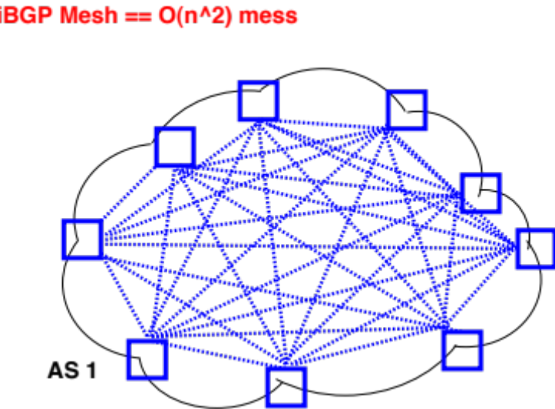
Scaling iBGP: route reflectors

Slide 94
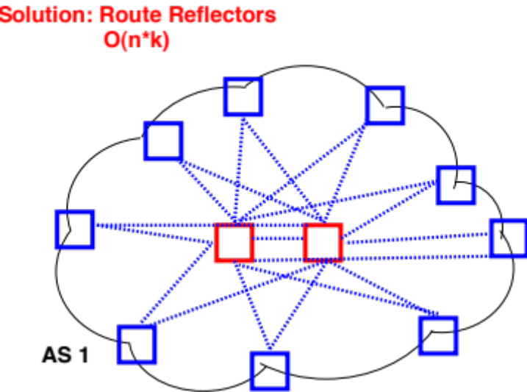
Scaling iBGP: route reflectors

Slide 95
Multiple Stable Configurations
BGP Wedgies [RFC 4264]
Typical policy:
  Prefer routes from customers
  Then prefer shortest paths

Slide 96
BGP Wedgies
3 4 5 1
3
4
4 5 1
2 3 4 5 1
5 1
2
5
1.2.0.0/16: 1 1 1 1
(Backup Path)
1
1.2.0.0/16: 1
Primary Path

Slide 97
BGP Wedgies
3 2 1 1 1 1
3
4
4 3 2 1 1 1 1
2 1 1 1 1
5 4 3 2 1 1 1 1
2
5
1.2.0.0/16: 1 1 1 1
(Backup Path)
1
1.2.0.0/16: 1
Primary Path

Slide 98
BGP Wedgies
3 prefers customer route: stable configuration!
3 2 1 1 1 1
3
4
4 5 1
2 1 1 1 1
5 1
2
5
1.2.0.0/16: 1 1 1 1
(Backup Path)
1
1.2.0.0/16: 1
Primary Path

Slide 99
Warmup for discussion
Given this routing table, to which
prefix would a router map each IP?
1.2.3.4
138.16.100.5
138.16.10.200
12.34.5.120
12.34.18.5
Prefix | Next Hop
1.0.0.0/8 | …
12.34.0.0/16 | …
12.34.16.0/20 | …
138.16.0.0/16 | …
138.16.100.0/24 | …

Slide 100
Longest Prefix Match
When performing a forwarding table lookup, select the most specific prefix that matches an address
Eg. 12.34.18.5
Prefix | Next Hop
1.0.0.0/8 | …
12.34.0.0/16 | …
12.34.16.0/20 | …
138.16.0.0/16 | …
138.16.100.0/24 | …
Internet routers have specialized memory called TCAM (Ternary Content Addressable Memory) to do longest prefix match fast (one clock cycle!)
Goal: forward at line rate (as fast as link allows)
Notes:
TCAM is very expensive
1.2.3.4
138.16.100.5
138.16.10.200
12.34.5.120
12.34.18.5
12.34.18.5

