Slide 1
CSCI-1680
Network Layer:
IP Forwarding realities
Nick DeMarinis
Based partly on lecture notes by Rodrigo Fonseca, David Mazières, Phil Levis, John Jannotti

Slide 2
Administrivia
Sign up for IP milestone meetings, preferably with your mentor TA, on or before Friday (Oct 6)
  You don’t need to show an implementation, but you are expected to talk about your design
  Look for calendar link in email
IP gearup II: Thursday 5-7pm in CIT368
  Implementation and debugging tips
HW1: Due Thursday (HW2 out either Thursday or next Tues)

Slide 3
Today
“Wrinkles” in IP forwarding
Longest Prefix Match
IP<->Link layer (ARP, DHCP)
Network Address Translation (NAT)
IPv6
After this: Routing

Slide 4

Default
Network A: 82.14.0.0/16
B: 1.3.0.0/16
D: 5.6.128.0/20
C: 1.3.25.0/24
Prefix | IF/Next hop
82.14.0.0/16 | (A)
1.3.0.0/16 | (B)
1.3.4.0/24 | (C)
5.6.128.0/20 | (D)
0.0.0.0/0 | (Default)
Warmup: based on the table, where would the router send packets destined for the following addresses:
5.6.128.100
1.3.1.1
8.8.8.8
1.3.4.8
(X) is placeholder—could be an IP or an interface name

Slide 5
What happens when prefixes overlap?
Prefix | IF/Next hop
1.3.0.0/16 | (B)
1.3.4.0/24 | (C)
1.3.4.5/32
0.0.0.0/0 | (Default)
An IP can match on more than one row
=> need to pick the most specific (longest) prefix
1.3.0.0/16
00000001 00000011 xxxxxxxx xxxxxxxx
1.3.4.0/24
00000001 00000011 00000100 xxxxxxxx

Slide 6
What happens when prefixes overlap?
Prefix | IF/Next hop
1.3.0.0/16 | (B)
1.3.4.0/24 | (C)
1.3.4.5/32
0.0.0.0/0 | (Default)
An IP can match on more than one row
=> need to pick the most specific (longest) prefix
1.3.0.0/16
00000001 00000011 xxxxxxxx xxxxxxxx
1.3.4.0/24
00000001 00000011 00000100 xxxxxxxx
More specific => best match!

Slide 7
What happens when prefixes overlap?
Prefix | IF/Next hop
1.3.0.0/16 | (B)
1.3.4.0/24 | (C)
1.3.4.5/32
0.0.0.0/0 | (Default)
An IP can match on more than one row
=> need to pick the most specific (longest) prefix
1.3.0.0/16
00000001 00000011 xxxxxxxx xxxxxxxx
1.3.4.0/24
00000001 00000011 00000100 xxxxxxxx
More specific => best match!
Other examples you’ll see…
0.0.0.0/0
xxxxxxxx xxxxxxxx xxxxxxxx xxxxxxxx
1.2.3.5/32
00000001 00000011 00000100 00000101

Slide 8
What happens when prefixes overlap?
Prefix | IF/Next hop
1.3.0.0/16 | (B)
1.3.4.0/24 | (C)
1.3.4.5/32
0.0.0.0/0 | (Default)
An IP can match on more than one row
=> need to pick the most specific (longest) prefix
1.3.0.0/16
00000001 00000011 xxxxxxxx xxxxxxxx
1.3.4.0/24
00000001 00000011 00000100 xxxxxxxx
More specific => best match!
Other examples you’ll see…
0.0.0.0/0
xxxxxxxx xxxxxxxx xxxxxxxx xxxxxxxx
=> Least specific!
(Used for default “catchall” routes)
1.2.3.5/32
00000001 00000011 00000100 00000101
=> Most specific!
(Refers to a single host,
often a local IP)

Slide 9
What happens when prefixes overlap?
Prefix | IF/Next hop
1.3.0.0/16 | (B)
1.3.4.0/24 | (C)
1.3.4.5/32
0.0.0.0/0 | (Default)
An IP can match on more than one row
=> need to pick the most specific (longest) prefix
1.3.0.0/16
00000001 00000011 xxxxxxxx xxxxxxxx
1.3.4.0/24
00000001 00000011 00000100 xxxxxxxx
More specific => best match!
Other examples you’ll see…
0.0.0.0/0
xxxxxxxx xxxxxxxx xxxxxxxx xxxxxxxx
=> Least specific!
(Used for default “catchall” routes)
1.2.3.5/32
00000001 00000011 00000100 00000101
=> Most specific!
(Refers to a single host,
often a local IP)
=>Longest prefix matching: can keep forwarding tables small by summarizing routes where possible, otherwise using specific prefixes

Slide 10

What happens at the link layer?
IF0
What does it mean to send to IF1?
IF1
IF2
1.2.1.3
1.2.2.100
1.2.1.1
1.2.2.1
The story so far:
=>Can “easily” communicate with nodes on the same network,
but what about other networks?
=> Routers know about multiple networks, forward packets between them
Prefix | IF/Next hop
1.2.1.0/24 | IF1
1.2.2.0/24 | IF2
8.0.0.0/30 | IF0
Default | 8.0.0.2

Slide 11
“Local delivery”:
what does it mean to send to IF1?
Src: 1.2.4.100
Dst: 1.2.1.3
. . .
1.2.1.2
So far: “easy” to communicate with nodes on the same network. But how?
To send a packet on a local network, we need:
Dest. IP (Network layer)
Dest. MAC address (Link layer)
Assume: link layer can figure out the rest once we fill in this info
IF1
1.2.1.3
1.2.1.1
 | Src | Dest
Link |  | ???
IP | 10.2.4.100 | 1.2.1.3
1.2.1.200
Subnet “A”: 1.2.1.0/24
Prefix | IF/Next hop
1.2.1.0/24 | IF1
… | …
=> How do we get the MAC address?
Notes:
Let’s first look at how we move packets between the two networks

Slide 12
“Glue” between L2 and L3
Need a way to connect get link layer info (mac address) from network-layer info (IP address)
“What MAC address has IP 1.2.3.4?”
Ask the network!
=> Address Resolution Protocol (ARP)

Slide 13
ARP: Address resolution protocol
Given an IP address, ask network for the MAC address
Maps IP addresses to mac addresses
  Request: “Who has 1.2.3.4?”
  Response: “aa:bb:cc:dd:ee:ff is at 1.2.3.4”
ARP table: hosts cache IP->mac mappings
Requests send to broadcast address: ff:ff:ff:ff:ff:ff
  Anyone can respond: problem?

Slide 14
A
bb:bb:bb:bb:bb:bb
(1.2.1.3)
A
aa:aa:aa:aa:aa:aa
(1.2.1.1)
Src Dst
Eth …:aa:aa:aa ff:ff:ff:ff:ff:ff
Who has 1.2.1.3?
Src Dst
Eth …:bb:bb:bb …:aa:aa:aa
1.2.1.3 is at bb:bb:bb:bb:bb:bb
Request is sent to broadcast address!
Anyone can respond. Problem?

Slide 15
Example
# arp -n
Address HWtype HWaddress Flags Mask Iface
172.17.44.1 ether 00:12:80:01:34:55 C eth0
172.17.44.25 ether 10:dd:b1:89:d5:f3 C eth0
172.17.44.6 ether b8:27:eb:55:c3:45 C eth0
172.17.44.5 ether 00:1b:21:22:e0:22 C eth0
Notes:
arp -an
netstat -rn

Slide 16
1.2.1.2
IF0
1.2.2.100
IF1
IF2
1.2.1.3
1.2.1.1
1.2.2.1
1.2.2.105
Subnet “B”: 1.2.2.0/24
1.2.1.200
Subnet “A”: 1.2.1.0/24
Notes:
Let’s first look at how we move packets between the two networks

Slide 17
End-to-end Principle
Keep the network layer simple
Application-specific features/requirements should by implemented by end hosts
  Reliability, security
  Application-specific functionality
Why?
Easier to implement, eg, reliability with end-to-end view
Easier for network layer to scale
Can implement new protocols without changing network

Slide 18
How do you get an IP address?

Slide 19
Getting an IP
Two ways to configure an IP:
Static configuration: manually specify IP address, mask, gateway, …
Automatic: ask the network for an IP when you connect!

Slide 20
Getting an IP
Two ways to configure an IP for a host:
Static configuration: manually specify IP address, mask, gateway, …
=> More common with network devices that don’t change often
Automatic: ask the network for an IP when you connect!
    => Most common for end hosts
    => Dynamic Host Configuration Protocol (DHCP)

Slide 21
DHCP: The idea
Networks are free to assign addresses within block to hosts
Solution: Dynamic Host Configuration Protocol
  Client: DHCP Discover to 255.255.255.255 (broadcast)
  Server(s): DHCP Offer to 255.255.255.255 (why broadcast?)
  Client: choose offer, DHCP Request (broadcast, why?)
  Server: DHCP ACK (again broadcast)
Result: address, gateway, netmask, DNS server

Slide 22
DHCP: The idea
Every network has a “pool” of IPs it can assign to hosts
  Some subset of its prefix (eg. 192.168.1.0/24)
When a host connects, it asks a DHCP server for an address from the pool
DHCP server(s) act like allocators: give “leases” to IPs, provide other config info

Slide 23
Host A
DHCP server
Src: A's MAC address
Dst: ff:ff:ff:ff:ff:ff
DHCPDISCOVER
Src: <Server MAC address>
Dst: ff:ff:ff:ff:ff:Ff
DHCPOFFER:
Your IP: 192.168.1.102
Mask: 255.255.255.0
Router: 192.168.1.1
...
(More steps after this)
=> Again, host needs to use broadcast address. Why?
=> Problem?

Slide 24
Obtaining Host IP Addresses - DHCP
Networks are free to assign addresses within block to hosts
Tedious and error-prone: e.g., laptop going from CIT to library to coffee shop
Solution: Dynamic Host Configuration Protocol
  Client: DHCP Discover to 255.255.255.255 (broadcast)
  Server(s): DHCP Offer to 255.255.255.255 (why broadcast?)
  Client: choose offer, DHCP Request (broadcast, why?)
  Server: DHCP ACK (again broadcast)
Result: address, gateway, netmask, DNS server

Slide 25
Problems with DHCP?
What happens if a random host decides to be a DHCP server?

Slide 26
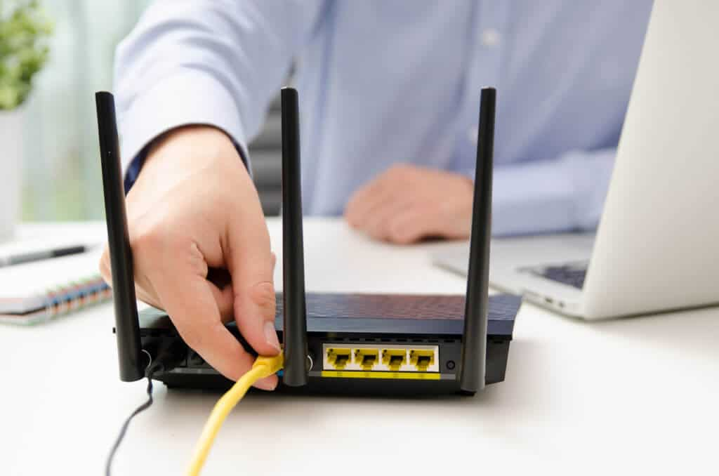
A home router
What’s in this thing?

Slide 27
Story time

Slide 28
About those home routers…
You get just one IP from your ISP…
=> Need to share IP among many devices on the same network!
Common to create a “private” IP range used within local network
=> Routers need to do extra work to share public IP among private IPs
=> Network Address Translation (NAT)
(A form of connection multiplexing)
Notes:
Address sharing

Slide 29
Private IPs (RFC1918)
Some IP ranges are reserved:
Many networks will use these blocks internally
These IPs should never be routed over the Internet!
  What would happen if they were?
Prefix | Use
127.0.0.0/8 | “Loopback” address—always for current host
10.0.0.0/8 | Reserved for private internal networks (RFC1918)
192.168.0.0/16 | IF2
172.16.0.0/12 | IF0

Slide 30
Network Address Translation
What happens when hosts need to share an IP address?
How to map private IP space to public IPs?
Notes:
Common in home routers

Slide 31
Network Address Translation (NAT)
Despite CIDR, it’s still difficult to allocate addresses
(2³² is only 4 billion)
NAT “hides” entire network behind one address
Hosts are given private addresses
Routers map outgoing packets to a free address/port
Router reverse maps incoming packets
Problems?
Notes:
Incoming flows
Shared ports
Breaks assumptions

Slide 32
NAT Example

Slide 33
Problems with NAT
Breaks end-to-end connectivity!
Technically a violation of layering
Need to do extra work at end hosts to establish end-to-end connection
  VoIP (Voice/Video conferencing)
  Games

Slide 34
NAT Traversal
Various methods, depending on the type of NAT
Examples:
ICE: Interactive Connectivity Establishment (RFC8445)
STUN: Session Traversal Utilities for NAT (RFC5389)
One idea: connect to external server via UDP, it tells you the address/port

Slide 35
IP challenge: Address space exhaustion
IP version 4: ~4 billion IP addresses
  World population: ~8 billion
  Est. number of devices on Internet (2021): >10-30 billion
Since 1990s: various tricks
  Smarter allocations by registrars
  Address sharing: Network Address Translation (NAT)
  DHCP
  Reclaiming unused space
Long term solution: IP version 6

Slide 36
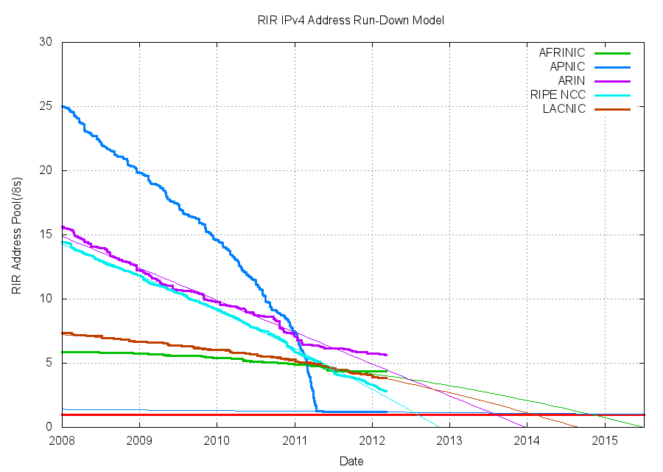
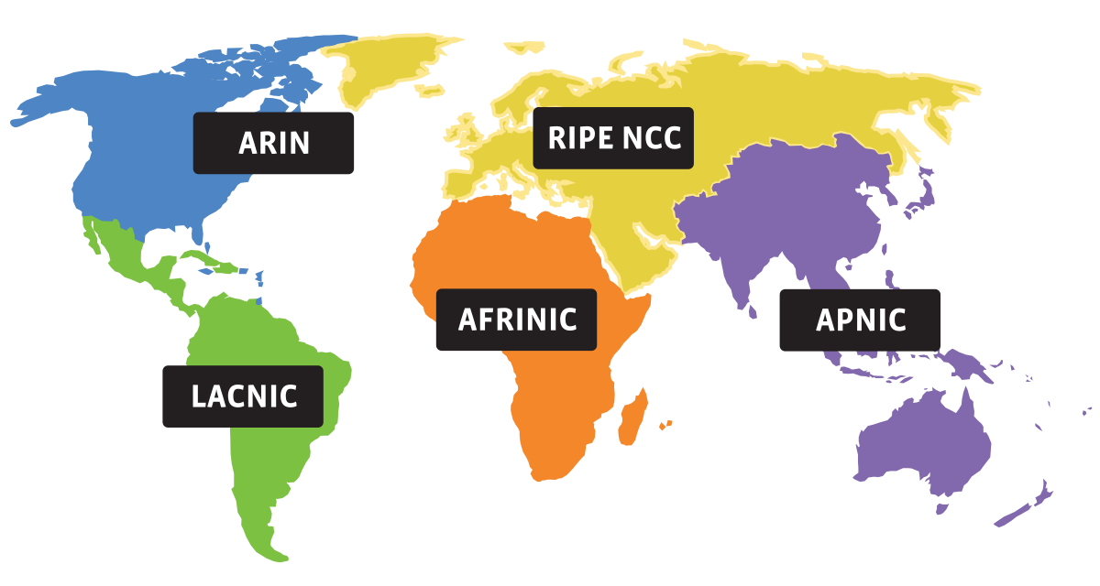
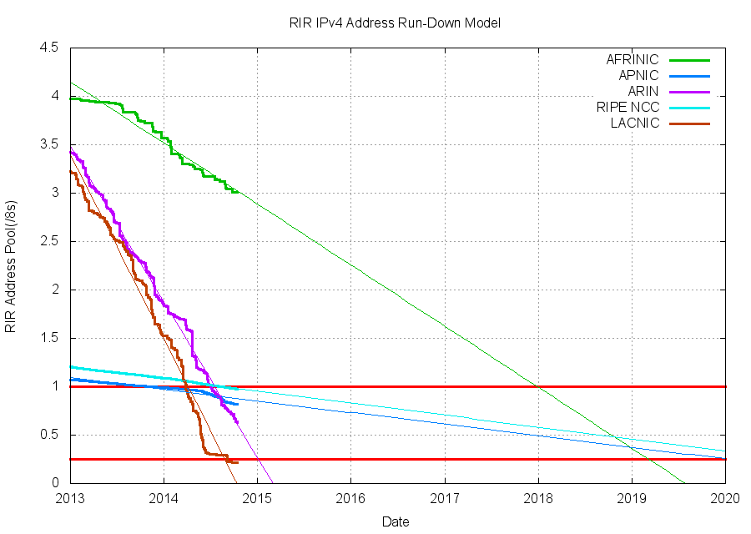
Source: potaroo.net/tools/ipv4
Notes:
Sorry the colors don’t line up

Slide 37
Source: potaroo.net/tools/ipv4

Slide 38
So what happened when we ran out of IPv4 addresses?
It’s not completely gone just yet, but close
Address block fragmentation
  Secondary market for IPv4
  E.g., in 2011 Microsoft bought >600K US IPv4 addresses for $7.5M
NATs galore
  Home NATs, carrier-grade NATs
Jun 2014

Slide 39
IPv6
Main motivation: IPv4 address exhaustion
Initial idea: larger address space
Need new packet format:
  REALLY expensive to upgrade all infrastructure!
  While at it, why don’t we fix a bunch of things in IPv4?
Work started in 1994, basic protocol published in 1998

Slide 40
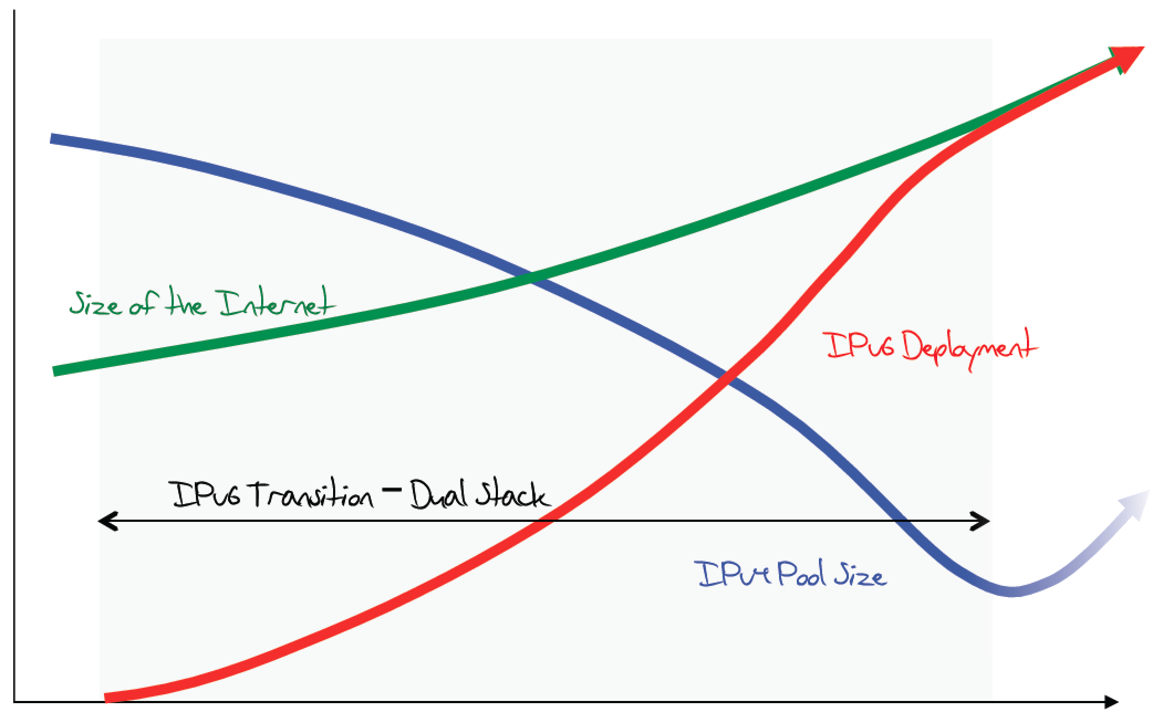
The original expected plan
From: http://www.potaroo.net/ispcol/2012-08/EndPt2.html

Slide 41
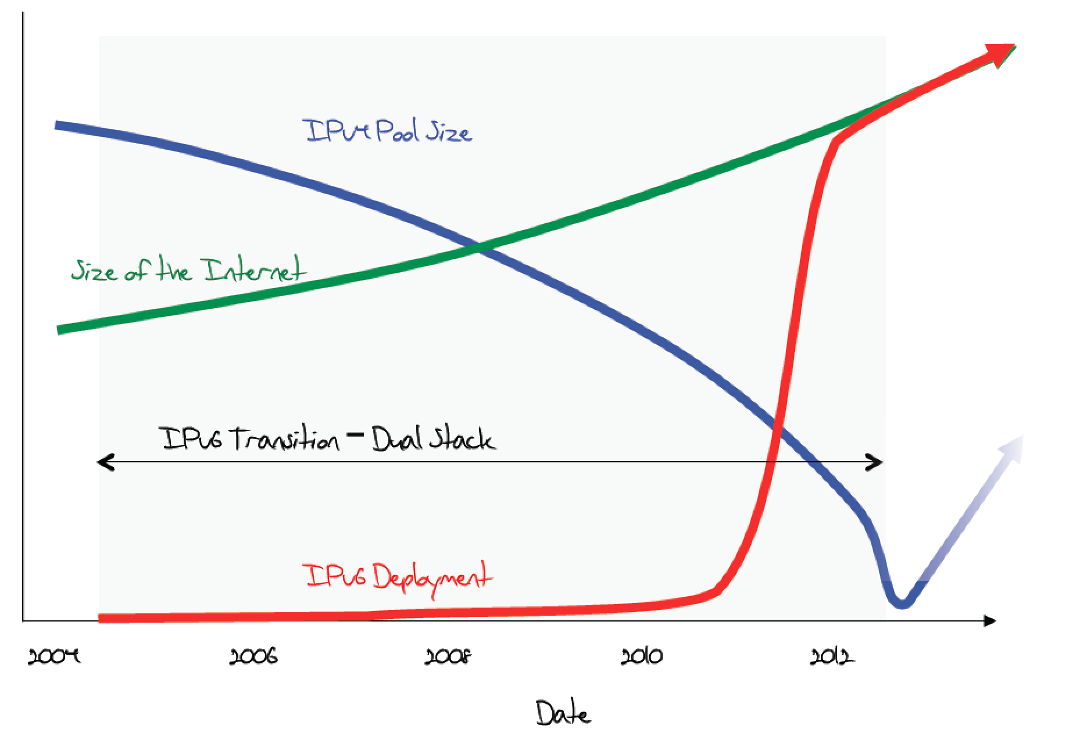
The plan in 2011

Slide 42
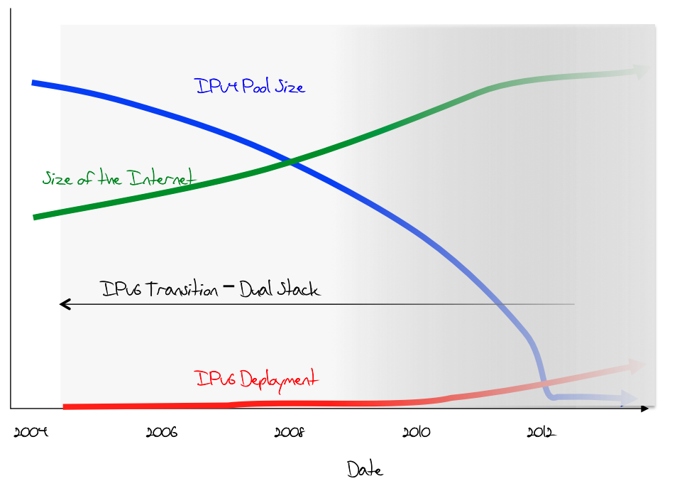
What was happening (late 2012)

Slide 43
June 6th, 2012

Slide 44
Transition is not painless
From http://www.internetsociety.org/deploy360/ipv6/ :
Why do each of these parties have to do something?

Slide 45
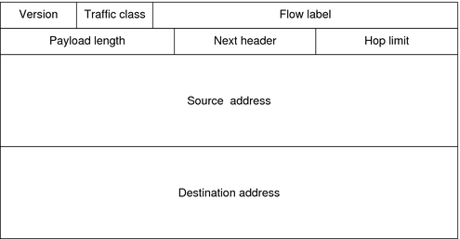
IP version 6
128-bit addresses!
Eg. 2600:3c03::f03c:91ff:fe6e:e3e1

Slide 46
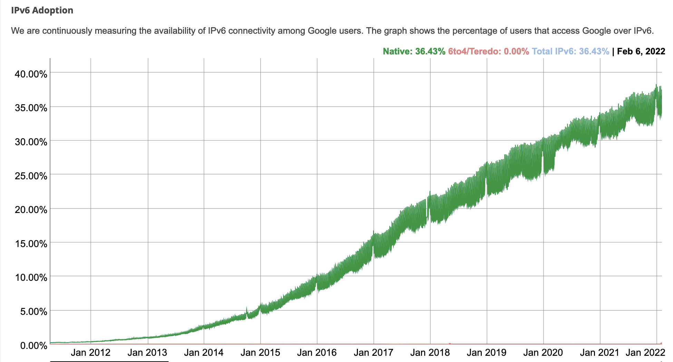
IPv6 Adoption
At Google:
Notes:
Just like routers provide access to the IPv4 space, all of the network elements in a path need to support IPv6—we basically need to build another graph, and allocate more addresses. This process has been happening gradually over the last 20 years, and now it’s starting to get better

Slide 47
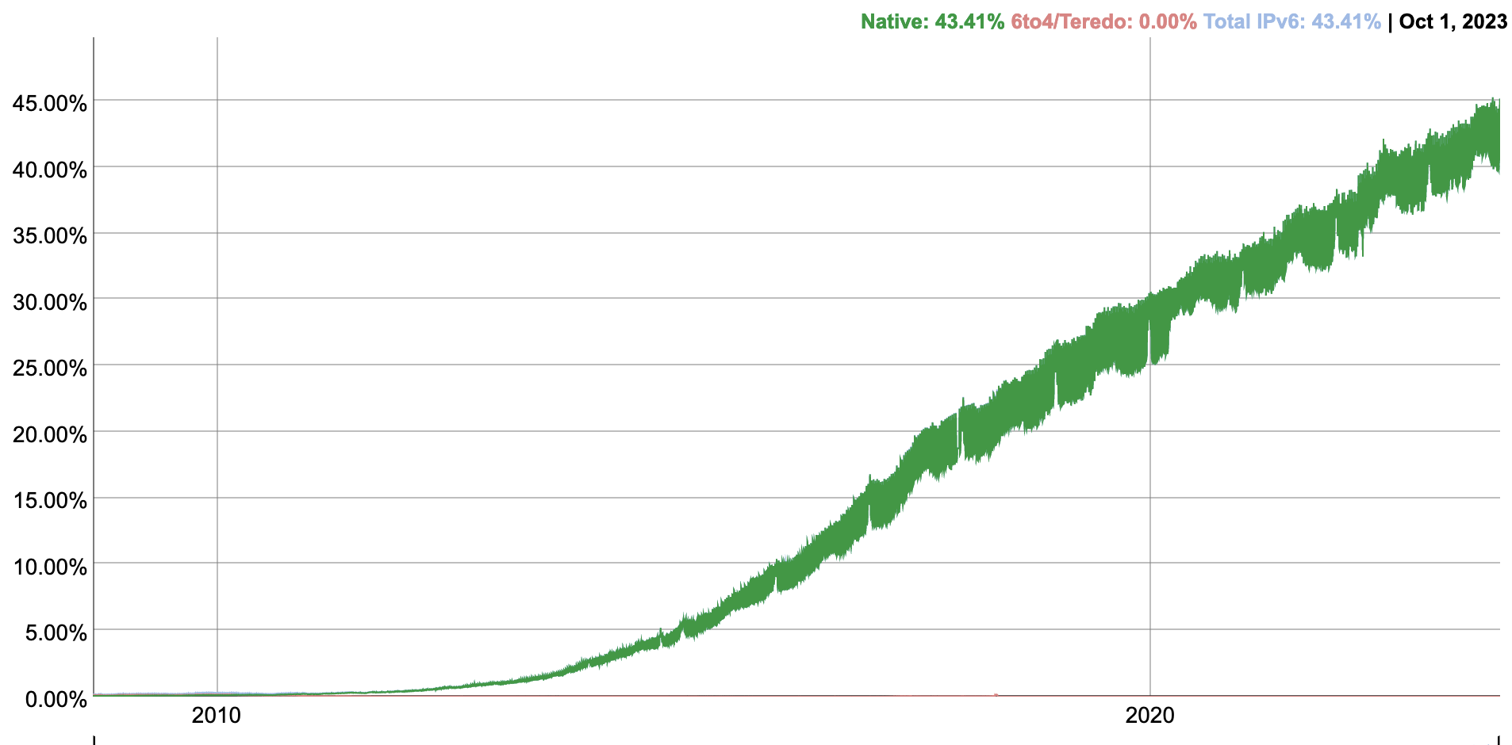
IPv6 Adoption
At Google:
Notes:
Just like routers provide access to the IPv4 space, all of the network elements in a path need to support IPv6—we basically need to build another graph, and allocate more addresses. This process has been happening gradually over the last 20 years, and now it’s starting to get better

Slide 48
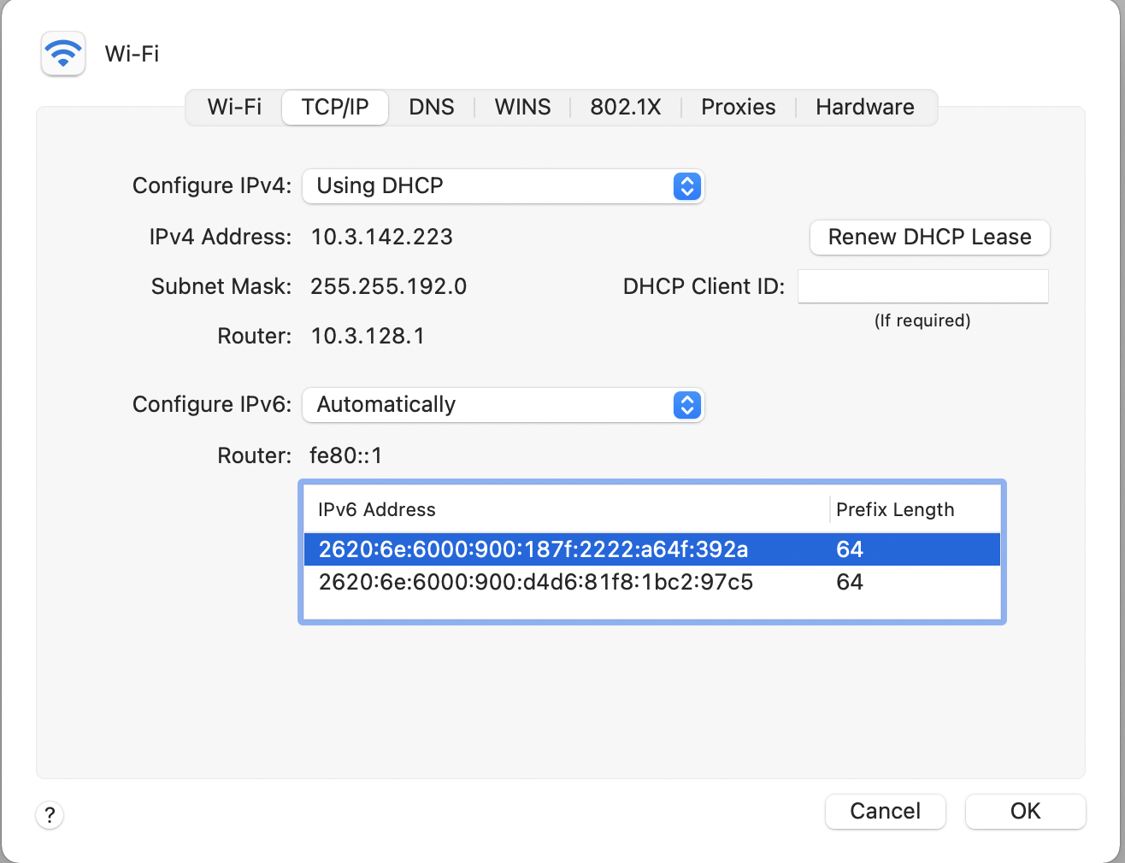
At Brown
Notes:
As of this semester I think, we now have IPv6!

Slide 49
IPv6 Key Features
128-bit addresses
Simplifies basic packet format through extension headers
  40-byte base header (fixed)
  Make less common fields optional
Security and Authentication

Slide 50
IPv6 Address Representation
Groups of 16 bits in hex notation
47cd:1244:3422:0000:0000:fef4:43ea:0001
Two rules:
  Leading 0’s in each 16-bit group can be omitted
  47cd:1244:3422:0:0:fef4:43ea:1
  One contiguous group of 0’s can be compacted
  47cd:1244:3422::fef4:43ea:1

Slide 51
IPv6 Addresses
Break 128 bits into 64-bit network and 64-bit interface
  Makes autoconfiguration easy: interface part can be derived from Ethernet address, for example
Types of addresses
  All 0’s: unspecified
  000…1: loopback
  ff/8: multicast
  fe8/10: link local unicast
  fec/10: site local unicast
  All else: global unicast

Slide 52
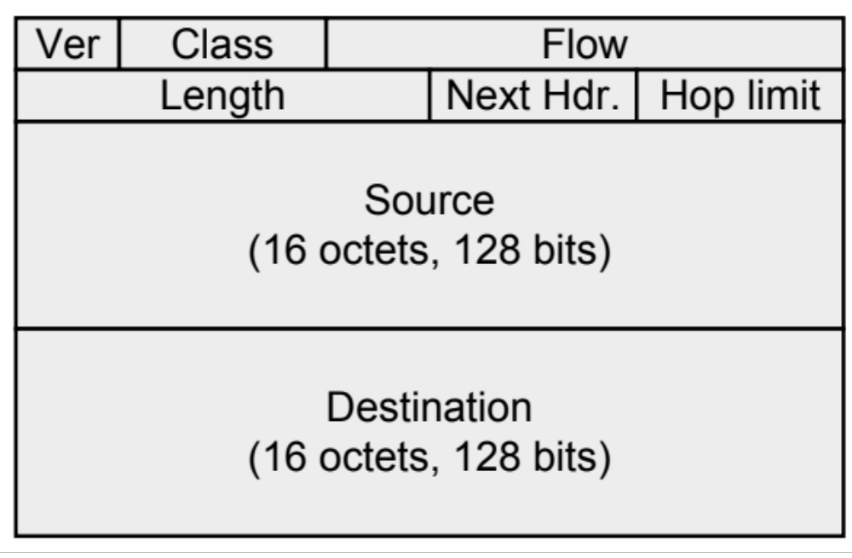
IPv6 Header

Slide 53
IPv6 Header Fields
Version: 4 bits, 6
Class: 8 bits, like TOS in IPv4
Flow: 20 bits, identifies a flow
Length: 16 bits, datagram length
Next Header, 8 bits: …
Hop Limit: 8 bits, like TTL in IPv4
Addresses: 128 bits
What’s missing?
  No options, no fragmentation flags, no checksum

Slide 54
Design Philosophy
Simplify handling
  New option mechanism (fixed size header)
  No more header length field
Do less work at the network (why?)
  No fragmentation
  No checksum
General flow label
  No semantics specified
  Allows for more flexibility
Still no accountability
With some content from Scott Shenker
Notes:
End-to-end principle

Slide 55
Interoperability
RFC 4038
  Every IPv4 address has an associated IPv6 address (mapped)
  Networking stack translates appropriately depending on other end
  Simply prefix 32-bit IPv4 address with 80 bits of 0 and 16 bits of 1:
  E.g., ::FFFF:128.148.32.2
Two IPv6 endpoints must have IPv6 stacks
Transit network:
  v6 – v6 – v6 : ✔
  v4 – v4 – v4 : ✔
  v4 – v6 – v4 : ✔
  v6 – v4 – v6 : ✗!!

Slide 56
Example Next Header Values
0: Hop by hop header
1: ICMPv4
4: IPv4
6:TCP
17: UDP
41: IPv6
43: Routing Header
44: Fragmentation Header
58: ICMPv6

Slide 57
Current State
IPv6 Deployment picking up
Most end hosts have dual stacks today (Windows, Mac OSX, Linux, *BSD, Solaris)
Requires all parties to work!
  Servers, Clients, DNS, ISPs, all routers
IPv4 and IPv6 will coexist for a long time

Slide 58
Coming Up
Routing: how do we fill the routing tables?
  Intra-domain routing: Tuesday, 10/4
  Inter-domain routing: Thursday, 10/6

Slide 59
Example
# arp -n
Address HWtype HWaddress Flags Mask Iface
172.17.44.1 ether 00:12:80:01:34:55 C eth0
172.17.44.25 ether 10:dd:b1:89:d5:f3 C eth0
172.17.44.6 ether b8:27:eb:55:c3:45 C eth0
172.17.44.5 ether 00:1b:21:22:e0:22 C eth0
# ip route
127.0.0.0/8 via 127.0.0.1 dev lo
172.17.44.0/24 dev enp7s0 proto kernel scope link src 172.17.44.22 metric 204
default via 172.17.44.1 dev eth0 src 172.17.44.22 metric 204
Notes:
arp -an
netstat -rn

Slide 60
Internet Control Message Protocol (ICMP)
Echo (ping)
Redirect
Destination unreachable (protocol, port, or host)
TTL exceeded
Checksum failed
Reassembly failed
Can’t fragment
Many ICMP messages include part of packet that triggered them
See http://www.iana.org/assignments/icmp-parameters

Slide 61
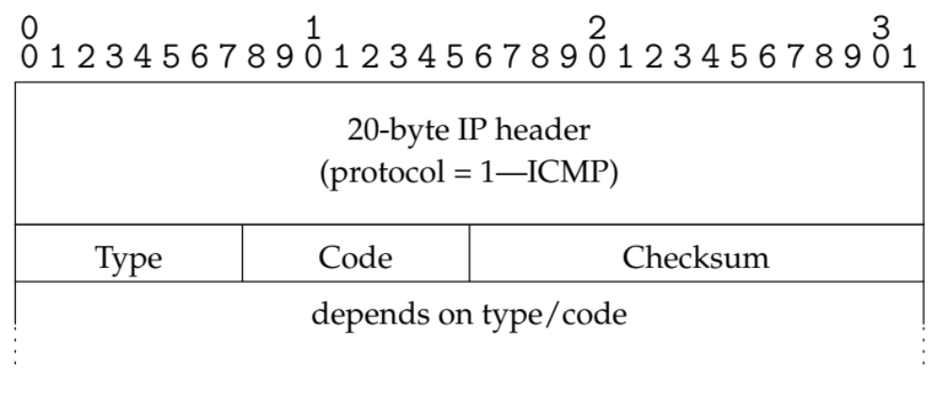
ICMP message format

Slide 62
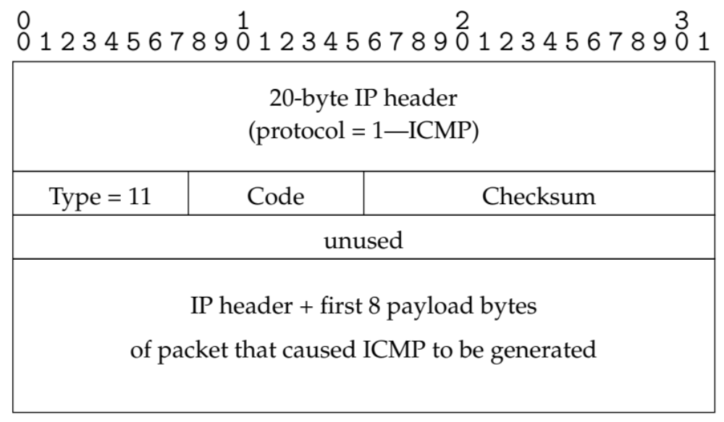
Example: Time Exceeded
Code usually 0 (TTL exceeded in transit)
Discussion: traceroute

Slide 63
A
1.2.1.1
B
1.2.1.3
listen(80)
Src Dst
IP 1.2.3.4 5.6.7.8
Port 12345 80
Src Dst
IP 5.6.7.8 1.2.3.4
Port 80 12345

Slide 64
Fragmentation & Reassembly
Each network has maximum transmission unit (MTU)
Strategy
  Fragment when necessary (MTU < size of datagram)
  Source tries to avoid fragmentation (why?)
  Re-fragmentation is possible
  Fragments are self-contained datagrams
  Delay reassembly until destination host
  No recovery of lost fragments
Notes:
Fragmentation: loss of one fragment implies all fragments discarded
Delay of entire packet is worst case delay over all fragments

Slide 65
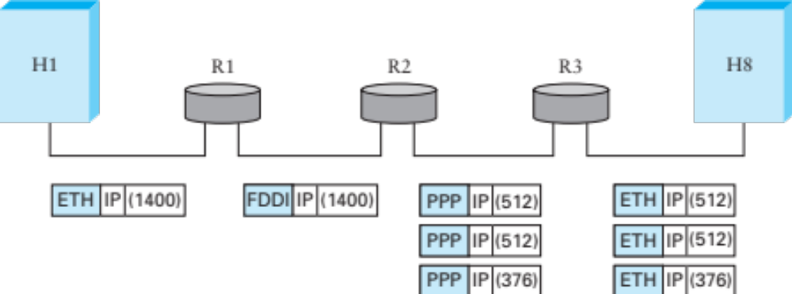
Fragmentation Example
Ethernet MTU is 1,500 bytes
PPP MTU is 576 bytes
  R2 must fragment IP packets to forward them
Notes:
Never reassemble: you never know if you’ll have all of the packets

Slide 66
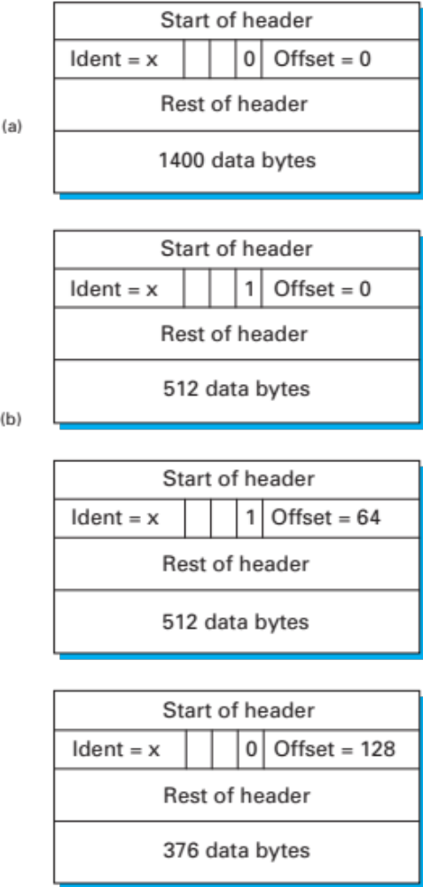
Fragmentation Example
IP addresses plus ident field identify fragments of same packet
MF (more fragments bit) is 1 in all but last fragment
Fragment offset multiple of 8 bytes
  Multiply offset by 8 for fragment position original packet
Notes:
No fragmentation
Fragmentation into three packets

