Slide 1
CSCI-1680
Network Layer:
IP & Forwarding
Rodrigo Fonseca
Based partly on lecture notes by David Mazières, Phil Levis, John Jannotti

Slide 2
Today
Network layer: Internet Protocol (v4)
Forwarding
Next 2 classes: Routing

Slide 3
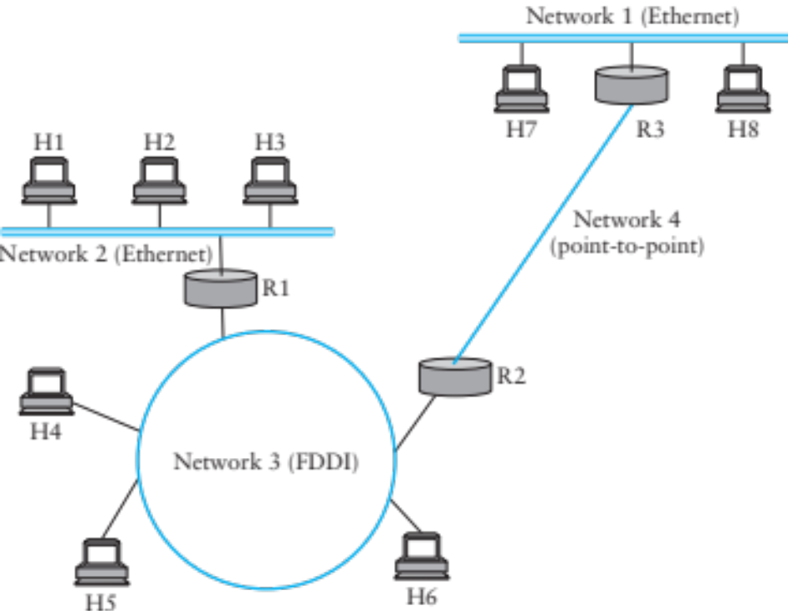
Internet Protocol Goal
How to connect everybody?
  New global network or connect existing networks?
Glue lower-level networks together:
  allow packets to be sent between any pair or hosts
Wasn’t this the goal of switching?

Slide 4
Inter-networking Challenges
Heterogeneity
  Different addresses
  Different service models
  Different allowable packet sizes
Scaling
Congestion control

Slide 5
How would you design such a protocol?
Circuits or packets?
  Predictability
Service model
  Reliability, timing, bandwidth guarantees
Any-to-any
  Finding nodes: naming, routing
  Maintenance (join, leave, add/remove links,…)
  Forwarding: message formats
Notes:
Because you have heterogeneous networks, you need to settle for the least common denominator.

Slide 6
IP’s Decisions
Packet switched
  Unpredictability, statistical multiplexing
Service model
  Lowest common denominator: best effort, connectionless datagram
Any-to-any
  Common message format
  Separated routing from forwarding
  Naming: uniform addresses, hierarchical organization
  Routing: hierarchical, prefix-based (longest prefix matching)
  Maintenance: delegated, hierarchical

Slide 7
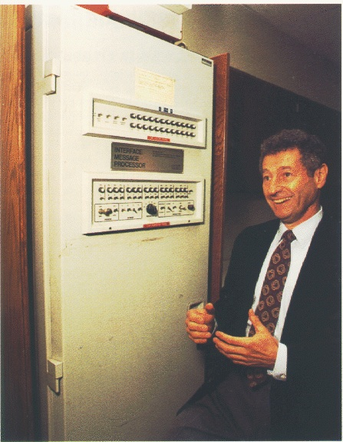
A Bit of History
Packet switched networks: Arpanet’s IMPs
  Late 1960’s
  RFC 1, 1969!
  Segmentation, framing, routing, reliability, reassembly, primitive flow control
Network Control Program (NCP)
  Provided connections, flow control
  Assumed reliable network: IMPs
  Used by programs like telnet, mail, file transfer
Wanted to connect multiple networks
  Not all reliable, different formats, etc…
Notes:
Interface Message Processors

Slide 10
TCP/IP Introduced
Vint Cerf, Robert Kahn
Replace NCP
Initial design: single protocol providing a unified reliable pipe
  Could support any application
Different requirements soon emerged, and the two were separated
  IP: basic datagram service among hosts
  TCP: reliable transport
  UDP: unreliable multiplexed datagram service

Slide 11
An excellent read
David D. Clark, “The design Philosophy of the DARPA Internet Protocols”, 1988
Primary goal: multiplexed utilization of existing interconnected networks
Other goals:
  Communication continues despite loss of networks or gateways
  Support a variety of communication services
  Accommodate a variety of networks
  Permit distributed management of its resources
  Be cost effective
  Low effort for host attachment
  Resources must be accountable
Notes:
In order.
Missing: security

Slide 12
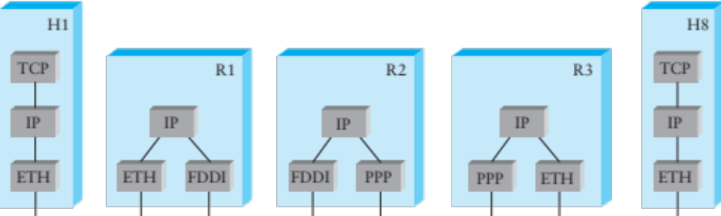
Internet Protocol
IP Protocol running on all hosts and routers
Routers are present in all networks they join
Uniform addressing
Forwarding/Fragmentation
Complementary:
  Routing, Error Reporting, Address Translation
Notes:
Assumes you have other routing protocols…

Slide 13
How does this work?
Routers are present in all networks they join
  Nodes only know how to talk on the networks they are in
What about addresses?
  IP addresses mean nothing for the L2 networks!
  Need a mapping
Forwarding
  Decide whether to deliver locally, or to another router in the same network
  Addresses are allocated in a way to make this work

Slide 14
IP Protocol
Provides addressing and forwarding
  Addressing is a set of conventions for naming nodes in an IP network
  Forwarding is a local action by a router: passing a packet from input to output port
IP forwarding finds output port based on destination address
  Also defines certain conventions on how to handle packets (e.g., fragmentation, time to live)
Contrast with routing
  Routing is the process of determining how to map packets to output ports (topic of next two lectures)
Notes:
Address: name + topological information

Slide 15
Service Model
Connectionless (datagram-based)
Best-effort delivery (unreliable service)
  packets may be lost
  packets may be delivered out of order
  duplicate copies of packets may be delivered
  packets may be delayed for a long time
It’s the lowest common denominator
  A network that delivers no packets fits the bill!
  All these can be dealt with above IP (if probability of delivery is non-zero…)

Slide 16
Format of IP addresses
Globally unique (or made seem that way)
  32-bit integers, read in groups of 8-bits: 128.148.32.110
Hierarchical organization:
  Assign blocks of contiguous addresses to the same parts of the network
  All hosts in the same network share the same prefix
  Networks can have different sizes (different prefix sizes)
  Addresses have network and host parts
Notes:
Quickly moved to variable prefix size.
How many possible IP addresses are there?

Slide 17
Prefix Notation
Significant bits + mask
E.g. all nodes which share prefix 128.148.0.0:
  16 MSB matter
  Mask is: 11111111 11111111 00000000 00000000
  Or 255.255.0.0
  Or /16
Could say
  128.148
  128.148/16
  128.148.0.0/16
  128.148.0.0 netmask 255.255.0.0

Slide 18
Forwarding Tables
Exploit hierarchical structure of addresses: need to know how to reach networks, not hosts
Keyed by network portion, not entire address
Next address should be local: router knows how to reach it directly* (we’ll see how soon)
Network | Next Address
212.31.32.* | 0.0.0.0
18.*.*.* | 212.31.32.5
128.148.*.* | 212.31.32.4
Default | 212.31.32.1
Notes:
How do you forward packets between nodes (routers, hosts, etc.)?

Slide 19
Classed Addresses
Hierarchical: network + host
  Saves memory in backbone routers (no default routes)
  Originally, routing prefix embedded in address
  Routers in same network must share network part
Inefficient use of address space
  Class C with 2 hosts (2/255 = 0.78% efficient)
  Class B with 256 hosts (256/65535 = 0.39% efficient)
  Shortage of IP addresses
  Makes address authorities reluctant to give out class B’s
Still too many networks
  Routing tables do not scale
Routing protocols do not scale

Slide 20
CIDR: Classless Inter-Domain Routing
Problems: routing table growth, granularity of allocation
Idea: assign blocks of contiguous networks to nearby networks
Represent blocks with a single pair
  (first network address, count)
Restrict block sizes to powers of 2
Use a bit mask (CIDR mask) to identify block size
Address aggregation: reduce routing tables
Notes:
Classful introduced lots of waste
Manage routing table size
Solves two problems:
- Routing table growth
- Granularity of address allocations

Slide 21
IP Forwarding Table
Network | Next Address
212.31.32/24 | 0.0.0.0
18/8 | 212.31.32.5
128.148/16 | 212.31.32.4
128.148.128/17 | 212.31.32.8
0/0 | 212.31.32.1
Forwarding is done by longest prefix matching
  More on this later
Notes:
Examples of subnet masks
18.0.0.0/8 => 00010010 00000000 00000000 00000000
11111111 00000000 00000000 00000000
128.148.0.0/16 => 10000000 10010100 00000000 00000000
11111111 11111111 00000000 00000000
128.148.0.0/16 => 10000000 10010100 10000000 00000000
11111111 11111111 10000000 00000000
/8 => 255.0.0.0
/16 => 255.255.0.0
/17 => 255.255.128.0
/24 => 255.255.255.0

Slide 22
Obtaining IP Addresses
Blocks of IP addresses allocated hierarchically
  ISP obtains an address block, may subdivide
  ISP: 128.35.16/20 10000000 00100011 00010000 00000000
  Client 1: 128.35.16/22 10000000 00100011 00010000 00000000
  Client 2: 128.35.20/22 10000000 00100011 00010100 00000000
  Client 3: 128.35.24/21 10000000 00100011 00011000 00000000
Blocks restricted to powers of 2
Global allocation: ICANN, /8’s (ran out!)
Regional registries: ARIN, RIPE, APNIC, LACNIC, AFRINIC
Notes:
Notice how Client 3 is twice the size of client 2.
Here are some IP addresses and prefixes you should know:
/8 => 16 million addresses
/16 => 65536 addresses
/24 => 255 addresses

Slide 23
How does this really work?
IP Addresses tell you how to get to a network
  That is what routers do
How to you actually get to a host?
  You have to use the underlying L2 network!

Slide 24
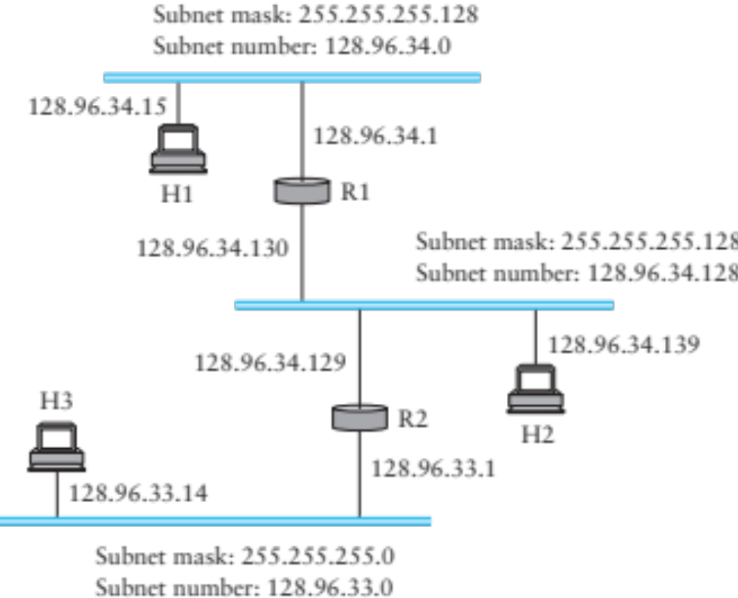
How does this really work?
H1-> H2: H2.ip & H1.mask != H1.subnet => no direct path
Notes:
128.96.34.139 = 10000000 01100000 00100010 10001011
Mask: 11111111 11111111 11111111 10000000
What are the CIDR prefixes?
H1? 255.255.255.128 => /25
H2? 255.255.255.128 => /25

Slide 25
R1’s Forwarding Table
Network | Subnet Mask | Next Address
128.96.34.0 | 255.255.255.128 | 128.96.34.1
128.96.34.128 | 255.255.255.128 | 128.96.34.130
128.96.33.0 | 255.255.255.0 | 128.96.34.129

Slide 26
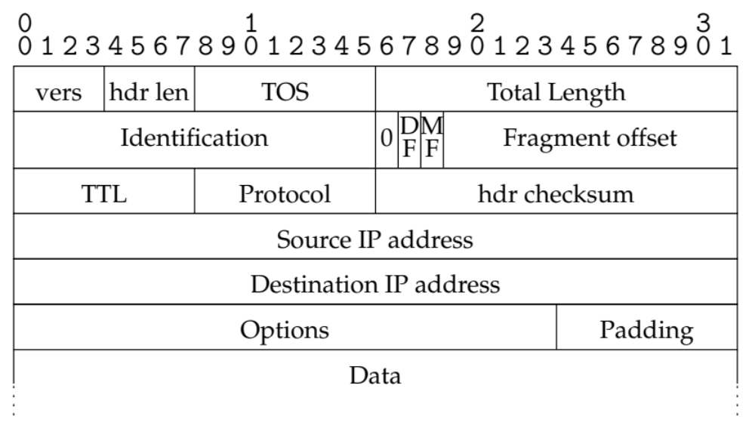
IP v4 packet format

Slide 27
IP header details
Forwarding based on destination address
TTL (time-to-live) decremented at each hop
  Originally was in seconds (no longer)
  Mostly prevents forwarding loops
  Other cool uses…
Fragmentation possible for large packets
  Fragmented in network if crossing link w/ small frame
  MF: more fragments for this IP packet
  DF: don’t fragment (returns error to sender)
Following IP header is “payload” data
  Typically beginning with TCP or UDP header

Slide 28
Other fields
Version: 4 (IPv4) for most packets, there’s also 6
Header length: in 32-bit units (>5 implies options)
  4 bits * 4 bytes = 64KiB max
Type of service (won’t go into this)
Protocol identifier (TCP: 6, UDP: 17, ICMP: 1, …)
Checksum over the header

Slide 29
Translating IP to lower level addresses or… How to reach these local addresses?
Map IP addresses into physical addresses
  E.g., Ethernet address of destination host
  or Ethernet address of next hop router
Techniques
  Encode physical address in host part of IP address (IPv6)
  Each network node maintains lookup table (IP->phys)

Slide 30
ARP – address resolution protocol
Dynamically builds table of IP to physical address bindings for a local network
Broadcast request if IP address not in table
All learn IP address of requesting node (broadcast)
Target machine responds with its physical address
Table entries are discarded if not refreshed

Slide 31
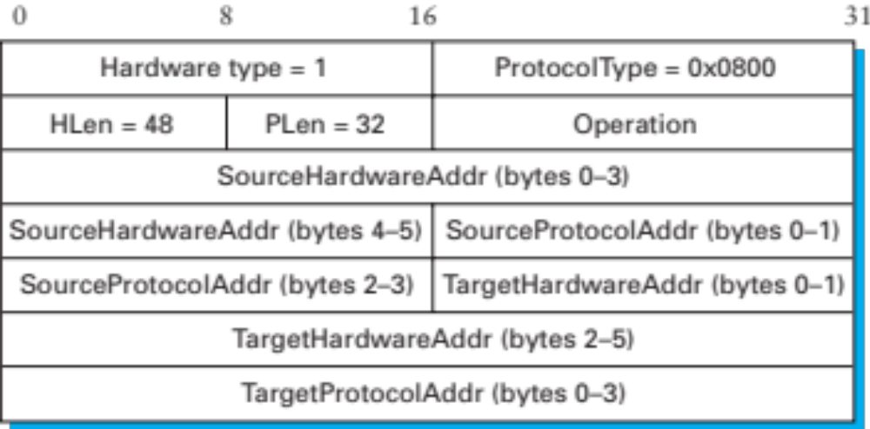
ARP Ethernet frame format
Why include source hardware address?

Slide 32
Obtaining Host IP Addresses - DHCP
Networks are free to assign addresses within block to hosts
Tedious and error-prone: e.g., laptop going from CIT to library to coffee shop
Solution: Dynamic Host Configuration Protocol
  Client: DHCP Discover to 255.255.255.255 (broadcast)
  Server(s): DHCP Offer to 255.255.255.255 (why broadcast?)
  Client: choose offer, DHCP Request (broadcast, why?)
  Server: DHCP ACK (again broadcast)
Result: address, gateway, netmask, DNS server

Slide 33
Network Address Translation (NAT)
Despite CIDR, it’s still difficult to allocate addresses (2³² is only 4 billion)
We’ll talk about IPv6 later
NAT “hides” entire network behind one address
Hosts are given private addresses
Routers map outgoing packets to a free address/port
Router reverse maps incoming packets
Problems?
Notes:
Incoming flows
Shared ports
Breaks assumptions

Slide 34
Fragmentation & Reassembly
Each network has maximum transmission unit (MTU)
Strategy
  Fragment when necessary (MTU < size of datagram)
  Source tries to avoid fragmentation (why?)
  Re-fragmentation is possible
  Fragments are self-contained datagrams
  Delay reassembly until destination host
  No recovery of lost fragments
Notes:
Fragmentation: loss of one fragment implies all fragments discarded
Delay of entire packet is worst case delay over all fragments

Slide 35
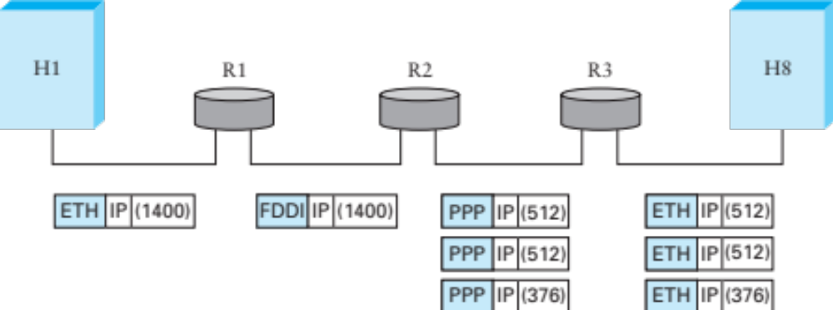
Fragmentation Example
Ethernet MTU is 1,500 bytes
PPP MTU is 576 bytes
  R2 must fragment IP packets to forward them
Notes:
Never reassemble: you never know if you’ll have all of the packets

Slide 36
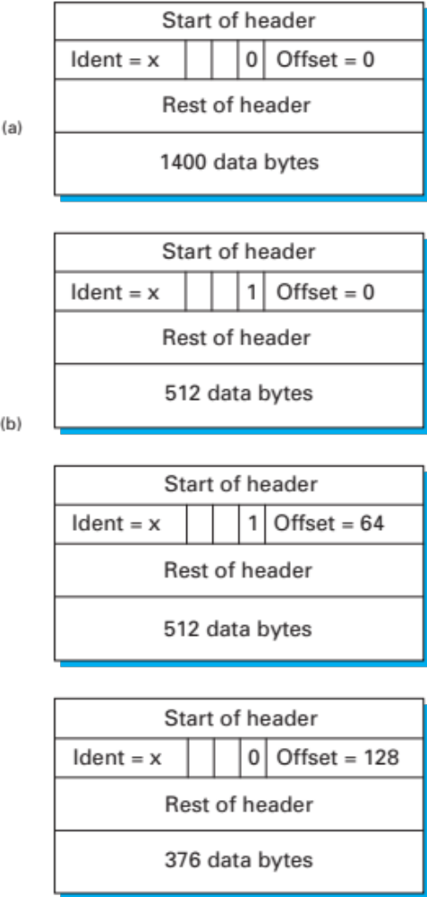
Fragmentation Example (cont)
IP addresses plus ident field identify fragments of same packet
MF (more fragments bit) is 1 in all but last fragment
Fragment offset multiple of 8 bytes
  Multiply offset by 8 for fragment position original packet
Notes:
No fragmentation
Fragmentation into three packets

Slide 37
Internet Control Message Protocol (ICMP)
Echo (ping)
Redirect
Destination unreachable (protocol, port, or host)
TTL exceeded
Checksum failed
Reassembly failed
Can’t fragment
Many ICMP messages include part of packet that triggered them
See http://www.iana.org/assignments/icmp-parameters

Slide 38
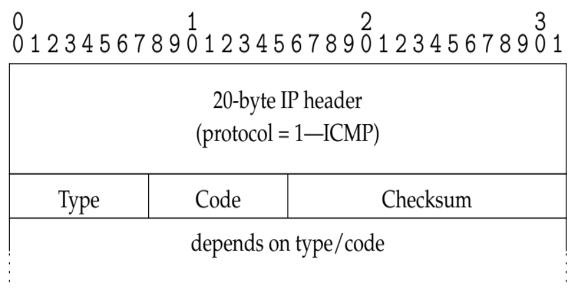
ICMP message format

Slide 39
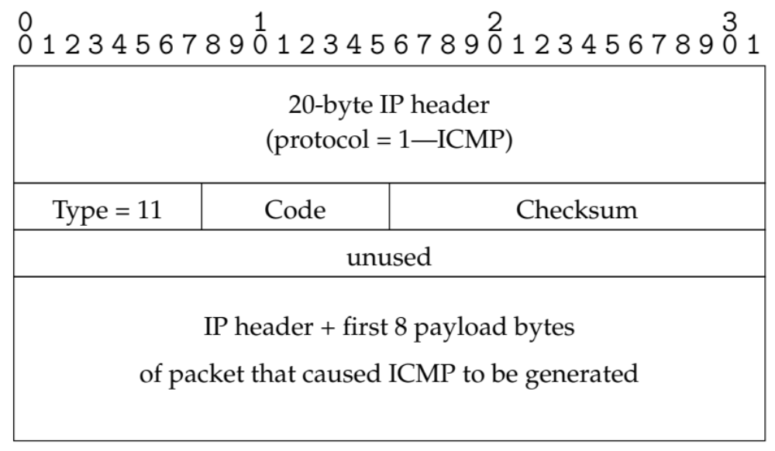
Example: Time Exceeded
Code usually 0 (TTL exceeded in transit)
Discussion: traceroute

Slide 40
Example: Can’t Fragment
Sent if DF=1 and packet length > MTU
What can you use this for?
Path MTU Discovery
  Can do binary search on packet sizes
  But better: base algorithm on most common MTUs
Notes:
Path MTU discovery

Slide 41
Coming Up
Routing: how do we fill the routing tables?
  Intra-domain routing: Tuesday, 10/4
  Inter-domain routing: Thursday, 10/6

Slide 42
Example
# arp -n
Address HWtype HWaddress Flags Mask Iface
172.17.44.1 ether 00:12:80:01:34:55 C eth0
172.17.44.25 ether 10:dd:b1:89:d5:f3 C eth0
172.17.44.6 ether b8:27:eb:55:c3:45 C eth0
172.17.44.5 ether 00:1b:21:22:e0:22 C eth0
# ip route
127.0.0.0/8 via 127.0.0.1 dev lo
172.17.44.0/24 dev enp7s0 proto kernel scope link src 172.17.44.22 metric 204
default via 172.17.44.1 dev eth0 src 172.17.44.22 metric 204
Notes:
arp -an
netstat -rn

