Slide 1
CSCI-1680
Layering and Encapsulation
Rodrigo Fonseca
Based partly on lecture notes by David Mazières, Phil Levis, John Jannotti

Slide 2
Today
Review
  Switching, Multiplexing
Layering and Encapsulation
Intro to IP, TCP, UDP
Extra material: sockets primer

Slide 3
Circuit Switching
Guaranteed allocation
  Time division / Frequency division multiplexing
Low space overhead
Easy to reason about
Failures: must re-establish connection
  For any failures along path
Overload: all or nothing
  No graceful degradation
Waste: allocate for peak, waste for less than peak
Set up time

Slide 4
Packet Switching
Break information in small chunks: packets
Each packet forwarded independently
  Must add metadata to each packet
Allows statistical multiplexing
  High utilization
  Very flexible
  Fairness not automatic
  Highly variable queueing delays
  Different paths for each packet

Slide 5
A Taxonomy of networks
Communication Network
Switched
Communication Network
Broadcast
Communication Network
Point-to-point network
Circuit-Switched
Communication Network
Packet-Switched
Communication Network
A hybrid of circuits and packets; headers include a “circuit identifier” established during a setup phase
Datagram
Network
Virtual Circuit Network

Slide 6

Traceroute map of the Internet, ~5 million edges, circa 2003. opte.org

Slide 7
Managing Complexity
Very large number of computers
Incredible variety of technologies
  Each with very different constraints
No single administrative entity
Evolving demands, protocols, applications
  Each with very different requirements!
How do we make sense of all this?

Slide 8
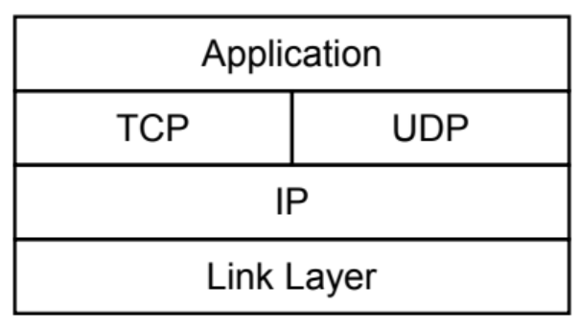
Layering
Separation of concerns
  Break problem into separate parts
  Solve each one independently
  Tie together through common interfaces: abstraction
  Encapsulate data from the layer above inside data from the layer below
  Allow independent evolution
Notes:
Example: deliver a letter
Interfaces

Slide 9
Analogy to Delivering a Letter
We did this drawing in class, for delivering a letter from you to a friend in Japan.
There are many layers, addressing schemes, well-defined interfaces, independent
Evolution, abstraction. A protocol is the communication between entities in the same
Level (e.g., you and your friend). Layers use the services of lower layers to provide
services to upper layers. (Of course, this is much more fun when we are drawing live,
hope this starts to get the idea across).
Notes:
Independent evolution: horse to truck to plane
Interface: envelope, address; road signs; how to ride a horse
Mail bag

Slide 10
Layers
Application – what the users sees, e.g., HTTP
Presentation – crypto, conversion between representations
Session – can tie together multiple streams (e.g., audio & video)
Transport – demultiplexes, provides reliability, flow and congestion control
Network – sends packets, using routing
Data Link – sends frames, handles media access
Physical – sends individual bits

Slide 11

OSI Reference Model
Application Protocol
Transport Protocol
Network Protocol
Link-Layer Protocol
Notes:
Open Systems Interconnect, ISO

Slide 12
Layers, Services, Protocols
Layer N+1
Service: abstraction provided to layer above
API: concrete way of using the service
Layer N
Protocol: rules for communication
within same layer
Layer N uses the services provided by N-1 to
implement its protocol and provide its own services
Layer N-1

Slide 13
Layers, Services, Protocols
Application
Service: user-facing application.
Application-defined messages
Service: multiplexing applications
Reliable byte stream to other node (TCP),
Unreliable datagram (UDP)
Transport
Network
Service: move packets to any other node in the network
IP: Unreliable, best-effort service model
Link
Service: move frames to other node across link.
May add reliability, medium access control
Physical
Service: move bits to other node across link

Slide 14
Protocols
What do you need to communicate?
  Definition of message formats
  Definition of the semantics of messages
  Definition of valid sequences of messages
    Including valid timings
Also, who do you talk to? …

Slide 15
Naming/Addressing
Each node typically has a unique* name
  When that name also tells you how to get to the node, it is called an address
Each layer can have its own naming/addressing
Routing is the process of finding a path to the destination
  In packet switched networks, each packet must have a destination address
  For circuit switched, use address to set up circuit
Special addresses can exist for broadcast/multicast/anycast
* within the relevant scope

Slide 16
Challenge
Decide on how to factor the problem
  What services at which layer?
  What to leave out?
  More on this later (End-to-end principle)
For example:
  IP offers pretty crappy service, even on top of reliable links… why?
  TCP: offers reliable, in-order, no-duplicates service. Why would you want UDP?
Notes:
Guiding principle: if you offer functionality in one layer, you force everyone above you to use it, even if they don’t need it.

Slide 17

IP as the Narrow Waist
Many applications protocols on top of UDP & TCP
IP works over many types of networks
This is the “Hourglass” architecture of the Internet.
  If every network supports IP, applications run over many different networks (e.g., cellular network)

Slide 18
Network Layer: Internet Protocol (IP)
Used by most computer networks today
  Runs over a variety of physical networks, can connect Ethernet, wireless, modem lines, etc.
Every host has a unique 4-byte IP address (IPv4)
  E.g., www.cs.brown.edu →128.148.32.110
  The network knows how to route a packet to any address
Need more to build something like the Web
  Need naming (DNS)
  Interface for browser and server software
  Need demultiplexing within a host: which packets are for web browser, Skype, or the mail program?

Slide 19
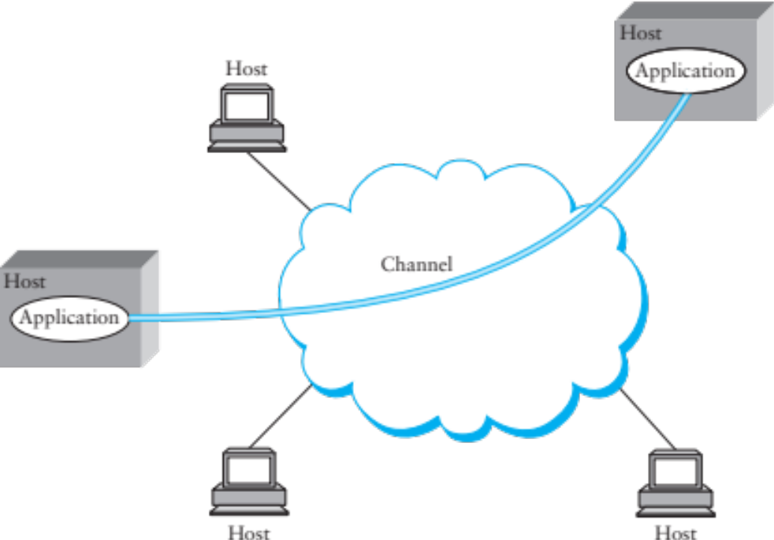
Inter-process Communication
Talking from host to host is great, but we want abstraction of inter-process communication
Solution: encapsulate another protocol within IP

Slide 20
Transport: UDP and TCP
UDP and TCP most popular protocols on IP
  Both use 16-bit port number & 32-bit IP address
  Applications bind a port & receive traffic on that port
UDP – User (unreliable) Datagram Protocol
  Exposes packet-switched nature of Internet
  Adds multiplexing on top of IP
  Sent packets may be dropped, reordered, even duplicated (but there is corruption protection)
TCP – Transmission Control Protocol
  Provides illusion of reliable ‘pipe’ or ‘stream’ between two processes anywhere on the network
  Handles congestion and flow control

Slide 21
Uses of TCP
Most applications use TCP
  Easier to program (reliability is convenient)
  Automatically avoids congestion (don’t need to worry about taking down the network
Servers typically listen on well-know ports:
  SSH: 22
  SMTP (email): 25
  Finger: 79
  HTTP (web): 80

Slide 22
Transport: UDP and TCP
UDP and TCP most popular protocols on IP
  Both use 16-bit port number & 32-bit IP address
  Applications bind a port & receive traffic on that port
UDP – User (unreliable) Datagram Protocol
  Exposes packet-switched nature of Internet
  Adds multiplexing on top of IP
  Sent packets may be dropped, reordered, even duplicated (but there is corruption protection)
TCP – Transmission Control Protocol
  Provides illusion of reliable ‘pipe’ or ‘stream’ between two processes anywhere on the network
  Handles congestion and flow control

Slide 23
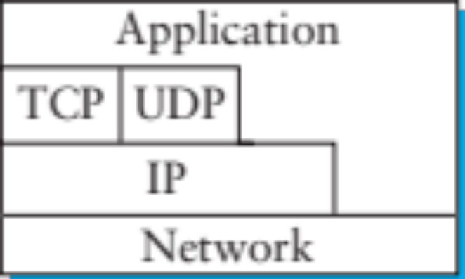
Internet Layering
Strict layering not required
  TCP/UDP “cheat” to detect certain errors in IP-level information like address
  Overall, allows evolution, experimentation

Slide 24
One more thing…
Layering defines interfaces well
  What if I get an Ethernet frame, and send it as the payload of an IP packet across the world?
Layering can be recursive
  Each layer agnostic to payload!
Many examples
  Tunnels: e.g., VXLAN is ETH over UDP (over IP over ETH again…)
  Our IP assignment: IP on top of UDP “links”

Slide 25
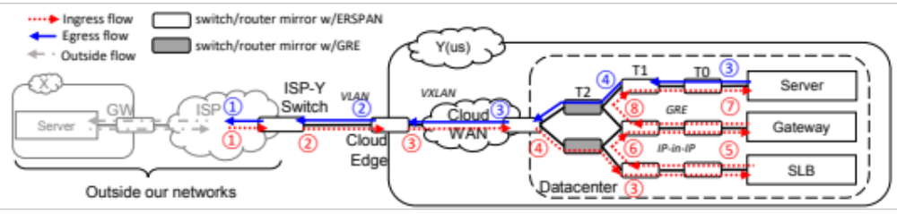
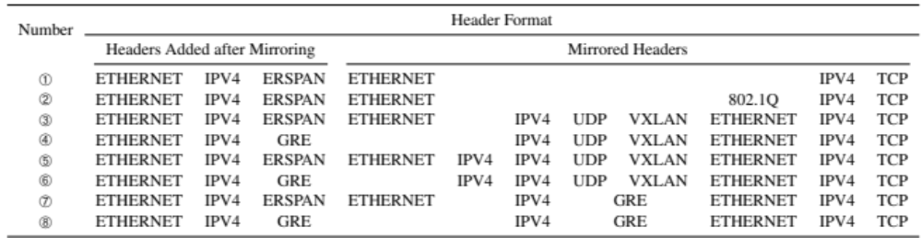
Example
* This is just an example, do not worry about the details, or the specific protocols!
From: Yu et al., A General, Easy to Program and Scalable Framework for Analyzing In-network Packet Traces, NSDI 2019

Slide 26
We didn’t cover these in class, but these concepts about the socket API are useful for, and exercised by, the Snowcast assignment!

Slide 27
Using TCP/IP
How can applications use the network?
Sockets API.
  Originally from BSD, widely implemented (*BSD, Linux, Mac OS X, Windows, …)
  Important do know and do once
  Higher-level APIs build on them
After basic setup, much like files

Slide 28
Sockets: Communication Between Machines
Network sockets are file descriptors too
Datagram sockets: unreliable message delivery
  With IP, gives you UDP
  Send atomic messages, which may be reordered or lost
  Special system calls to read/write: send/recv
Stream sockets: bi-directional pipes
  With IP, gives you TCP
  Bytes written on one end read on another
  Reads may not return full amount requested, must re-read

Slide 29
System calls for using TCP
Client Server
socket – make socket
bind – assign address, port
listen – listen for clients
socket – make socket
bind* – assign address
connect – connect to listening socket
accept – accept connection
This call to bind is optional, connect can choose address & port.

Slide 30
Socket Naming
Recall how TCP & UDP name communication endpoints
  IP address specifies host (128.148.32.110)
  16-bit port number demultiplexes within host
  Well-known services listen on standard ports (e.g. ssh – 22, http – 80, mail – 25, see /etc/services for list)
  Clients connect from arbitrary ports to well known ports
A connection is named by 5 components
  Protocol, local IP, local port, remote IP, remote port
  TCP requires connected sockets, but not UDP

Slide 31
Dealing with Address Types
All values in network byte order (Big Endian)
  htonl(), htons(): host to network, 32 and 16 bits
  ntohl(), ntohs(): network to host, 32 and 16 bits
  Remember to always convert!
All address types begin with family
  sa_family in sockaddr tells you actual type
Not all addresses are the same size
  e.g., struct sockaddr_in6 is typically 28 bytes, yet generic struct sockaddr is only 16 bytes
  So most calls require passing around socket length
  New sockaddr_storage is big enough

Slide 32
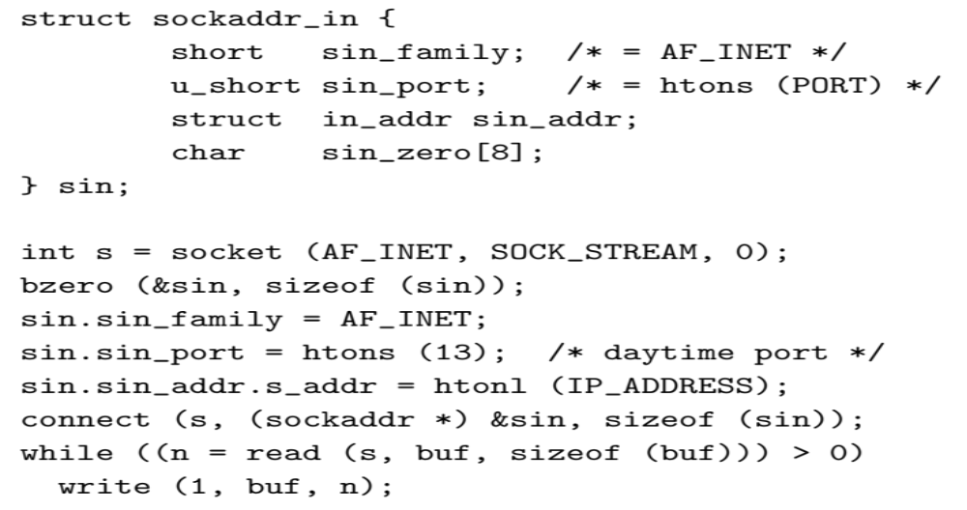
Client Skeleton (IPv4)

Slide 33
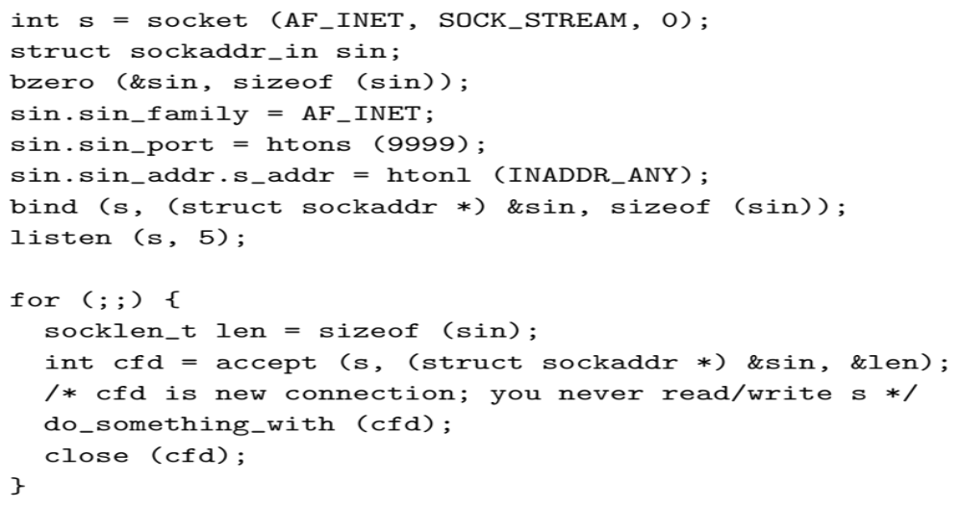
Server Skeleton (IPv4)

Slide 34
Using UDP
Call socket with SOCK_DGRAM, bind as before
New calls for sending/receiving individual packets
  sendto(int s, const void *msg, int len, int flags, const struct sockaddr *to, socklen t tolen);
  recvfrom(int s, void *buf, int len, int flags, struct sockaddr *from, socklen t *fromlen);
  Must send/get peer address with each packet
Example: udpecho.c
Can use UDP in connected mode (Why?)
  connect assigns remote address
  send/recv syscalls, like sendto/recvfrom w/o last two arguments

Slide 35
Uses of UDP Connected Sockets
Kernel demultiplexes packets based on port
  Can have different processes getting UDP packets from different peers
Feedback based on ICMP messages (future lecture)
  Say no process has bound UDP port you sent packet to
  Server sends port unreachable message, but you will only receive it when using connected socket

Slide 36
Serving Multiple Clients
A server may block when talking to a client
  Read or write of a socket connected to a slow client can block
  Server may be busy with CPU
  Server might be blocked waiting for disk I/O
Concurrency through multiple processes
  Accept, fork, close in parent; child services request
Advantages of one process per client
  Don’t block on slow clients
  May use multiple cores
  Can keep disk queues full for disk-heavy workloads

Slide 37
Threads
One process per client has disadvantages:
  High overhead – fork + exit ~100μsec
  Hard to share state across clients
  Maximum number of processes limited
Can use threads for concurrency
  Data races and deadlocks make programming tricky
  Must allocate one stack per request
  Many thread implementations block on some I/O or have heavy thread-switch overhead
Rough equivalents to fork(), waitpid(), exit(), kill(), plus locking primitives.

Slide 38
Non-blocking I/O
fcntl sets O_NONBLOCK flag on descriptor
int n;
if ((n = fcntl(s, F_GETFL)) >= 0)
fcntl(s, F_SETFL, n|O_NONBLOCK);
Non-blocking semantics of system calls:
  read immediately returns -1 with errno EAGAIN if no data
  write may not write all data, or may return EAGAIN
  connect may fail with EINPROGRESS (or may succeed, or may fail with a real error like ECONNREFUSED)
  accept may fail with EAGAIN or EWOULDBLOCK if no connections present to be accepted

Slide 39
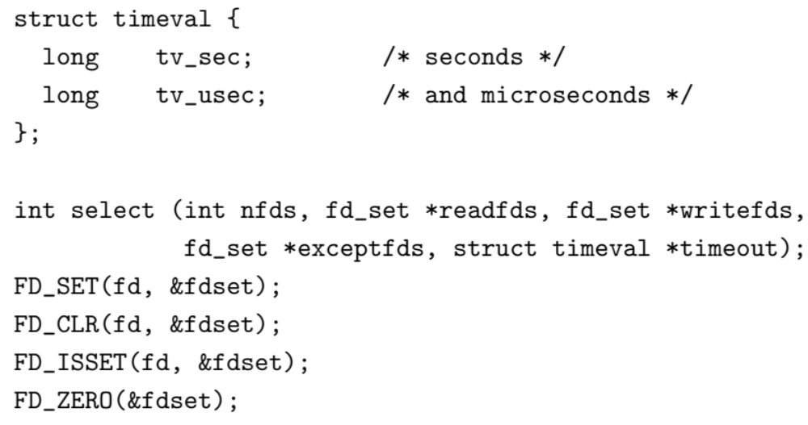
How do you know when to read/write?
Entire program runs in an event loop

Slide 40
Event-driven servers
Quite different from processes/threads
  Race conditions, deadlocks rare
  Often more efficient
But…
  Unusual programming model
  Sometimes difficult to avoid blocking
  Scaling to more CPUs is more complex

Slide 41
Coming Up
Next class: Physical Layer
Thu 13th: Snowcast milestones: last commit
  Let us know if you don’t have a slot!
Pushed some dates:
  Snowcast now due Monday

