Slide 1
CSCI-1680 - Computer Networks
Rodrigo Fonseca (rfonseca)
http://www.cs.brown.edu/courses/cs168
Based partly on lecture notes by David Mazières, Phil Levis, John Jannotti, Peterson & Davie

Slide 2
Cast
Instructor: Rodrigo Fonseca (rfonseca)
HTA: Sungseob Whang
Grad TA: Michael Markovitch
TA: Yi Zhang
How to reach us: Piazza
  https://piazza.com/brown/fall2017/cs168

Slide 3
Overview
Goal: learn concepts underlying networks
  How do networks work? What can one do with them?
  Gain a basic understanding of the Internet
  Gain experience writing protocols
  Tools to understand new protocols and applications
“From 2 communicating machines to the entire Internet”

Slide 4
Prerequisites
CSCI-0330 (or equivalent).
  We assume basic OS concepts (kernel/user, threads/processes, I/O, scheduling)
Low-level programming or be willing to learn quickly
  threads, locking, explicit memory management, …
We allow any* language
  No high-level networking APIs, though (unless you write them yourself)
  You will be bit twiddling and byte packing…
Notes:
Consult with us

Slide 5
Administrivia
All assignments will be on the course page
http://www.cs.brown.edu/courses/cs168/f17
Texts (not required):
  Peterson and Davie, Computer Networks - A Systems Approach, 4th or 5th editions or
  Kurose and Ross, ‘Computer Networking: A Top-Down Approach (6th or 7th editions)
You are responsible to check the web page and piazza!
  All announcements will be there
  Textbook chapters corresponding to lectures: read them before class
  Handouts, due dates, programming resources, etc…
  Subject to change (reload before checking assignments)

Slide 6
What do you do?
“Written” component
  Exams: Midterm (15%) and Final (25%)
  Homework: 3 written assignments (15%)
    Short answer and design questions
4 Programming Projects (45%)
  Snowcast: streaming music server
  IP, as an overlay, on top of UDP
  TCP, on top of your IP
  Final (short, fun, to be decided)
Must pass two components individually

Slide 7
Mechanics
Content:
  Lecture slides are the authoritative content
  Only what we cover in class will be tested
Tools:
  Discussions: Piazza
  HW submission/grading + exam grading: Gradescope
  Project development and submission: Github
  Sign up for these (see HW0)
Groups
  Snowcast is individual, other projects in pairs

Slide 8
Networks
What is a network?
  System of lines/channels that interconnect
  E.g., railroad, highway, plumbing, postal, telephone, social, computer
Computer Network
  Moves information
  Nodes: general-purpose computers (most nodes)
  Links: wires, fiber optics, EM spectrum, composite…

Slide 9
Why are computer networks cooler?
Many nodes are general-purpose computers
Very easy to innovate and develop new uses of the network: you can program the nodes
Contrast with the ossified Telephone network:
  Can’t program most phones
  Intelligence in the network, control by parties vested in the status quo, …
Notes:
Why are computer networks cooler?

Slide 10
Examples of Innovation
WhatsApp: as of Jan 2016, reached 1B monthly active users in 7 years
  57 engineers by then!
Uber disrupted transportation
  Connectivity allowed a global dispatch service
Mirai Botnet (!)
  ~50,000 IoT Devices (cameras, DVRs, routers)
  100s of Gbps attacks in late 2016

Slide 11

Growth of the Internet
Source: Miguel Angel Todaro

Slide 12
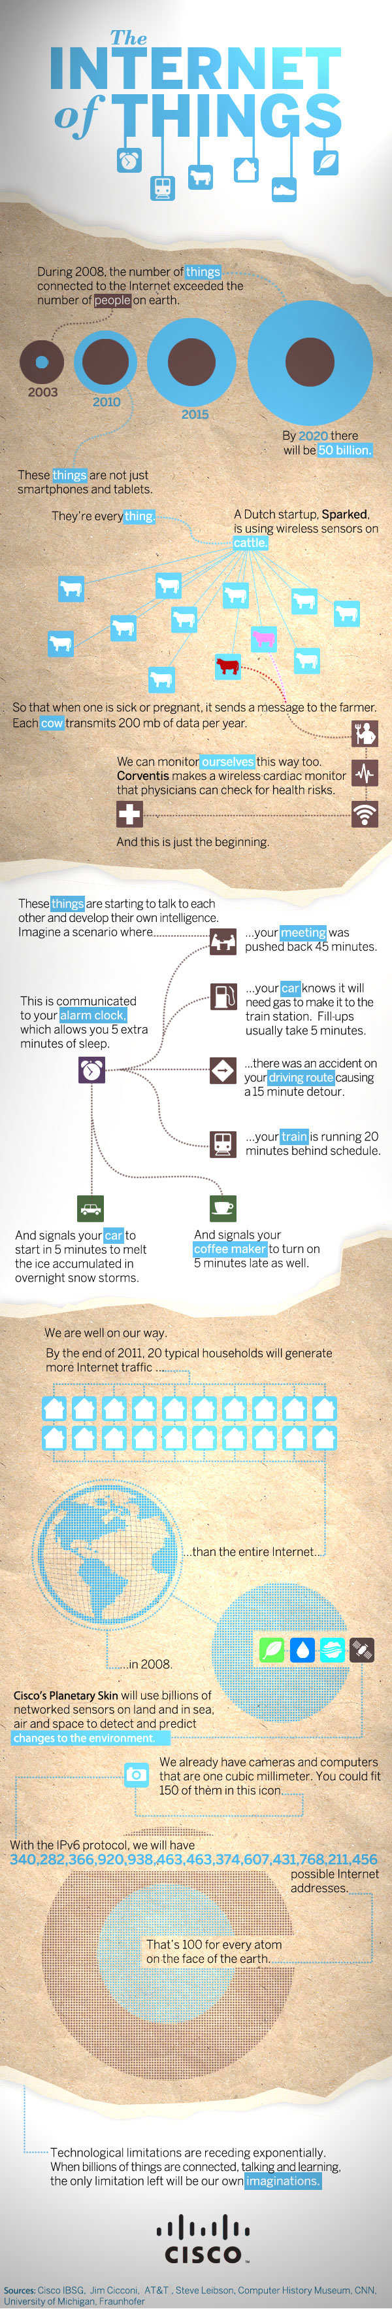
Source: Cisco

Slide 13
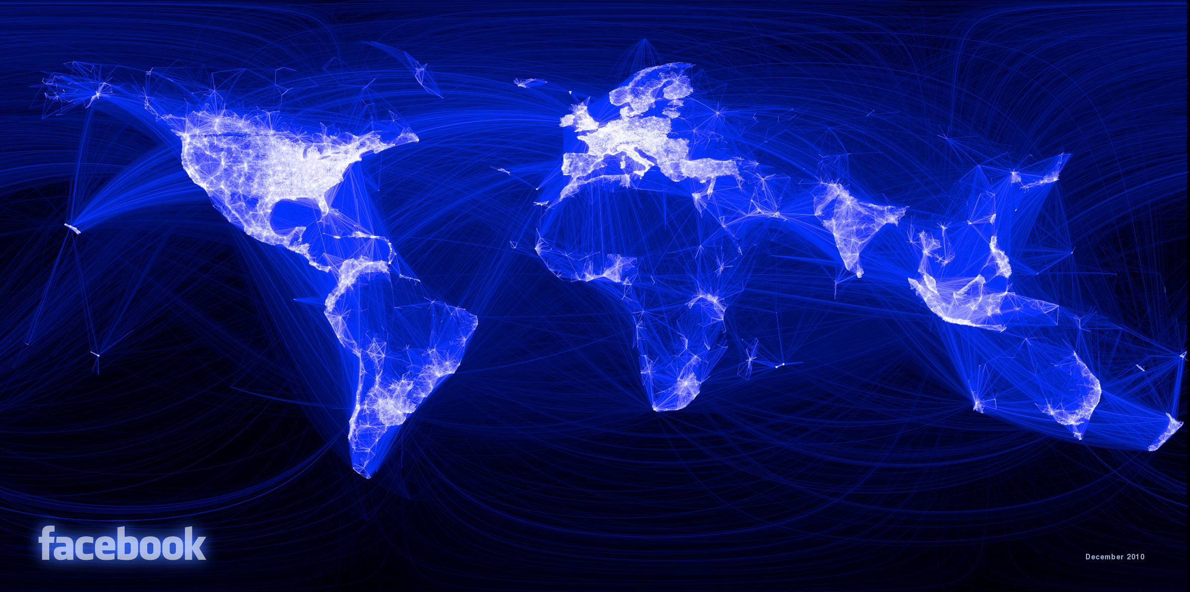
Source: Facebook

Slide 14

Traceroute map of the Internet, ~5 million edges, circa 2003. opte.org

Slide 15
Why should you take this course?
Impact
  Social, economic, political, educational, …
  Why should you care about NetNeutrality?
  What does it mean to run out of IP addresses?
  How could Egypt shut down the Internet internally?
  How could Pakistan shut down Youtube globally?
Continuously changing and evolving
  Incredible complexity
  Any fact you learn will be inevitably out of date
  Learn general underlying principles
Learn to program the network
Networks are cool!
Notes:
Also, because networks are so successful that they are disappearing from your sight!

Slide 16
Roadmap
Assignments: learn by implementing
  Warm up: Snowcast, a networked music server
    Get a feel for how applications use the network
Build knowledge from the ground up
  Link individual nodes
  Local networks with multiple nodes
  IP: Connect hosts across several networks
  Transport: Connect processes on different hosts
  Applications
A few cross-cutting issues
  Security, multimedia, overlay networks, P2P…

Slide 17
Recurring Themes
How to find who to talk to
  Addresses and names, discovery, routing
Decide how to talk to them
  Encodings, Protocols
Make sure communication is correct, only among intended parties
  Error correction, encryption, …
How to do this at scale
  Planetary scale (or beyond)

Slide 18
Stretch
(and I won’t look if you are shopping and want to flee)

Slide 19
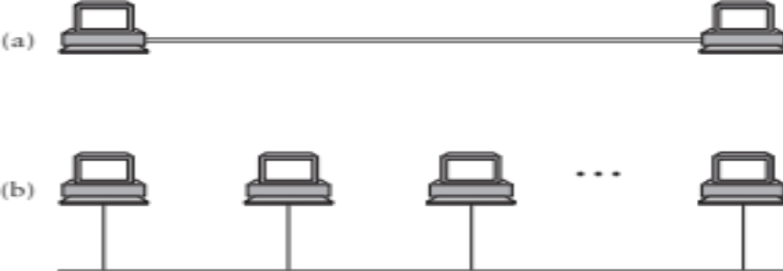
Building Blocks
Nodes: Computers (hosts), dedicated routers, …
Links: Coax, twisted pair, fiber, radio, …

Slide 20
How to connect more nodes?
Multiple wires
Shared medium

Slide 21
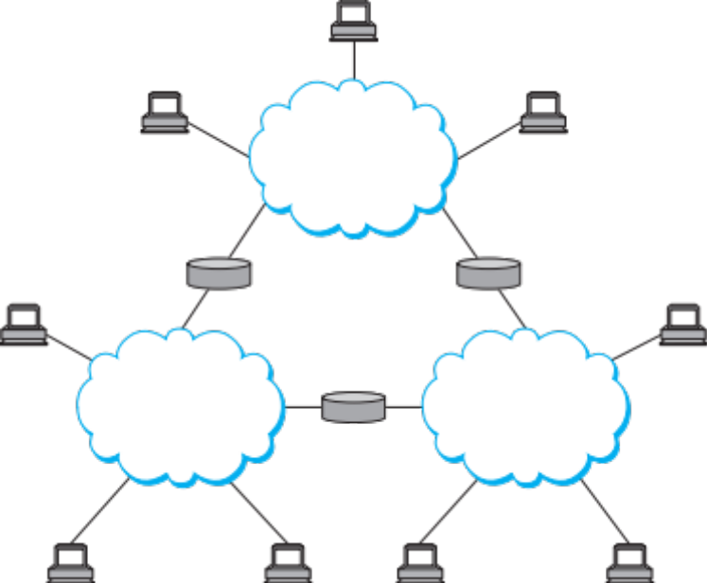

From Links to Networks
To scale to more nodes, use switching
  Nodes can connect to multiple other nodes
  Recursively, one node can connect to multiple networks
Notes:
Notice how we have some central elements connecting the hosts: switches
We want to create the illusion that the nodes are all connected to each other

Slide 22
Switching Strategies
Circuit Switching – virtual link between two nodes
  Set up circuit (e.g. dialing, signaling) – may fail: busy
  Transfer data at known rate
  Tear down circuit
Packet Switching
  Forward bounded-size messages.
  Each message can have different senders/receivers
  Focus of this course
Analogy: circuit switching reserves the highway for a cross-country trip. Packet switching interleaves everyone’s cars.

Slide 23
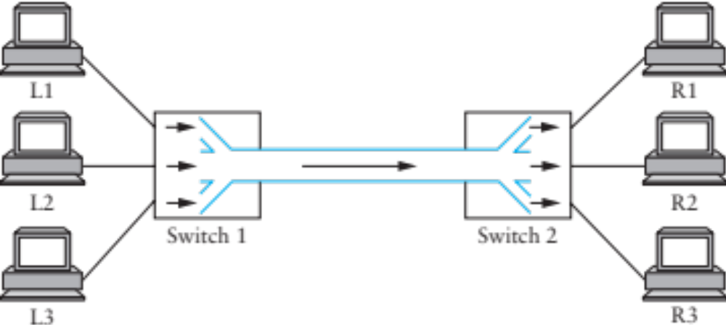
Multiplexing
What to do when multiple flows must share a link?

Slide 24
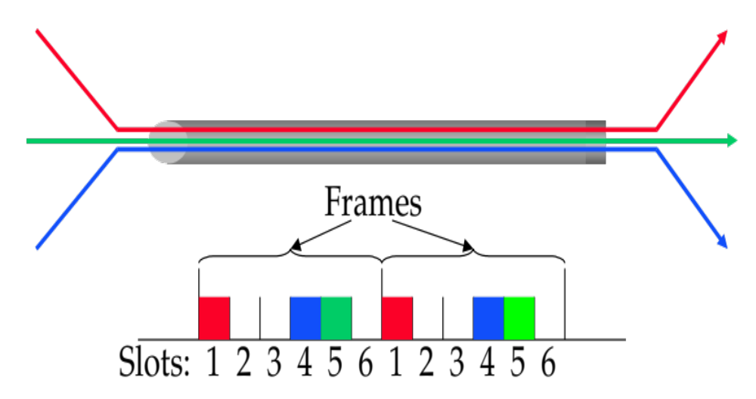
STDM
Synchronous time-division multiplexing
  Divide time into equal-sized quanta, round robin
  Illusion of direct link for switched circuit net
  But wastes capacity if not enough flows
  Also doesn’t degrade gracefully when more flows than slots

Slide 25
FDM
Frequency-division multiplexing: allocates a frequency band for each flow
  Same as TV channels and radio stations
Similar drawbacks to STDM
  Wastes bandwidth if someone not sending
  Can run out of spectrum

Slide 26
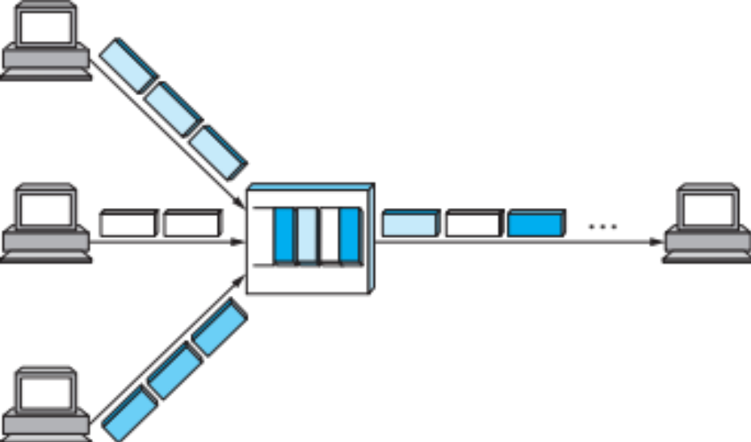
Statistical Multiplexing
Idea: like STDM but with no pre-determined time slots (or order!)
Maximizes link utilization
  Link is never idle if there are packets to send

Slide 27
Statistical Multiplexing
Cons:
  Hard to guarantee fairness
  Unpredictable queuing delays
  Packets may take different paths
Yet…
  This is the main model used on the Internet
Think of running a restaurant
  For a fixed set of people that go there every day
  Or on a busy corner of Manhattan
    When would you take reservations?

Slide 28
Roadmap
Assignments: learn by implementing
  Warm up: Snowcast, a networked music server
    Get a feel for how applications use the network
Build knowledge from the ground up
  Link individual nodes
  Local networks with multiple nodes
  IP: Connect hosts across several networks
  Transport: Connect processes on different hosts
  Applications
A few cross-cutting issues
  Security, multimedia, overlay networks, P2P…

Slide 29
Coming Up
Snowcast: start TODAY!
Next class:
  More on layering
  How to use the network from the application: sockets
Then…
  We start moving up the network stack, starting from how two computers can talk to each other.

