Slide 1


Slide 2
Understanding what CNNs learn
https://distill.pub/2020/circuits/zoom-in/

Slide 3
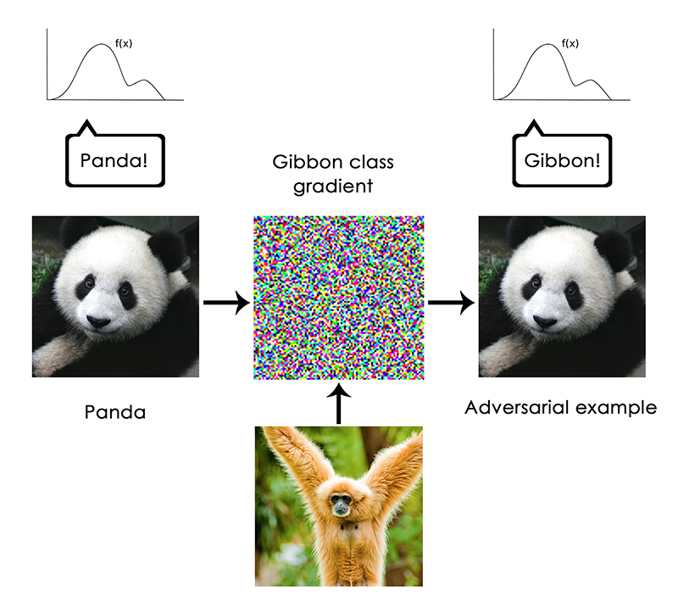
Francois Chollet - https://blog.keras.io/the-limitations-of-deep-learning.html
Notes:
But no

Slide 4
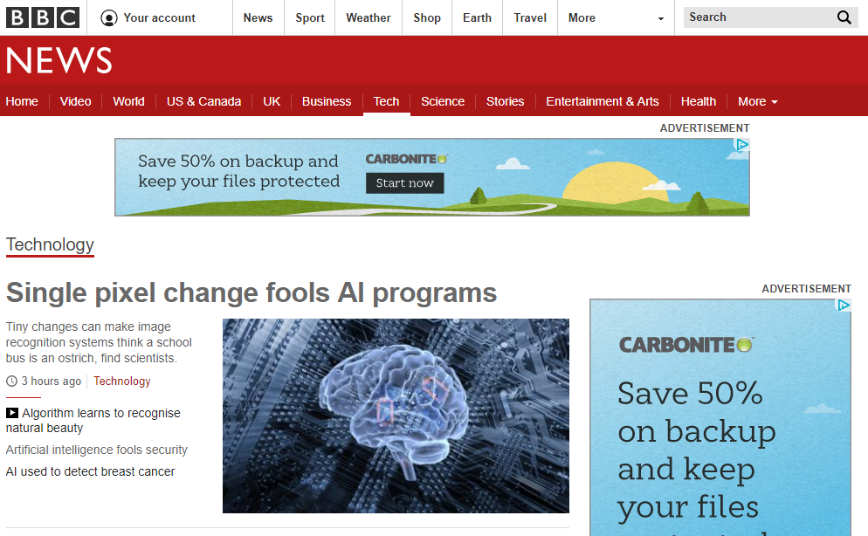
3rd November 2017

Slide 5
Yes, it’s a blue brain image : (

Slide 6
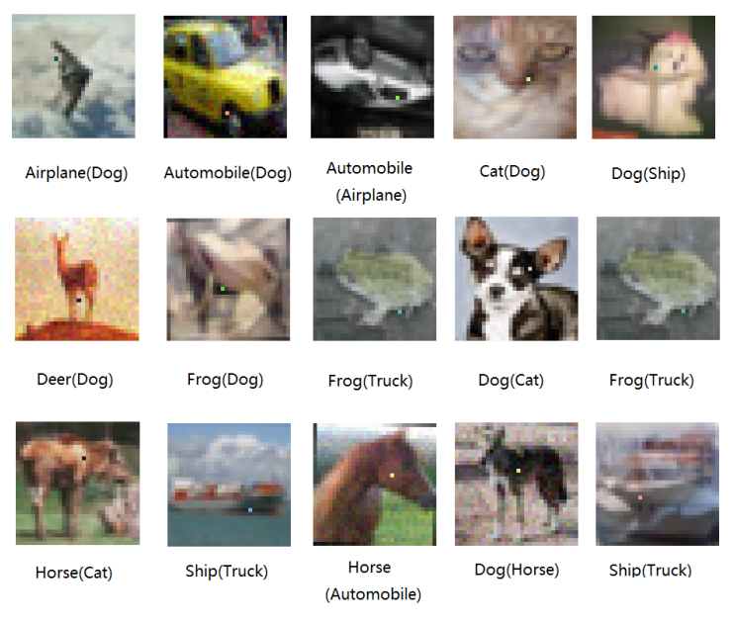
Su et al., One pixel attack for fooling deep neural networks
https://arxiv.org/abs/1710.08864

Slide 7
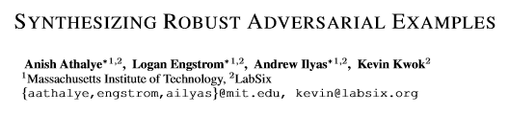
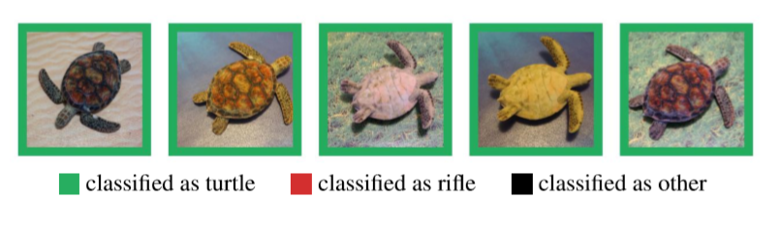
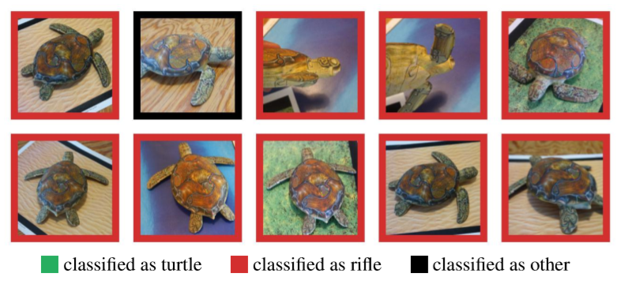
https://arxiv.org/pdf/1707.07397.pdf

Slide 8
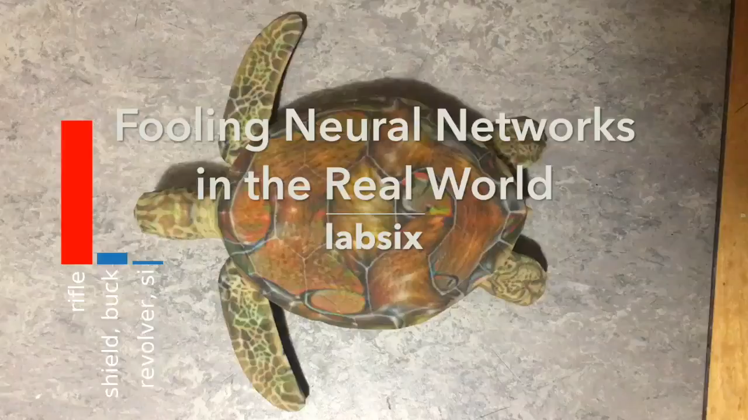

Slide 9
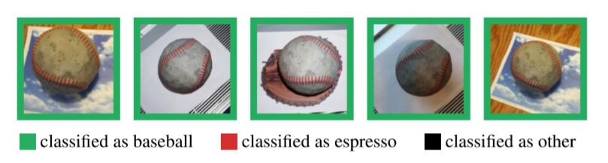
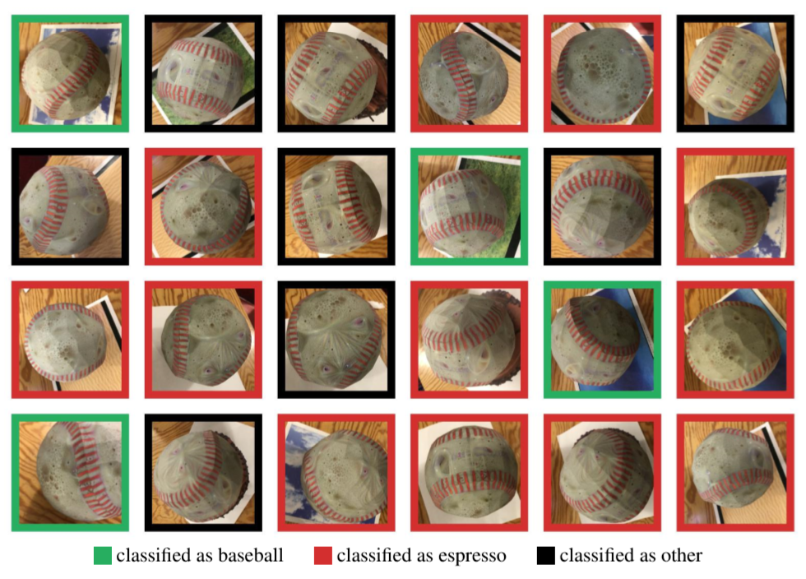

Slide 10
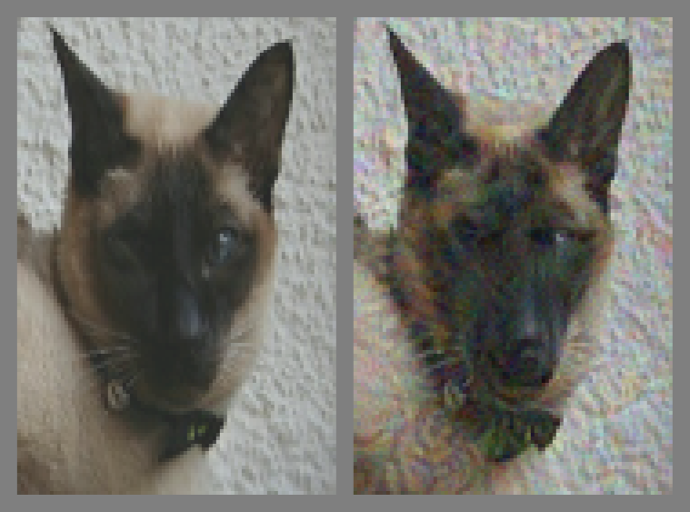
For next time: human + CV adversarial examples
https://arxiv.org/abs/1802.08195
JT note: does this work?

Slide 11
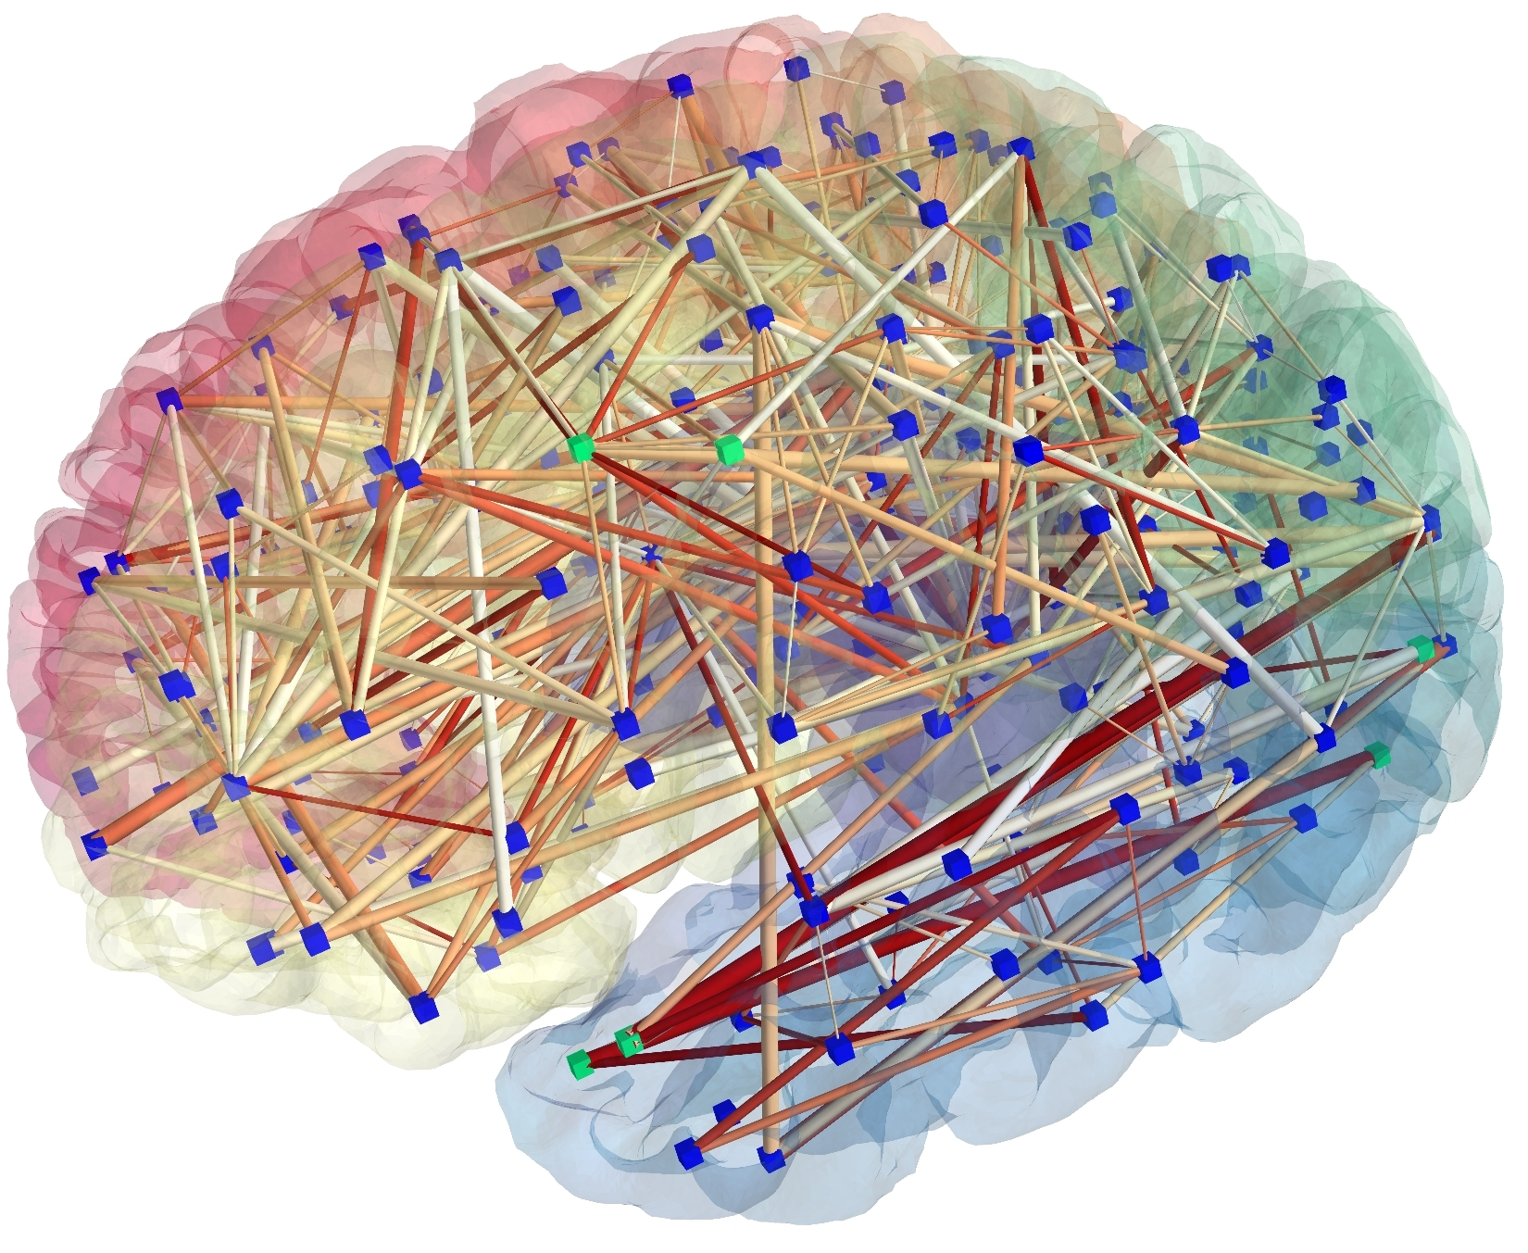
Connectomics:Neural nets for neural nets
[Patric Hagmann]
Notes:
This is some of James’ work with Harvard Brain Science Center.
The brain represented as a network: image obtained from MR connectomics. (Provided by Patric Hagmann, CHUV-UNIL, Lausanne, Switzerland)

Slide 12
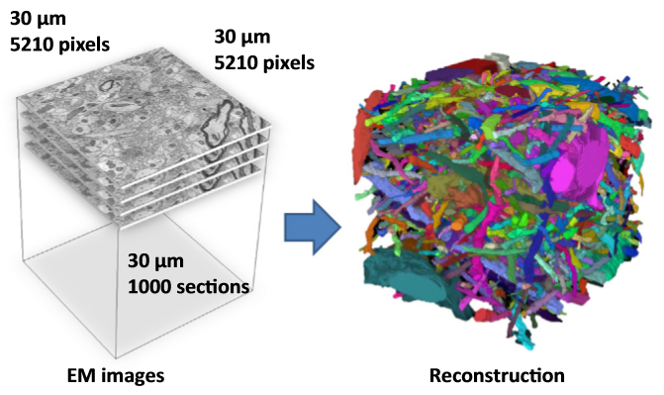
Vision for understanding the brain
1mm cubed of brain
Image at 5-30 nanometers
How much data?
[Kaynig-Fittkau et al.]

Slide 13
Vision for understanding the brain
1mm cubed of brain
Image at 5-30 nanometers
How much data?
1 Petabyte – 1,000,000,000,000,000
~ All photos uploaded to Facebook per day
[Kaynig-Fittkau et al.]

Slide 14
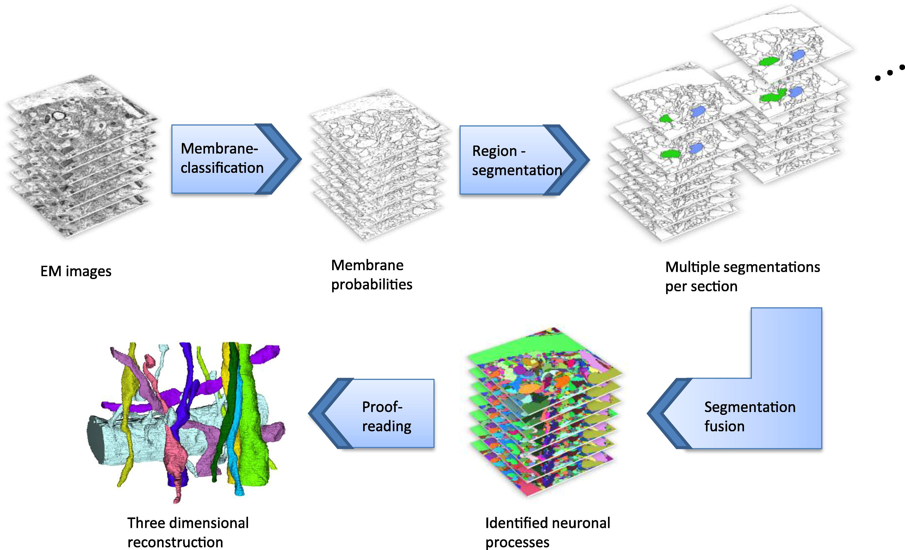
[Kaynig-Fittkau et al.]

Slide 15
[Kaynig-Fittkau et al.]

Slide 16
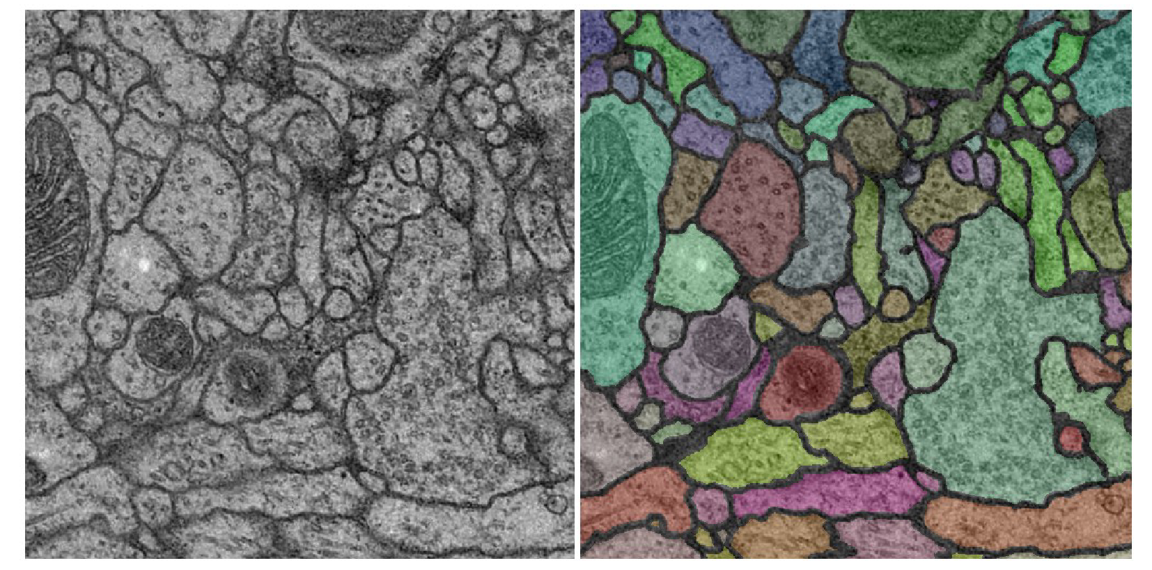

Vision for understanding the brain
Instance segmentation (but the instances sometimes look quite different!)
Notes:
Use computer vision to classify neurons in the brain.
Attempt to build a connectivity graph of all neurons – ‘connectome’ – so that we can map and simulate brain function.

Slide 17
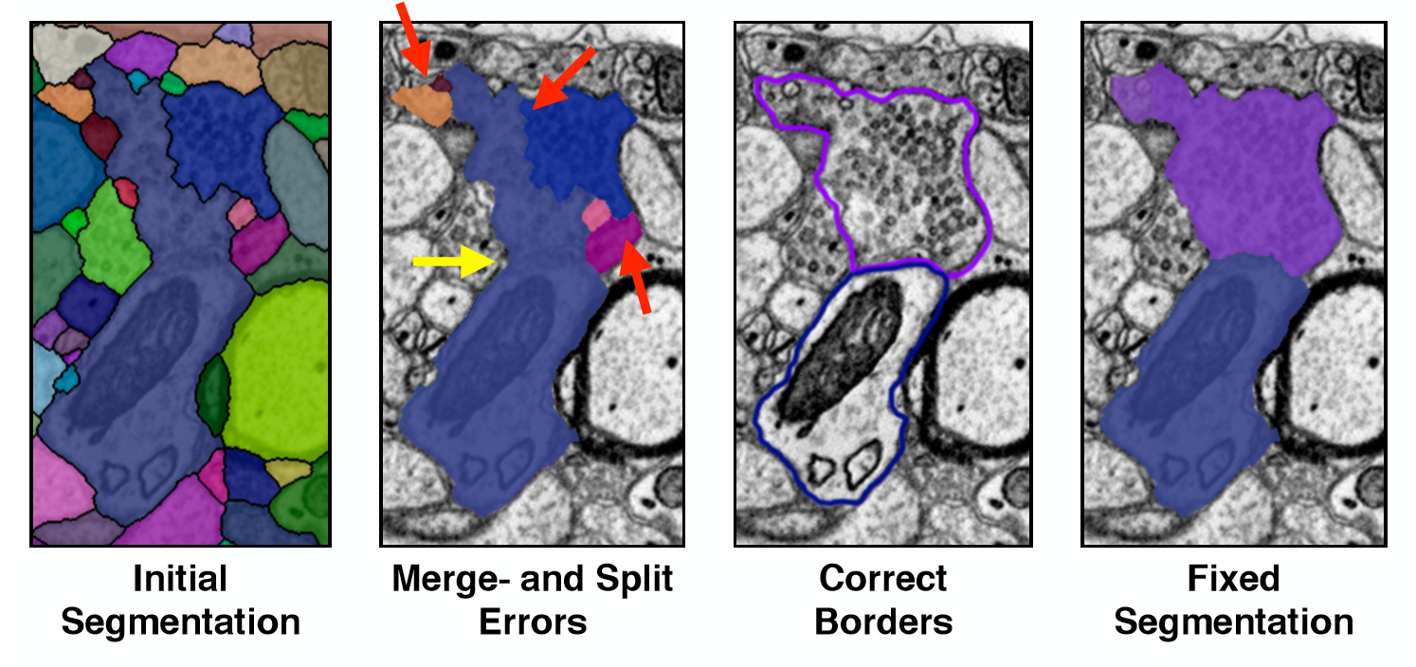
[Haehn et al.]
Notes:
https://arxiv.org/abs/1704.00848

Slide 18
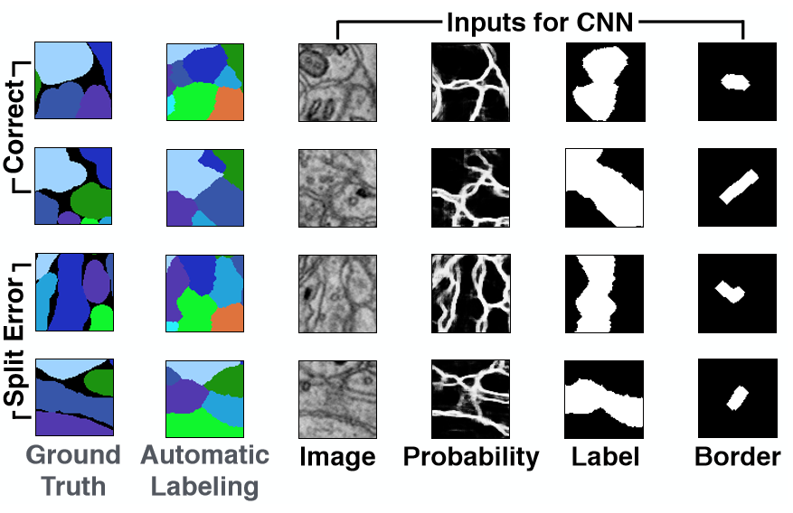
[Haehn et al.]
Notes:
https://arxiv.org/abs/1704.00848

Slide 19
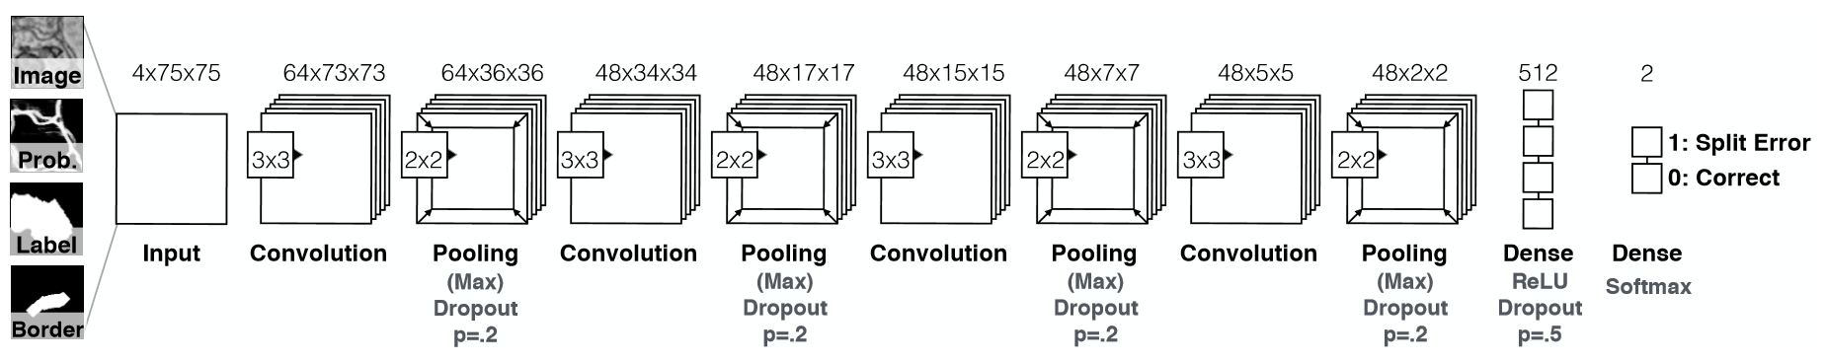
Network Architecture
[Haehn et al.]
Notes:
170,000 parameters
9000 positive / negative example patches
75 x 75
80,000 image patches
https://arxiv.org/abs/1704.00848

Slide 20
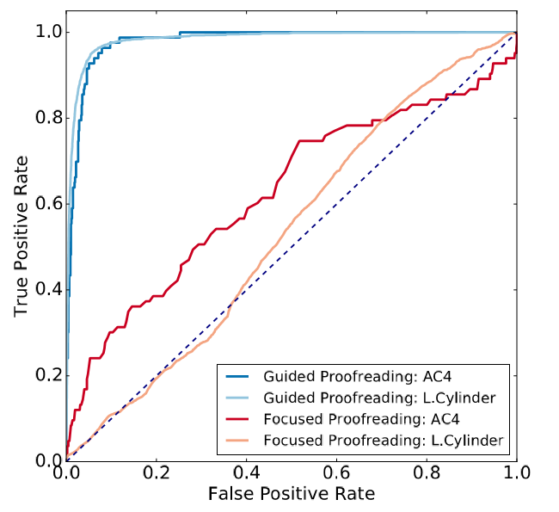
[Haehn et al.]
Notes:
https://arxiv.org/abs/1704.00848

Slide 21
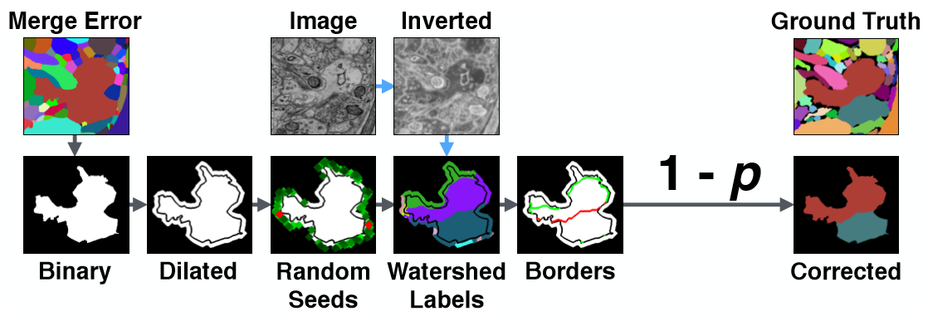
Detecting Merge Errors
Notes:
https://arxiv.org/abs/1704.00848

Slide 22
Big space of designs!
But we still don’t even know how many layers we need.

Slide 23
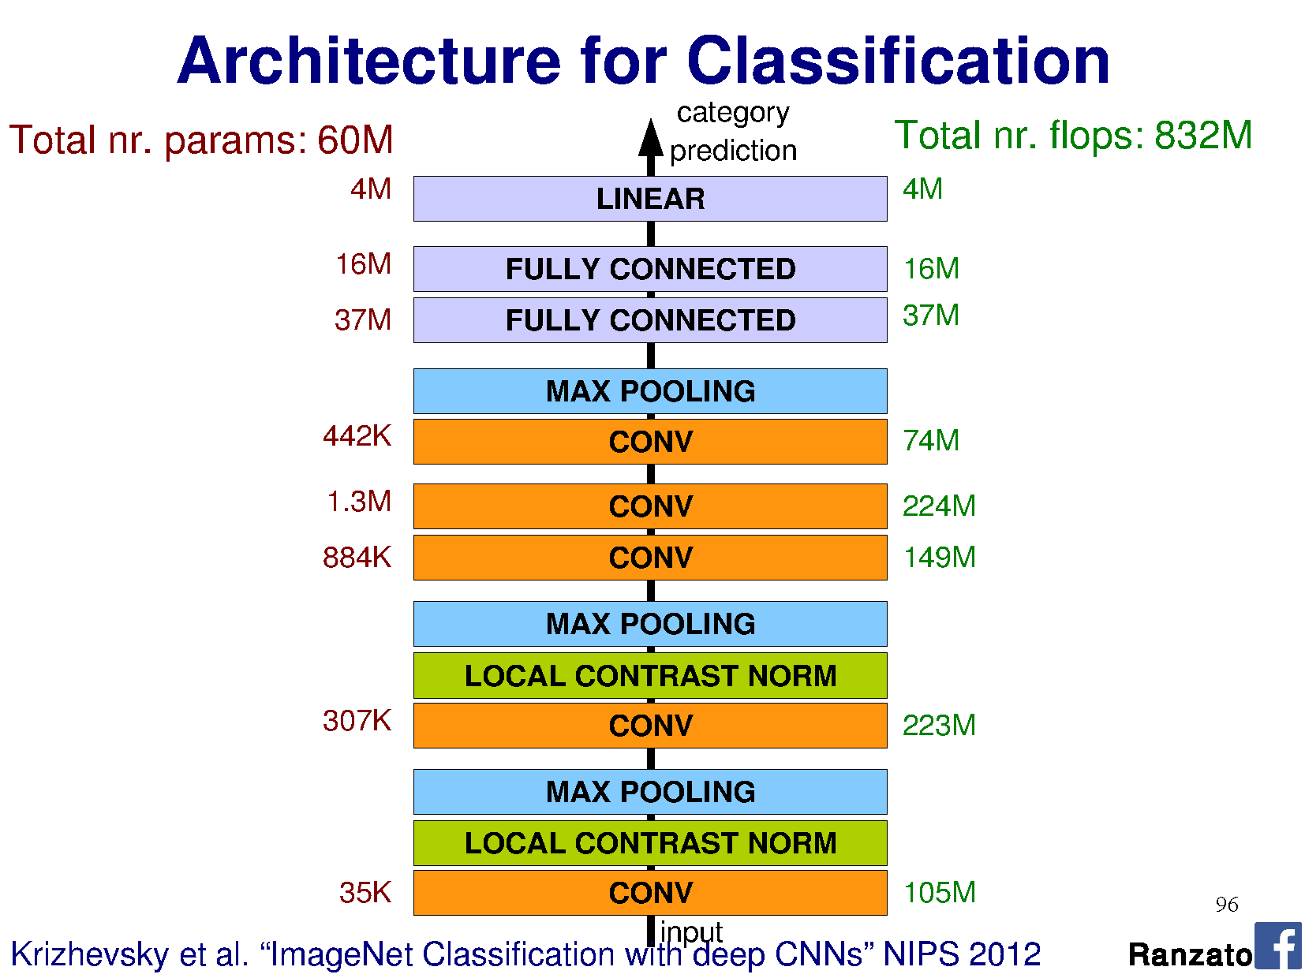
Notes:
FLOPS = just to execute, not train.

Slide 24
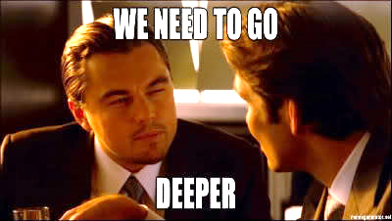

Slide 25


Slide 26
VERY DEEP CONVOLUTIONAL NETWORKS FOR LARGE-SCALE IMAGE RECOGNITION
Beyond AlexNet
Karen Simonyan & Andrew Zisserman 2015
These are the pre-trained “VGG” networks
that you use in project 4
Notes:
VGG = Visual Geometry Group at Oxford, UK

Slide 27
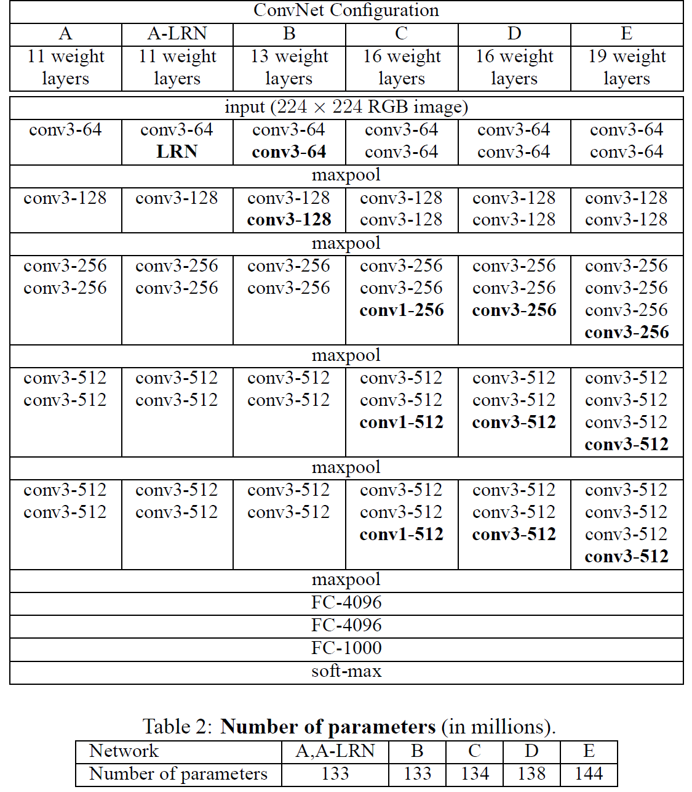
Notes:
Compared to Alex-Net – Deeper, smaller convolutions, more parameters

Slide 28
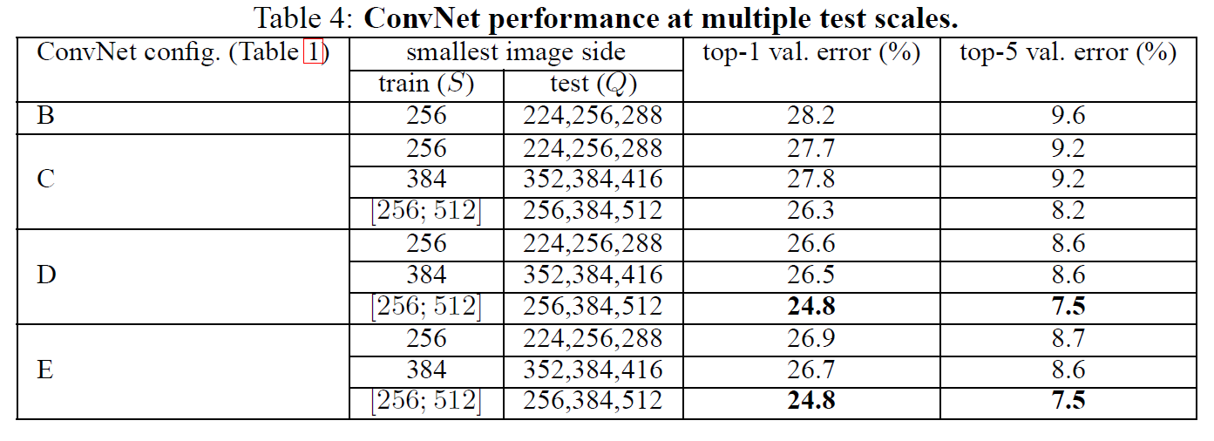

Slide 29
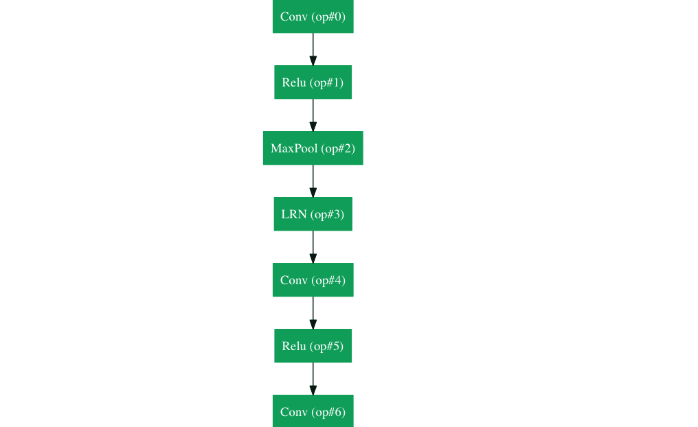
Google LeNet (2014)
22 layers
6.67% error
ImageNet top 5

Slide 30
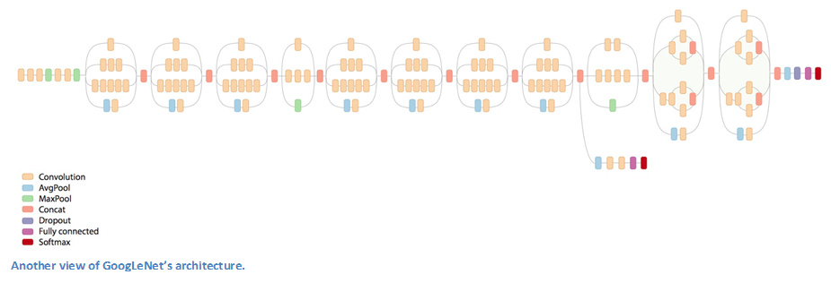
Inception!

Slide 31
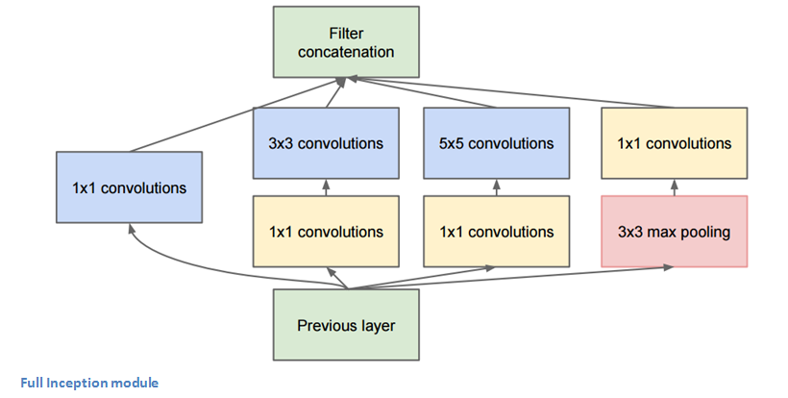
Parallel layers

Slide 32
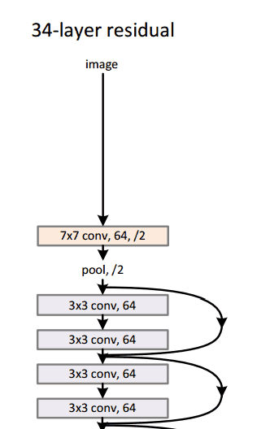
ResNet (He et al., 2015)
ResNet won ILSVRC 2015 with a top-5 error rate of 3.6%
Depending on their skill and expertise, humans generally hover around a 5-10% error.
Superhuman performance!
But the task is arguably
not well defined.
Notes:
They actually have a 152-layer model
http://kaiminghe.com/cvpr16resnet/cvpr2016_deep_residual_learning_kaiminghe.pdf

Slide 33
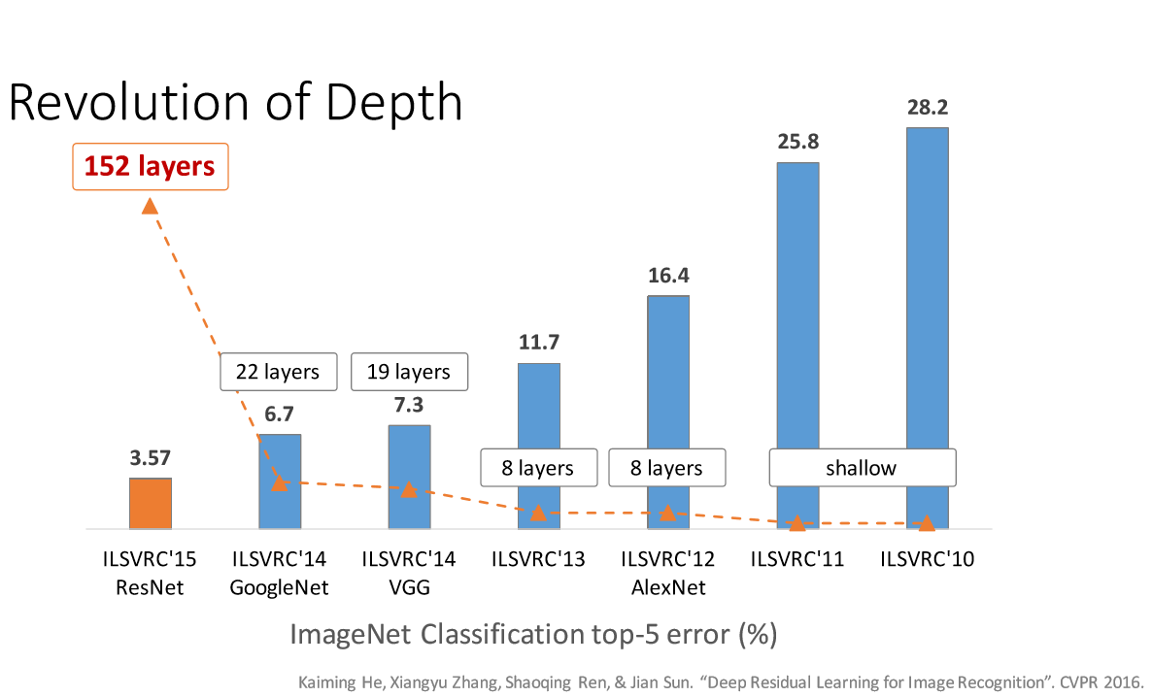

Slide 34
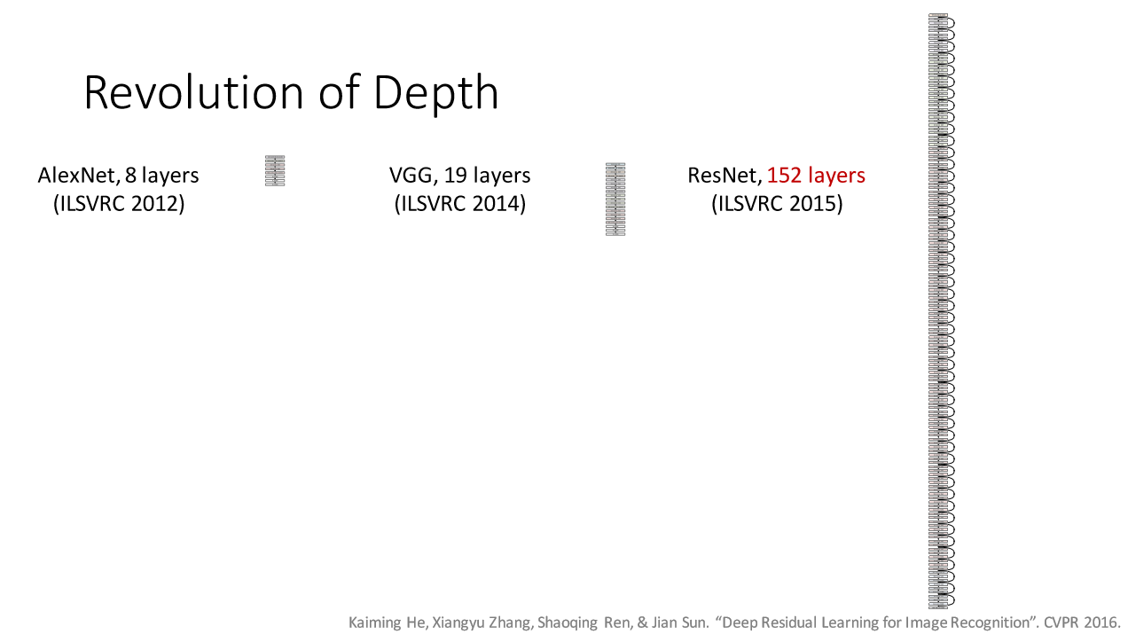
Notes:
The CIFAR-10 and CIFAR-100 are labeled subsets of the 80 million tiny images dataset. They were collected by Alex Krizhevsky, Vinod Nair, and Geoffrey Hinton. The CIFAR-10 dataset
The CIFAR-10 dataset consists of 60000 32x32 colour images in 10 classes, with 6000 images per class. There are 50000 training images and 10000 test images.

Slide 35
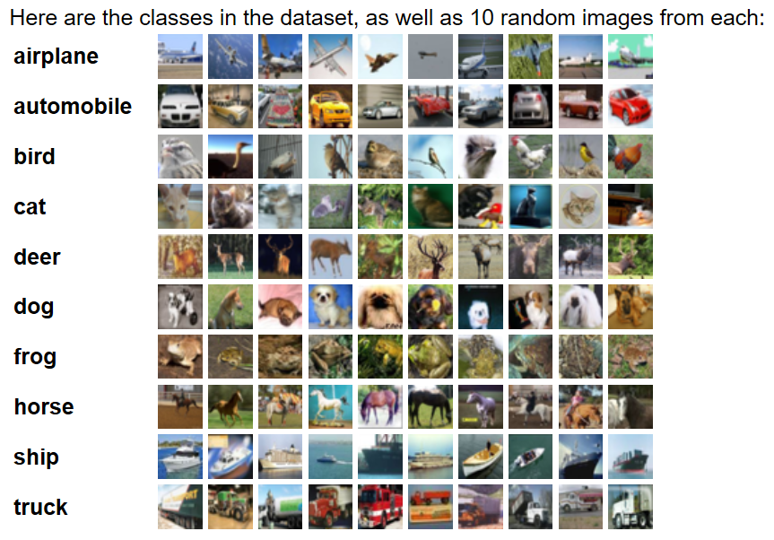
CIFAR-10
60,000 32x32 color images, 10 classes
Notes:
The CIFAR-10 and CIFAR-100 are labeled subsets of the 80 million tiny images dataset. They were collected by Alex Krizhevsky, Vinod Nair, and Geoffrey Hinton.
The CIFAR-10 dataset
The CIFAR-10 dataset consists of 60000 32x32 colour images in 10 classes, with 6000 images per class. There are 50000 training images and 10000 test images.

Slide 36
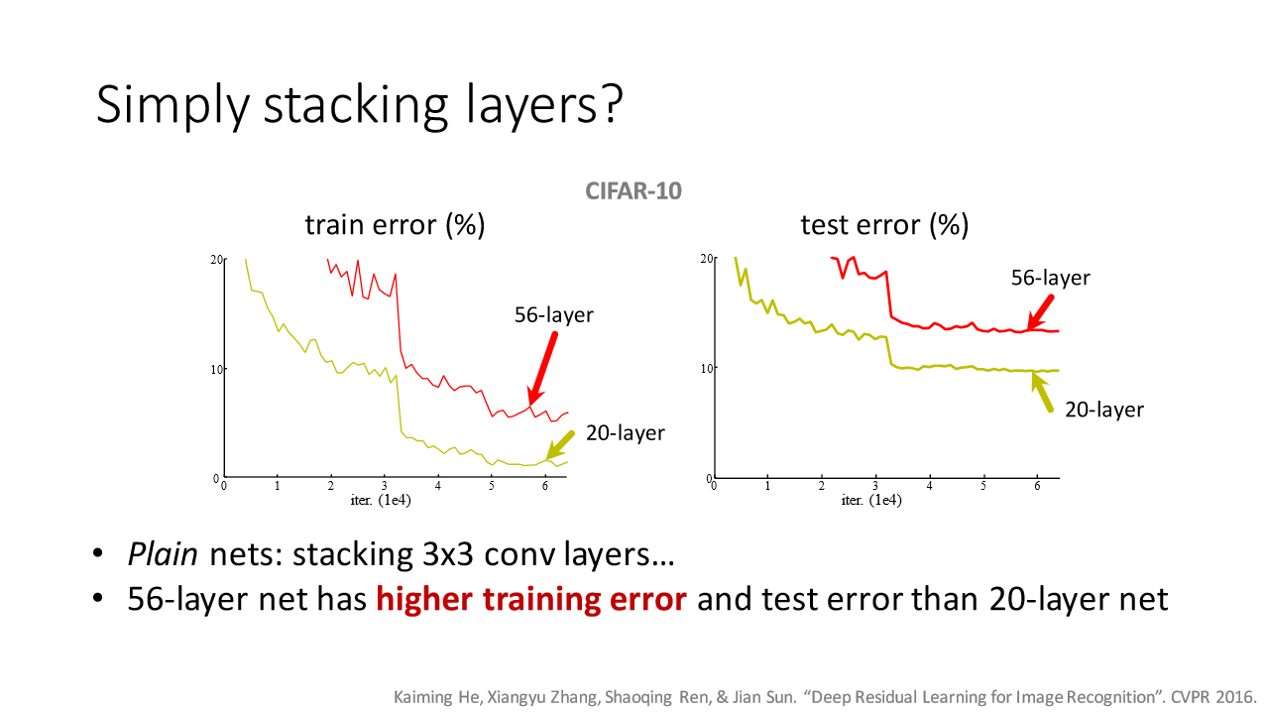

Slide 37
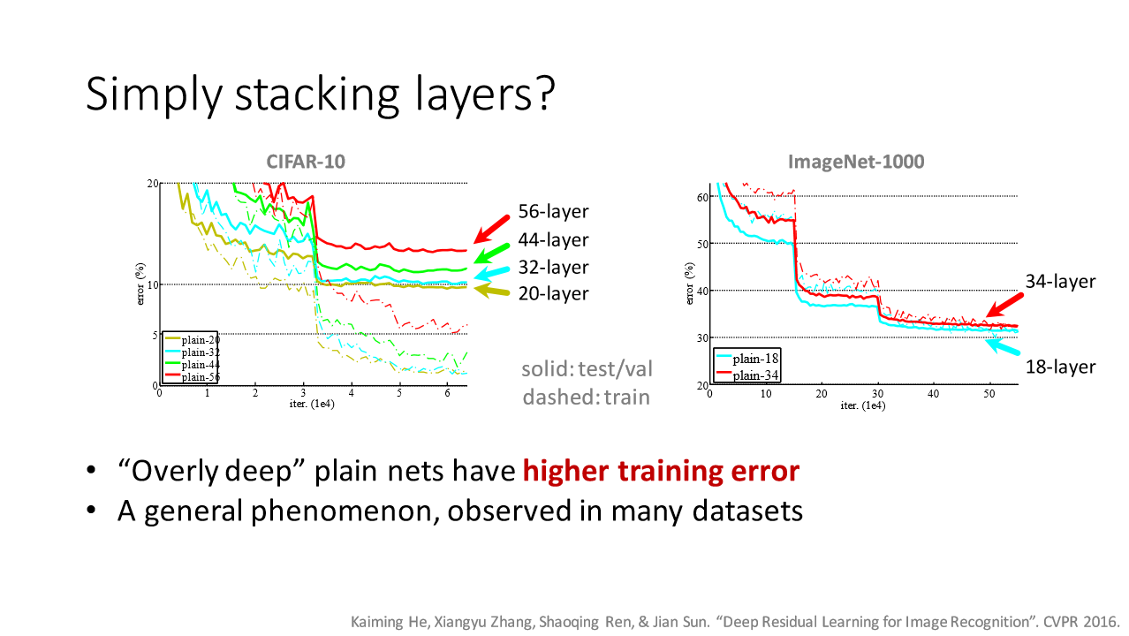

Slide 38
Vanishing/exploding gradient problem
Backpropagation:
- Compute gradient update for every neuron which was involved in the output across layers
Involves chaining partial derivates over many layers!
If derivative < 1, gradient gets smaller and smaller as we go deeper and deeper -> vanishing gradients!
If derivative > 1, gradient gets larger and larger as we go deeper and deeper -> exploding gradients!

Slide 39

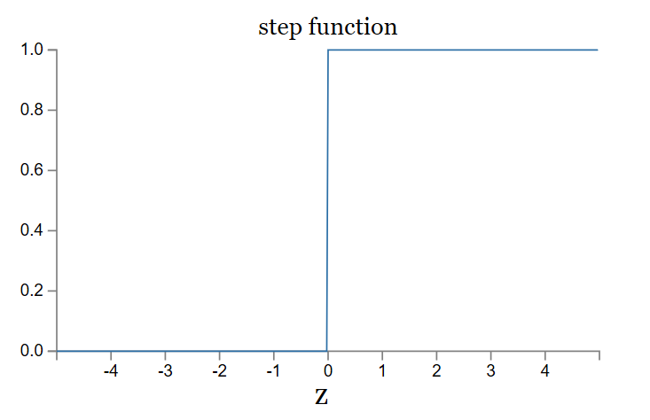
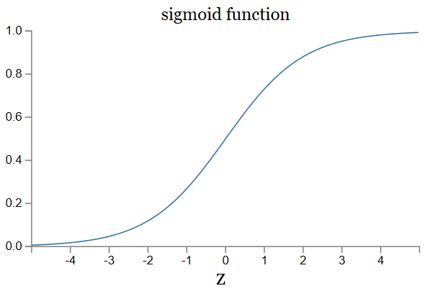

Vanishing/exploding gradient re: activation
If derivative < 1, gradient gets smaller and smaller as we go deeper and deeper -> vanishing gradients!
If derivative > 1, gradient gets larger and larger as we go deeper and deeper -> exploding gradients!
Sigmoid
ReLU
$$σ\left(z\right)=max⁡(0,x)$$

Slide 40
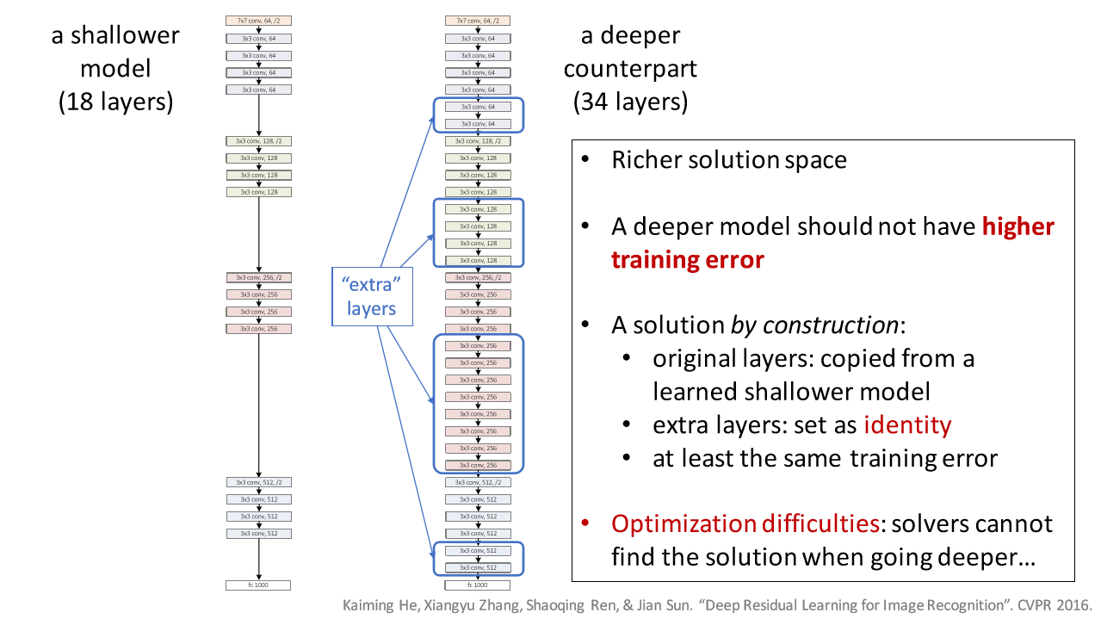

Slide 41
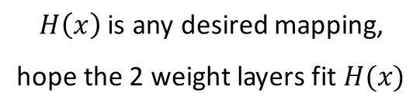
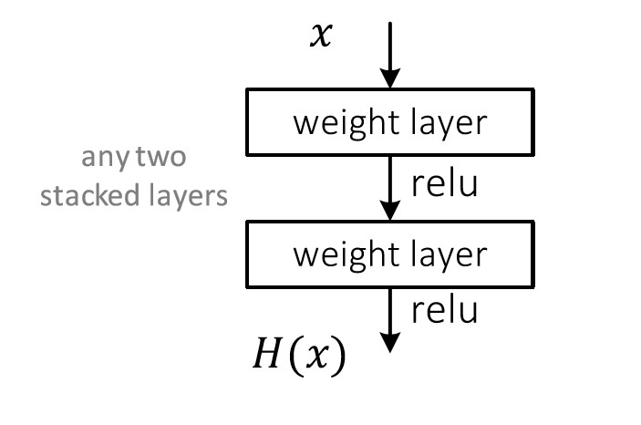
Regular net

Slide 42
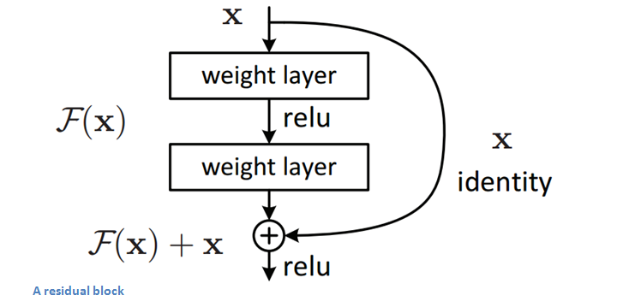
Residual Unit
Notes:
The idea behind a residual block is that you have your input x go through conv-relu-conv series. This will give you some F(x).
That result is then added to the original input x.
Let’s call that H(x) = F(x) + x. In traditional CNNs, your H(x) would just be equal to F(x) right?
So, instead of just computing that transformation (straight from x to F(x)), we’re computing the term that you MUST add, F(x), to your input, x.
Basically, the mini module shown below is computing a “delta” or a slight change to the original input x to get a slightly altered representation.
(When we think of traditional CNNs, we go from x to F(x) which is a completely new representation that doesn’t keep any information about the original x). The authors believe that “it is easier to optimize the residual mapping than to optimize the original, unreferenced mapping”.

Slide 43
Residual Unit
The inputs of a lower layer is added to a node in a higher layer.
Notes:
If identity were the optimal mapping, then we would set all the weight layers to 0 and be done.
If the optimal mapping were close to the identity, then this formulation makes it easier to find small fluctuations.
But, the identity transform is not optimal (duh),

Slide 44
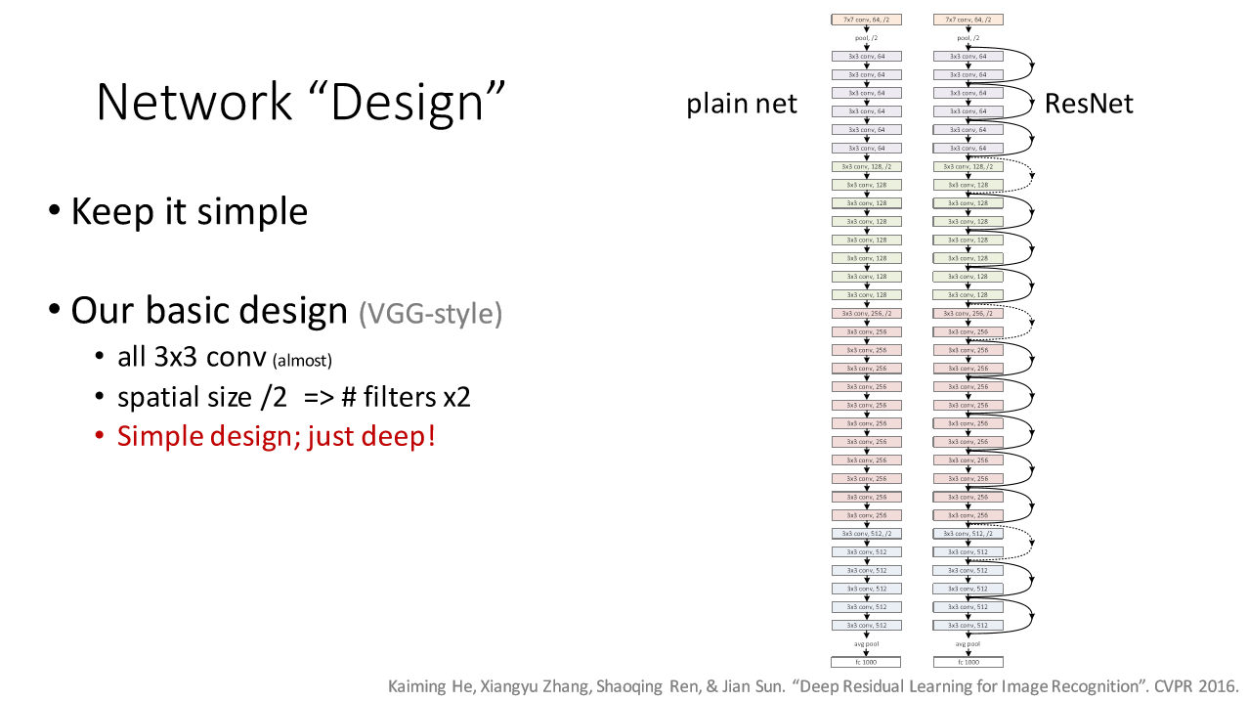

Slide 45
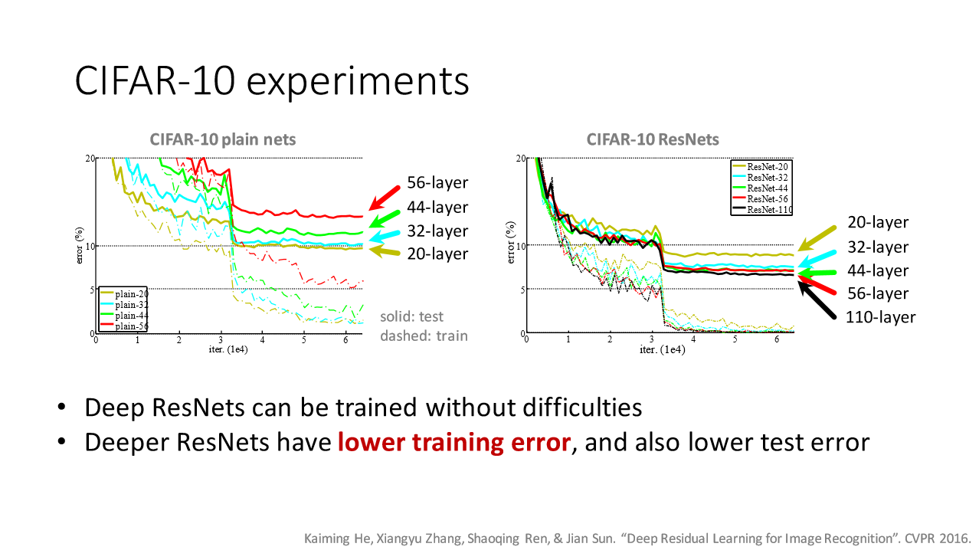
Training rate change – lower allows finer exploration of narrow ‘valleys’ in energy landscape.
Why so steep?

Slide 46
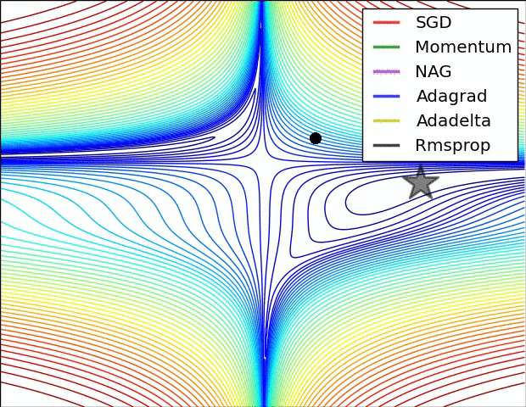
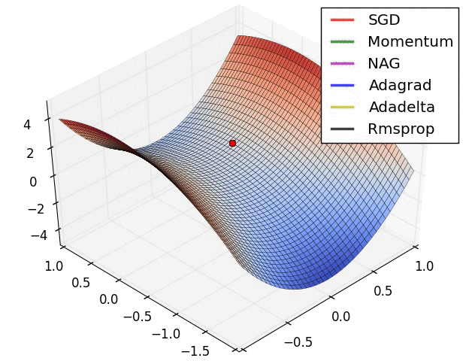
Flat regions in energy landscape
Notes:
Also lets us see how different kinds of learning algorithms work.

Slide 47
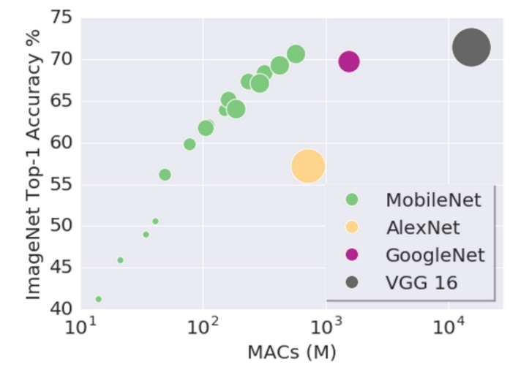
James, do we have to go deeper?
Compute vs. parameters / multiply-adds
Hmm…efficient nets…
might be useful for final project ???
https://www.infoq.com/news/2017/06/google-mobilenets-tensorflow
https://arxiv.org/abs/1704.04861
Notes:
http://theorangeduck.com/page/neural-network-not-working

Slide 48
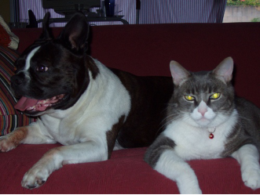
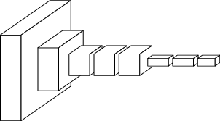
ConvNets perform classification
< 1 millisecond
“tabby cat”
1000-dim vector
end-to-end learning
[Slides from Long, Shelhamer, and Darrell]

Slide 49
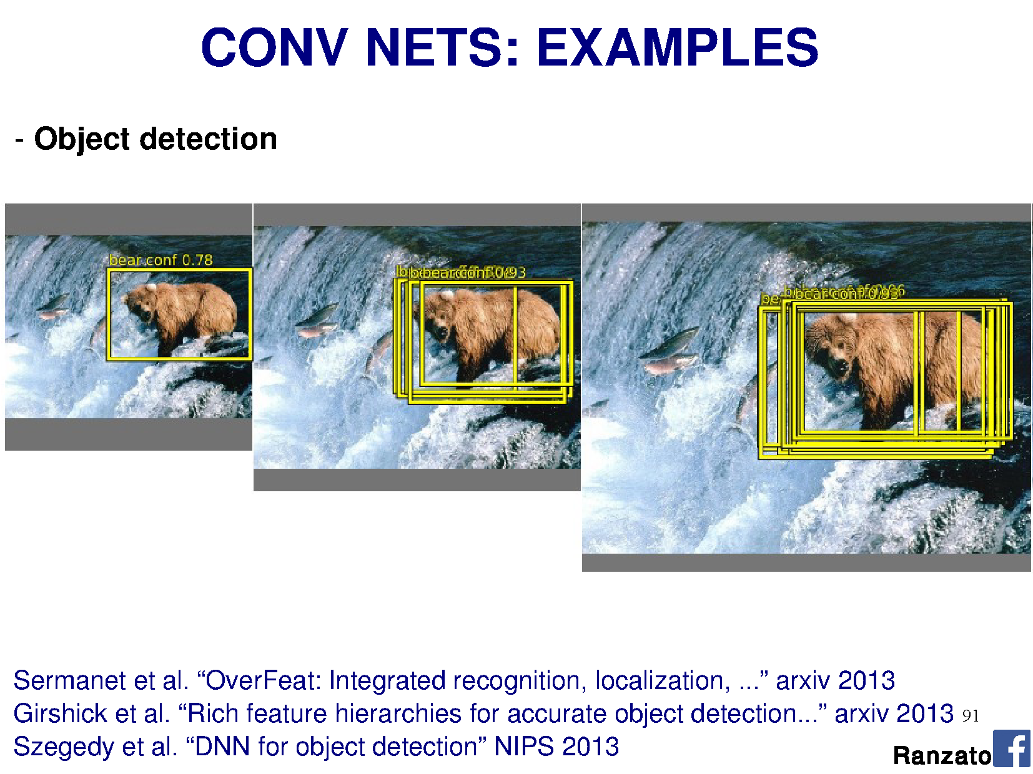

Slide 50
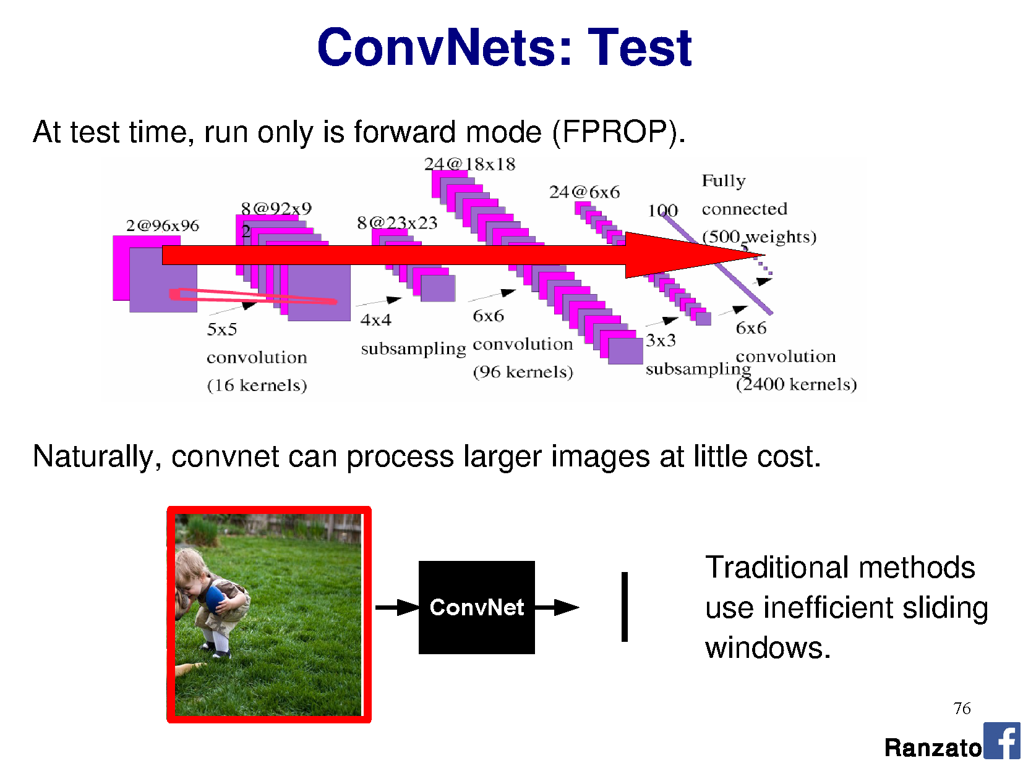

Slide 52
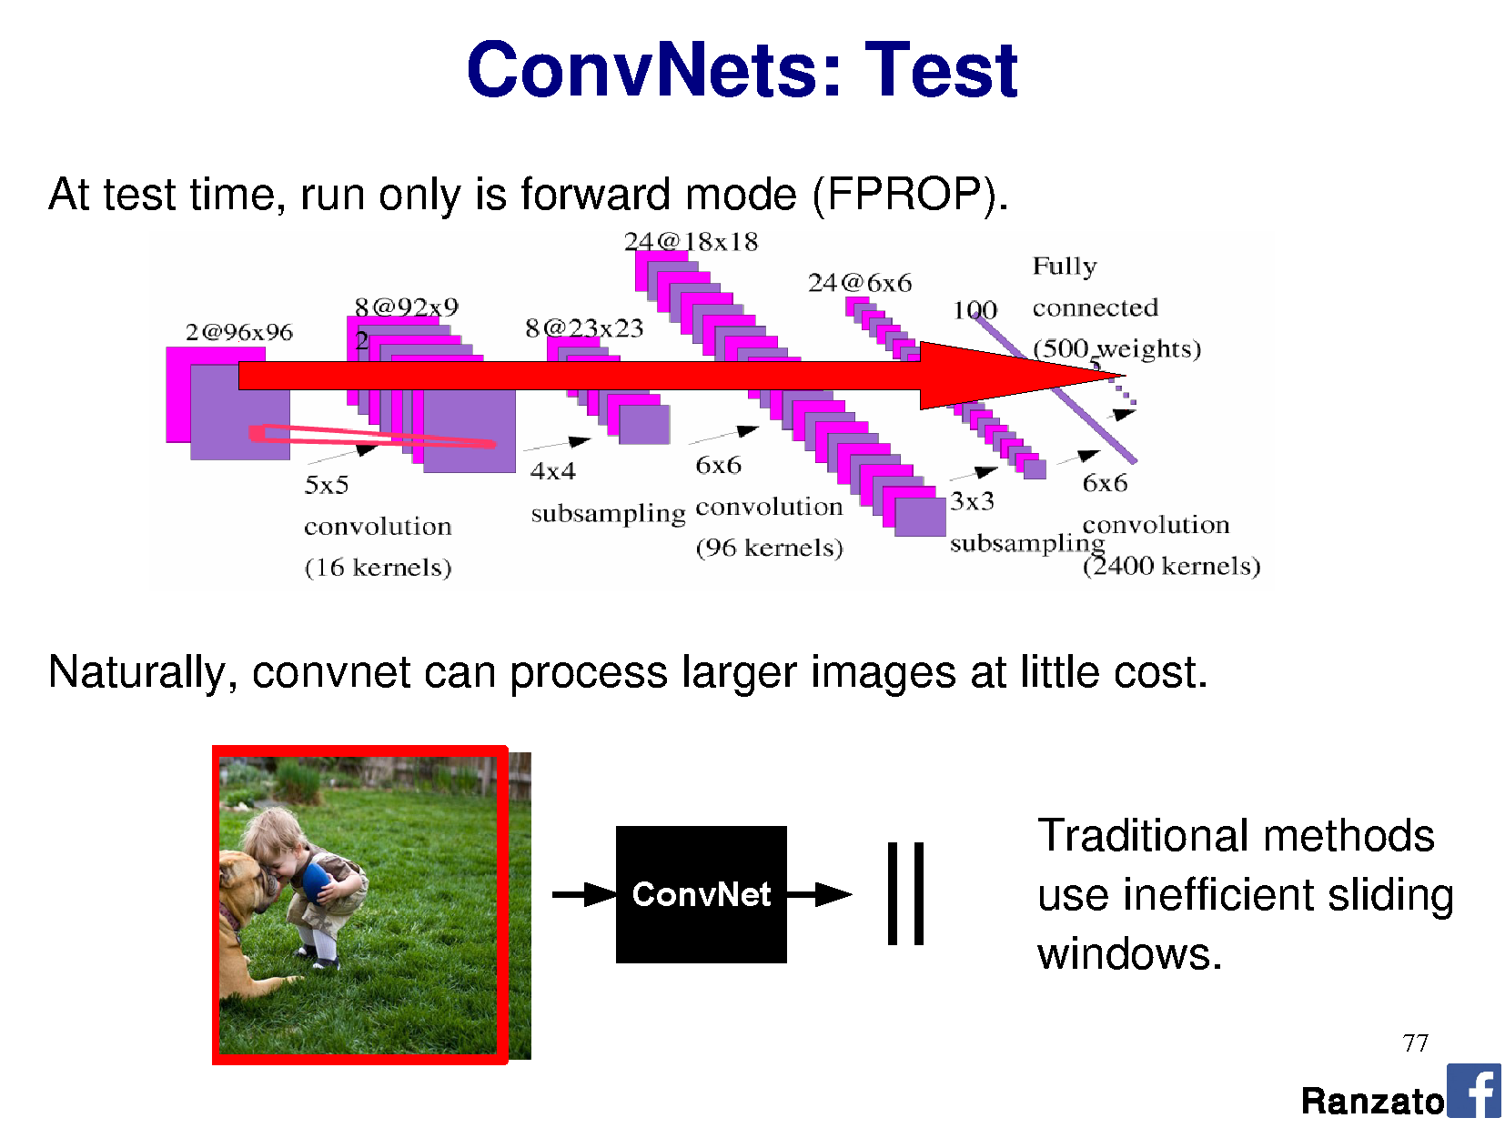

Slide 53
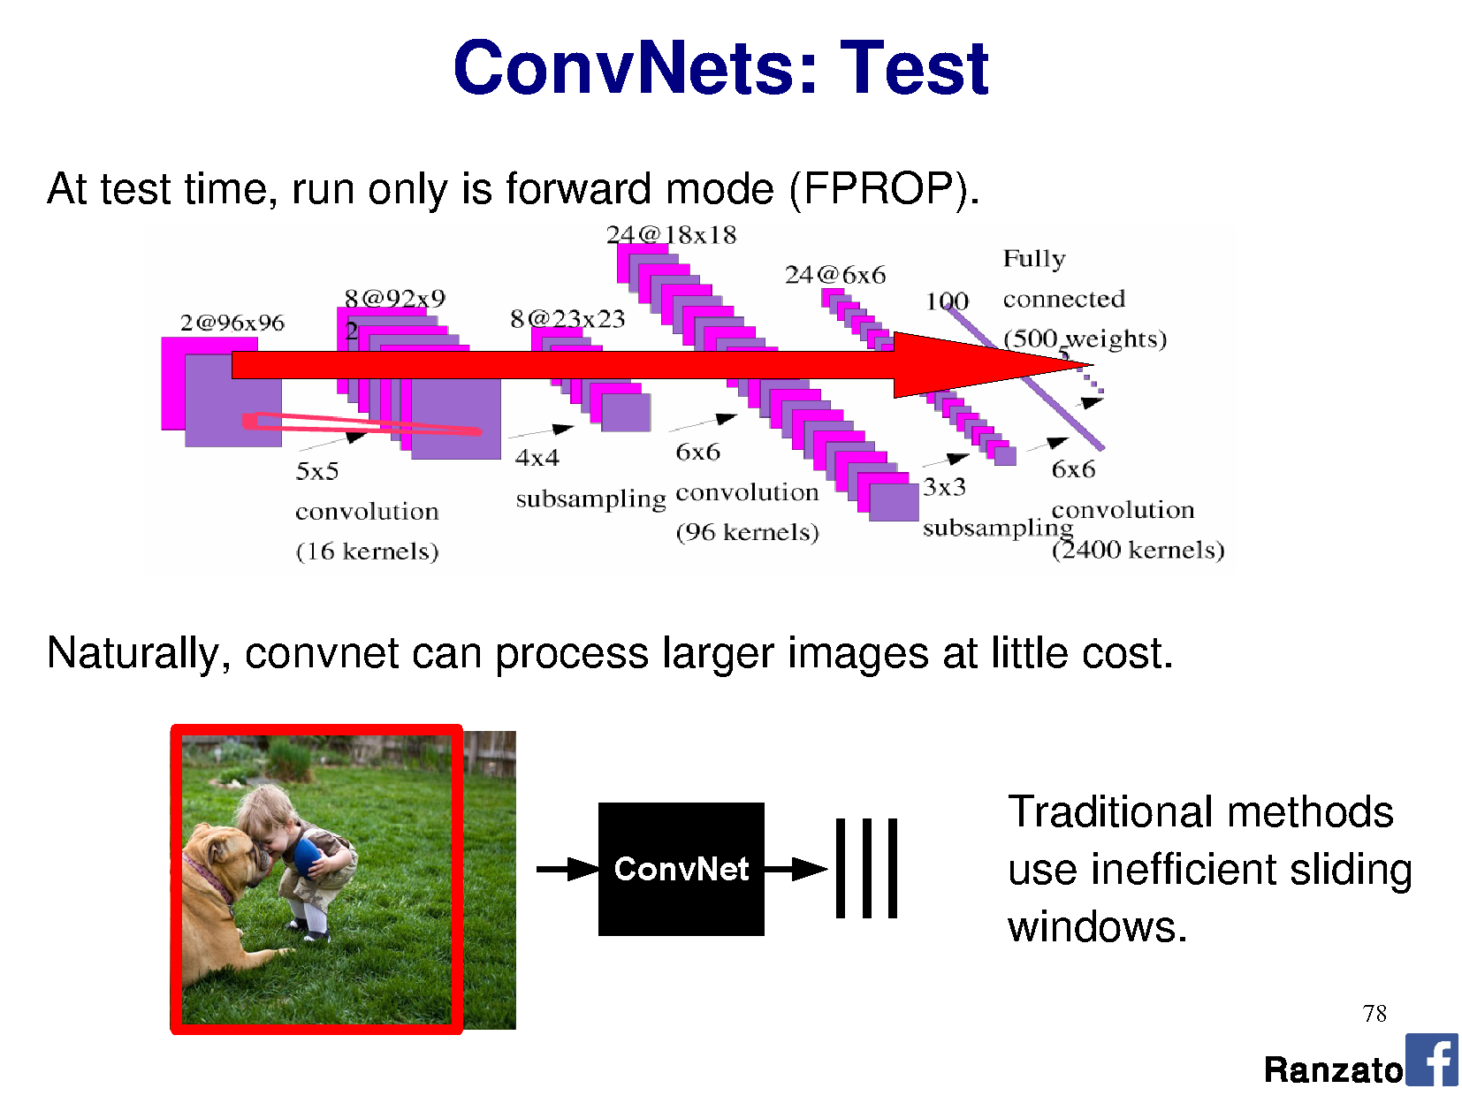

Slide 54
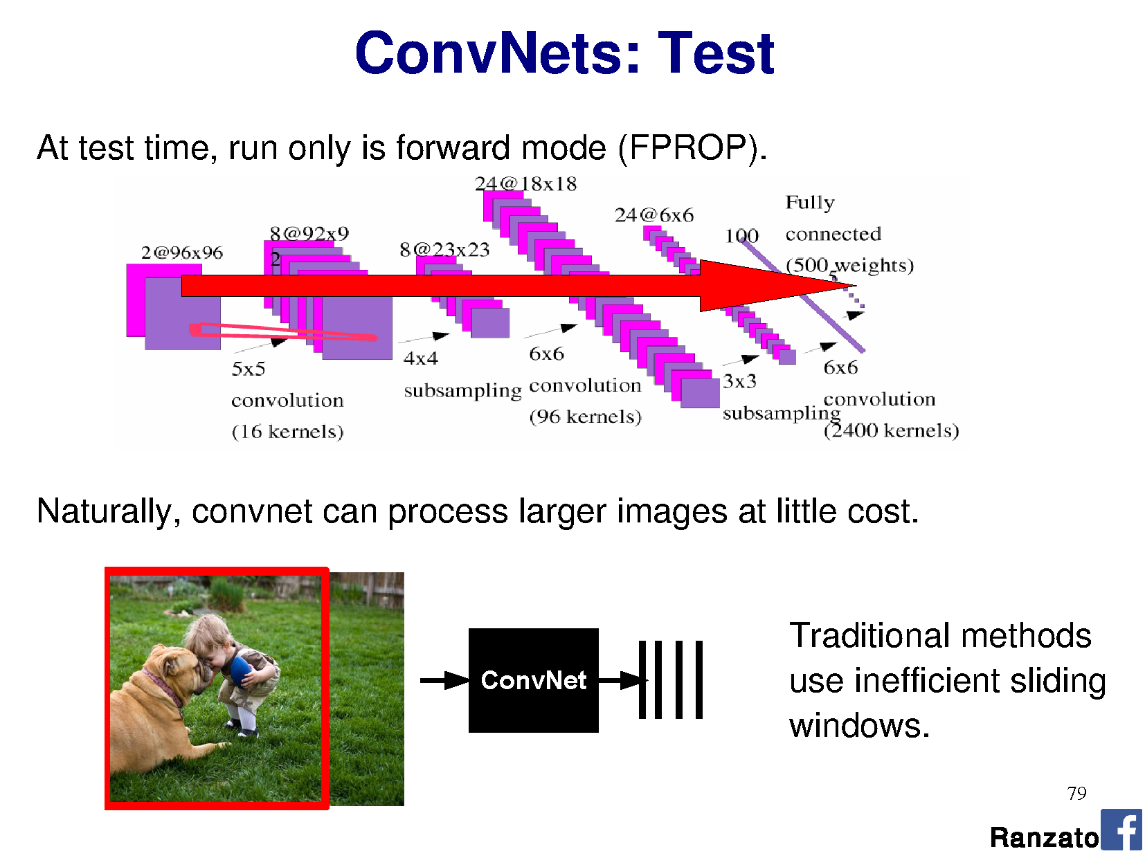

Slide 55

R-CNN: Region-based CNN
Figure: Girshick et al.
Notes:
https://blog.athelas.com/a-brief-history-of-cnns-in-image-segmentation-from-r-cnn-to-mask-r-cnn-34ea83205de4
http://www.cs.cornell.edu/courses/cs7670/2014sp/slides/VisionSeminar14.pdf
Where do the region proposals come from?
Step 3. Uses ‘selection search’ to find fewest bounding boxes with most recall.
Step 3. Features are pre-trained on ImageNet, then fine tuned end to end
Step 4. Classify regions = SVM on features learned from CNN.
I still have to test every region -> still slow.

Slide 56
Stage 2: Efficient region proposals?
Brute force on 1000x1000 = 250 billion rectangles
  Testing the CNN over each one is too expensive
Let’s use B.C. vision! Before CNNs
  Hierarchical clustering for segmentation
Uijlings et al., 2012, Selection Search
Thanks to Song Cao
Notes:
Brute force all shapes and sizes of rectangle over an image = ((m+1) choose 2 ) x ((n+1) choose 2)
B.C. vision = before CNNs

Slide 57

Remember clustering for segmentation?
Oversegmentation
Undersegmentation
Hierarchical Segmentations

Slide 58
Cluster low-level features
Define similarity on color, texture, size, ‘fill’
Greedily group regions together by selecting the pair with highest similarity
  Until the whole image become a single region
Draw a bounding box around each one
  Into a hierarchy
Notes:
http://www.cs.cornell.edu/courses/cs7670/2014sp/slides/VisionSeminar14.pdf
Fill = amount of bounding box full of the region (/ image size)

Slide 59

Algorithm
[13] Felzenszwalb and Huttenlocher - Efficient Graph-Based Image Segmentation, IJCV 2004

Slide 60

Vs Ground Truth
Thanks to Song Cao
Notes:
http://www.cs.cornell.edu/courses/cs7670/2014sp/slides/VisionSeminar14.pdf

Slide 61

Thanks to Song Cao

Slide 62
R-CNN: Region-based CNN
Figure: Girshick et al.
10,000 proposals with recall 0.991 is better….
but still takes 17 seconds per image to generate them.
Then I have to test each one!
Notes:
https://blog.athelas.com/a-brief-history-of-cnns-in-image-segmentation-from-r-cnn-to-mask-r-cnn-34ea83205de4
http://www.cs.cornell.edu/courses/cs7670/2014sp/slides/VisionSeminar14.pdf
Where do the region proposals come from?
Step 3. Uses ‘selection search’ to find fewest bounding boxes with most recall.
Step 3. Features are pre-trained on ImageNet, then fine tuned end to end
Step 4. Classify regions = SVM on features learned from CNN.
I still have to test every region -> still slow.

Slide 63

Fast R-CNN
Multi-task loss
RoI = Region of Interest
Figure: Girshick et al.
Notes:
Selection search itself is slow – 20 seconds per image to generate regions.
Figure 1. Fast R-CNN architecture. An input image and multiple regions of interest (RoIs) are input into a fully convolutional network. Each RoI is pooled into a ﬁxed-size feature map and then mapped to a feature vector by fully connected layers (FCs). The network has two output vectors per RoI: softmax probabilities and per-class bounding-box regression offsets. The architecture is trained end-to-end with a multi-task loss.
Note: Calling your thing ‘fast’ in computing is not descriptive. In three years, it will no longer be fast, and you will look silly.

Slide 64
Fast R-CNN
Convolve whole image into feature map (many layers; abstracted)
For each candidate RoI:
  Squash feature map weights into fixed-size ‘RoI pool’ – adaptive subsampling!
    Divide RoI into H x W subwindows, e.g., 7 x 7, and max pool
  Learn classification on RoI pool with own fully connected layers (FCs)
  Output classification (softmax) + bounds (regressor)
Figure: Girshick et al.
Notes:
Figure 1. Fast R-CNN architecture. An input image and multiple regions of interest (RoIs) are input into a fully convolutional network. Each RoI is pooled into a ﬁxed-size feature map and then mapped to a feature vector by fully connected layers (FCs). The network has two output vectors per RoI: softmax probabilities and per-class bounding-box regression offsets. The architecture is trained end-to-end with a multi-task loss.

Slide 65

Martian lava field, NASA, Wikipedia
Notes:
https://en.wikipedia.org/wiki/Pareidolia#/media/File:Elephant_on_Mars.jpg

Slide 66

Old Man of the Mountain, Franconia, New Hampshire
Notes:
Now collapsed, 2003.

Slide 67

Pareidolia
http://smrt.ccel.ca/2013/12/16/pareidolia/

Slide 68

Reddit for more : )
https://www.reddit.com/r/Pareidolia/top/

Slide 69


Pareidolia
Seeing things which aren’t really there…
DeepDream as reinforcement pareidolia
Notes:
The word derives from the Greek words para (παρά, "beside, alongside, instead [of]" — in this context meaning something faulty or wrong) and the noun eidōlon (εἴδωλον "image, form, shape" — the diminutive of eidos).
DeepDream is a kind of reinforcement pareidolia
Reddit for more : )
https://www.reddit.com/r/Pareidolia/top/

Slide 70


Powerpoint Alt-text Generator
Vision-based
caption generator
2018
2020
Notes:
If you pass in the screenshot of the Alt Text box, and ask Powerpoint to generate a caption, it says:
“A screenshot of a cell phone.”

Slide 71




Prosopagnosia
[…]

Slide 72
https://www.washingtonpost.com/news/magazine/wp/2019/08/21/feature/my-life-with-face-blindness/
https://www.nytimes.com/2020/01/17/opinion/sunday/facebook-facial-recognition-accessibility.html

Slide 73





What if we want pixels out?
monocular depth estimation Eigen & Fergus 2015
semantic
segmentation
optical flow Fischer et al. 2015
boundary prediction Xie & Tu 2015
[Long et al.]
Notes:
these networks can not only do semantic segmentation, but many other pixelwise prediction tasks
these could likewise extend to video

Slide 74


Slide 75
R-CNN does detection
many seconds
R-CNN
“dog”
“cat”
[Long et al.]

Slide 76

~1/10 second
???
end-to-end learning
[Long et al.]

Slide 77

Fully Convolutional Networks for Semantic Segmentation
Jonathan Long* Evan Shelhamer* Trevor Darrell
UC Berkeley
[CVPR 2015] Slides from Long, Shelhamer, and Darrell

Slide 78

A classification network…
Number of perceptrons in MLP layer, e.g., 1024
Number of filters, e.g., 64
“tabby cat”
[Long et al.]
Notes:
note omissions
“activations”
fixed size input, single label output
desire: efficient per-pixel output

Slide 79

A classification network…
“tabby cat”
[Long et al.]
Notes:
note omissions
“activations”
fixed size input, single label output
desire: efficient per-pixel output

Slide 80
A classification network…
…
“tabby cat”
The response of every kernel across all positions are attached densely to the array of perceptrons in the fully-connected layer.
[Long et al.]
Notes:
note omissions
“activations”
fixed size input, single label output
desire: efficient per-pixel output

Slide 81
A classification network…
…
“tabby cat”
The response of every kernel across all positions are attached densely to the array of perceptrons in the fully-connected layer.
AlexNet: 256 filters over 6x6 response map
Each 2,359,296 response is attached to one of 4096 perceptrons, leading to 37 mil params.
[Long et al.]
Notes:
note omissions
“activations”
fixed size input, single label output
desire: efficient per-pixel output

Slide 82
Problem
We want a label at every pixel
Current network gives us a label for the whole image.
Approach:
  Make CNN for every sub-image size ?
  ‘Convolutionalize’ all layers of network, so that we can treat it as one (complex) filter and slide around our full image.

Slide 83


Slide 84


Slide 85

Long, Shelhamer, and Darrell 2014

Slide 86
A classification network…
…
“tabby cat”
The response of every kernel across all positions are attached densely to the array of perceptrons in the fully-connected layer.
AlexNet: 256 filters over 6x6 response map
Each 2,359,296 response is attached to one of 4096 perceptrons, leading to 37 mil params.
[Long et al.]
Notes:
note omissions
“activations”
fixed size input, single label output
desire: efficient per-pixel output

Slide 87


Slide 88



Slide 89

Convolutionalization
Number of filters
Number of filters
1x1 convolution operates across all filters in the previous layer, and is slid across all positions.
[Long et al.]

Slide 90



Back to the fully-connected perceptron…
Perceptron is connected to every
value in the previous layer
(across all channels; 1 visible).
[Long et al.]
Notes:
Seems fine, right?
Going to learn a neural network to classify an image. Learn weights from a large database of images using back propagation.
How many perceptrons do you think we need to represent the ‘complexity’ of natural images?
How big are the weight matrices?
How many weight parameters did you learn in your HOG-based SVM classification? How big was the database? Did it work?
The more parameters we have, the larger the database we need to ‘map out’ the high-dimensional space.
Are we wasting any knowledge in this representation?

Slide 91

Notes:
This is the major trick.
For each layer of the neural network, we’re going to learn multiple filters.

Slide 92
1x1
100
Notes:
This is the major trick.
For each layer of the neural network, we’re going to learn multiple filters.

Slide 93
Convolutionalization
# filters, e.g. 1024
# filters, e.g., 64
1x1 convolution operates across all filters in the previous layer, and is slid across all positions.
e.g., 64x1x1 kernel, with shared weights over 13x13 output, x1024 filters = 11mil params.
[Long et al.]

Slide 94

Becoming fully convolutional
Multiple outputs
Arbitrary-sized image
When we turn these operations into a convolution, the 13x13 just becomes another parameter and our output size adjust dynamically.
Now we have a vector/matrix output, and our network acts itself like a complex filter.
[Long et al.]

Slide 95
Long, Shelhamer, and Darrell 2014

Slide 96

Upsampling the output
Some upsampling algorithm to return us to H x W
[Long et al.]

Slide 97

End-to-end, pixels-to-pixels network
[Long et al.]

Slide 98
End-to-end, pixels-to-pixels network
upsampling
conv, pool,
nonlinearity
pixelwise
output + loss
[Long et al.]

Slide 99
What is the upsampling layer?
This one.
Hint: it’s an upsampling network
[Long et al.]

Slide 100

‘Deconvolution’ networks learn to upsample
Often called “deconvolution”, but misnomer.
Not the deconvolution that we saw in deblurring -> that is division in the Fourier domain.
‘Transposed convolution’ is better.
Zeiler et al., Deconvolutional Networks, CVPR 2010
Noh et al., Learning Deconvolution Network for Semantic Segmentation, ICCV 2015
Notes:
The network architecture here is VGG
Six days to train on an NVIDIA Titan X GPU

Slide 101

Upsampling with transposed convolution
Convolution
Notes:
https://www.quora.com/How-do-fully-convolutional-networks-upsample-their-coarse-output
https://github.com/vdumoulin/conv_arithmetic
https://en.wikipedia.org/wiki/Deconvolution
Also called ‘backwards strided convolution’.
Where the convolutions overlap, we ADD the output.
How do we apply the weights when the kernel crosses multiple input pixels from the previous layer?

Slide 102


Upsampling with transposed convolution
Transposed convolution = padding/striding smaller image then weighted sum of input x filter: ‘stamping’ kernel
Convolution
2x2, stride 1, 3x3 kernel,
upsample to 4x4
2x2, stride 2, 3x3 kernel,
upsample to 5x5.
Notes:
https://www.quora.com/How-do-fully-convolutional-networks-upsample-their-coarse-output
https://github.com/vdumoulin/conv_arithmetic
https://en.wikipedia.org/wiki/Deconvolution
Also called ‘backwards strided convolution’.
Where the convolutions overlap, we ADD the output.
How do we apply the weights when the kernel crosses multiple input pixels from the previous layer?

Slide 103
Kernel
1
1
1
1
1
1
1
1
1
Feature map
1 | 2
3 | 4
Padded feature map
 |  | 1 | 2
 |  | 3 | 4
Inspired by andriys
Notes:
Thanks to andriys
https://datascience.stackexchange.com/questions/6107/what-are-deconvolutional-layers
Note that the kernel here is not normalized, so if we were applying it as an image processing operation, then it would brighten the image significantly.
Note also that, in CNNs, there’s no need to normalize kernels – the operations on feature maps can learn to produce a large response if required.

Slide 104
Kernel
1
1
1
1
1
1
1
1
1
Output feature map
Input feature map
1 | 2
3 | 4
1 | 1 | 1
1 | 1 | 1
1 | 1 | 1
Padded input feature map
 |  | 1 | 2
 |  | 3 | 4
Inspired by andriys
Notes:
Thanks to andriys
https://datascience.stackexchange.com/questions/6107/what-are-deconvolutional-layers
Note that the kernel here is not normalized, so if we were applying it as an image processing operation, then it would brighten the image significantly.
Note also that, in CNNs, there’s no need to normalize kernels – the operations on feature maps can learn to produce a large response if required.

Slide 105
Kernel
1
1
1
1
1
1
1
1
1
Output feature map
Input feature map
1 | 2
3 | 4
1 | 4 | 4 | 3
1 | 4 | 4 | 3
1 | 4 | 4 | 3
Padded input feature map
 |  | 1 | 2
 |  | 3 | 4
Inspired by andriys
Notes:
Thanks to andriys
https://datascience.stackexchange.com/questions/6107/what-are-deconvolutional-layers
Note that the kernel here is not normalized, so if we were applying it as an image processing operation, then it would brighten the image significantly.
Note also that, in CNNs, there’s no need to normalize kernels – the operations on feature maps can learn to produce a large response if required.

Slide 106
Kernel
1
1
1
1
1
1
1
1
1
Output feature map
Input feature map
1 | 2
3 | 4
1 | 4 | 7 | 6 | 3
1 | 4 | 7 | 6 | 3
1 | 4 | 7 | 6 | 3
Padded input feature map
 |  | 1 | 2
 |  | 3 | 4
Inspired by andriys
Notes:
Thanks to andriys
https://datascience.stackexchange.com/questions/6107/what-are-deconvolutional-layers
Note that the kernel here is not normalized, so if we were applying it as an image processing operation, then it would brighten the image significantly.
Note also that, in CNNs, there’s no need to normalize kernels – the operations on feature maps can learn to produce a large response if required.

Slide 107
Kernel
1
1
1
1
1
1
1
1
1
Output feature map
Input feature map
1 | 2
3 | 4
1 | 4 | 7 | 8 | 5 | 2
1 | 4 | 7 | 8 | 5 | 2
1 | 4 | 7 | 8 | 5 | 2
Padded input feature map
 |  | 1 | 2
 |  | 3 | 4
Inspired by andriys
Notes:
Thanks to andriys
https://datascience.stackexchange.com/questions/6107/what-are-deconvolutional-layers
Note that the kernel here is not normalized, so if we were applying it as an image processing operation, then it would brighten the image significantly.
Note also that, in CNNs, there’s no need to normalize kernels – the operations on feature maps can learn to produce a large response if required.

Slide 108
Kernel
1
1
1
1
1
1
1
1
1
Output feature map
Input feature map
1 | 2
3 | 4
1 | 4 | 7 | 8 | 5 | 2
5 | 8 | 11 | 8 | 5 | 2
5 | 8 | 11 | 8 | 5 | 2
4 | 4 | 4
Padded input feature map
 |  | 1 | 2
 |  | 3 | 4
Inspired by andriys
Notes:
Thanks to andriys
https://datascience.stackexchange.com/questions/6107/what-are-deconvolutional-layers
Note that the kernel here is not normalized, so if we were applying it as an image processing operation, then it would brighten the image significantly.
Note also that, in CNNs, there’s no need to normalize kernels – the operations on feature maps can learn to produce a large response if required.

Slide 109
Kernel
1
1
1
1
1
1
1
1
1
Output feature map
Input feature map
1 | 2
3 | 4
1 | 4 | 7 | 8 | 5 | 2
5 | 18 | 21 | 18 | 5 | 2
5 | 18 | 21 | 18 | 5 | 2
4 | 14 | 14 | 10
Padded input feature map
 |  | 1 | 2
 |  | 3 | 4
Inspired by andriys
Notes:
Thanks to andriys
https://datascience.stackexchange.com/questions/6107/what-are-deconvolutional-layers
Note that the kernel here is not normalized, so if we were applying it as an image processing operation, then it would brighten the image significantly.
Note also that, in CNNs, there’s no need to normalize kernels – the operations on feature maps can learn to produce a large response if required.

Slide 110
Kernel
1
1
1
1
1
1
1
1
1
Output feature map
Input feature map
1 | 2
3 | 4
1 | 4 | 7 | 8 | 5 | 2
5 | 18 | 31 | 34 | 21 | 8
9 | 32 | 55 | 60 | 37 | 14
11 | 38 | 66 | 64 | 43 | 16
7 | 24 | 41 | 44 | 27 | 10
3 | 10 | 17 | 18 | 11 | 4
Padded input feature map
 |  | 1 | 2
 |  | 3 | 4
Inspired by andriys
Notes:
Thanks to andriys
https://datascience.stackexchange.com/questions/6107/what-are-deconvolutional-layers
Note that the kernel here is not normalized, so if we were applying it as an image processing operation, then it would brighten the image significantly.
Note also that, in CNNs, there’s no need to normalize kernels – the operations on feature maps can learn to produce a large response if required.

Slide 111
Kernel
1
1
1
1
1
1
1
1
1
Cropped output feature map
Input feature map
1 | 2
3 | 4
18 | 31 | 34 | 21
32 | 55 | 60 | 37
38 | 66 | 64 | 43
24 | 41 | 44 | 27
Padded input feature map
 |  | 1 | 2
 |  | 3 | 4
Inspired by andriys
Notes:
Thanks to andriys
https://datascience.stackexchange.com/questions/6107/what-are-deconvolutional-layers
Note that the kernel here is not normalized, so if we were applying it as an image processing operation, then it would brighten the image significantly.
Note also that, in CNNs, there’s no need to normalize kernels – the operations on feature maps can learn to produce a large response if required.

Slide 112


Is uneven overlap a problem?
Uneven overlap across output
Yes = causes grid artifacts
Could fix it by picking stride/kernel numbers which have no overlap…
Notes:
https://datascience.stackexchange.com/questions/6107/what-are-deconvolutional-layers
https://distill.pub/2016/deconv-checkerboard/

Slide 113
Is uneven overlap a problem?
Uneven overlap across output
Yes = causes grid artifacts
Could fix it by picking stride/kernel numbers which have no overlap…
Or…think in frequency!
Introduce explicit bilinear upsampling before transpose convolution; let kernels of transpose convolution learn to fill in only high-frequency detail.
https://distill.pub/2016/deconv-checkerboard/
Notes:
https://datascience.stackexchange.com/questions/6107/what-are-deconvolutional-layers
https://distill.pub/2016/deconv-checkerboard/

Slide 114
‘Deconvolution’ networks learn to upsample
Often called “deconvolution”, but misnomer.
Not the deconvolution that we saw in deblurring -> that is division in the Fourier domain.
‘Transposed convolution’ is better.
Zeiler et al., Deconvolutional Networks, CVPR 2010
Noh et al., Learning Deconvolution Network for Semantic Segmentation, ICCV 2015

Slide 115
But we have downsampled so far…
How do we ‘learn to create’ or ‘learn to restore’
new high frequency detail?

Slide 116

Spectrum of deep features
Combine where (local, shallow) with what (global, deep)
Fuse features into deep jet
(cf. Hariharan et al. CVPR15 “hypercolumn”)
[Long et al.]

Slide 117

Learning upsampling kernels with skip layer refinement
interp + sum
Skip to fuse layers!
interp + sum
End-to-end, joint learning
of semantics and location
dense output
[Long et al.]

Slide 118
Learning upsampling kernels with skip layer refinement
interp + sum
Skip to fuse layers!
interp + sum
dense output
[Long et al.]

Slide 119
Learning upsampling kernels with skip layer refinement
interp + sum
Skip to fuse layers!
interp + sum
End-to-end, joint learning
of semantics and location
dense output
[Long et al.]

Slide 120

UNet [Ronneberger et al., 2015]

Slide 121

Skip layer refinement
input image
stride 32
stride 16
stride 8
ground truth
no skips
1 skip
2 skips
[Long et al.]

Slide 122

Training + testing
Train full image at a time without patch sampling
Reshape network to take input of any size
Forward time is ~100ms for 500 x 500 x 21 output
[Long et al.]

Slide 123

Results
FCN
SDS*
Truth
Input
Relative to prior state-of-the-art SDS:
30% relative improvement
for mean IoU
286× faster
*Simultaneous Detection and Segmentation Hariharan et al. ECCV14
[Long et al.]
Notes:
+ NYUD net for multi-modal input and SIFT Flow net for multi-task output

Slide 124

Even more:
Faster
R-CNN
(FCN)
‘Region Proposal Network’ uses CNN feature maps.
Then, FCN on top to classify.
End to end object detection.
Ren et al. 2016
https://arxiv.org/abs/1506.01497
Notes:
https://blogs.microsoft.com/next/2015/12/10/microsoft-researchers-win-imagenet-computer-vision-challenge/#sm.00017fqnl1bz6fqf11amuo0d9ttdp

Slide 125

Even more! Mask R-CNN
Extending Faster R-CNN for Pixel Level Segmentation
He et al. - https://arxiv.org/abs/1703.06870
Add new training data: segmentation masks
Second output which is segmentation mask
Notes:
TensorFlow implementation: https://github.com/CharlesShang/FastMaskRCNN

Slide 126


Slide 127


Slide 128
Deep Image Prior demo
https://warlock.ai/deepimageprior/
Generate some images and animations from this.

Slide 129
https://dmitryulyanov.github.io/deep_image_prior
https://box.skoltech.ru/index.php/s/INaUzvTWLak3h7Q#pdfviewer

Slide 130








Neural Style
make your own easily on deepart.io
Andrej Karpathy

Slide 131
Why is VGG a good network for style transfer?
Relation to adversarial examples and ‘robust features’ here:
https://distill.pub/2019/advex-bugs-discussion/response-4/
Robustness of modern architectures to small image perturbations:
- https://arxiv.org/pdf/1903.12261.pdf

Slide 132


Slide 133


Slide 134


Slide 135


Slide 136

Any directed acyclic graph (DAG) of differentiable modules is allowed.

Slide 137


Slide 138
What about learning across ‘domains’?

Slide 139


Slide 140

Notes:
http://journal.frontiersin.org/article/10.3389/frobt.2015.00036/full

Slide 141

Two-stream networks –
action recognition
[Simonyan et al. 2014]
Notes:
http://journal.frontiersin.org/article/10.3389/frobt.2015.00036/full

Slide 142

[Simonyan et al. 2014]

Slide 143
Capsule Networks
https://medium.com/ai%C2%B3-theory-practice-business/understanding-hintons-capsule-networks-part-i-intuition-b4b559d1159b

Slide 144

What can we do with an FCN?
Long, Shelhamer, and Darrell 2014

Slide 145

im2gps (Hays & Efros, CVPR 2008)
How much can an image tell about its geographic location?
6 million geo-tagged Flickr images
http://graphics.cs.cmu.edu/projects/im2gps/

Slide 146

How much can an image tell about its geographic location?
Notes:
Think Pair Share -> How might I work out where this image is?

Slide 147

Nearest Neighbors according to gist + bag of SIFT + color histogram + a few others

Slide 148


Slide 149

Im2gps

Slide 150

Example Scene Matches

Slide 151

Voting Scheme
Notes:
Probability map for that same image
Explain the green circles and how they relate to evaluation
151

Slide 152

im2gps

Slide 153


Slide 154


Slide 155

Effect of Dataset Size

Slide 156

Population density ranking
High Predicted Density
Low Predicted Density

Slide 157

Where is This?
[Vesselova, Kalogerakis, Hertzmann, Hays, Efros. Image Sequence Geolocation. ICCV’09]
Notes:
157

Slide 158

Where is This?

Slide 159


Where are These?
15:14,
June 18th, 2006
16:31,
June 18th, 2006
Notes:
Individually each photograph is 16%, but together they reinforce each other well
159

Slide 160

Where are These?
15:14,
June 18th, 2006
16:31,
June 18th, 2006
17:24,
June 19th, 2006
Notes:
If you know that brits love to vacation in greece…
160

Slide 161

Results
im2gps – 10% (geo-loc within 400 km)
temporal im2gps – 56%

Slide 162
PlaNet - Photo Geolocation with Convolutional Neural Networks
Tobias Weyand, Ilya Kostrikov, James Philbin
ECCV 2016

Slide 163

Discretization of Globe

Slide 164
Network and Training
Network Architecture: Inception with 97M parameters
26,263 “categories” – places in the world
126 Million Web photos
2.5 months of training on 200 CPU cores

Slide 165


Slide 166

Notes:
Figure 7. The top-5 most confident images from the Flickr dataset for the S2 cells on the left, showing the diverse visual representation of places that PlaNet learns.

Slide 167


PlaNet vs im2gps (2008, 2009)
Notes:
Table 1. Comparison of PlaNet with Im2GPS. Percentages are the fraction of images from the Im2GPS test set that were localized within the given radius. (Numbers for the original Im2GPS are approximate as they were extracted from a plot in the paper.)
Table 3. Median localization error (km) by image category on the Im2GPS test set. Manmade Landmark are landmark buildings like the Eiffel Tower, Natural Landmark are geographical features like the Grand Canyon, City Scene and Natural Scene are photos taken in cities or in nature not showing any distinctive landmarks, and Animal are photos of individual animals.

Slide 168

Spatial support for decision
Notes:
Figure 10. Left: Input image, right: Heatmap of the probability of the correct class when sliding an occluding window over the image as in [53]. (a) Grand Canyon. Occluding the distinctive mountain formation makes the confidence in the correct location drop the most. (b) Norway. While the house in the foreground is fairly generic, the snowy mountain range on the left is the most important cue. (c) Shanghai. Confidence in the correct location increases if the palm trees in the foreground are covered since they are not common in Shanghai.

Slide 169

PlaNet vs Humans
Notes:
Figure 9. Top: GeoGuessr panorama, Bottom: Ground truth location (yellow), human guess (green), PlaNet guess (blue).

Slide 170

PlaNet vs. Humans
Notes:
Error increases up the y-axis, so human performance is worse than PlaNet.

Slide 171
PlaNet summary
Very fast geolocalization method by categorization.
Uses far more training data than previous work (im2gps)
Better than humans!

Slide 172


Learning Deep Representations For Ground-to-Aerial Geolocalization
Tsung-Yi Lin, Yin Cui, Serge Belongie, James Hays
CVPR 2015

Slide 173

View From Your Window Contest
June 9, 2010 – Feb. 4, 2015
Where was the photo taken?
Notes:
Consider the picture here. Where do you think the picture was taken? (pause, pause, pause)
This photo was from the popular “view from your window” contest. A weekly fun competition that had been running almost for 5 years. In the contest, contenstents were asked to localize where the image was taken. And it can be anywhere on the earth.
You may recognize the building architecture is quite unique. The train running on the street is a clue. Or the blue sign reading “Pizzeria”. All these visual information can be great information to geolocalize the image.

Slide 174

Ans:
Milano, Italy
Notes:
This is someone’s careful response to the contest. A diverse set of publicly available data sources were used to localize the image.
We can see there is a diversity of

Slide 175





To Geolocalize a Photo
One can capture every corner on the earth
…
Notes:
One popular approach used to geolocalize an image is to match the query image to geo-referenced ground-level images (such as images provided by Google street-view).

Slide 176


To Geolocalize a Photo
Notes:
As an alternative, another popular approach used in the “view from your window contest” is to localize the query images by matching it to the aerial imagery. Which has the advantage that can densely cover a large region.

Slide 177


Slide 178


Slide 179

How To Match Ground-to-Aerial?
Shan et al., Accurate Geo-registration by Ground-to-Aerial Image Matching, 3DV’14
Bansal et al., Ultra-wide baseline façade matching for geo-localization, ECCV workshop’12
Notes:
We are particularly interested in matching ground-to-aerial images.
However, the images look quite different because of the illumination, occlusions, imaging device, time of day, moving objects like car, and so on… All these variations make the matching problem challenging.
A couple works from shan, bansal group tried to address that before.

Slide 180


Are these the same location?
Ground
Aerial
Notes:
To demonstrate the level of difficulty of ground-to-aerial geolocalization, we select four cross-view pairs. Some of them are from the same locations, some are not.
The top row shows the ground-level images and the bottom row shows the aerial images.
Guess which pairs are from the same location?

Slide 181
Are these the same location?
Ground
Aerial
Notes:
In this example, only center two pairs are from the same location. Which is quite challenging for human.

Slide 182

Why Don’t You Just…
Sparse Keypoint Matching + RANSAC
Notes:
Matching ground-to-aerial images is also quite challenging computationally.
The obviously thing to try would be SIFT + RANSAC but due to all variations mentioned in the previous slide. It doesn’t work
And this motivates us to learn a better feature representations with deep learning so that the ground and aerial images can be matched

Slide 183

Cross-view Pairs
Ground
Aerial
Notes:
As with any approach using deep learning, we need significant amount of data to learn from.
In our case, we will be learning from corresponding ground-aerial pairs as shown in this slide.

Slide 184


Street view Projection on
depth estimates
Heading Direction
GPS location
0°
Street-view car
Notes:
we collect these pairs by using information captured by google street-view car and aerial imagery.
Google provides the heading direction and gps location so we know the camera pose of each street view panorama image.

Slide 185
Street view Projection on
depth estimates
Heading Direction
GPS location
0°
Street-view car
Notes:
Google also provides rough depth estimates which we use to assign a dominant depth to each street-view crop.

Slide 186

Street view Projection on
depth estimates
45°
Heading Direction
GPS location
0°
Street-view car
Notes:
Together with known camera pose and depth estimates, we compute the homography to align the dominant plane of the street-view crop to aerial image crops.

Slide 187







7 Cities: 78k Corresponding Pairs
San Francisco
San Diego
Chicago
Charleston
Tokyo
Rome
Lyon
Notes:
We use the process to generate a city scale cross-view image collection which we will use for training the deep learning model.

Slide 188






“Siamese” ConvNet for Ground-to-Aerial Matching
Notes:
The siamese network consists of two networks that have identical architecture, here labeled as A and B.
And we use the alex net architecture without fc8 layer..
The network can embed input images onto an embedding space.

Slide 189
“Siamese” ConvNet for Ground-to-Aerial Matching
Notes:
In the training stage, the network takes a pair of data as input.
Given a pair of images form the same location, which we called it a positive pair, the learning process will try to pull the images from the same location together in the embedding space.

Slide 190
“Siamese” ConvNet for Ground-to-Aerial Matching
Notes:
Given a pair of images that are from different location, which we called it negative pairs, the learning process will push the images from different locations away

Slide 191



Contrastive Loss
red: similar pairs
blue: dissimilar pairs
2
2
m = level from which to invert
Hadsell, Chopra, Yann LeCun,
Dimensionality Reduction by Learning an Invariant Mapping,
CVPR06
Notes:
Specifically, we use contrastive loss, which tries to pull positive pairs to have pair distance 0 and push the negative pair away such that it has pair distance larger than margin m.

Slide 192

Pair Distance Distribution
Green: positive pairs
Red: negative pairs
Margin
AlexNet-CNN Model
Where-CNN Model
50k iterations
Distribution of distances between positive/negative pairs.
Notes:
To demonstrate the value of our siamese network, first let’s look at the distribution of distances between positive and negative pairs if we simply use the off the shelf alexnet trained on imagenet. You can see that the positive pairs aren’t really closer together than the negative pairs.
We use the average pair distance from this experiment to set the margin for our siamese network and after 50k learning iterations we have a new embedding with the pair distances on the right.
And now there are many positive pairs that have smaller distance compared to the negative pairs.

Slide 193

Notes:
Let’s take a look at the matching pairs that have small distance in the learned feature embedding. The figure shows the positive pairs that are correctly verified by the network with high confidence.

Slide 194
Notes:
And here shows the negative pairs that are mistaken by the network as matching pairs.

Slide 195
For ground-aerial image pairs, should A, B networks share the same weights?
Notes:
In the face verification literature, A and B share the same network architecture as well as the parameters.
The reason is the input face data is from the same domain.

Slide 196

Quantitative Evaluation
Minor improvement with ‘domain-specific’ weights.
Notes:
We train this domain specific network, and to our surprise, it only gave us 2% AP improvement.

Slide 197
Quantitative Evaluation (AP)
Random: 5% (1:20 pos. to neg. pairs)
HoG2x2 (BoW): 7.9%
Places-CNN: 10.2%
ImageNet-CNN: 11.3%
Where-CNN (ours): 41.9%
Notes:
Here shows the quantitative results measured by average precision on the verification task
If we randomly assign matched and unmatched to the test pairs, the ap is 5%.

