Slide 1


Slide 2
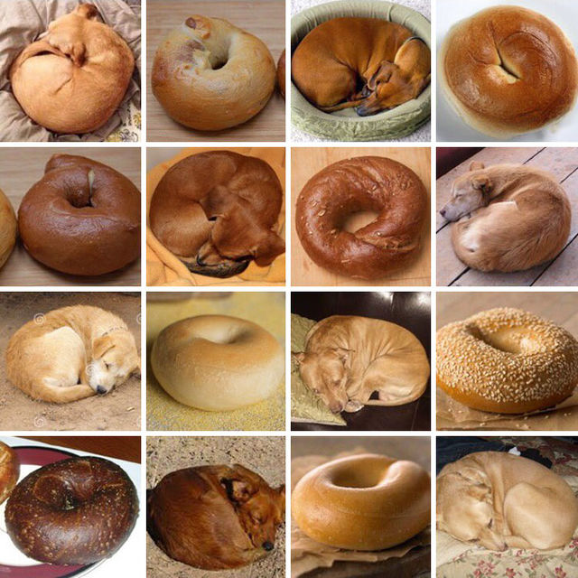
Notes:
Breed of dog: various…
Maybe there’s a Dashund in there…

Slide 3

Notes:
Breed of dog: Komondor

Slide 4
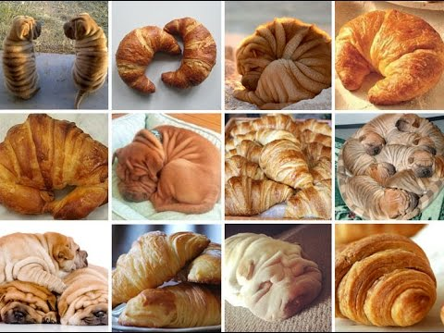
Notes:
Breed of dog: Shar Pei (Chinese)

Slide 5
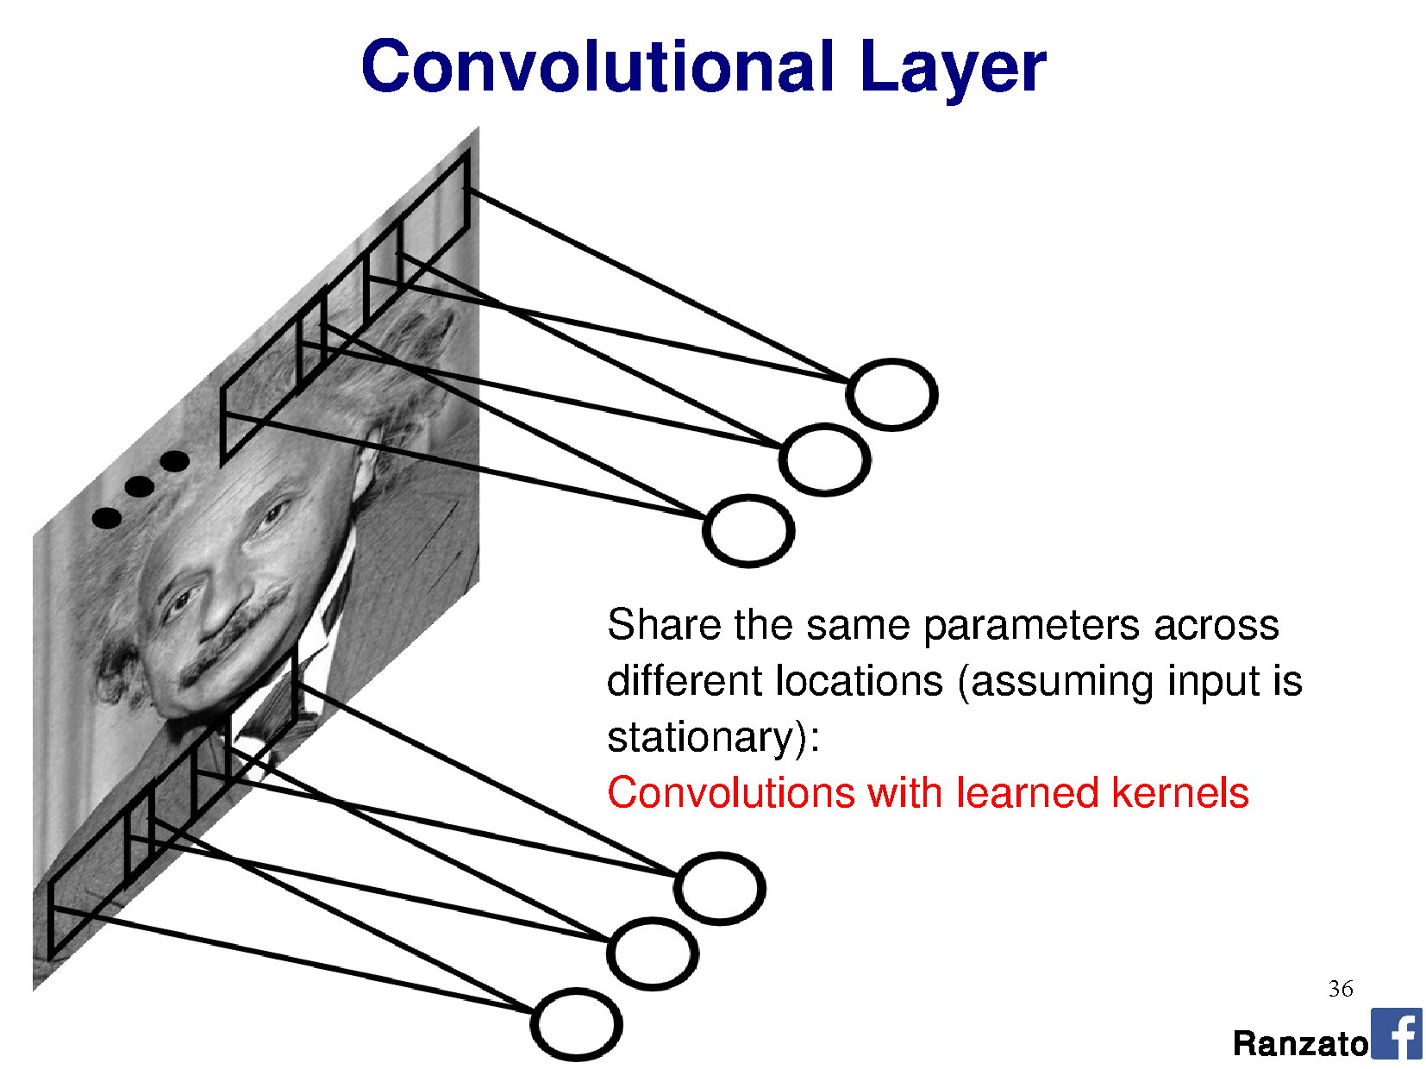


Perceptron:
This is convolution!

Slide 6
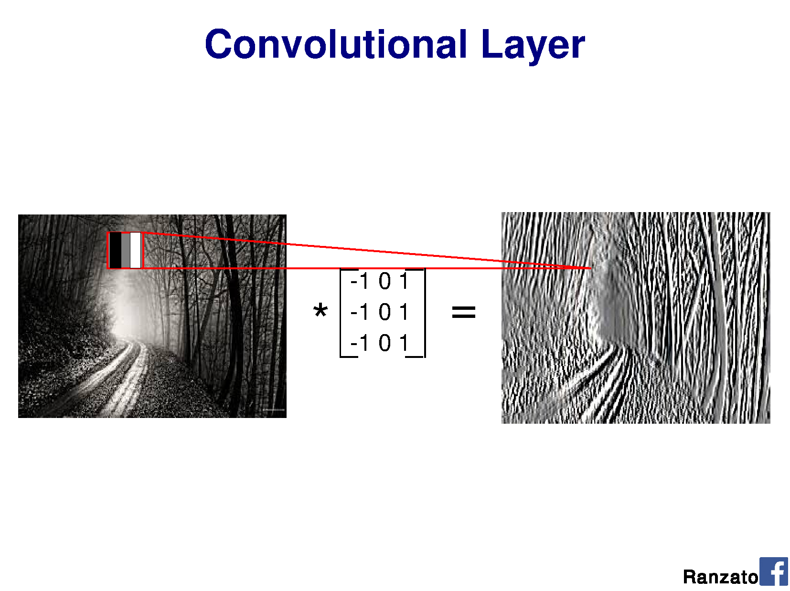
v
v
v
Shared weights
v
Notes:
Output should be a little smaller, as we aren’t padding

Slide 7
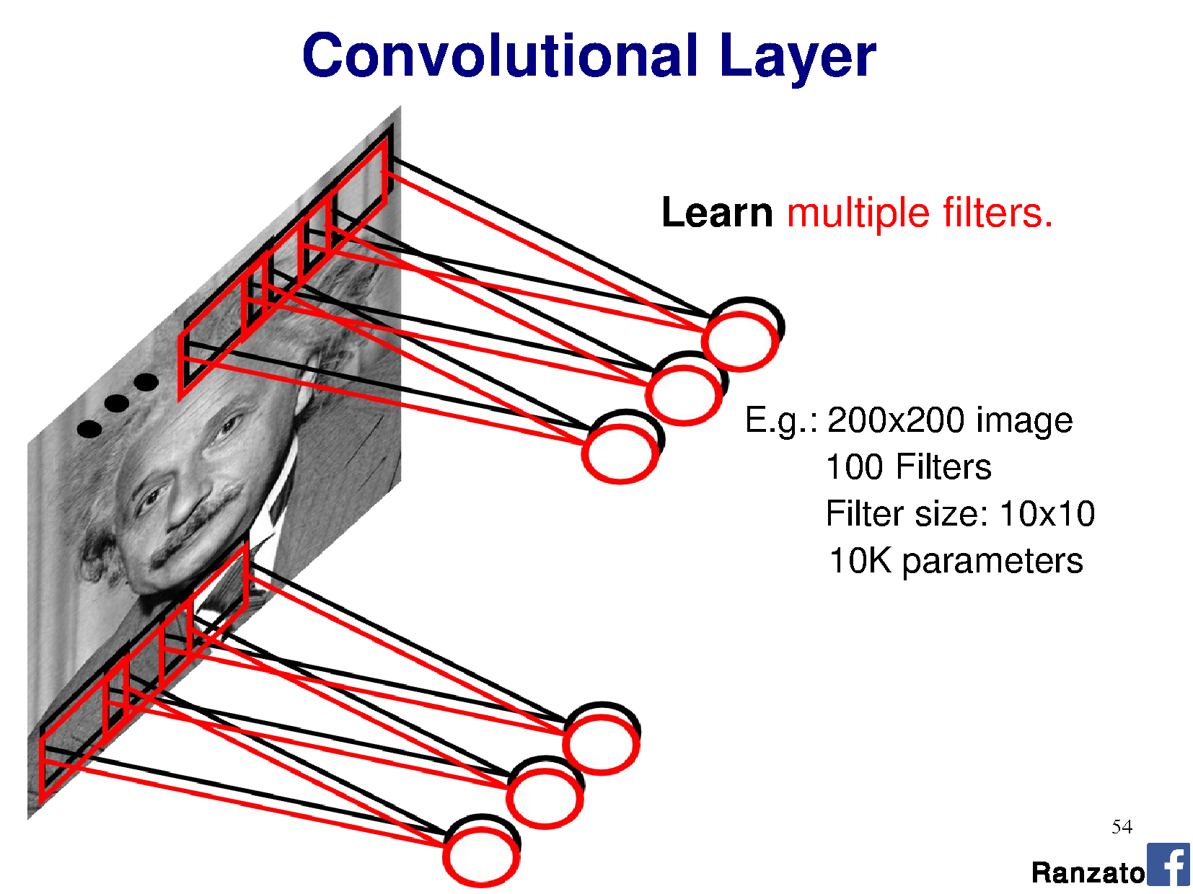
Filter = ‘local’ perceptron.
Also called kernel.
Notes:
This is the major trick.
For each layer of the neural network, we’re going to learn multiple filters.

Slide 8
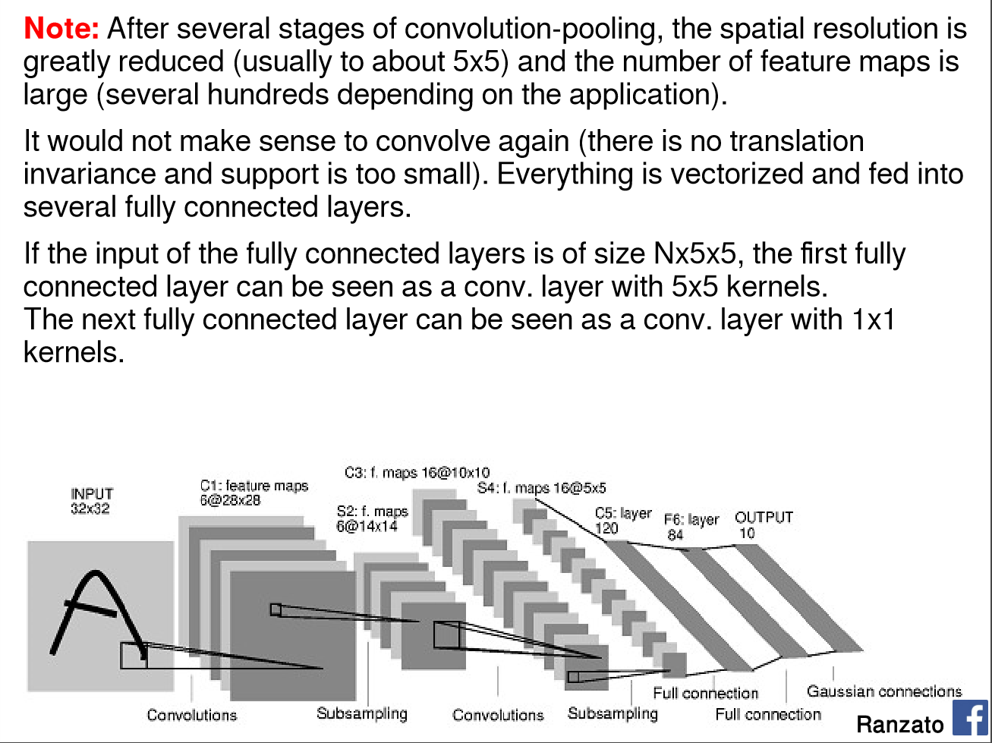
Yann LeCun’s MNIST CNN architecture

Slide 9
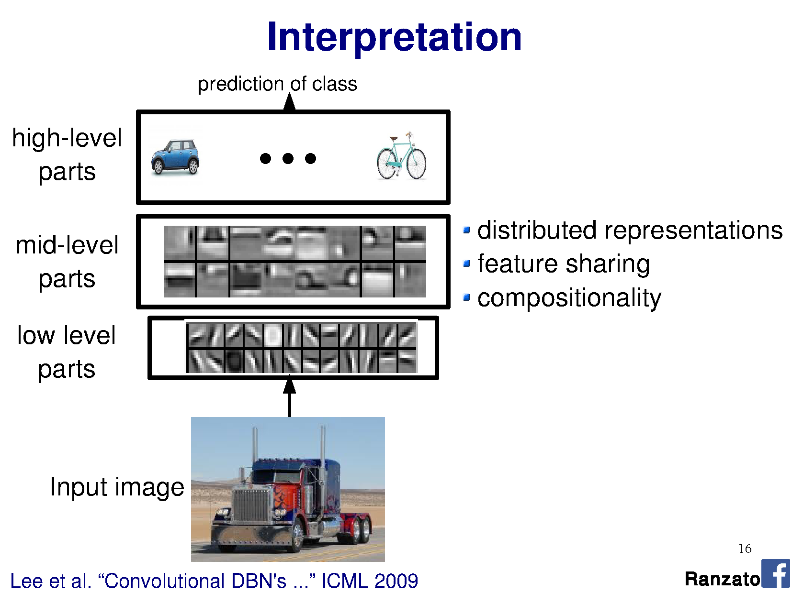

Slide 10
DEMO
http://scs.ryerson.ca/~aharley/vis/conv/
Thanks to Adam Harley for making this.
More here: http://scs.ryerson.ca/~aharley/vis

Slide 11
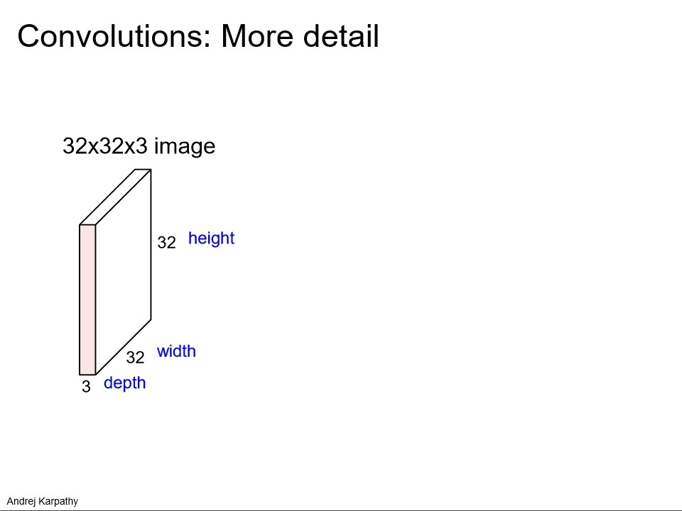

Slide 12
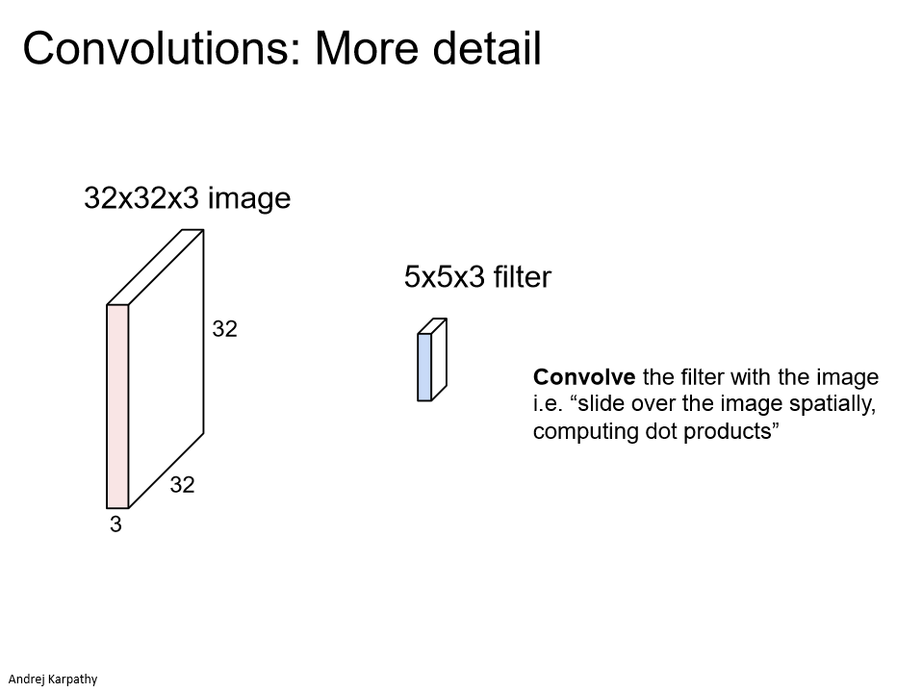

Slide 13
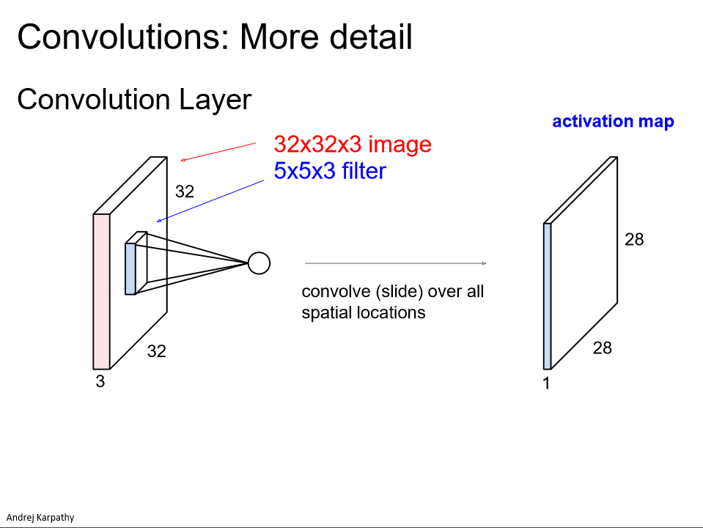

Slide 14
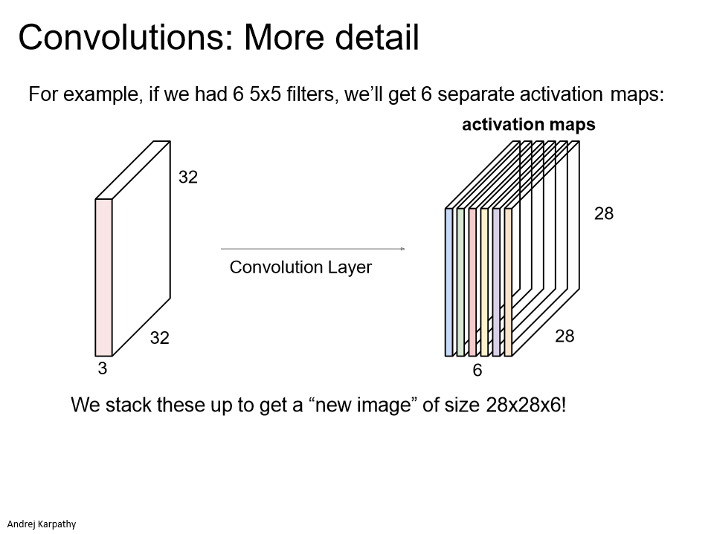

Slide 15
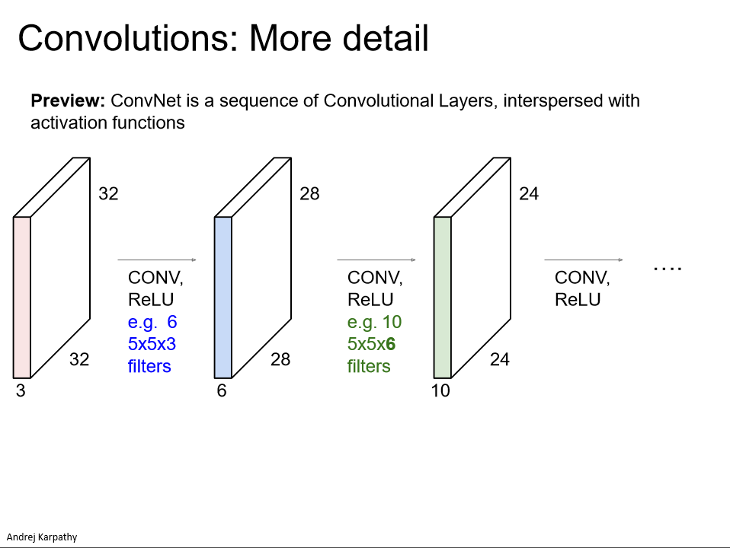

Slide 16
Think-Pair-Share
Input size: 96 x 96 x 3
Kernel size: 5 x 5 x 3
Stride: 1
Max pooling layer: 4 x 4
Output feature map size?
a) 5 x 5
b) 22 x 22
c) 23 x 23
d) 24 x 24
e) 25 x 25
Input size: 96 x 96 x 3
Kernel size: 3 x 3 x 3
Stride: 3
Max pooling layer: 8 x 8
Output feature map size?
a) 2 x 2
b) 3 x 3
c) 4 x 4
d) 5 x 5
e) 12 x 12
Notes:
Answers:
Left: 23 x 23 -> 96 – 2 – 2 from valid region only. Then, 92 x 92 / 4 = 23x23
Right: 4 x 4 -> 94 – 1 – 1 from valid region only. Then,

Slide 17
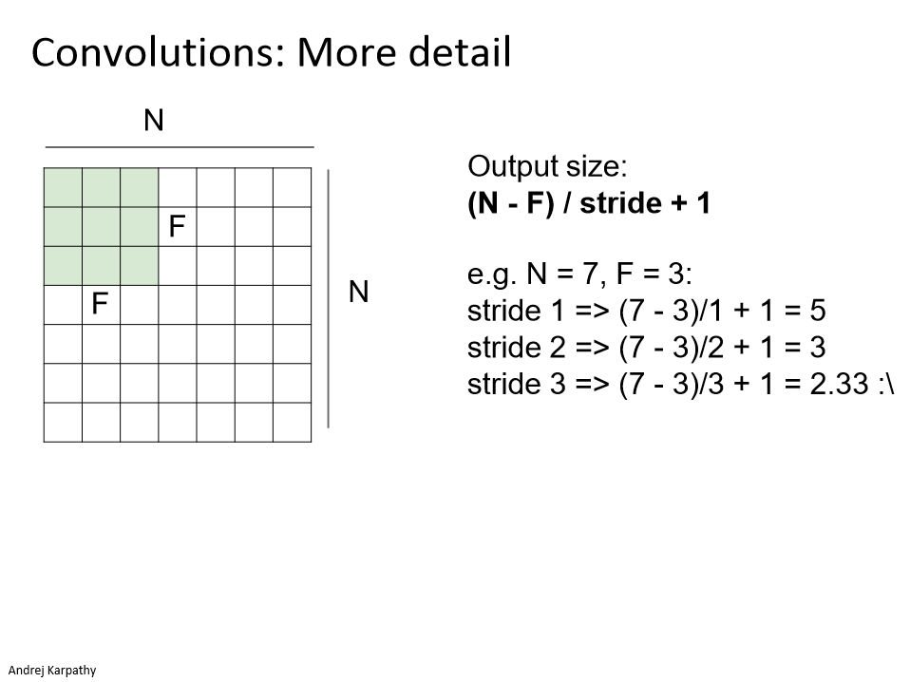
Notes:
Stride 1
Stride 2
Stride 3

Slide 18
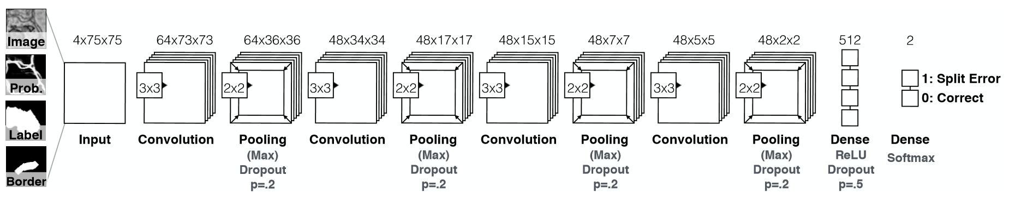
Our connectomics diagram
Auto-generated from network declaration by nolearn (for Lasagne / Theano)
Input
75x75x4
Conv 1
3x3x4
64 filters
Conv 2
3x3x64
48 filters
Conv 3
3x3x48
48 filters
Conv 4
3x3x48
48 filters
Max pooling
2x2 per filter
Max pooling
2x2 per filter
Max pooling
2x2 per filter
Max pooling
2x2 per filter
Notes:
https://github.com/dnouri/nolearn
More details: https://people.cs.pitt.edu/~kovashka/cs2750_sp17/ml_11_cnns.pdf

Slide 19
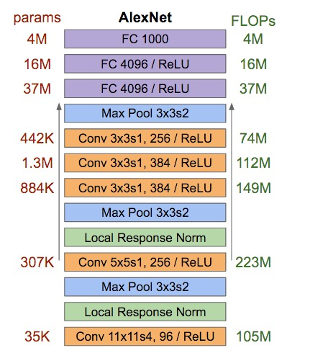
Reading architecture diagrams
Layers
Kernel sizes
Strides
# channels
# kernels
Max pooling

Slide 20
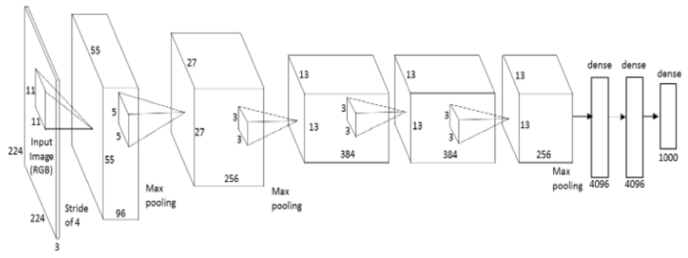
AlexNet diagram (simplified)
[Krizhevsky et al. 2012]
Input size
227 x 227 x 3
227
227
3x3
Stride 2
3x3
Stride 2
Conv 1
11 x 11 x 3
Stride 4
96 filters
Conv 2
5 x 5 x 96
Stride 1
256 filters
Conv 3
3 x 3 x 256
Stride 1
384 filters
Conv 4
3 x 3 x 192
Stride 1
384 filters
Conv 4
3 x 3 x 192
Stride 1
256 filters
Notes:
Input: 227 x 227 x 3 image.
11x11 kernel, stride 4 (AlexNet – 11x11x3 kernels, 96 of them)
5x5 kernel, stride 1, max pool 2x2 (AlexNet – 5x5x48 kernels, 256 of them)
3x3 kernels, (AlexNet – 3x3x256 kernels, 384 of them)
3x3 kernels (AlexNet – 3x3x192 kernels, 384 of them)
3x3 kernels, (AlexNet – 3x3x192 kernels, 256 of them)
FC – 2048 neurons
FC – 2048 neurons
Output – 1000 neurons

Slide 21
AlexNet diagram (simplified)
[Krizhevsky et al. 2012]
Input size
227 x 227 x 3
227
227
3x3
Stride 2
3x3
Stride 2
Eh?
Conv 3
3 x 3 x 256
Stride 1
384 filters
Conv 4
3 x 3 x 192
Stride 1
256 filters
Conv 1
11 x 11 x 3
Stride 4
96 filters
Conv 2
5 x 5 x 48
Stride 1
256 filters
Conv 4
3 x 3 x 192
Stride 1
384 filters
Eh? Shouldn’t these be equal?
Notes:
Input: 227 x 227 x 3 image.
11x11 kernel, stride 4 (AlexNet – 11x11x3 kernels, 96 of them)
5x5 kernel, stride 1, max pool 2x2 (AlexNet – 5x5x48 kernels, 256 of them)
3x3 kernels, (AlexNet – 3x3x256 kernels, 384 of them)
3x3 kernels (AlexNet – 3x3x192 kernels, 384 of them)
3x3 kernels, (AlexNet – 3x3x192 kernels, 256 of them)
FC – 2048 neurons
FC – 2048 neurons
Output – 1000 neurons

Slide 22
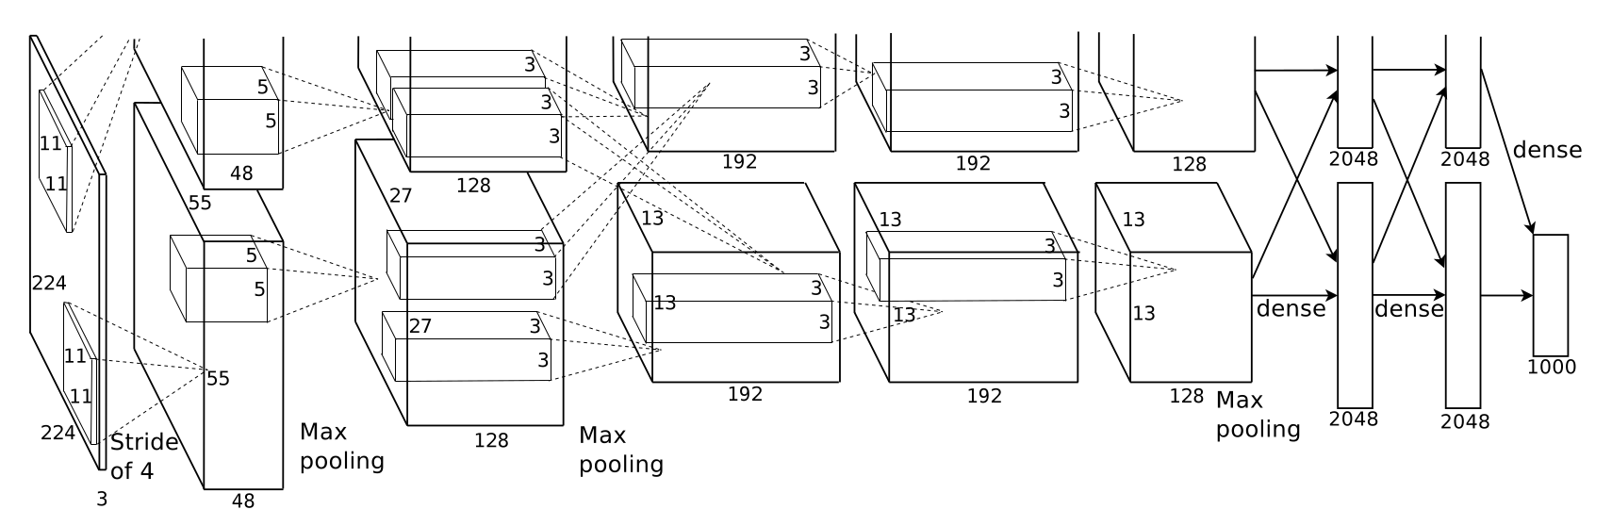
AlexNet diagram (unsimplified)
[Krizhevsky et al. 2012]
Not enough memory for all the weights – use two GPUs!
GPU 1
GPU 2
227
227
Notes:
Input: 227 x 227 x 3 image.
11x11 kernel, stride 4 (AlexNet – 11x11x3 kernels, 96 of them)
5x5 kernel, stride 1, max pool 2x2 (AlexNet – 5x5x48 kernels, 256 of them)
3x3 kernels, (AlexNet – 3x3x256 kernels, 384 of them)
3x3 kernels (AlexNet – 3x3x192 kernels, 384 of them)
3x3 kernels, (AlexNet – 3x3x192 kernels, 256 of them)
FC – 2048 neurons
FC – 2048 neurons
Output – 1000 neurons
3GB memory on each GPU at the time - GTX 580 GPU

Slide 23
Wait, why isn’t it called a correlation neural network?
It could be.
Deep learning libraries implement correlation.
Correlation relates to convolution via a 180deg rotation of the kernel. When we learn kernels, we could easily learn them flipped.
Associative property of convolution ends up not being important to our application, so we just ignore it.
[p.323, Goodfellow]
Notes:
Commutative: a * b = b * a
Associative: a * (b * c) = (a * b) * c

Slide 24
What does it mean to convolve over
greater-than-first-layer hidden units?
Notes:
Commutative: a * b = b * a
Associative: a * (b * c) = (a * b) * c

Slide 25
Yann LeCun’s MNIST CNN architecture

Slide 26
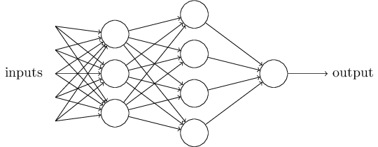
Multi-layer perceptron (MLP)
…is a ‘fully connected’ neural network with non-linear activation functions.
‘Feed-forward’ neural network
Nielson

Slide 27
Does anyone pass along the weight without an activation function?
No – this is linear chaining.
Input
vector
Output vector

Slide 28
Does anyone pass along the weight without an activation function?
No – this is linear chaining.
Input
vector
Output vector

Slide 29
Are there other activation functions?
Yes, many.
As long as:
- Activation function s(z) is well-defined
as z -> -∞ and z -> ∞
- These limits are different
Then we can make a step! [Think visual proof]
It can be shown that it is universal for function approximation.

Slide 30

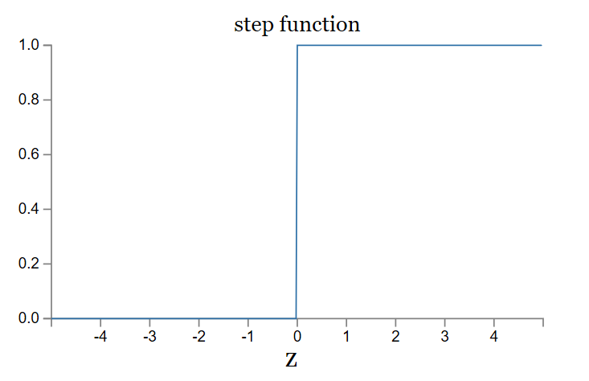
Activation functions:
Rectified Linear Unit
ReLU

Slide 31
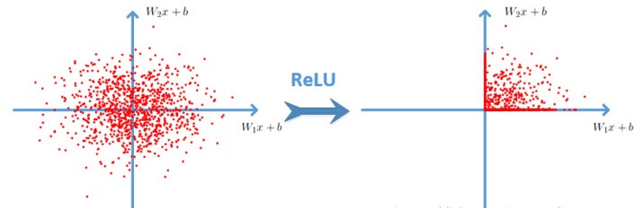
Cyh24 - http://prog3.com/sbdm/blog/cyh_24
Notes:
http://prog3.com/sbdm/blog/cyh_24
http://prog3.com/sbdm/blog/cyh_24/article/details/50593400

Slide 32
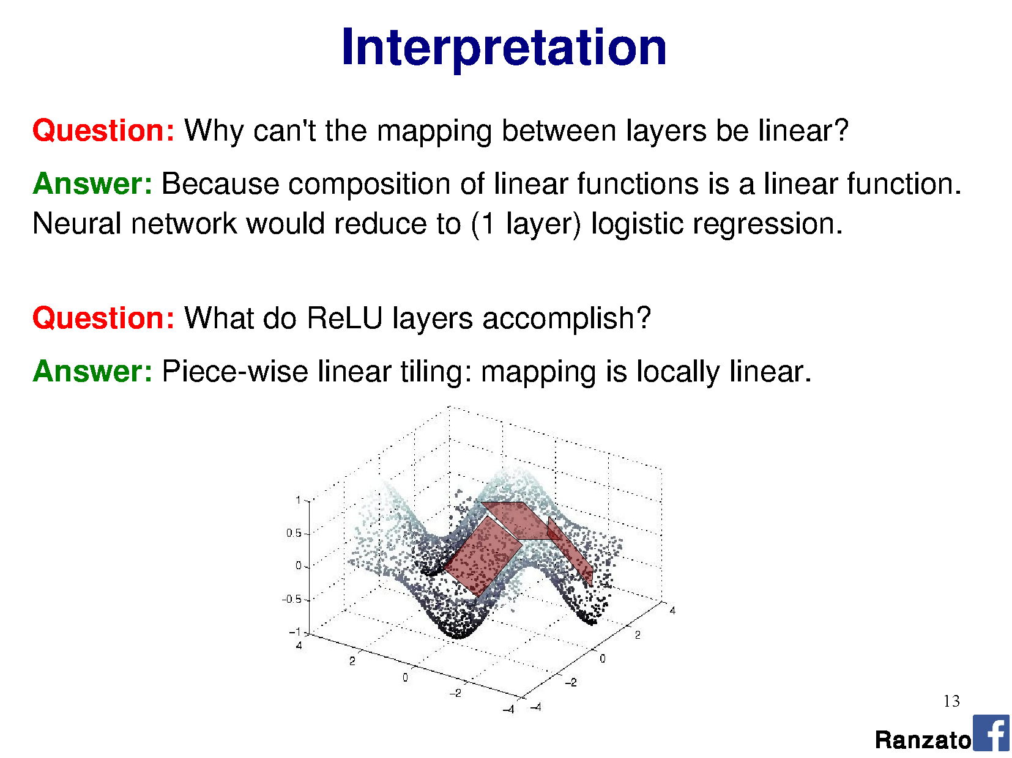
Rectified Linear Unit
Ranzato

Slide 33
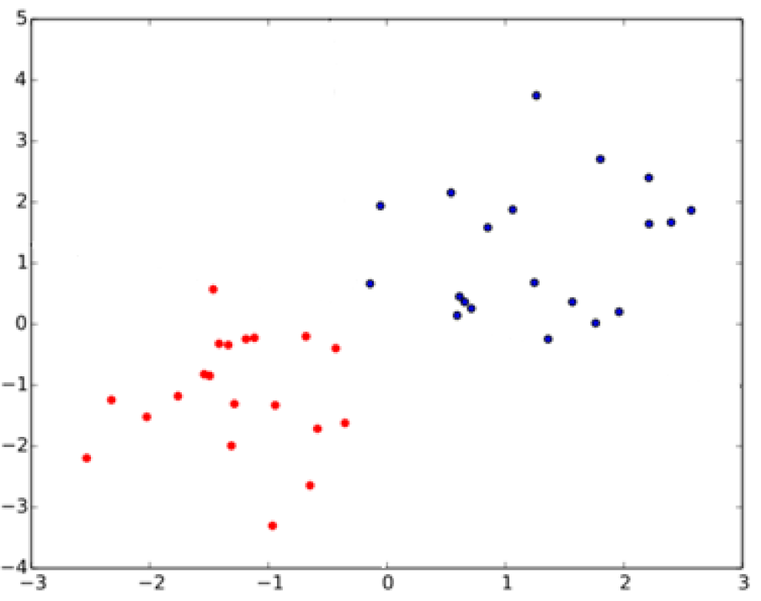
What is the relationship between SVMs
and perceptrons?
SVMs attempt to learn the support vectors which maximize the margin between classes.
Notes:
In separable problems, perceptron training can also aim at finding the largest separating margin between the classes. The so-called perceptron of optimal stability can be determined by means of iterative training and optimization schemes, such as the Min-Over algorithm (Krauth and Mezard, 1987)^{[11]} or the AdaTron (Anlauf and Biehl, 1989)) .^{[12]} AdaTron uses the fact that the corresponding quadratic optimization problem is convex. The perceptron of optimal stability, together with the kernel trick, are the conceptual foundations of the support vector machine.
https://en.wikipedia.org/wiki/Perceptron
Perceptron of optimal stability can be computed via the Min-Over algorithm (Krauth and Mezard, 1987)^{[11]} or the AdaTron (Anlauf and Biehl, 1989) algorithm.

Slide 34
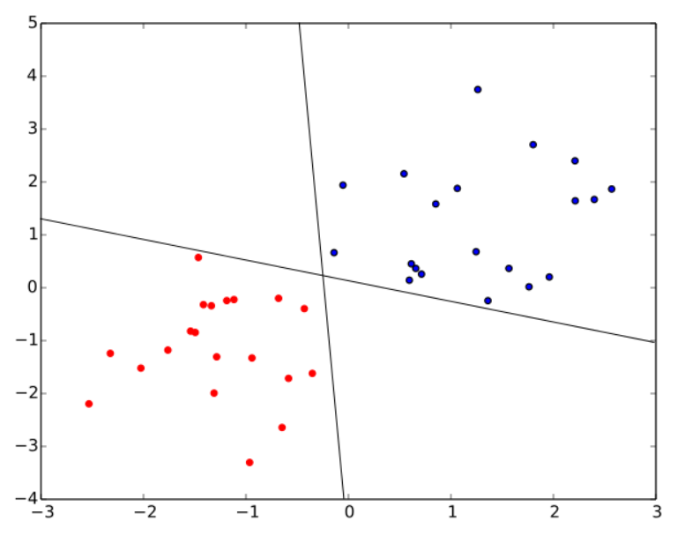
What is the relationship between SVMs
and perceptrons?
SVMs attempt to learn the support vectors which maximize the margin between classes.
A perceptron does not.
Both of these perceptron classifiers are equivalent.
‘Perceptron of optimal
stability’ is used in SVM:
Perceptron
+ optimal stability
+ kernel trick
= foundations of SVM
Notes:
In separable problems, perceptron training can also aim at finding the largest separating margin between the classes. The so-called perceptron of optimal stability can be determined by means of iterative training and optimization schemes, such as the Min-Over algorithm (Krauth and Mezard, 1987)^{[11]} or the AdaTron (Anlauf and Biehl, 1989)) .^{[12]} AdaTron uses the fact that the corresponding quadratic optimization problem is convex. The perceptron of optimal stability, together with the kernel trick, are the conceptual foundations of the support vector machine.
https://en.wikipedia.org/wiki/Perceptron
Perceptron of optimal stability can be computed via the Min-Over algorithm (Krauth and Mezard, 1987)^{[11]} or the AdaTron (Anlauf and Biehl, 1989) algorithm.

Slide 35
Why is pooling useful again?
What kinds of pooling operations might we consider?
Notes:
In separable problems, perceptron training can also aim at finding the largest separating margin between the classes. The so-called perceptron of optimal stability can be determined by means of iterative training and optimization schemes, such as the Min-Over algorithm (Krauth and Mezard, 1987)^{[11]} or the AdaTron (Anlauf and Biehl, 1989)) .^{[12]} AdaTron uses the fact that the corresponding quadratic optimization problem is convex. The perceptron of optimal stability, together with the kernel trick, are the conceptual foundations of the support vector machine.
https://en.wikipedia.org/wiki/Perceptron
Perceptron of optimal stability can be computed via the Min-Over algorithm (Krauth and Mezard, 1987)^{[11]} or the AdaTron (Anlauf and Biehl, 1989) algorithm.

Slide 36
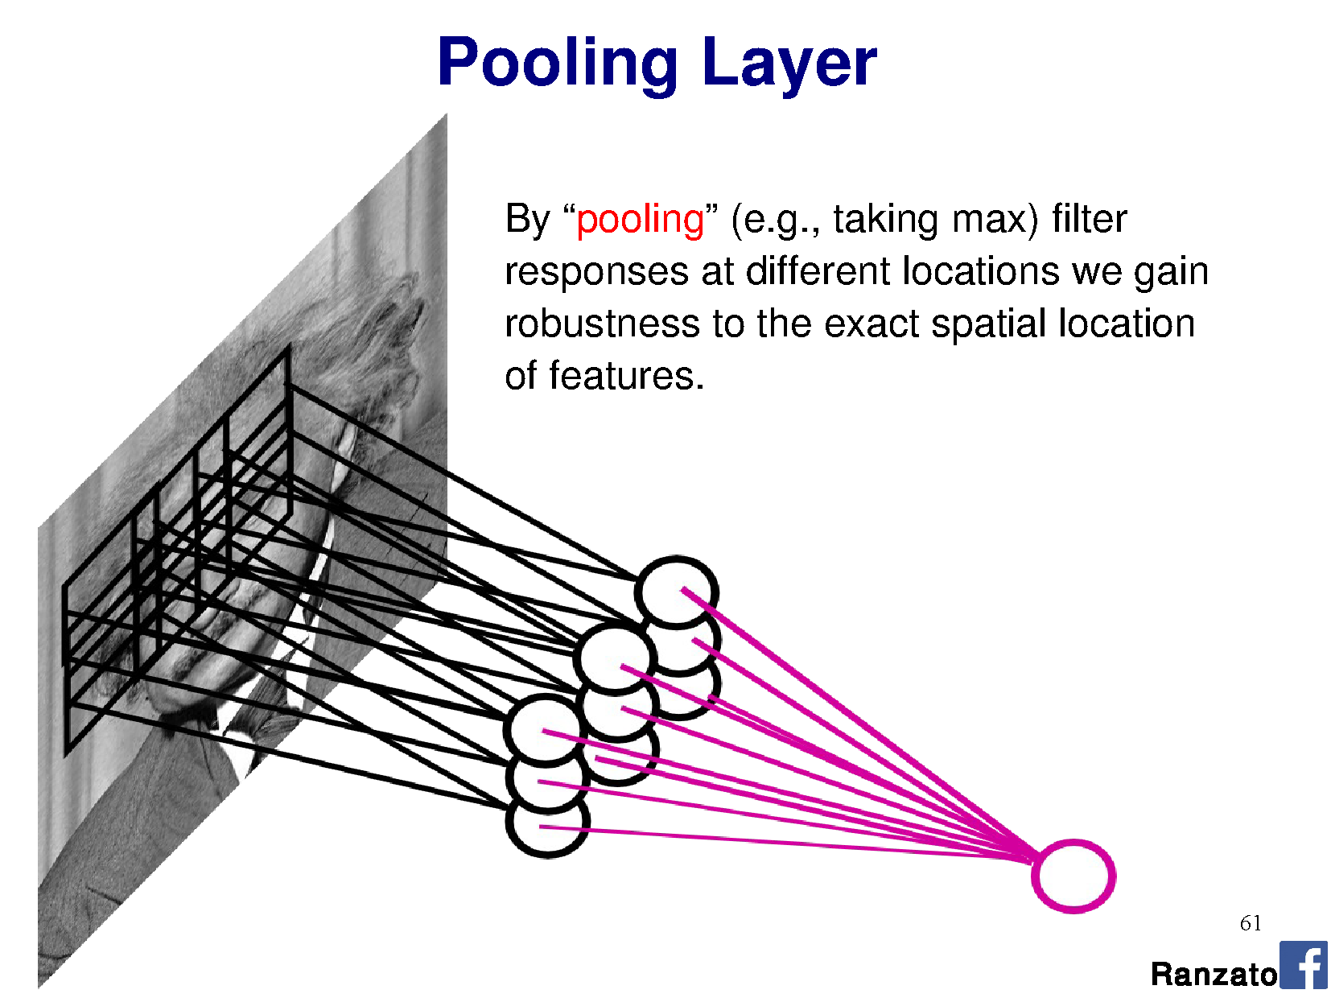
By pooling responses at different locations,
we gain robustness to the exact spatial location of image features.
Useful for classification, when I don’t care about _where_ I ‘see’ a feature!
Pooling layer output
Convolutional layer output

Slide 37
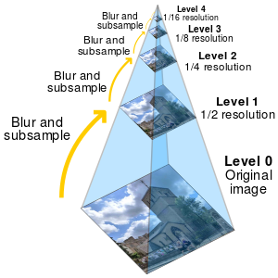
Pooling is similar to downsampling
…but on feature maps, not the input!
…except sometimes we don’t want to blur,
as other functions might be better for classification.

Slide 38
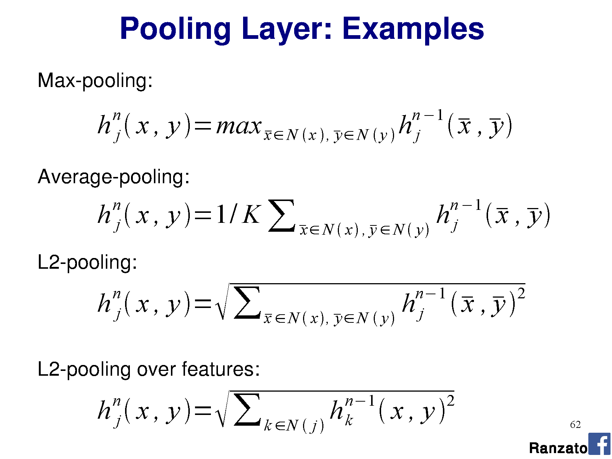

Slide 39
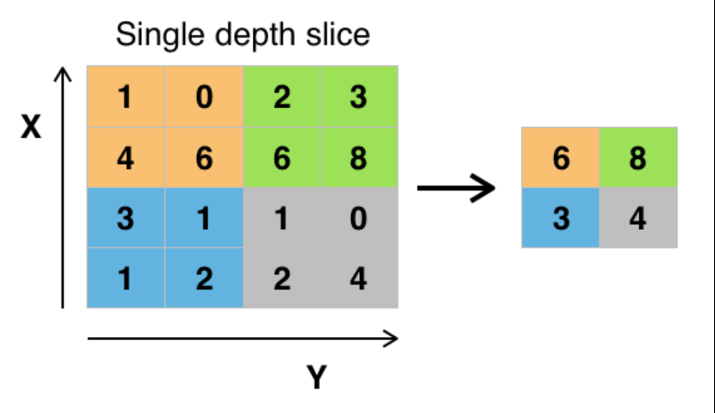
Max pooling
Wikipedia

Slide 40
OK, so what about invariances?
What about translation, scale, rotation?
Convolution is translation equivariant (‘shift-equivariant’)
– we could shift the image and the kernel would give us a corresponding (‘equal’) shift in the feature map.
But! If we rotated or scaled the input, the same kernel would give a different response.
Pooling lets us aggregate (avg) or pick from (max) responses, but the kernels themselves must be trained and so learn to activate on scaled or rotated instances of the object.
Notes:
Invariant = change the input by the property, no change in the output property
Equivariant = change the input by the property, equivalent change in the output property

Slide 41
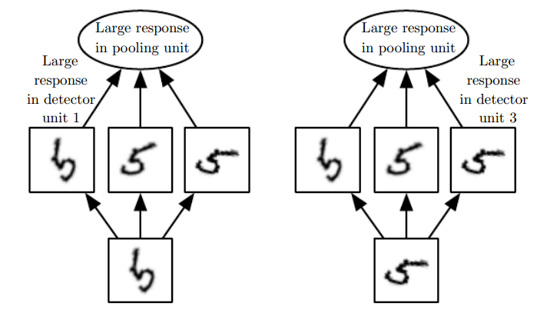
If we max pooled over depth (# kernels)…
Three different kernels trained to fire on different rotations of ‘5’.
Fig 9.9, Goodfellow et al. [the book]

Slide 43
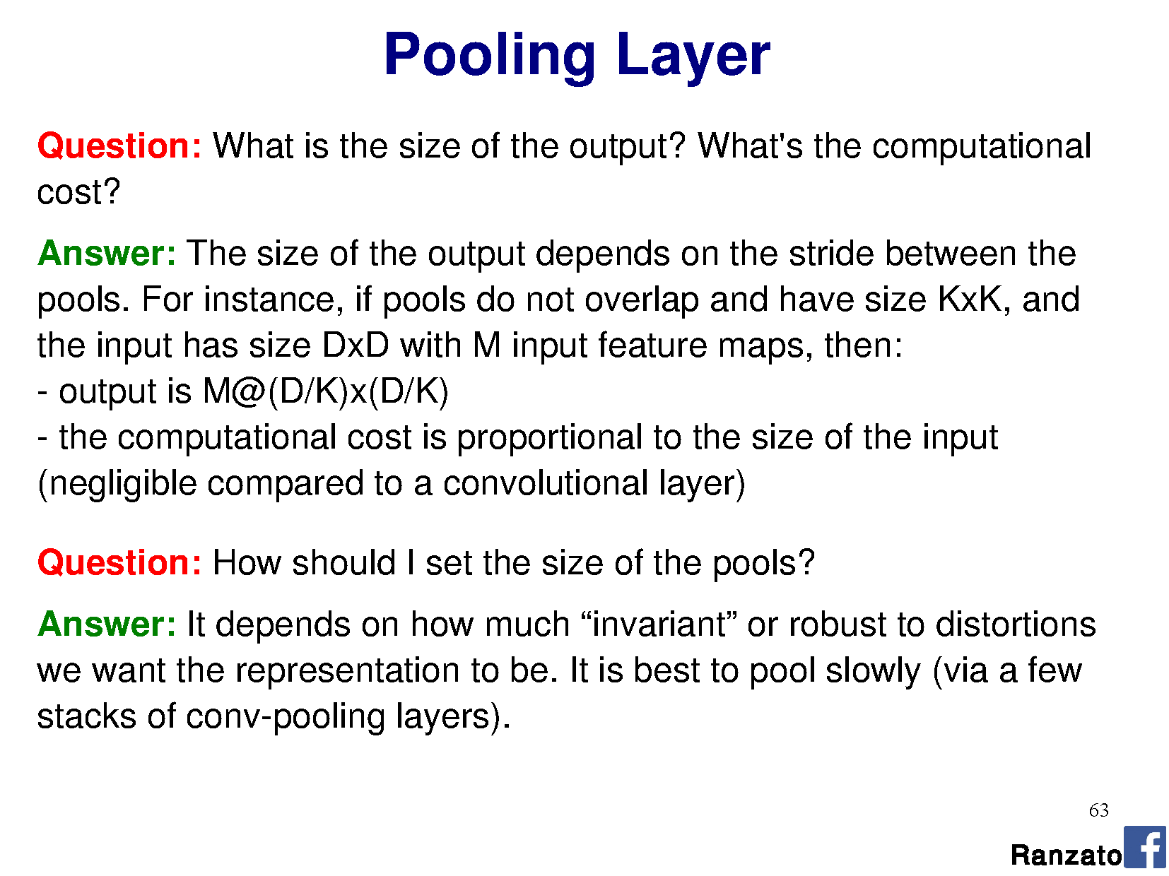

Slide 44
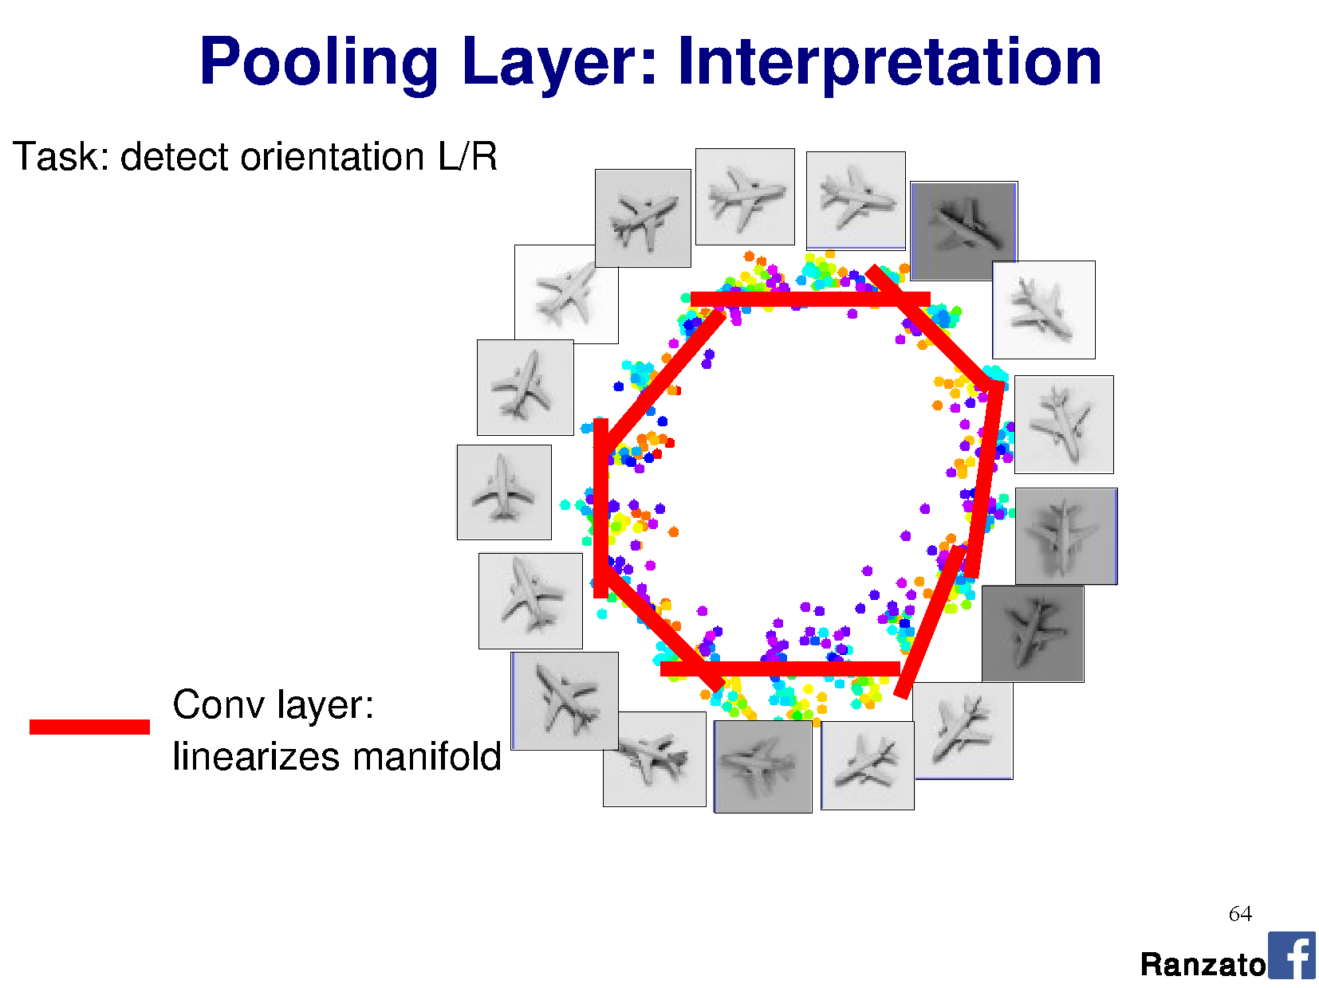

Slide 45
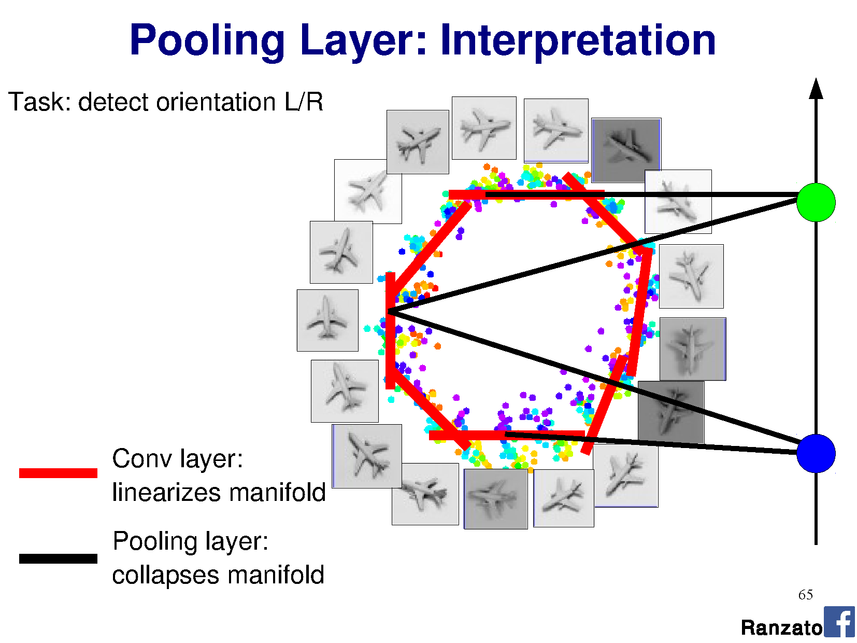

Slide 46
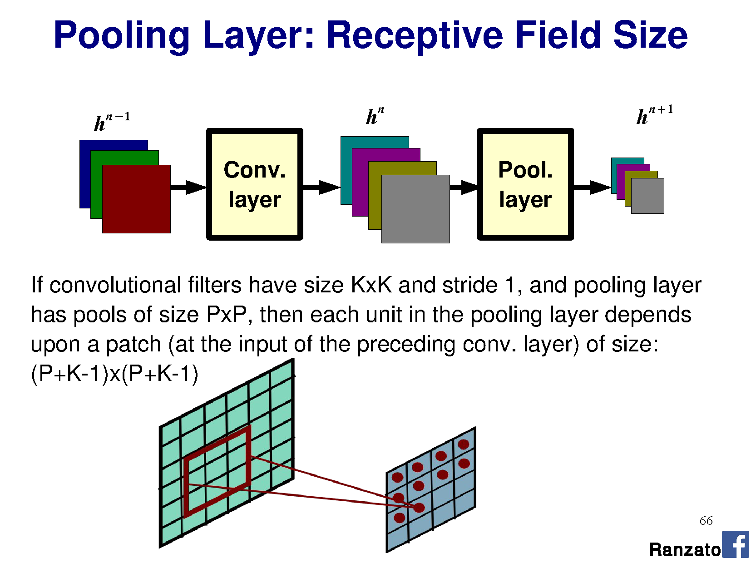

Slide 48
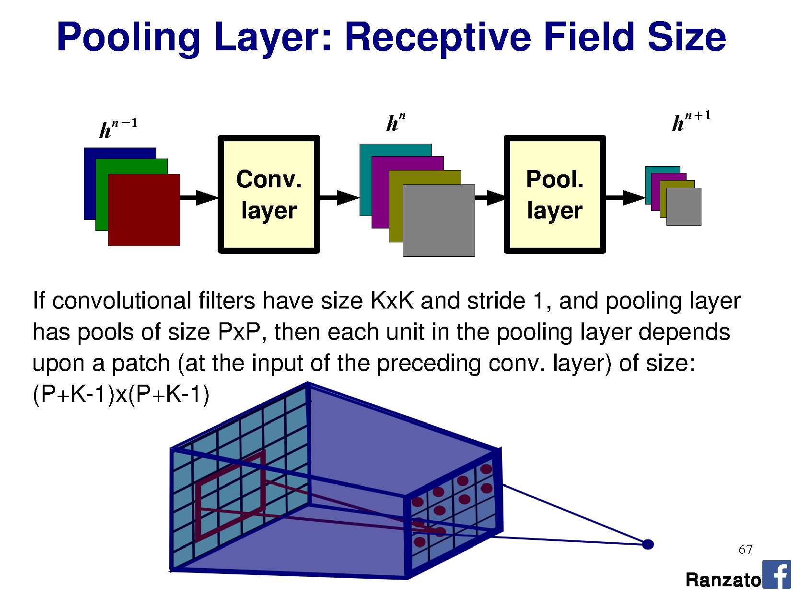

Slide 49
I’ve heard about many more terms of jargon!
Skip connections
Residual connections
Batch normalization
…we’ll get to these in a little while.

Slide 50
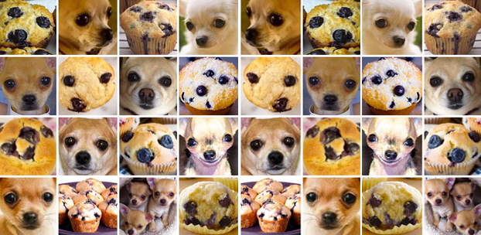
Notes:
Breed of dog: Chihuahua

Slide 51
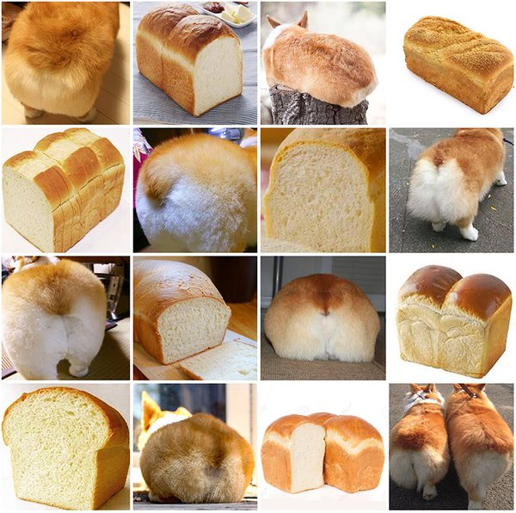
Notes:
Breed of dog: Corgi

Slide 52
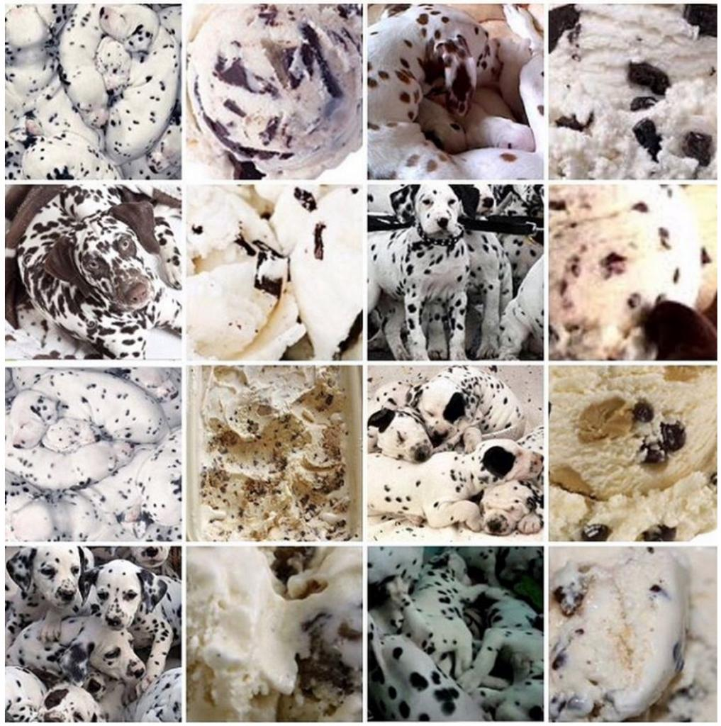
Notes:
Breed of dog: Dalmatian

Slide 53
Training Neural Networks
Learning the weight matrices W

Slide 54
Gradient descent
f(x)
x
Notes:
Note: this is not a convex function.
A convex function must conform such that the line segment between any two points on the graph of the function lies above or on the graph. [Wiki]
https://en.wikipedia.org/wiki/Convex_function
For this function, if we draw a line from the first point on x to a point about 1/3 of the way along x, then the function’s response lies above that line.

Slide 55
Gradient descent
f(x)
x
Notes:
Note: this is not a convex function either.
A convex function must conform such that the line segment between any two points on the graph of the function lies above or on the graph. [Wiki]
https://en.wikipedia.org/wiki/Convex_function
For this function, if we draw a line from the first valley to the second valley, then the function’s response lies above that line.

Slide 56

General approach
Pick random starting point.
f(x)
$$a_{1}$$
x

Slide 57

General approach
Compute gradient at point (analytically or by finite differences)
f(x)
$$∇ f(a_{1})$$
$$a_{1}$$
x

Slide 58

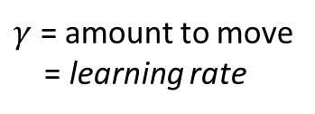

General approach
Move along parameter space in direction of negative gradient
f(x)
$$a_{2}=a_{1}−γ∇ f\left(a_{1}\right)$$
$γ$ = amount to move
= learning rate
$$a_{1}$$
$$a_{2}$$
x

Slide 59


General approach
Move along parameter space in direction of negative gradient.
f(x)
$γ$ = amount to move
= learning rate
$$a_{3}=a_{2}−γ∇ f\left(a_{2}\right)$$
$$a_{1}$$
$$a_{2}$$
$$a_{3}$$
x

Slide 60
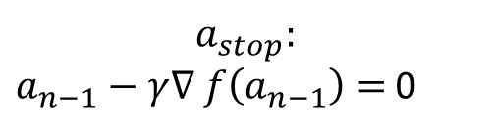

General approach
Stop when we don’t move any more.
f(x)
$$a_{stop}:$$
$a_{n−1}−γ∇ f\left(a_{n−1}\right)=$ 0
$$a_{1}$$
$$a_{2}$$
$$a_{3}$$
$$a_{stop}$$
x

Slide 61
Gradient descent
Optimizer for functions.
Guaranteed to find optimum for convex functions.
  Non-convex = find local optimum.
  Most vision problems aren’t convex.
Works for multi-variate functions.
  Need to compute matrix of partial derivatives (“Jacobian”)
f(x)
x

Slide 62




Why would I use this over Least Squares?
If my function is convex,
why can’t I just use linear least squares?
Analytic solution = normal equations
You can, yes.
$$x={\left(A^{T}A\right)}^{−1}A^{T}b$$
Notes:
https://en.wikipedia.org/wiki/Linear_least_squares_(mathematics)#Derivation_of_the_normal_equations

Slide 63
Why would I use this over Least Squares?
But now imagine that I have 1,000,000 data points.
Matrices are _huge_.
Even for convex functions, gradient descent allows me to iteratively solve the solution without requiring very large matrices.
We’ll see how.
Notes:
https://en.wikipedia.org/wiki/Linear_least_squares_(mathematics)#Derivation_of_the_normal_equations

Slide 64

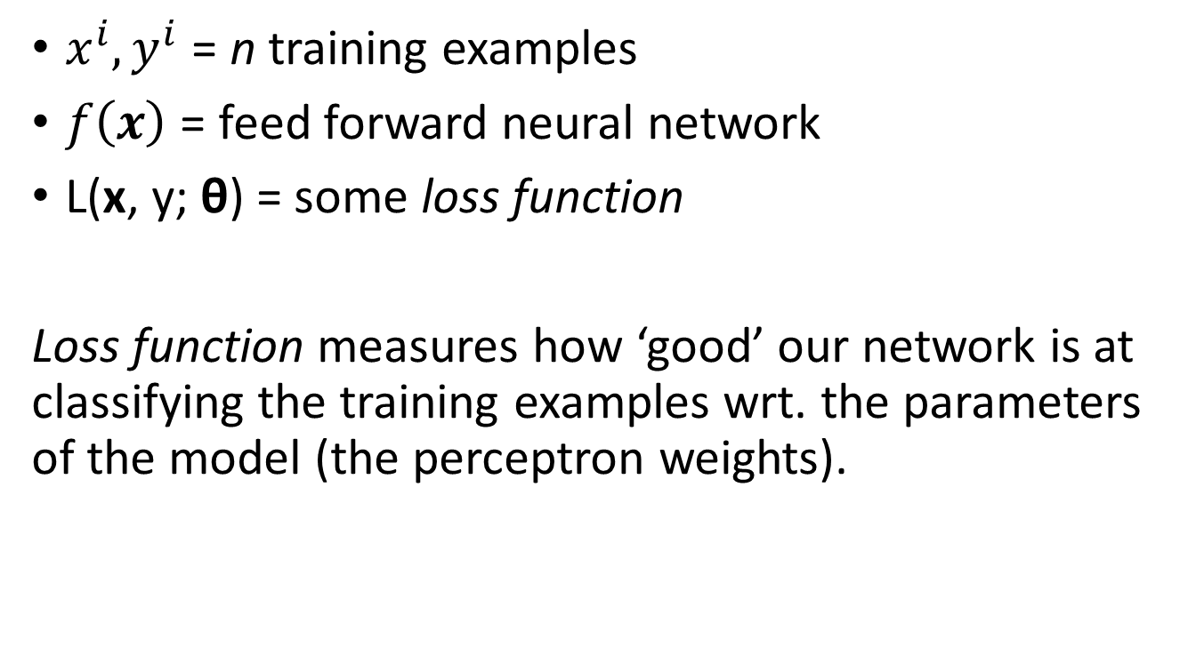
Train NN with Gradient Descent
$x^{i},y^{i}$ = n training examples
$f\left(x\right)$ = feed forward neural network
L(x, y; θ) = some loss function
Loss function measures how ‘good’ our network is at classifying the training examples wrt. the parameters of the model (the perceptron weights).
$$\frac{1}{n}\sum_{i=1}^{n}{{\left\|f\left(x^{i}\right)−y^{i}\right\|}^{2}}$$

Slide 65
Train NN with Gradient Descent
Loss function
(Evaluate NN
on training data)
$$a_{1}$$
$$a_{2}$$
$$a_{3}$$
$$a_{stop}$$
Model parameters
(perceptron weights)

Slide 66
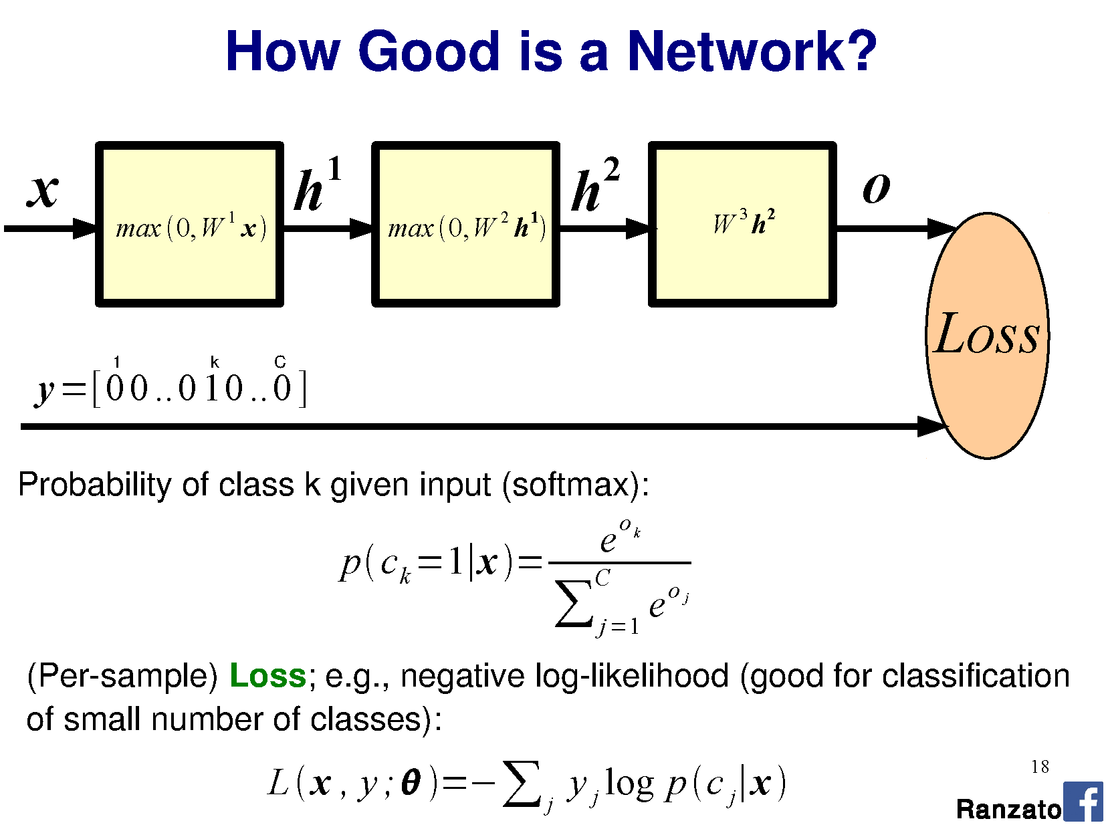
utput

Slide 67

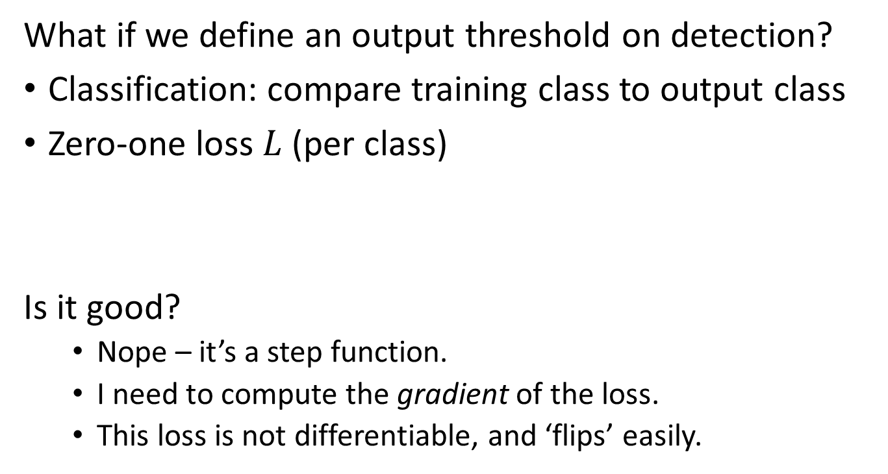
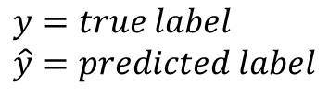
What is an appropriate loss?
What if we define an output threshold on detection?
Classification: compare training class to output class
Zero-one loss $L$(per class)
Is it good?
  Nope – it’s a step function.
  I need to compute the gradient of the loss.
  This loss is not differentiable, and ‘flips’ easily.
$$y=true label \\ \hat{y}=predicted label$$

Slide 68
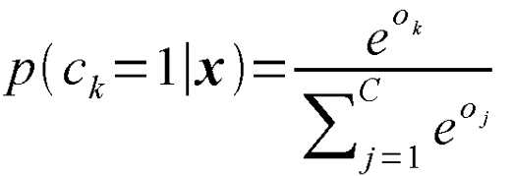
Classification as probability
Special function on last layer - ‘Softmax’ σ():
  “Squashes" a C-dimensional vector O of arbitrary real values to a C-dimensional vector σ(O) of real values in the range (0, 1) that add up to 1.
  Turns the output into a probability distribution on classes.
Notes:
"squashes" a K-dimensional vector z of arbitrary real values to a K-dimensional vector σ ( z ) of real values in the range (0, 1) that add up to 1.
Used as the loss in logistic regression
Add softmax graph
http://dataaspirant.com/2017/03/07/difference-between-softmax-function-and-sigmoid-function/
Different from a sigmoid – sigmoid just ensures that function output is between [0,1]; softmax ensures sum of vector is equal to 1 (probability distribution).
Note that softmax is not ‘scale invariant’ – the size of the values in O matters. Scaling O linearly will produce a different distribution as output.

Slide 69
Classification as probability
Softmax example:
  “Squashes" a C-dimensional vector O of arbitrary real values to a C-dimensional vector σ(O) of real values in the range (0, 1) that add up to 1.
  Turns the output into a probability distribution on classes.
Output from perceptron layer
‘distance from class boundary’
O = [2.0, 0.7, 0.2, -0.3, -0.6, -2.5]
σ(O) = [0.616, 0.168, 0.102, 0.061, 0.046, 0.007]
Notes:
e.g., a set of perceptrons provide us with distances from their classification boundaries for
Example:
e^{O_k} = {7.38906, 2.01375, 1.2214, 0.740818, 0.548812, 0.082085}
Sum e^{O_k} = 11.994825

Slide 70
Softmax
utput
Softmax

Slide 71
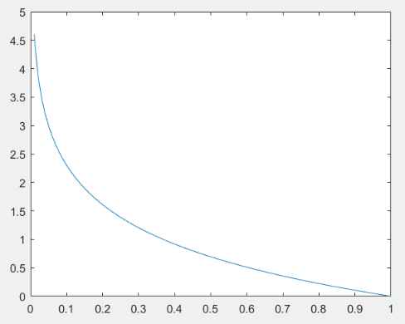
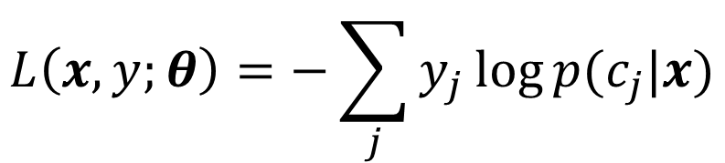
Cross-entropy loss function
Negative log-likelihood
Measures difference between
predicted and training
probability distributions
(see Project 4 for more details)
Is it a good loss?
  Differentiable
  Cost decreases as
  probability increases
$$L\left(x,y;θ\right)=−\sum_{j}{y_{j}\log{p(c_{j}|x)}}$$
L
p(c_{j}|x)
Notes:
https://en.wikipedia.org/wiki/Loss_functions_for_classification
If p(y) is 0.9, and we classify the object as 0.9, then we would wish for a low loss. -log(p) = ~0.1. So, loss = 0.9 * -log(p) = 0.0949. = low.
If p(y) is 0.1, and we classify the object as 0.9, then we would wish for a high loss. –log(p) = ~0.1. So, loss = 0.-1 = higher.
Why is this differentiable?
Gradient wrt x of log(x) = 1 / x

Slide 72
Softmax
utput

Slide 73
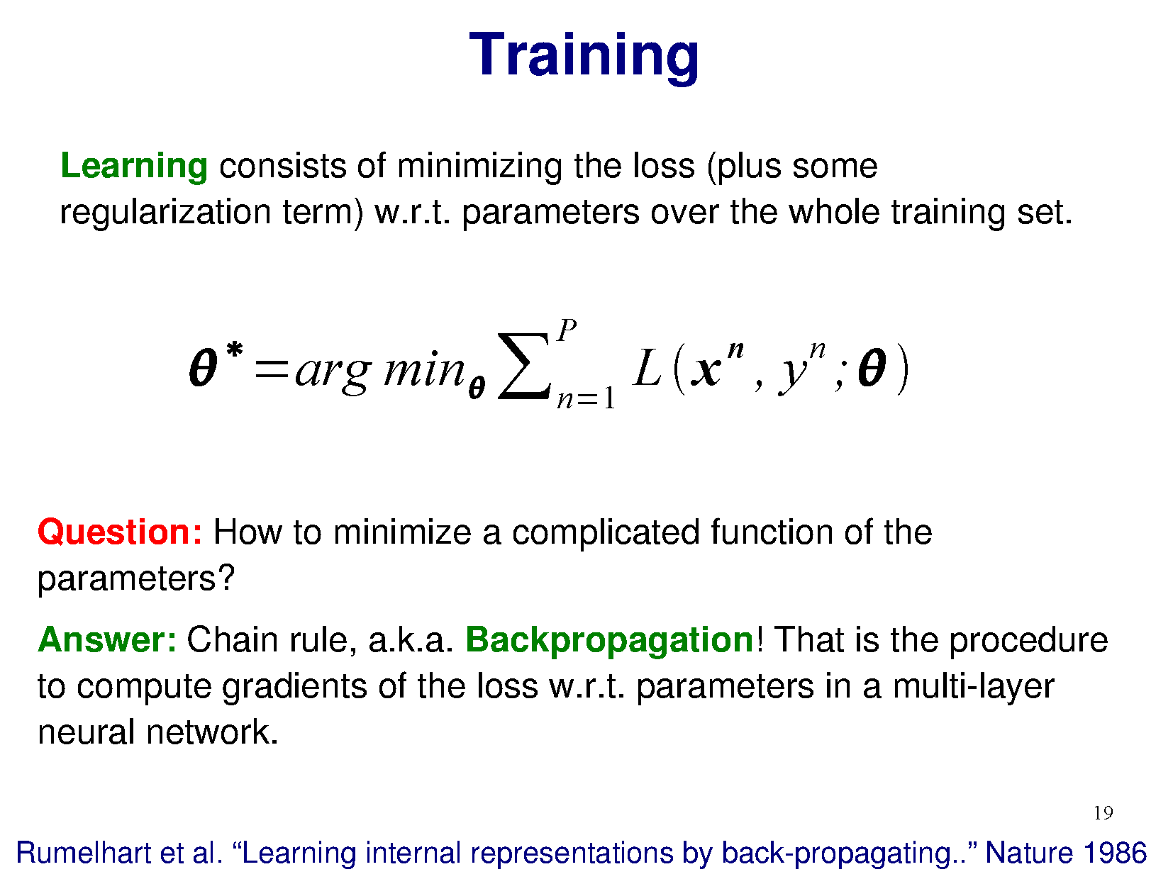
Training
Learning consists of minimizing the loss wrt. parameters
over the whole training set.

Slide 74
Training
Learning consists of minimizing the loss wrt. parameters
over the whole training set.

Slide 75
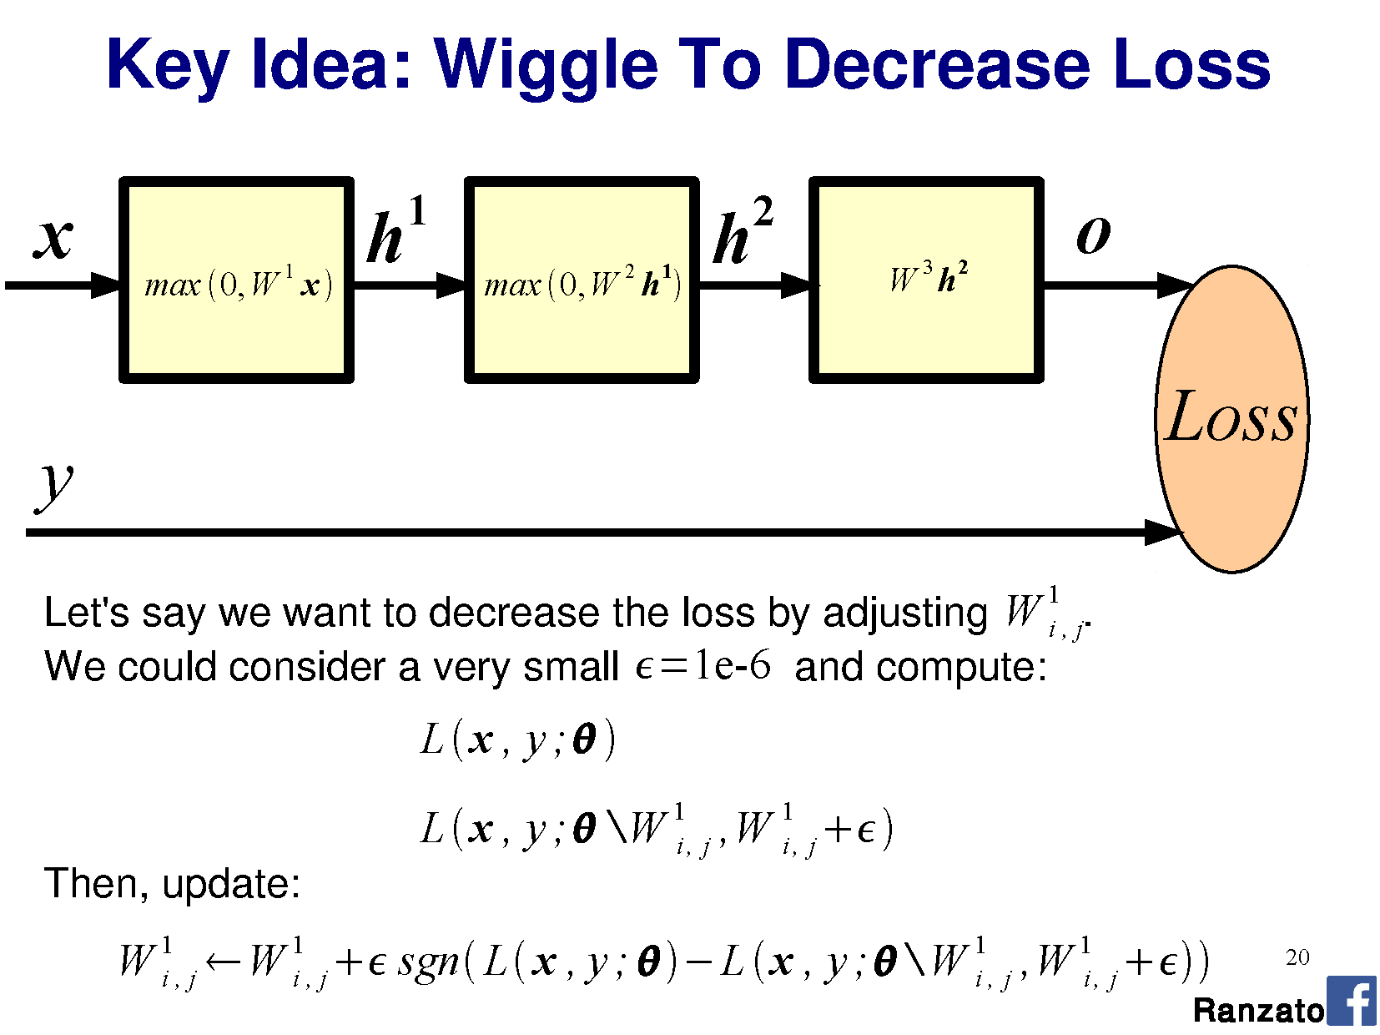
Softmax

Slide 76
Softmax
Notes:
Conceptually, this slide is merely saying that we could vary W at a particular neuron in a particular layer, see how the loss value changed, and then update W by some small amount based on whether the loss moved in the right direction or not.
Here, mathematically we just look at the sign and multiply it by some tiny eta.
But – that seems inefficient. The problem is really to say ‘by how much should I move’?
Here, we want to apply gradient descent. That means we need to compute a gradient – a derivative.
Given that we have this multi-layer setup, we’re going to have to compute a _lot_ of derivatives!
Let’s first try and consider how the loss changes wrt. the output softmax layer.

Slide 77
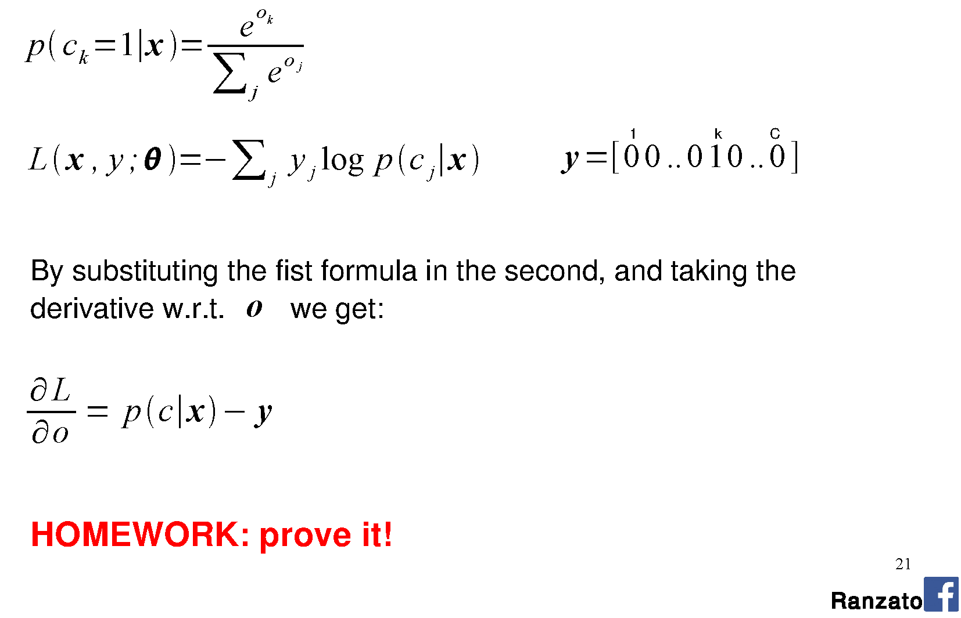
Derivative of loss wrt. softmax

Slide 78
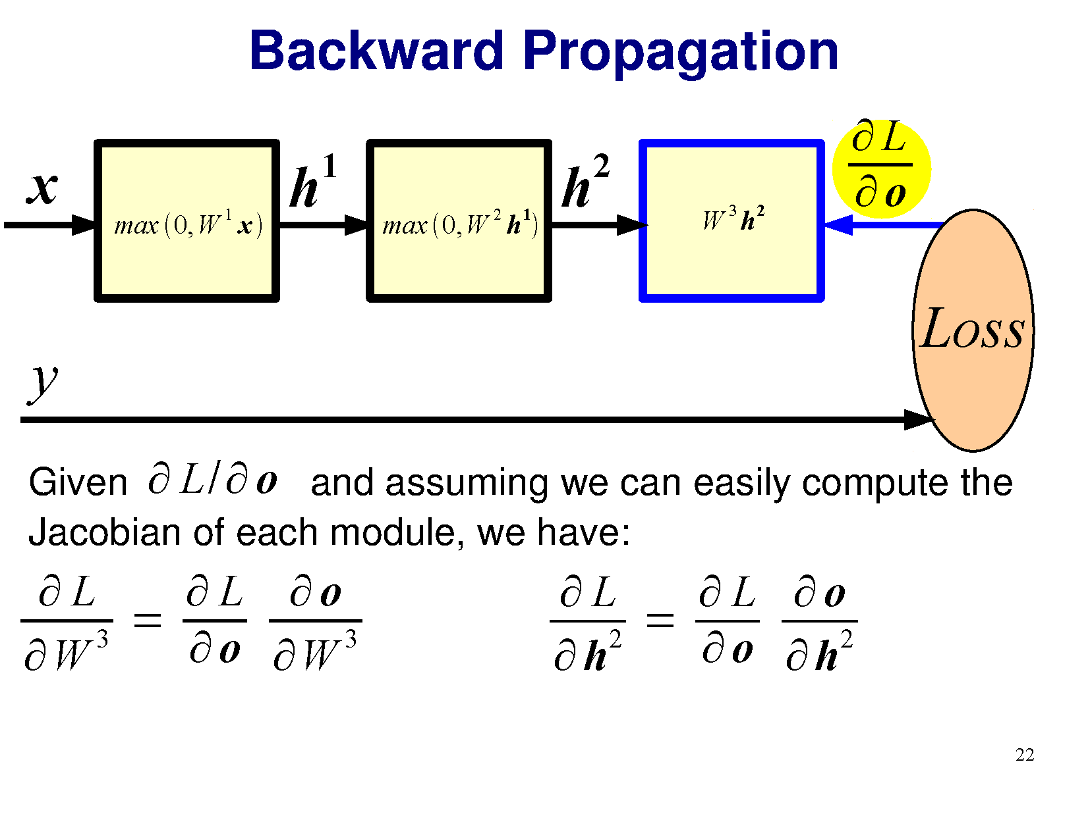
Notes:
Chain rule from calculus on partial derivatives.
Jacobian is matrix of partial derivatives

Slide 79
<- Chain rule from calculus
Notes:
Chain rule from calculus on partial derivatives.
Jacobian is matrix of partial derivatives

Slide 80
Notes:
Chain rule from calculus on partial derivatives.
Jacobian is matrix of partial derivatives
Here, we have both
derivative of loss wrt. derivative of W^3
derivative of loss wrt. derivative of h^2
because their matrix multiplication produces the output (which goes into the softmax). We need to compute derivatives for both components, and ‘carry’ them backwards with us.

Slide 81
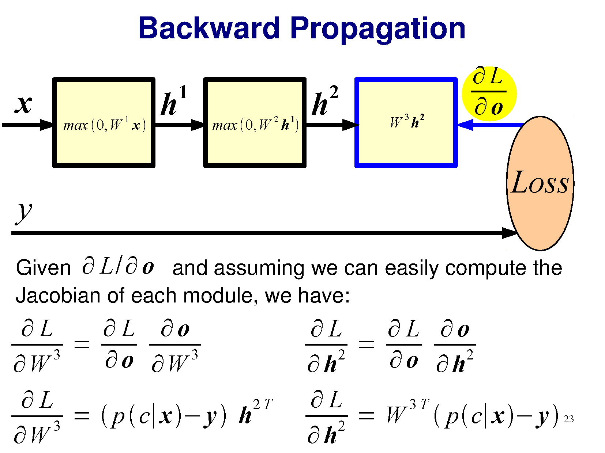
Notes:
Here, we provide the derivations given that the loss is the cross-entropy loss and that the output logit function is softmax.

Slide 82


Slide 83


Slide 84

Notes:
a.e. = almost everywhere -> idea from measure theory which states that “a property holds almost everywhere if the set of elements for which the property does not hold is a set of measure zero”
Set of measure zero -> “A set of points capable of being enclosed in intervals whose total length is arbitrarily small.”

Slide 85
But the ReLU is not differentiable at 0!
Right. Fudge!
‘0’ is the best place for this to occur, because we don’t care about the result (it is no activation).
‘Dead’ perceptrons
ReLU has unbounded positive response:
  Potential faster convergence / overstep

Slide 86
Notes:
a.e. = almost everywhere -> idea from measure theory which states that “a property holds almost everywhere if the set of elements for which the property does not hold is a set of measure zero”
Set of measure zero -> “A set of points capable of being enclosed in intervals whose total length is arbitrarily small.”
https://en.wikipedia.org/wiki/Backpropagation

Slide 87

Optimization demo
http://www.emergentmind.com/neural-network
Thank you Matt Mazur
Notes:
https://en.wikipedia.org/wiki/Backpropagation
http://colah.github.io/posts/2015-08-Backprop/

Slide 88


Slide 89


Slide 90


Slide 91


Slide 92

Notes:
Doodle
Poodle cross with …

Slide 93

Wow
false positives
what class
no good filtr
so misclassified
cool kernel
Notes:
Shiba Inu

Slide 94

Stochastic Gradient Descent
Dataset can be too large to strictly apply gradient descent wrt. all data points.
Instead, randomly sample a data point, perform gradient descent per point, and iterate.
  True gradient is approximated only
  Picking a subset of points: “mini-batch”
Randomly initialize starting $W$ and pick learning rate $γ$
While not at minimum:
  Shuffle training set
  For each data point i=1…n (maybe as mini-batch)
    Gradient descent
“Epoch“
Notes:
Epoch: running through every training data example and performing SGD
Diagram for different normalizations

Slide 95

Stochastic Gradient Descent
Loss will not always decrease (locally) as training data point is random.
Still converges over time.
Wikipedia

Slide 96

Gradient descent oscillations
Wikipedia

Slide 97
Gradient descent oscillations
Slow to converge to the (local) optimum
Wikipedia

Slide 98

Momentum
Adjust the gradient by a weighted sum of the previous amount plus the current amount.
Without momentum: $θ_{t+1}= θ_{t} − γ\frac{∂L}{∂θ}$
With momentum (new $α$parameter):
$θ_{t+1}= θ_{t} − γ\left(α{\left[\frac{∂L}{∂θ}\right]}_{t−1}+{\left[\frac{∂L}{∂θ}\right]}_{t}\right)$
Notes:
Called momentum because it forces the gradient to change more slowly, and helps prevent oscillations

Slide 99


Slide 100
But James…
…I thought we were going to treat machine learning like a black box? I like black boxes.
Deep learning is:
- a black box
Training data
Classifier

Slide 101

But James…
…I thought we were going to treat machine learning like a black box? I like black boxes.
Deep learning is:
- a black box
- also a black art.
http://www.isrtv.com/
Notes:
http://www.isrtv.com/forums/topic/12039-custom-button-box-for-iracing/

Slide 102
But James…
…I thought we were going to treat machine learning like a black box? I like black boxes.
Many approaches and hyperparameters:
Activation functions, learning rate, mini-batch size,
momentum…
Often these need tweaking, and you need to know what they do to change them intelligently.

Slide 103



Nailing hyperparameters + trade-offs
Notes:
Aaron in March/April 2017

Slide 104
Lowering the learning rate = smaller steps in SGD
-Less ‘ping pong’
-Takes longer to get to the optimum
Wikipedia

Slide 105


Flat regions in energy landscape
Notes:
Also lets us see how different kinds of learning algorithms work.

Slide 106


Slide 107


Slide 108


Slide 109
Problem of fitting
Too many parameters = overfitting
Not enough parameters = underfitting
More data = less chance to overfit
How do we know what is required?

Slide 110
Regularization
Attempt to guide solution to not overfit
But still give freedom with many parameters

Slide 111

Data fitting problem
[Nielson]

Slide 112


Which is better?
Which is better a priori?
9th order polynomial
1st order polynomial
[Nielson]
Notes:
How do we know a priori how many parameters we need?
Cross-validation is one way.
Occam’s razor: the simplest solution is most likely the right one; “Plurality must never be posited without necessity” [literal Latin translation]
https://en.wikipedia.org/wiki/Occam's_razor

Slide 113
Regularization
Attempt to guide solution to not overfit
But still give freedom with many parameters
Idea:
Penalize the use of parameters to prefer small weights.

Slide 114



Regularization:
Idea: add a cost to having high weights
$λ$ = regularization parameter
$$λ$$
[Nielson]
Notes:
n is size of training data
Intuitively, the effect of regularization is to make it so the network prefers to learn small weights, all other things being equal. Large weights will only be allowed if they considerably improve the first part of the cost function. Put another way, regularization can be viewed as a way of compromising between finding small weights and minimizing the original cost function.

Slide 115
Both can describe the data…
…but one is simpler.
Occam’s razor:
  “Among competing hypotheses, the one with the fewest assumptions should be selected”
  For us:
  Large weights cause large changes in behaviour in response to small changes in the input.
  Simpler models (or smaller changes) are more robust to noise.
Notes:
Why does this help reduce overfitting?

Slide 116


Regularization
Idea: add a cost to having high weights
$λ$ = regularization parameter
$$λ$$
$$λ$$
Normal cross-entropy loss (binary classes)
Regularization term
[Nielson]
Notes:
n is size of training data
Intuitively, the effect of regularization is to make it so the network prefers to learn small weights, all other things being equal. Large weights will only be allowed if they considerably improve the first part of the cost function. Put another way, regularization can be viewed as a way of compromising between finding small weights and minimizing the original cost function.

Slide 117
Regularization: Dropout
Our networks typically start with random weights.
Every time we train = slightly different outcome.
Why random weights?
If weights are all equal,
response across filters
will be equivalent.
  Network doesn’t train.
[Nielson]
Notes:
http://stackoverflow.com/questions/20027598/why-should-weights-of-neural-networks-be-initialized-to-random-numbers
Why do networks only _typically_ start with random weights?
Sometimes we adjust the weights of already-trained networks. This is called ‘fine-tuning’.

Slide 118
Regularization
Our networks typically start with random weights.
Every time we train = slightly different outcome.
Why not train 5 different networks with random starts and vote on their outcome?
  Works fine!
  Helps generalization because error due to overfitting is averaged; reduces variance.
Notes:
Any problem here?
But, kind of slow?

Slide 119

Regularization: Dropout
[Nielson]

Slide 120

Regularization: Dropout
At each mini-batch:
Randomly select a subset of neurons.
Ignore them.
On test: half weights outgoing to compensate for training on half neurons.
Effect:
Neurons become less dependent on output of connected neurons.
Forces network to learn more robust features that are useful to more subsets of neurons.
Like averaging over many different trained networks with different random initializations.
Except cheaper to train.
[Nielson]

Slide 121
Many forms of ‘regularization’
Adding more data is a kind of regularization
Pooling is a kind of regularization
Data augmentation is a kind of regularization

