Slide 1
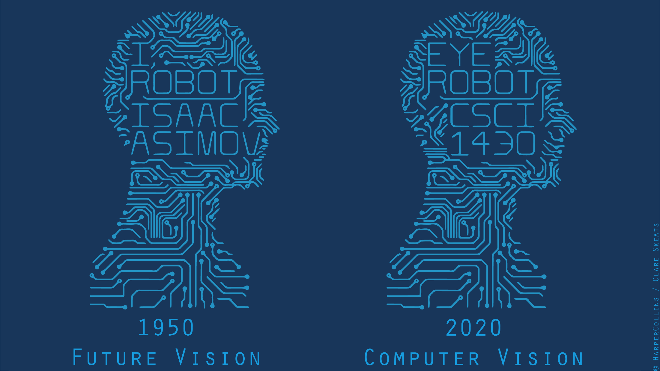

Slide 2

Notes:
Article: https://www.thedailybeast.com/clearview-ai-facial-recognition-company-that-works-with-law-enforcement-says-entire-client-list-was-stolen
Client list: https://www.buzzfeednews.com/article/ryanmac/clearview-ai-fbi-ice-global-law-enforcement
Includes:
2,228 law enforcement agencies, companies, and institutions
Many on 30-day free trials

Slide 3
!!! Warning !!!
Learning jargon is always painful…
…even if the concepts behind the jargon are not hard.
So, let’s get used to it.
“In mathematics you don't understand things.
You just get used to them.”
von Neumann
(telling a joke)
Notes:
John von Neumann (/vɒn ˈnɔɪmən/; Hungarian: Neumann János Lajos, pronounced [ˈnɒjmɒn ˈjaːnoʃ ˈlɒjoʃ]; December 28, 1903 – February 8, 1957) was a Hungarian-American mathematician, physicist, inventor, computer scientist, and polymath. He made major contributions to a number of fields, including mathematics (foundations of mathematics, functional analysis, ergodic theory, geometry, topology, and numerical analysis), physics (quantum mechanics, hydrodynamics, and quantum statistical mechanics), economics (game theory), computing (Von Neumann architecture, linear programming, self-replicating machines, stochastic computing), and statistics.
(This slide is not saying that von Neumann is a joke; merely that he was joking…)

Slide 4
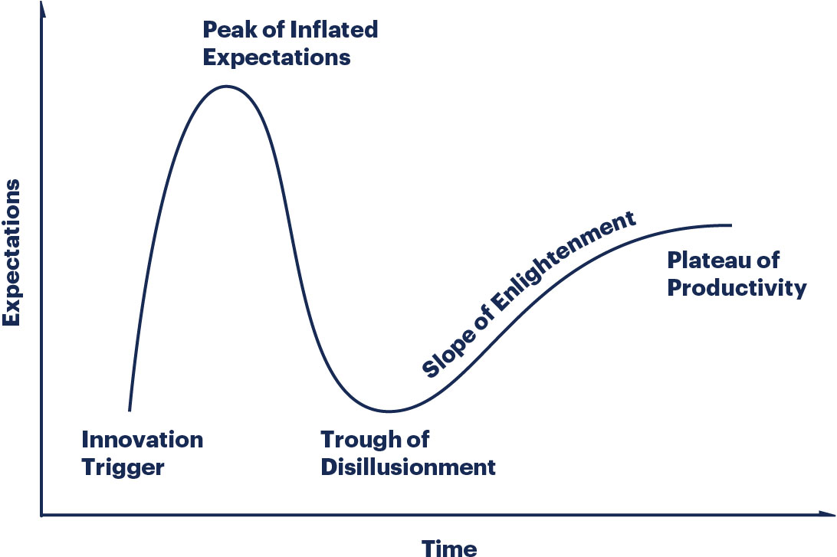
Gartner Hype Cycle
Notes:
Gartner, Inc. is an American research and advisory firm providing information technology related insight for IT and other business leaders located across the world. Its headquarters are in Stamford, Connecticut, United States. It was known as Gartner Group, Inc until 2000, when it was then changed to Gartner.^{[6]}
https://www.gartner.com/en/research/methodologies/gartner-hype-cycle
http://www.gartner.com/technology/research/methodologies/hype-cycle.jsp
https://en.wikipedia.org/wiki/Hype_cycle#/media/File:Hype-Cycle-General.png
Apologies for the low resolution…

Slide 5

Notes:
https://medium.com/the-mission/rocket-ai-2016s-most-notorious-ai-launch-and-the-problem-with-ai-hype-d7908013f8c9
Temporally Recurrent Optimal Learning = TROL(L)

Slide 6
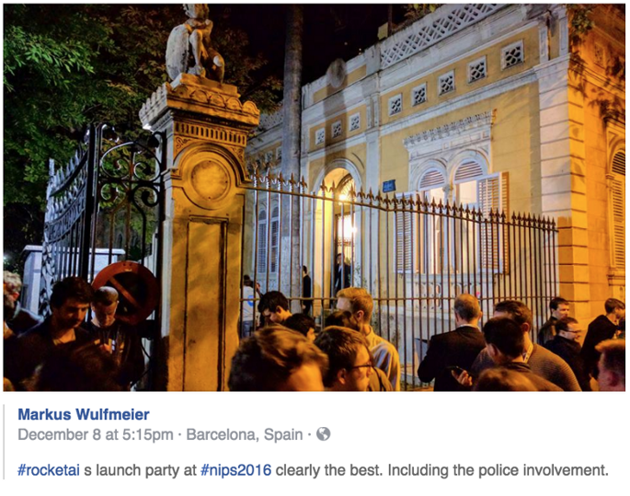
Rocket AI
Launch party
@ NIPS 2016
[now NeurIPS]
Neural
Information
Processing
Systems
Academic
conference
Notes:
https://medium.com/the-mission/rocket-ai-2016s-most-notorious-ai-launch-and-the-problem-with-ai-hype-d7908013f8c9

Slide 7
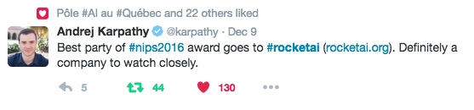
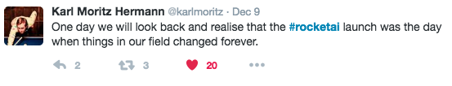
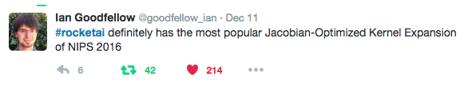
Rocket AI
Notes:
Jacobian-Optimized Kernel Expansion = J-O-K-E

Slide 8
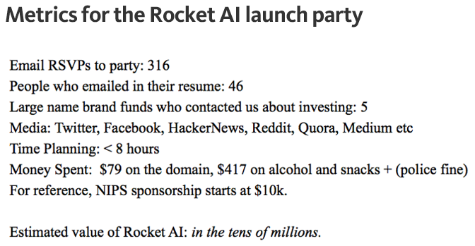
Rocket AI
Article by Riva-Melissa Tez
Notes:
https://medium.com/the-mission/rocket-ai-2016s-most-notorious-ai-launch-and-the-problem-with-ai-hype-d7908013f8c9

Slide 9
Notes:
https://medium.com/the-mission/rocket-ai-2016s-most-notorious-ai-launch-and-the-problem-with-ai-hype-d7908013f8c9
Temporally Recurrent Optimal Learning = TROL(L)
(HBO Silicon Valley)
Hotdog / NotHotdog: https://medium.com/@timanglade/how-hbos-silicon-valley-built-not-hotdog-with-mobile-tensorflow-keras-react-native-ef03260747f3

Slide 10
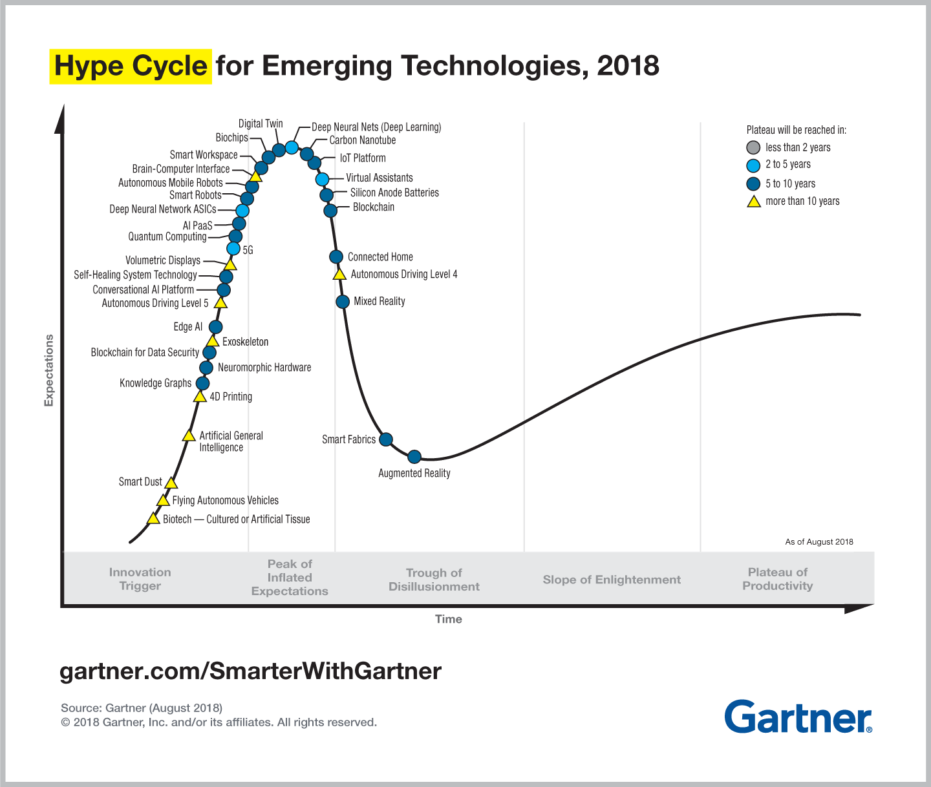
Notes:
Most of what has been making ‘machine learning’ hot is ‘deep neural networks’

Slide 11
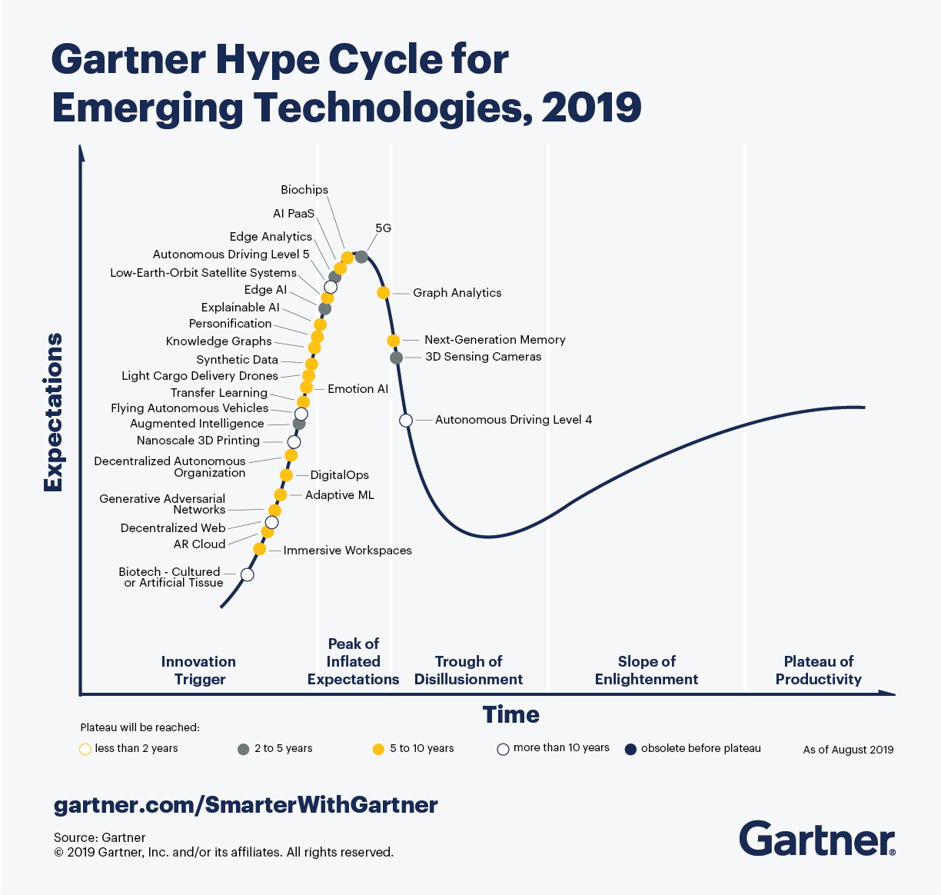

Slide 12
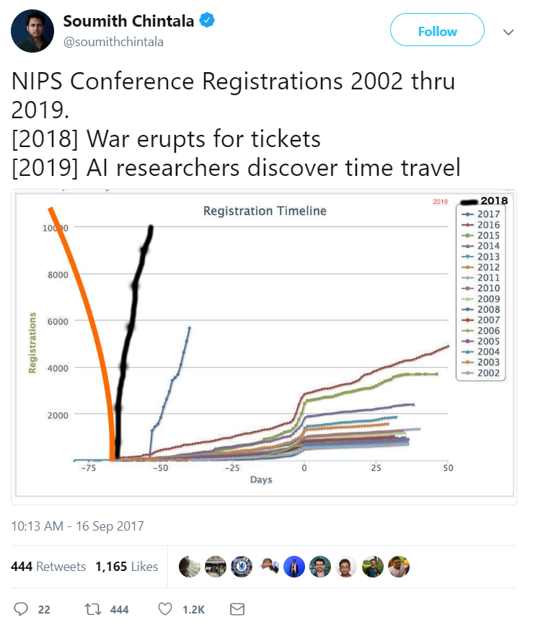
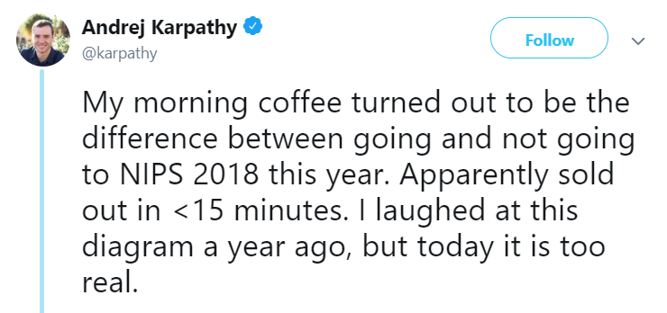

Slide 13
So far…
PASCAL VOC = ~75% 20-class
ImageNet = ~75% 1000-class, top 5
Human brains used intuition and understanding of how we think vision works to develop computer vision systems, and it’s pretty good.

Slide 14
Image formation (+database+labels)
Filtering (gradients/transforms)
Feature points (saliency+description)
Dictionary building (compression/quantization)
Classifier (decision making)
Captured+manual.
Hand designed.
Hand designed.
Hand designed.
Learned.
Recognition:
Classification
Object Detection
Segmentation

Slide 15
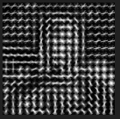
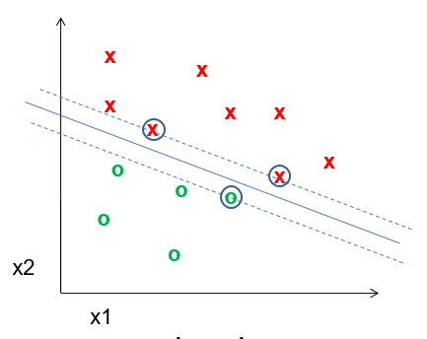
Well, what do we have?
Best performing visions systems have commonality:
Hand designed features
  Gradients + non-linear operations
  (exponentiation, clamping, binning)
  Features in combination (parts-based models)
  Multi-scale representations
Machine learning from databases
Linear classifiers (SVM)
  Some non-linear kernel tricks

Slide 16
But it’s still not that good…
PASCAL VOC = ~75% 20-class
ImageNet = ~75% 1000-class, top 5
ImageNet (human) = ~95%
Problems:
Lossy features
Lossy quantization
‘Imperfect’ classifier
Notes:
The classifier is provably optimal under assumptions, but our assumptions about the data are too simplistic (incorrect)

Slide 17
But it’s still not that good…
PASCAL VOC = ~75% 20-class
ImageNet = ~75% 1000-class, top 5
ImageNet (human) = ~95%
How to solve?
  Features: More principled modeling?
  We know why the world looks (it’s physics!);
  Let’s build better physically-meaningful models.
  Quantization: More data and more compute?
  It’s just an interpolation problem; let’s represent the space with fewer data approximations.
  Classifier: …

Slide 18
The limits of learning?
Where should we put our effort?

Slide 19
Previous claim:
It is more important to have
more or better labeled data than to use
a different supervised learning technique.
“The Unreasonable Effectiveness of Data” - Norvig

Slide 20
No free lunch theorem
Hume (c.1739):
“Even after the observation of the frequent or constant conjunction of objects, we have no reason to draw any inference concerning any object beyond those of which we have had experience.”
-> Learning beyond our experience is impossible.
Notes:
http://www.no-free-lunch.org/
David Hume – 18th century Scottish philosopher, known for empiricism. E.g., all human knowledge is found through experience, and genuine knowledge must either be directly traceable to objects perceived in experience, or result from abstract reasoning about relations between ideas which are derived from experience.
-> calling the rest "nothing but sophistry and illusion“ (sophistry -> false argument, esp. intended to deceive)

Slide 21
No free lunch theorem for ML
Wolpert (1996):
‘No free lunch’ for supervised learning:
“In a noise-free scenario where the loss function is the misclassification rate, if one is interested in off-training-set error, then there are no a priori distinctions between learning algorithms.”
-> Averaged over all possible datasets,
no learning algorithm is better than any other.
Notes:
http://www.no-free-lunch.org/
Algorithm A learns to find the minimum of a cost function, and outperforms algorithm B. For another cost function, algorithm B
"We show that all algorithms that search for an extremum of a cost function perform exactly the same, when averaged over all possible cost functions. In particular, if algorithm A outperforms algorithm B on some cost functions, then loosely speaking there must exist exactly as many other functions where B outperforms A. Starting from this we analyze a number of the other a priori characteristics of the search problem, like its geometry and its information-theoretic aspects. This analysis allows us to derive mathematical benchmarks for assessing a particular search algorithm's performance. We also investigate minimax aspects of the search problem, the validity of using characteristics of a partial search over a cost function to predict future behavior of the search algorithm on that cost function, and time-varying cost functions. We conclude with some discussion of the justifiability of biologically-inspired search methods."
Wolpert and Macready (1995)

Slide 22
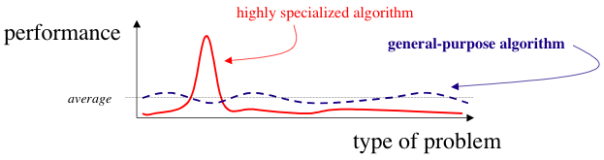
OK, well, let’s give up. Class over.
No, no, no!
We can build a classifier which better matches the characteristics of the problem!
Notes:
Or….high performance is possible by making more assumptions.

Slide 23
But…didn’t we just do that?
PASCAL VOC = ~75%
ImageNet = ~75%; human performance = ~95%
We used intuition and understanding of how we think vision works, but it still has limitations.
Why?

Slide 24
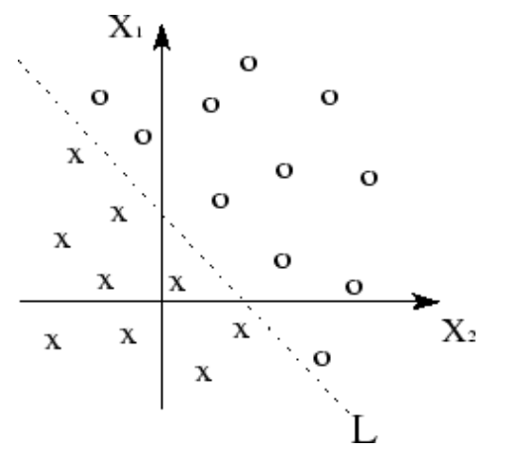
Linear spaces - separability
+ kernel trick to transform space.
Linearly separable data
+ linear classifer = good.
Kawaguchi
Notes:
http://www.ece.utep.edu/research/webfuzzy/docs/kk-thesis/kk-thesis-html/node19.html

Slide 25
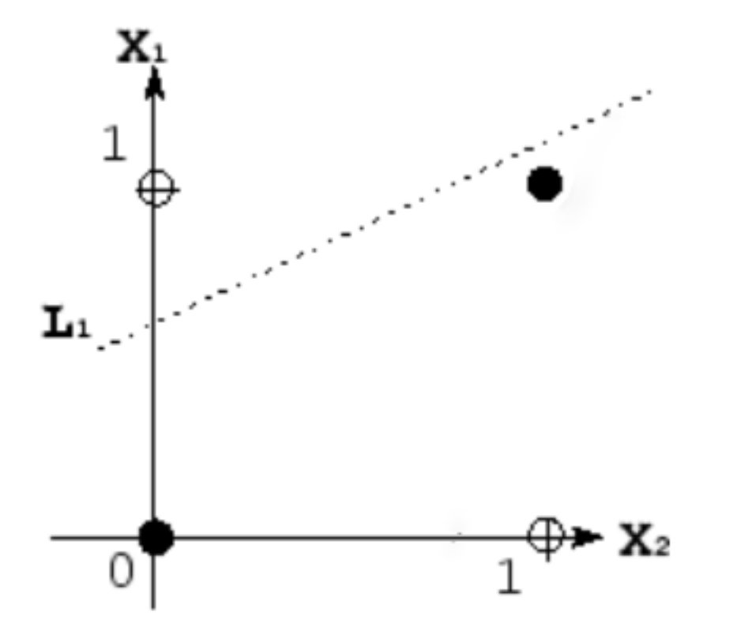
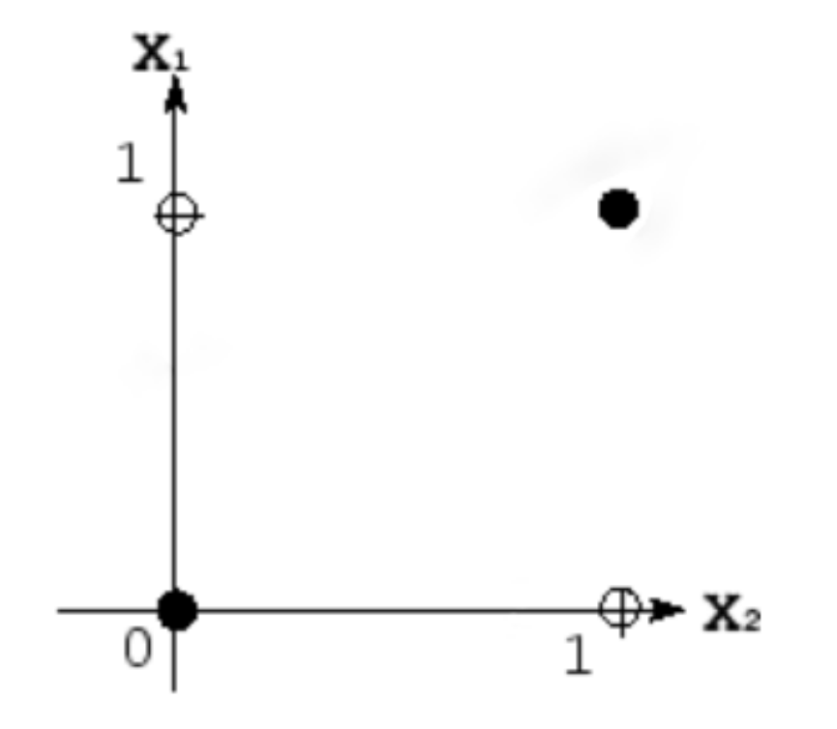
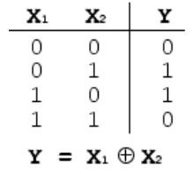
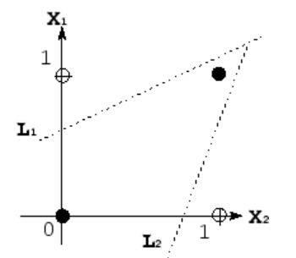
Non-linear spaces - separability
Take XOR – exclusive OR
E.G., human face has two eyes XOR sunglasses
Kawaguchi
Notes:
http://www.ece.utep.edu/research/webfuzzy/docs/kk-thesis/kk-thesis-html/node19.html
Human face example: human appearance has two eyes OR sunglasses

Slide 26
Non-linear spaces - separability
Linear functions are insufficient on their own.
Kawaguchi
Notes:
http://www.ece.utep.edu/research/webfuzzy/docs/kk-thesis/kk-thesis-html/node19.html

Slide 27
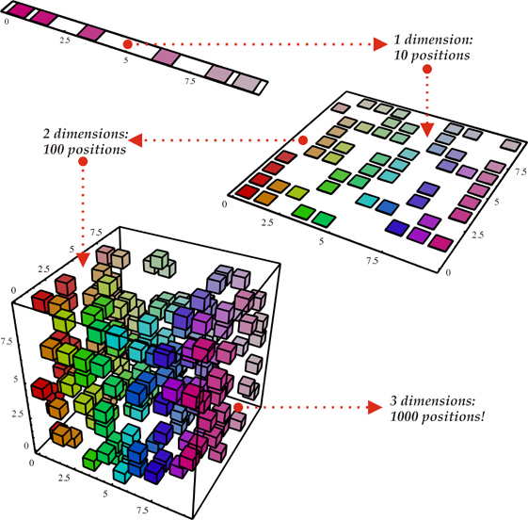
Curse of Dimensionality
Every feature that we
add requires us to
learn the useful
regions in a much
larger volume.
d binary variables =
O(2^{d}) combinations
Notes:
https://haifengl.wordpress.com/2016/02/29/there-is-no-big-data-in-machine-learning/
“In high-dimensional learning, is there ever ‘big data’?”

Slide 28
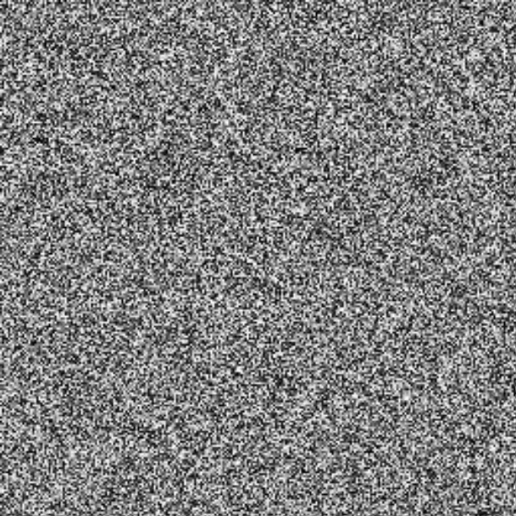
Curse of Dimensionality
Not all regions of this high-dimensional space are meaningful.
>> I = rand(256,256);
>> imshow(I);
@ 8bit = 256 values ^ 65,536

Slide 29
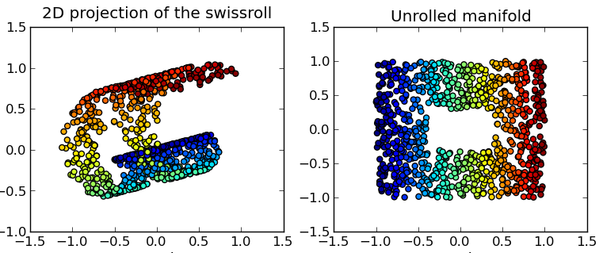
Related: Manifold Learning
Learning locally low-dimensional Euclidean spaces connected and embedded within a high-dim. space.
Wikipedia
Notes:
Classic toy example: Swiss roll

Slide 30
Local constancy / smoothness of feature space
All existing learning algorithms we have seen assume smoothness or local constancy.
  -> New example will be near existing examples
  -> Each region in feature space requires an example
  -> Cannot generalize beyond examples
Extreme example: k-NN classifier. The number of regions cannot be more than the number of examples.
How to try and represent this high-dimensional space in a way which maximizes generalization?

Slide 31
Local constancy / smoothness of feature space
At the extreme: Take k-NN classifier.
The number of regions cannot be more than the number of examples.
-> No way to generalize beyond examples
How to try and represent a complex function with
more factors than regions?

Slide 32
More specialization?
PASCAL VOC = ~75%
ImageNet = ~75%; human performance = ~95%
Is there a way to make our system
better suited to the problem?

Slide 33
Image formation (+database+labels)
Filtering (gradients/transforms)
Feature points (saliency+description)
Dictionary building (compression/quantization)
Classifier (decision making)
Captured+manual.
Hand designed.
Hand designed.
Hand designed.
Learned.
Recognition:
Classification
Object Detection
Segmentation

Slide 34
Wouldn’t it be great if we could…
Image formation (+database+labels)
Filtering (gradients/transforms)
Feature points (saliency+description)
Dictionary building (compression/quantization)
Classifier (decision making)
Captured+manual.
Learned.
Learned.
End to end learning!
Learned.
Learned.
Recognition:
Classification
Object Detection
Segmentation

Slide 35
Well if we can do that, then what about…
Image formation (+database)
Filtering (gradients/transforms)
Feature points (saliency+description)
Dictionary building (compression/quantization)
Classifier (decision making)
Captured+no labels.
Learned.
Learned.
Unsupervised
End to end learning!
Learned.
Learned.
Recognition:
Classification
Object Detection
Segmentation

Slide 36
Goals
Build a classifier which is more powerful
at representing complex functions
and more suited to the learning problem.
What does this mean?
1. Assume that the underlying data generating function relies on a composition of factors in a hierarchy.
Dependencies between regions in feature space
= factor composition

Slide 37
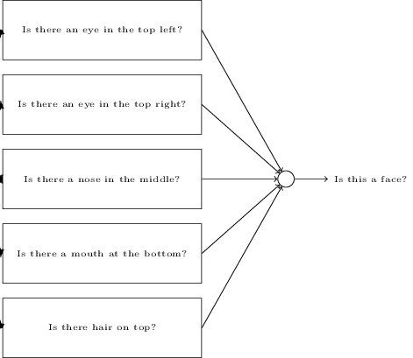
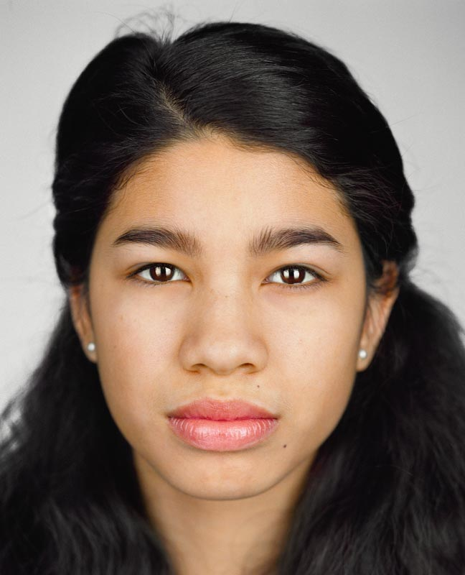
Example
Nielsen, National Geographic
Notes:
We saw this a bit with decision trees, Viola Jones, etc., but we’re going to generalize this concept farther.
http://neuralnetworksanddeeplearning.com/chap1.html
Face (National Geographic): http://ngm.nationalgeographic.com/2013/10/changing-faces/schoeller-photography

Slide 38
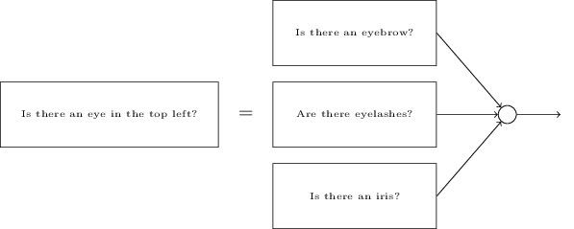
Example
Nielsen, National Geographic

Slide 39
Non-linear spaces - separability
Composition of linear functions can represent
more complex functions.
Kawaguchi
Notes:
http://www.ece.utep.edu/research/webfuzzy/docs/kk-thesis/kk-thesis-html/node19.html

Slide 40
Goals
Build a classifier which is more powerful
at representing complex functions
and more suited to the learning problem.
What does this mean?
1. Assume that the underlying data generating function relies on a composition of factors in a hierarchy.
2. Learn a feature representation specific to the dataset.
10k/100k + data points + factor composition
= sophisticated representation.

Slide 41

Reminder: Viola Jones Face Detector
Combine thousands of ‘weak classifiers’
-1
+1
Two-rectangle features
Three-rectangle features
Etc.
Learn how to combine in cascade with boosting
Stage 1
H₁(x) > t₁?
Yes
Stage 2
H₂(x) > t₂?
Stage N
H_{N}(x) > t_{N}?
Yes
…
Pass
No
No
No
Examples
Reject
Reject
Reject
CC BY-SA 3.0, https://commons.wikimedia.org/w/index.php?curid=801361

Slide 42
Viola Jones
Image formation (+database+labels)
Features (saliency+description)
Classifier
(decision making)
Captured+manual.
Specified space, but selected automatically.
Learned combination.
Recognition:
Object Detection

Slide 43
Neural Networks

Slide 44






Neural Networks
Basic building block for composition is a
perceptron (Rosenblatt c.1960)
Linear classifier – vector of weights w and a ‘bias’ b
$$x_{1}$$
$$w=(w_{1},w_{2},w_{3})$$
$$b=0.3$$
$$x_{2}$$
Output (binary)
$$x_{3}$$

Slide 45
Binary classifying an image
Each pixel of the image would be an input.
So, for a 28 x 28 image, we vectorize:
x = 1 x 784
w is a vector of weights for each pixel, 784 x 1
b is a scalar bias per perceptron
Result = xw + b -> (1x784) x (784x1) + b = (1x1)+b

Slide 46



Neural Networks - multiclass
Add more perceptrons
$$x_{1}$$
Binary output
$$x_{2}$$
Binary output
$$x_{3}$$
Binary output

Slide 47
Multi-class classifying an image
Each pixel of the image would be an input.
So, for a 28 x 28 image, we vectorize.
x = 1 x 784
W is a matrix of weights for each pixel/each perceptron
  W = 10 x 784 (10-class classification)
b is a bias per perceptron (vector of biases); (1 x 10)
Result = xW + b -> (1x784) x (784 x 10) + b
-> (1 x 10) + (1 x 10) = output vector

Slide 48




Bias convenience
Let’s turn this operation into a multiplication only:
  Create a ‘fake’ feature with value 1 to represent the bias
  Add an extra weight that can vary
1
$$x_{1}$$
$$w=({b,w}_{1},w_{2},w_{3})$$
$$x_{2}$$
Output (binary)
$$x_{3}$$

Slide 49
A single-layer of perceptrons can learn any
univariate function!
  To some approximation;
  more perceptrons = a better approximation
  Combination of many step functions
  Function must be differentiable
Input
vector
Output vector
…
PUT SIMPLE VISUAL PROOF

Slide 50
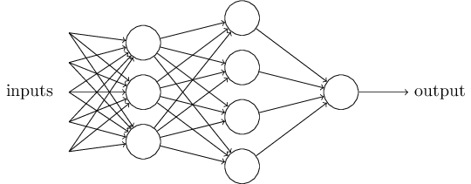
Composition
Attempt to represent complex functions as compositions of smaller functions.
Outputs from one perception are fed into inputs of another perceptron.
Nielsen

Slide 51
Composition
Layer 1
Layer 2
Sets of layers and the connections (weights) between them define the network architecture.
Nielsen

Slide 52
Composition
Hidden Layer 1
Hidden Layer 2
Layers that are in between the input and the output are called hidden layers, because we are going to learn their weights via an optimization process.
Nielsen

Slide 53
Composition
Hidden Layer 1
Hidden Layer 2
Multiple
Matrix!
Matrix!
Matrix!
It’s all just matrix multiplication!
GPUs -> special hardware for fast/large matrix multiplication.
Nielsen

Slide 54
Problem 1 with all linear functions
We have formed chains of linear functions.
We know that linear functions can be reduced
  g = f(h(x))
Our composition of functions is really
just a single function : (

Slide 55
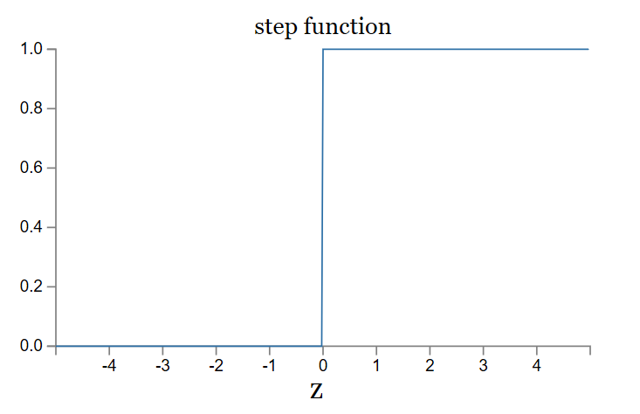
Problem 2 with all linear functions
Linear classifiers: small change in input can cause large change in binary output
= problem for composition of functions
Activation function for a perceptron:
Heaviside function
Nielsen
Notes:
NOTE: perceptions classically have Heaviside step functions as activations – uh-oh!

Slide 56
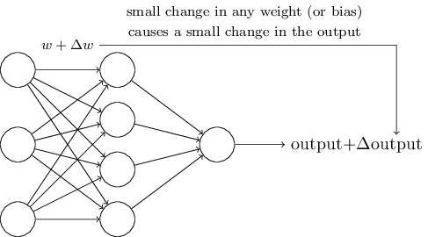
Problem 2 with all linear functions
Linear classifiers: small change in input can cause large change in binary output.
We want:
Nielsen

Slide 57
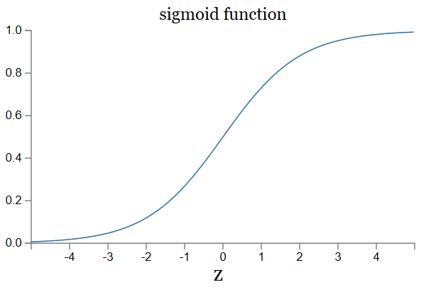


Let’s introduce non-linearities
We’re going to introduce non-linear functions to transform the features.
Nielsen

Slide 58
Universality
A single-layer of perceptrons can learn any
univariate function:
  Combination of many step functions
  So long as it is differentiable
  To some approximation;
  More perceptrons = a better approximation
Visual proof (Michael Nielson):
http://neuralnetworksanddeeplearning.com/chap4.html
- using non-linear activation functions
Notes:
Visual proof is with sigmoid activation functions

Slide 59
Perceptron model
Use is grounded in theory
  Universal approximation theorem (Goodfellow 6.4.1)
Can represent a NAND circuit, from which any binary function can be built by compositions of NANDs
With enough parameters, it can approximate
any function.

Slide 60
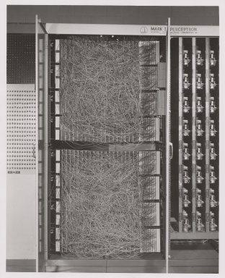
Mark 1 Perceptron
c.1960
20x20 pixel
camera feed
Wikipedia
Notes:
Rosenblatt - 1957 at the Cornell Aeronautical Laboratory
The Mark I Perceptron machine was the first implementation of the perceptron algorithm. The machine was connected to a camera that used 20×20 cadmium sulfide photocells to produce a 400-pixel image. The main visible feature is a patchboard that allowed experimentation with different combinations of input features. To the right of that are arrays of potentiometers that implemented the adaptive weights.[2]:213
In a 1958 press conference organized by the US Navy, Rosenblatt made statements about the perceptron that caused a heated controversy among the fledgling AI community; based on Rosenblatt's statements, The New York Times reported the perceptron to be "the embryo of an electronic computer that [the Navy] expects will be able to walk, talk, see, write, reproduce itself and be conscious of its existence."^{[4]}

Slide 61
If a single-layer network can learn any function…
…given enough parameters…
…then why do we go deeper?
Intuitively, composition is efficient because it allows reuse.
Empirically, deep networks do a better job than shallow networks at learning such hierarchies of knowledge.

Slide 62
Multi-layer perceptron (MLP)
…is a ‘fully connected’ neural network with non-linear activation functions.
‘Feed-forward’ neural network
Nielson

Slide 63
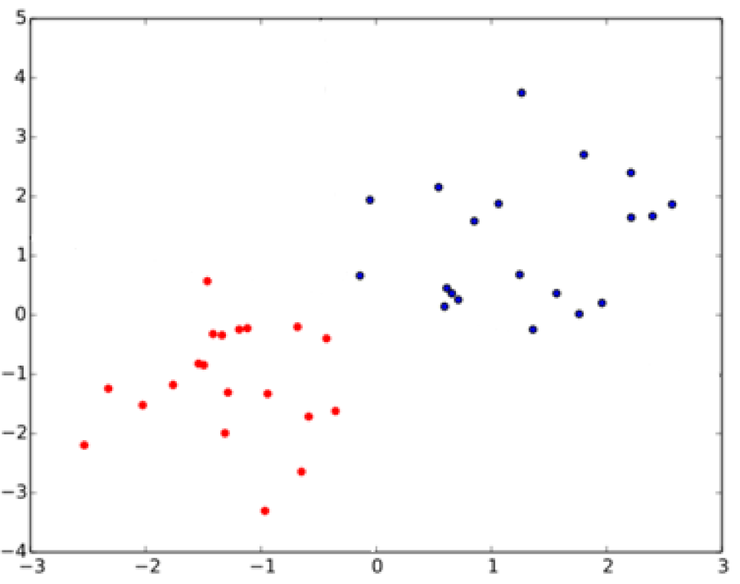
What is the relationship between SVMs
and perceptrons?
SVMs attempt to learn the support vectors which maximize the margin between classes.
Notes:
In separable problems, perceptron training can also aim at finding the largest separating margin between the classes. The so-called perceptron of optimal stability can be determined by means of iterative training and optimization schemes, such as the Min-Over algorithm (Krauth and Mezard, 1987)^{[11]} or the AdaTron (Anlauf and Biehl, 1989)) .^{[12]} AdaTron uses the fact that the corresponding quadratic optimization problem is convex. The perceptron of optimal stability, together with the kernel trick, are the conceptual foundations of the support vector machine.
https://en.wikipedia.org/wiki/Perceptron
Perceptron of optimal stability can be computed via the Min-Over algorithm (Krauth and Mezard, 1987)^{[11]} or the AdaTron (Anlauf and Biehl, 1989) algorithm.

Slide 64
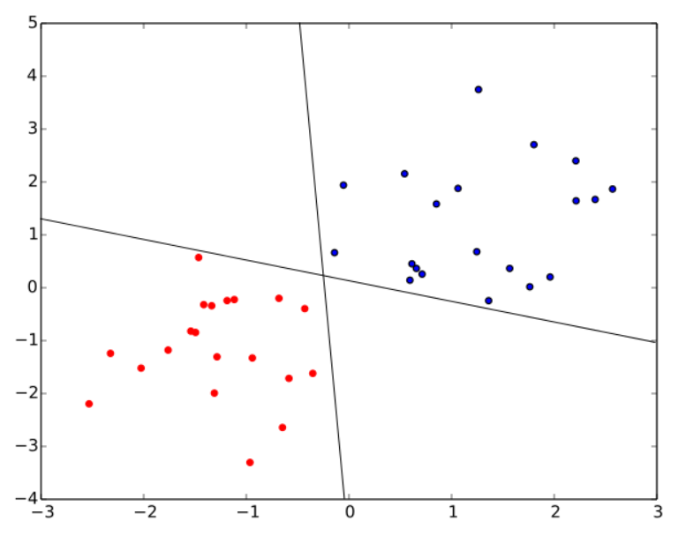
What is the relationship between SVMs
and perceptrons?
SVMs attempt to learn the support vectors which maximize the margin between classes.
A perceptron does not.
Both of these perceptron classifiers are equivalent.
‘Perceptron of optimal
stability’ is used in SVM:
Perceptron
+ optimal stability
+ kernel trick
= foundations of SVM
Notes:
In separable problems, perceptron training can also aim at finding the largest separating margin between the classes. The so-called perceptron of optimal stability can be determined by means of iterative training and optimization schemes, such as the Min-Over algorithm (Krauth and Mezard, 1987)^{[11]} or the AdaTron (Anlauf and Biehl, 1989)) .^{[12]} AdaTron uses the fact that the corresponding quadratic optimization problem is convex. The perceptron of optimal stability, together with the kernel trick, are the conceptual foundations of the support vector machine.
https://en.wikipedia.org/wiki/Perceptron
Perceptron of optimal stability can be computed via the Min-Over algorithm (Krauth and Mezard, 1987)^{[11]} or the AdaTron (Anlauf and Biehl, 1989) algorithm.

Slide 65
Does anyone pass along the weight without an activation function?
No – this is linear chaining.
Input
vector
Output vector

Slide 66
Does anyone pass along the weight without an activation function?
No – this is linear chaining.
Input
vector
Output vector

Slide 67
Are there other activation functions?
Yes, many.
As long as:
- Activation function s(z) is well-defined
as z -> -∞ and z -> ∞
- These limits are different
Then we can make a step! [Think visual proof]
It can be shown that it is universal for function approximation.

Slide 68

Activation functions:
Rectified Linear Unit
ReLU

Slide 69
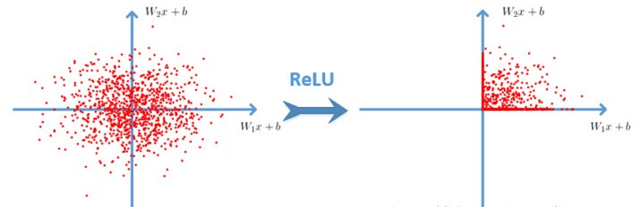
Cyh24 - http://prog3.com/sbdm/blog/cyh_24
Notes:
http://prog3.com/sbdm/blog/cyh_24
http://prog3.com/sbdm/blog/cyh_24/article/details/50593400

Slide 70
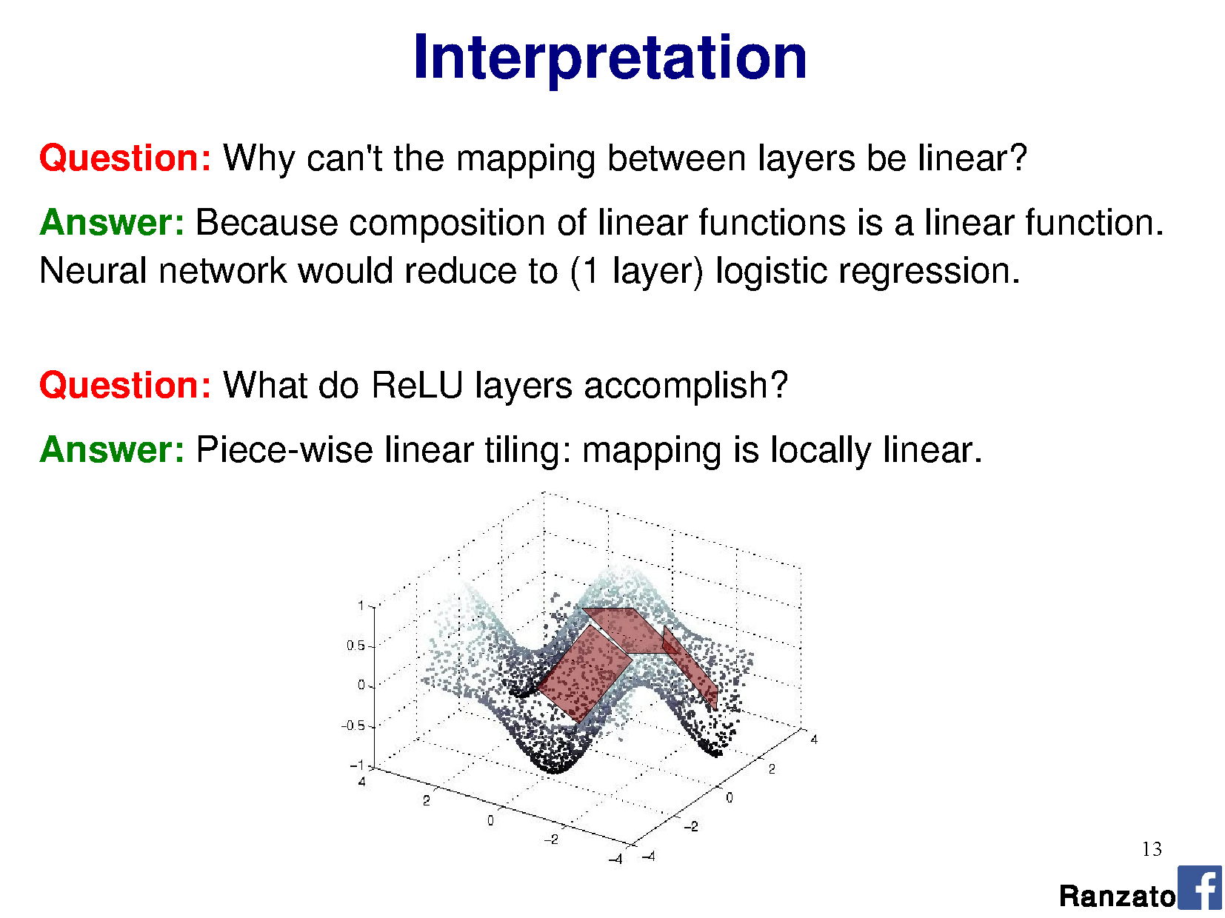
Rectified Linear Unit
Ranzato

Slide 71
Goals
Build a classifier which is more powerful at representing complex functions and more suited to the learning problem.
What does this mean?
1. Assume that the underlying data generating function relies on a composition of factors.
2. Learn a feature representation that is specific to the dataset.

Slide 72
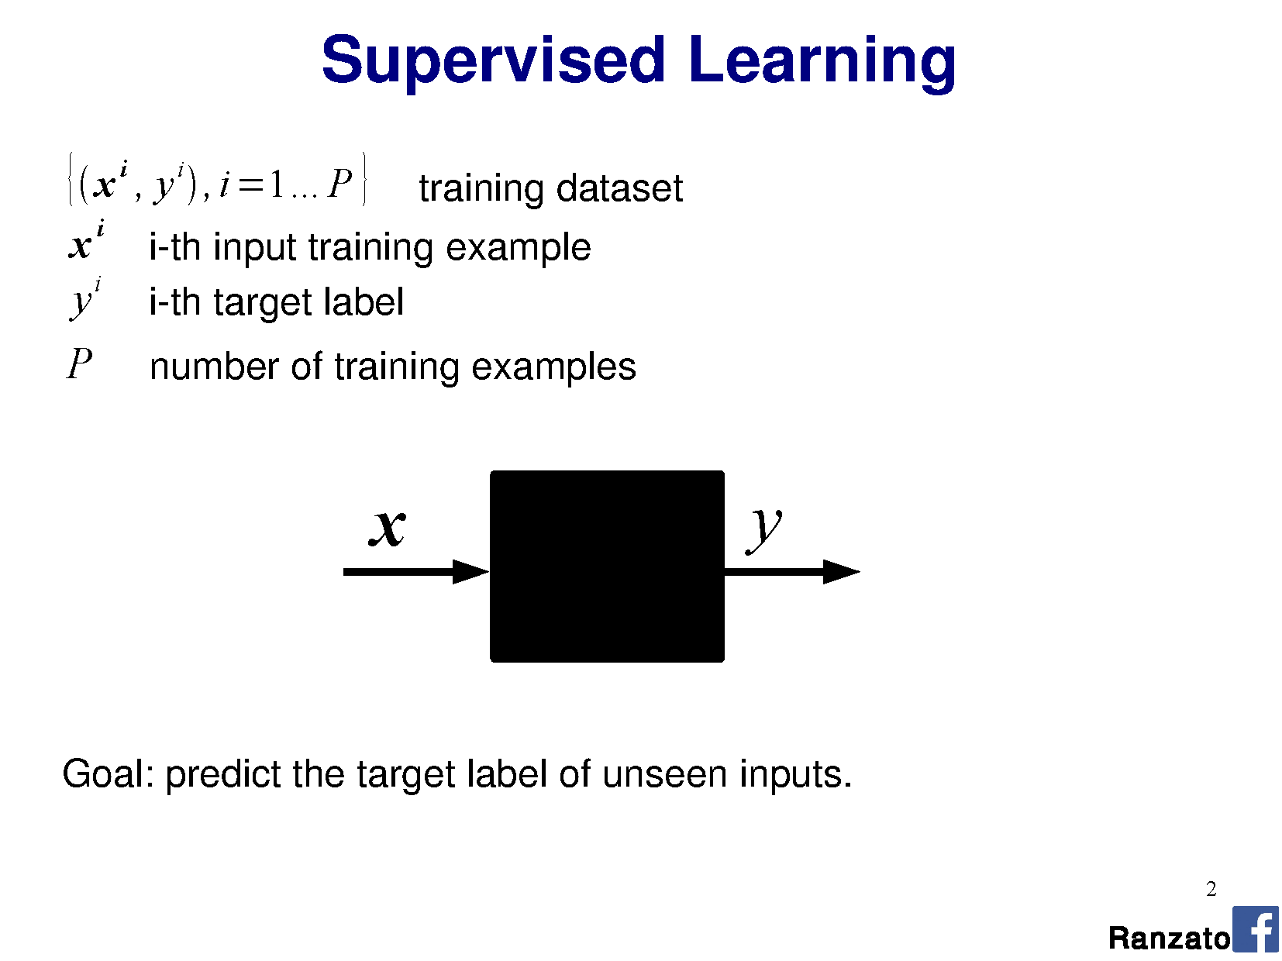
Notes:
Marc'Aurelio Ranzato

Slide 73
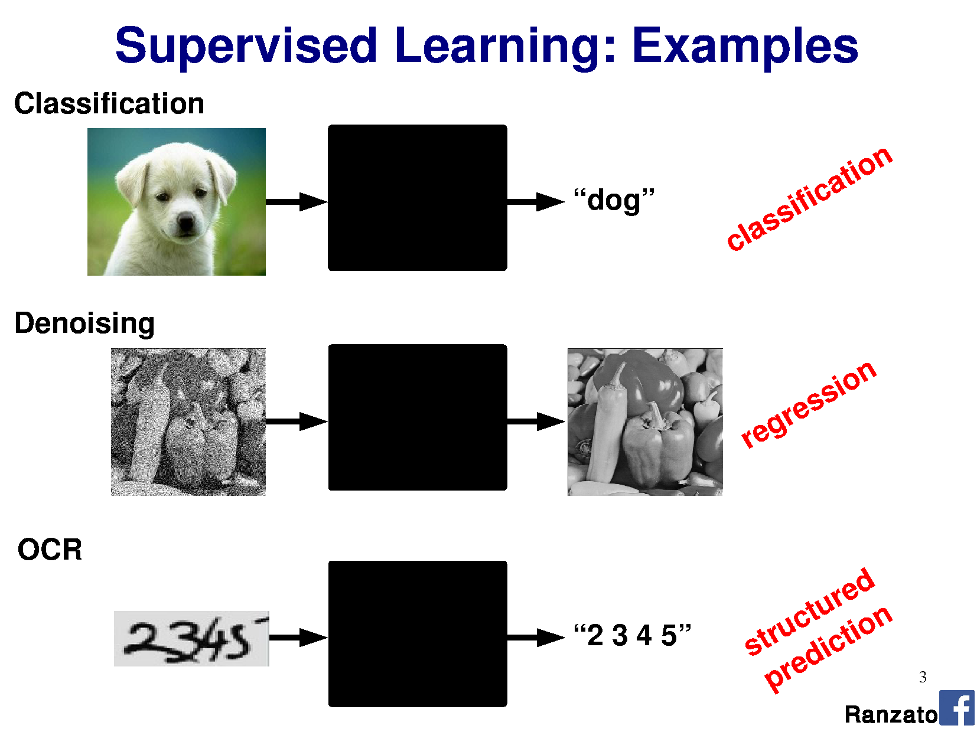

Slide 74
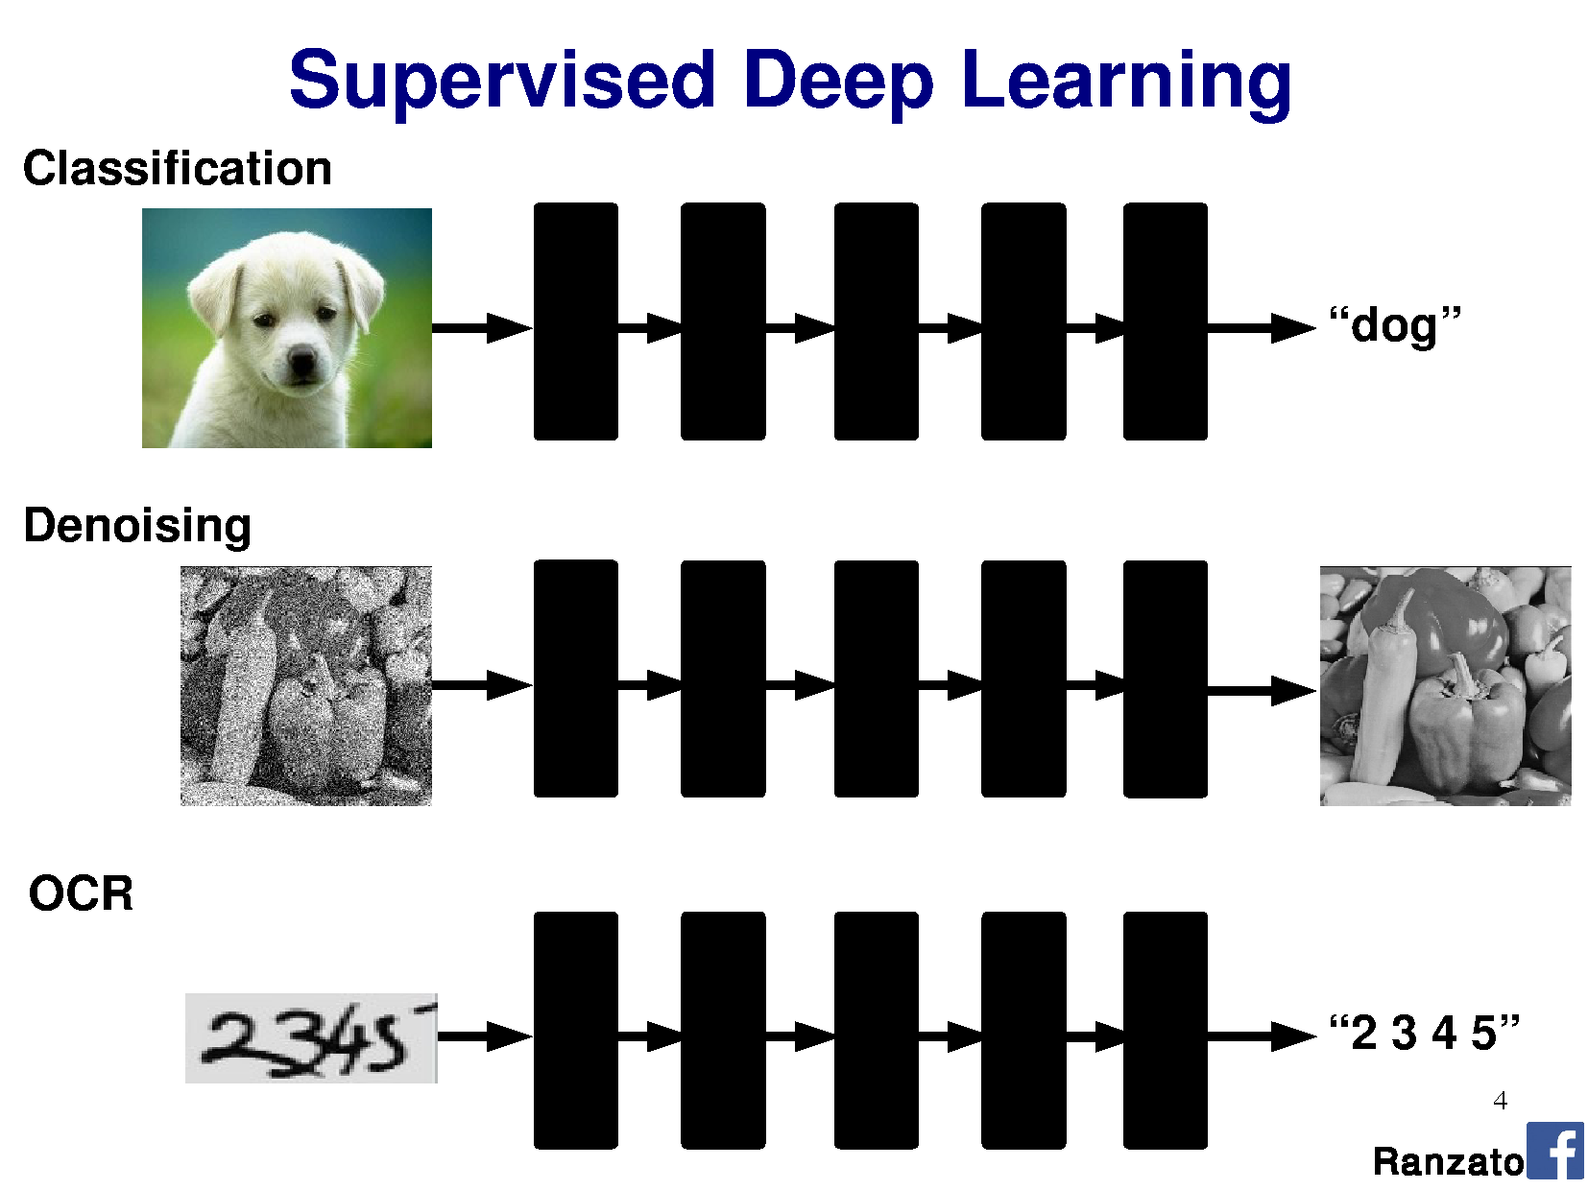
Notes:
Sequence together many linear classifiers to approximate a more complex function.

Slide 75
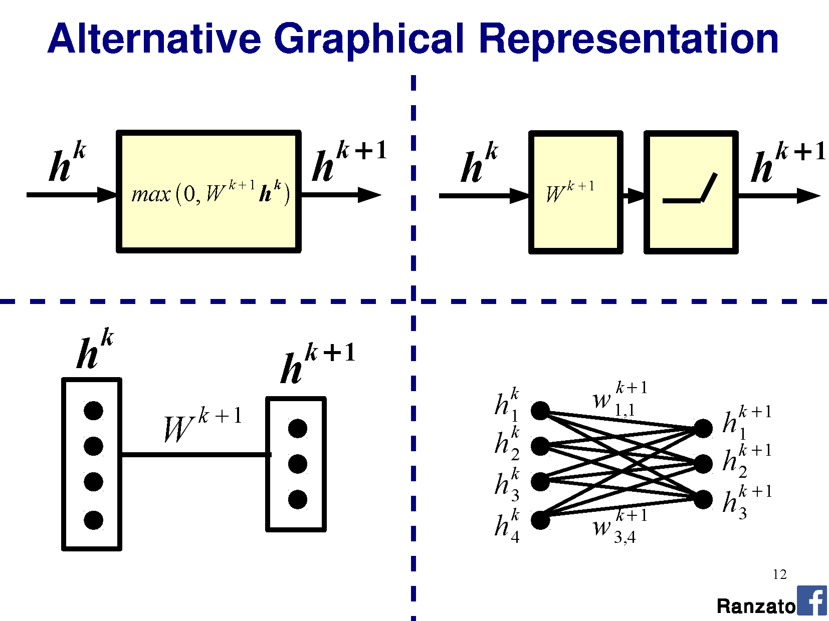

Slide 76
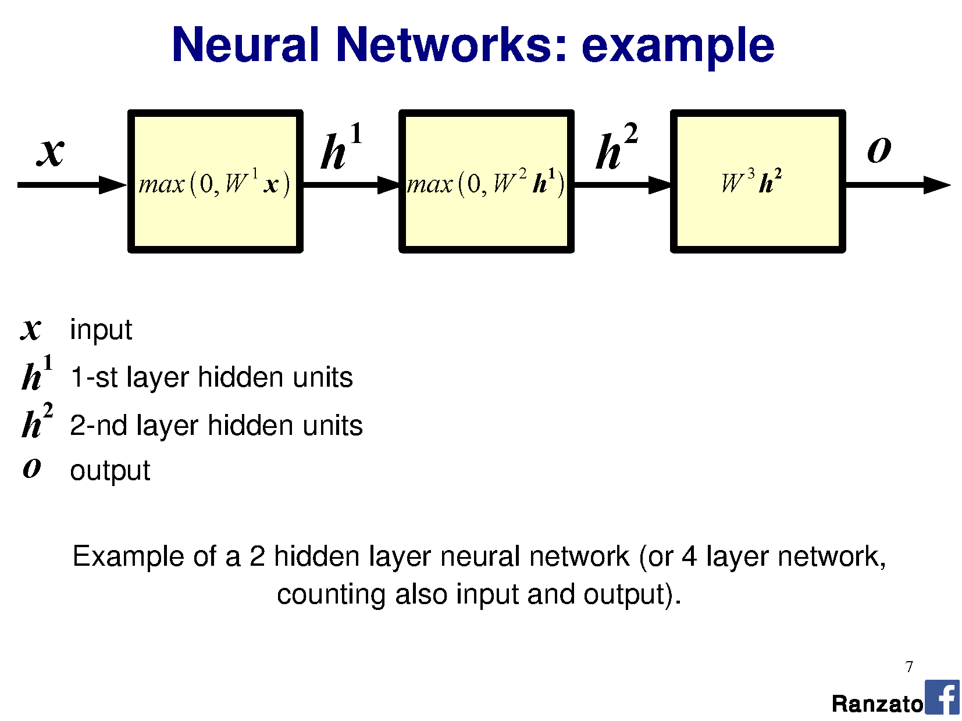

Slide 77
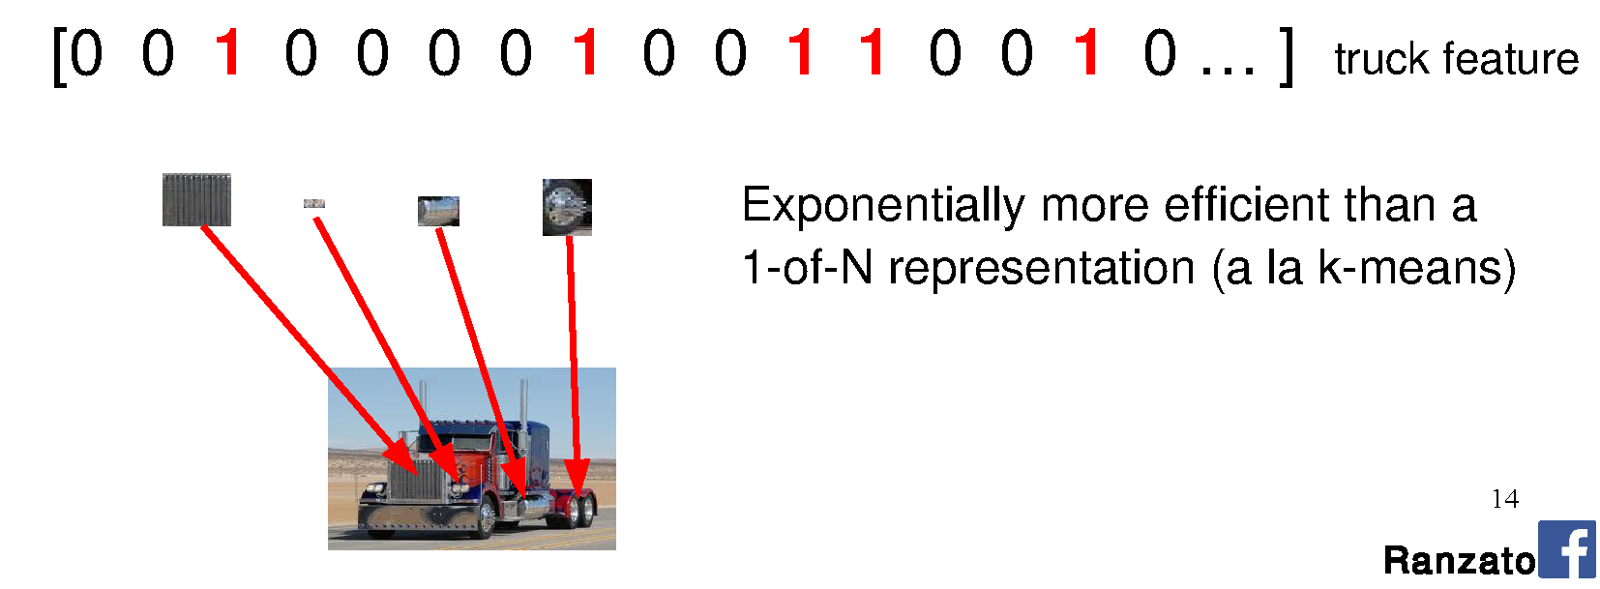
Why do we need many layers?
A hierarchical structure is potentially more efficient because we can reuse intermediate computations.
Different representations can be distributed across classes.

Slide 78
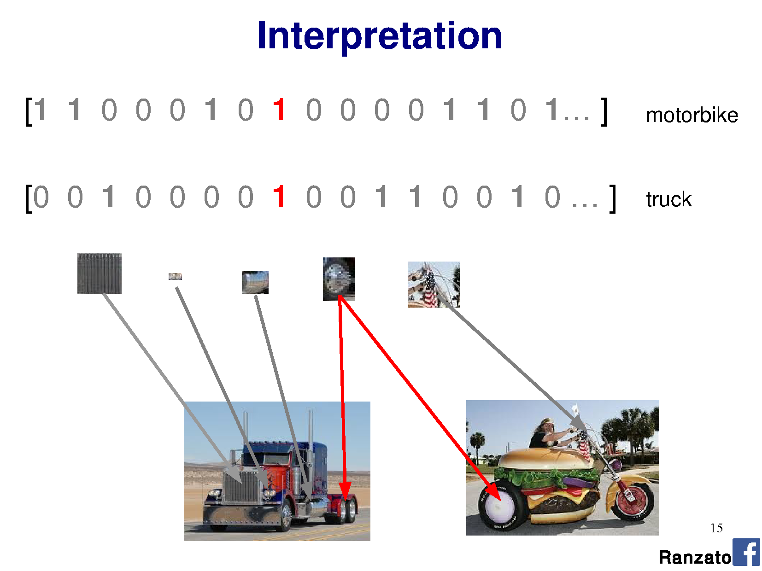

Slide 79
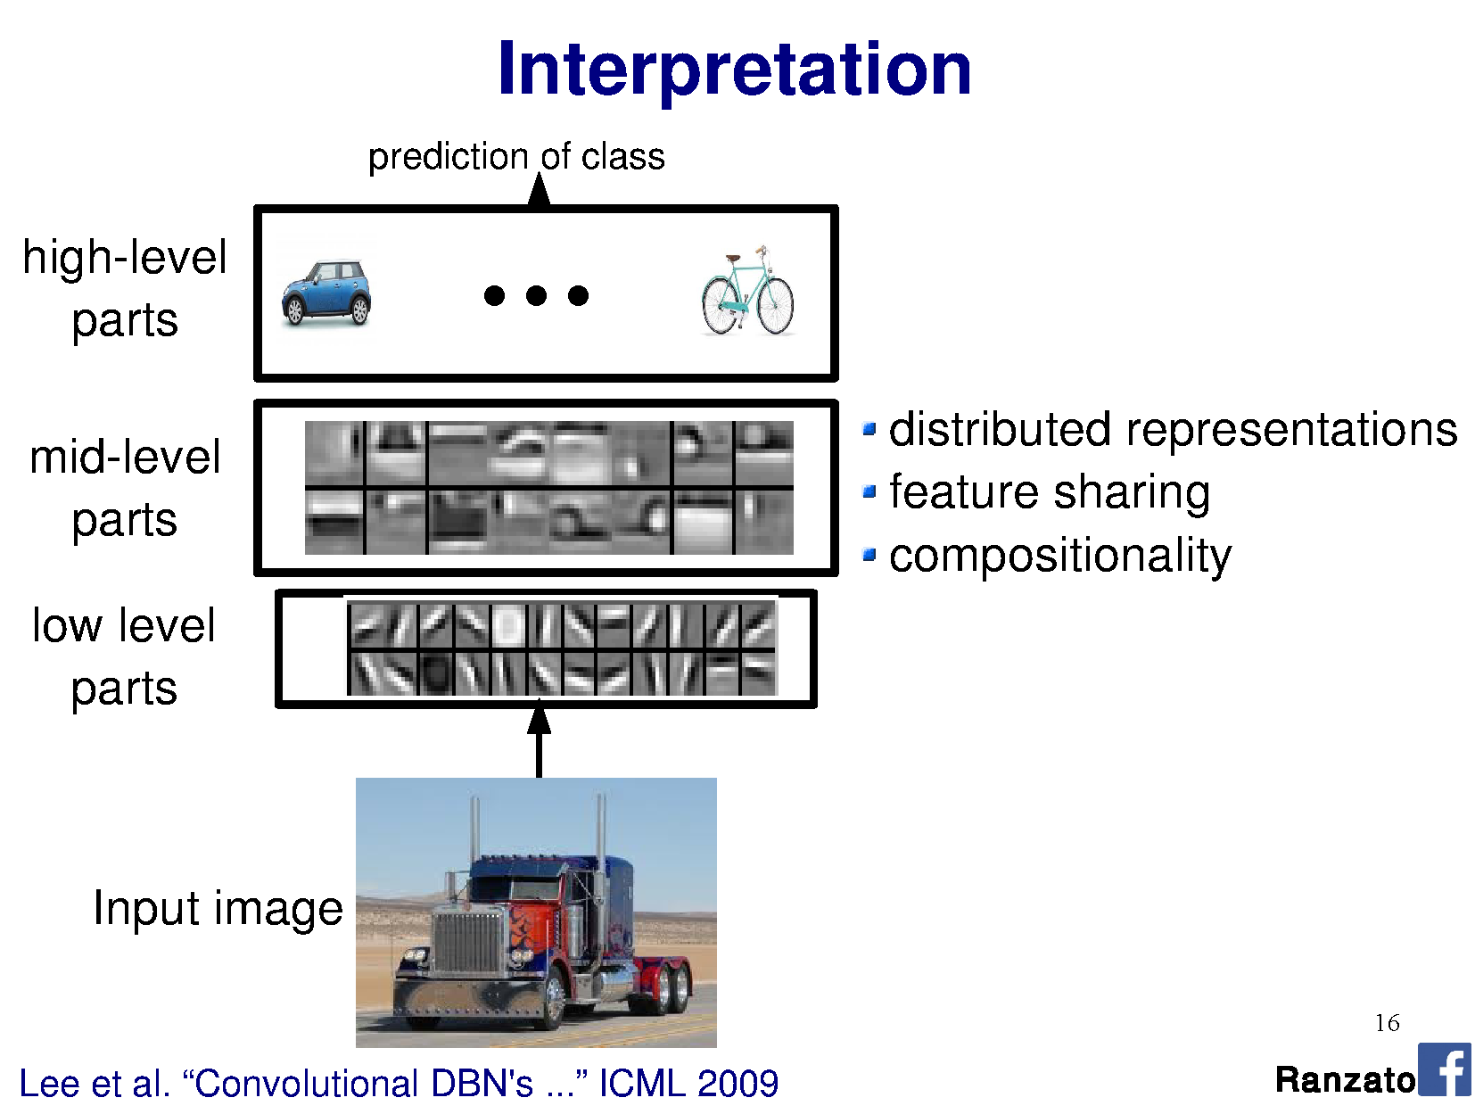

Slide 80
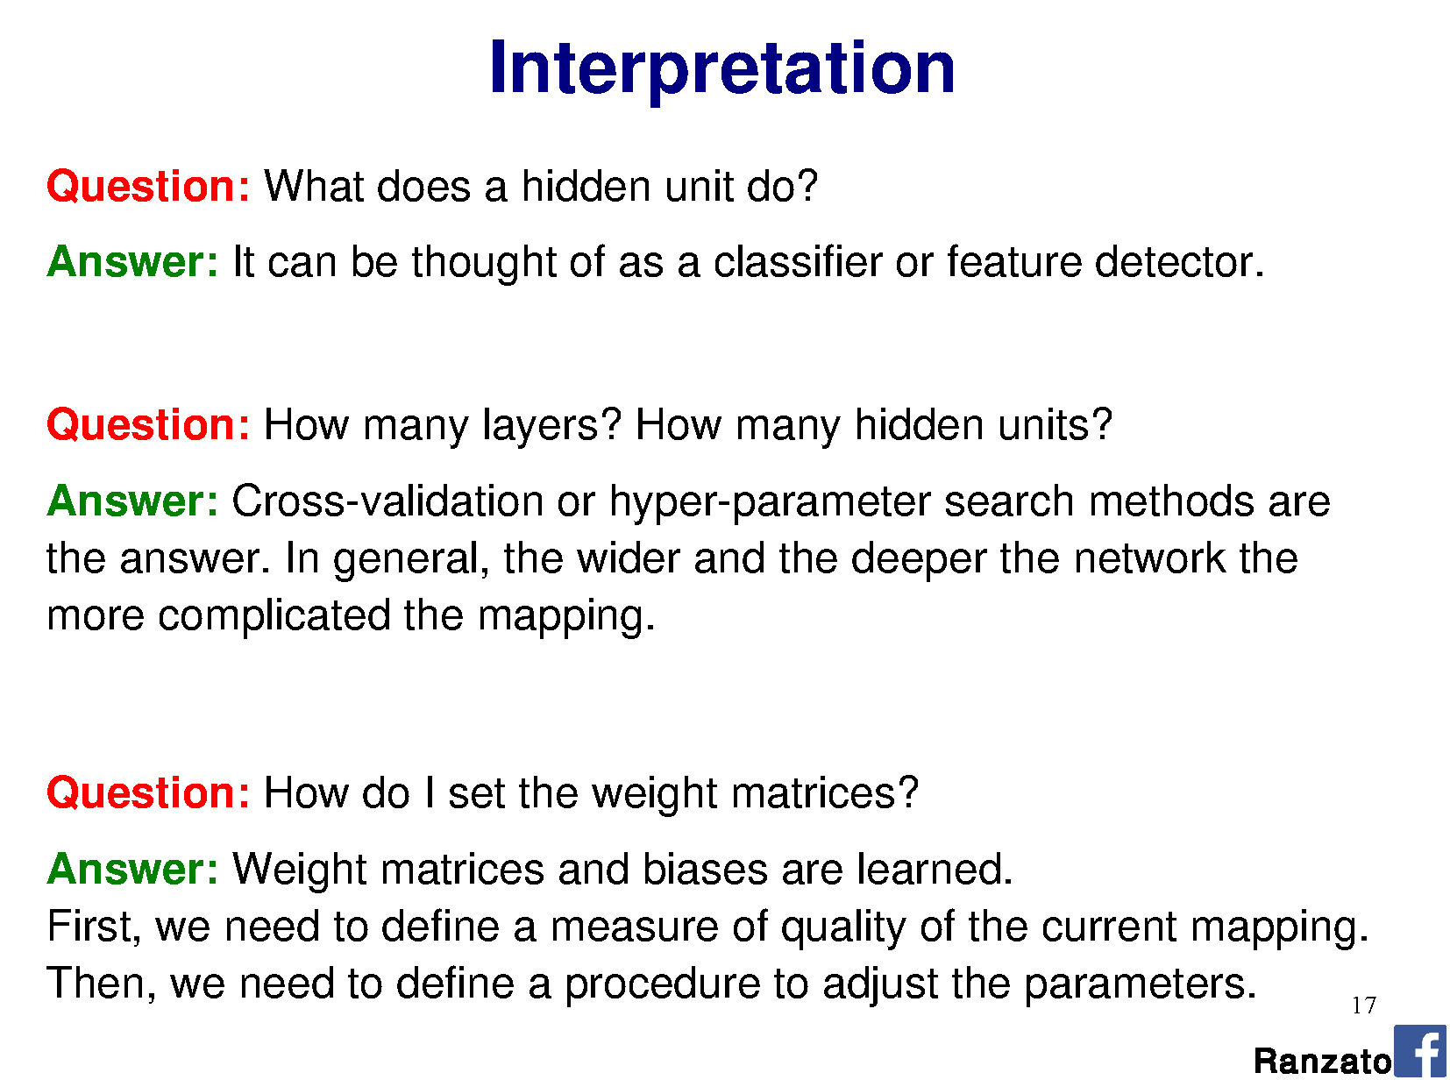

Slide 82
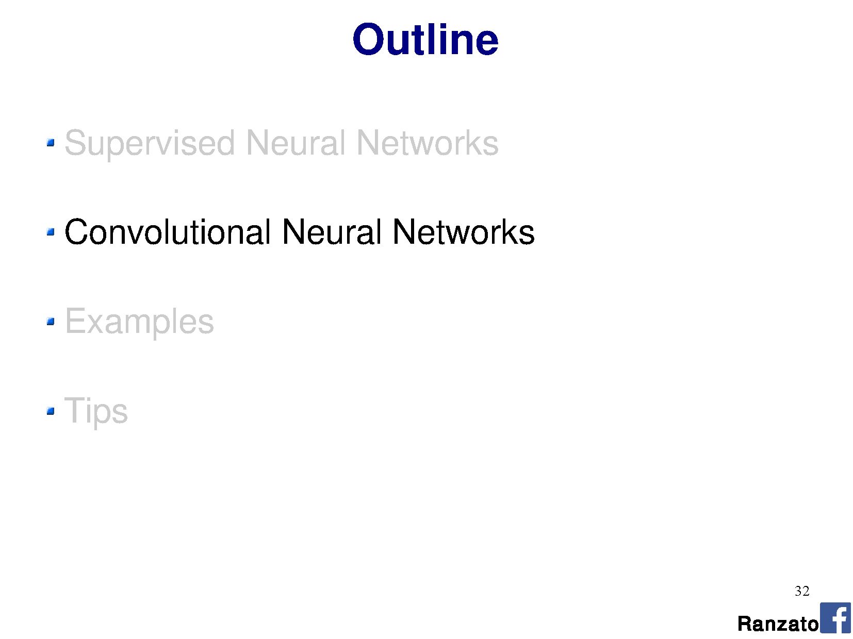

Slide 83
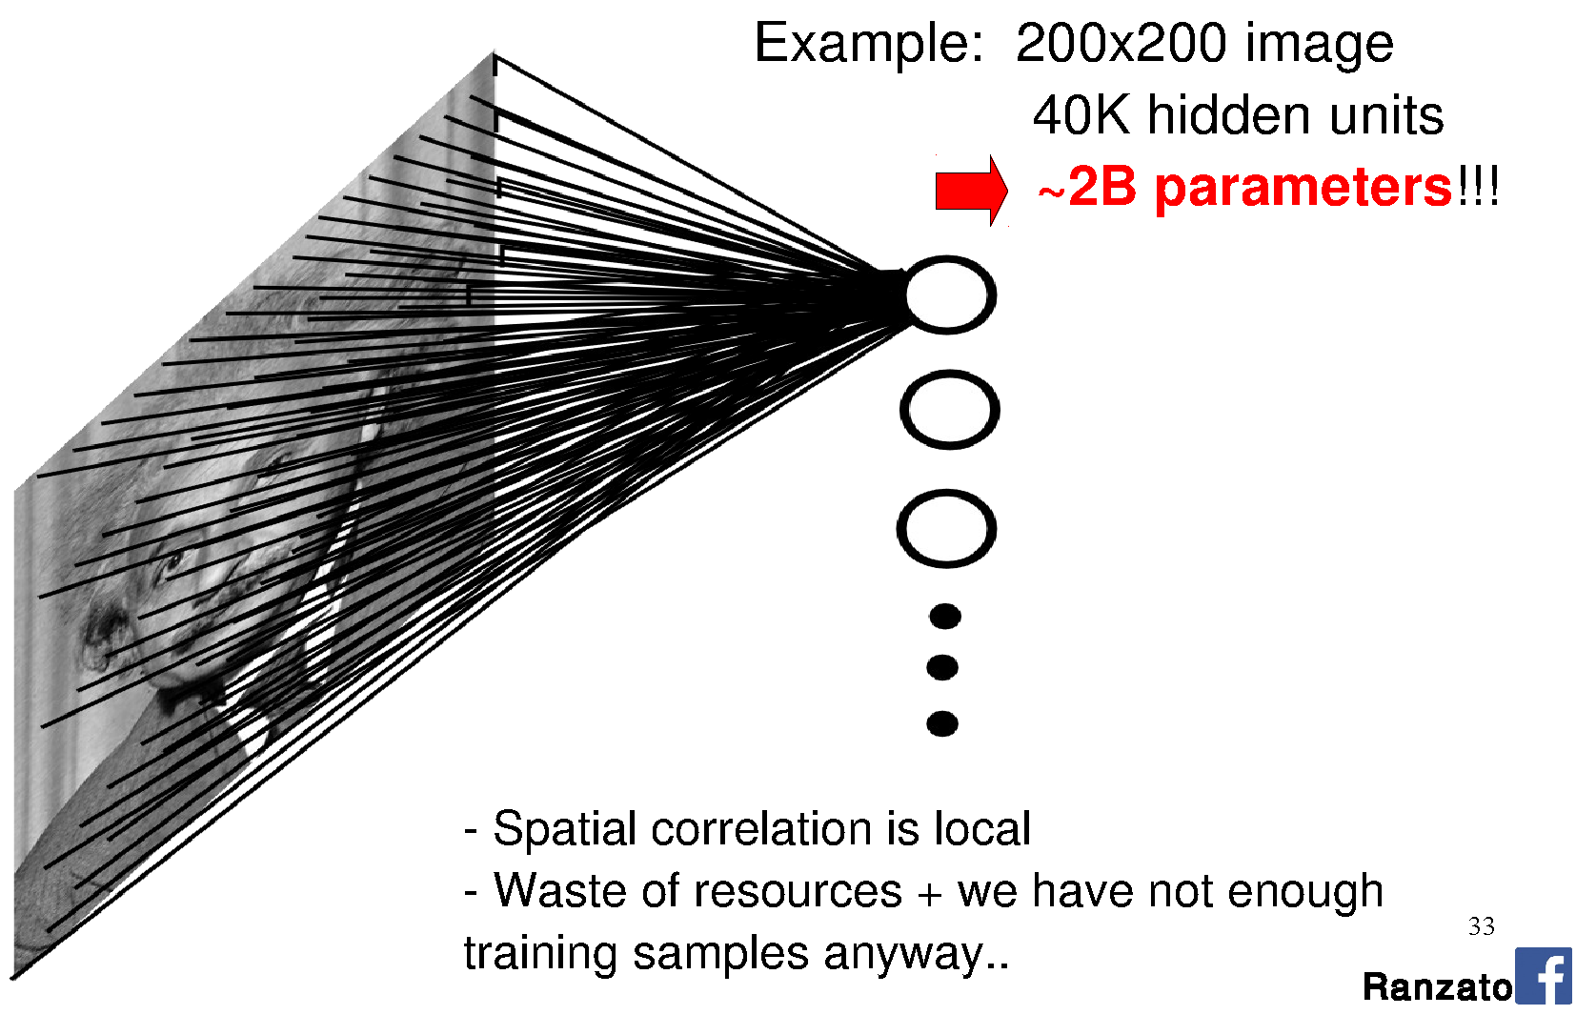
Images as input to neural networks
Notes:
Seems fine, right?
Going to learn a neural network to classify an image. Learn weights from a large database of images using back propagation.
How many perceptrons do you think we need to represent the ‘complexity’ of natural images?
How big are the weight matrices?
How many weight parameters did you learn in your HOG-based SVM classification? How big was the database? Did it work?
The more parameters we have, the larger the database we need to ‘map out’ the high-dimensional space.
Are we wasting any knowledge in this representation?

Slide 84
Images as input to neural networks

Slide 85
Images as input to neural networks

Slide 86
Motivation
Sparse interactions – receptive fields
  Assume that in an image, we care about ‘local neighborhoods’ only for a given neural network layer.
  Composition of layers will expand local -> global.

Slide 87
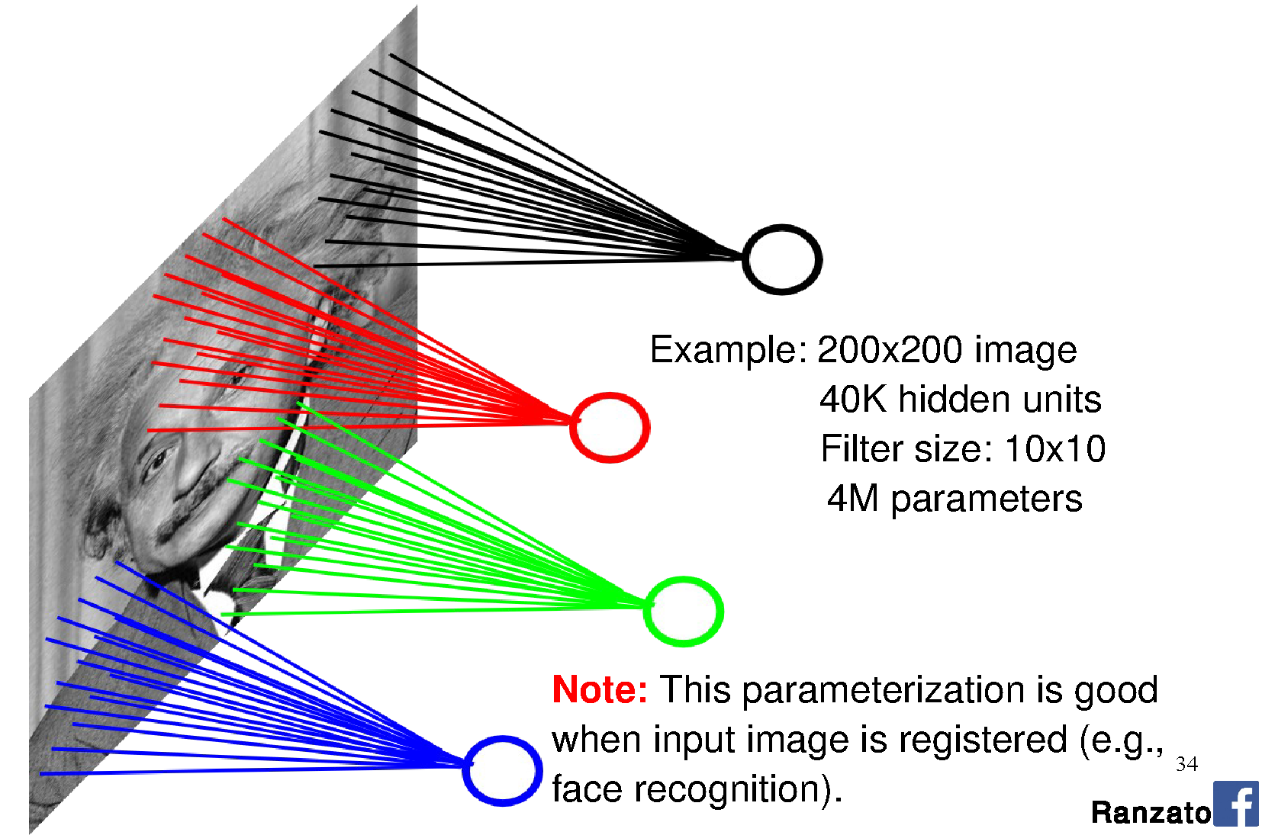

Slide 88
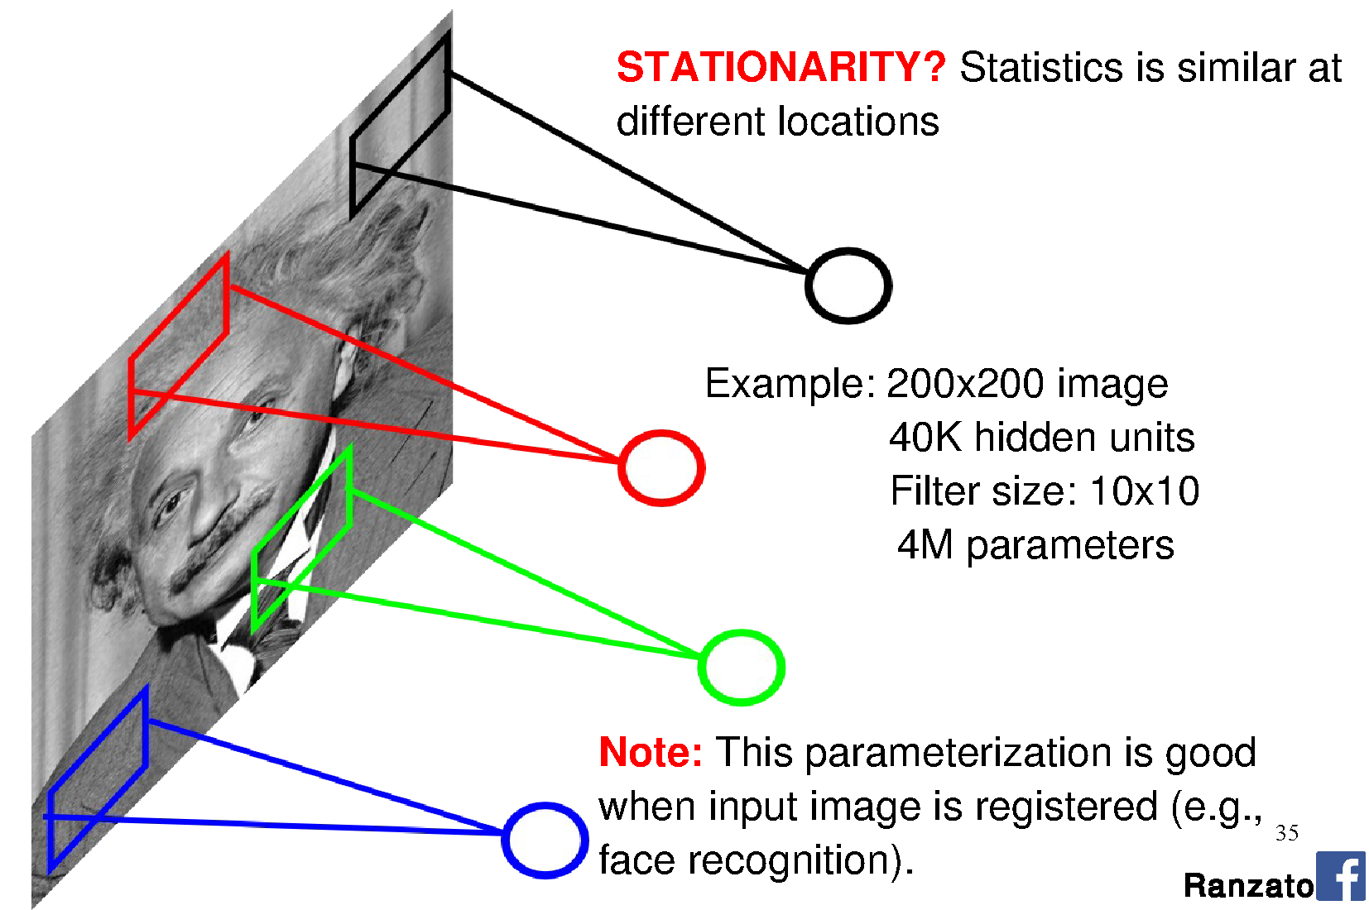

Slide 89
Motivation
Sparse interactions – receptive fields
  Assume that in an image, we care about ‘local neighborhoods’ only for a given neural network layer.
  Composition of layers will expand local -> global.
Parameter sharing
  ‘Tied weights’ – use same weights for more than one perceptron in the neural network.
  Leads to equivariant representation
    If input changes (e.g., translates), then output changes similarly

Slide 90
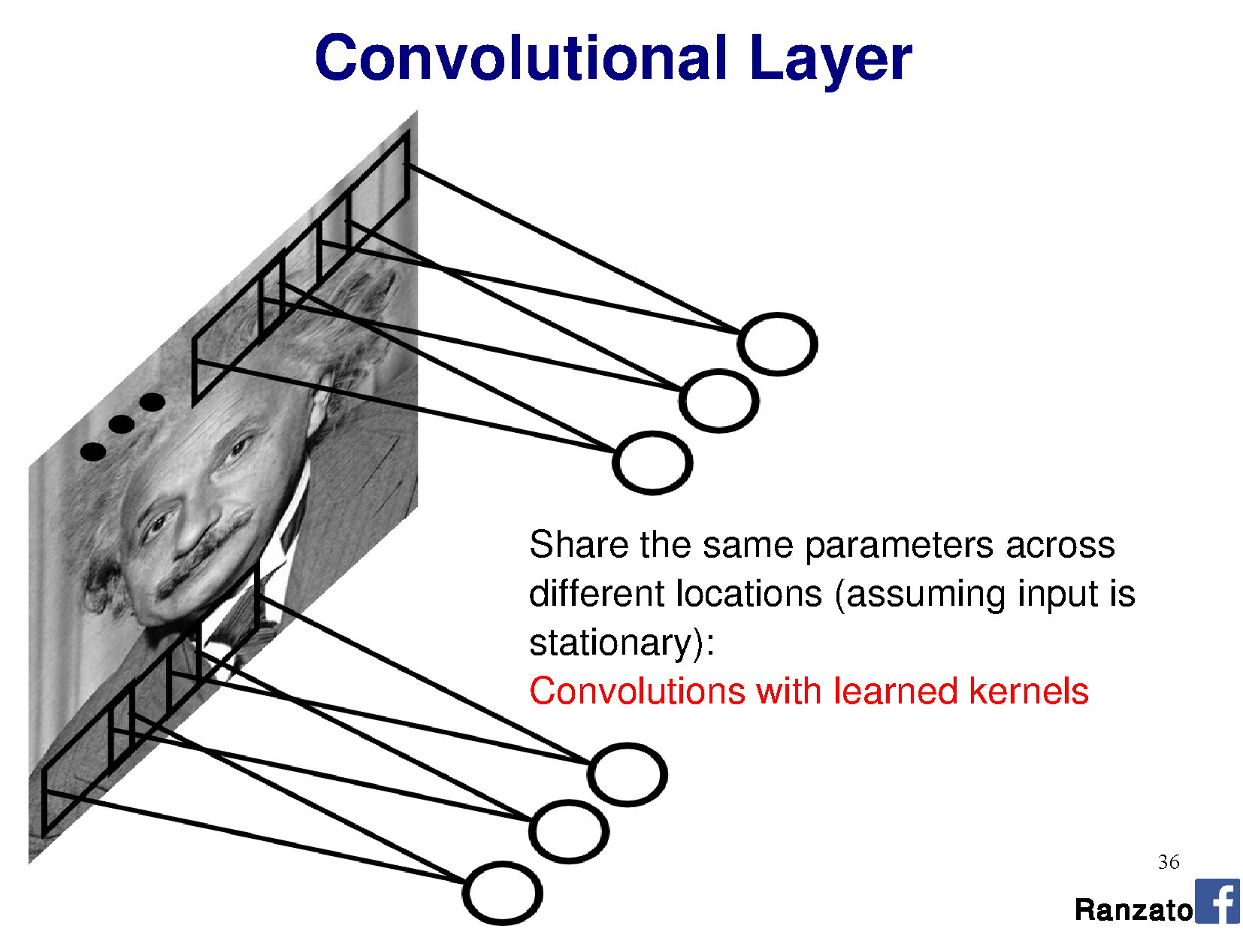

Slide 91
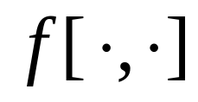
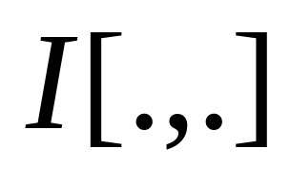


Filtering reminder:
Correlation (rotated convolution)
1
1
1
1
1
1
1
1
1
0 | 0 | 0 | 0 | 0 | 0 | 0 | 0 | 0 | 0
0 | 0 | 0 | 0 | 0 | 0 | 0 | 0 | 0 | 0
0 | 0 | 0 | 90 | 90 | 90 | 90 | 90 | 0 | 0
0 | 0 | 0 | 90 | 90 | 90 | 90 | 90 | 0 | 0
0 | 0 | 0 | 90 | 90 | 90 | 90 | 90 | 0 | 0
0 | 0 | 0 | 90 | 0 | 90 | 90 | 90 | 0 | 0
0 | 0 | 0 | 90 | 90 | 90 | 90 | 90 | 0 | 0
0 | 0 | 0 | 0 | 0 | 0 | 0 | 0 | 0 | 0
0 | 0 | 90 | 0 | 0 | 0 | 0 | 0 | 0 | 0
0 | 0 | 0 | 0 | 0 | 0 | 0 | 0 | 0 | 0
 | 0 | 10 | 20 | 30 | 30 | 30 | 20 | 10
 | 0 | 20 | 40 | 60 | 60 | 60 | 40 | 20
 | 0 | 30 | 60 | 90 | 90 | 90 | 60 | 30
 | 0 | 30 | 50 | 80 | 80 | 90 | 60 | 30
 | 0 | 30 | 50 | 80 | 80 | 90 | 60 | 30
 | 0 | 20 | 30 | 50 | 50 | 60 | 40 | 20
 | 10 | 20 | 30 | 30 | 30 | 30 | 20 | 10
 | 10 | 10 | 10 | 0 | 0 | 0 | 0 | 0
Credit: S. Seitz
Notes:
Correlation / convolution -> same thing for symmetric filters.
Many deep learning libraries use correlation but call it convolution. NBD. We can learn the difference (rotation) away

Slide 92
Perceptron:
This is convolution!

Slide 93


Convolution
3x3 kernel
v
v
v
Shared weights
v
Notes:
Output should be a little smaller, as we aren’t padding

Slide 94

Filter = ‘local’ perceptron.
Also called kernel.
Notes:
This is the major trick.
For each layer of the neural network, we’re going to learn multiple filters.

Slide 96

n = layer number
K = kernel size
j = # channels (input)
or # filters (depth)

Slide 97


Slide 98


Slide 99

Stride = 1

Slide 100

Stride = 1

Slide 101
Stride = 3

Slide 102
Stride = 3

Slide 103
Stride = 3

Slide 104
Stride = 3

Slide 105


Slide 107


Slide 108
- add multiple filters per layer

Slide 109


Slide 110

By pooling responses at different locations,
we gain robustness to the exact spatial location of image features.

Slide 111

Pooling is similar to downsampling
…except sometimes we don’t want to blur,
as other functions might be better for classification.

Slide 112


Slide 113


Slide 114

Max pooling
Wikipedia

Slide 116


Slide 117


Slide 118


Slide 120


Slide 121


Slide 122


Slide 123

N(x,y) = model pixel values in window as a normal distribution
m = mean
σ = variance

Slide 125


Slide 126


Slide 127


Slide 128


Slide 129


Slide 130

Yann LeCun’s MNIST CNN architecture

Slide 131
DEMO
http://scs.ryerson.ca/~aharley/vis/conv/
Thanks to Adam Harley for making this.
More here: http://scs.ryerson.ca/~aharley/vis

Slide 133
a multi-layer perceptron (‘fully connected layers’).

Slide 134
a multi-layer perceptron (‘fully connected layers’).

Slide 135


Slide 136


Slide 137


Slide 138


Slide 139


Slide 140


Slide 141


Slide 142


Slide 143


Slide 144


Slide 145
Think-Pair-Share
Input size: 96 x 96 x 3
Kernel size: 5 x 5 x 3
Stride: 1
Max pooling layer: 4 x 4
Output feature map size?
a) 5 x 5
b) 22 x 22
c) 23 x 23
d) 24 x 24
e) 25 x 25
Input size: 96 x 96 x 3
Kernel size: 3 x 3 x 3
Stride: 3
Max pooling layer: 8 x 8
Output feature map size?
a) 2 x 2
b) 3 x 3
c) 4 x 4
d) 5 x 5
e) 12 x 12
Notes:
Answers:
Left: 23 x 23 -> 96 – 2 – 2 from valid region only. Then, 92 x 92 / 4 = 23x23
Right: 4 x 4 -> 94 – 1 – 1 from valid region only. Then,

Slide 146

Notes:
Stride 1
Stride 2
Stride 3

Slide 147

Our connectomics diagram
Auto-generated from network declaration by nolearn (for Lasagne / Theano)
Input
75x75x4
Conv 1
3x3x4
64 filters
Conv 2
3x3x64
48 filters
Conv 3
3x3x48
48 filters
Conv 4
3x3x48
48 filters
Max pooling
2x2 per filter
Max pooling
2x2 per filter
Max pooling
2x2 per filter
Max pooling
2x2 per filter
Notes:
https://github.com/dnouri/nolearn
More details: https://people.cs.pitt.edu/~kovashka/cs2750_sp17/ml_11_cnns.pdf

Slide 148

Reading architecture diagrams
Layers
Kernel sizes
Strides
# channels
# kernels
Max pooling

Slide 149

AlexNet diagram (simplified)
[Krizhevsky et al. 2012]
Input size
227 x 227 x 3
227
227
3x3
Stride 2
3x3
Stride 2
Conv 1
11 x 11 x 3
Stride 4
96 filters
Conv 2
5 x 5 x 96
Stride 1
256 filters
Conv 3
3 x 3 x 256
Stride 1
384 filters
Conv 4
3 x 3 x 192
Stride 1
384 filters
Conv 4
3 x 3 x 192
Stride 1
256 filters
Notes:
Input: 227 x 227 x 3 image.
11x11 kernel, stride 4 (AlexNet – 11x11x3 kernels, 96 of them)
5x5 kernel, stride 1, max pool 2x2 (AlexNet – 5x5x48 kernels, 256 of them)
3x3 kernels, (AlexNet – 3x3x256 kernels, 384 of them)
3x3 kernels (AlexNet – 3x3x192 kernels, 384 of them)
3x3 kernels, (AlexNet – 3x3x192 kernels, 256 of them)
FC – 2048 neurons
FC – 2048 neurons
Output – 1000 neurons

Slide 150
AlexNet diagram (simplified)
[Krizhevsky et al. 2012]
Input size
227 x 227 x 3
227
227
3x3
Stride 2
3x3
Stride 2
Eh?
Conv 3
3 x 3 x 256
Stride 1
384 filters
Conv 4
3 x 3 x 192
Stride 1
256 filters
Conv 1
11 x 11 x 3
Stride 4
96 filters
Conv 2
5 x 5 x 48
Stride 1
256 filters
Conv 4
3 x 3 x 192
Stride 1
384 filters
Eh? Shouldn’t these be equal?
Notes:
Input: 227 x 227 x 3 image.
11x11 kernel, stride 4 (AlexNet – 11x11x3 kernels, 96 of them)
5x5 kernel, stride 1, max pool 2x2 (AlexNet – 5x5x48 kernels, 256 of them)
3x3 kernels, (AlexNet – 3x3x256 kernels, 384 of them)
3x3 kernels (AlexNet – 3x3x192 kernels, 384 of them)
3x3 kernels, (AlexNet – 3x3x192 kernels, 256 of them)
FC – 2048 neurons
FC – 2048 neurons
Output – 1000 neurons

Slide 151

AlexNet diagram (unsimplified)
[Krizhevsky et al. 2012]
Not enough memory for all the weights – use two GPUs!
GPU 1
GPU 2
227
227
Notes:
Input: 227 x 227 x 3 image.
11x11 kernel, stride 4 (AlexNet – 11x11x3 kernels, 96 of them)
5x5 kernel, stride 1, max pool 2x2 (AlexNet – 5x5x48 kernels, 256 of them)
3x3 kernels, (AlexNet – 3x3x256 kernels, 384 of them)
3x3 kernels (AlexNet – 3x3x192 kernels, 384 of them)
3x3 kernels, (AlexNet – 3x3x192 kernels, 256 of them)
FC – 2048 neurons
FC – 2048 neurons
Output – 1000 neurons
3GB memory on each GPU at the time - GTX 580 GPU

Slide 152


Slide 153


Slide 154


Slide 155


Slide 156


Slide 157


Slide 158


Slide 159


Slide 160


Slide 161


Slide 162


Slide 163


Slide 164


Slide 165


Slide 166


Slide 167

Notes:
FLOPS = just to execute, not train.

Slide 168


Slide 169


Slide 170


Slide 171
Wait, why isn’t it called a correlation neural network?
It could be.
Deep learning libraries actually implement correlation.
Correlation relates to convolution via a 180deg rotation of the kernel. When we learn kernels, we could easily learn them flipped.
Associative property of convolution ends up not being important to our application, so we just ignore it.
[p.323, Goodfellow]
Notes:
Commutative: a * b = b * a
Associative: a * (b * c) = (a * b) * c

Slide 172
Phew!
Monday:
How to Train your Dragon Network
Project 4: Out Friday
Questions
Code part 1
Due 15th.

Slide 173
More ConvNet explanations
https://ujjwalkarn.me/2016/08/11/intuitive-explanation-convnets/

