Slide 1
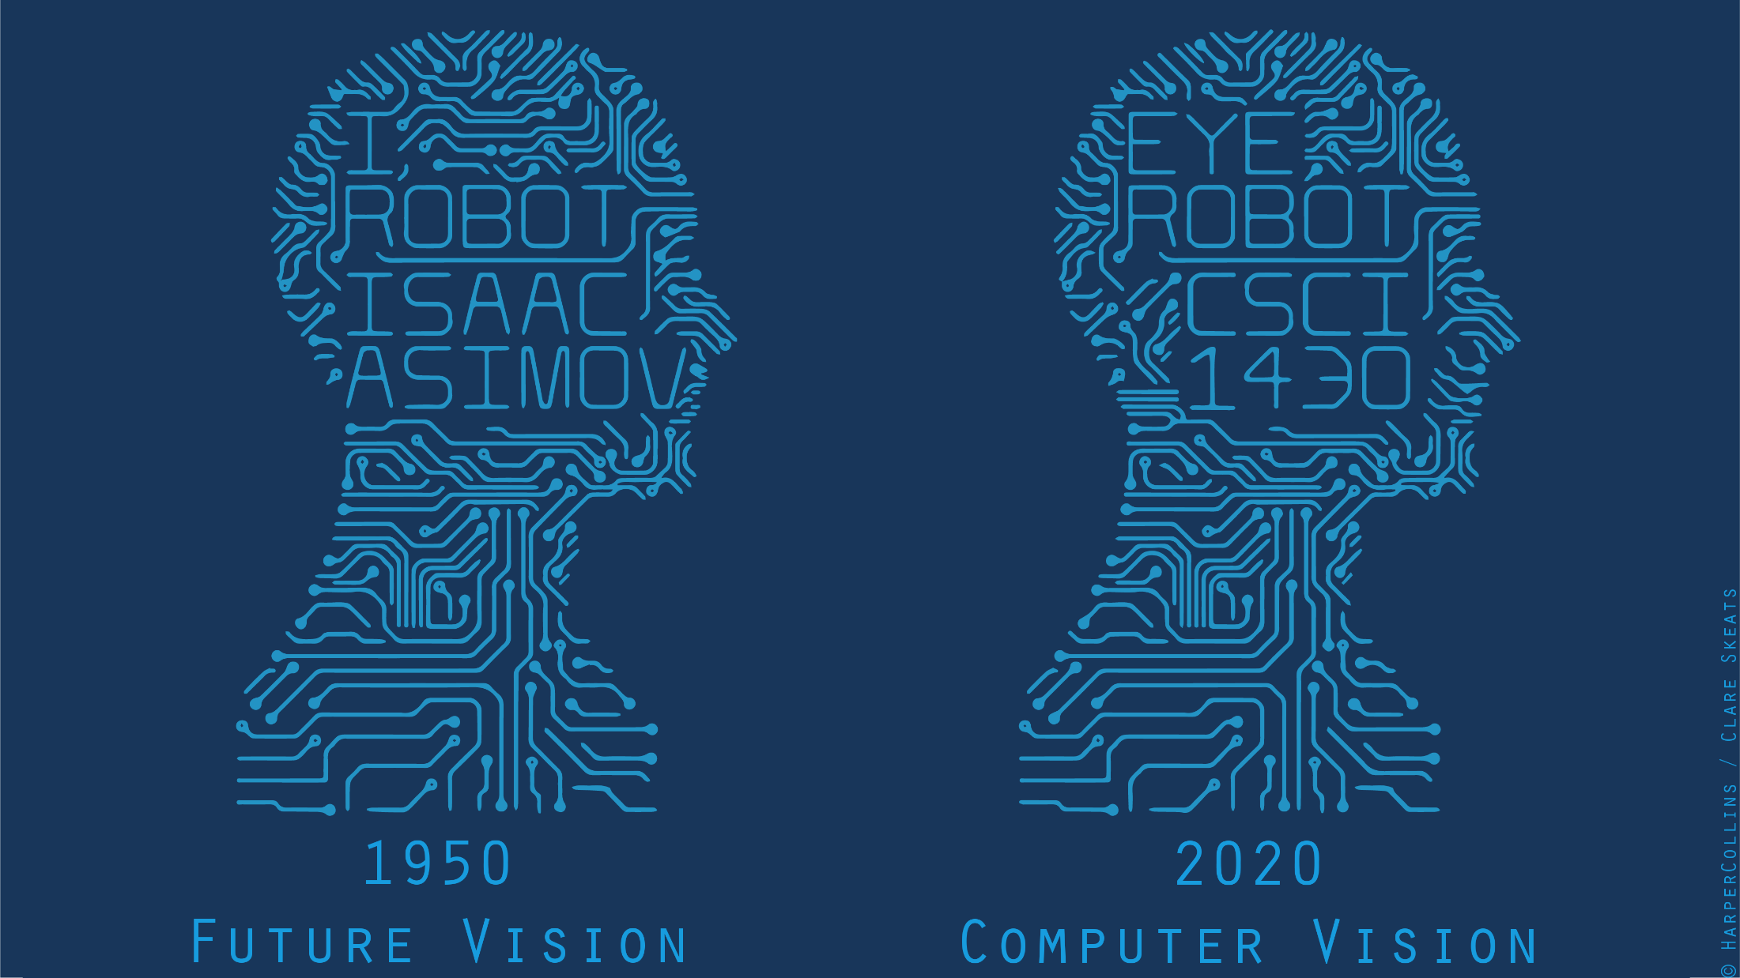
Notes:
Welcome to a class with some curious content!
Today we’re going to be discussing cameras, and how light and color affect image formation.

Slide 2
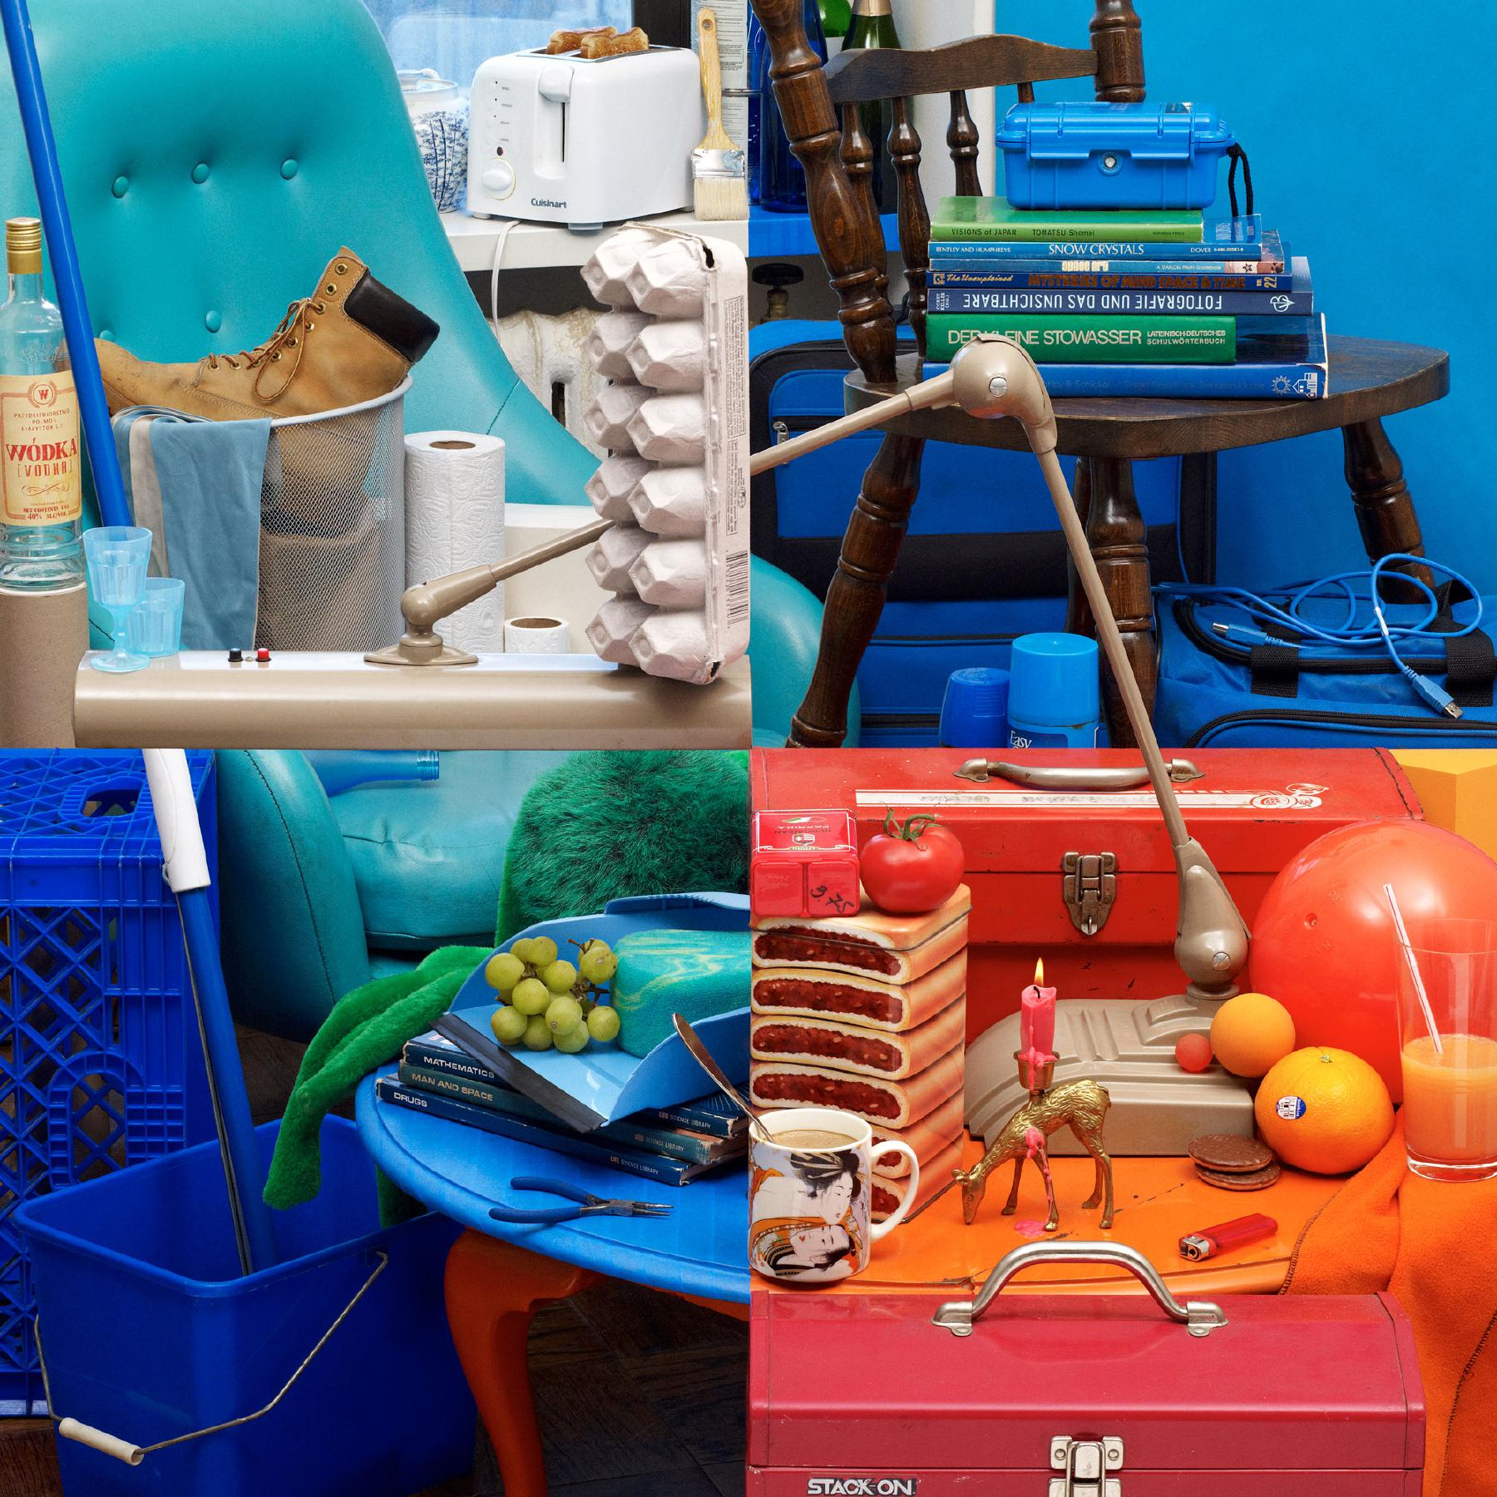
Bela Borsodi
Notes:
To start us off, let’s look at these four colorful images.
Think for a minute - what can you tell me about the differences between these images?
http://www.belaborsodi.com/

Slide 3
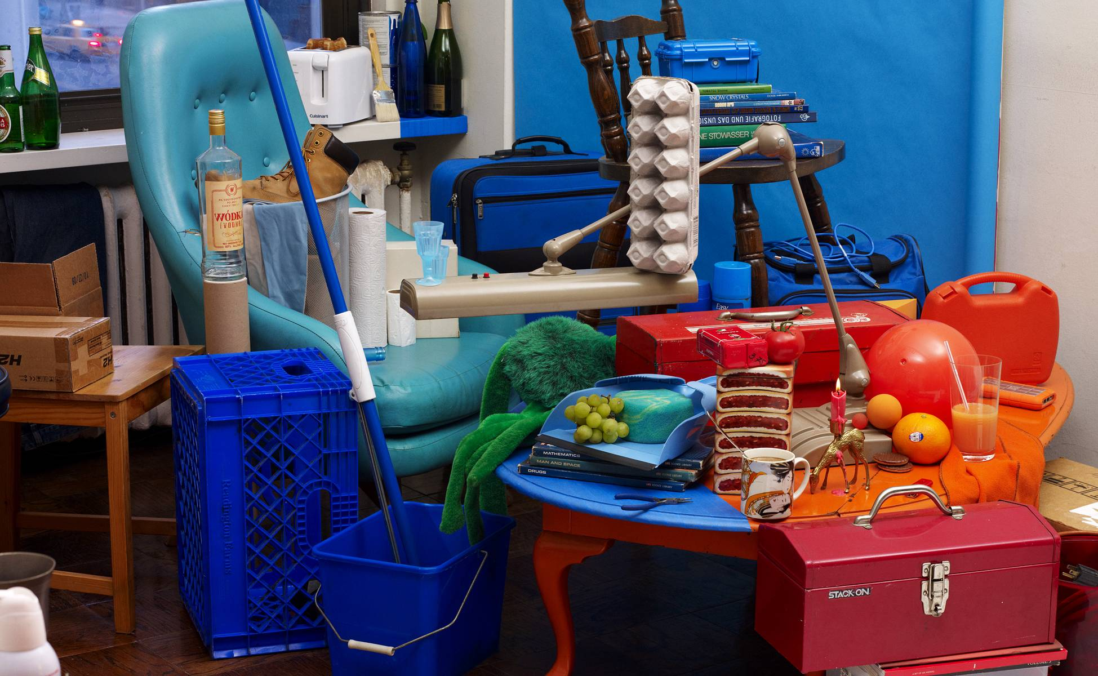
Bela Borsodi
Notes:
Major trick. The scene was arranged by looking through the viewfinder of the camera, which, as like the image, offers a fixed perspective which makes this possible.
http://youtube.com/watch?v=oJGN6sX5Ekg
Later on, we’re going to

Slide 4
Recap so far
What is an image?
  Sampling and aliasing
  Thinking in frequency
Image filtering
  Kernels and their responses
  Kernel orientation
  Kernel sizes and scale spaces
Local features
  Detection by finding corners via peaks
  Description by hand-coding local ‘texture’
  Matching robustly

Slide 5
Color
Elephant in room:

Slide 6
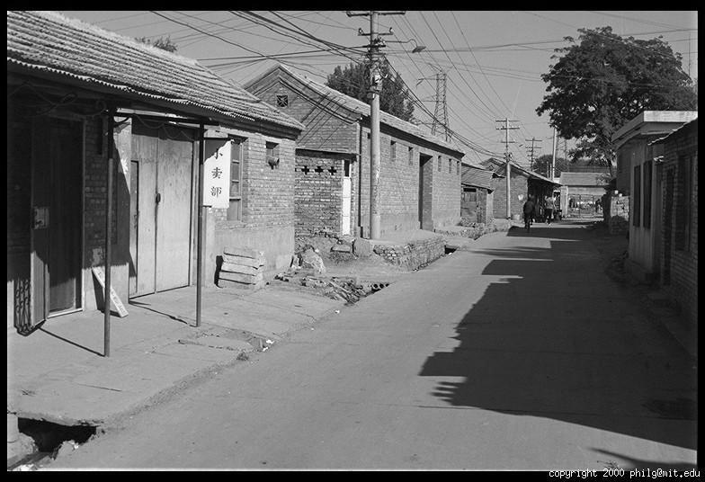
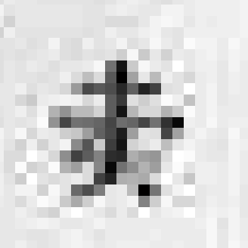
Grayscale intensity
0.92 | 0.93 | 0.94 | 0.97 | 0.62 | 0.37 | 0.85 | 0.97 | 0.93 | 0.92 | 0.99
0.95 | 0.89 | 0.82 | 0.89 | 0.56 | 0.31 | 0.75 | 0.92 | 0.81 | 0.95 | 0.91
0.89 | 0.72 | 0.51 | 0.55 | 0.51 | 0.42 | 0.57 | 0.41 | 0.49 | 0.91 | 0.92
0.96 | 0.95 | 0.88 | 0.94 | 0.56 | 0.46 | 0.91 | 0.87 | 0.90 | 0.97 | 0.95
0.71 | 0.81 | 0.81 | 0.87 | 0.57 | 0.37 | 0.80 | 0.88 | 0.89 | 0.79 | 0.85
0.49 | 0.62 | 0.60 | 0.58 | 0.50 | 0.60 | 0.58 | 0.50 | 0.61 | 0.45 | 0.33
0.86 | 0.84 | 0.74 | 0.58 | 0.51 | 0.39 | 0.73 | 0.92 | 0.91 | 0.49 | 0.74
0.96 | 0.67 | 0.54 | 0.85 | 0.48 | 0.37 | 0.88 | 0.90 | 0.94 | 0.82 | 0.93
0.69 | 0.49 | 0.56 | 0.66 | 0.43 | 0.42 | 0.77 | 0.73 | 0.71 | 0.90 | 0.99
0.79 | 0.73 | 0.90 | 0.67 | 0.33 | 0.61 | 0.69 | 0.79 | 0.73 | 0.93 | 0.97
0.91 | 0.94 | 0.89 | 0.49 | 0.41 | 0.78 | 0.78 | 0.77 | 0.89 | 0.99 | 0.93

Slide 7
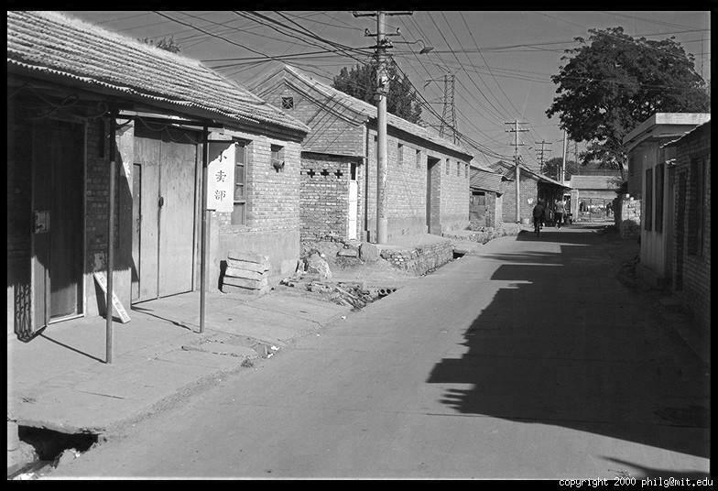
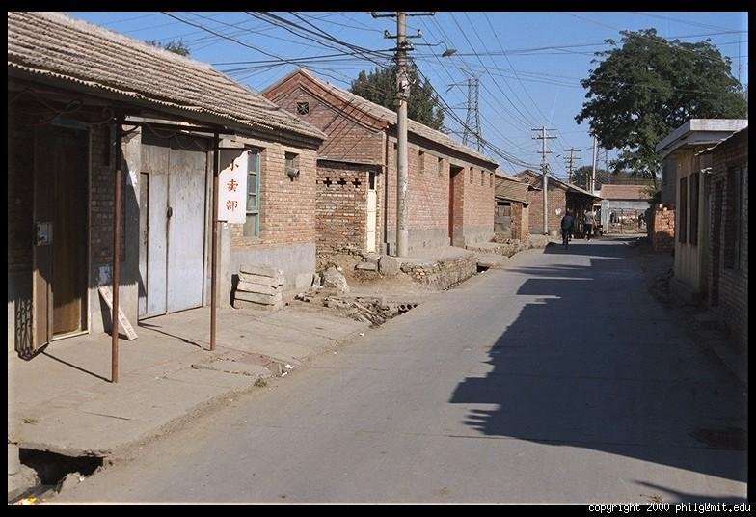
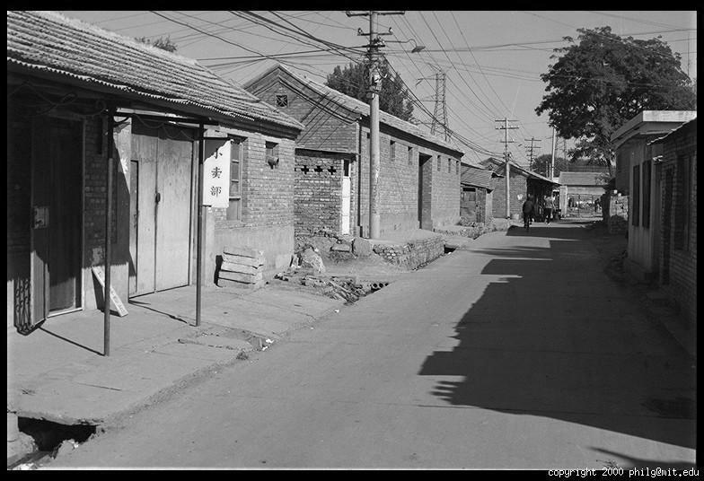
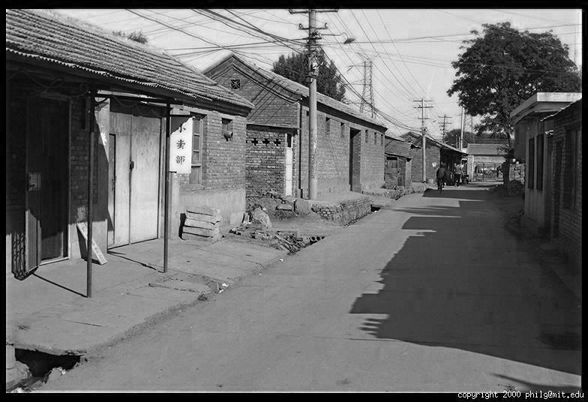
Color
R
G
B
James Hays

Slide 8
Images in Python Numpy
N x M RGB image “im”
  im[0,0,0] = top-left pixel value in R-channel
  Im[x, y, b] = x pixels to right, y pixels down in the b^{th} channel
  Im[N-1, M-1, 3] = bottom-right pixel in B-channel
Column
Row
R
0.92 | 0.93 | 0.94 | 0.97 | 0.62 | 0.37 | 0.85 | 0.97 | 0.93 | 0.92 | 0.99
0.95 | 0.89 | 0.82 | 0.89 | 0.56 | 0.31 | 0.75 | 0.92 | 0.81 | 0.95 | 0.91
0.89 | 0.72 | 0.51 | 0.55 | 0.51 | 0.42 | 0.57 | 0.41 | 0.49 | 0.91 | 0.92
0.96 | 0.95 | 0.88 | 0.94 | 0.56 | 0.46 | 0.91 | 0.87 | 0.90 | 0.97 | 0.95
0.71 | 0.81 | 0.81 | 0.87 | 0.57 | 0.37 | 0.80 | 0.88 | 0.89 | 0.79 | 0.85
0.49 | 0.62 | 0.60 | 0.58 | 0.50 | 0.60 | 0.58 | 0.50 | 0.61 | 0.45 | 0.33
0.86 | 0.84 | 0.74 | 0.58 | 0.51 | 0.39 | 0.73 | 0.92 | 0.91 | 0.49 | 0.74
0.96 | 0.67 | 0.54 | 0.85 | 0.48 | 0.37 | 0.88 | 0.90 | 0.94 | 0.82 | 0.93
0.69 | 0.49 | 0.56 | 0.66 | 0.43 | 0.42 | 0.77 | 0.73 | 0.71 | 0.90 | 0.99
0.79 | 0.73 | 0.90 | 0.67 | 0.33 | 0.61 | 0.69 | 0.79 | 0.73 | 0.93 | 0.97
0.91 | 0.94 | 0.89 | 0.49 | 0.41 | 0.78 | 0.78 | 0.77 | 0.89 | 0.99 | 0.93
G
0.92 | 0.93 | 0.94 | 0.97 | 0.62 | 0.37 | 0.85 | 0.97 | 0.93 | 0.92 | 0.99
0.95 | 0.89 | 0.82 | 0.89 | 0.56 | 0.31 | 0.75 | 0.92 | 0.81 | 0.95 | 0.91
0.89 | 0.72 | 0.51 | 0.55 | 0.51 | 0.42 | 0.57 | 0.41 | 0.49 | 0.91 | 0.92
0.96 | 0.95 | 0.88 | 0.94 | 0.56 | 0.46 | 0.91 | 0.87 | 0.90 | 0.97 | 0.95
0.71 | 0.81 | 0.81 | 0.87 | 0.57 | 0.37 | 0.80 | 0.88 | 0.89 | 0.79 | 0.85
0.49 | 0.62 | 0.60 | 0.58 | 0.50 | 0.60 | 0.58 | 0.50 | 0.61 | 0.45 | 0.33
0.86 | 0.84 | 0.74 | 0.58 | 0.51 | 0.39 | 0.73 | 0.92 | 0.91 | 0.49 | 0.74
0.96 | 0.67 | 0.54 | 0.85 | 0.48 | 0.37 | 0.88 | 0.90 | 0.94 | 0.82 | 0.93
0.69 | 0.49 | 0.56 | 0.66 | 0.43 | 0.42 | 0.77 | 0.73 | 0.71 | 0.90 | 0.99
0.79 | 0.73 | 0.90 | 0.67 | 0.33 | 0.61 | 0.69 | 0.79 | 0.73 | 0.93 | 0.97
0.91 | 0.94 | 0.89 | 0.49 | 0.41 | 0.78 | 0.78 | 0.77 | 0.89 | 0.99 | 0.93
B
0.92 | 0.93 | 0.94 | 0.97 | 0.62 | 0.37 | 0.85 | 0.97 | 0.93 | 0.92 | 0.99
0.95 | 0.89 | 0.82 | 0.89 | 0.56 | 0.31 | 0.75 | 0.92 | 0.81 | 0.95 | 0.91
0.89 | 0.72 | 0.51 | 0.55 | 0.51 | 0.42 | 0.57 | 0.41 | 0.49 | 0.91 | 0.92
0.96 | 0.95 | 0.88 | 0.94 | 0.56 | 0.46 | 0.91 | 0.87 | 0.90 | 0.97 | 0.95
0.71 | 0.81 | 0.81 | 0.87 | 0.57 | 0.37 | 0.80 | 0.88 | 0.89 | 0.79 | 0.85
0.49 | 0.62 | 0.60 | 0.58 | 0.50 | 0.60 | 0.58 | 0.50 | 0.61 | 0.45 | 0.33
0.86 | 0.84 | 0.74 | 0.58 | 0.51 | 0.39 | 0.73 | 0.92 | 0.91 | 0.49 | 0.74
0.96 | 0.67 | 0.54 | 0.85 | 0.48 | 0.37 | 0.88 | 0.90 | 0.94 | 0.82 | 0.93
0.69 | 0.49 | 0.56 | 0.66 | 0.43 | 0.42 | 0.77 | 0.73 | 0.71 | 0.90 | 0.99
0.79 | 0.73 | 0.90 | 0.67 | 0.33 | 0.61 | 0.69 | 0.79 | 0.73 | 0.93 | 0.97
0.91 | 0.94 | 0.89 | 0.49 | 0.41 | 0.78 | 0.78 | 0.77 | 0.89 | 0.99 | 0.93
James Hays

Slide 9
Anatomy
But what is color?

Slide 10
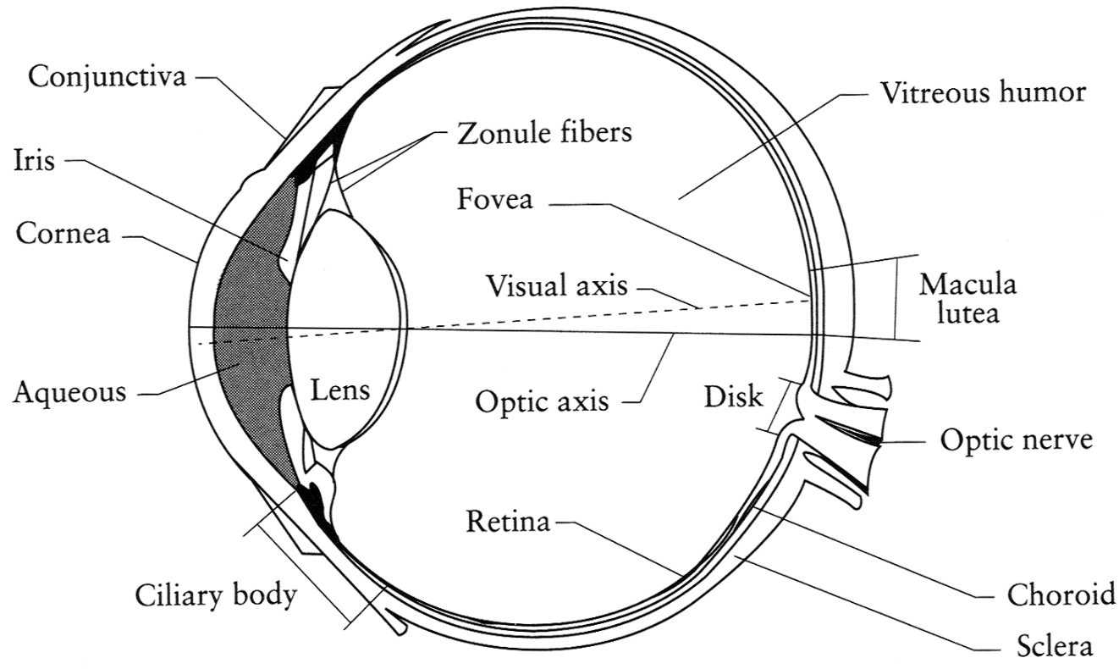
The Eye
The human eye is a camera
  Iris - colored annulus with radial muscles
  Pupil - the hole (aperture) whose size is controlled by the iris
  What’s the sensor?
    photoreceptor cells (rods and cones) in the retina
Slide by Steve Seitz

Slide 11
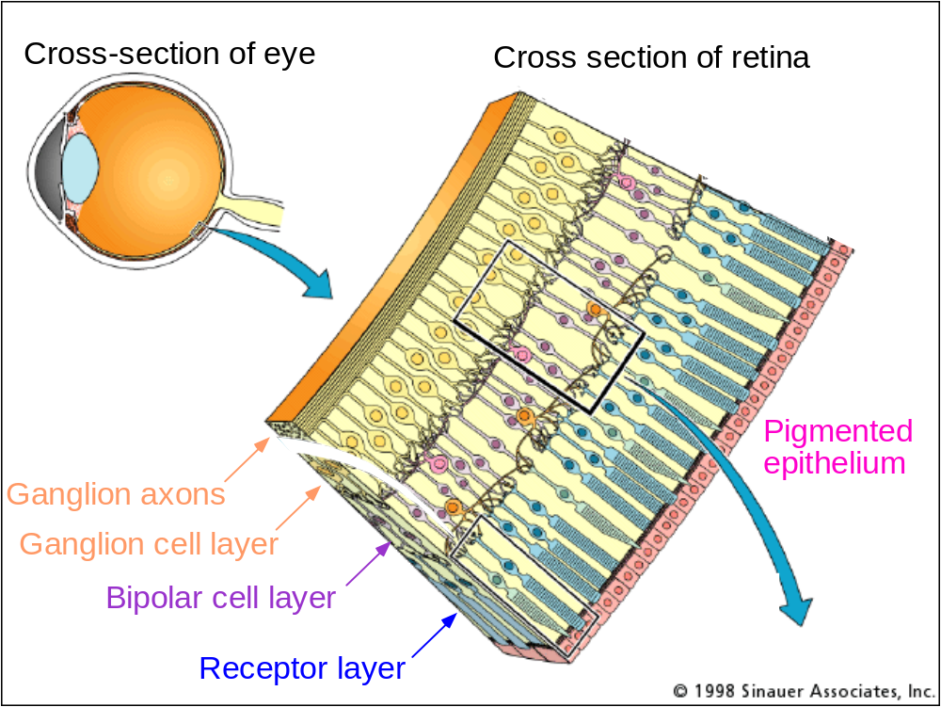
The Retina
Axon = nerve fibre
Ganglion cell = a neuron (nerve cell)
Bipolar cell = pass ‘graded signal changes’
Notes:
Pigmented epithelium - https://www.sciencedirect.com/topics/neuroscience/retinal-pigment-epithelium
Performs many functions.

Slide 12
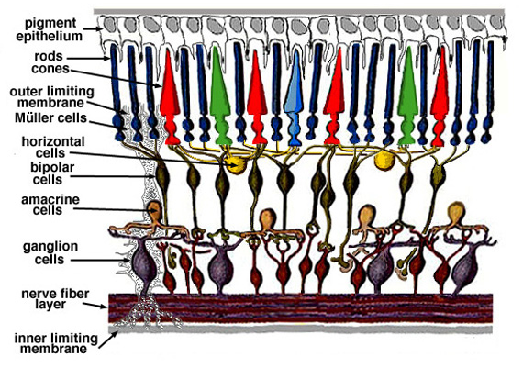
Retina up-close
Light
Notes:
Tapetum lucidum

Slide 13
Wait, the blood vessels are in front of the photoreceptors??
https://www.youtube.com/watch?v=L_W-IXqoxHA
Notes:
Yes, and you can see them!

Slide 14
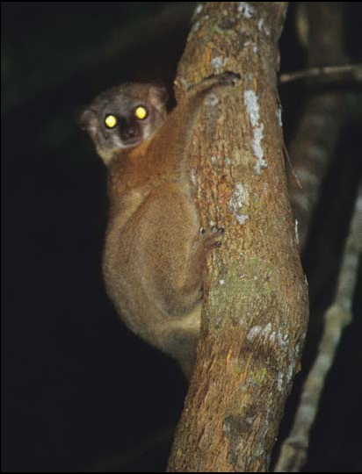
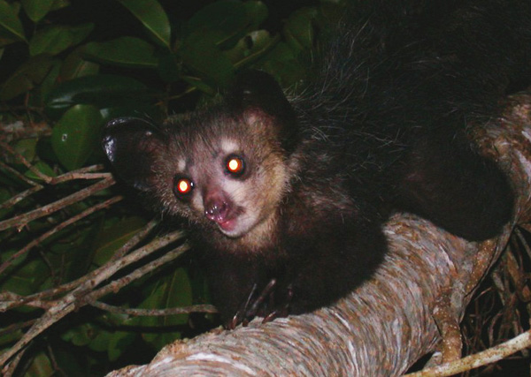
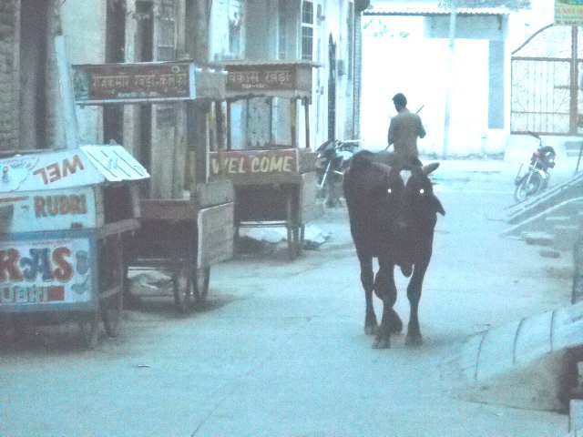
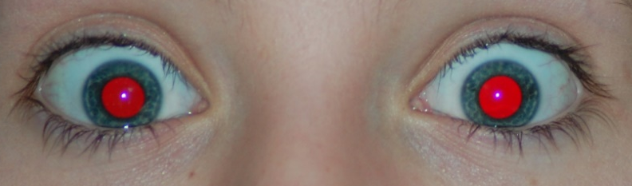
What humans don’t have: tapetum lucidum
Human eyes can reflect a tiny bit and blood in the retina makes this reflection red.
James Hays
Notes:
Animals with Tapetum Lucidum also have RPE, just not in the same part of the eye.
The tapetum lucidum /təˈpiːtəm/ (Latin: "bright tapestry; coverlet", plural tapeta lucida)^{[1]} is a layer of tissue in the eye of many vertebrates.^{[2]} Lying immediately behind the retina, it reflects visible light back through the retina, increasing the light available to the photoreceptors, though blurring the initial image of the light on focus. The tapetum lucidum contributes to the superior night vision of some animals. Many of these animals are nocturnal, especially carnivores that hunt their prey at night, while others are deep sea animals.

Slide 15
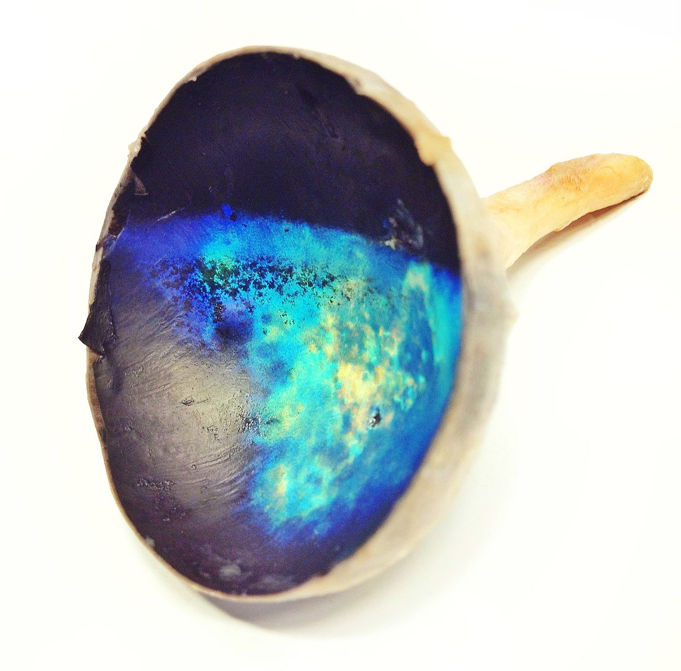
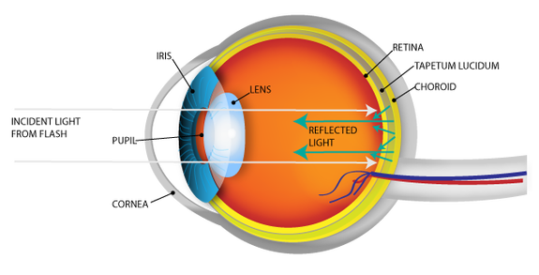
Tapetum lucidum exposed (cow eye)
Notes:
Image on the right is a photo of a tapetum lucidum from a cow.

Slide 16
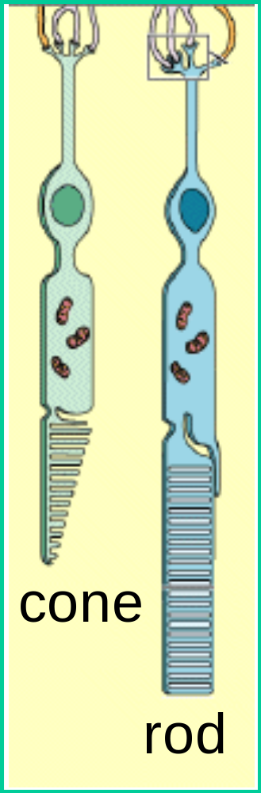
Two types of light-sensitive receptors
Cones
cone-shaped
less sensitive
operate in high light
color vision
Rods
rod-shaped
highly sensitive
operate at night
gray-scale vision
© Stephen E. Palmer, 2002
James Hays

Slide 17
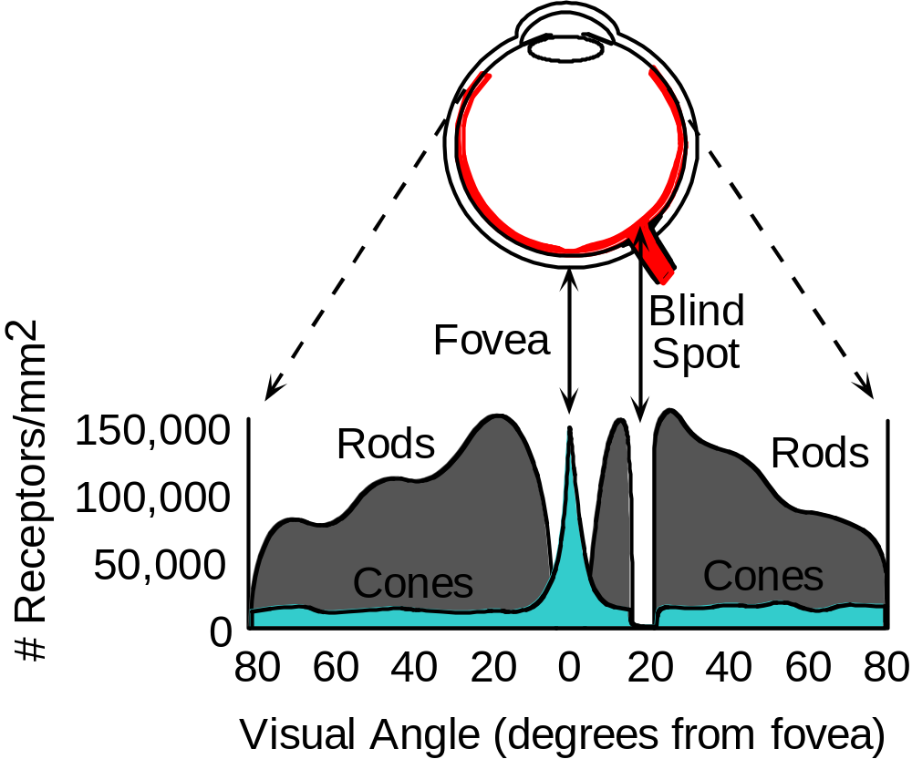
Distribution of Rods and Cones
Night Sky: why are there more stars off-center?
Averted vision: http://en.wikipedia.org/wiki/Averted_vision
© Stephen E. Palmer, 2002
James Hays

Slide 18
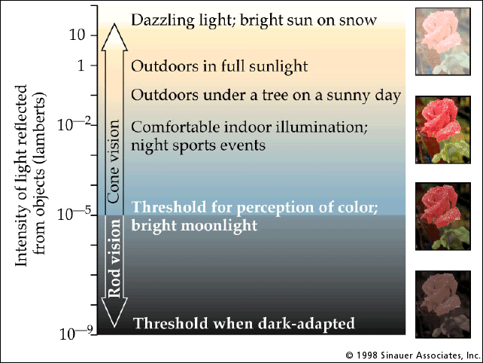
Rod / Cone sensitivity
Notes:
Motivation for HDR -> show range of intensity that an 8-bit image can capture.

Slide 19
Eye Movements
Saccades
Can be consciously controlled. Related to perceptual attention.
200ms to initiation, 20 to 200ms to carry out. Large amplitude.
Microsaccades
Involuntary. Smaller amplitude. Especially evident during prolonged fixation. Function debated.
Ocular microtremor (OMT)
involuntary. high frequency (up to 80Hz), small amplitude.
Smooth pursuit – tracking an object
James Hays

Slide 20
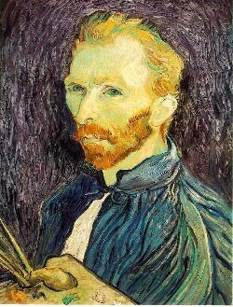
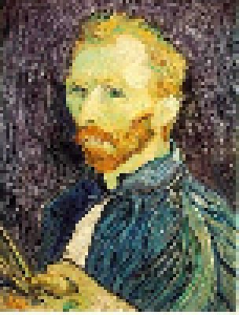
Does the eye alias?
4x downsample nearest neighbor
  Spatially, apparently not.
  The retina (sensor) has high resolution, but the optics (lens) of the eye cannot meet that resolution.
  The image is blurred optically before being sampled (removes high-frequency content!)
[Thanks to Leslie Bresnahan]
Notes:
https://extellireader.wordpress.com/2009/03/03/aliasing-in-sensory-and-neurobiological-systems/

Slide 21
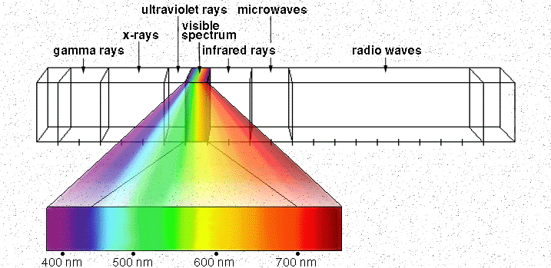
Electromagnetic Spectrum
Wavelength of light and its perceived color
http://www.yorku.ca/eye/photopik.htm
Notes:
At least 3 spectral bands required (e.g. R,G,B)

Slide 22
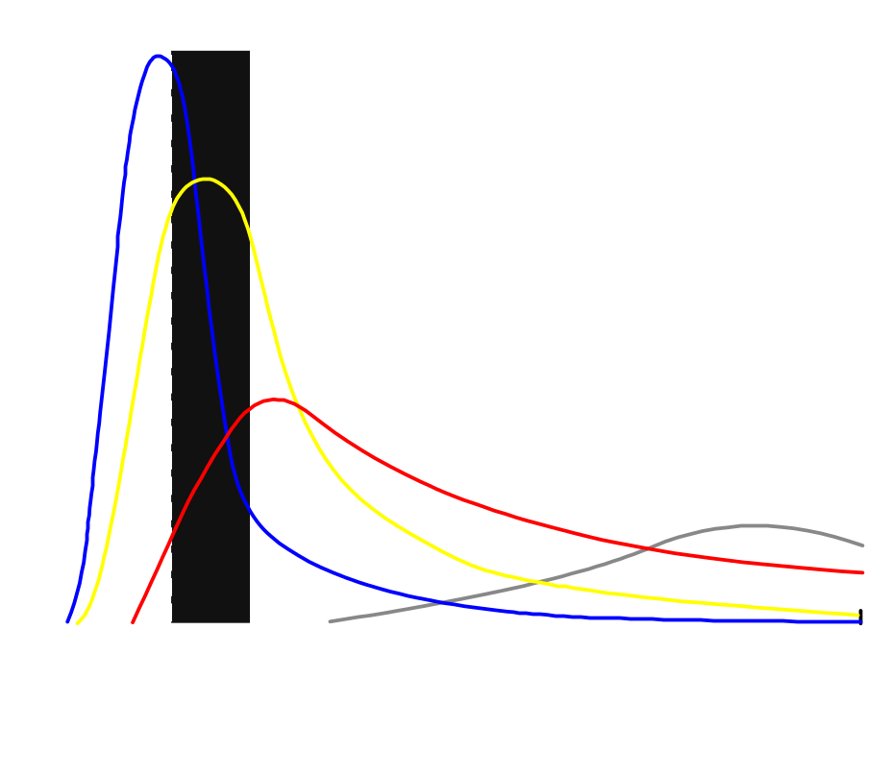
Visible Light
Why do we see light of these wavelengths?
…because that’s where the
Sun radiates EM energy
© Stephen E. Palmer, 2002
Notes:
Because that’s where the Sun’s peak radiation was
Because the atmosphere is fairly transparent in that range
Because biology has many important markers in that range (but that’s because of the previous two reasons)

Slide 23

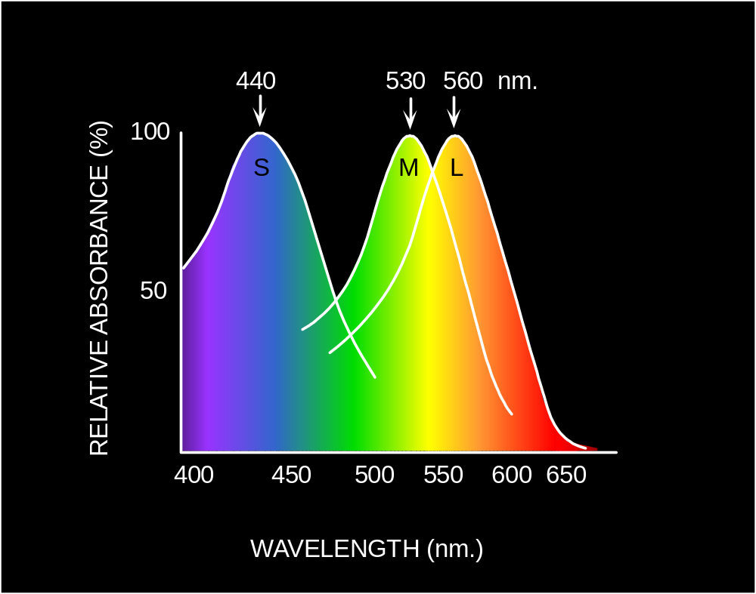
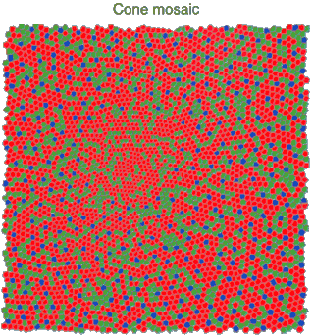
Physiology of Color Vision
Three kinds of cones:
© Stephen E. Palmer, 2002

Slide 24

The Physics of Light
Any patch of light can be completely described
physically by its spectrum: the number of photons
(per time unit) at each wavelength 400 - 700 nm.
© Stephen E. Palmer, 2002

Slide 25
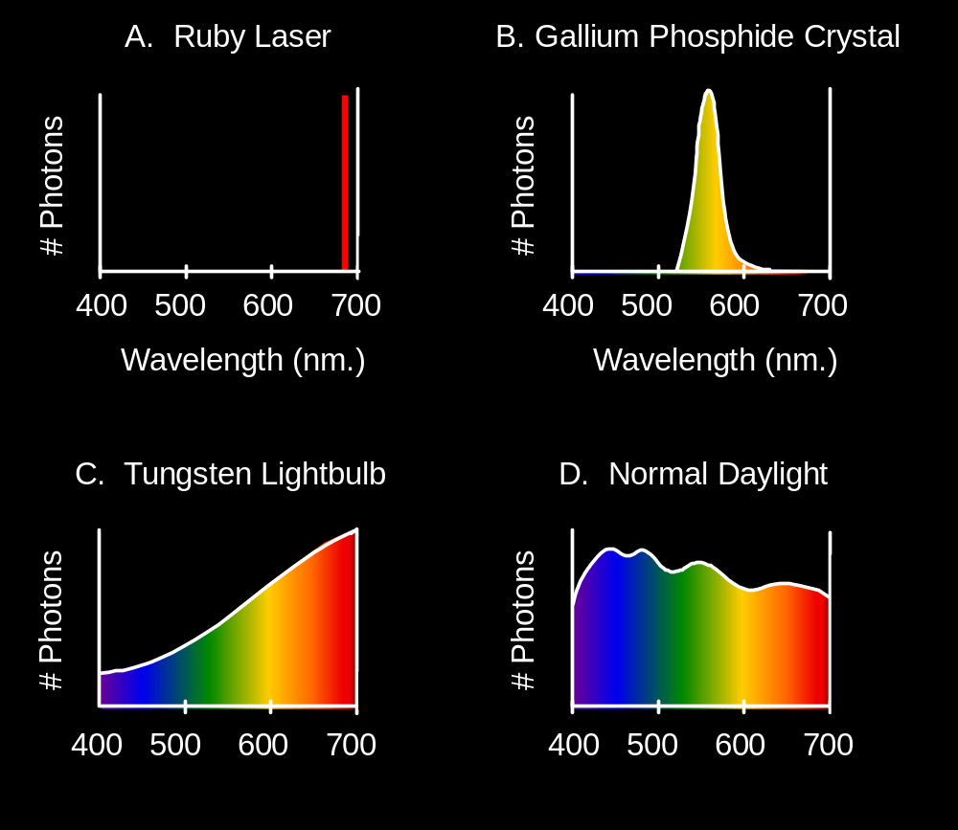
The Physics of Light
Some examples of the spectra of light sources
© Stephen E. Palmer, 2002

Slide 26
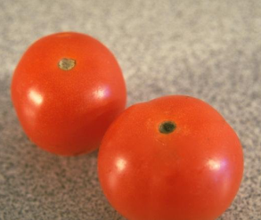
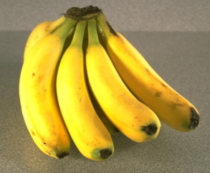
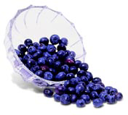
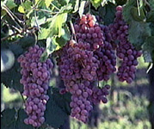
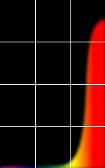
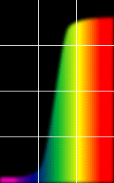
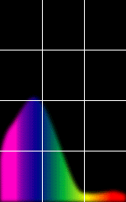
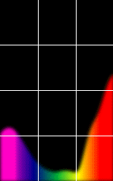
The Physics of Light
Some examples of the reflectance spectra of surfaces
Red
Yellow
Blue
Purple
% Photons Reflected
400 700
400 700
400 700
400 700
Wavelength (nm)
© Stephen E. Palmer, 2002

Slide 27

The Psychophysical Correspondence
There is no simple functional description for the perceived
color of all lights under all viewing conditions, but …...
A helpful constraint:
Consider only physical spectra with normal distributions
mean
area
variance
© Stephen E. Palmer, 2002

Slide 28
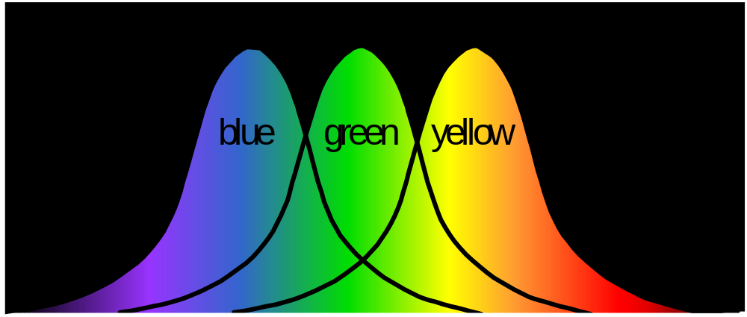
The Psychophysical Correspondence
Mean
Hue
# Photons
Wavelength
© Stephen E. Palmer, 2002

Slide 29

The Psychophysical Correspondence
Variance
Saturation
# Photons
Wavelength
© Stephen E. Palmer, 2002

Slide 30
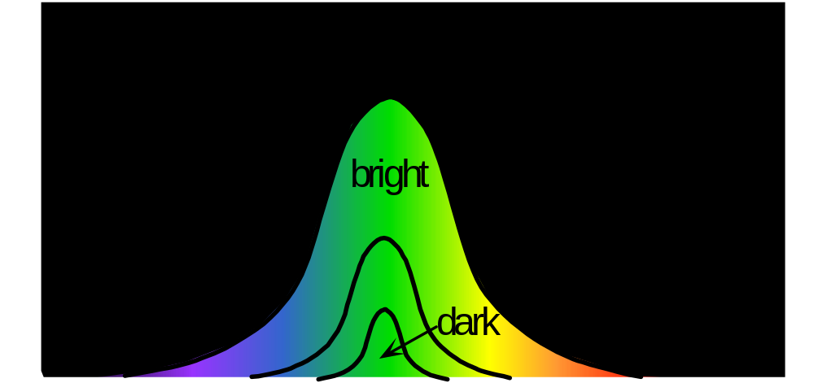
The Psychophysical Correspondence
Area
Brightness
# Photons
Wavelength
© Stephen E. Palmer, 2002

Slide 31
Physiology of Color Vision
Three kinds of cones:
Why are M and L cones so close?
Why are there 3?
© Stephen E. Palmer, 2002

Slide 32
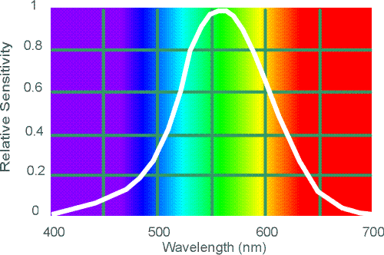
Electromagnetic Spectrum
Human Luminance Sensitivity Function
http://www.yorku.ca/eye/photopik.htm
Notes:
At least 3 spectral bands required (e.g. R,G,B)

Slide 33
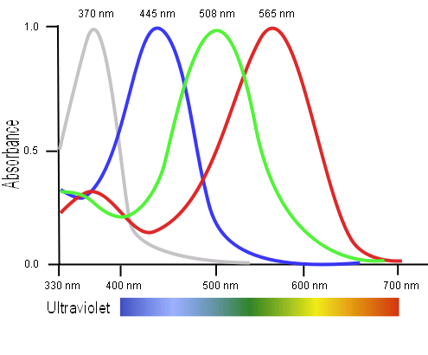
Tetrachromatism
Bird cone responses
Most birds, and many other animals, have cones for ultraviolet light.
Some humans seem to have four cones (12% of females).
True tetrachromatism is _rare_; requires learning.
James Hays
Notes:
http://www.sciencealert.com/scientists-have-found-a-woman-whose-eyes-have-a-whole-new-type-of-colour-receptor
Assuming that colour blind men pass this fourth cone cell onto their daughters, Mollon estimated that around 12 percent of the female population should be tetrachromats.
But all of his tests showed that these women could only perceive the same colours as the rest of us - which meant only three of their cone cell types were working, so they weren't true tetrachromats.

Slide 34
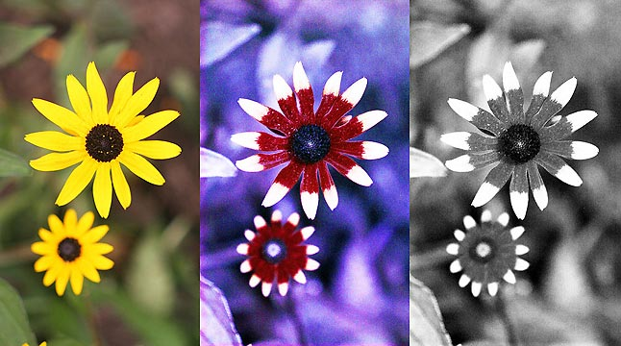
Bee vision
Notes:
Does color exist?
http://www.askamathematician.com/2012/06/q-do-colors-exist/
http://www.radiolab.org/story/211178-rip-rainbow/

Slide 35
Mantis Shrimp
16 photoreceptor types
‘Mantis Shrimp’ camera: https://www.theatlantic.com/science/archive/2018/04/mantis-shrimp-eye-camera/557195/

Slide 36
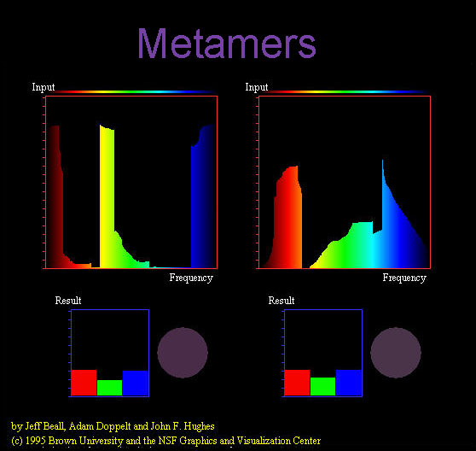
Notes:
Does color exist?

Slide 37
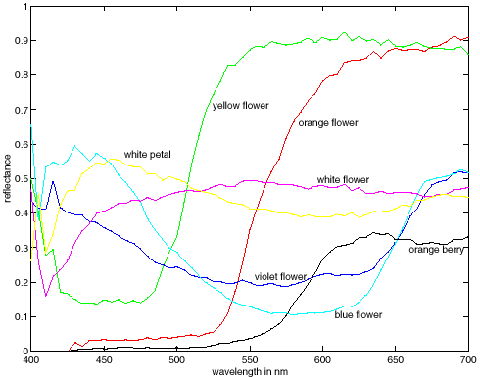
More Spectra
metamers
James Hays
Notes:
Metamerism can be illuminant based or observer based. Color blindness produced well known instances of metamerism.

Slide 38

Impossible Colors
Can you make the cones respond in ways that typical light spectra never would?
http://en.wikipedia.org/wiki/Impossible_colors
James Hays

Slide 39
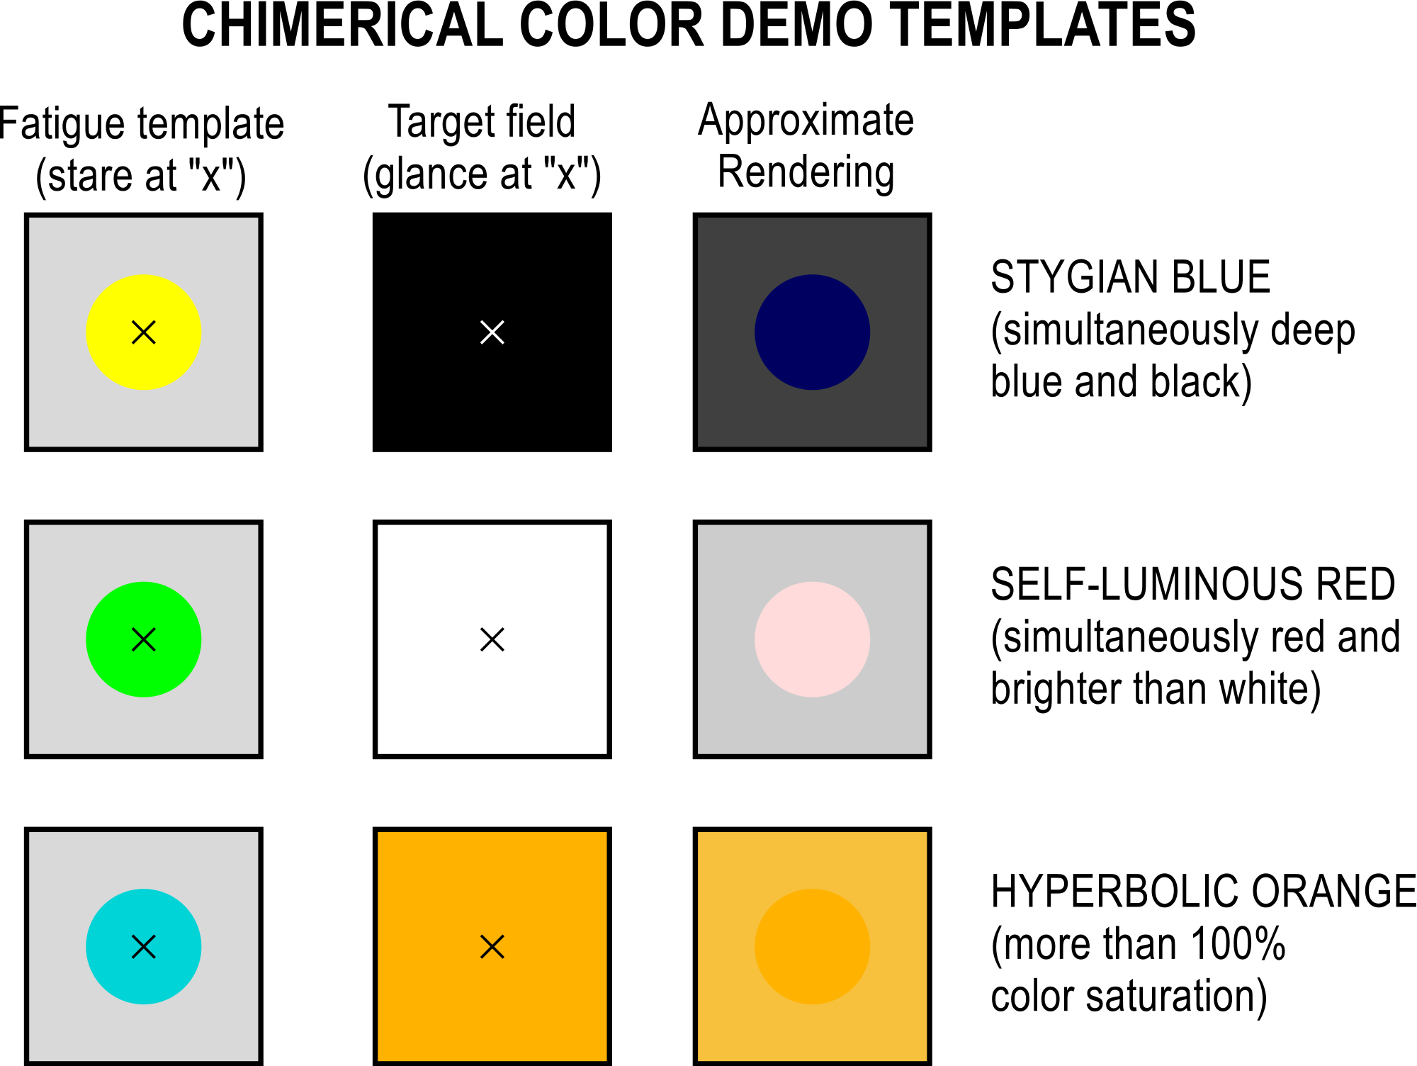
Notes:
By staring at a "fatigue template" for 20-60 seconds, then switching to a neutral target, it is possible to view "impossible" colors.

Slide 40
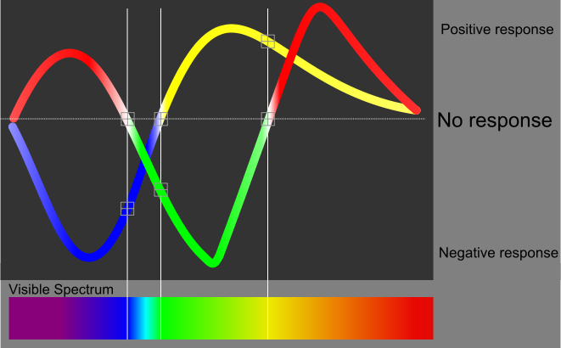
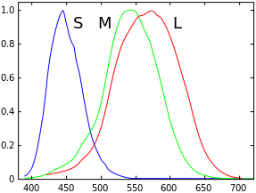
Impossible Colors
Can we make the cones respond in ways that typical light spectra never would?
http://en.wikipedia.org/wiki/Impossible_colors
Relative sensitivity
Wavelength (nm)
Notes:
The human eye's red-to-green and blue-to-yellow values of each one-wavelength visible color

Slide 41
What is color?
Why do we even care about human vision in this class?
Notes:
Does color exist?

Slide 42
Why do we care about human vision?
We don’t, necessarily.
But biological vision shows that it is possible to make important judgements from images.
James Hays

Slide 43
Why do we care about human vision?
We don’t, necessarily.
But biological vision shows that it is possible to make important judgements from images.
It’s a human world -> cameras imitate the frequency response of the human eye to try to see as we see.

Slide 44
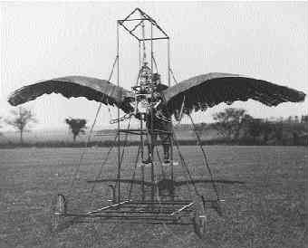
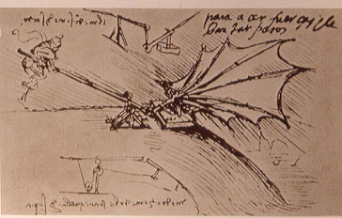
Ornithopters
James Hays

Slide 45
"Can machines fly like a bird?"
No, because airplanes don’t flap.
"Can machines fly?"
Yes, but airplanes use a different mechanism.
"Can machines perceive?"
Is this question like the first, or like the second?
Adapted from Peter Norvig
Notes:
Norvig – director of research at Google; Brown alumnus (applied math)

Slide 46
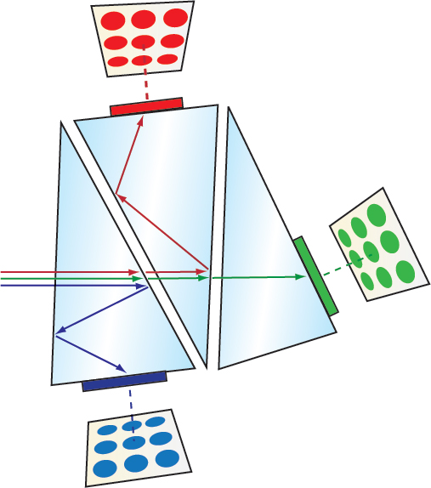
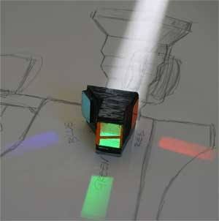
Cameras with Three Sensors
Objective Lens
[Edmund Optics; Adam Wilt]
Notes:
https://www.edmundoptics.eu/resources/application-notes/imaging/understanding-camera-sensors-for-machine-vision-applications/
https://www.adamwilt.com/TechDiffs/CCDColor.html

Slide 47


Color Sensing in Camera (RGB)
3-chip vs. 1-chip: quality vs. cost
Why more green?
Why 3 colors?
http://www.cooldictionary.com/words/Bayer-filter.wikipedia
Slide by Steve Seitz

Slide 48


Cheaper/More Compact Color Sensing: Bayer Grid
Estimate RGB
at ‘G’ cells from neighboring values
Slide by Steve Seitz

Slide 49
Why more green?
Approximate human spectral sensitivity
Less than ~400nm to 10nm = ultraviolet (UV)
Human visible portion of electromagnetic (EM) spectrum
Greater than ~700nm to 1mm = infrared (IR)

Slide 50


RGB Camera Color Response
What’s going on over here?
MaxMax.com
Notes:
https://www.quora.com/Why-is-there-a-significant-difference-between-image-sensors-and-human-eyes-Spectral-response
http://www.maxmax.com/ndvi_camera_technical.htm
http://www.maxmax.com/faq/camera-tech/spectral-response
NOTE the strong response into long wavelengths (near IR). Many camera sensors can see into infrared range, but the lens system includes an IR low-pass filter which blocks incoming IR light.
What is quantum efficiency?
Literally “the percentage of photons hitting the device's photoreactive surface that produce charge carriers. It is measured in electrons per photon or amps per watt.” https://en.wikipedia.org/wiki/Quantum_efficiency

Slide 51


Display Color Response

Slide 52

Display Color Response

Slide 53

Color spaces
How can we represent color?
http://en.wikipedia.org/wiki/File:RGB_illumination.jpg

Slide 54





Color spaces: RGB
Default color space
0,1,0
R = 1
(G=0,B=0)
1,0,0
G = 1
(R=0,B=0)
0,0,1
B = 1
(R=0,G=0)
Any color = r*R + g*G + b*B
Strongly correlated channels
Non-perceptual
Image from: http://en.wikipedia.org/wiki/File:RGB_color_solid_cube.png

Slide 55


Primaries (basis) for a camera or display
Generate chromatic light by mixing light of different fixed spectral distributions. Typically mixes three ‘primaries’.
$$C_{E}\left(λ\right)=α_{1}E_{1}\left(λ\right)+α_{2}E_{2}(λ)+α_{2}E_{3}(λ)$$
Standards body: CIE = Commission internationale de l’eclairage (International Commission on Illumination)
CIE-RGB (1931):
$$C\left(λ\right)=α_{R}E_{R}\left(λ\right)+α_{G}E_{G}(λ)+α_{B}E_{B}(λ)$$
where $E_{i}$ are the primaries, $α_{i}$ are the intensities, and
$E_{R}\left(λ\right)=δ\left(λ−λ_{R}\right)$, where $λ_{R}=700.0nm$
$E_{G}\left(λ\right)=δ\left(λ−λ_{G}\right)$, where $λ_{G}=546.1nm$
$E_{B}\left(λ\right)=δ\left(λ−λ_{B}\right)$, where $λ_{B}=435.8nm$
Why 700nm?
Eye response is consistent around this wavelength, e.g., robust to display noise in nm output
Why these?
Easily reproduced accurately by mercury vapor gas-discharge lamp
[UCL CS APMA 2010; Wikipedia]

Slide 56
CIE XYZ (1931)
All color sensations that are visible to a human with average eyesight.
  Derived from experimentation.
Y is luminance -> brightness
X,Z plane contains all possible chromaticities for a given Y luminance.
Cannot represent how objects look, or paints
- Purely how the eye will perceive light.
[UCL CS APMA 2010; Wikipedia]

Slide 57


Gamut
The range of colors possible given a primary basis.
Here, CIE RGB gamut is embedded as a color triangle within the CIE XYZ gamut of the human eye.
Where in diagram:
$$x=\frac{X}{X+Y+Z}$$
$$y=\frac{Y}{X+Y+Z}$$
[UCL CS APMA 2010; Wikipedia]
Notes:
This gamut is for a given (arbitrary) luminance, the Y of CIE XYZ, as it only represents color and not brightness/intensity or saturation.
NOTICE how much of the visible spectrum is not represented by CIE-RGB!!
Dot in middle is D65 white point (what is D65? A ‘color temperature’, e.g., a color which is said to be white.

Slide 58

Another example
The gamut of sRGB.
- Common standard for images if no profile is known.
Around the outer curve are the light wavelengths in nanometers – 380 to 700 nm.
[UCL CS APMA 2010; Wikipedia]
Notes:
How was XYZ measured?
“The observer would alter the brightness of each of the three primary beams until a match to the test color was observed. Not all test colors could be matched using this technique. When this was the case, a variable amount of one of the primaries could be added to the test color, and a match with the remaining two primaries was carried out with the variable color spot. For these cases, the amount of the primary added to the test color was considered to be a negative value. In this way, the entire range of human color perception could be covered. When the test colors were monochromatic, a plot could be made of the amount of each primary used as a function of the wavelength of the test color. These three functions are called the color matching functions for that particular experiment. “
[Wikipedia]

Slide 59

But this CIE RGB basis has some problems…
The color matching functions are the amounts of primaries needed to match the monochromatic test color at the wavelength shown on the horizontal scale.
The CIE 1931 RGB color matching functions.
NOTE – we need _negative_ amounts of red! This means that it is impossible to display certain perceptual colors using CIE RGB emissive displays, hence why the gamut cannot show all colors.
What does this say about human perception?
[UCL CS APMA 2010; Wikipedia]

Slide 60
Is color a vector space?
Think-Pair-Share
Got it. C = r*R + g*G + b*B
Notes:
https://arcsecond.wordpress.com/2008/10/06/calculoergosum/
Has certain properties of vector spaces, e.g., we can make a new basis from a different set of colors, like cyan, magenta, and yellow for instance.
But, it’s clamped at 1, and it doesn’t have negative values.

Slide 61

Color spaces: HSV
Intuitive color space

Slide 62
If you had to choose, would you rather go without:
- intensity (‘value’), or
- hue + saturation (‘chroma’)?
Think-Pair-Share
James Hays
Notes:
Think Pair Share

Slide 63
If you had to choose, would you rather go without luminance or chrominance?

Slide 64

Most information in intensity
Only color shown – constant intensity
James Hays

Slide 65
Most information in intensity
Only intensity shown – constant color
James Hays

Slide 66
Most information in intensity
Original image
James Hays

Slide 67



Color spaces: HSV
Intuitive color space
H
(S=1,V=1)
S
(H=1,V=1)
V
(H=1,S=0)
James Hays

Slide 68






Color spaces: YCbCr
Fast to compute, good for compression, used by TV
Y=0
Y=0.5
Y
(Cb=0.5,Cr=0.5)
Cr
Cb
(Y=0.5,Cr=0.5)
Cb
Y=1
Cr
(Y=0.5,Cb=05)
James Hays
Notes:
The colorimetric difference between a given color in a television picture and a standard color of equal luminance.

Slide 69

Most JPEG images & videos subsample chroma
Notes:
http://users.wfu.edu/matthews/misc/jpg_vs_gif/JpgCompTest/

Slide 70
Is color perception a vector space?

Slide 71




Color spaces: L*a*b*
“Perceptually uniform”* color space
L
(a=0,b=0)
a
(L=65,b=0)
b
(L=65,a=0)
James Hays
Notes:
* almost

Slide 72

XKCD

Slide 73
More references
https://www.colorsystem.com/
A description of many different color systems developed through history.
Navigate from the right-hand links.
Thanks to Alex Nibley!

Slide 74


Slide 75

Notes:
Mapping linear scales to hue does not produce smooth perceptual changes.
It looks like there are sharp changes across these ranges, e.g., red, yellow, green, cyan, blue, purple.
Rainbow Color Map (Still) Considered Harmful
http://people.renci.org/~borland/pdfs/RainbowColorMap_VisViewpoints.pdf

Slide 76
Rainbow color map considered harmful
Borland and Taylor
Notes:
In actual fact, these are smooth uniformly increasing functions (gradients), with no such boundaries.
Rainbow Color Map (Still) Considered Harmful
http://people.renci.org/~borland/pdfs/RainbowColorMap_VisViewpoints.pdf

Slide 77
Why Does color look like it
Maps smoothly to a circle?
“Intuitive” color space?
Wait a minute…

Slide 78
‘Color’ != position on EM spectrum
Our cells induce color perception
by interpreting spectra.
Most mammals are dichromats:
Lack ‘L’ cone; cannot distinguish green-red
1% of men (protanopia color blindness)
Trichromaticity evolved.
No implicit reason for effect of
extra cone to be linear.
Thanks to Cam Allen-Lloyd
Notes:
https://www.reddit.com/r/askscience/comments/1u735d/why_is_the_color_spectrum_cyclical/?st=iz4h40gv&sh=11370a3d
https://www.reddit.com/r/askscience/comments/1qjdbr/why_does_red_look_like_violet_the_color_spectrum/cddyd6t/?st=iz4h5jad&sh=6baffb3d
https://en.wikipedia.org/wiki/Trichromacy
https://en.wikipedia.org/wiki/Evolution_of_color_vision
https://en.wikipedia.org/wiki/Evolution_of_color_vision_in_primates
Cam Allen-Lloyd is a PhD student at Brown.

Slide 79
‘Color’ != position on EM spectrum
Many different ways to parameterize color.
Ask Prof. Thomas Serre for a qualified answer.
Or…
“When some primates started growing a third cone in their retinas, the old bipolar system remained, with the third cone adding a 2nd dimension of color encoding: red versus green. since color is now encoded in a 2d space, you find that you can draw a circle of colors in that space, which when you think about the fact that wavelength is 1d is really weird.”
- aggasalk, Reddit.
Thanks to Alexander Nibley
Notes:
https://www.reddit.com/r/askscience/comments/1u735d/why_is_the_color_spectrum_cyclical/?st=iz4h40gv&sh=11370a3d
https://www.reddit.com/r/askscience/comments/1qjdbr/why_does_red_look_like_violet_the_color_spectrum/cddyd6t/?st=iz4h5jad&sh=6baffb3d
https://en.wikipedia.org/wiki/Evolution_of_color_vision
https://en.wikipedia.org/wiki/Evolution_of_color_vision_in_primates
aggasalk is a self-described
Cam Allen-Lloyd is a PhD student at Brown.

Slide 80

Held and Hein (1963)
Notes:
https://marom.net.technion.ac.il/files/2016/07/Held-1963.pdf
https://youtu.be/okKuKsHbKt0?t=1021

Slide 81

A Bird’s-Eye View of Nature’s Hidden Order
Natalie Wolchover, Quanta Magazine 2016
Notes:
https://www.quantamagazine.org/hyperuniformity-found-in-birds-math-and-physics-20160712/

