Slide 1
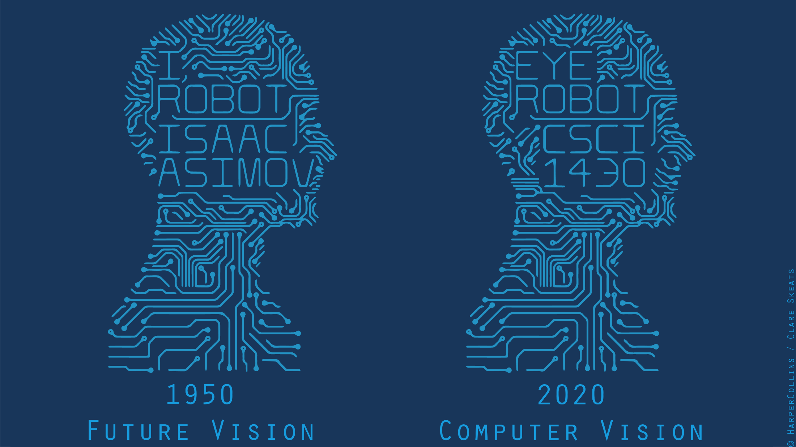

Slide 2
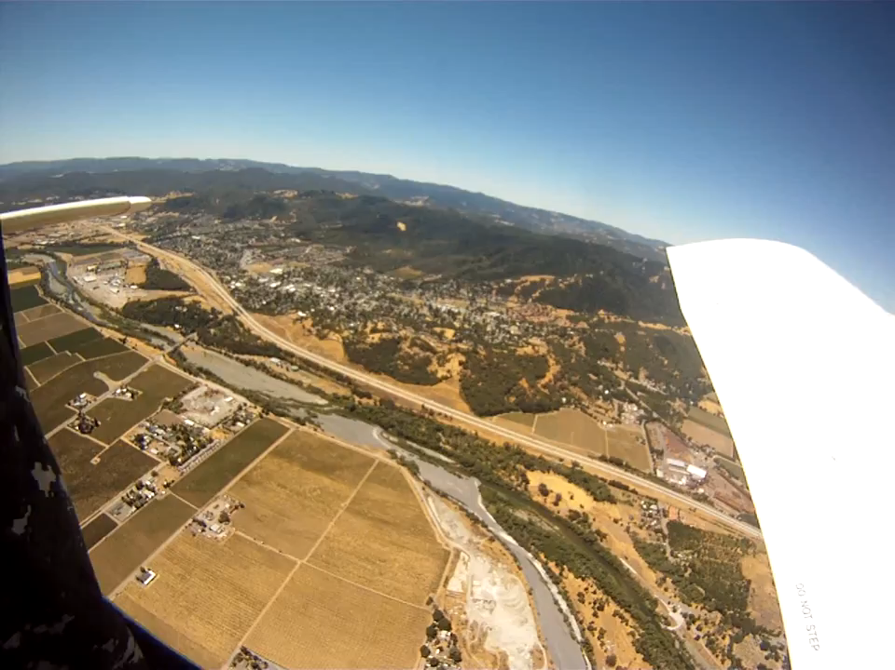

Slide 3
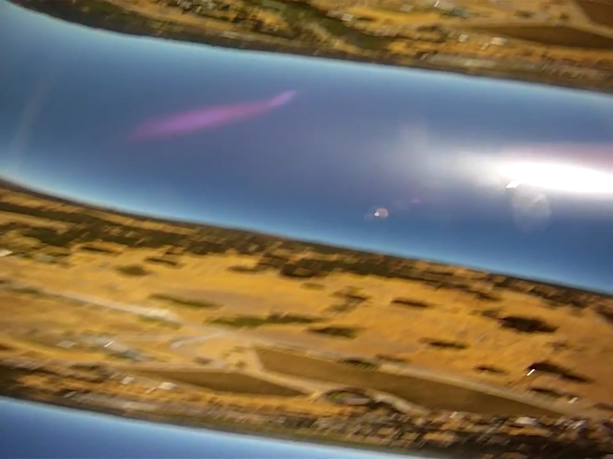

Slide 4
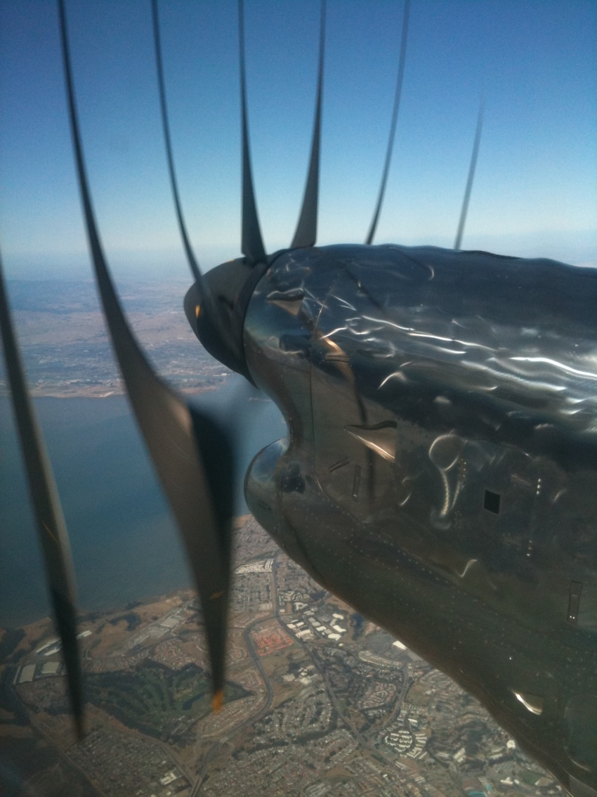
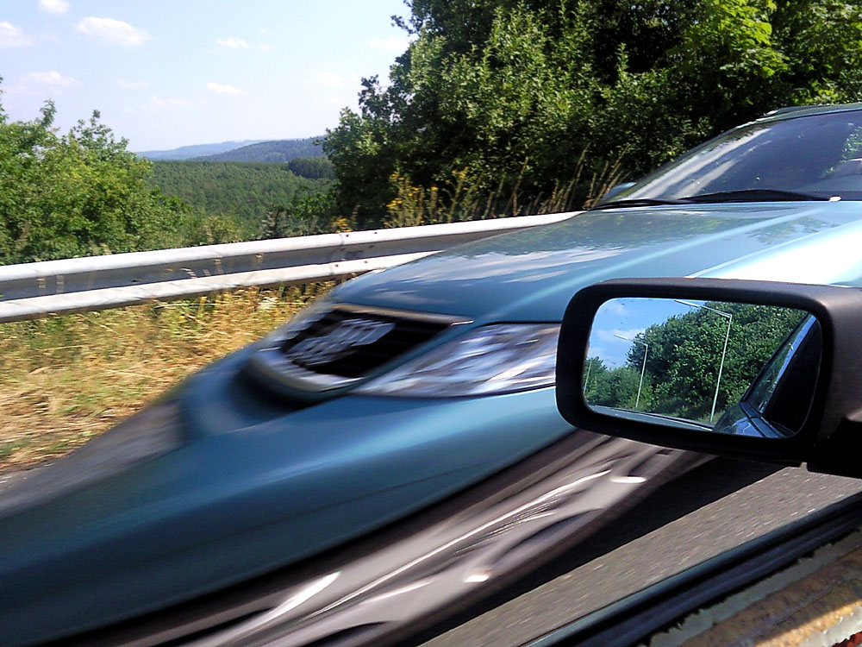
Capture Frequency - Rolling `Shutter’
James Hays
Notes:
http://en.wikipedia.org/wiki/Rolling_shutter
Even DSLRs have this problem.

Slide 5
Fourier Series &
Fourier Transforms
Thinking in frequency

Slide 6
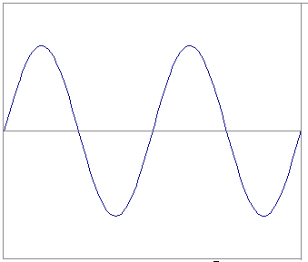
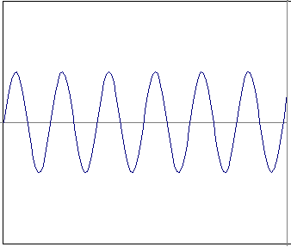
I understand frequency as in waves…
…but how does this relate to the complex
signals we see in natural images?
…to image frequency?

Slide 7
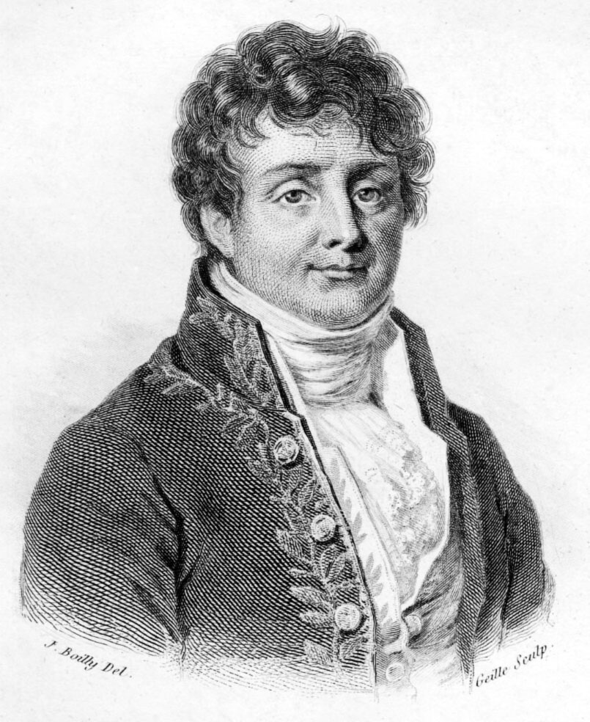
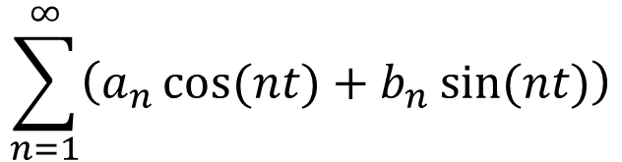
Fourier series
Jean Baptiste Joseph Fourier (1768-1830)
A bold idea (1807):
Any univariate function can be rewritten as a weighted sum of sines and cosines of different frequencies.
Our building block:
Add enough of them to get any signal g(t) you want!
$$\sum_{n=1}^{∞}{\left(a_{n}\cos{(nt)}+b_{n}\sin{(nt)}\right)}$$
Hays

Slide 8
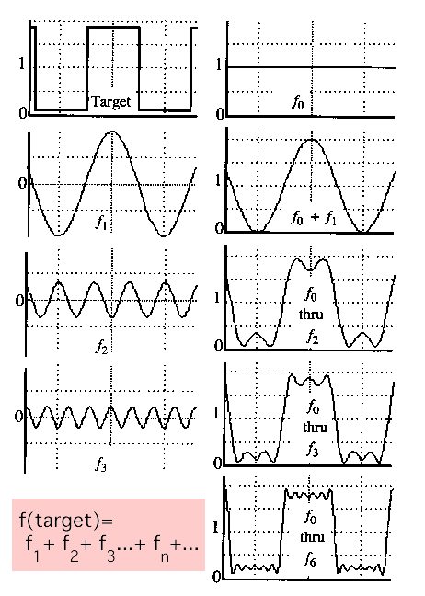
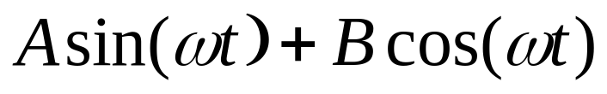
Fourier series
A bold idea (1807):
Any univariate function can be rewritten as a weighted sum of sines and cosines of different frequencies.
Our building block:
Add enough of them to get any signal g(t) you want!
Hays
Notes:
Explain notation

Slide 9
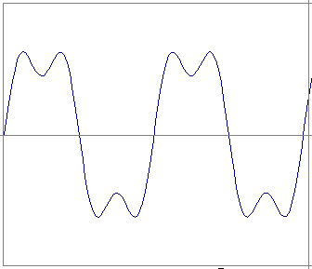
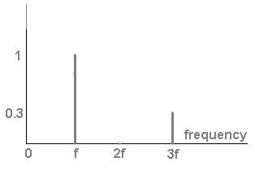
t = [0,2], f = 1
g(t) = (1)sin(2πf t) + (1/3)sin(2π(3f) t)
g
=
+
t
Coefficient
Slides: Efros

Slide 10
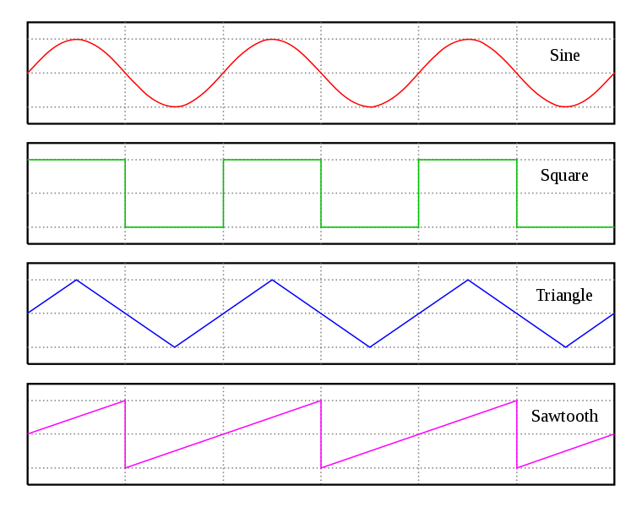
Square wave spectra

Slide 11
Square wave spectra
=
+
=

Slide 12
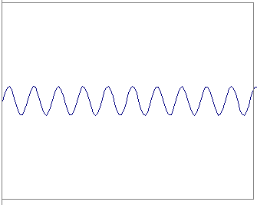
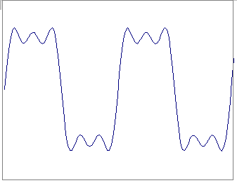
Square wave spectra
=
+
=

Slide 13
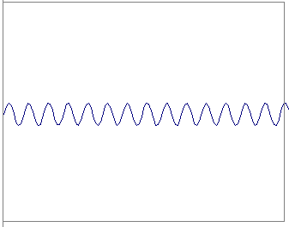
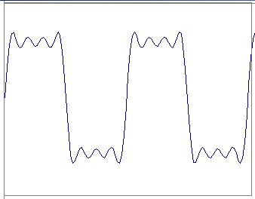
Square wave spectra
=
+
=

Slide 14
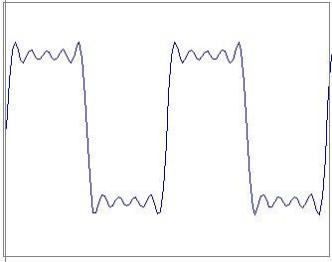
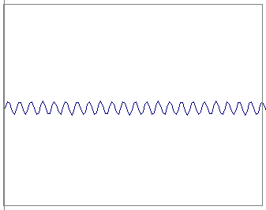
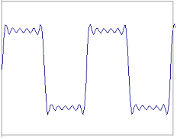
Square wave spectra
=
+
=

Slide 15
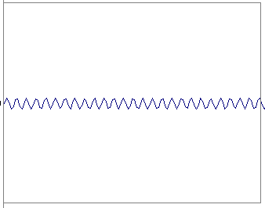
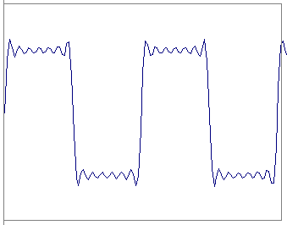
Square wave spectra
=
+
=

Slide 16
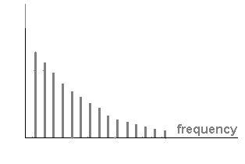

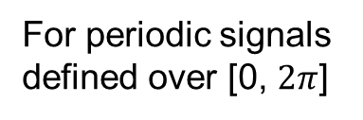
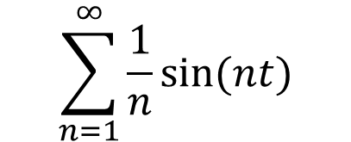
Square wave spectra
0
$$2π$$
$$\sum_{n=1}^{∞}{\frac{1}{n}\sin{(nt)}}$$
=
For periodic signals defined over [0, $2π$]
Coefficient

Slide 17
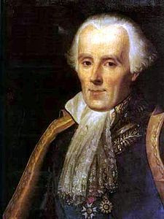
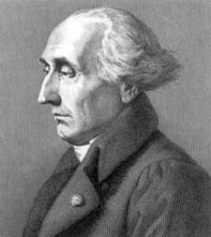
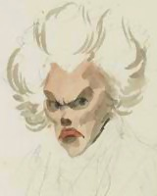
Jean Baptiste Joseph Fourier (1768-1830)
A bold idea (1807):
Any univariate function can be rewritten as a weighted sum of sines and cosines of different frequencies.
Don’t believe it?
  Neither did Lagrange, Laplace, Poisson and other big wigs
  Not translated into English until 1878!
But it’s (mostly) true!
  Called Fourier Series
  Applies to periodic signals
...the manner in which the author arrives at these equations is not exempt of difficulties and...his analysis to integrate them still leaves something to be desired on the score of generality and even rigour.
Laplace
Legendre
Lagrange
Reviewer #2
Hays

Slide 18
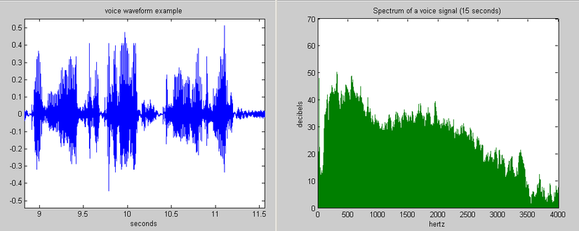
Example: Music
We think of music in terms of pitches (frequencies) at different loudnesses (amplitudes).
Slide: Hoiem

Slide 19
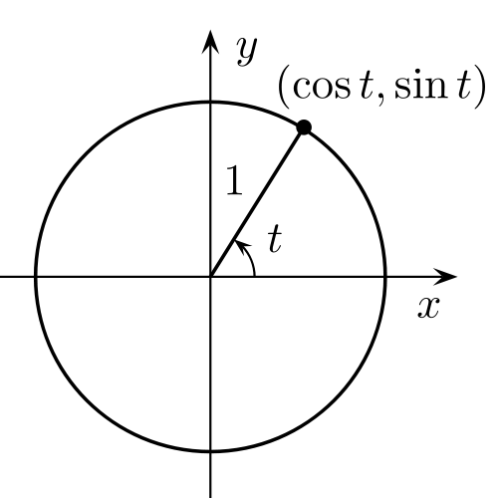
Sine/cosine and circle
sin t
cos t
Wikipedia – Unit Circle

Slide 20
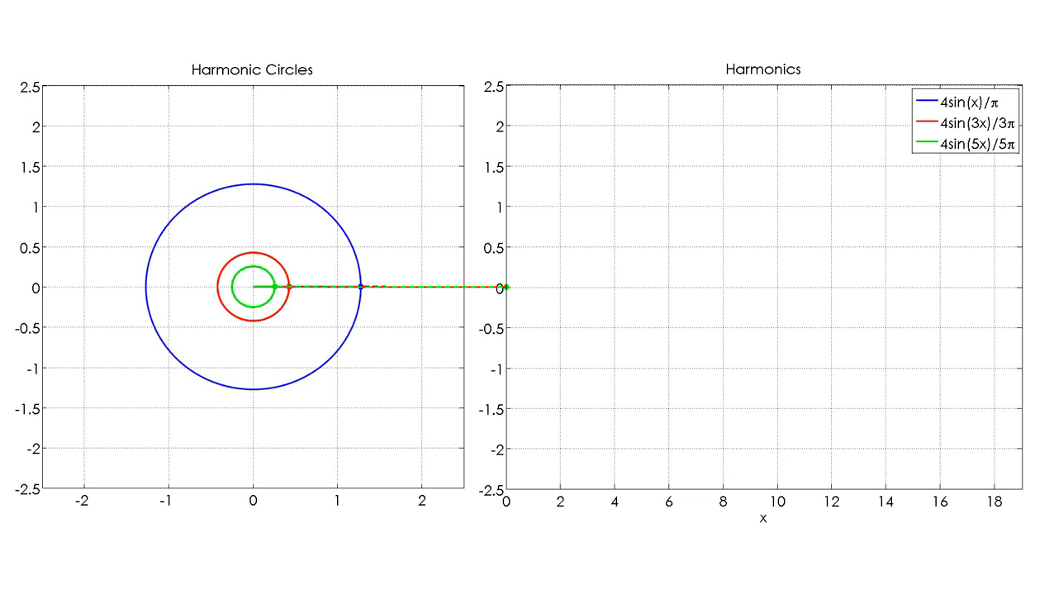
Square wave (approx.)
Mehmet E. Yavuz
Notes:
http://www.mathworks.com/matlabcentral/fileexchange/49533-fourier-series-animation-using-harmonic-circles

Slide 21
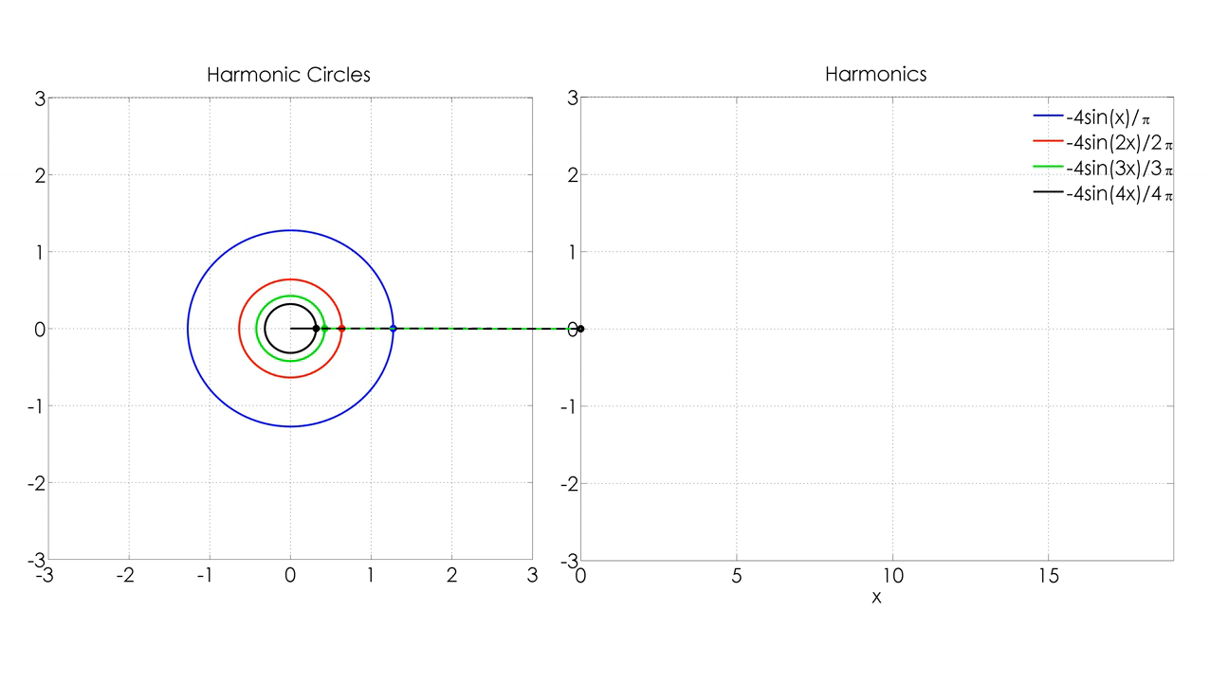
Sawtooth wave (approx.)
Mehmet E. Yavuz

Slide 22
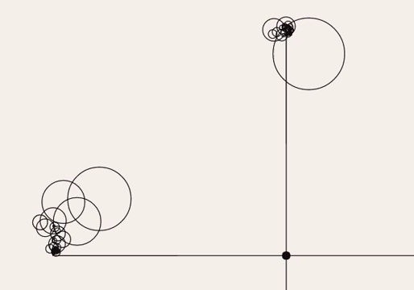
One series in each of x and y
Generative Art, じゃがりきん, Video, 2018

Slide 23
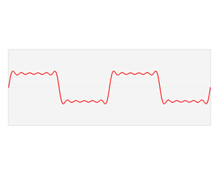
Wikipedia – Fourier transform

Slide 24
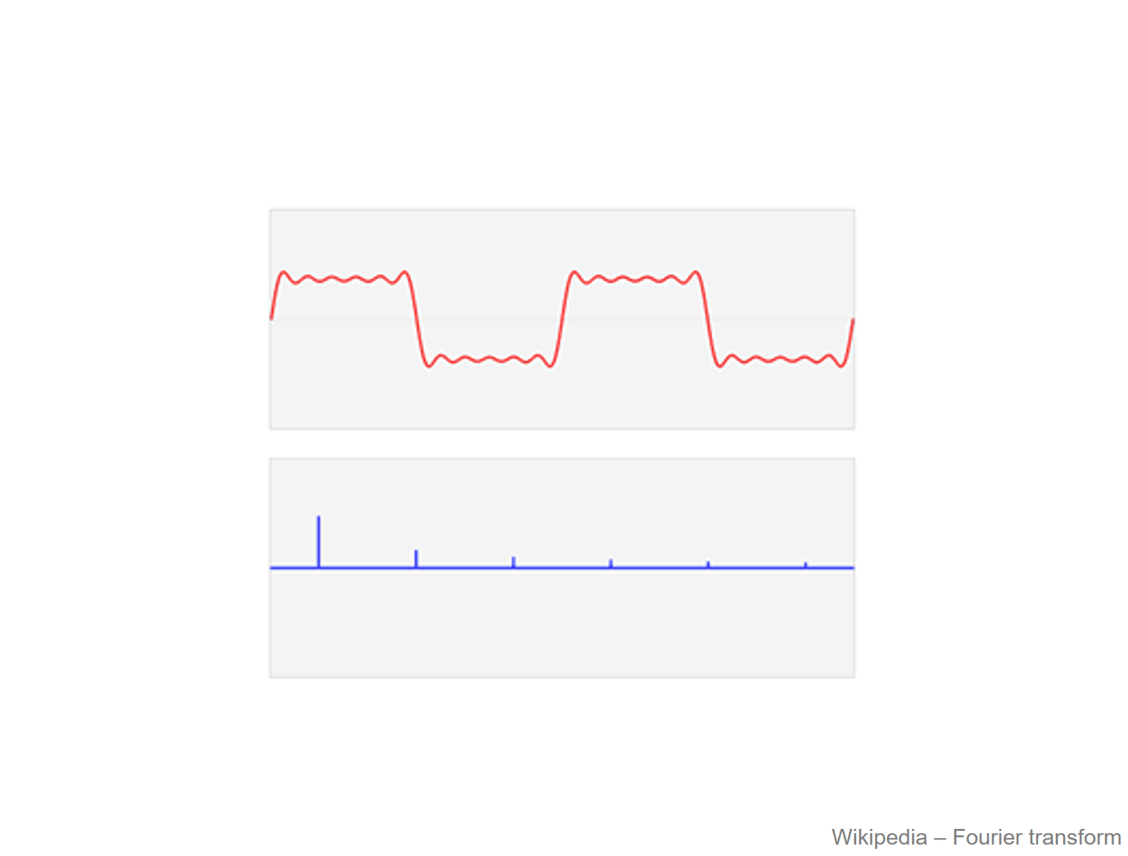

Spatial
domain
Amplitude
Frequency domain
Frequency
Equivalent amplitude image representation

Slide 25

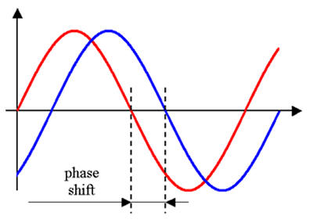
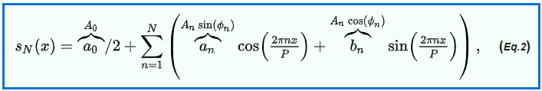

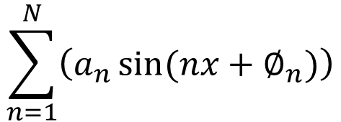
Amplitude-phase form
Add phase term to shift
cos values into sin values
$$\sum_{n=1}^{N}{\left(a_{n}\sin{(nx+∅_{n})}\right)}$$
Phase
Morse
[Peppergrower; Wikipedia]
Notes:
Equation images from https://en.wikipedia.org/wiki/Fourier_series
This has a great example of the different ways of representing the Fourier series;
sine-cosine
amplitude-phase
Euler complex exponential form

Slide 26
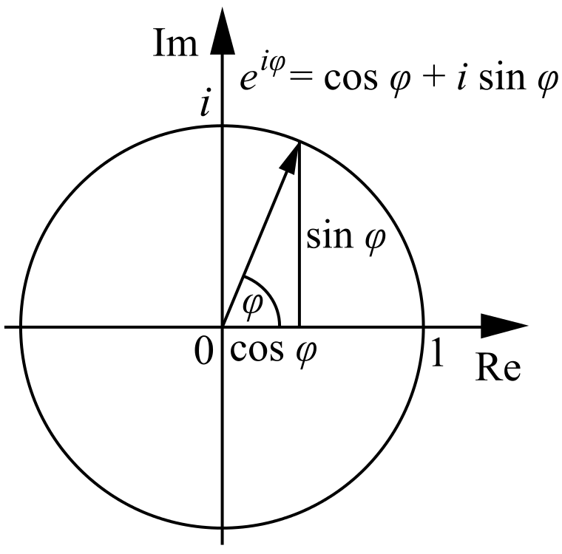
Fourier Transform
Stores the amplitude and phase at each frequency:
  For mathematical convenience, this is often notated in terms of real and complex numbers
  Related by Euler’s formula
Hays

Slide 27
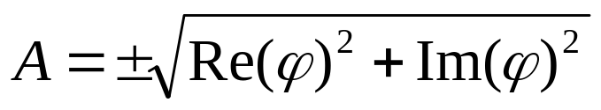
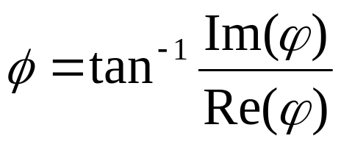
Fourier Transform
Stores the amplitude and phase at each frequency:
  For mathematical convenience, this is often notated in terms of real and complex numbers
  Related by Euler’s formula
  Amplitude encodes how much signal there is at a particular frequency:
  Phase encodes spatial information (indirectly):
Hays

Slide 28

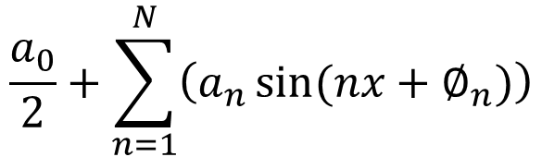
Amplitude-phase form
Add component of infinite frequency
= mean of signal over period
= value around which signal fluctuates
$$\frac{a_{0}}{2}+\sum_{n=1}^{N}{\left(a_{n}\sin{(nx+∅_{n})}\right)}$$
$$\frac{a_{0}}{2}$$
Average of signal
over period
Electronics signal processing calls this the ‘DC offset’

Slide 29

How to read Fourier transform images
We display the space such that
inf-frequency coefficient is in the center.
Fourier transform component image
$$\frac{a_{0}}{2}+\sum_{n=1}^{N}{\left(a_{n}\sin{(nx+∅_{n})}\right)}$$
$a_{0}$ location

Slide 30
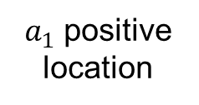
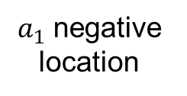
How to read Fourier transform images
Image is rotationally symmetric about center because of negative frequencies
Fourier transform component image
$$\frac{a_{0}}{2}+\sum_{n=1}^{N}{\left(a_{n}\sin{(nx+∅_{n})}\right)}$$
$a_{1}$ positive location
e.g., wheel rotating
one way or the other
$a_{1}$ negative location
For real-valued signals, positive and negative frequencies are complex conjugates (see additional slides).

Slide 31
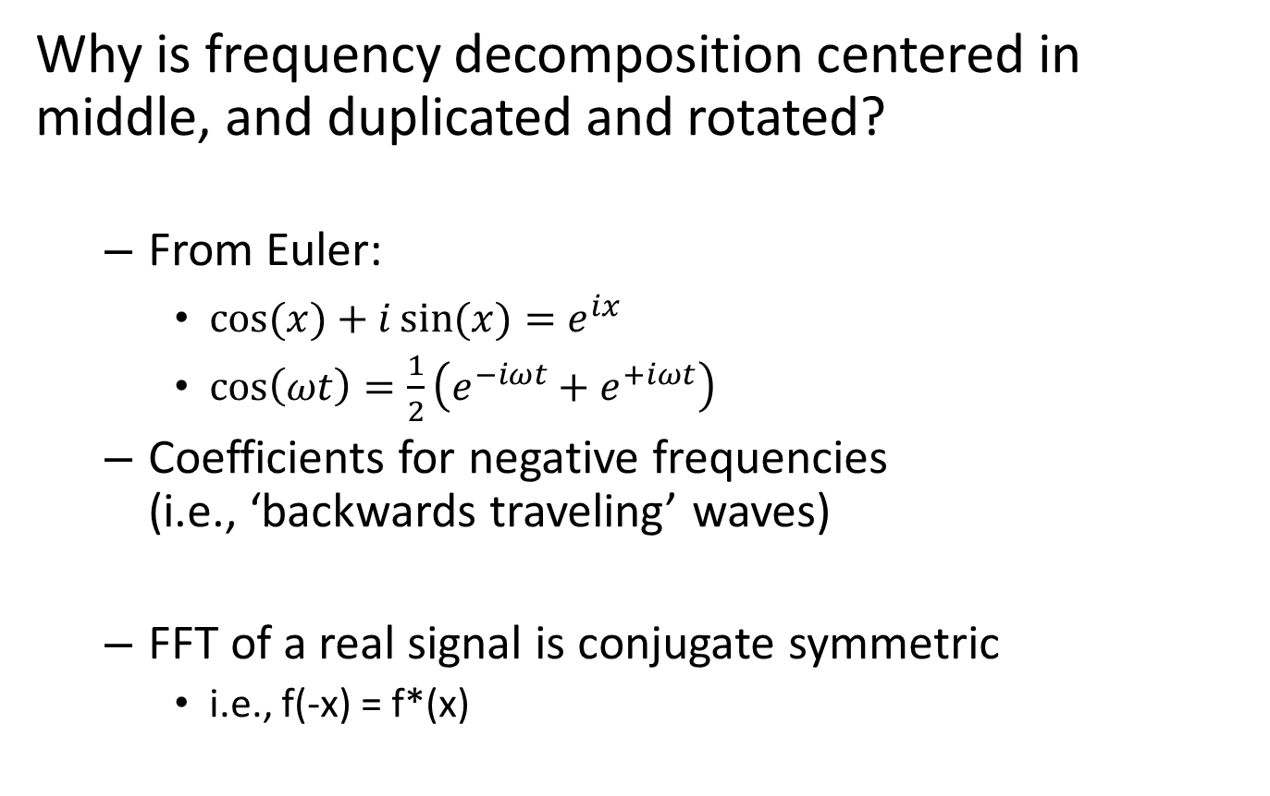
A few questions
Why is frequency decomposition centered in middle, and duplicated and rotated?
  From Euler:
    $\cos{(x)}+i\sin{(x)}=e^{ix}$
    $\cos\left(ωt\right)=\frac{1}{2}\left({e^{−iωt}+e}^{+iωt}\right)$
  Coefficients for negative frequencies
  (i.e., ‘backwards traveling’ waves)
  FFT of a real signal is conjugate symmetric
    i.e., f(-x) = f*(x)
Notes:
https://en.wikipedia.org/wiki/Euler%27s_formula
http://www.bitweenie.com/listings/negative-frequency/
Conjugate symmetric: equal real part and imaginary part but with opposite sign. i.e., 3 + 4i has complex conjugate 3 − 4i

Slide 32
How to read Fourier transform images
Image is as large as maximum frequency
by resolution of input under Nyquist frequency
Fourier transform component image
X / 2
$$\frac{a_{0}}{2}+\sum_{n=1}^{N}{\left(a_{n}\sin{(nx+∅_{n})}\right)}$$
N
Nyquist frequency is half the sampling rate of the signal.
Sampling rate is size of image (X and Y), so Fourier transform images are (±X/2, ±Y/2).
- Y / 2
- X / 2
X / 2

Slide 33
A few questions…
If we have infinite frequencies, why does the image end?
  Sampling theory. Frequencies higher than Nyquist frequency end up falling on an existing sample.
    i.e., they are ‘aliases’ for existing samples!
  Nyquist frequency is half the sampling frequency.
  (Nyquist frequency is not Nyquist-Shannon rate, which is sampling required to reconstruct alias-free signal. Both are derived from same theory.)

Slide 34

Periodicity
Fourier decomposition assumes periodic signals with infinite extent.
  E.G., our image is assumed to repeated forever
‘Fake’ signal is image wrapped around
Convention is to pad with zeros to reduce effect.
Hays
Notes:
http://math.stackexchange.com/questions/26432/discrete-fourier-transform-effects-of-zero-padding-compared-to-time-domain-inte

Slide 35
A few questions
How is the Fourier decomposition computed?
Intuitively, by correlating the signal with a set of waves of increasing frequency!

Slide 36

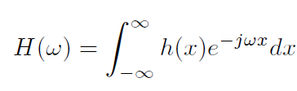
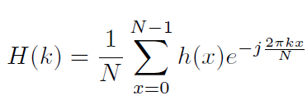
Computing the Fourier Transform
Continuous
Discrete
k = -N/2..N/2
Fast Fourier Transform (FFT): NlogN

Slide 37
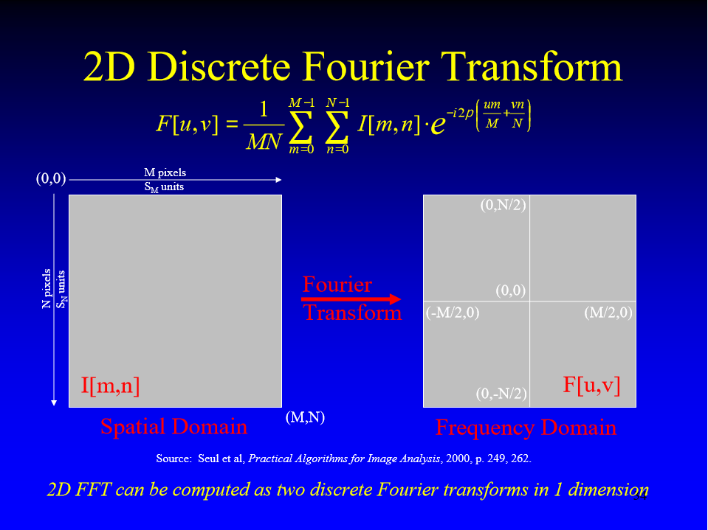
Earl F. Glynn
Notes:
http://research.stowers-institute.org/efg/Report/FourierAnalysis.pdf

Slide 38
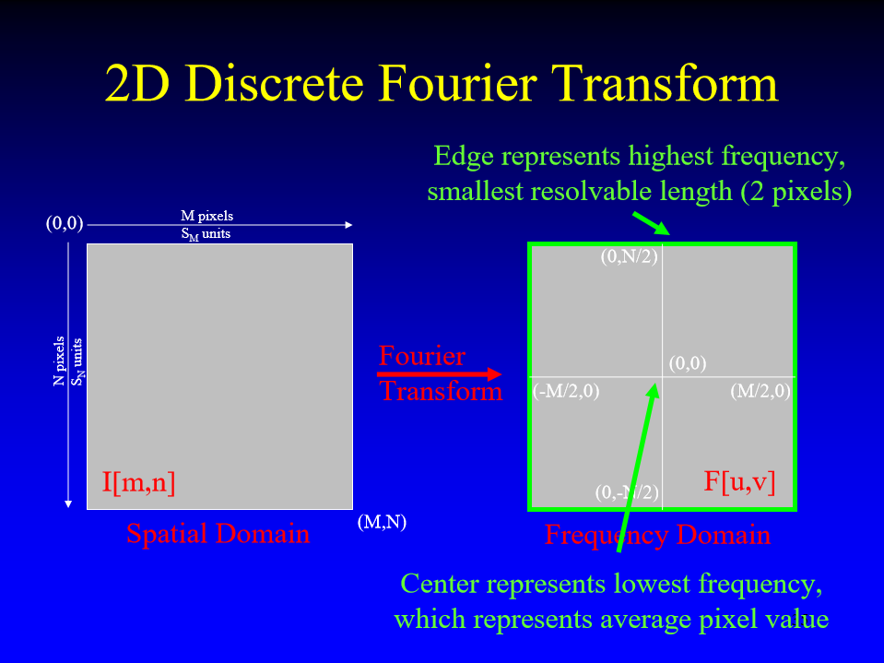
Earl F. Glynn
Notes:
http://research.stowers-institute.org/efg/Report/FourierAnalysis.pdf

Slide 39






Fourier analysis in images
Spatial domain images
Fourier decomposition amplitude images
http://sharp.bu.edu/~slehar/fourier/fourier.html#filtering More: http://www.cs.unm.edu/~brayer/vision/fourier.html

Slide 40


Signals can be composed
Spatial domain images
+
=
Fourier decomposition amplitude images
http://sharp.bu.edu/~slehar/fourier/fourier.html#filtering More: http://www.cs.unm.edu/~brayer/vision/fourier.html

Slide 41


Natural image
Fourier decomposition
Amplitude image
Natural image
What does it mean to be at pixel x,y?
What does it mean to be more or less bright in the Fourier decomposition image?

Slide 42
Brian Pauw demo
Live Fourier decomposition images
  Using FFT2 function
I hacked it a bit
http://www.lookingatnothing.com/index.php/archives/991
Notes:
Maru the cat: https://www.youtube.com/watch?v=2XID_W4neJo

Slide 43








Think-Pair-Share
Hoiem
Match the spatial domain image to the
Fourier amplitude image
1
2
3
4
5
A
B
C
D
E
Notes:
1 - D
2 – B
3 – A
4 - E
5 – C
Note: I had to zoom in on some of these images and use log scaling and high multipliers for you to see some kind of patterning at all!

Slide 44

Fourier Bases
Teases away ‘fast vs. slow’ changes in the image.
Blue = sine
Green = cosine
This change of basis is the Fourier Transform
Hays

Slide 45
Fourier Bases
Hays

Slide 46

Basis reconstruction
Danny Alexander

Slide 47

Now we can edit frequencies!

Slide 48


Low and High Pass filtering

Slide 49

Removing frequency bands
Brayer

Slide 50

High pass filtering + orientation

Slide 51
Brian Pauw demo
Live Fourier decomposition images
  Using FFT2 function
This time, for editing images.
Notes:
Maru the cat: https://www.youtube.com/watch?v=2XID_W4neJo

Slide 52
Fourier Transform
Stores the amplitude and phase at each frequency:
  For mathematical convenience, this is often notated in terms of real and complex numbers
  Related by Euler’s formula
Hays

Slide 53
Fourier Transform
Stores the amplitude and phase at each frequency:
  For mathematical convenience, this is often notated in terms of real and complex numbers
  Related by Euler’s formula
Hays

Slide 54
Fourier Transform
Stores the amplitude and phase at each frequency:
  For mathematical convenience, this is often notated in terms of real and complex numbers
  Related by Euler’s formula
  Amplitude encodes how much signal there is at a particular frequency:
  Phase encodes spatial information (indirectly):
Hays

Slide 55
Amplitude / Phase
Amplitude tells you “how much”
Phase tells you “where”
Translate the image?
  Amplitude unchanged
  Adds a constant to the phase.
Morse
[Peppergrower; Wikipedia]
Notes:
Phase congruency edge detection: http://homepages.inf.ed.ac.uk/rbf/CVonline/LOCAL_COPIES/OWENS/LECT7/node2.html
Magnitude Amplitude of combined cosine and sine
Phase Relative proportions of sine and cosine
Bryan Morse, BYU Computer Science
http://www.astro.umd.edu/~lgm/ASTR410/ft_ref2.pdf

Slide 56

What about phase?
Efros

Slide 57


What about phase?
Amplitude
Phase
Efros

Slide 58

What about phase?
Efros

Slide 59


What about phase?
Amplitude
Phase
Efros

Slide 60
John Brayer, Uni. New Mexico
“We generally do not display PHASE images because most people who see them shortly thereafter succumb to hallucinogenics or end up in a Tibetan monastery.”
https://www.cs.unm.edu/~brayer/vision/fourier.html
Notes:
https://www.cs.unm.edu/~brayer/vision/fourier.html

Slide 61
Think-Pair-Share
In Fourier space, where is more of the information that we see in the visual world?
  Amplitude
  Phase

Slide 62


Cheebra
Zebra phase, cheetah amplitude
Cheetah phase, zebra amplitude
Efros

Slide 63
The frequency amplitude of natural images are quite similar.
  Heavy in low frequencies, falling off in high frequencies
  Will any image be like that, or is it a property of the world we live in?
Most information in the image is carried in the phase, not the amplitude.
Efros

Slide 64
What is the relationship to phase in audio?
In audio perception, frequency is important but phase is not.
In visual perception, both are important.
??? : (

Slide 65


Slide 66


Slide 67


Slide 68


Slide 69


Slide 70


Slide 71

Notes:
California Academy of Sciences
San Francisco’s Golden Gate Park
~ Summer 2017

Slide 72

Notes:
http://www.bbc.com/news/world-asia-china-41277549

Slide 73

Notes:
Xilinshui village

Slide 74
Properties of Fourier Transforms
Linearity
Fourier transform of a real signal is symmetric about the origin
The energy of the signal is the same as the energy of its Fourier transform
See Szeliski Book (3.4)

Slide 75


The Convolution Theorem
The Fourier transform of the convolution of two functions is the product of their Fourier transforms
Convolution in spatial domain is equivalent to multiplication in frequency domain!
Hays

Slide 76

Filtering in spatial domain
1
0
-1
2
0
-2
1
0
-1
*
=
Convolution
Hays

Slide 77


Filtering in frequency domain
Element-wise product
FFT
FFT
=
Inverse FFT
Slide: Hoiem
Notes:
What do I product? Do I change the phase, too?

Slide 78
Filtering in frequency domain
Element-wise product
Fourier transform
Fourier transform
Inverse
Fourier transform
Slide: Hoiem
Notes:
What do I product? Do I change the phase, too?

Slide 79


Hays
Why does the Gaussian filter give a nice smooth image, but the square filter give edgy artifacts?
Gaussian
Box filter
Notes:
Things we can’t understand without thinking in frequency

Slide 80

Why do we have those lines in the image?
Sharp edges in an image or kernel need _all_ frequencies to represent them.
=
coefficient
Efros

Slide 81

Box filter / sinc filter duality
Hays
What is the box filter in the frequency domain?
http://madebyevan.com/dft/
Notes:
Dual functions – box(x) and sinc(x)

Slide 82


Evan Wallace demo
Made for CSCI1230
1D example
Forbes 30 under 30
  Figma (collaborative design tools)
http://madebyevan.com/dft/
with Dylan Field
Notes:
https://twitter.com/figmadesign/status/816356525748781056
http://www.browndailyherald.com/2012/09/10/cs-undergrad-wins-tech-fellowship/

Slide 83


Box filter / sinc filter duality
Hays
What is the box filter in the frequency domain?
What is the sinc filter in the frequency domain?
Box filter
Sinc filter
sinc(x) = sin(x) / x
Spatial Domain Frequency Domain
Frequency Domain Spatial Domain
Notes:
Dual functions – box(x) and sinc(x)
Sinc function has components out to infinity, has zero crossings (lose signal), and has negative coefficients.

Slide 84


Frequency domain magnitude
Box filter (spatial)

Slide 85


Gaussian filter duality
Fourier transform of one Gaussian…
…is another Gaussian (with inverse variance).
Why is this useful?
  Smooth degradation in frequency components
  No sharp cut-off
  No negative values
  Never zero (infinite extent)
Frequency domain magnitude
Gaussian filter (spatial)
Frequency domain magnitude
Box filter (spatial)
Notes:
http://www.imagemagick.org/Usage/fourier/#blurring
http://www.imagemagick.org/Usage/fourier/#circle_spectrum

Slide 86
Hays
Ringing artifacts -> ‘Gibbs effect’
Where infinite series can never be reached
Gaussian
Box filter
Notes:
Things we can’t understand without thinking in frequency

Slide 87
Is convolution invertible?
If convolution is just multiplication in the Fourier domain, isn’t deconvolution just division?
Sometimes, it clearly is invertible (e.g. a convolution with an identity filter)
In one case, it clearly isn’t invertible (e.g. convolution with an all zero filter)
What about for common filters like a Gaussian?

Slide 88






Convolution
*
=
FFT
FFT
iFFT
.x
=
Hays

Slide 89
Deconvolution?
iFFT
FFT
FFT
=
./
Hays
Notes:
It works… if everything is double precision with no noise

Slide 90

But under more realistic conditions
Random noise, .000001 magnitude
iFFT
FFT
FFT
=
./
Hays

Slide 91

But under more realistic conditions
Random noise, .0001 magnitude
iFFT
FFT
FFT
=
./
Hays

Slide 92

But under more realistic conditions
Random noise, .001 magnitude
iFFT
FFT
FFT
=
./
Hays

Slide 93

But you can’t invert multiplication by 0!
A Gaussian is only zero at infinity…
Hays

Slide 94





With a random filter…
Random noise, .001 magnitude
iFFT
FFT
FFT
=
./
Notes:
Random filter is easier to invert / deconvolve. The inversion isn’t perfect, still.

Slide 95
Deconvolution is hard.
Active research area.
Even if you know the filter (non-blind deconvolution), it is still hard and requires
strong regularization to counteract noise.
If you don’t know the filter (blind deconvolution),
then it is harder still.

Slide 96


Application: Hybrid Images
When we see an image from far away, we are effectively subsampling it!
A. Oliva, A. Torralba, P.G. Schyns, SIGGRAPH 2006

Slide 97

Hybrid Image in FFT
Hybrid Image
Low-passed Image
High-passed Image

Slide 98

How would math have changed if the onesie had been invented?!?! : (
Hays

Slide 99
Fast Fourier Transform in Matlab
Filtering with fft (fft2 -> 2D)
Displaying with fft
im = double(imread(‘…'))/255;
im = rgb2gray(im); % “im” should be a gray-scale floating point image
[imh, imw] = size(im);
hs = 50; % filter half-size
fil = fspecial('gaussian', hs*2+1, 10);
fftsize = 1024; % should be order of 2 (for speed) and include padding
im_fft = fft2(im, fftsize, fftsize); % 1) fft im with padding
fil_fft = fft2(fil, fftsize, fftsize); % 2) fft fil, pad to same size as image
im_fil_fft = im_fft .* fil_fft; % 3) multiply fft images
im_fil = ifft2(im_fil_fft); % 4) inverse fft2
im_fil = im_fil(1+hs:size(im,1)+hs, 1+hs:size(im, 2)+hs); % 5) remove padding
figure(1), imagesc(log(abs(fftshift(im_fft)))), axis image, colormap jet
Slide: Hoiem

Slide 100


Applications of Fourier analysis
Fast filtering with large kernels
Fourier Optics
  Fraunhofer diffraction is Fourier transform of slit in the ‘far field’.
  Light spectrometry for astronomy
Circular aperture = Airy disc diffraction pattern
Wikipedia for graphics
Notes:
https://en.wikipedia.org/wiki/Diffraction
https://en.wikipedia.org/wiki/Fraunhofer_diffraction
http://hyperphysics.phy-astr.gsu.edu/hbase/phyopt/sinslitd.html
https://en.wikipedia.org/wiki/Airy_disk

Slide 101
Index cards before you leave
Fourier decomposition is tricky
I want to know what is confusing to you!
- Take 1 minute to talk to your partner about the lecture
- Write down on the card something that you’d like clarifying.

Slide 102
Thinking in Frequency - Compression
How is it that a 4MP image can be compressed to a few hundred KB without a noticeable change?

Slide 103





Lossy Image Compression (JPEG)
8x8 blocks
8x8 blocks
The first coefficient B(0,0) is the DC component, the average intensity
The top-left coeffs represent low frequencies, the bottom right represent high frequencies
Block-based Discrete Cosine Transform (DCT)
Slides: Efros

Slide 104

Using DCT in JPEG
The first coefficient B(0,0) is the DC component, the average intensity
The top-left coeffs represent low frequencies, the bottom right – high frequencies

Slide 105



Image compression using DCT
Compute DCT filter responses in each 8x8 block
Quantize to integer (div. by magic number; round)
  More coarsely for high frequencies (which also tend to have smaller values)
  Many quantized high frequency values will be zero
Filter responses
Quantization divisers (element-wise)
Quantized values

Slide 106
JPEG Encoding
Entropy coding (Huffman-variant)
Quantized values
Linearize B like this.
Helps compression:
We throw away the high frequencies (‘0’).
The zig zag pattern increases in frequency space, so long runs of zeros.

Slide 107







Color spaces: YCbCr
Fast to compute, good for compression, used by TV
Y=0
Y=0.5
Y
(Cb=0.5,Cr=0.5)
Cr
Cb
(Y=0.5,Cr=0.5)
Cb
Y=1
Cr
(Y=0.5,Cb=05)
James Hays
Notes:
The colorimetric difference between a given color in a television picture and a standard color of equal luminance.

Slide 108

Most JPEG images & videos subsample chroma
Notes:
http://users.wfu.edu/matthews/misc/jpg_vs_gif/JpgCompTest/

Slide 109
JPEG Compression Summary
Convert image to YCrCb
Subsample color by factor of 2
  People have bad resolution for color
Split into blocks (8x8, typically), subtract 128
For each block
  Compute DCT coefficients
  Coarsely quantize
    Many high frequency components will become zero
  Encode (with run length encoding and then Huffman coding for leftovers)
http://en.wikipedia.org/wiki/YCbCr
http://en.wikipedia.org/wiki/JPEG

