Slide 1
More Summary Statistics
March 5, 2013

Slide 2
The Big Picture
Overall Goal
Build a Concordance of a text
Locations of words
Frequency of words
Today: Summary Statistics
Administrative stuff
Nitpicky Python details
A new kind of statement
Count the number of words in Moby Dick
Compute the average word length of Moby Dick
Find the longest word in Moby Dick
Get the vocabulary size of Moby Dick

Slide 3
Administrative Stuff
Homeworks are shifting back half a week
TA office hours are probably changing
Code you submit as homework must work!
  (You will lose points for errors or incorrect answers)
Homework must be done in Python 2.6.6

Slide 4
The Big Picture
Overall Goal
Build a Concordance of a text
Locations of words
Frequency of words
Today: Summary Statistics
Administrative stuff
Nitpicky Python details
A new kind of statement
Count the number of words in Moby Dick
Compute the average word length of Moby Dick
Find the longest word in Moby Dick
Get the vocabulary size of Moby Dick

Slide 5
Literals vs. Variables
"How does Python know what's a variable?"
A literal is a piece of data that we give directly to Python
  'hello' is a string (str) literal
  So are "hey there" and '''wazzup'''
  5 is an integer (int) literal
  32.8 is a floating-point (float) literal

Slide 6
Literals vs. Variables
"How does Python know what's a variable?"
Variable names are made up of:
  Letters (uppercase and lowercase)
  Numbers (but only after the first letter)
  Underscores
Names for functions and types follow the same rules
Anything else must be a literal or operator!

Slide 7
Literals vs. Variables
"How does Python know what's a variable?"
fileName = "MobyDick.txt"
print( 'fileName' + " = " + fileName )

Slide 8
The Big Picture
Overall Goal
Build a Concordance of a text
Locations of words
Frequency of words
Today: Summary Statistics
Administrative stuff
Nitpicky Python details
A new kind of statement
Count the number of words in Moby Dick
Compute the average word length of Moby Dick
Find the longest word in Moby Dick
Get the vocabulary size of Moby Dick

Slide 9
Review: Basic Types
Integers
Floats
Strings
Booleans
3
-100
1234
12.7
-99.999
1234.0
'12'
'hi'
'Moby'
True
False

Slide 10
New Type: Booleans
Either True or False
  Note the capitalization
>>> x = True
>>> x
True
>>> y = False
>>> y
False

Slide 11
New Type: Booleans
Either True or False
  Note the capitalization
New Operators
Remember
Numerical Operators
Operator | Example | Result
Sum | 1 + 2 | 3
Difference | 1 – 2 | -1

Slide 12
New Type: Booleans
Either True or False
  Note the capitalization
New Operators
Boolean Operators
Operator | Example | Result
Equality | 1 == 2
Inequality | 1 != 2
Less Than | 1 < 2
Less Than or Equal To | 1 <= 2
Greater Than | 1 > 2
Greater Than or Equal To | 1 >= 2
Remember
Numerical Operators
Operator | Example | Result
Sum | 1 + 2 | 3
Difference | 1 – 2 | -1

Slide 13
New Type: Booleans
Either True or False
  Note the capitalization
New Operators
Boolean Operators
Operator | Example | Result
Equality | 1 == 2 | False
Inequality | 1 != 2 | True
Less Than | 1 < 2 | True
Less Than or Equal To | 1 <= 2 | True
Greater Than | 1 > 2 | False
Greater Than or Equal To | 1 >= 2 | False
Remember
Numerical Operators
Operator | Example | Result
Sum | 1 + 2 | 3
Difference | 1 – 2 | -1

Slide 14
New Type: Booleans
Either True or False
  Note the capitalization
New Operators
These are expressions
Assignments have only one equals sign.
Boolean Operators
Operator | Example | Result
Equality | 1 == 2 | False
Inequality | 1 != 2 | True
Less Than | 1 < 2 | True
Less Than or Equal To | 1 <= 2 | True
Greater Than | 1 > 2 | False
Greater Than or Equal To | 1 >= 2 | False

Slide 15
Boolean Types
Last Boolean Operators: and, or and not
Boolean Operators
Operator | Examples |  | Result
and | (4<5) and (6<3)
or | (4<5) or (6<3)
not | not(4<5)

Slide 16
Boolean Types
Last Boolean Operators: and, or and not
Boolean Operators
Operator | Examples |  | Result
and | (4<5) and (6<3) | True and False
or | (4<5) or (6<3) | True or False
not | not(4<5) | not(True)

Slide 17
Boolean Types
Last Boolean Operators: and, or and not
Boolean Operators
Operator | Examples |  | Result
and | (4<5) and (6<3) | True and False | False
or | (4<5) or (6<3) | True or False | True
not | not(4<5) | not(True) | False

Slide 18
Boolean Types
Last Boolean Operators: and, or and not
Boolean Operators
Operator | Examples |  | Result
and | (4<5) and (6<3) | True and False | False
or | (4<5) or (6<3) | True or False | True
not | not(4<5) | not(True) | False
More Examples |  | Result
(4<5) and ((6<3) or (5==5))
(5==4) or (not(6<3))

Slide 19
Boolean Types
Last Boolean Operators: and, or and not
Boolean Operators
Operator | Examples |  | Result
and | (4<5) and (6<3) | True and False | False
or | (4<5) or (6<3) | True or False | True
not | not(4<5) | not(True) | False
More Examples |  | Result
(4<5) and ((6<3) or (5==5)) | True and (False or True)
(5==4) or (not(6<3))

Slide 20
Boolean Types
Last Boolean Operators: and, or and not
Boolean Operators
Operator | Examples |  | Result
and | (4<5) and (6<3) | True and False | False
or | (4<5) or (6<3) | True or False | True
not | not(4<5) | not(True) | False
More Examples |  | Result
(4<5) and ((6<3) or (5==5)) | True and (False or True) | True
(5==4) or (not(6<3))

Slide 21
Boolean Types
Last Boolean Operators: and, or and not
Boolean Operators
Operator | Examples |  | Result
and | (4<5) and (6<3) | True and False | False
or | (4<5) or (6<3) | True or False | True
not | not(4<5) | not(True) | False
More Examples |  | Result
(4<5) and ((6<3) or (5==5)) | True and (False or True) | True
(5==4) or (not(6<3)) | False or not(False)

Slide 22
Boolean Types
Last Boolean Operators: and, or and not
Boolean Operators
Operator | Examples |  | Result
and | (4<5) and (6<3) | True and False | False
or | (4<5) or (6<3) | True or False | True
not | not(4<5) | not(True) | False
More Examples |  | Result
(4<5) and ((6<3) or (5==5)) | True and (False or True) | True
(5==4) or (not(6<3)) | False or not(False) | True

Slide 23
Review: Statements
Expression Statements
Assignment Statements
For Statements
If Statements
Gives you output
Stores a value in a variable
“For each element in myList, do something”
If A is true, then do something, otherwise do something else

Slide 24
Boolean Statements (If Stmts)
“If something’s true, do A”
def compare(x, y):
if x > y:
print(x, ' is greater than ', y)

Slide 25
Boolean Statements (If Stmts)
“If something’s true, do A, otherwise, do B”
def compare(x, y):
if x > y:
print(x, ' is greater than ', y)
else:
print(x, ' is less than or equal to ', y)

Slide 26
Boolean Statements (If Stmts)
“If something’s true, do A, otherwise, check something else; if that's true, do B, otherwise, do C”
def compare(x, y):
if x > y:
print(x, ' is greater than ', y)
else:
if x < y:
print(x, ' is less than ', y)
else:
print(x, ' is equal to ', y)

Slide 27
Review: Other Things
Lists (a type of data structure)
[0,1,2]
[‘hi’,’there’]
[‘hi’,0.0]
[1,2,3,4,5,True,False,`true’,’one]

Slide 28
Review: Other Things
Lists (a type of data structure)
Files (an object that we can open, read, close)
[0,1,2]
[‘hi’,’there’]
[‘hi’,0.0]
[1,2,3,4,5,True,False,`true’,’one]
myFile = open(fileName,`r’)

Slide 29
The Big Picture
Overall Goal
Build a Concordance of a text
Locations of words
Frequency of words
Today: Summary Statistics
Administrative stuff
Nitpicky Python details
A new kind of statement
Count the number of words in Moby Dick
Compute the average word length of Moby Dick
Find the longest word in Moby Dick
Get the vocabulary size of Moby Dick

Slide 30
A Shortcut to List Length
Preloaded Functions
len | List | Integer
>>> len([3, 47, 91, -6, 18])
>>> uselessList = ['contextless', 'words']
>>> len(uselessList)
>>> creature = 'woodchuck'
>>> len(creature)

Slide 31
Python Functions
Preloaded Functions
len | List OR String | Integer

Slide 32
Python Functions
Preloaded Functions
len | List OR String | Integer
float | Number (as an Integer, Float, or String) | Float
int | Number (as an Integer, Float, or String) | Integer
str | Integer, Float, String, or List | String
These functions cast a variable of one type to another type

Slide 33
Python Functions
Preloaded Functions
len | List OR String | Integer
float | Number (as an Integer, Float, or String) | Float
int | Number (as an Integer, Float, or String) | Integer
str | Integer, Float, String, or List | String
range | Two Integers Start Index (Inclusive) End Index (Exclusive) | List of Integers
These functions cast a variable of one type to another type

Slide 34
The Big Picture
Overall Goal
Build a Concordance of a text
Locations of words
Frequency of words
Today: Summary Statistics
Administrative stuff
Nitpicky Python details
A new kind of statement
Count the number of words in Moby Dick
Compute the average word length of Moby Dick
Find the longest word in Moby Dick
Get the vocabulary size of Moby Dick

Slide 35
Compute the Average Word Length of Moby Dick
def avgWordLengthInMobyDick():
'''Gets the average word length in MobyDick.txt'''
return avg

Slide 36
Compute the Average Word Length of Moby Dick
def avgWordLengthInMobyDick():
'''Gets the average word length in MobyDick.txt'''
myList = readMobyDick()
s = 0
for word in myList:
s = s + len(word)
avg = s/float(len(myList))
return avg

Slide 37
Is our Program Accurate?
>>> MDList = readMobyDick()
>>> MDList[0:99]
['CHAPTER', '1', 'Loomings', 'Call', 'me', 'Ishmael.', 'Some', 'years', 'ago--never', 'mind', 'how', 'long', 'precisely--', 'having', 'little', 'or', 'no', 'money', 'in', 'my', 'purse,', 'and', 'nothing', 'particular', 'to', 'interest', 'me', 'on', 'shore,', 'I', 'thought', 'I', 'would', 'sail', 'about', 'a', 'little', 'and', 'see', 'the', 'watery', 'part', 'of', 'the', 'world.', 'It', 'is', 'a', 'way', 'I', 'have', 'of', 'driving', 'off', 'the', 'spleen', 'and', 'regulating', 'the', 'circulation.', 'Whenever', 'I', 'find', 'myself', 'growing', 'grim', 'about', 'the', 'mouth;', 'whenever', 'it', 'is', 'a', 'damp,', 'drizzly', 'November', 'in', 'my', 'soul;', 'whenever', 'I', 'find', 'myself', 'involuntarily', 'pausing', 'before', 'coffin', 'warehouses,', 'and', 'bringing', 'up', 'the', 'rear', 'of', 'every', 'funeral', 'I', 'meet;', 'and']

Slide 38
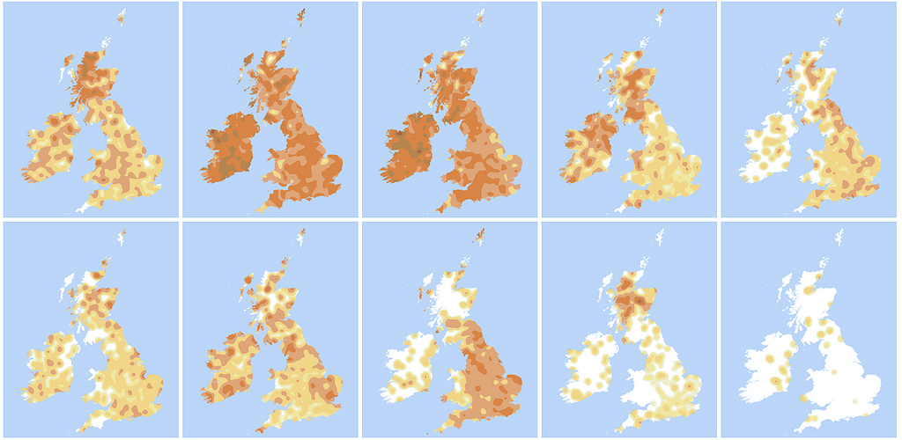
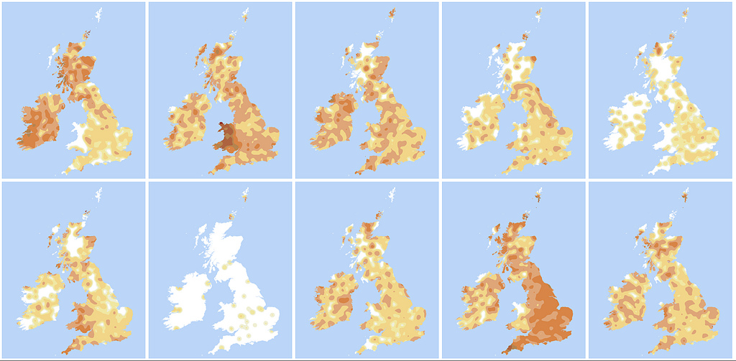
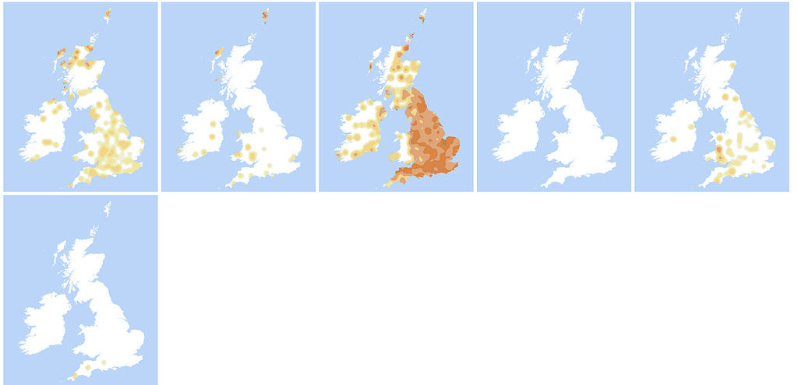
Break
Alphabet Maps of the UK and Ireland (url on site)

Slide 39
The Big Picture
Overall Goal
Build a Concordance of a text
Locations of words
Frequency of words
Today: Summary Statistics
Administrative stuff
Nitpicky Python details
A new kind of statement
Count the number of words in Moby Dick
Compute the average word length of Moby Dick
Find the longest word in Moby Dick
Get the vocabulary size of Moby Dick

Slide 40
Get the Longest Word in Moby Dick
def getLongestWordInMobyDick():
'''Returns the longest word in MobyDick.txt'''
return longestword

Slide 41
Get the Longest Word in Moby Dick
def getLongestWordInMobyDick():
'''Returns the longest word in MobyDick.txt'''
myList = readMobyDick()
longestword = ""
for word in myList:
if len(word) > len(longestword):
longestword = word
return longestword

Slide 42
Get the Longest Word in Moby Dick
def getLongestWordInMobyDick():
'''Returns the longest word in MobyDick.txt'''
myList = readMobyDick()
longestword = ""
for word in myList:
if len(word) > len(longestword):
longestword = word
return longestword
Is our program accurate?

Slide 43
The Big Picture
Overall Goal
Build a Concordance of a text
Locations of words
Frequency of words
Today: Summary Statistics
Administrative stuff
Nitpicky Python details
A new kind of statement
Count the number of words in Moby Dick
Compute the average word length of Moby Dick
Find the longest word in Moby Dick
Get the vocabulary size of Moby Dick

Slide 44
Boolean Expressions on Strings
Boolean Operators on Strings
Operator | Example | Result
Equality | ‘a’ == ‘b’ | False
Inequality | ‘a’ != ‘b’ | True
Less Than | 'a' < 'b' | True
Less Than or Equal To | 'a' <= 'b' | True
Greater Than | 'a' > 'b' | False
Greater Than or Equal To | 'a' >= 'b' | False

Slide 45
Writing a vocabSize Function
def vocabSize():
myList = readMobyDick()
uniqueList = noReplicates()
return len(uniquelist)

Slide 46
Writing a vocabSize Function
def vocabSize():
myList = readMobyDick()
uniqueList = noReplicates()
return len(uniquelist)
def noReplicates(wordList):
'''takes a list as argument, returns a list free of replicate items. slow implementation.'''
def isElementOf(myElement,myList):
'''takes a string and a list and returns True if the string is in the list and False otherwise.'''

Slide 47
What does slow implementation mean?
Re-comment the lines and run vocabSize()
  Hint: Ctrl-C (or Command-C) will abort the call.

Slide 48
What does slow implementation mean?
Re-comment the lines and run vocabSize()
  Hint: Ctrl-C (or Command-C) will abort the call.
There’s a faster way to write noReplicates()
  What if we can sort the list?
  ['a','a','a','and','and','at',…,'zebra']

