Slide 1
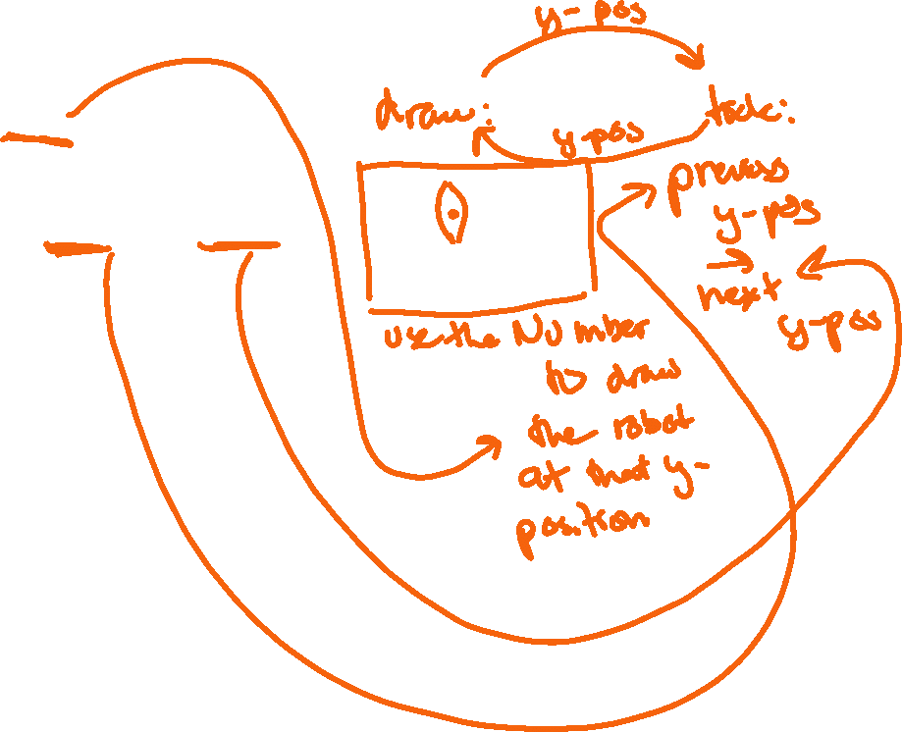
1. The changing/dynamic info (“State”) for robot was just the rocket y coordinate (a Number)
fun falling-robot(y :: Number) -> Image:
place-image(image, x, y, on-image)
end
fun update-coord(state :: Number) -> Number:
state + DOWN-SPEED
end
fun boost-robot(coord :: Number, key :: String) -> Number:
if key == "b":
coord - 40
...
end
my-reactor = reactor:
init: 0,
to-draw: falling-robot,
on-tick: update-coord,
on-key: boost-robot
end

Slide 2
2. What’s the “State” for the Pulsing Star?
data GameState:
| game(x :: Number, y :: Number, size :: Number, shrinking :: Boolean)
end
fun draw-star(gs :: GameState) -> Image:
place-image(
star(gs.size, “solid”, “yellow”),
gs.x,
gs.y,
on-image)
end
fun next-star(gs :: GameState)-> GameState:
# add code to wrap x and y back around, and to flip
# gs.shrinking between true and false
if gs.shrinking:
game(gs.x + 3, gs.y + 2, gs.size - 1, false)
else:
game(gs.x + 3, gs.y + 2, gs.size + 1, true)
end
my-reactor = reactor:
init: game(0, 0, 10, false),
to-draw: draw-star,
on-tick: next-star
end

Slide 3
Possible GameState for breakout game
data GameState:
| game(paddle-x :: Number, ball :: BallInfo, bricks :: List<Brick>)
end
data BallInfo:
| ball-info(x :: Number, y :: Number, going-left :: Boolean, going-down :: Boolean, speed :: Number)
end
data Brick:
| brick(top-left-x :: Number, top-left-y :: Number, color :: String)
end

