Slide 1
Lecture 28 helper slides debugging/tracing and loops practice

Slide 2
Using the debugger/tracer
Start the debugger by right clicking in your code window and selecting “Debug …” (green bug icon about halfway down)
In the space where your console window usually shows up, you’ll now see “Debugger” and a sequence of blue/gray arrow icons
Click in the gray area next to the line that you want to start tracing from. A small red circle should appear. This is a “breakpoint”, where Python will stop running and let you control when steps execute
Press the 180-green arrow left of debug/console to start your program running
  Python will put a dark blue highlight on the line that you told it to start from
Press the straight-down blue arrow icon in the debugger window to advance the evaluation one step. The dark blue highlight will move and the variables window will update accordingly

Slide 3
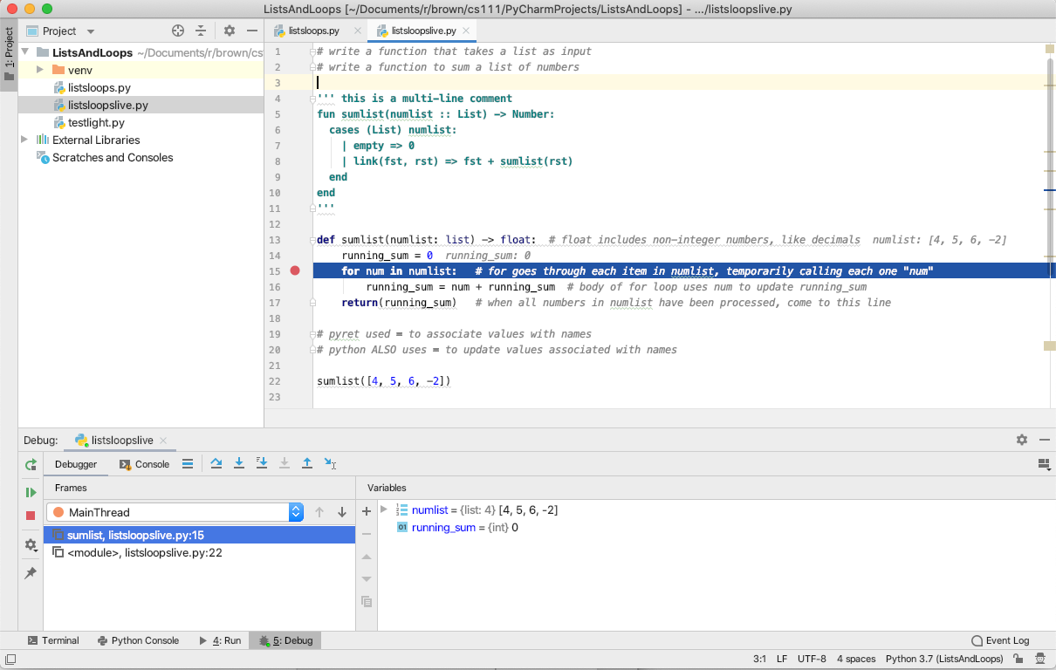
Next line of code to execute
(re)start
program
Step Over
Step Into
How to move through your code
See variable values update

Slide 4
Group work: what gets returned if return(count) goes at each of the option spots?
def z_letters(word: str) -> int:
"count how many times z is in the word"
count = 0
for char in word:
if char == "z":
count = count + 1
# OPTION 1 -- return goes here
# OPTION 2 -- return goes here
# OPTION 3 -- return goes here
# OPTION 4 -- return goes here

