Slide 1
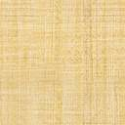
Welcome to CS 111
Computing Foundations: Data
An introduction to computing, data science, and programming for students in any concentration
Grab a seat
(or a spot on the floor)

Slide 2
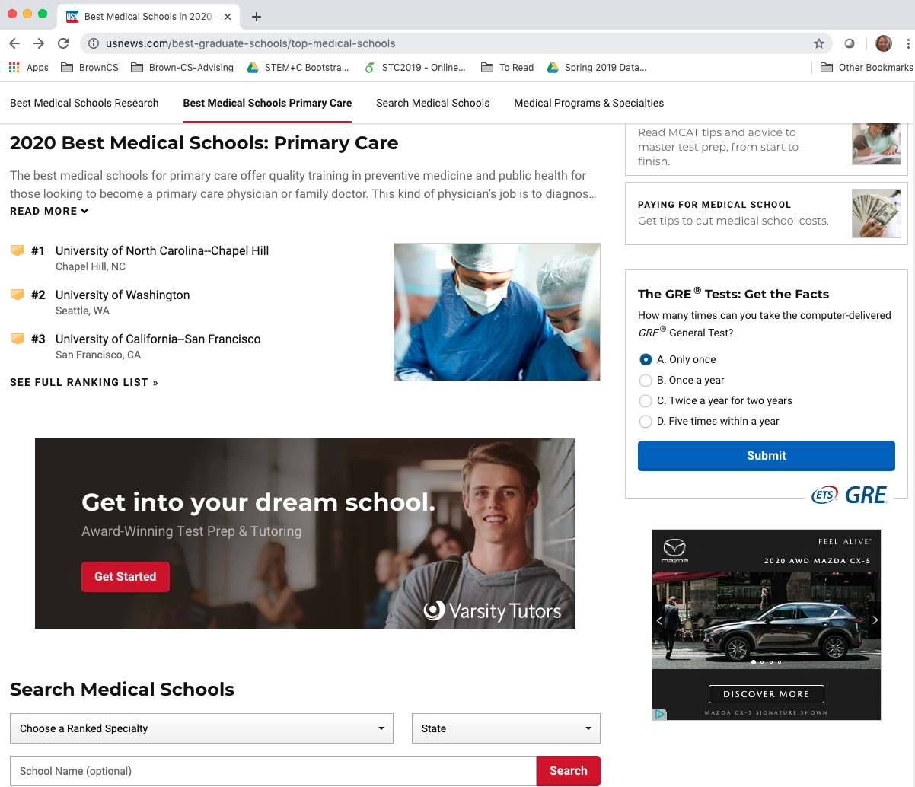
Where did building this USNews site use ...
computer science?
data science?
data management/
data engineering?
What do these terms even mean???
Notes:
https://www.usnews.com/best-graduate-schools/top-medical-schools

Slide 3






What do you notice?
What do you wonder?
Armenia
Bangladesh
Austria
Colombia
Niger
Zambia

