Slide 1

Binary Notation and Intro to Computer Graphics
Notes:
This took 45 minutes even including the demo (I used paint) and quite a number of questions.

Slide 2
Dealing with Binary
Binary numbers in their native notation are not very user friendly
Hex notation (shorthand for Hexadecimal) is an easier and more intuitive way to express binary values
Many programs and programming languages allow the use of Hex to denote binary values

Slide 3
Hex Notation using 4 bit Nibbles
Binary Hex
0000 0
0001 1
0010 2
0011 3
0100 4
0101 5
0110 6
0111 7
Binary Hex
1000 8
1001 9
1010 A
1011 B
1100 C
1101 D
1110 E
1111 F

Slide 4
Hex Example….
So the one byte Binary numbers:
  0010 0001 = 21 Hex = 33 Decimal
  Or 128 + 64 +32+16 +8+4+2+1
  1010 0100 = A4 Hex = 164 Decimal
  Or 128+64+32+16+8+4+2+1

Slide 5
Remember……
DIGITAL - Digital means discrete.
Digital representation is comprised of a limited number of data points to encode information.
Our electronic devices use Digital techniques to work with data and information
Since we have a limited number of data points to work with, it means that all digital representations are approximations of the real thing

Slide 6
Representing Digital Samples
The values associated with Digital Samples are stored in Binary form, which is a very easy and inexpensive way for electrical machines to store and manipulate values by using simple building block electronic circuits built out of transistors
So, you should think of a computer or any digital device as a machine that can store, manipulate and move large amounts of binary information at very high rates of speed

Slide 7
Graphics Buzzwords
Pixel-
a spatial sample of a digital image. A pixel element is the basic component of a digitized image, which contains a set of numbers representing the features (color, intensity) of that spatial sample (a pixel may only have ONE color and intensity, therefore it is the lowest element of an image)
Bitmap-
a method of representing and storing digital images and graphics whereby the image is composed of a collection of individual pixels

Slide 8
More Buzz
Resolution-
The capacity for detail contained in a message or signal. Representations with high resolution capture more detail than those with low resolution
In the case of digital images, resolution is primarily determined by :
Number of pixels
Size of Pixels
Density of Pixels

Slide 9
Digital Images and Pictures
A picture (as on your computer monitor) consists of many “pixels”
(= “picture element”). A pixel is a very small area of uniform color and intensity. Think of your laptop monitor as consisting of over 1,000,000 discrete small squares, or pixels.

Slide 10
Bitmap Graphics
To display things on the computer monitor, a modern-day computer has built in hardware (memory) for storing a “bitmap” that represents the “picture” that should be displayed on the monitor.
The Bitmap is stored in MEMORY…..the more bits stored, the more memory required….

Slide 11
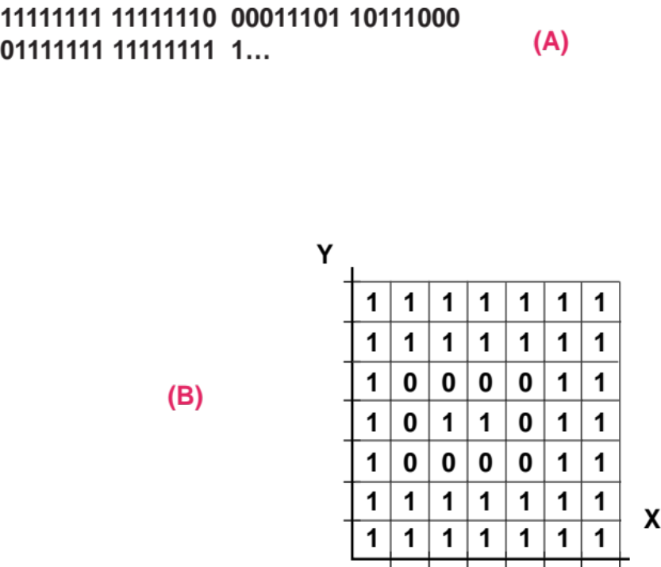
Graphic images
(for display) graphic images are composed of pixels
this type of graphic is called bit-mapped or raster graphics
the image is stored as a sequence of bits (a) representing the pixel properties (b)

Slide 12
Resolution
This is a very low resolution (3 pixels by 4 pixels) picture of the letter “Y”.

Slide 13
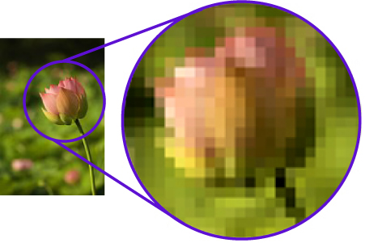
A magnified bit map

Slide 14
Red, Green, Blue RGB
RGB color values are supported in all browsers.
An RGB color value is specified with: rgb( RED , GREEN , BLUE ).
Each parameter defines the intensity of the color as an integer between 0 and 255.
For example, rgb(0,0,255) is rendered as blue, because the blue parameter is set to its highest value (255) and the others are set to 0

Slide 15
Color Levels of Intensity
For a black and white (Grayscale) picture we might use, say, 8 bits (one byte) to represent 256 levels of intensity, from 0 (black) to 255 (white)
For a color picture for each pixel we would have 3 bytes, one each for the intensity of red, green, and blue respectively
(0,0,0) would still be black, while (255,0,0) would be red, (255,255,255) is white, etc.
This is commonly called RGB (Red, Green, Blue)
RGB typically uses 3 bytes (24 bits) for each pixel so that equates to 16,777,216 different possible colors

Slide 16
Demo using RGB Color Picker
https://www.rapidtables.com/web/color/RGB_Color.html

Slide 17
Image Resolution
Resolution (Accuracy) is determined by two primary factors, pixel size and number of pixels
Higher Resolution renders an image with greater accuracy for any given size
Resolution is directly proportional to number of bits used for storage (memory)
Color accuracy is also proportional to memory as is brightness and contrast since their values must also be stored for each pixel
There is a delicate balance between image size and apparent resolution

Slide 18
Advantages of Bitmap Graphics
It is easier to create hardware to go from a bitmap representation to the actual display on the monitor (which is why monitors use bitmaps)
It is easier to draw pictures of things with imprecise boundaries, (or that consist of so many parts it would not be feasible to draw them all)
Your PC utilizes Bitmap Graphics to display everything that appears on your screen
Ability to create multiple layers which can be overlayed to create composites

Slide 19
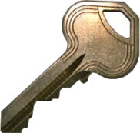
Original Image

Slide 20

Magnified

Slide 21
Vector Graphics
An alternative scheme for representing images is called “vector graphics” In vector graphics objects are represented explicitly.
This picture might be represented as:
square at (1,1) height 3, width 2 color red
line from (1,2) to (10, 7) width .1 color blue

Slide 22
Vector Graphic Images
Object-oriented or vector graphics treat the image as a collection of graphic objects such as lines, curves, and figures
Best rendered on special vector graphics machines
Vector graphics are resolution independent and highly scalable
Vector graphics are easily edited and often more compact in storage
Vector graphic images must often be converted to bitmapped images for display on bitmapped systems such as a PC

Slide 23
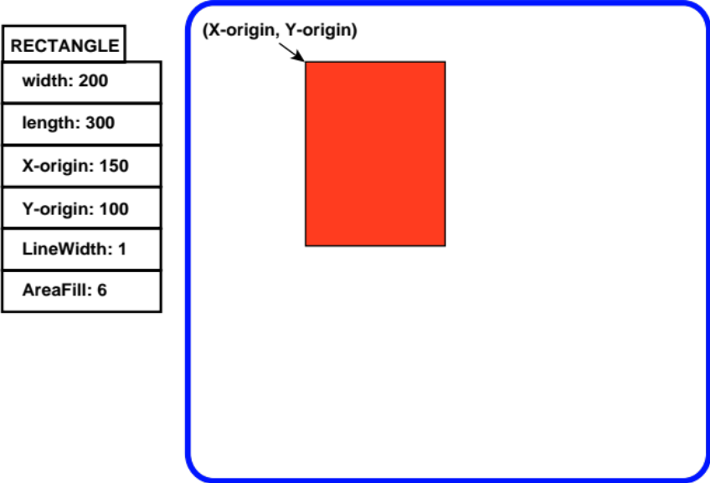
Vector Graphics
the image is composed of graphic objects (lines, curves, figures, etc.)
each object is defined by its graphic properties
these properties may be changed and scaled easily

Slide 24
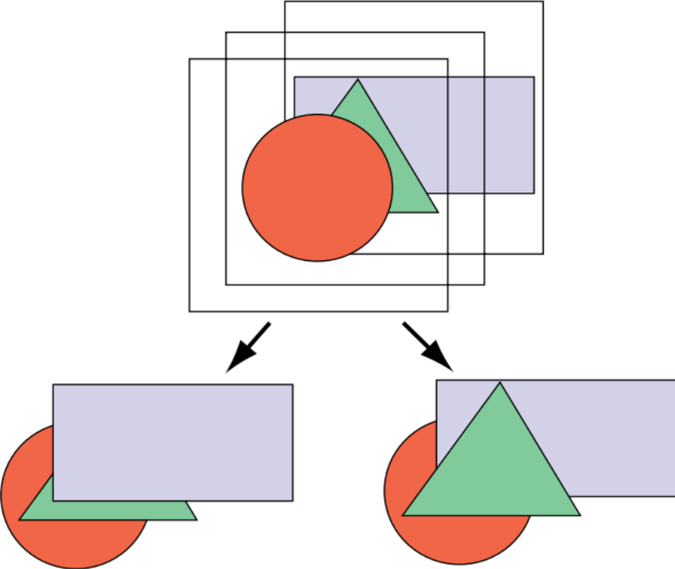
Vector Graphics
each object occupies a separate layer
layers may be moved, scaled, and arranged in different orders
objects may be deleted and inserted easily

Slide 25
Advantages of Vector Graphics
Because the program “knows” there is a square, it can do things like rotate the square, enlarge it, paint it a different color, etc. These things are not directly possible in bitmap graphics because there we simply have small bits of color at particular locations. There is no knowledge of what the color “represents.”

Slide 26
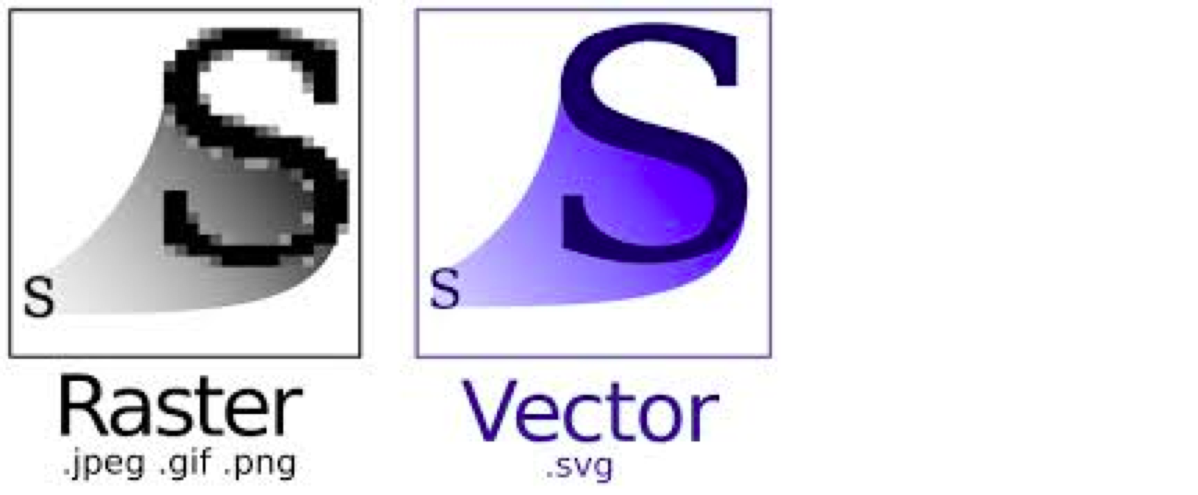
Magnified

Slide 27
Side by side Bit Mapped and Vector Graphics Demo

Slide 28
Typical Graphic Applications
Bit-mapped graphics
Vector graphics
Painting programs
Image processing
Text displays
Computer Aided Design
Illustration
3-D modeling and rendering
Animation
3-D Games and Simulations

Slide 29
Graphics Summary
Bit map graphics dominate due to their implementation on PCs (low cost)
Pure vector systems (hardware and software) used for specialized applications where image quality and accuracy is the most important objective
Vector graphics can be simulated on Bit Mapped Systems (such as the demo shown in lecture)
Lots of work and fun can be achieved with both
https://www.makeuseof.com/what-is-vector-file/

Slide 30
Millionaire Quiz!

Slide 31
Questions?

Slide 32
t

