Slide 1
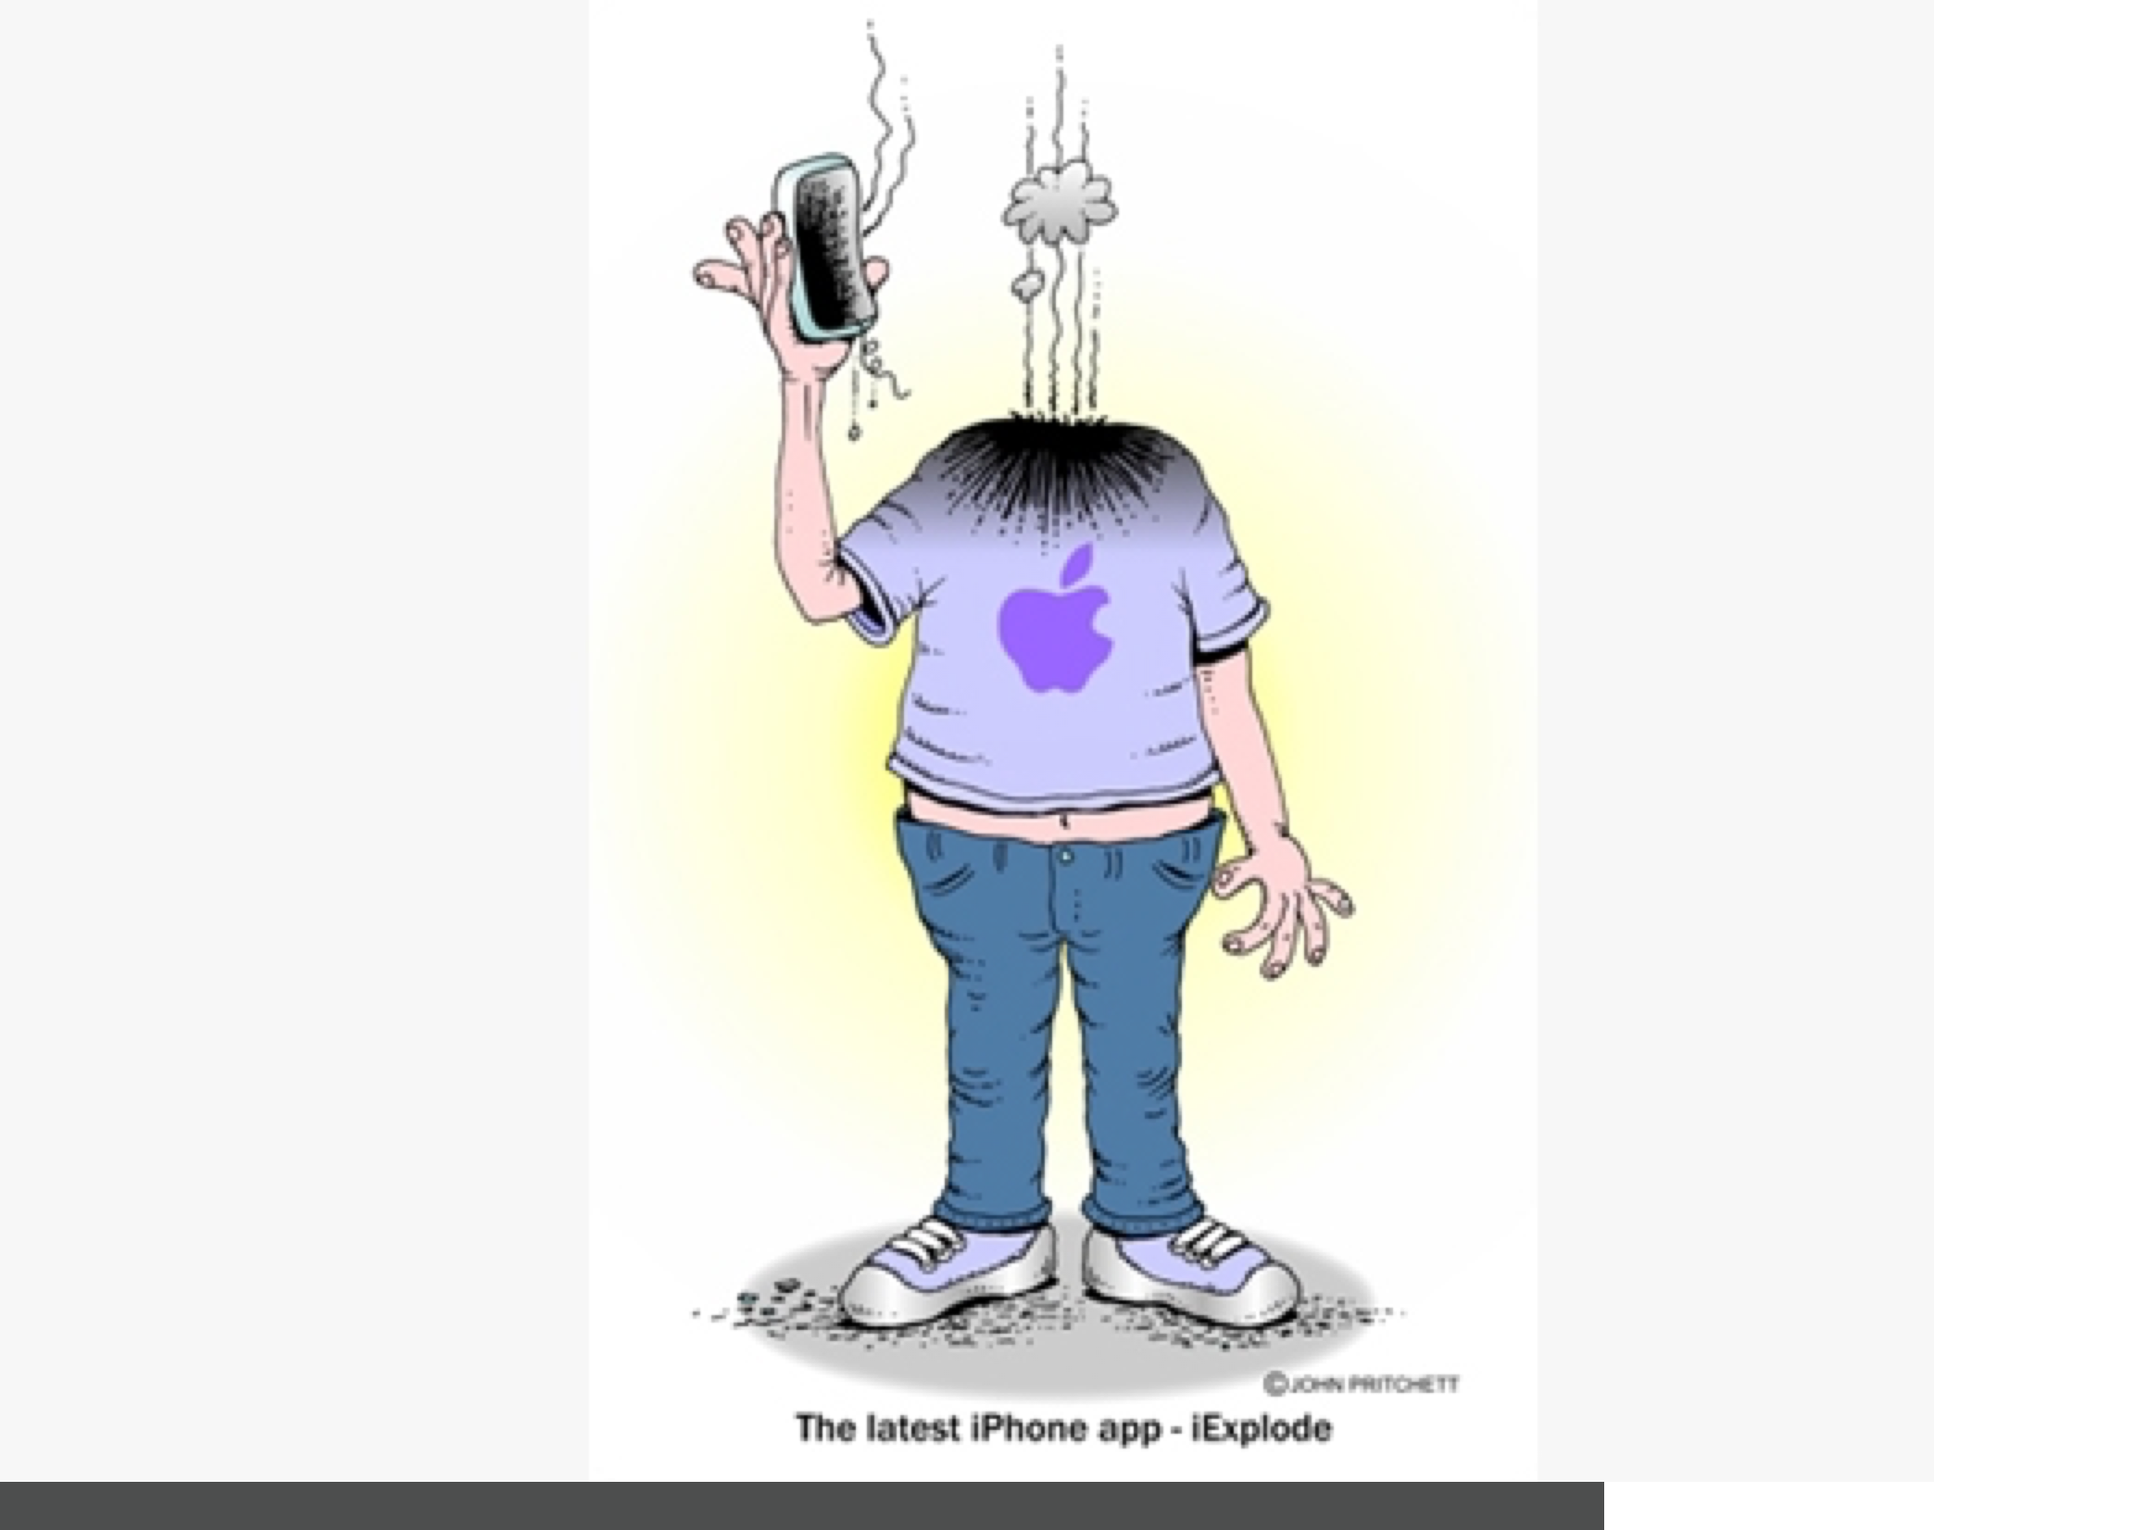

Slide 2
Secondary Memory, Storage, Peripherals and Input /Output
Lecture 6

Slide 3
The Uber Stack
Applications
Middleware
Operating Systems
Computers
Processors | Memories | Display Components | Interconnects
Materials
Physics
Notes:
Fed from developments in lowest and highest levels
Even if you don’t remember the past, you are condemned to repeat it…
What is the cycle time?

Slide 4
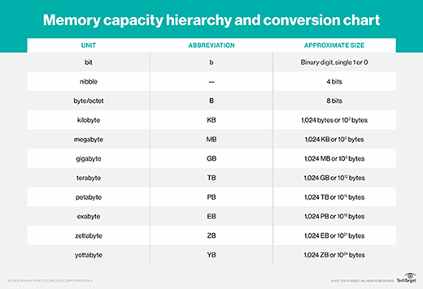
Werner Buchholz is credited by Fred Brooks -- author of the classic software engineering tome The Mythical Man-Month: Essays on Software Engineering and an early IBM hardware architect and IBM System/360 OS project manager -- as the originator of the term byte. According to Brooks, Buchholz came up with byte while helping to design IBM's first transistorized supercomputer, the 7030 STRETCH, in 1956.
Terabyte vs. other byte measures
Measurements that are smaller than a terabyte include a kilobyte, megabyte and gigabyte.
A terabyte is one of the largest units of storage media that products on the market use today, but it is not the biggest unit of measurement in data storage. Units larger than a terabyte include a petabyte, exabyte, zettabyte, yottabyte and brontobyte. A geopbyte is also larger than a terabyte and refers to 10³⁰ bytes, or 1,000 brontobytes.
Additional units of measurement become necessary as the amount of data in the world increases. And it'sdown any time soon. Actual drive capacity may not currently go beyond the terabyte scale, but this will undoubtedly change as storage media technology evolves.
To further explore TB vs. GB and how other units compare, refer to the below chart.

Slide 5
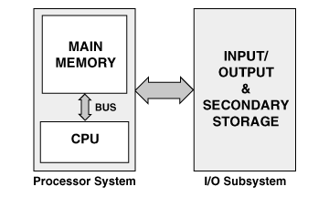
Von Neumann Architecture
based on stored program design
processor system
  CPU
  memory
input/output system
  input/output devices
  storage
Peripherals
Just about everything outside of the CPU/Main Memory falls under the general classification of an “I/O or Peripheral Device”

Slide 6
I/O Subsystem
Input/Output
  exchanging data and instructions between
  the user and the computer
  The user may be a human being, but it may also be a machine….like a car engine or a valve in a nuclear power plant
Storage (Non Volatile)
  auxiliary storage for data and instructions

Slide 7
Storage Systems
Backup or alternative storage in place of (volatile) RAM
cheaper, mass storage for long term use
storage devices (and media) are distinguished by their capacities, speed, and cost

Slide 8
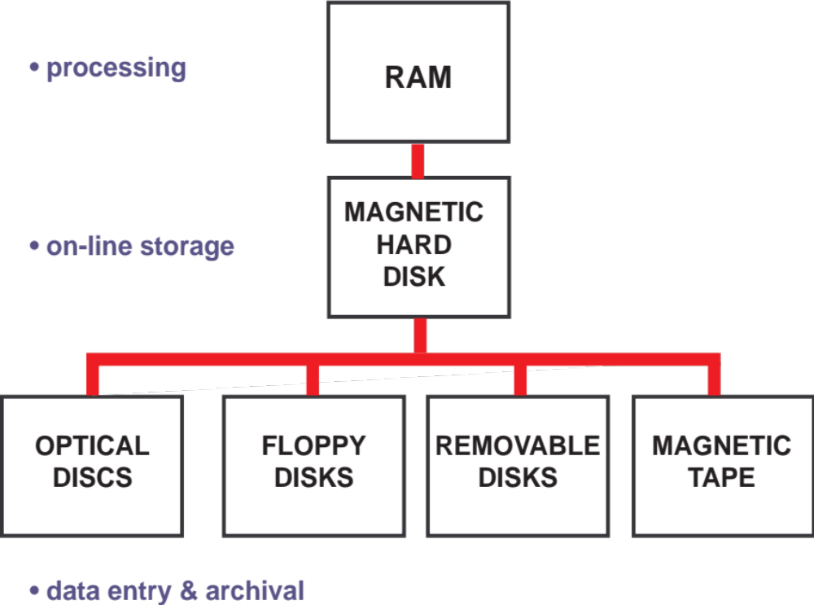
Memory Storage Systems
Flash Memory

Slide 9
Types of Access
RANDOM ACCESS (Main Memory, Flash)
  items are independently addressed
  access time is constant
DIRECT ACCESS (Disc Drives)
  items are independently addressed in regions
  access time is variable—though not significantly
SEQUENTIAL ACCESS (Tape Systems)
  items are organized in sequence (linearly)
  access time is significantly variable

Slide 10
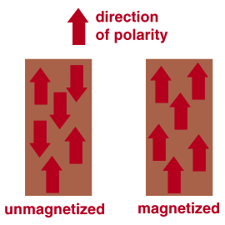
Magnetic Tape-Sequential Access
stores data represented by magnetized particles in linear tracks
magnetized clusters or domains are aligned to represent binary codes

Slide 11
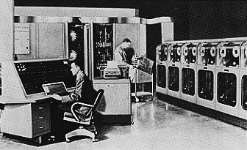
Tape Drives in action…1950’s-70’s

Slide 12
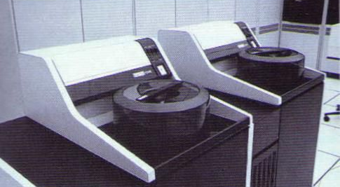
Disk Drives circa 1980
66Mb 400 lbs! $40,000 each

Slide 13
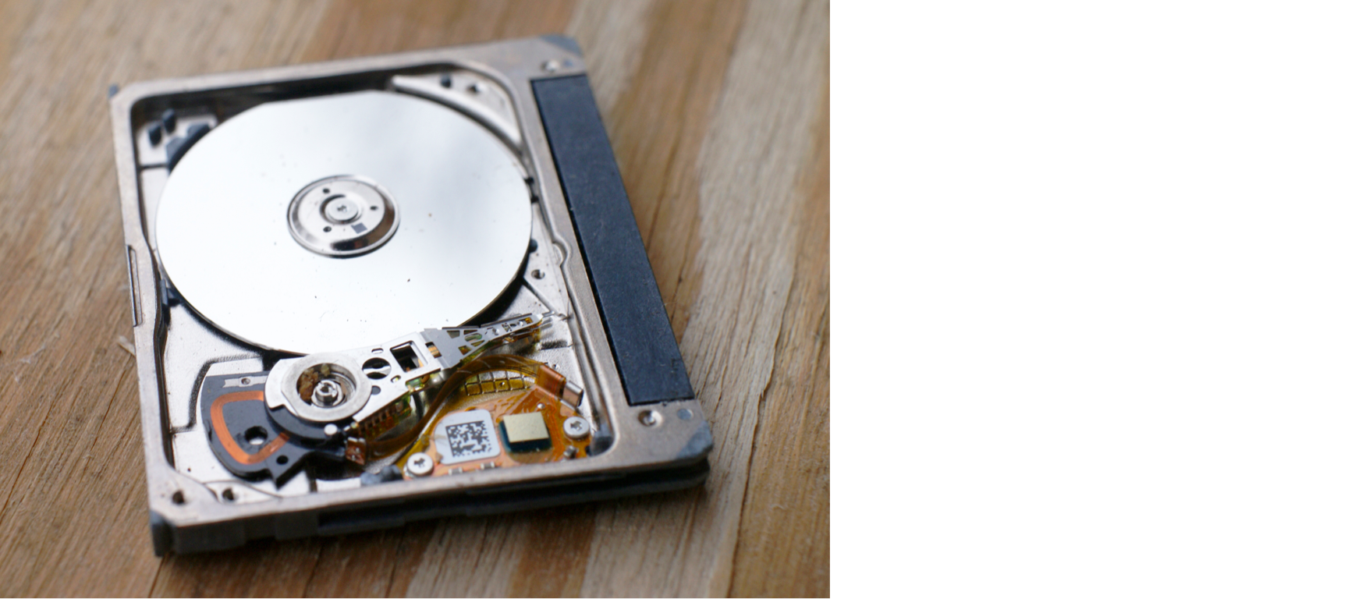
Micro Drive
1” disk capable of storing 64 GIGABYTES
Spinning at up to 7200 RPM!

Slide 14
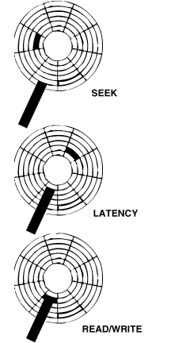
Direct Access
SEEK — controller advances read/write head to proper track
LATENCY — waits for proper sector to rotate under head
READ/WRITE — disk head scans the sector for read or write

Slide 15
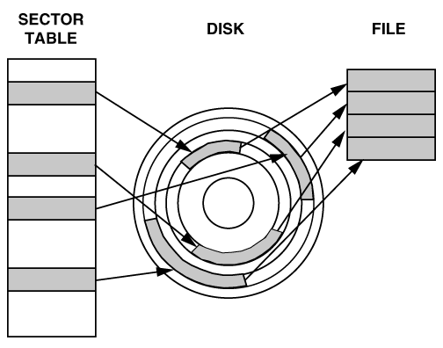
Disk vs. File Organization
data is stored in blocks
blocks occupy sectors
sectors on tracks
files have names
files are indefinite in size
files may be updated (in part or whole)
Files may become fragmented over time, which causes data transfers to slow down

Slide 16
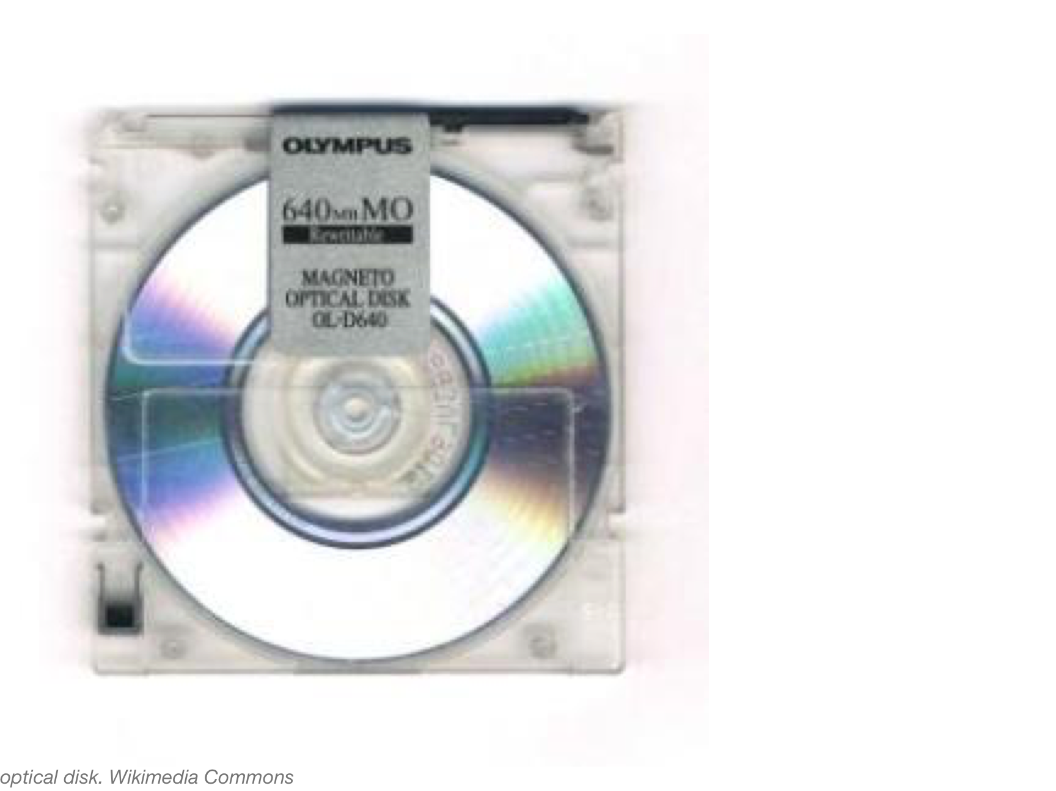
Optical Disk

Slide 17
Optical Discs
Compact Disc–Read Only Memory (CD-ROM)
  archived and published information
  Relatively high capacity (650 Mbytes)
Compact Disc–Recordable (CD-RW
  recordable
  readable using CD-ROM technology
Digital Versatile Discs (DVD)/DVD-R)
  Very high capacity, storages (5-15 Gbytes)
  Multiple Layers, tighter spacing in the same size as CD
  And then…
  BLUE RAY (3-10 times the capacity of today’s DVDs)

Slide 18
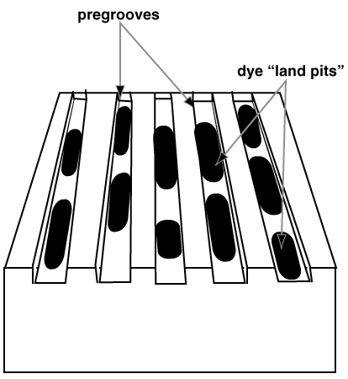
Optical Drive Reading and Writing
discs are “burnt” one at a time
high intensity red
or blue laser beam used for reading/ recording pregrooved tracks
low intensity beam for reading/ higher intensity for burning

Slide 19
Flash Memory
Non Volatile Memory
Small, Convenient and Reliable
Random Access
Relatively expensive in terms of cost/Mb compared to Dynamic RAM
Not as fast as Dynamic Ram
Prices dropping every day, capacity increasing!

Slide 20
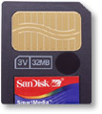
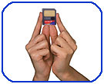
Flash Card
64 Gigabytes on a chip...and growing!

Slide 21
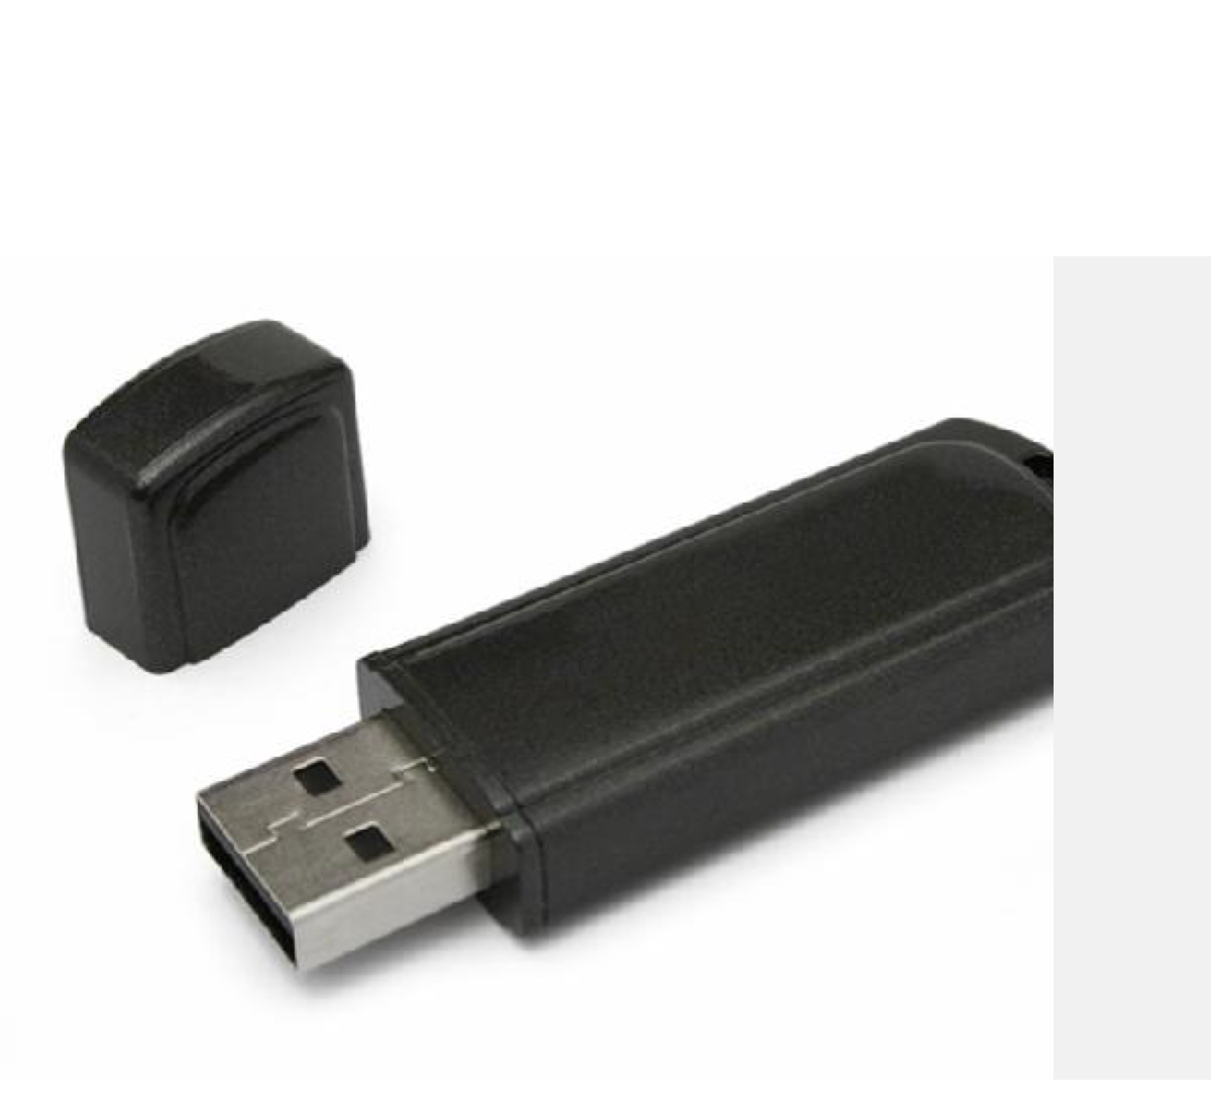
USB Flash Drive
128 GB
for $13!

Slide 22
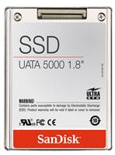
The future disk technology
Looks like a hard drive storage unit — but there are no moving parts inside. More and more systems are replacing magnetic discs with SSD

Slide 23
Data Input Peripherals
keyboards
mouse(s)
scanners
digital cameras and imagers
microphones and sound digitizers
Video digitizers
Sensors (temp, pressure, humidity, vibration, speed, chemical, etc, etc,)
Switches
Secondary Storage Devices
Network Connections (Modems)

Slide 24
Output Peripherals
Video output displays
  Color LCD predominately
Printers
  character, line, and page(laser)
Audio output
Secondary Storage Devices
Network Connections

Slide 25
Connecting all this stuff
Parallel Bus
  Contains many signal paths for very fast data transfer
  Bulkier, expensive cable and connectors
  Limited distance capability
Serial Bus
  Limited paths
  Lower cost, lower size, lower weight
  Longer distance (generally)
Wireless
  Wi-Fi and Bluetooth

Slide 26
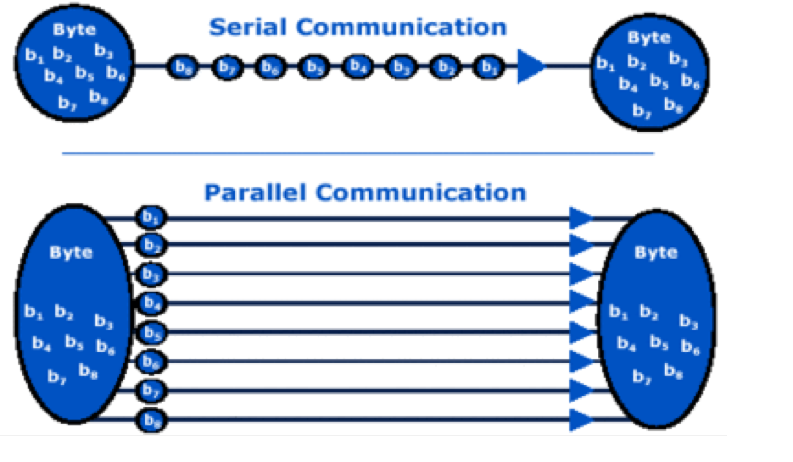
Serial vs. Parallel Data Transfer

Slide 27
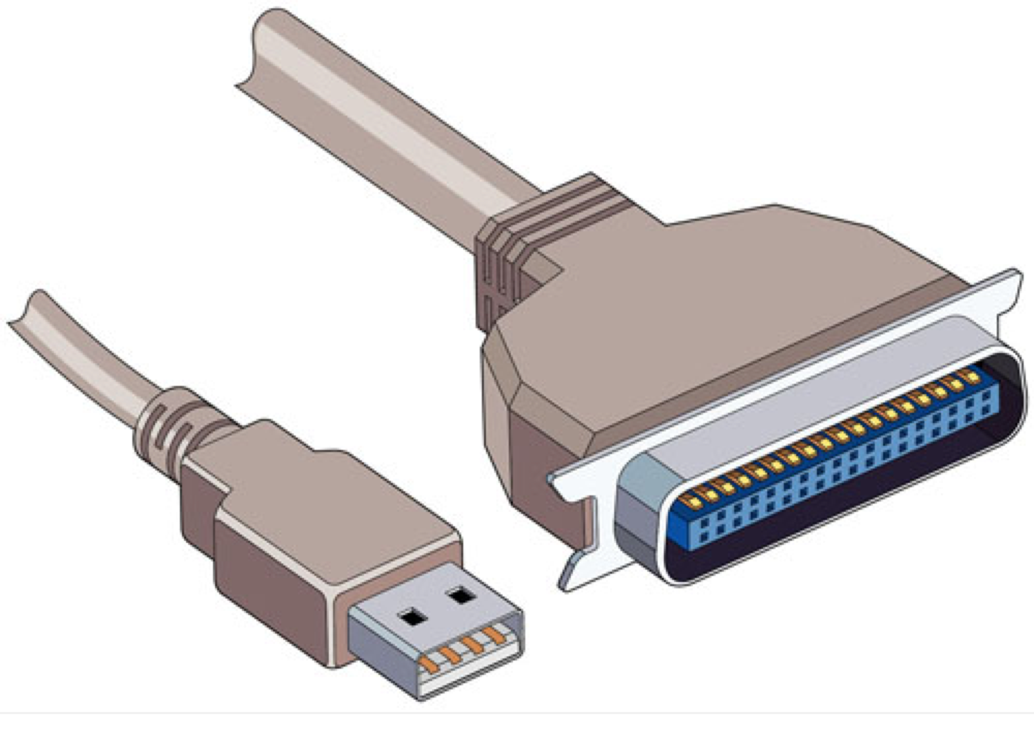
Serial vs. Parallel Connections

Slide 28
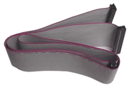
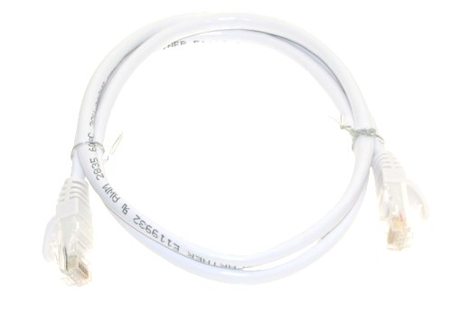
Parallel / Serial Bus
Flat Parallel Computer
Cable
Serial Computer Cable

Slide 29
Where are parallel busses used?
All of the paths inside the CPU and between the CPU, main memory and video processor are implemented using parallel busses for the very fastest transfer rates.
Any plug in cards use parallel busses as well as internal magnetic and optical disk drives.
Most of these busses are either 16, 32 or 64 bits wide

Slide 30
Where are serial busses used?
Serial busses are primarily used to connect external devices and peripherals. The data transfer rates of peripherals connected via serial are generally slower than those connected by parallel.
Serial is convenient, relatively inexpensive and getting faster all of the time.
The current serial standard for peripherals is called USB 2.0 and USB 3.0

Slide 31
USB 2.0
Max transfer speed of 400Mbps (Megabits per second), 40 times faster than the predecessor USB 1.1
Supports up to 127 devices connected to the same controller chip!
A USB cable can be 5 meters long without causing any performance problems
USB has become the ubiquitous serial connection standard for practically every external PC peripheral

Slide 32
USB 3.0!
Standard introduced in 2008
Up to 5 Gigabits per second!
10 times faster than USB 2.0

Slide 33
USB 4.0
Introduced at the end of 2020
Up to 40GBps!

Slide 34
Apple’s Thunderbolt
“The most advanced I/O EVER!” per Apple
Supports high resolution video and high performance data transfers through a SINGLE compact port
Up to 20 Gb/sec transfer speed!
40 times faster that USB 2 and 4 time faster than USB 3. Compatible with USB 4.0

Slide 35
Clocking Data on the Bus
Both serial and parallel busses transfer data using a clock signal that ensures that data is sent and received at certain times based on the clock speed.
Without the clock, data transfers would be less reliable given the variation in cable length and other environmental factors

Slide 36
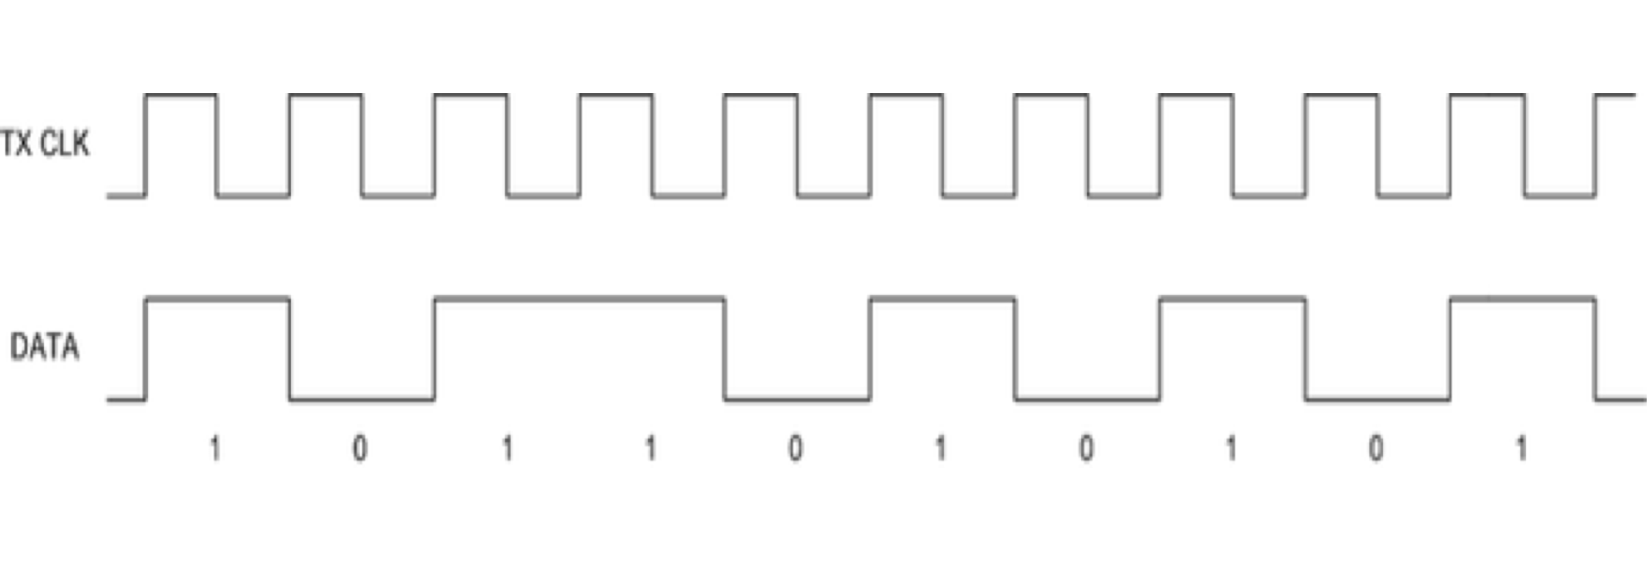
Clocking Data

Slide 37

Wireless Connections

Slide 38
Wireless I/O
Wifi: Wireless local area network (LAN) technology that uses Internet Protocol to transfer data between devices. Latest generation (n) operates at >100 megabits/second and has an indoor range of about 150 ft.
Bluetooth: Personal area network (PAN) Very low power with range of <20 ft in most applications and speeds of 80 kilobits/second

Slide 39
I/O Example using a car climate control system
Fan
Compressor
Touchscreen
Flash Memory
On/Off Switches, Temperature, Humidity Sensors

Slide 40
Questions?

