Slide 1
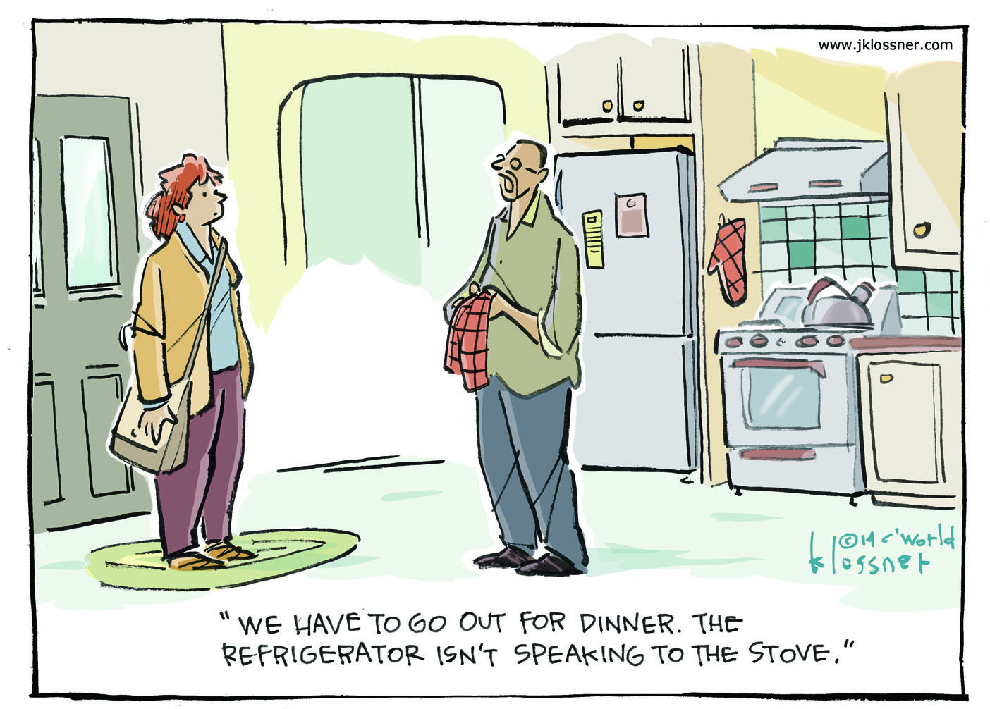

Slide 2


Pervasive Computing aka
“The Internet of Things”
With slides contributed by Uğur Çetintemel

Slide 3
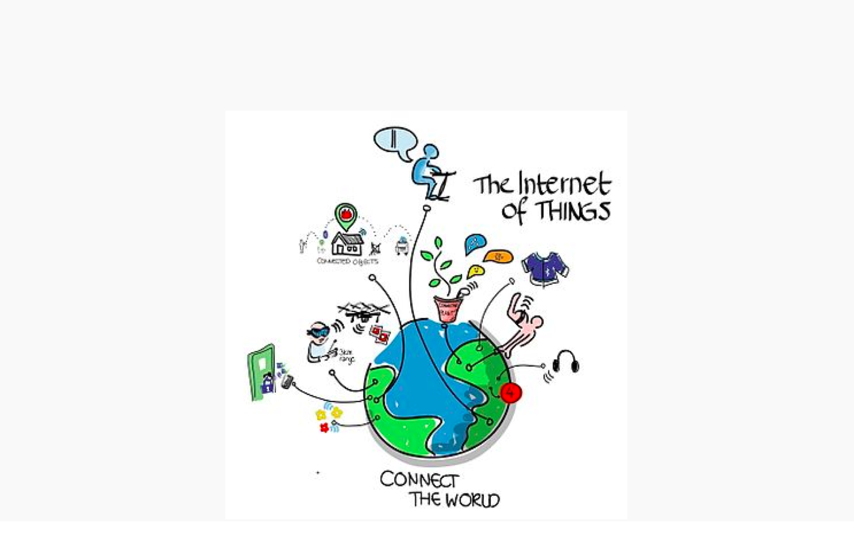
The Internet of Things - IoT

Slide 4
What is Pervasive Computing / IoT?
Numerous, easily accessible, often inconspicuous computing devices and sensors/effectors
Often mobile or embedded in the environment
Connected to an increasingly ubiquitous network structure
In some cases, Connected to existing systems

Slide 5
For the IT Industry
Pervasive Computing is rapidly emerging as the next generation in computing
Failure to act upon this trend may be a very costly
If history holds, the innovative firms which establish a critical mass early in the generation life cycle are the ones with superior returns on investment

Slide 6
For the Computer User
Simplicity of use
Ubiquitous access
Minimal technical expertise
More intuitive interaction
Reliability

Slide 7
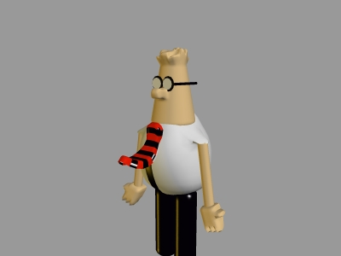
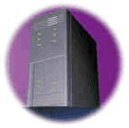
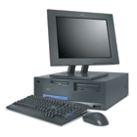
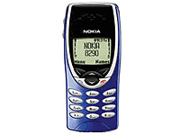
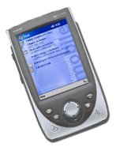
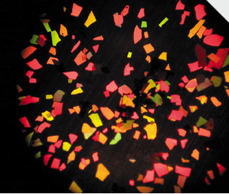
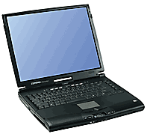
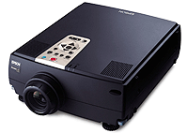
Trend towards Pervasive Computing
size
one computer, many people
one computer, one person
one person, many computers
smart dust
number

Slide 8
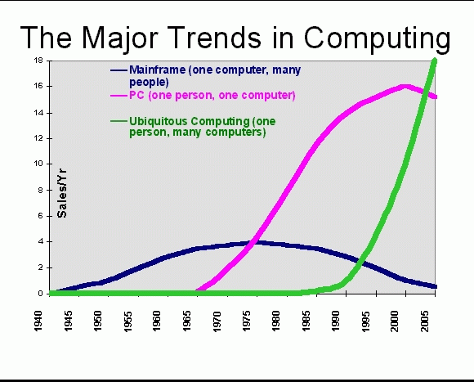
Sales Confirm this Trend!

Slide 9
Growth of Internet Connectivity
machine-to-machine
Embedded
Internet
people-to-machine
Mobile
Internet
people-to-people
WWW
Email
research
network
Internet timeline

Slide 10
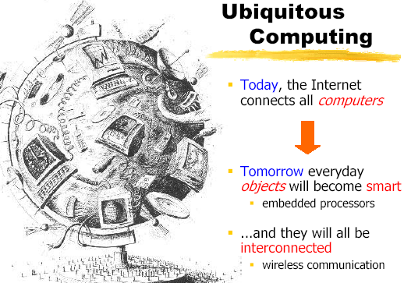
Where are we going?
Today
“all computers are connected via the Internet”
Tomorrow
“everyday objects will become smart”
  embedded processors
“...and they will be increasingly interconnected”
  wireless communication

Slide 11
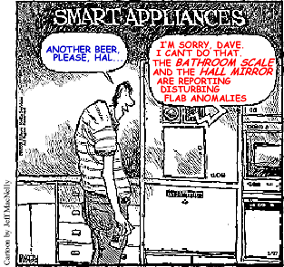
Smart Everyday Objects, Interconnected…?

Slide 12
The Real Thing
Natural technology trends
  Computation is becoming essentially free
  Communication is becoming ubiquitous
Smart devices
  Huge numbers of computing devices in the world
  What are we doing with them?
Modes of operation
  Programs controlling other programs
  Human-in-the-loop: “computing should be only as visible as I desire; no more, no less...”
Content Delivery
  Anything I am entitled to see or hear, always available

Slide 13
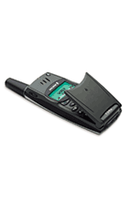
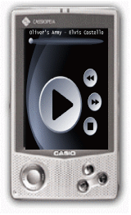

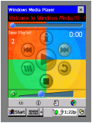
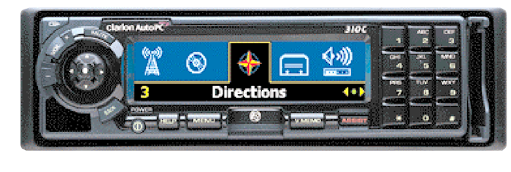
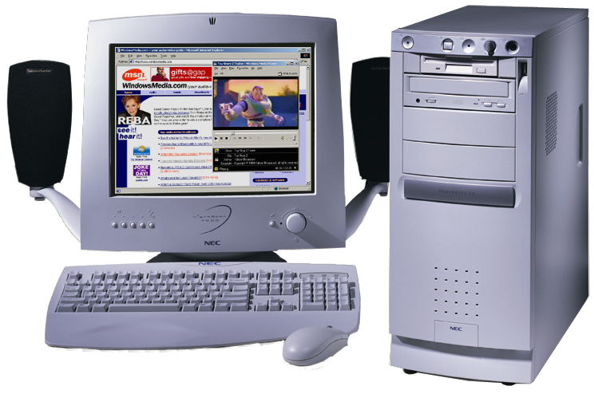
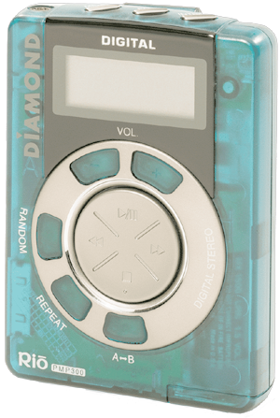
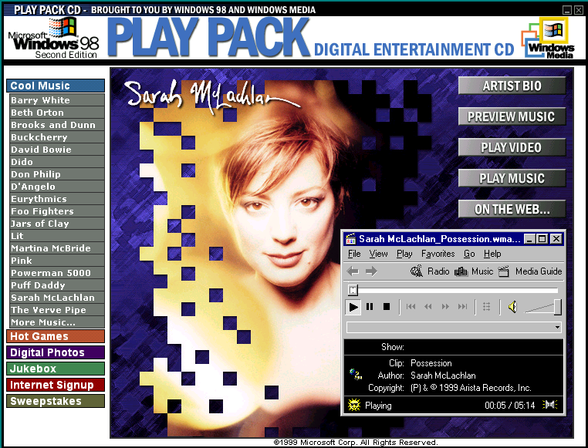

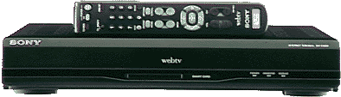
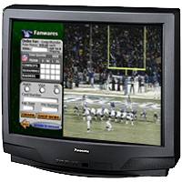
Digital Media World
Many devices
Wired or wireless
Access from anywhere
Intuitive User interface
Personalized delivery
What you want, when and where you want it..
Content Rich Services

Slide 14
Content is driving the imperative!
Bandwidth (wired and wireless) will continue to increase at decreasing cost
Computing power will continue to grow at decreasing cost
Bandwidth and computing power are quickly becoming (or have already become) taken for granted and commoditized in the value chain
CONTENT that takes advantage of bandwidth and computing power will drive the value chain in the future and justify future investments in broadband capacity

Slide 15
Mobility
Consumers increasingly want to access any content that they are entitled to receive anywhere, anytime on an increasing number of devices, on their schedule, not someone else's
  Example: Time shifting using DVRs (TIVO) is the way to watch TV at home.
The current trends in wireless broadband (4G/5G) enable unicasting/broadcasting of high quality digitally compressed content at over 100Mbits/sec to consumers who are traveling at speeds as fast as 120mph

Slide 16
Mobile is taking over
“The Numbers Are Clear: Mobile Is Taking Over The World
The unstoppable growth of mobile connectivity is linking virtually the entire human population - and that will re-construct how people around the world engage in shopping, banking, entertainment, work, healthcare and learning.”
6.8 Billion Subscribers!!

Slide 17
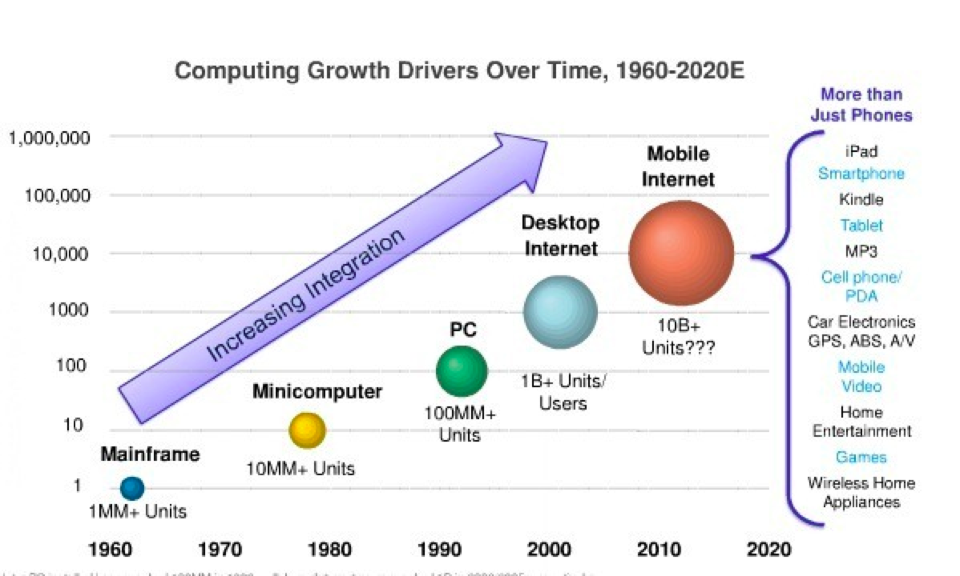
Computing Growth Drivers

Slide 18



How is all these possible?
Moore’s Law (1965)
Improved communications technology
IPV6
Decreasing Cost…driven by
#1 above
and massive adoption

Slide 19
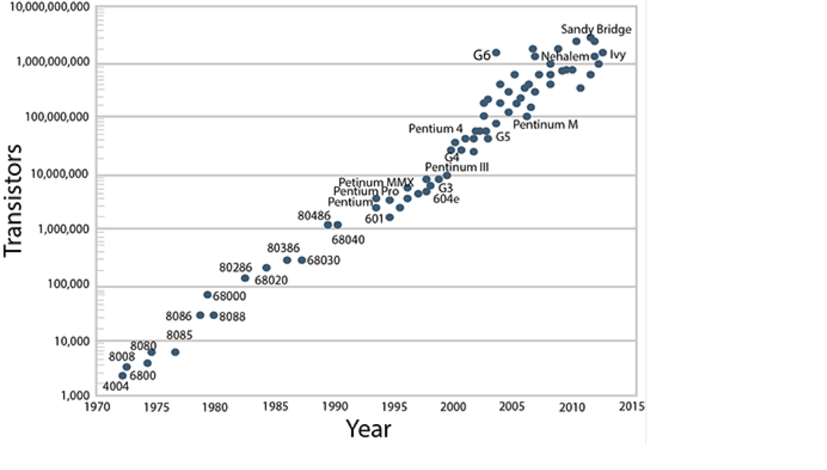
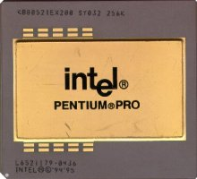
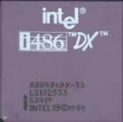
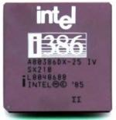
Transistors per Integrated Circuit Processor

Slide 20
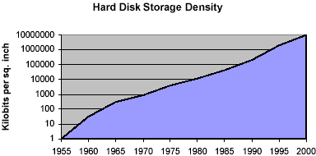
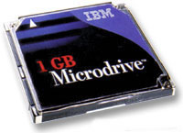
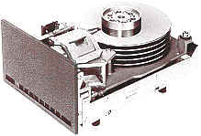

Storage Density

Slide 21
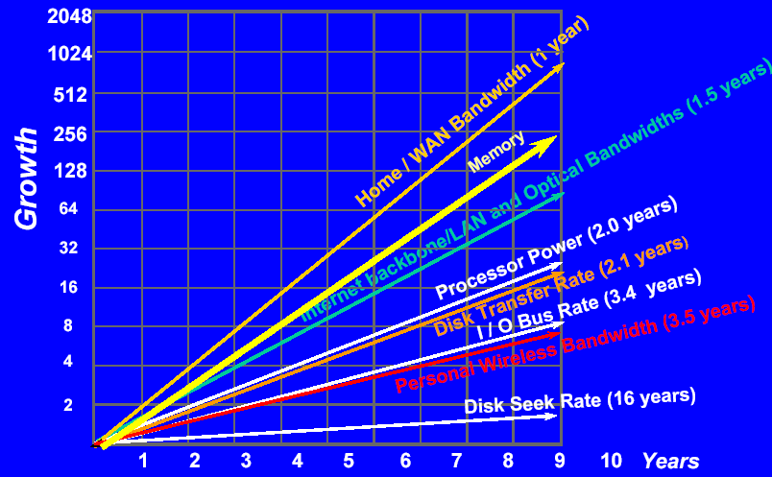
Growth Speed of Key Technologies Obeys Moore’s Law

Slide 22
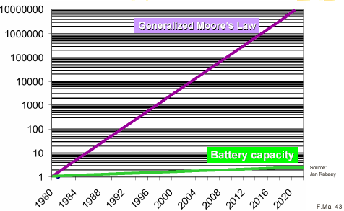
Not Everything Obeys Moore’s Law
Power Consumption, not speed, is a key issue for future processor design!

Slide 23
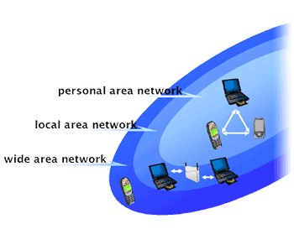
Progress in Communication Technologies
Fiber optics: Gbit/s to Tbit/s
Wireless
  WAN: mobile phone: GSM, GPRS , 3G, 4G, 5G
  LAN: 802.11, HiperLan (> 10 Mbs)
  Personal Area Networks (PANS): Bluetooth (700Kbs), IR
  Body area networks (2400baud)
Powerline technique
  coffee maker “automatically” connected to the Internet

Slide 24
Example: Smart Dust
Autonomous sensing and communication in a millimeter – “dust motes”
  Sensors for temperature, humidity, light, motion
  Direction, tilt, video, orientation
With bidirectional radio or laser + battery
Costs < $1
Typical Applications
  Defense related battlefield sensors, motion detectors etc.
  Inventory control on boxes which communicate with crates, trucks, plane etc to tell you where they are
  Product quality monitoring – vibration, humidity, overheating

Slide 25
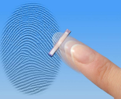
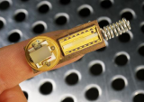
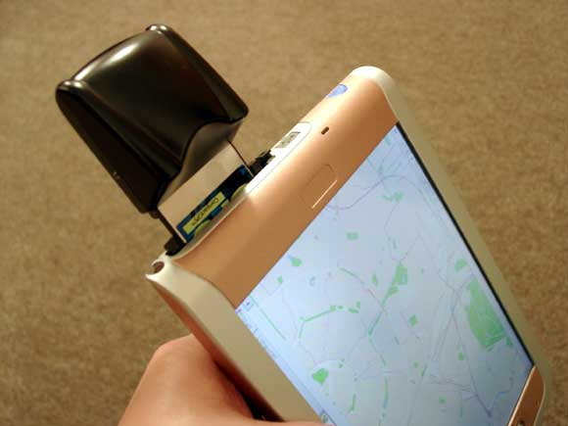
Sensor Technology
Miniaturized cameras, microphones
Fingerprint sensor
Radio sensors (RFID)
  without power supply
Location sensors
  GPS
…

Slide 26
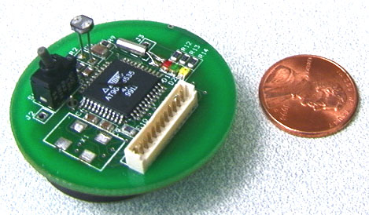
Example: Motes
Manufactured by Crossbow
http://www.xbow.com
Processor: 4MHz
RAM Memory: 128 Kbytes
On-Board Flash: 512 K bytes
Radio: 916 Mhz, 52K bps
Antenna: On-board, optional external
TinyOS from Berkeley

Slide 27
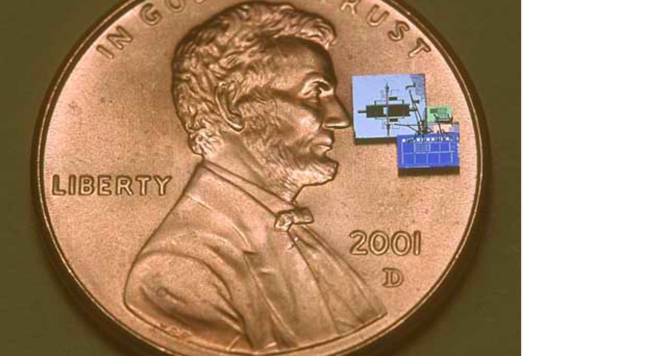
Getting smaller all the time!

Slide 28
Computer Science Challenges
Almost all domains are affected
  systems infrastructures, networking, security, user interfaces, programming paradigms, embedded systems, AI, speech recognition, …
Many new research and technical challenges emerge!

Slide 29
From the very large to the very small…….

Slide 30
Cloud Computing
While computing is getting smaller, it’s also getting BIGGER!
Cloud Computing is “Timesharing for the 21st Century”
Provides shared resources at “lower” cost and faster abailability….

Slide 31
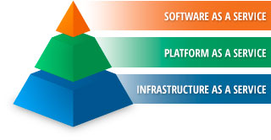

Slide 32

Infrastructure as a Service (IaaS)
Fundamental computing resource provisioning
  Server hardware, storage, networking, OS, DB, CPU, Memory, Virtual Machines
Service provider owns assets, is responsible for facilities, running and maintaining system solution
Commercial Industry
  All computing resources combined as a single resource pool allocated on demand
  Examples:
    Amazon Compute Cloud (EC2)
    Amazon Simple Storage Service (S3)
    IBM SmartCloud Enterprise
    DropBox

Slide 33
Platform as a Service (PaaS)
Delivery of a computing platform and solution stack as a service
Commercial Industry
  Enables users to create cloud based applications
  Utilities, network, security, storage, cpu, server, OS combined as part of a platform via a higher layer of utilities, an encapsulation of IaaS capabilities
  Examples:
    Google AppEngine
    Microsoft Windows Azure
    Microsoft Office 360

Slide 34
Software as a Service (SaaS)
Applications available to service consumers
via browser-based interfaces
Applications run on cloud infrastructure
On demand software delivery model
Commercial Industry
  Service Provider provides data center, servers, OS, software, apps
  Examples:
    Salesforce.com
    Google Apps
    Amazon PayGo POS
    Microsoft Office 360
    Amazon Web and Retail Services

Slide 35
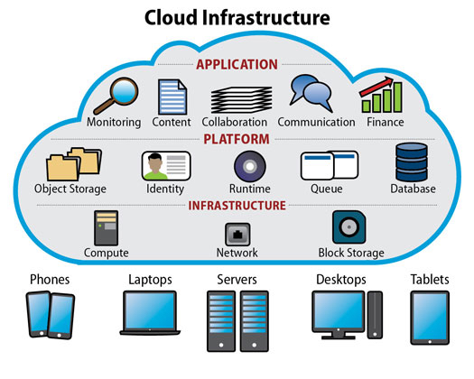

Slide 36
Ubiquitous Applications that we rarely think about….

Slide 37
Traffic Control
  Red Light Alert and Detection
  Electronic Crossing Guard
  Bike Path Alert Systems
  Railway Crossings Alert Systems
  Air Traffic Control !!!

Slide 38
Environmental Monitoring
Remote sensors which monitor environmental data such as Temperature, Humiditiy, Wind speed, Toxicity levels in Water, etc
Video Monitoring of protected coast land with automatic detection of anomalies
Connected to a wide area network with data recording in real time at centralized locations
Environmental networks are often Radio Frequency based using satellites or other RF systems

Slide 39
Non Invasive Medical Monitoring
Much research and development involving non invasive sensors that allow remote patient monitoring
Blood pressure, blood chemistry, heartbeat, tumor detection, etc
Data is sent via the Internet to diagnostic centers which can process and generate alerts based on abnormal readings

Slide 40
Location services
Mobile 911 Location services are rolled out nationwide.
Global Positioning System direction services
OnStar, Google Maps, Waze, etc.
Personal location services
  Children
  Elderly
  Teenagers

Slide 41
Logistics Management
RFID (Radio Frequency Identification Devices) enable retailers to track goods from their point of manufacture all the way to the store shelf
RFID tags embedded in living creatures enable immediate identification together with examination of medical history
RFIDs now permit automatic monitoring and tracking of practically any item that carries them

Slide 42
Smart Appliances
Refrigerators and cabinets that keep inventory of food by reading barcode labels or RF ID tags
  Order food automatically via the Internet
  Keep track of expiration dates
  Automatically create recipes based on food you have
  Calculate Caloric intake based on consumption
  Stoves and ovens that automatically cook food perfectly every time based on the food weight and ID

Slide 43
Smart Working and Living Spaces
Automatic and optimal control of heat, light and other environmental factors
Sensors and audio to guide sight impaired or handicapped occupants
Emergency notification to you wherever you are!
Ability to see what the kids are doing when you are away!

Slide 44
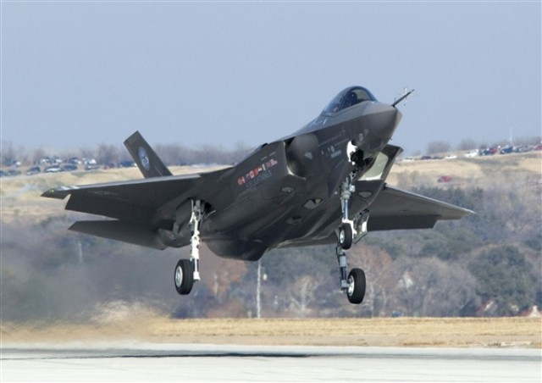
F-35 Strike Fighter
8 Million Lines of Code!

Slide 45
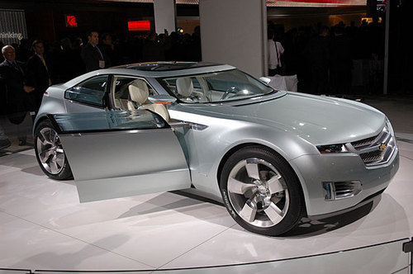
”Chevy Volt - More
Software Than Car”
- Manufacturing Business Technology 11/2
“Powered by a “system of systems,” software makes up
over 40 percent of the car -- up from just 5 percent in the
1980s -- which features over 100 electronic controllers, 10
million lines of code, and even its own IP address.”

Slide 46
8 million lines of code
10 million lines of code
What could possibly go wrong?

Slide 47
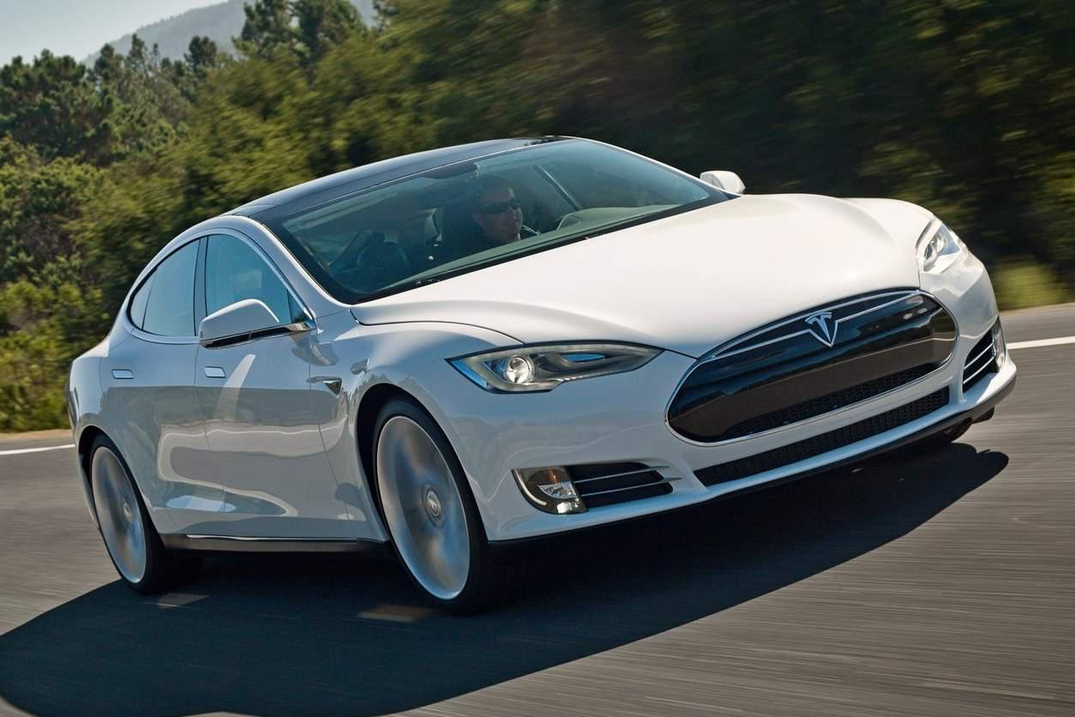
The Tesla Model S
52 Embedded Processors!
100 percent of new cars will be internet connected by 2023

Slide 48
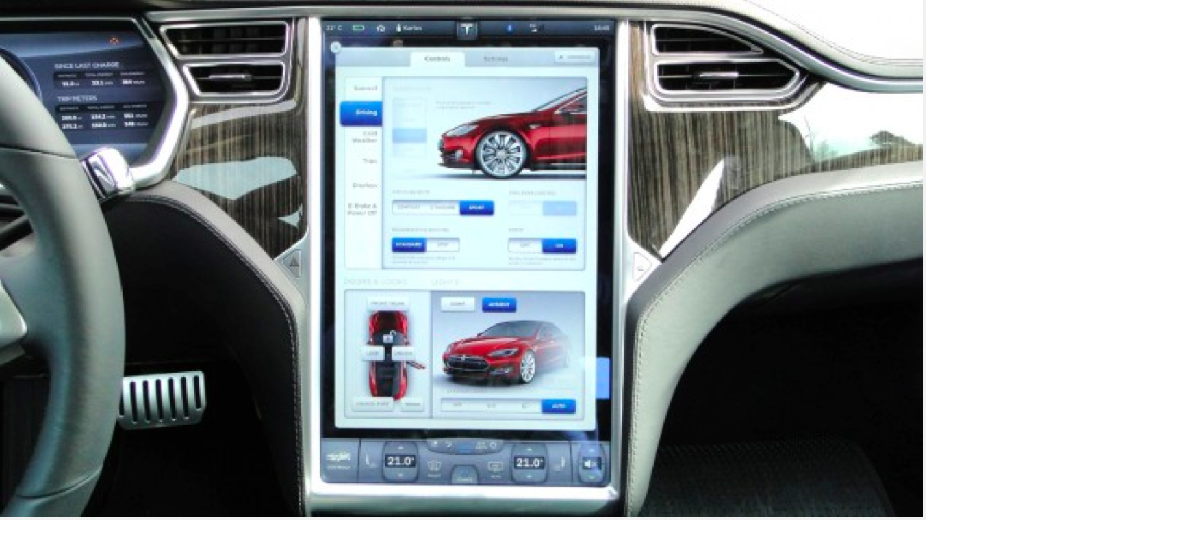
Look Ma, No buttons!
Controlled via a 17 inch Touchscreen and downloaded over the Internet

Slide 49
Perimeter Security
Video monitoring of borders and coastland
Automatic alerts to local authorities of intrusions
Possible Identification based on physical characteristics
Monitoring of phones, internet traffic
Big constitutional issues concerning privacy, etc

Slide 50
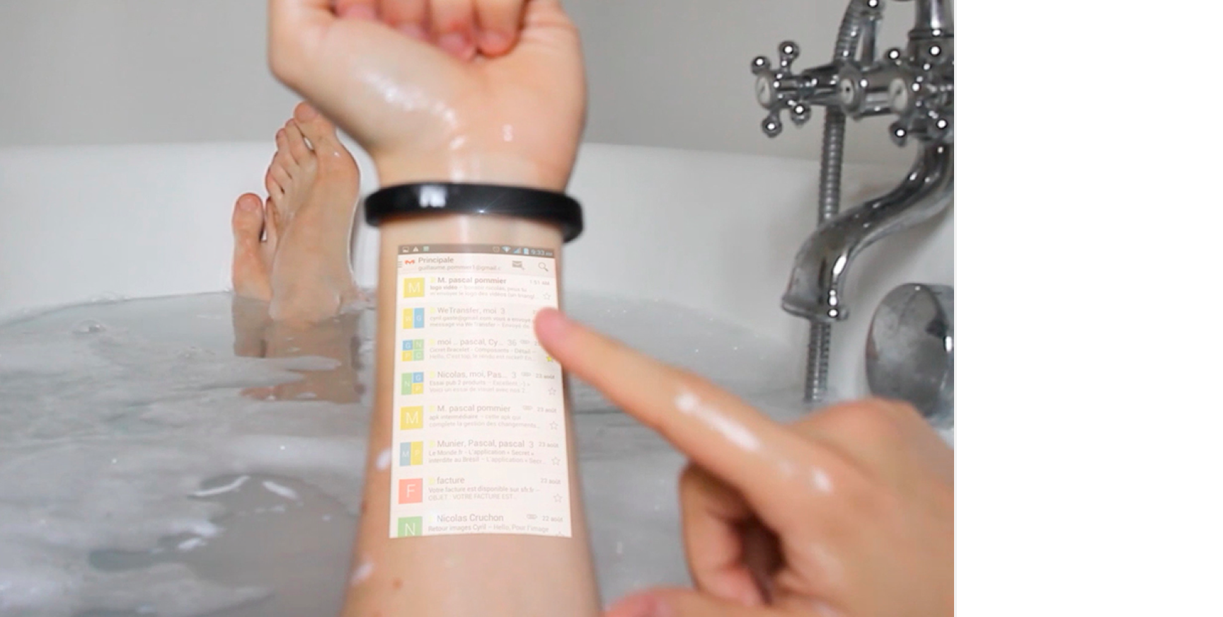
Cicret Digital Bracelet
Project and operate your cellphone on your arm via a wireless bracelet

Slide 51
The Body Electric (BioElectronics)
Computing Power Over or Under the Skin
  Digital “skin” made of silicon transistors that are grafted to the body
  Capable of monitoring and wirelessly reporting a wide range of bodily functions and chemistry
  The Cyborg era has arrived!
  http://www.youtube.com/watch?v=KAx8QUaKG18

Slide 52
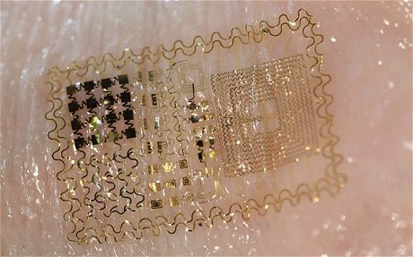
Digital Skin !

Slide 53
What are some of the possibilities with
Digital Skin?
Automatic injection of medicines
Monitoring of vital signs
  Blood Sugar Levels
  Heart Rate
  Oxygen Levels
  Neurological events and seizure control
  Cancer Detection!!!
  To Name a Few!
  All automatically uploaded via wireless to the Internet and to your Doctor’s Patient Records System!

Slide 54
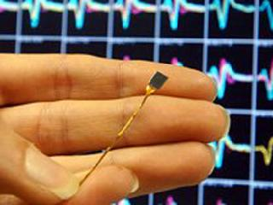
Researchers at Brown University hope that devices implanted
in the brains of quadriplegics will allow them
to to move a computer cursor by using their minds
AP photo / Chitose Suzuki
The BrainGate Neural Interface System consists of a silicon
wafer with 100 electrodes and a wire that will extend outside the skull.

Slide 55
Brain Gate Demo

Slide 56
Bio Computing
Use of molecules, DNA and nano materials to create computing structures based on organic materials
https://www.youtube.com/watch?v=M9A2F1SYdjw

Slide 57
the bottom line
It is increasingly easy to capture, store, search and share information of practically any sort as a result of the evolving digital revolution
The cost continues to decrease
The performance continues to increase
This ability has both benefits and significant dangers
We should all be aware of what is happening and how it will affect our lives

Slide 58
the bottom line
Pervasive computing/IoT is one of the largest areas of research, development and activity
It affects all of us
We participate in it without even knowing it!
Every time you use your cellphone, touch a keyboard, swipe a card, or walk down the street you are a participant.
One day you might be able to do it just by thinking it!

Slide 59
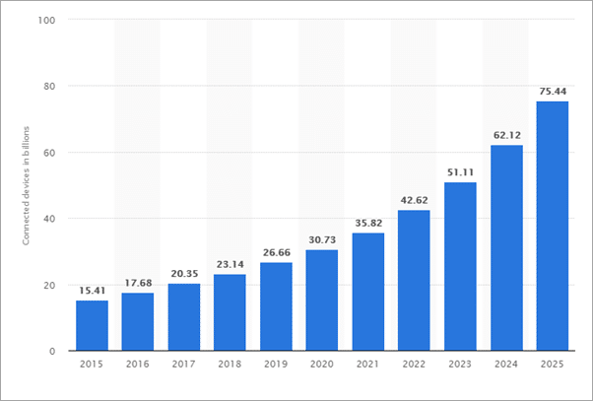
7.6 Billion Humans….
76 Billion IOTDevices?

Slide 60
Some of the Latest Good and Not So Good IoT ideas…...

Slide 61
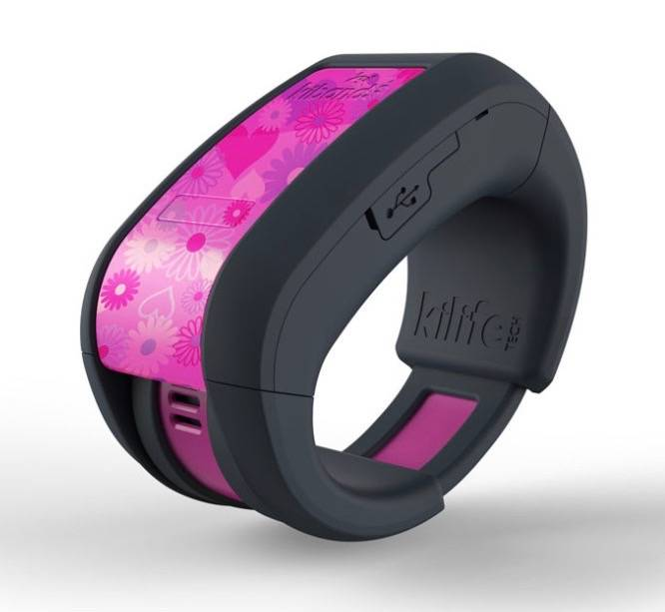
KiBand – kid tracking bracelet

Slide 62
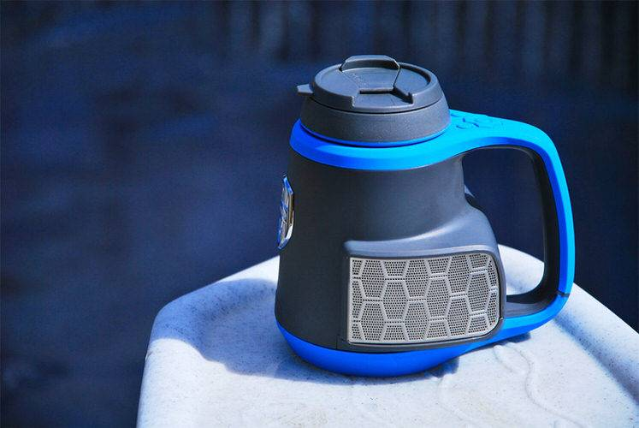
Dubstein

Slide 63

Kafon Mine Drone

Slide 64

Robotic Suitcase that follows its owner

Slide 65

The Kiss Phone

Slide 66
Computer Controlled TRASH receptacl

Slide 67
Remember one thing however….
The more IOT devices we use,
  The more vulnerable we are to attack!

Slide 68
QUESTIONS?
Thank you for taking CS2!!!.. We hope you enjoyed it!

