Slide 1
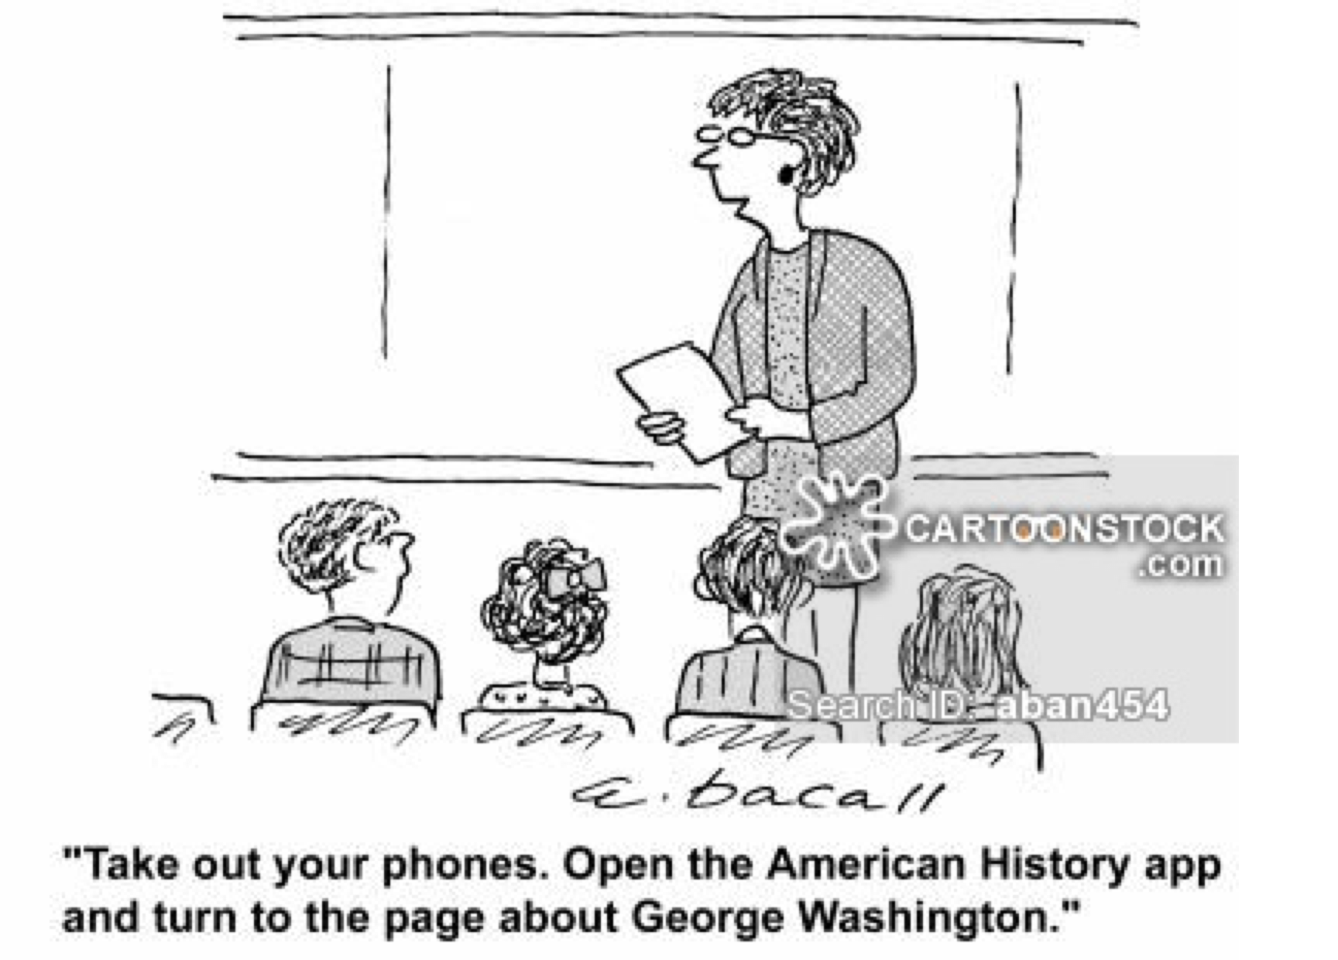

Slide 2
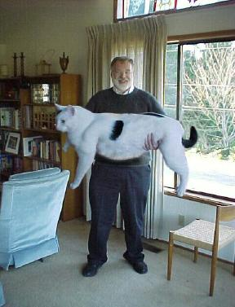
Digital Imaging and Processing: Is seeing, believing?
Digital Imaging

Slide 3
The Nature of Visible Light
A very small part of the total spectrum of electromagnetic waves
Unlike sound, electromagnetic waves can travel through a vacuum
They include the categories of Radio, Microwave, and Visible light waves
They vary in frequency and amplitude

Slide 4
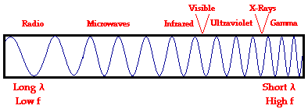
Electromagnetic Spectrum

Slide 5
What is light?
Normally when we use the term "light," we are referring to a type of electromagnetic wave which stimulates the retina of our eyes. In this sense, we are referring to visible light, a small spectrum of the enormous range of frequencies of electromagnetic radiation.

Slide 6
What is light?
This visible light region consists of a spectrum of wavelengths, which range from approximately 700 nanometers (abbreviated nm) to approximately 400 nm;
that would be 7 x 10-7 meter to 4 x 10-7 meter. This narrow band of visible light is affectionately known as ROYGBIV

Slide 7
Fundamental Colors
Dispersion of visible light (through) a prism for instance) produces the colors red (R), orange (O), yellow (Y), green (G), blue (B), indigo (I), and violet (V). It is because of this that visible light is sometimes referred to as ROYGBIV

Slide 8
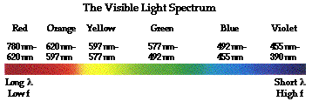
The visible light spectrum

Slide 9
White and Black
When all of the colors strike our eye at the same time, we perceive that as WHITE
Black is defined as the absence of light. It is actually not a real color

Slide 10
Our eyes
The retinas of our eyes contain cells called Rods and Cones. Rods are sensitive to intensity while cones are sensitive to wavelength (color)
As it turns out our cones are sensitive to Red, Green and Blue above all else

Slide 11
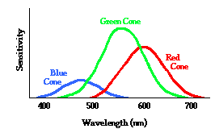
Relative Sensitivity of our eyes

Slide 12
Photography Timeline
1822 – Nicéphore Niépce takes the first fixed, permanent photograph, of an engraving of Pope Pius VII
1826 – Nicéphore Niépce takes the first fixed, permanent photograph from nature a landscape that required an eight hour exposure
1839 - William Fox Talbot invented the positive / negative process widely used in modern photography
1861 – The first color photographis shown by James Clerk Maxwell
1887 – Celluloid film base introduced
1888 – Kodak n°1 box camera is mass marketed; first easy-to-use camera.

Slide 13
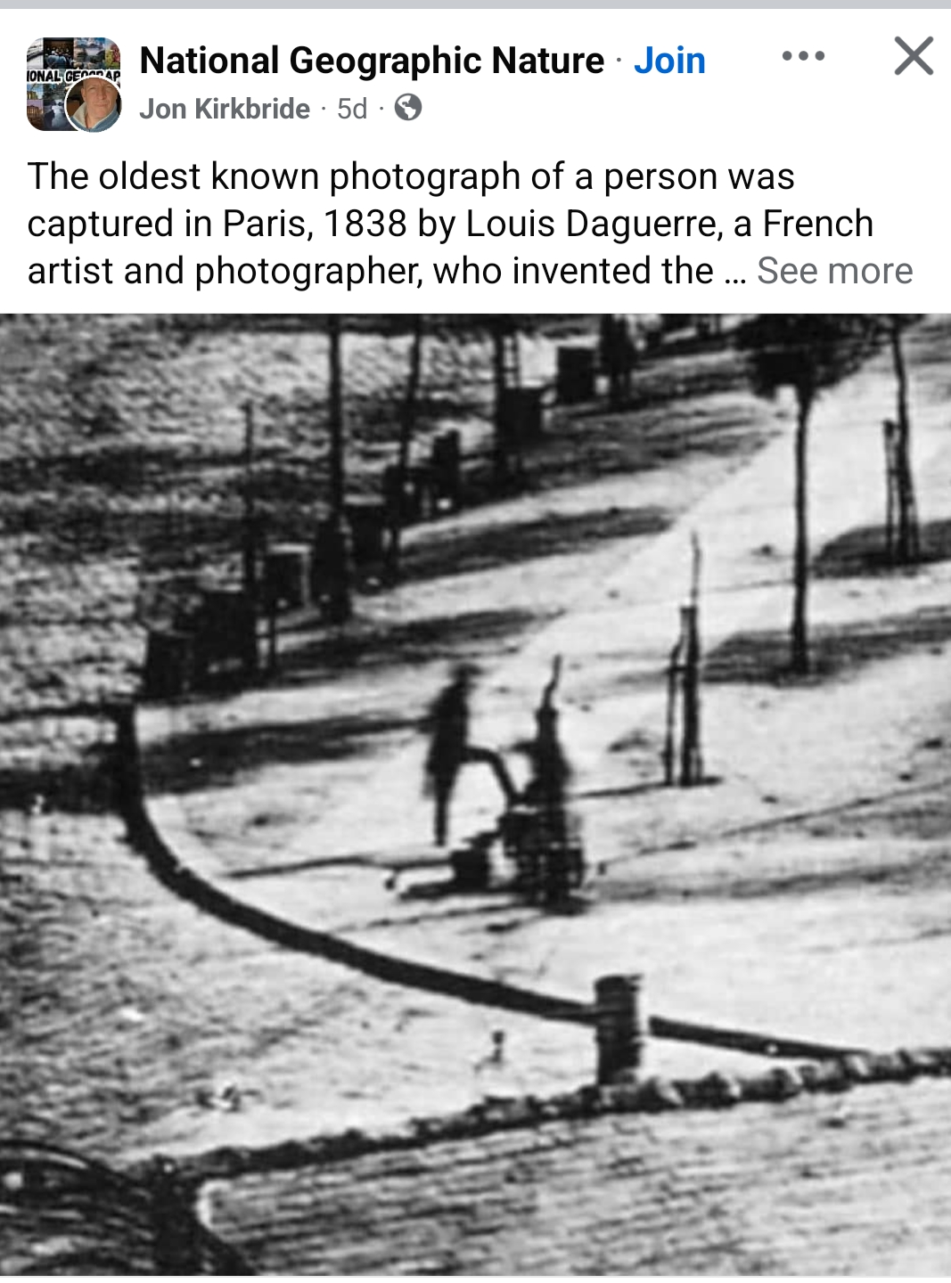

Slide 14
Timeline cont.
1891 – William Kennedy Laurie Dickson develops the "kinetoscopic camera" (motion pictures) while working for Thomas Edison
1902 – Arthur Korn devises practical phototelegraphy technology (enabling the electronic transmission of pictures)
1939 – Agfacolor negative-positive color material, the first modern "print" film
1948 - Edwin H. Land introduces the first Polaroid instant image camera
1972 – Polaroid introduces the SX-70 system

Slide 15
Timeline cont.
1973 – Fairchild Semiconductor releases the first image solid state CCD chip; 100 X 100 pixels
1986 – Kodak scientists develop the world's first megapixel digital image sensor
1991-1995 First consumer and professional digital cameras introduced (Apple, Casio, and Kodak)
2008 – Polaroid announces it is discontinuing the production of all instant film products, citing the rise of digital imaging technology.
2009 - Kodak announces the discontinuance of Kodachrome film as their dominance in film photography dies

Slide 16
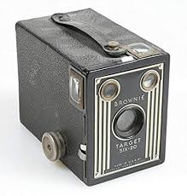
Kodak “Brownie Camera”

Slide 17
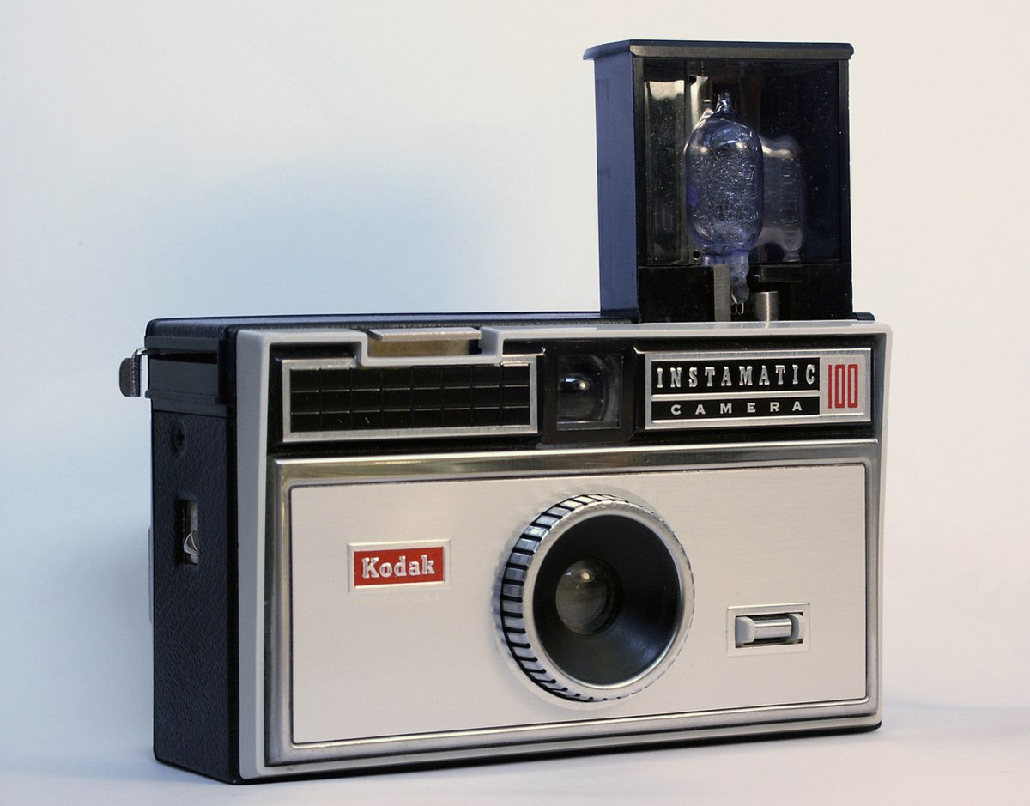
Kodak Instamatic – 1960-75
50 Million Produced

Slide 18
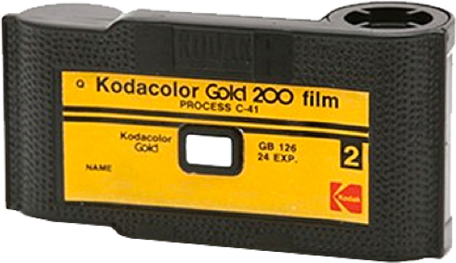
Kodak Instamatic Film Cartridges
490 × 283
126 Film - The Darkroom Photo Lab
Visit
Ima

Slide 19
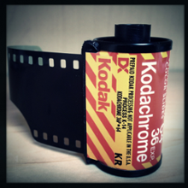
Kodak 35mmfilm cannister

Slide 20
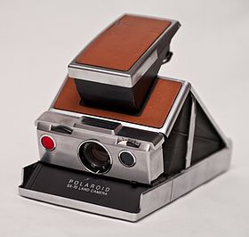
Polaroid SX-70 Instant Camera 1972

Slide 21
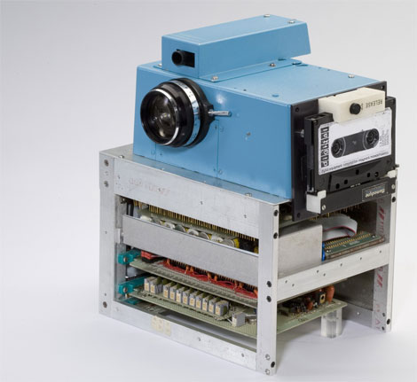
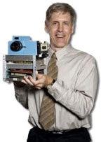
Kodak Digital Camera Prototype– 1975 – First One Ever!!
CCD Imager
Black+white
23 sec record
21
Notes:
21
Way back in 1975 -- when Kodachrome color slides and Kodak Instamatics were all the rage -- Kodak researcher Steve Sasson built the first digicam, cobbled together from spare parts and bleeding edge digital technology.The lens was from a used parts bin on Kodak's Super 8 camera assembly line, it used a futuristic CCD image sensor (now commonplace) and took 23 seconds to record a crude 100 line black and white image onto cassette tape.Sasson explains, "On the side of our portable contraption, we shoehorned in a portable digital cassette instrumentation recorder.† Add to that 16 nickel cadmium batteries, a highly temperamental new type of CCD imaging area array, an a/d converter implementation stolen from a digital voltmeter application, several dozen digital and analog circuits all wired together on approximately half a dozen circuit boards, and you have our interpretation of what a portable all electronic still camera might look like."

Slide 22

1991 - Kodak/Nikon Digital DSLR
$20,000
Available to Professional News Photographers

Slide 23
Business Question:
Since Kodak and Polaroid had access to the same digital technologies as everyone else,
why did they fail to shift their business models and become leaders in digital instant photography?

Slide 24
Digital Camera Basics
A digital camera takes light and focuses it via the lens onto a sensor made out of silicon. It is made up of a grid of tiny photosites that are sensitive to light. Each photosite is usually called a pixel, a contraction of "picture element". There are millions of these individual pixels in the sensor of a DSLR camera

Slide 25
Digital Imaging Basics
Image Acquisition
Digital Image Representation
Storage Implications and Compression
Image Processing

Slide 26
Charged Coupled Devices
Invented over 40 years ago
Consists of a 2D array of transistors and capacitors (pixels) that are very sensitive to light
Photons hit the array which creates and stores electrical charges proportional to intensity of the light
The values for each pixel are then converted to binary numbers and stored in memory in the camera/computer

Slide 27
CCDs Continued
Originally used in spy satellites and astronomy applications due to high sensitivity
Recent popularity for consumer applications has resulted in dramatic cost reduction
Now used in every type of imaging
Replacing film in most applications
Higher equipment cost, lower operational cost

Slide 28
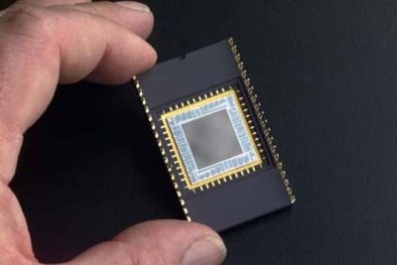
A Charged Coupled Device (CCD)
A
Outputs an analog electrical signal that must be sampled and converted to digital

Slide 29
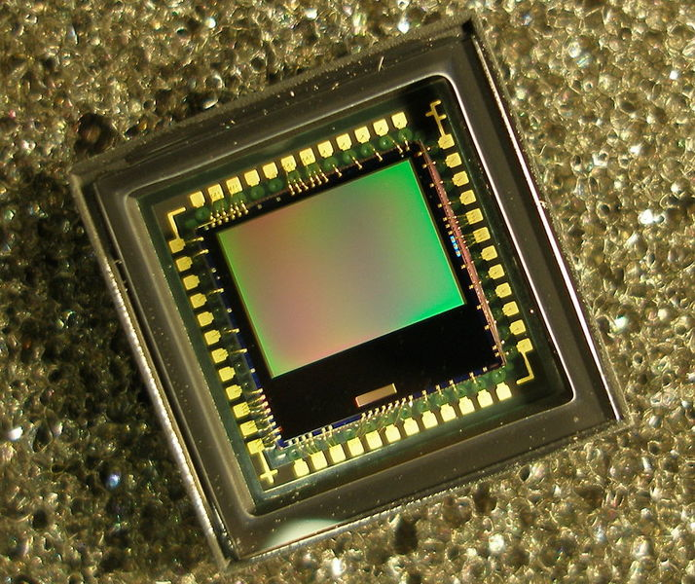
CMOS Sensor
Outputs a digital binary signal for every pixel

Slide 30
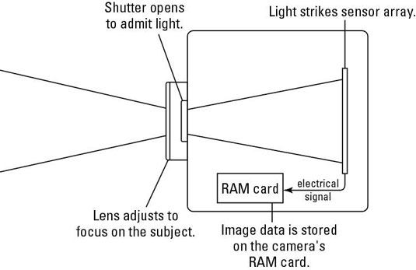
Digital Camera Diagram

Slide 31
Image Acquisition
PC
running
Photoshop
Or similar
program
CAMERA
I/O Interface
(USB/ Firewire)
Storage

Slide 32
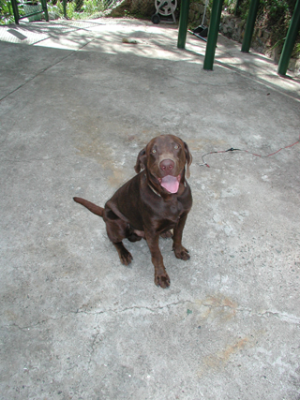
A Digital Camera has predefined Pixels
Each pixel is then assigned a
numeric value in binary
which corresponds to color and
luminence
Image is projected onto Camera’s
sensor
by camera lens
Sensor consists of an array of
Millions of light sensitive transistors
and capacitors

Slide 33
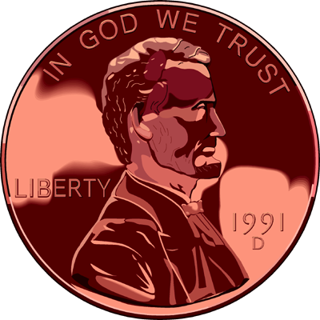
Analog Images
Analog Images are represented by waves of photons traveling through space
a natural image is typically represented by a continuous or analog signal (such as a photograph, video frame, etc.)

Slide 34
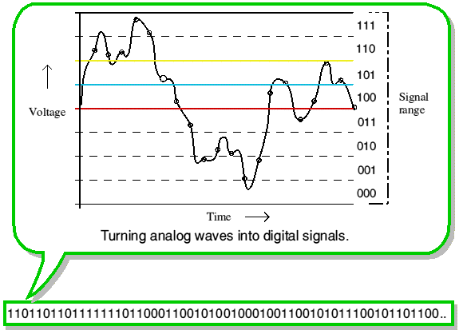
Analog into Digital

Slide 35
Image Acquisition
Acquisition determines ultimate resolution
Remember, you cannot “create” resolution after the fact
The more samples (pixels) “acquired” the better the resolution (accuracy)
The higher the resolution, the more data acquired, hence more storage required

Slide 36
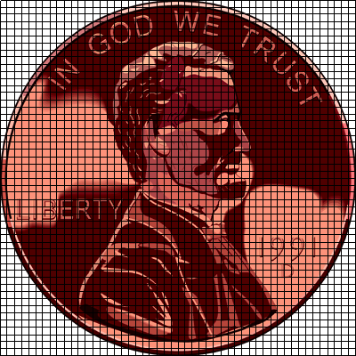
Representing Digital Images
Digital images are composed of PIXELS (or picture elements)
digitizing samples the natural image into discrete components

Slide 37

Representing Digital Images
Digital images are composed of PIXELS (or picture elements)
each discrete sample is averaged to represent a uniform value for that area in the image

Slide 38
Representing Digital Images
Digital images are composed of PIXELS (or picture elements)
PICTURE RESOLUTION is the number of pixels or samples used to represent the image

Slide 39
Representing Digital Images
Digital images are composed of PIXELS (or picture elements)
ASPECT RATIO expresses this resolution as the product of the no. of horizontal pixels by the no. of vertical pixels

Slide 40
Representing Digital Images
Digital images are composed of PIXELS (or picture elements)
this image is square, 50 X 50
typical ratios are 320 X 200 or 1.6:1, 640 X 480, 800 X 600, and 1024 X 768--all of which are 1.33:1

Slide 41
Pixels and Resolution
Images are represented (ultimately) as arrays of pixels (picture elements).
Image resolution is the number of pixels in the image (e.g., 600x1000)
Display resolution is the number of pixels in the display device (often expressed in dots per square inch, or dpi).

Slide 42
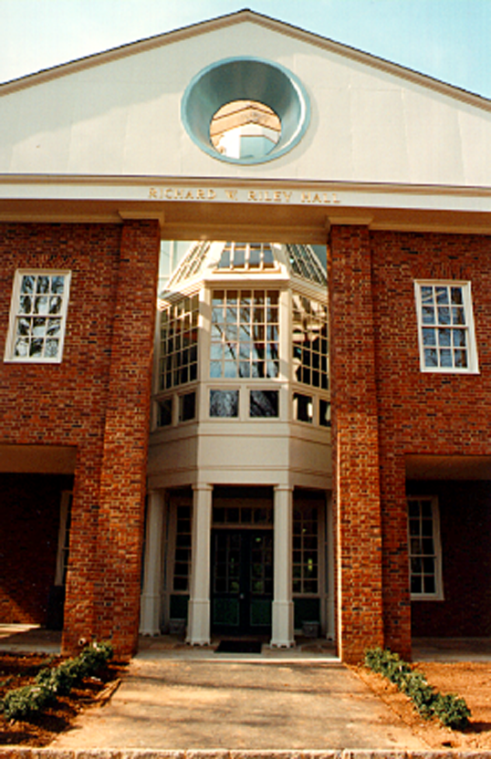
Representing Digital Images
Picture resolution determines both the amount of detail as well as its storage requirements
here is a (edited) digitized image with a resolution of 272 X 416

Slide 43

Representing Digital Images
Picture resolution determines both the amount of detail as well as its storage requirements
notice the changes when the resolution is reduced (136 X 208)

Slide 44

Representing Digital Images
Picture resolution determines both the amount of detail as well as its storage requirements
notice more changes when the resolution is reduced (68 X 104)

Slide 45

Representing Digital Images
QUANTIZING a sampled image refers to representing each discrete sample by a set of numbers chosen from a given scale
imagine a simple image with a bright object in the foreground surrounded by a dark background

Slide 46
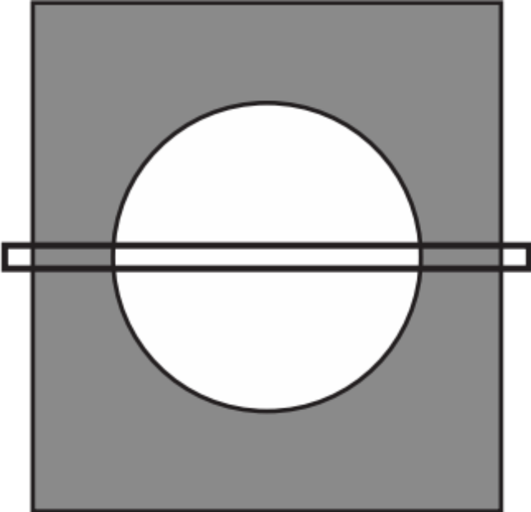
Representing Digital Images
QUANTIZING a sampled image refers to representing each discrete sample by a set of numbers chosen from a given scale
suppose that we sampled the signal horizontally across the middle of the image

Slide 47
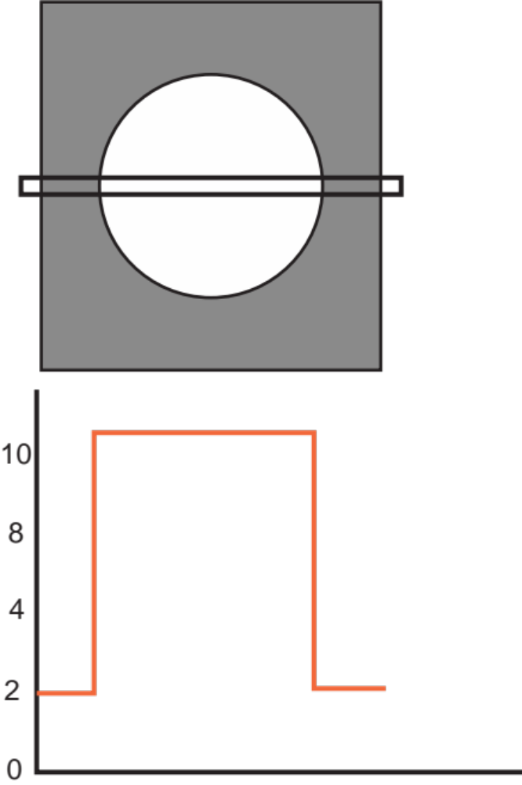
Representing Digital Images
QUANTIZING a sampled image refers to representing each discrete sample by a set of numbers chosen from a given scale
if we assigned a numeric scale for the signal it might look like this

Slide 48
Representing Color
The RGB (red, green, blue) color system represents color by specifying the intensity of red, green, and blue light.
24 bit color would use 8 bits (one byte) for each color.
In this scheme we specify 8 numbers in base 16 (hexadecimal) = rrggbb.

Slide 49
Representing Grayscale
For black and white images we need to represent the shade.
A binary image would represent only white or black pixels.
Four bits per pixel would allow “16 shades of gray”

Slide 50
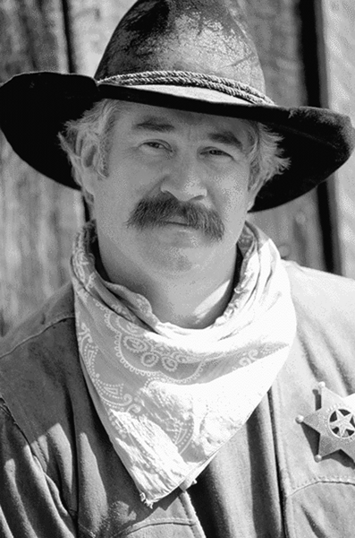
Representing Digital Images
DYNAMIC RANGE refers to the number of values for the measuring scale used in quantizing
Here is an intensity or graylevel image with 256 levels (i.e., 0 to 255 scale)

Slide 51
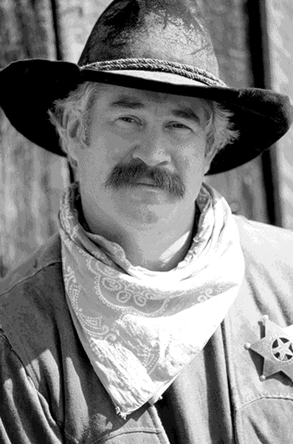
Representing Digital Images
DYNAMIC RANGE refers to the number of values for the measuring scale used in quantizing
Here is an intensity or graylevel image with 16 levels (i.e., 0 to 15 scale)

Slide 52
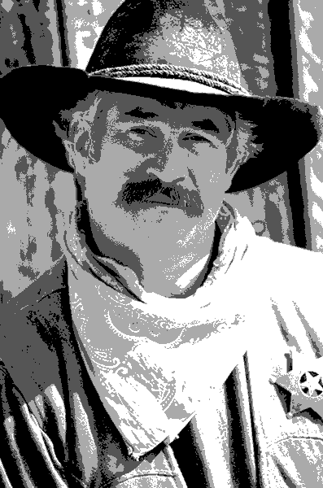
Representing Digital Images
DYNAMIC RANGE refers to the number of values for the measuring scale used in quantizing
Here is an intensity or graylevel image with 4 levels (i.e., 0 to 3 scale)

Slide 53
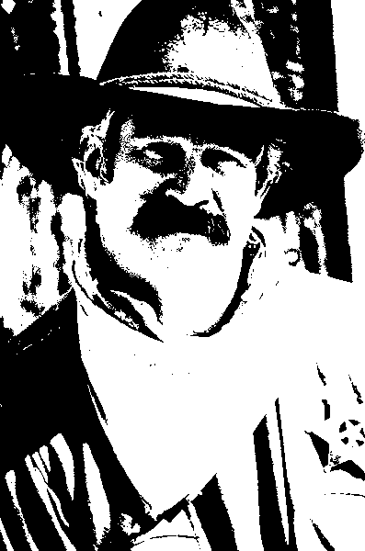
Representing Digital Images
DYNAMIC RANGE refers to the number of values for the measuring scale used in quantizing
Here is an intensity or graylevel image with 2 levels (i.e., 0 to 1 scale or a binary image)

Slide 54
Image Modification
Computer
Program
Original Image
Revised Image

Slide 55
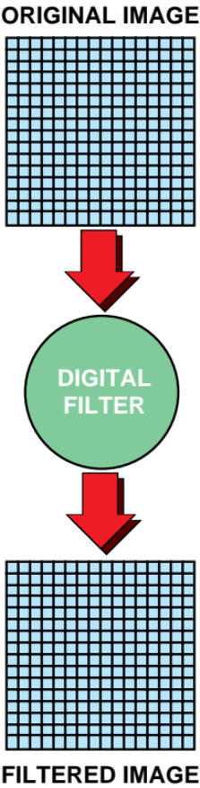
Processing Digital Images
digital images are often processed using “digital filters”
digital filters are based on mathematical functions that operate on the pixels of the image

Slide 56
Processing Digital Images
there are two classes of digital filters: global and local
global filters transform each pixel uniformly according to the function regardless of its location in the image
local filters transform a pixel depending upon its relation to surrounding ones

Slide 57
Global Filters
Brightness and Contrast control
Histogram thresholding
Histogram stretching or equalization
Color corrections
Hue-shifting and colorizing
Inversions

Slide 58
Global Intensity Modification
Let us just consider black and white images (so each pixel is represented in, say, one byte = 256 possibilities).
A global intensity modification technique would change, say, all pixels with intensity 111 to intensity 158.
Why would one want to do such a thing?

Slide 59

Contrast

Slide 60
Making a Picture Brighter
To make an overly dark picture brighter, generally raise the light intensity numbers.
Output light intensity
Make brighter
No modification
Input light intensity

Slide 61
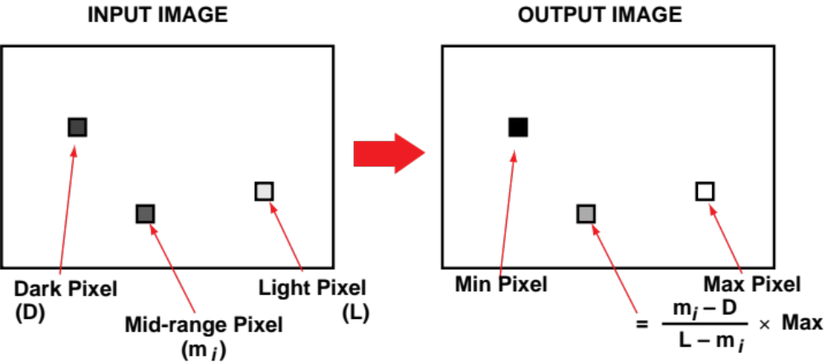
Global Filters
Histogram stretching redistributes pixel values in the image that has poor contrast
Equalization improves images with poor contrast

Slide 62
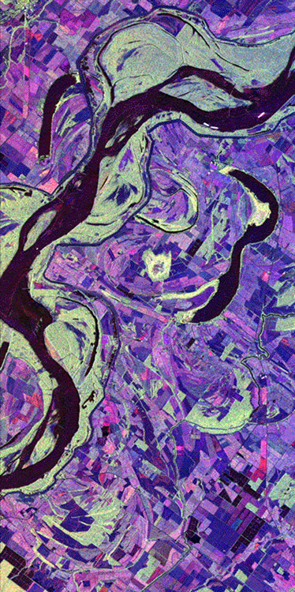
Global Filters
Hue-shifting is used to modify the color makeup of an image
Pseudo-coloring assigns hues to intensity ranges for better rendering of details
Colorized image of Mississippi at Vicksburg

Slide 63
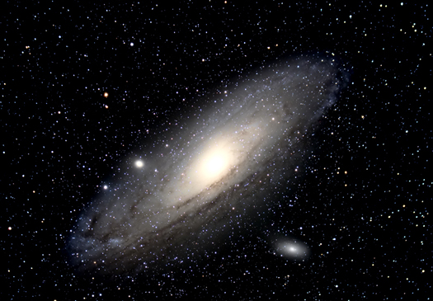
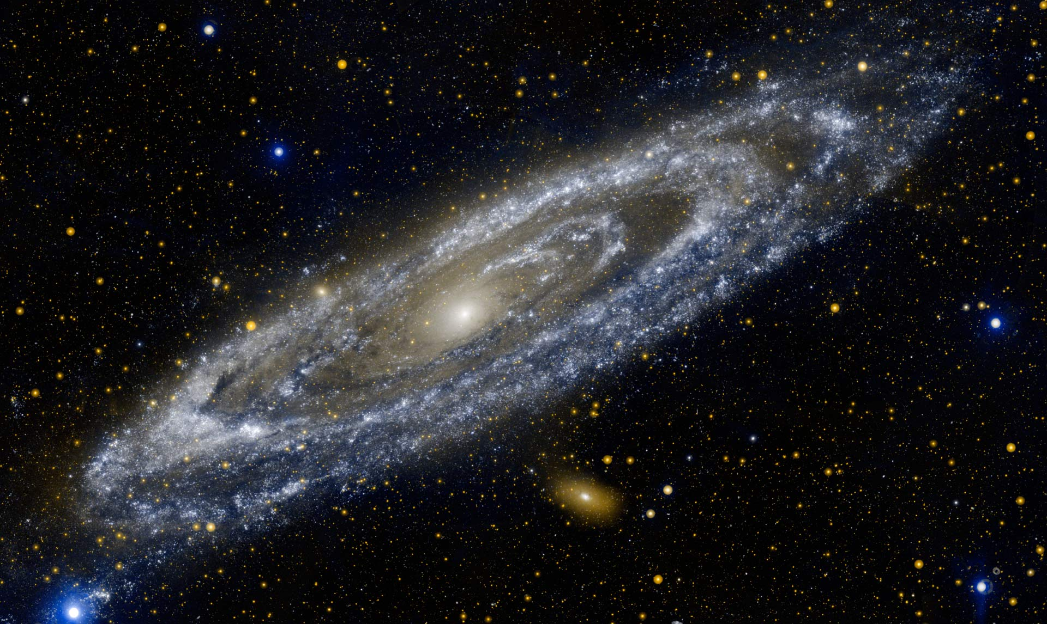
Hue Shifting in Astronomy

Slide 64
Demo
Image Editing Demo

Slide 65
Local Filters
Sharpening
Blurring
Edge and line detection
Noise filters

Slide 66
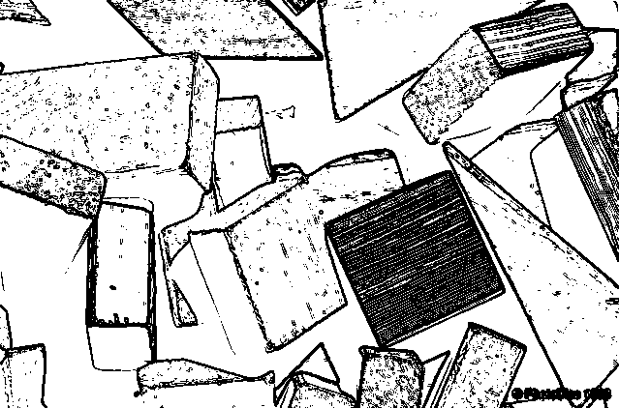
Local Filters
Edge and line detection filters subtract all parts of the image except edges or boundaries between two different regions
edge detection is often used to recognized objects of interest in the image
edges and lines detected in an image of toy blocks

Slide 67
Editing Images
editing or retouching an image involves selecting a region of the digital image for processing using some special effect
image compositing combines components of two or more images into a single image
painting (or rotoscoping) an image is to edit the image by hand with graphic tools that alter color and details

Slide 68

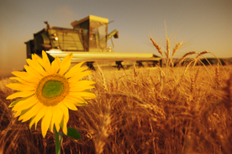
Editing Images
compositing images involves combining separate image layers into one image
layers may be moved and arranged

Slide 69
Computer Animation
Computer animation is simply computer graphics for sequences of scenes designed to be viewed in rapid succession.
Commercial computer animation is very labor intensive.

Slide 70
Animation and Physics
The goal of computer animation research is to model not just how the world looks, but how it changes.
For example, how do clothes fold when the body inside moves, or how do the limbs of a person (or a dog) move when the person/dog is walking.

Slide 71
Graphics and Image Processing
The distinction between computer graphics and image processing is becoming increasingly blurry.
This is because many of the most advanced image processing techniques employ computer graphics ideas like modeling and rendering.

Slide 72
Noise Reduction Techniques
Noise in an image is the insertion of random, spurious pixel values because of non-image events like the decay of a photograph, or errors in the transmission of the image (as when a picture is transmitted from a satellite to the ground station).

Slide 73
Graphics and Scene Recognition
These techniques require (to a greater or lesser degree) scene recognition - the ability to infer from one or more images what is in the scene, and where.
Scene recognition is normally considered to be part of AI (Artificial Intelligence - the study of how to make computers behave “intelligently”).
E.G. Google Lens app

Slide 74
Digital Image Files
Digital images are converted to files for storage and transfer
The file type is a special format for ordering and storing the bytes that make up the image
File types or formats are not necessarily compatible
You must often match the file type with the application (.psd = photoshop)

Slide 75
Storing Digital Images
TIFF (Tagged Image File Format)
  used by most document preparation programs
  has optional lossless compression
  Windows and Macintosh formats differ
GIF (Graphic Interchange Format)
  indexed color image (up to 256 colors)
  compressed
  used in Web applications

Slide 76
Storing Digital Images
JPEG (Joint Photographic Experts Group)
  lossy compression with variable controls
  also used in Web applications
WMF (Windows Metafile Format)
  “metafile” formats permit a variety of image types
PICT
  the metafile format for Macintosh apps

Slide 77
With Digital Imaging
You can create just about anything…..

Slide 78
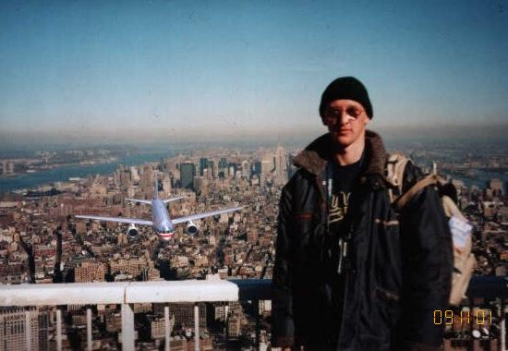
911 Accidental Tourist

Slide 79
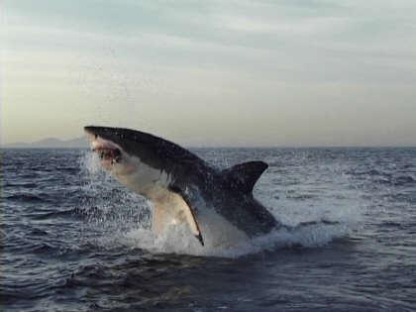
Great White Taken in South Africa

Slide 80
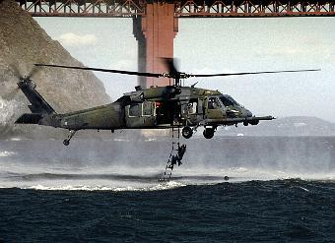
Rescue Diver Drill Under the Golden Gate

Slide 81
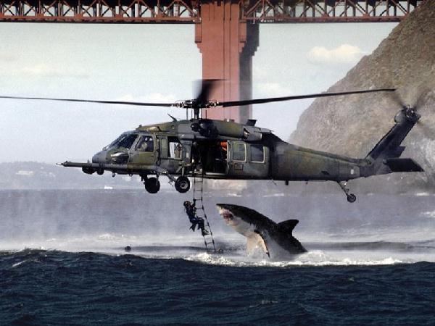
Shark attacking rescue diver in San Francisco Bay!

Slide 82
Quick Review
We convert analog image information into digital format by sampling and analog to digital conversion (Quantizing)
The more samples, the better the resolution hence, more accuracy
We can reduce resolution but we cannot create it after the fact
Once in digital form, we can easily modify the image, store it, and send it anywhere in the world!

Slide 83
Detailed Primer on Digital Photography
In case you want to know more!
http://datagenetics.com/blog/may12018/index.html

Slide 84
Questions?

