Slide 1
CSCI-2950-u
Switching and Routing
Overview
Rodrigo Fonseca
Most slides from CS-168

Slide 2
Switched Ethernet
Most common link layer today
Most popular bandwidths: 1Gbps, 10Gbps, 40Gbps growing
All switched, in practice
  No CSMA-CD

Slide 3
Ethernet Addressing
Globally unique, 48-bit unicast address per adapter
  Example: 00:1c:43:00:3d:09 (Samsung adapter)
  24 msb: organization
  http://standards.ieee.org/develop/regauth/oui/oui.txt
Broadcast address: all 1s
Multicast address: first bit 1
Adapter can work in promiscuous mode

Slide 4
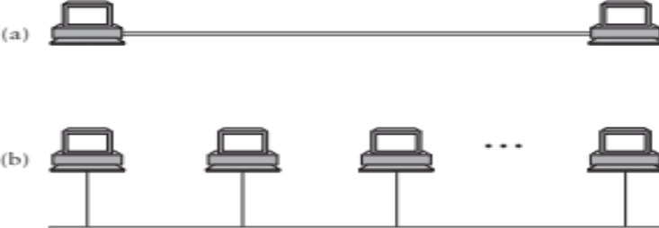

Scaling
Direct-link networks don’t scale
Solution: use switches to connect network segments

Slide 5
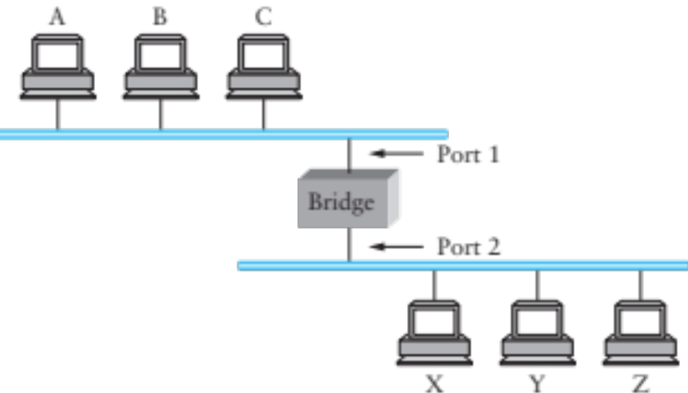
Bridges and Extended LANs
LANs have limitations
  E.g. Ethernet < 1024 hosts, < 2500m
Connect two or more LANs with a bridge
  Operates on Ethernet addresses
  Forwards packets from one LAN to the other(s)
Ethernet switch is just a multi-way bridge

Slide 6
Learning Bridges
Idea: don’t forward a packet where it isn’t needed
  If you know recipient is not on that port
Learn hosts’ locations based on source addresses
  Build a table as you receive packets
  Table is a cache: if full, evict old entries. Why is this fine?
Table says when not to forward a packet
  Doesn’t need to be complete for correctness
Notes:
Never forward to INCOMING port…
What if hosts move? TIMEOUT
What if no space? Still works

Slide 7
Bridges
Unicast: forward with filtering
Broadcast: always forward
Multicast: always forward or learn groups
Difference between bridges and repeaters?
  Bridges: same broadcast domain; copy frames
  Repeaters: same broadcast and collision domain; copy signals

Slide 8
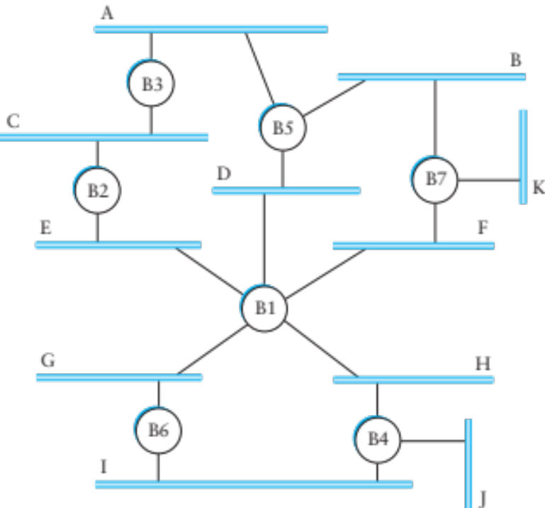
Dealing with Loops
Problem: people may create loops in LAN!
  Accidentally, or to provide redundancy
  Don’t want to forward packets indefinitely

Slide 9
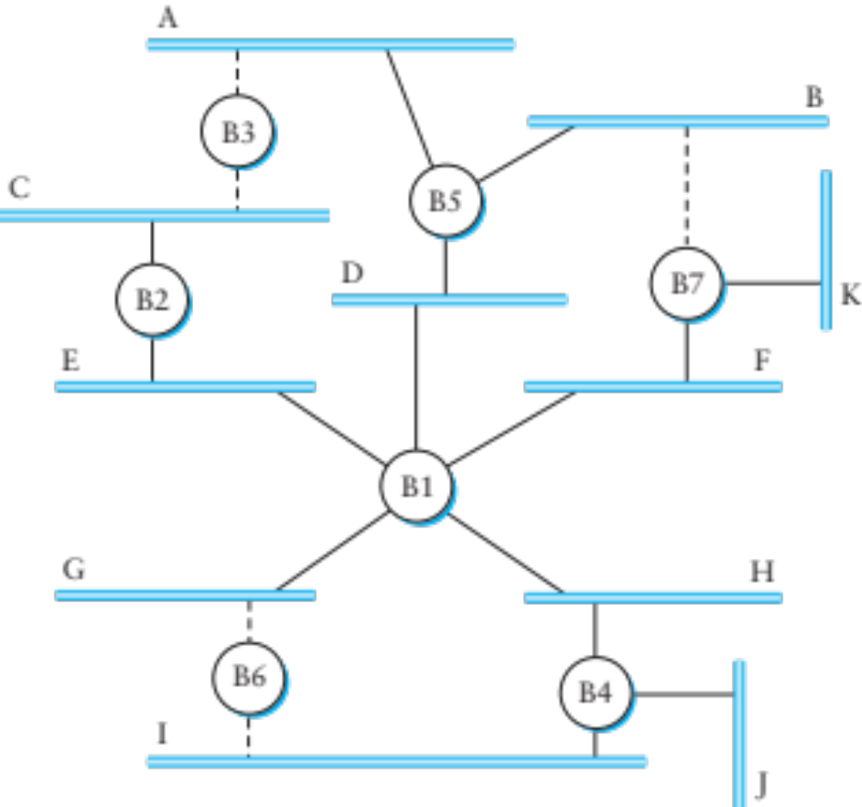
Spanning Tree
Need to disable ports, so that no loops in network
Like creating a spanning tree in a graph
  View switches and networks as nodes, ports as edges

Slide 10
Distributed Spanning Tree Algorithm
Every bridge has a unique ID (Ethernet address)
Goal:
  Bridge with the smallest ID is the root
  Each segment has one designated bridge, responsible for forwarding its packets towards the root
    Bridge closest to root is designated bridge
    If there is a tie, bridge with lowest ID wins

Slide 11
Spanning Tree Protocol
Spanning Tree messages contain:
  ID of bridge sending the message
  ID sender believes to be the root
  Distance (in hops) from sender to root
Bridges remember best config msg on each port
Send message when you think you are the root
Otherwise, forward messages from best known root
  Add one to distance before forwarding
  Don’t forward if you know you aren’t dedicated bridge
In the end, only root is generating messages

Slide 12
Spanning Tree Protocol (cont.)
Forwarding and Broadcasting
Port states*:
  Root port: a port the bridge uses to reach the root
  Designated port: the lowest-cost port attached to a single LAN
  If a port is not a root port or a designated port, it is a discarding port.
* In a later protocol RSTP, there can be ports configured as backups and alternates.

Slide 13
Root Port
Designated Port
Discarding Port

Slide 14
Algorhyme
I think that I shall never see
a graph more lovely that a tree.
A tree whose crucial property
is loop-free connectivity.
A tree that must be sure to span
so packet can reach every LAN.
First the root must be selected.
By ID, it is elected.
Least cost paths from root are traced.
In the tree, these paths are placed.
A mesh is made by folks like me,
then bridges find a spanning tree.
Radia Perlman

Slide 15
Limitations of Bridges
Scaling
  Spanning tree algorithm doesn’t scale
  Broadcast does not scale
  No way to route around congested links, even if path exists
May violate assumptions
  Could confuse some applications that assume single segment
    Much more likely to drop packets
    Makes latency between nodes non-uniform
  Beware of transparency

Slide 16
Multiple Paths
L2: TRILL
  L2 RBridges run link state protocol among themselves
  Add shim header, with destination RBridge, hopcount
L3: OSPF, IS-IS support multiple paths
ECMP is possible in both

Slide 17
VLANs
b1
a1
b2
a2
Company network, A and B departments
  Broadcast traffic does not scale
  May not want traffic between the two departments
  Topology has to mirror physical locations
  What if employees move between offices?

Slide 18
VLANs
a2
a1
b2
b1
Solution: Virtual LANs
  Assign switch ports to a VLAN ID (color)
  Isolate traffic: only same color
  Trunk links may belong to multiple VLANs
  Encapsulate packets: add 12-bit VLAN ID
Easy to change, no need to rewire

Slide 19
VLANs
Limit the broadcast domain
Each VLAN becomes an IP subnet
Switches implement VLANs
  First switch adds VLAN tag
    Port, MAC address, Protocol
  Last switch strips it off
We will read a couple of interesting papers for next class on VLANs and campus networks

Slide 20
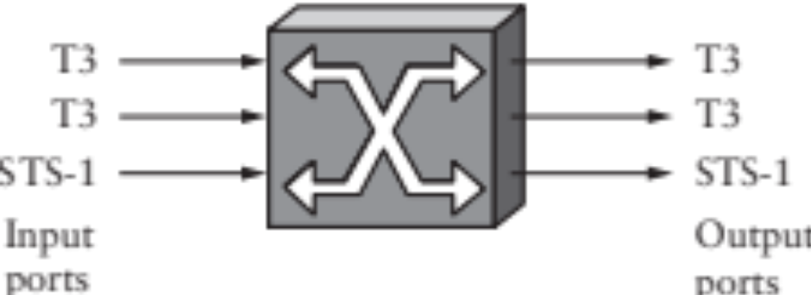
Switching
Switches must be able to, given a packet, determine the outgoing port
Some ways to do this:
  Virtual Circuit Switching
  Datagram Switching
  Label switching
  Source Routing

Slide 21
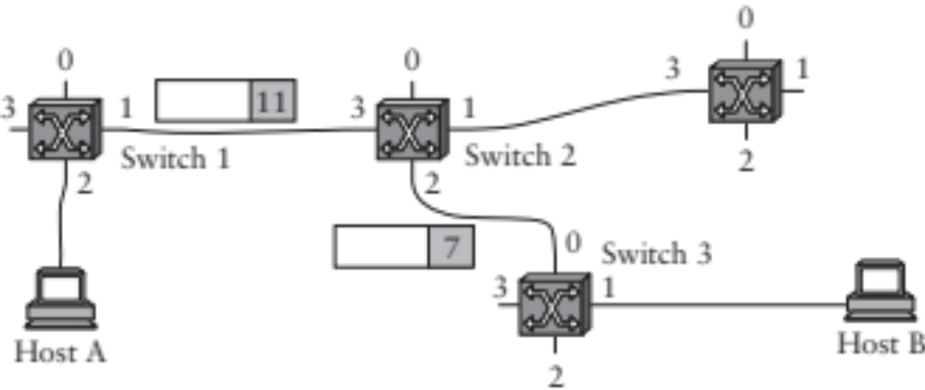
Virtual Circuit Switching
Explicit set-up and tear down phases
  Establishes Virtual Circuit Identifier on each link
  Each switch stores VC table
Subsequent packets follow same path
  Switches map [in-port, in-VCI] : [out-port, out-VCI]
Also called connection-oriented model

Slide 22
Virtual Circuit Model
Requires one RTT before sending first packet
Connection request contain full destination address, subsequent packets only small VCI
Setup phase allows reservation of resources, such as bandwidth or buffer-space
  Any problems here?
If a link or switch fails, must re-establish whole circuit
Example: ATM
Notes:
What is the domain of each VCI?
And the address?

Slide 23
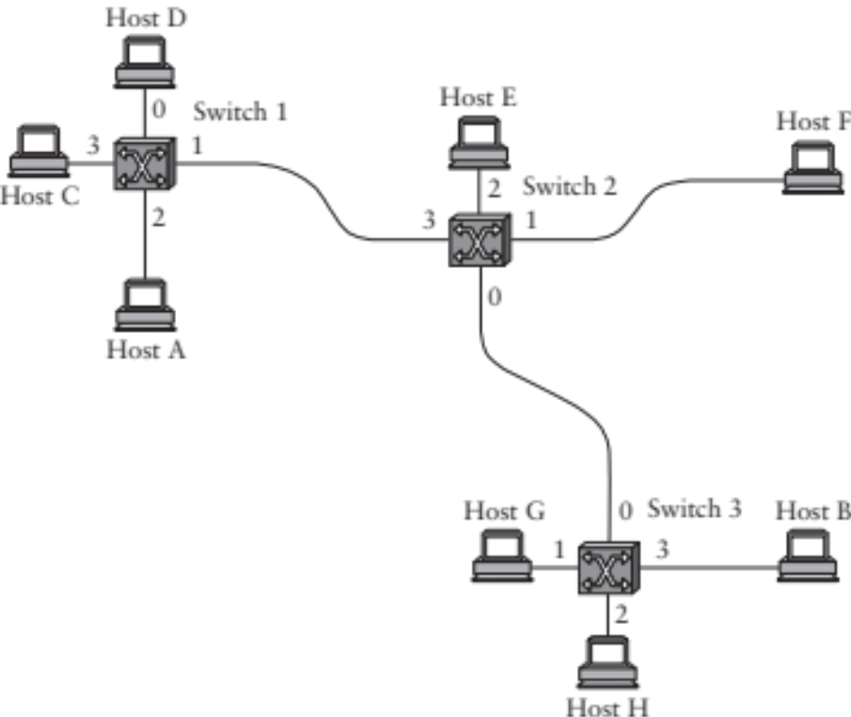
Datagram Switching
Switch 2
Addr | Port
A | 3
B | 0
C | 3
D | 3
E | 2
F | 1
G | 0
H | 0
Each packet carries destination address
Switches maintain address-based tables
  Maps [destination address]:[out-port]
Also called connectionless model

Slide 24
Datagram Switching
No delay for connection setup
Source can’t know if network can deliver a packet
Possible to route around failures
Higher overhead per-packet
Potentially larger tables at switches
Notes:
Why larger tables?

Slide 25
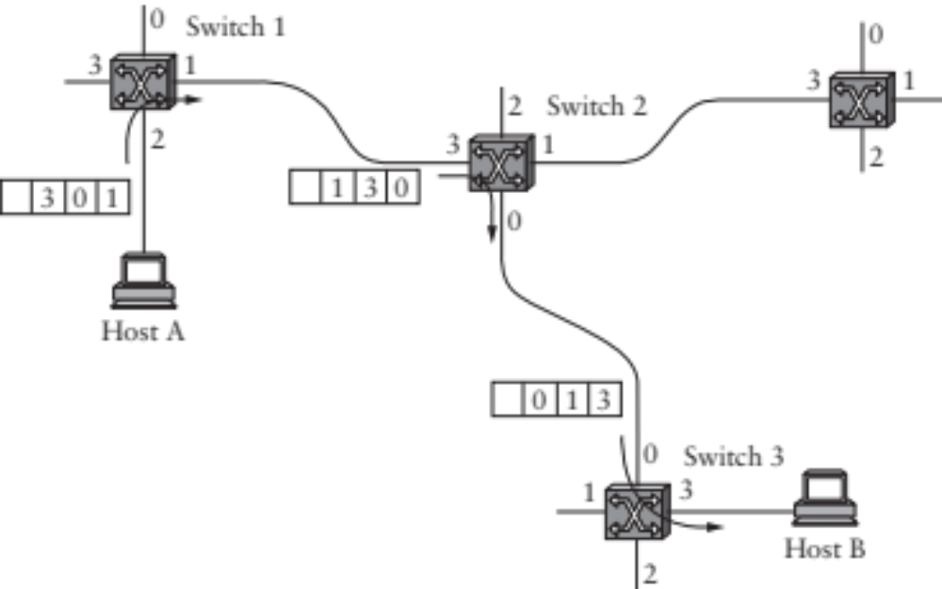
Source Routing
Packets carry entire route: ports
Switches need no tables!
  But end hosts must obtain the path information
Variable packet header
Notes:
May be loose or strict.
Brittle if there are changes host doesn’t know about.

Slide 26
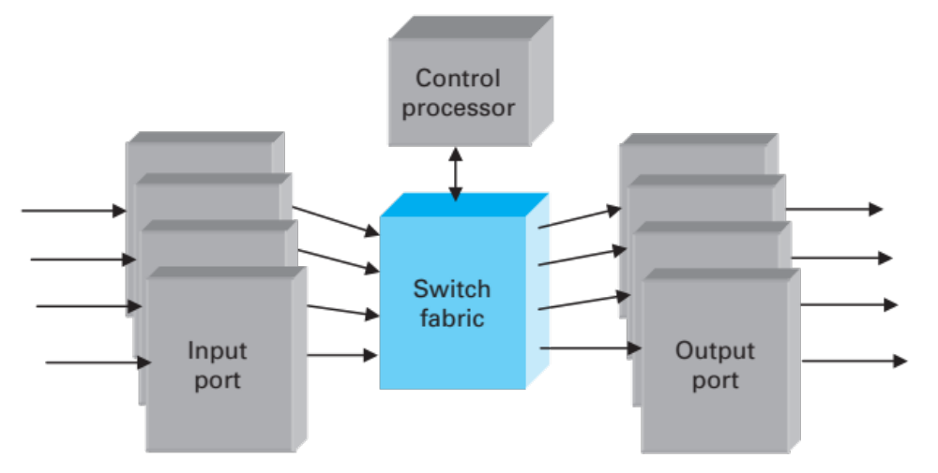
Generic Switch Architecture
Goal: deliver packets from input to output ports
Three potential performance concerns:
  Throughput in bytes/second
  Throughput in packets/second
  Latency
Notes:
Different if packets are variable size

Slide 27
Cut through vs. Store and Forward
Two approaches to forwarding a packet
  Receive a full packet, then send to output port
  Start retransmitting as soon as you know output port, before full packet
Cut-through routing can greatly decrease latency
Disadvantage
  Can waste transmission (classic optimistic approach)
  CRC may be bad
  If Ethernet collision, may have to send runt packet on output link

Slide 28
Buffering
Buffering of packets can happen at input ports, fabric, and/or output ports
Queuing discipline is very important
Consider FIFO + input port buffering
  Only one packet per output port at any time
  If multiple packets arrive for port 2, they may block packets to other ports that are free
  Head-of-line blocking
2
Port 1
1
2
Port 2
Notes:
Also allows QoS, Prioritization

Slide 29
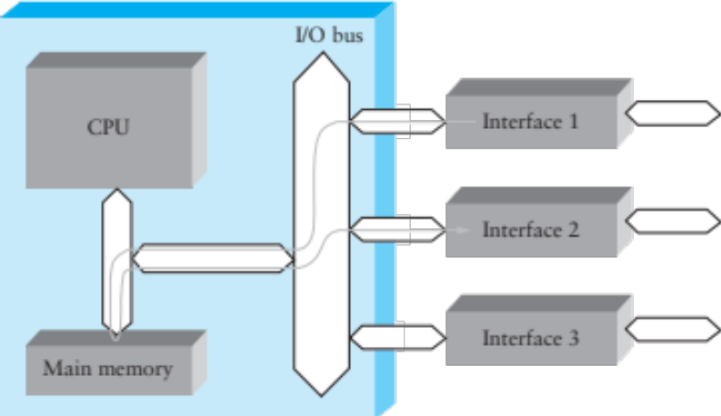
Shared Memory Switch
1st Generation – like a regular PC
  NIC DMAs packet to memory over I/O bus
  CPU examines header, sends to destination NIC
  I/O bus is serious bottleneck
  For small packets, CPU may be limited too
  Typically < 0.5 Gbps

Slide 30
Shared Bus Switch
2st Generation
  NIC has own processor, cache of forwarding table
  Shared bus, doesn’t have to go to main memory
  Typically limited to bus bandwidth
    (Cisco 5600 has a 32Gbps bus)

Slide 31
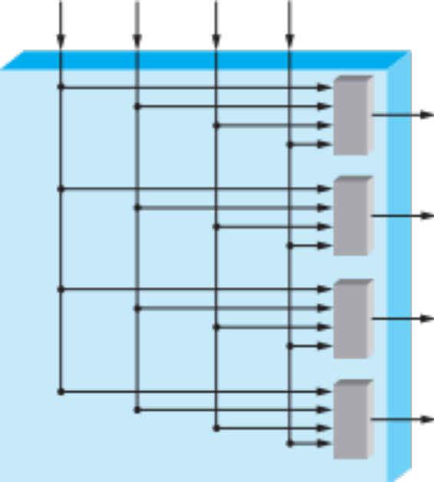
Point to Point Switch
3rd Generation: overcomes single-bus bottleneck
Example: Cross-bar switch
  Any input-output permutation
  Multiple inputs to same output requires trickery
  Cisco 12000 series: 60Gbps
Notes:
Layer 3 routers are similar

Slide 32
IP Protocol
Provides addressing and forwarding
  Addressing is a set of conventions for naming nodes in an IP network
  Forwarding is a local action by a router: passing a packet from input to output port
IP forwarding finds output port based on destination address
  Also defines certain conventions on how to handle packets (e.g., fragmentation, time to live)
Contrast with routing
  Routing is the process of determining how to map packets to output ports (topic of next two lectures)

Slide 33
CIDR Forwarding Table
Example Host:
address 212.31.32.15, net mask 212.31.32/24
Network | Next Address
18/8 | 212.31.32.5
128.148/16 | 212.31.32.4
128.148.128/17 | 212.31.32.8
0/0 | 212.31.32.1
Use longest prefix match
Default route: 0.0.0.0/0 (match any address)
(also called Default Gateway)

Slide 34
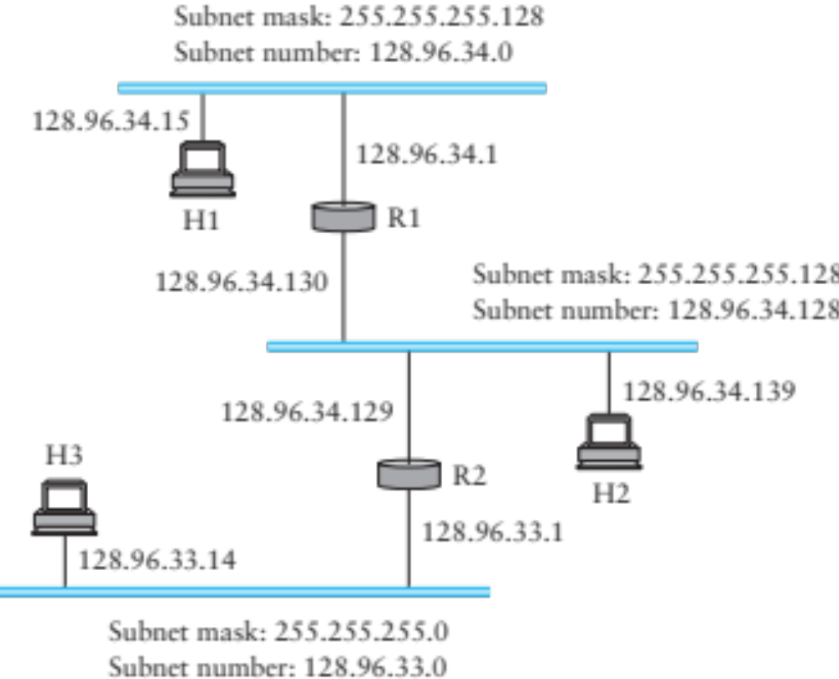
Example
H1-> H2: H2.ip & H1.mask != H1.subnet => no direct path
Notes:
128.96.34.139 = 10000000 01100000 00100010 10001011
Mask: 11111111 11111111 11111111 10000000

Slide 35
R1’s Forwarding Table
Network | Subnet Mask | Next Address
128.96.34.0 | 255.255.255.128 | 128.96.34.1
128.96.34.128 | 255.255.255.128 | 128.96.34.130
128.96.33.0 | 255.255.255.0 | 128.96.34.129

Slide 36
Translating IP to lower level addresses or… How to reach these local addresses?
Map IP addresses into physical addresses
  E.g., Ethernet address of destination host
  or Ethernet address of next hop router
Techniques
  Encode physical address in host part of IP address (IPv6)
  Each network node maintains lookup table (IP->phys)

Slide 37
ARP – address resolution protocol
Dynamically builds table of IP to physical address bindings for a local network
Broadcast request if IP address not in table
All learn IP address of requesting node (broadcast)
Target machine responds with its physical address
Table entries are discarded if not refreshed

Slide 38
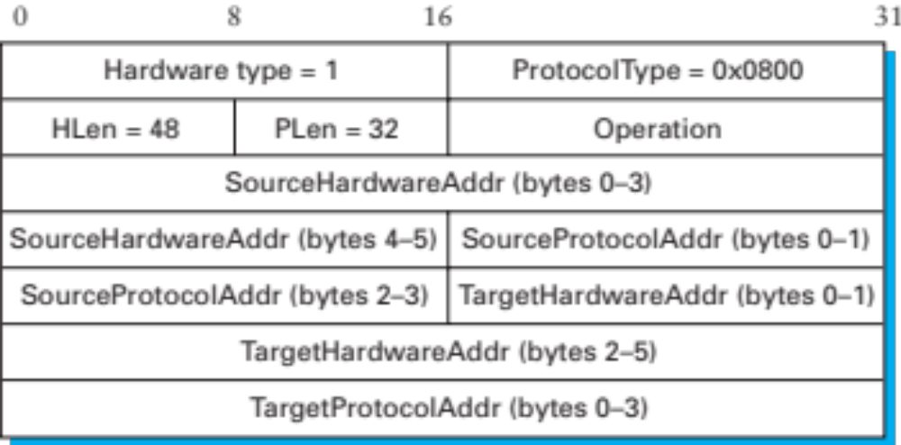
ARP Ethernet frame format
Why include source hardware address? Why not?

Slide 39
Obtaining Host IP Addresses - DHCP
Networks are free to assign addresses within block to hosts
Tedious and error-prone: e.g., laptop going from CIT to library to coffee shop
Solution: Dynamic Host Configuration Protocol
  Client: DHCP Discover to 255.255.255.255 (broadcast)
  Server(s): DHCP Offer to 255.255.255.255 (why broadcast?)
  Client: choose offer, DHCP Request (broadcast, why?)
  Server: DHCP ACK (again broadcast)
Result: address, gateway, netmask, DNS server

Slide 40
Label Switching (MPLS)
Packet carries a ‘label’: an identifier that the switch uses to select the outgoing port
First switch decides on the label based on the packet
The label switching table is set up in advance
Switch can also change the label before forwarding
  {in port, in label} -> {out port, out label}
Makes for simpler switch design
Multiprotocol above and below
  Single forwarding algorithm

