Slide 1
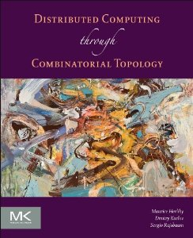
Renaming and Oriented Manifolds
Companion slides for
Distributed Computing
Through Combinatorial Topology
Maurice Herlihy & Dmitry Kozlov & Sergio Rajsbaum
TexPoint fonts used in EMF.
Read the TexPoint manual before you delete this box.: AAAA
Notes:
1

Slide 2
Autonomous Air Traffic Control
DL227
AA082
36,000 ft
35,000 ft
AL991
34,000 ft
33,000 ft
Pick your own altitude!
How many choices do you need?

Slide 3
Road Map
An Upper Bound: 2n+1 Names
Weak Symmetry-Breaking
The Index Lemma
Binary Colorings
A Lower Bound for 2n-Renaming

Slide 4
Road Map
An Upper Bound: 2n+1 Names
Weak Symmetry-Breaking
The Index Lemma
Binary Colorings
A Lower Bound for 2n-Renaming

Slide 5
Index Independence
Avoid trivial solutions …
P_{i} chooses output name i?
P_{i} knows its name, but not i
Can test names for order & equality only
Output depends on input and interleavings only

Slide 6
Protocol for 2n+1 Names
¾^{n} = {P₀, …, P_{n}}
Let …
¢^{2n} = {0, …,2n}
chromatic subdivision
We will construct
rigid simplicial map
½: Rename(¾^{n}) → ¢^{2n}

Slide 7
Protocol for 2n Names
½: Rename(¾^{n}) → ¢^{2n}
means that a wait-free
immediate snapshot protocol exists
we will also display the protocol …

Slide 8
2 processes,
3 names
0
1
2
0
easy to check that map is rigid,
and depends only on order of process names
Notes:
rename2.pdf

Slide 9
shared Boolean flag[2] = {false, false}
// code for P_1
flag[1] := true
if (flag[0])
decide 1
else
decide 0
// code for P_0
flag[0] := true
if (flag[1])
decide 2
else
decide 0

Slide 10
3 processes,
5 names
0
2
2
1
1
0
1
2
0
Index-independent ) symmetric on boundary
Notes:
rename2.pdf

Slide 11
3 processes,
5 names
0
2
2
1
1
0
1
2
0
Index-independent ) symmetric on boundary
Notes:
rename2.pdf

Slide 12
3 processes,
5 names
0
2
2
1
1
0
1
2
0
add “central” n-simplex
Notes:
rename3.eps

Slide 13
3 processes,
5 names
0
union each boundary simplex with complementary central face
2
2
1
1
0
1
2
0
Notes:
rename3.eps

Slide 14
3 processes,
5 names
0
Central vertex for
P₀ gets 2n
2
2
4
1
1
0
1
2
0
Notes:
rename3.eps

Slide 15
3 processes,
5 names
0
2
2
3
4
1
1
that’s too many!
add new names?
5
0
1
2
0
Notes:
rename3.eps

Slide 16
3 processes,
5 names
0
use 2-process
subdivision
here
2
2
1
1
0
1
2
0
Notes:
rename3.eps

Slide 17
3 processes,
5 names
0
except go “down”
from 2n-1
2
2
3
4
1
1
1
2
3
0
1
2
0
Notes:
rename4.eps

Slide 18
3 processes,
5 names
0
2
2
3
4
1
1
1
2
3
take relative subdivision
0
1
2
0
Notes:
rename4.eps

Slide 19
rename(tag, first, direction, r)
peers := {P | same tag, round}
direction?
dn
up
first :=
first + 2|peers|
first :=
first - 2|peers|
Am I max peer?
yes
no
return rename(
tag+peers, first,
!direction, r+1)
return first

Slide 20
Road Map
An Upper Bound: 2n+1 Names
Weak Symmetry-Breaking
The Index Lemma
Binary Colorings
A Lower Bound for 2n-Renaming

Slide 21
Weak Symmetry-Breaking
If all processes participate …
At least one chooses 0, at least one chooses 1
chooses 0
choses 1
Notes:
Weak symmetry-breaking requires breaking processes into two groups.

Slide 22
Weak Symmetry-Breaking
If fewer participate …
we don’t care.
chooses 0
choses 1
Notes:
Weak symmetry-breaking requires breaking processes into two groups.

Slide 23
Claim:
Weak symmetry-breaking is equivalent to 2n-renaming
Lower bound for WSB is lower bound for 2n-renaming …
Upper bound too …

Slide 24
WSB ) 2n-Renaming
WSB
suppose q
choose 0
and n+1-q
choose 1
Notes:
Weak symmetry-breaking requires breaking processes into two groups.

Slide 25
WSB ) 2n-Renaming
WSB
renaming
0…2q
renaming
2n-1, …, 2q+1
Notes:
Weak symmetry-breaking requires breaking processes into two groups.

Slide 26
WSB ) 2n-Renaming
WSB
renaming
0…2q
renaming
2n-1, …, 2q+1
Ranges do not overlap
Notes:
Weak symmetry-breaking requires breaking processes into two groups.

Slide 27
2n-Renaming ) WSB
2n-renaming
3
0
1
Notes:
Weak symmetry-breaking requires breaking processes into two groups.

Slide 28
2n-Renaming ) WSB
2n-renaming
Cannot all be 0 or all 1
parity
parity
3 (mod2) = 1
parity
0 (mod 2) = 1
1 (mod 2) = 1
Notes:
Weak symmetry-breaking requires breaking processes into two groups.

Slide 29
Theorem
There is no 3-process weak symmetry-breaking protocol
Hence no renaming for 3 processes and 4 names

Slide 30
Reminder: Cannot Map Boundary Around a Hole
Hole is an obstruction
?

Slide 31
WSB Output Complex
1
0
0
0
1
1

Slide 32
Protocol Complex (schematic)

Slide 33
Boundary = 2-Process
Executions

Slide 34
Protocol Complex for One Process Execution
¥( ) decides 1 WLOG
¥( ) decides 1 by symmetry
¥( ) decides 1 by symmetry

Slide 35
2-Process execution might be mapped this way …
boundary
protocol
Wraps around
-1 times
output

Slide 36
2-Process execution might be mapped that way …
boundary
protocol
Wraps around
+2 times
output

Slide 37
In General …
boundary
protocol
Wraps around hole
3k-1 ≠ 0 times
QED!
output

Slide 38
Conjecture
For n+1 processes …
the boundary wraps around the hole …
(n+1) ¢ k ≠ 0 times …
so 2n-renaming is impossible!

Slide 39
Conjecture
For n+1 processes …
Wrong!
Only holds if n+1 is a prime power!
the boundary wraps around the hole …
(n+1) ¢ k ≠ 0 times …
so 2n-renaming is impossible!

Slide 40
Road Map
An Upper Bound: 2n+1 Names
Weak Symmetry-Breaking
The Index Lemma
Binary Colorings
A Lower Bound for $2n$-Renaming

Slide 41
Simplex

Slide 42
Oriented Simplex
Sequence:
and even permutations:

Slide 43
Oriented Simplex
Clockwise …
Counter-clockwise …

Slide 44
Induced orientation on faces

Slide 45
Oriented n-manifold with boundary
Adjacent n-simplexes induce opposite orientations on common face

Slide 46
Oriented n-manifold with boundary

Slide 47
Oriented n-manifold with boundary
Arbitrary (n+1)-coloring

Slide 48
Content: number of properly-colored n-simplexes …

Slide 49
Content: number of properly-colored n-simplexes …
+1
+1
-1
Counted by orientation.
C = 1-1+1=1

Slide 50
Content: number of properly-colored n-simplexes …
+1
+1
If content is non-zero, there are properly-colored simplexes.
If zero, there may or may not be properly-colored simplexes.
-1
Counted by orientation.
C = 1-1+1=1

Slide 51
Content: number of properly-colored n-simplexes …
If content is non-zero, there are properly-colored simplexes.
-1
+1
C = 1-1+1=1
If zero, there may or may not be properly-colored simplexes.
+1
Counted by orientation.

Slide 52
Index_{i}: number of boundary (n-1)-simplexes properly colored by colors other than i …
Counted by orientation.
+1
Let i =
+1
-1
I₀ = 1-1+1=1

Slide 53
Index Lemma
+1
+1
+1
+1
-1
-1
C = (-1)^{i} I_{i}

Slide 54
Proof for Dim 2
Let S be the number of 01 edges counted by orientation
boundary edges contribute to I_{i}
Internal edges contribute 0
-1
+1
So S = I_{i}

Slide 55
Proof for Dim 2
For properly colored triangle, 01 edge adds same value to both C and I_{i}
-1
+1

Slide 56
Proof for Dim 2
For non-properly colored triangle, either no 01-edges …
-1

Slide 57
Proof for Dim 2
For non-properly colored triangle, either or two 01-edges that cancel
-1
-1
+1
So S = C

Slide 58
Think of the index as the number of times the boundary of K is wrapped around the boundary of ¢^{2n}
1
2
0
0
1
0
1
1

Slide 59
Think of the index as the number of times the boundary of K is wrapped around the boundary of ¢^{2n}

Slide 60
Think of the index as the number of times the boundary of K is wrapped around the boundary of ¢^{2n}

Slide 61
Think of the index as the number of times the boundary of K is wrapped around the boundary of ¢^{2n}

Slide 62
Think of the index as the number of times the boundary of K is wrapped around the boundary of ¢^{2n}

Slide 63
Think of the index as the number of times the boundary of K is wrapped around the boundary of ¢^{2n}

Slide 64
Think of the index as the number of times the boundary of K is wrapped around the boundary of ¢^{2n}

Slide 65
Think of the index as the number of times the boundary of K is wrapped around the boundary of ¢^{2n}

Slide 66
Think of the index as the number of times the boundary of K is wrapped around the boundary of ¢^{2n}

Slide 67
Think of the index as the number of times the boundary of K is wrapped around the boundary of ¢^{2n}

Slide 68
Think of the index as the number of times the boundary of K is wrapped around the boundary of ¢^{2n}
-1

Slide 69
Road Map
An Upper Bound: 2n+1 Names
Weak Symmetry-Breaking
The Index Lemma
Binary Colorings
A Lower Bound for 2n-Renaming

Slide 70
Strategy
Ch^{N}(¾) = WF immediate snapshot protocol complex

Slide 71
Protocol Complex
Every simplex properly colored by process name

Slide 72
= 0
= 1
Every vertex colored by binary decision value

Slide 73
Every vertex colored by
(name + value) mod n+1
=
+
=
+
=
+
=
+

Slide 74
Every vertex colored by
(name + value) mod n+1
Properly colored , monochrome

Slide 75
Number of monochromatic n-simplexes …
?
Determined by coloring on boundary!

Slide 76
If number of monochromatic simplexes is
determined by boundary …
We can color interior vertexes any way we want!

Slide 77
If number of monochromatic simplexes is
determined by boundary …
All 0
We can color interior vertexes any way we want!

Slide 78
Only 0-monochromatic simplexes …
Easier to count!
All 0

Slide 79
Road Map
An Upper Bound: 2n+1 Names
Weak Symmetry-Breaking
The Index Lemma
Binary Colorings
A Lower Bound for 2n-Renaming

Slide 80
Anonymity & Symmetry
¦ = { }
permutation ¼
¦ = { }
simplicial map ¼

Slide 81
Orientations of symmetric simplexes?
Oriented +1

Slide 82
“Flip” reverses orientation

Slide 83
k flips to “center”
Orientation (-1)^{k}

Slide 84
k flips to “center”
Anonymity ) complex is symmetric …
Orientation (-1)^{k}

Slide 85
k flips to “center”
Anonymity ) complex is symmetric …
Orientation (-1)^{2k} = +1
k flips to symmetric edge

Slide 86
Symmetric boundary simplexes have same orientation

Slide 87
How many monochromatic simplexes?

Slide 88
How many monochromatic n-simplexes?
No 1-monochromatic n-simplexes

Slide 89
+1
How many 0-monochromatic n-simplexes?

Slide 90
WLOG “corner” color is 0
+k₀
How many 0-monochromatic n-simplexes?

Slide 91
There are n+1 symmetric simplexes …
same orientation.
+(n+1)k₀
How many 0-monochromatic n-simplexes?

Slide 92
q-face has k_{q} 0-monochromatic simplexes …
+k_{q}
How many 0-monochromatic n-simplexes?

Slide 93
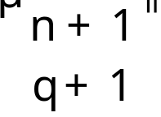
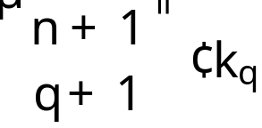
There are symmetric faces…
+
How many 0-monochromatic n-simplexes?

Slide 94
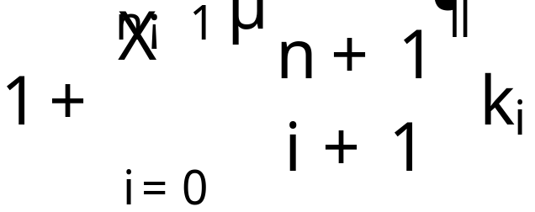
Total number of monochromatic simplexes …
Counted by orientation …
Integers k_{i} …
WSB requires this number to be zero …

Slide 95
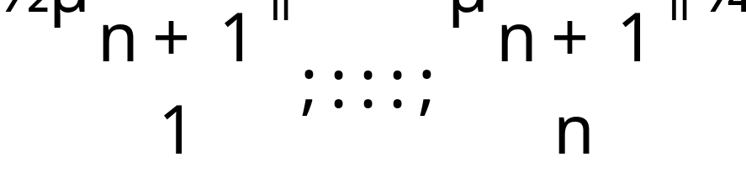
This sum cannot be zero if …
Binomial coefficients have a common factor!

Slide 96
Fact
Binomial coefficients have a common factor
if and only if n+1 is a prime power

Slide 97
Lower Bound
2n-Renaming is impossible if …
n+1 is not a prime power

Slide 98
n=5 smallest n for which impossibility fails …
Possible to prove that an algorithm exists …
But no explicit constriction known …
Yet.

Slide 99
This work is licensed under a Creative Commons Attribution-Noncommercial 3.0 Unported License.

