Slide 1

Simulations and Reductions
Companion slides for
Distributed Computing
Through Combinatorial Topology
Maurice Herlihy & Dmitry Kozlov & Sergio Rajsbaum
TexPoint fonts used in EMF.
Read the TexPoint manual before you delete this box.: AAAA
Notes:
1

Slide 2
Reduction in Complexity Theory
SAT is NP-Complete
Hard to prove
CLIQUE reduces to SAT
Much easier to prove
Therefore CLIQUE is NP-Complete
Reduction is powerful

Slide 3
Reduction in Distributed Computing
Task T impossible for n+1 asynchronous processes if any t can fail
Easy to prove only if n = t
t+1 processes can “simulate” n+1 processes where any t can fail
[Borowsky Gafni]
Therefore task T impossible for n+1 asynchronous processes if any t can fail
Reduction still powerful?

Slide 4
Observations
Reduction often easier than proof from first principles
Existence of reduction is important …
How reduction works? Not so much.

Slide 5
Limitations
Actual reductions often complex, ad-hoc model-specific arguments
Clever but complex
What does it mean for one model to “simulate” another?
Specific examples only

Slide 6
Goal
Define when one model of computation “simulates” another
Covers many cases, not all.
Technique to prove when a simulation exists
No need for explicit construction
Strong enough to support reduction

Slide 7
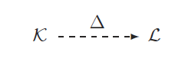
Task Specification
Input complex
Output complex
Task Specification

Slide 8
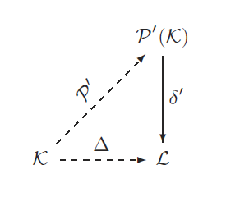
How a Protocol Solves a Task
Protocol complex
Protocol operator
Decision map

Slide 9
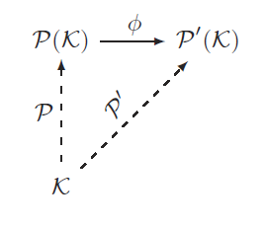
A Simulation
Simulation map
One protocol
Another protocol

Slide 10
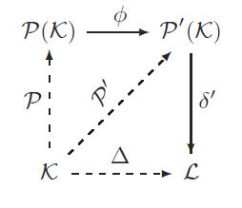
A Reduction
The Diagram commutes

Slide 11
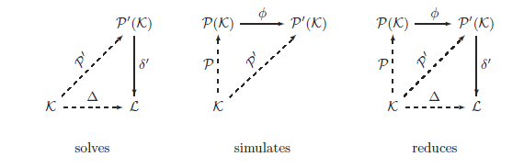
Summary

Slide 12
Strategy
Show that simulation maps exist
Construct simulation map explicitly

Slide 13
N&S Conditions
In each model …
(I,O,¢) has a protocol iff …
f: |skel^{t} I| → |O|
carried by ¢.
for model-specific t

Slide 14
Models that Solve the Same Colorless Tasks
processes | fault-tolerance | model
t+1 | wait-free | layered IS
n+1 | t-resilient | layered IS
n+1 | wait-free | (t+1)-set layered IS
n+1 | t-resilient, 2t<n+1 | message-passing
n+1 | A-resilient, min core t+1 | layered IS adversary
n+1 | t-resilient n+1 > (dim I +2)t | Byzantine

Slide 15
Some Implications
(t+1)-process wait-free can simulate an (n+1)-process wait-free, and vice-versa
If 2t > n+1, (n+1)-process t-resilient message-passing can simulate IS, and vice-versa.
Any adversary can simulate any other adversary whose minimum core size is the same or larger.
An adversary with minimum core size k can simulate a wait-free k-set layered IS.
t-resilient Byzantine can simulate t-resilient layered IS if n + 1 > (dim(I) + 2)t.

Slide 16
BG Simulation
Borowsky-Gafni
Explicit construction
n+1 processes, adversary A
simulate
m+1 processes, adversary A’
where A, A’ have same min core size

Slide 17
Safe Agreement
Validity
all processes that decide, decide some process's input.
Agreement
all processes that decide, decide the same value
we do not require termination!

Slide 18
Propose-Resolve
propose(v)
called once when joining protocol
resolve()
may be called multiple times
returns v if protocol resolved
returns ? if protocol still unresolved

Slide 19
Propose
level
announce
0
?
0
?
0
?
n+1
0
?
0
?

Slide 20
Propose: Unsafe Zone
level
announce
0
?
announce
value with
level 1
1
v
0
?
0
?
0
?

Slide 21
Propose: Unsafe Zone
level
announce
0
?
1
v
take
snapshot
0
?
0
?
0
?

Slide 22
Propose: Safe Zone
level
announce
0
?
0
v
if someone
has 2,
back off
to level 0
0
?
2
w
0
?

Slide 23
Propose: Safe Zone
level
announce
0
?
if no one
has 2,
move to
level 2
2
v
0
?
1
w
0
?

Slide 24
Resolve
level
announce
0
?
2
v
0
?
1
w
0
?
if anyone has 1, return ?

Slide 25
Resolve
level
announce
0
?
2
v
0
?
2
w
0
?
return value at least index with 2

Slide 26
Propose
method propose(input: value)
announce[i] := input
level[i] := 1
snap = snapshot(level)
if (9 j | level[j] = 2)
then
level[i] := 0
else
level[i] := 2

Slide 27
Resolve
method resolve(): value
snap = snapshot(level)
if (9 j | level[j] = 1)
then
return ?
else
return announce[j]
for min {j : level[j] = 2}

Slide 28
What it does
if no one halts in unsafe region (level 1) …
then all resolve same input
if someone halts in unsafe region …
never resolves

Slide 29
BG Simulation
There are t+1 processes …
who do a wait-free simulation of
a t-resilient (n+1)-process protocol
transforms between t-resilient and wait-free

Slide 30
BG Simulation
Use safe agreement …
to agree on simulated snapshots

Slide 31
BG Simulation
Each simulating process participates in…
multiple simultaneous safe agreements

Slide 32
BG Simulation
If one process fails in unsafe region …
it blocks one simulated snapshot …
one simulated crash

Slide 33
BG Simulation
If t out of t+1 halt in unsafe region …
simulates t out of n+1 failures …
remaining process simulates n+1-t survivors

Slide 34
BG Simulation Code
shared mem: array[0..R][0..m] of value
shared agree: array[0..R][0..m] of SafeAgree
local pc: array[0..m] of int := {0,...,0}

Slide 35
BG Simulation Code
shared mem: array[0..R][0..m] of value
shared agree: array[0..R][0..m] of SafeAgree
local pc: array[0..m] of int := {0,...,0}
shared simulated R £ m memory

Slide 36
BG Simulation Code
shared mem: array[0..R][0..m] of value
shared agree: array[0..R][0..m] of SafeAgree
local pc: array[0..m] of int := {0,...,0}
shared safe agreement object
one per memory location

Slide 37
BG Simulation Code
shared mem: array[0..R][0..m] of value
shared agree: array[0..R][0..m] of SafeAgree
local pc: array[0..m] of int := {0,...,0}
program counters,
one per simulated process

Slide 38
BG Simulation Code
method run(input: value): state
for j := 0 to m do
agree[0][j].propose(input)
input value ! final state
set as many inputs as possible to mine
(OK because colorless tasks)

Slide 39
BG Simulation Code
simulate Q_{j}
do forever
for j := 0 to m do
r := pc[j]
v := agree[r][j].resolve()
…
program counter
agree on prior round’s snapshot

Slide 40
BG Simulation Code
do forever
…
if v ≠ ? then
mem[r][j] := v
if pc[j] = R then
return v
if snapshot resolved …
write snapshot to memory
if simulated state is final, return it

Slide 41
BG Simulation Code
if survivor set reached this round…
do forever
…
if survivor set present then
view := values in snapshot(mem[r])
agree[r+1][j].propose(view)
pc[j] := pc[j] + 1
take a snapshot
propose snapshot to write for next round
advance program counter

Slide 42
Two Styles of Colorless Simulation
Combinatorial: simulation map exists
Operational: construct simulation explicitly

Slide 43
The Simulation

Slide 44
This work is licensed under a Creative Commons Attribution-ShareAlike 2.5 License.
You are free:
  to Share — to copy, distribute and transmit the work
  to Remix — to adapt the work
Under the following conditions:
  Attribution. You must attribute the work to “Distributed Computing through Combinatorial Topology” (but not in any way that suggests that the authors endorse you or your use of the work).
  Share Alike. If you alter, transform, or build upon this work, you may distribute the resulting work only under the same, similar or a compatible license.
For any reuse or distribution, you must make clear to others the license terms of this work. The best way to do this is with a link to
  http://creativecommons.org/licenses/by-sa/3.0/.
Any of the above conditions can be waived if you get permission from the copyright holder.
Nothing in this license impairs or restricts the author's moral rights.

Slide 45








