Slide 1

Colorless Wait-Free Computation
Companion slides for
Distributed Computing
Through Combinatorial Topology
Maurice Herlihy & Dmitry Kozlov & Sergio Rajsbaum
TexPoint fonts used in EMF.
Read the TexPoint manual before you delete this box.: AAAA
Notes:
1

Slide 2
Colorless Tasks
32
19
21
2
Notes:
In a colorless task, process identity is unimportant, in the sense that each process can take another’s input or output values. Here they swap values,

Slide 3
Colorless Tasks
32
19
32
21
3
Notes:
But it is OK for one thread to adapt another’s input or output value.

Slide 4
Colorless Tasks
The set of input values …
determines the set of output values.
Number and identities irrelevant…
for both input and output values

Slide 5
Examples
32
32
Consensus
32
OK
k-set agreement
32
7
32
OK
Notes:
Consensus and set agreement are simple examples of colorless tasks where any process can take another’s input or output values.

Slide 6
Non-Examples
Weak Symmetry-Breaking
When all participate …
At least one on group 0, group 1
Not OK!
Notes:
Not all interesting tasks are colorless. For example, in weak symmetry-breaking, it is not legal to replace one process's output with another's: if one process joins group 0, it is not legal for them all to join group zero.

Slide 7
Yes
No
Yes
No
No!
No!
Majority
Not OK!
No!
Notes:
Majority is another example of a task where it is not legal for one thread to adapt another’s input or output value.

Slide 8
Road Map
Operational Model
Combinatorial Model
Main Theorem

Slide 9
Processes
A process is a state machine
Could be Turing machines or more powerful
9
Notes:
It is convenient to model a process as a sequential automaton with a possibly infinite set of states. Remarkably, the set of computable tasks in a given system does not change if the individual processes are modeled as Turing machines, or as even more powerful automata with infinite numbers of states, capable of solving ``undecidable'' problems that Turing machines cannot. The important questions of distributed computing are concerned with communication and dissemination of knowledge, and are largely independent of the computational power of individual processes.

Slide 10
Processes
A process’s state is called its view
Process names taken from a domain ¦
Each process has a unique name (color)
P_{i} 2 ¦
10
Notes:
Each process has a unique name taken from a universe of names $\Pi$. Each process state $q$ also includes a mutable view component, denoted view(q), which typically changes from state to state over an execution. This component represents what the process ``knows'' about the current computation, including any local variables the process may use.

Slide 11
Processes
Each process “knows” its own name
But not the names of the other processes
11
Notes:
Each process ``knows'' its name, but it does not know a priori the names of the participating processes. Instead, each process includes its own name in each communication, so processes learn the names of other participating processes dynamically as the computation unfolds.

Slide 12
Processes
Often, P_{i} is just i
Sometimes P_{i} and i are distinct, and the process “knows” P_{i} but not i
12
Notes:
A distributed system is a set of communicating state machines called \emph{processes}. It is convenient to model a process as a sequential automaton with a possibly infinite set of states. Remarkably, the set of computable tasks in a given system does not change if the individual processes are modeled as Turing machines, or as even more powerful automata with infinite numbers of states, capable of solving ``undecidable'' problems that Turing machines cannot. The important questions of distributed computing are concerned with communication and dissemination of knowledge, and are largely independent of the computational power of individual processes.

Slide 13
Processes
There are n+1 processes
13
Notes:
A distributed system is a set of communicating state machines called \emph{processes}. It is convenient to model a process as a sequential automaton with a~possibly infinite set of states. Remarkably, the set of computable tasks in a given system does not change if the individual processes are modeled as Turing machines, or as even more powerful automata with infinite numbers of states, capable of solving ``undecidable'' problems that Turing machines cannot. The important questions of distributed computing are concerned with communication and dissemination of knowledge, and are largely independent of the computational power of individual processes.

Slide 14
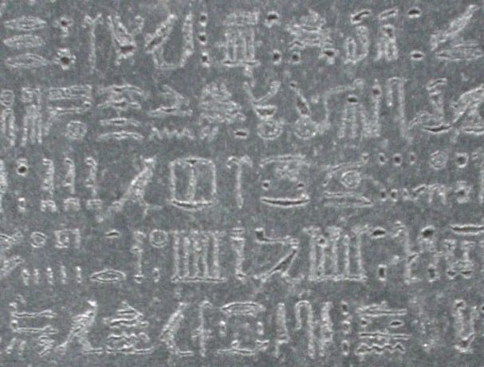
Shared Read-Write Memory
For now, they communicate via reading & writing shared memory
14
Notes:
For the time being, we will consider a model of computation in which processes communicate by reading and writing a shared memory. In modern shared-memory multiprocessors, often called \emph{multicores}, memory is a sequence of individually-addressable \emph{words}. Multicores provide instructions that read or write individual memory words

Slide 15
Immediate Snapshot
Individual reads & writes are too low-level …
A snapshot = atomic read of all memory
We will use immediate snapshot …
Notes:
For our purposes, we will use an idealized version of this model, recasting conventional read and write instructions into equivalent forms that have a cleaner combinatorial structure. Superficially, this idealized model may not look like your laptop, but in terms of task solvability, these models are equivalent: any algorithm in the idealized model can be translated to an an algorithm for the more realistic model, and vice-versa.

Slide 16
Immediate Snapshot
write view to memory
adjacent steps!
take snapshot
Notes:
We combine writes and snapshots as follows. An \emph{immediate snapshot} takes place in two contiguous steps. In the first step, a process writes its view to a word in memory, possibly concurrently with other processes. In the very next step, it takes a snapshot of some or all of the memory, possibly concurrently with other processes. It is important to understand that that in an immediate snapshot, the snapshot step takes place \emph{immediately after} the write step.

Slide 17
Immediate Snapshot
Concurrent steps
write view to memory
write view to memory
take snapshot
take snapshot
Notes:
Here the red and blue processes take steps at the same time.

Slide 18
Immediate Snapshot
immediate
mem[i] := view;
snap := snapshot(mem[*])
Notes:
In our pseudo-code examples, here is how we write immediate snapshots.

Slide 19
P | Q | R
write
snap
 | write
 | snap
 |  | write
 |  | snap
{p} | {p,q} | {p,q,r}
P | Q | R
write
snap
 | write | write
 | snap | snap
{p} | {p,q,r} | {p,q,r}
P | Q | R
write | write | write
snap | snap | snap
{p,q,r} | {p,q,r} | {p,q,r}
Notes:
Here are three examples of immediate snapshot executions. Notice that as we “perturb” each execution, only one process’s view changes.

Slide 20
Realistic?
No!
My laptop reads only a few contiguous memory words at a time
Yes!
Simpler lower bounds: if it’s impossible with IS, it’s impossible on your laptop.
Can implement IS from read-write
Notes:
Superficially, a model based on immediate snapshots may seem unrealistic. As noted, modern multicores do not provide snapshots directly. At best, they provide the ability to atomically read a small, constant number of contiguous memory words. Moreover, in modern multicores, concurrent read and write instructions are typically interleaved in an arbitrary order. Nevertheless, the idealized model includes immediate snapshots for two reasons. First, immediate snapshots simplify lower bounds. It is clear that any task that is impossible using immediate snapshots is also impossible using single-word reads and writes. Moreover, we will see that immediate snapshots yield simpler combinatorial structures than reading and writing individual words. Second, perhaps surprisingly, immediate snapshots do not affect task solvability. It is well-known (see the chapter notes) that one can construct a wait-free snapshot from single-word reads and writes, and we will see in Chapter~\ref{chapter:simcolor} how to construct a wait-free immediate snapshot from snapshots and single-word write instructions. It follows that any task that can be solved using immediate snapshots can be solved using single-word reads and writes, although a direct translation may be impractical.

Slide 21
Crashes
Processes may halt without warning
as many as n out of n+1
Notes:
Failures are halting failures: a process simply stops and takes no more steps. When designing a protocol, it is important to know what kinds of failures your protocol must tolerate.

Slide 22
Asynchronous
Notes:
In asynchronous models, processes take steps at any rate.
Asynchronous comes from Greek: a (not) + synchronous (at the same time).
Synchronous comes from Greek: syn = together, chronos = time.

Slide 23
Asynchronous Failures
??
detection impossible
Notes:
The asynchronous model is difficult because it is impossible to tell whether another process has failed or is just slow.

Slide 24
Configurations
C = {s₀, …, s_{n}}
set of simultaneous process states
initial configurations
final configurations
Notes:
A \emph{configuration} $C$ is a set of process states corresponding to the state of the system at a moment in time. Each process appears at most once in a configuration: if $s_0,s_1$ are distinct states in $C_i$, then $\name(s_0)\neq\name(s_1)$. An \emph{initial configuration} $C_0$ is one where every process state is an initial state, and a a \emph{final configuration} is one where every process state is a final state. Name components are immutable: each process retains its name from one configuration to the next. We use $\names(C)$ for the set of names of processes whose states appear in $C$, and $\act(C)$ for the subset whose states are not final.

Slide 25
Executions
processes that communicate
C₀, S₀, C₁, S₁, …,S_{r}, C_{r+1}
initial configuration
final configuration
next configuration
Notes:
An \emph{execution} defines the order in which processes communicate. Formally, an \emph{execution} is an alternating (usually, but not necessarily, finite) sequence of configurations and sets of process names:

Slide 26
Executions
triple is a concurrent step
C₀, S₀, C₁, S₁, …,S_{r}, C_{r+1}
Processes in S₀ said to participate in step
Only P_{i} 2 S₀ can change between C₀ and C₁
state change result of communication
Notes:
The processes whose states appear in a step are said to \emph{participate} in that step, and similarly for executions. It is essential that only the processes that participate in a step change state. In this way, the model captures the restriction that processes change state only as a result of explicit communication occurring within the schedule.

Slide 27
Executions
finite
C₀, S₀, C₁, S₁, …, S_{r}, C_{r+1}
infinite
C₀, S₀, C₁, S₁, …,
partial
C₀, S₀, C₁, S₁, …, S_{r}, C_{r+1}
Notes:
Executions are usually (but not always) finite, and a partial execution is a prefix of a longer execution.

Slide 28
Crashes are Implicit
C₀, S₀, C₁, S₁, …, S_{r}, C_{r+1}
If P_{i}‘s state not final in the final configuration
then P_{i} has crashed.
crash cannot be detected in finite time
Notes:
Crashes are implicit. If an execution's last configuration is not final, because it includes processes whose states are not final, then those processes are considered to have crashed. This definition captures an essential property of asynchronous systems: it is ambiguous whether an active process has failed (and will never take a step), or whether it is just slow (and will be scheduled in the execution's extension). As noted earlier, this ambiguity is a key aspect of asynchronous systems.

Slide 29
Colorless Tasks
(I, O, ¢)
(colorless) input assignment
carrier map
¢: I ! 2^{O}
(colorless) output assignment
Notes:
A colorless task is given by a set of colorless input assignments $\cI$, a set of colorless output assignments $\cO$, and a relation $\Delta$ which specifies, for each input assignment, which output assignments can be chosen. Note that a colorless task specification is independent of the number of participating processes, or their names.

Slide 30
(Colored) Input Assignments
{(P_{j}, v_{j}), | P_{j} 2 ¦, v_{j} 2 V^{in}}
name, value pair
domain of process names
domain of input values
Notes:
Crashes are implicit. If an execution's last configuration is not final, because it includes processes whose states are not final, then those processes are considered to have crashed. This definition captures an essential property of asynchronous systems: it is ambiguous whether an active process has failed (and will never take a step), or whether it is just slow (and will be scheduled in the execution's extension). As noted earlier, this ambiguity is a key aspect of asynchronous systems.

Slide 31
Colorless Input Assignments
{(P_{j}, v_{j}), | P_{j} 2 ¦, v_{j} 2 V^{in}}
discard process names, keep values
Notes:
Crashes are implicit. If an execution's last configuration is not final, because it includes processes whose states are not final, then those processes are considered to have crashed. This definition captures an essential property of asynchronous systems: it is ambiguous whether an active process has failed (and will never take a step), or whether it is just slow (and will be scheduled in the execution's extension). As noted earlier, this ambiguity is a key aspect of asynchronous systems.

Slide 32
(Colorless)
Output Assignments
{(P_{j}, v_{j}), | P_{j} 2 ¦, v_{j} 2 V^{out}}
{(P_{j}, v_{j}), | P_{j} 2 ¦, v_{j} 2 V^{out}}
Notes:
Crashes are implicit. If an execution's last configuration is not final, because it includes processes whose states are not final, then those processes are considered to have crashed. This definition captures an essential property of asynchronous systems: it is ambiguous whether an active process has failed (and will never take a step), or whether it is just slow (and will be scheduled in the execution's extension). As noted earlier, this ambiguity is a key aspect of asynchronous systems.

Slide 33
Example: Binary Consensus
I = {{0}, {1}, {0,1}}
All start with 0
All start with 1
start with both

Slide 34
Example: Binary Consensus
I = {{0}, {1}, {0,1}}
O = {{0}, {1}}
All decide 0
All decide 1

Slide 35
Example: Binary Consensus
¢({0}) = {{0}}
All start with 0,
all decide 0

Slide 36
Example: Binary Consensus
¢({0}) = {{0}}
¢({1}) = {{1}}
All start with 1,
all decide 1

Slide 37
Example: Binary Consensus
¢({0}) = {{0}}
¢({1}) = {{1}}
¢({0,1}) = {{0},{1}}
with mixed inputs,
all decide 0,
or all decide 1

Slide 38
Colorless Layered Protocol
shared mem array 0..N-1,0..n of Value
view := input
for l := 0 to N-1 do
immediate
mem[l][i] := view;
snap := snapshot(mem[l][*])
view := set of values in snap
return δ(view)

Slide 39
Colorless Layered Protocol
shared mem array 0..N-1,0..n of Value
view := input
for j := 0 to N-1 do
immediate
mem[j][i] := view;
snap := snapshot(mem[j][*])
view := set of values in snap
return δ(view)
2-dimensional memory array
row is clean per-layer memory
column is per-process word

Slide 40
Colorless Layered Protocol
shared mem array 0..N-1,0..n of Value
view := input
for j := 0 to N-1 do
immediate
mem[j][i] := view;
snap := snapshot(mem[j][*])
view := set of values in snap
return δ(view)
initial view is input value

Slide 41
Colorless Layered Protocol
shared mem array 0..N-1,0..n of Value
view := input
for l := 0 to N-1 do
immediate
mem[j][i] := view;
snap := snapshot(mem[j][*])
view := set of values in snap
return δ(view)
run for N layers

Slide 42
Colorless Layered Protocol
shared mem array 0..N-1,0..n of Value
view := input
for j := 0 to N-1 do
immediate
mem[l][i] := view;
snap := snapshot(mem[l][*])
view := set of values in snap
return δ(view)
layer l : immediate write & snapshot of row l

Slide 43
Colorless Layered Protocol
shared mem array 0..N-1,0..n of Value
view := input
for j := 0 to N-1 do
immediate
mem[j][i] := view;
snap := snapshot(mem[j][*])
view := set of values in snap
return δ(view)
new view is set of values seen

Slide 44
Colorless Layered Protocol
shared mem array 0..N-1,0..n of Value
view := input
for j := 0 to N-1 do
immediate
mem[j][i] := view;
snap := snapshot(mem[j][*])
view := set of values in snap
return δ(view)
finally apply decision value to final view

Slide 45
{p},q,r
Q
{p},{p,q},r
R
{p},{p,q},{p,q,r}
R
{p},q,{p,r}
Q
{p},{p,q,r},{p,r}
QR
{p},{p,q,r}
P
R
p,{q},r
{p,q},{q},r
{p,q},{q},{p,q,r}
P
R
P
Q
p,{q},{q,r}
{p,q,r},{q},{q,r}
PR
R
{p,q,r},{q}
p,q,r
P
Q
p,q,{r}
{p,r},q,{r}
{p,r},{p,q,r},{r}
Q
P
PQ
p,{q,r},{r}
{p,q,r},{q,r},{r}
PR
PQ
QR
{p,q},r
{p,q,r},{r}
R
PQR
{p,r},q
{p,q},{p,q,r}
Q
p,{q,r}
P
{p,r},{p,q,r}
{p,q,r}
{q,r},{p,q,r}
Notes:
Fig4-2.pdf

Slide 46
{p},q,r
Q
{p},{p,q},r
R
{p},{p,q},{p,q,r}
R
{p},q,{p,r}
Q
{p},{p,q,r},{p,r}
QR
{p},{p,q,r}
P
R
p,{q},r
{p,q},{q},r
{p,q},{q},{p,q,r}
P
R
P
Q
p,{q},{q,r}
{p,q,r},{q},{q,r}
PR
R
{p,q,r},{q}
p,q,r
P
Q
p,q,{r}
{p,r},q,{r}
{p,r},{p,q,r},{r}
Q
P
PQ
p,{q,r},{r}
{p,q,r},{q,r},{r}
PR
PQ
QR
{p,q},r
{p,q,r},{r}
R
Colorless configurations for processes P,Q,R, inputs
p,q,r, final configurations in black.
PQR
{p,r},q
{p,q},{p,q,r}
Q
p,{q,r}
P
{p,r},{p,q,r}
{p,q,r}
{q,r},{p,q,r}
Notes:
Fig4-2.pdf

Slide 47
Road Map
Operational Model
Combinatorial Model
Main Theorem

Slide 48
Vertex = Process State
Process ID (color)
7
Value (input or output)

Slide 49
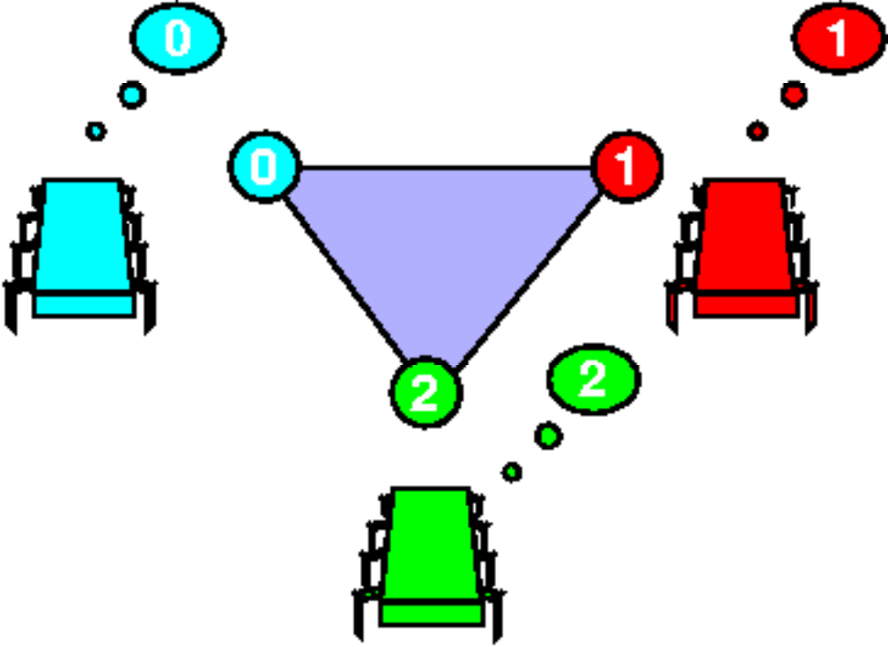
Simplex = Global State

Slide 50
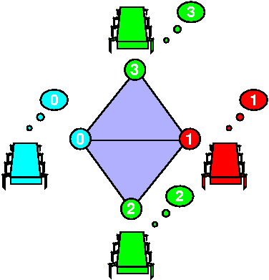
Complex = Global States

Slide 51
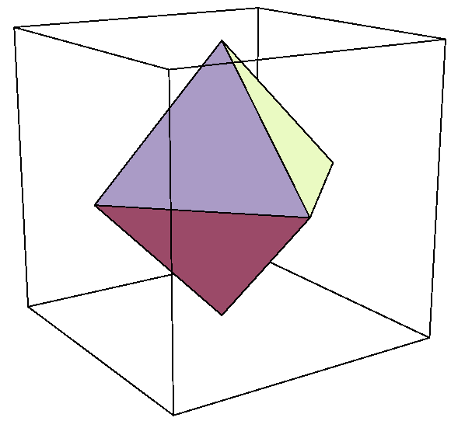
Input Complex for Binary Consensus
0
All possible initial states
0
1
0
Processes: red, green, blue
1
Independently assigned 0 or 1

Slide 52
Output Complex for Binary Consensus
All possible final states
0
0
0
1
Output values all 0 or all 1
1
1
Two disconnected simplexes

Slide 53
Carrier Map for Consensus
All 0 outputs
All 0 inputs

Slide 54
Carrier Map for Consensus
All 1 inputs
All 1 outputs

Slide 55
Carrier Map for Consensus
All 0 outputs
Mixed 0-1 inputs
All 1 outputs

Slide 56
Task Specification
(I, O, ¢)
Input complex
Carrier map
¢: I ! 2^{O}
Output complex

Slide 57
Colorless Tasks
(I, P, ¥)
(colorless) input complex
strict carrier map
¥: I ! 2^{P}
(colorless) protocol complex
Notes:
A colorless task is given by a set of colorless input assignments $\cI$, a set of colorless output assignments $\cO$, and a relation $\Delta$ which specifies, for each input assignment, which output assignments can be chosen. Note that a colorless task specification is independent of the number of participating processes, or their names.

Slide 58
Protocol Complex
Vertex: process name, view
all values read and written
Simplex: compatible set of views
Each execution defines a simplex

Slide 59

Example: Synchronous Message-Passing
Round 0
Round 1

Slide 60

Failures: Fail-Stop
Partial broadcast

Slide 61
Single Input: Round Zero
No messages sent
0
View is input value
0
0
Same as input simplex

Slide 62
Round Zero Protocol Complex
0
No messages sent
0
1
View is input value
0
1
Same as input complex

Slide 63
Single Input: Round One
0
0
0
0
0
0
0
0
0
0
0
0
0
0
0
0
0
0
0
0
0

Slide 64
Single Input: Round One
0
0
0
0
0
0
0
0
0
0
0
0
0
0
0
0
0
no one fails
0
0
0
0

Slide 65
Single Input: Round One
0
0
0
0
0
0
0
0
0
0
0
0
0
0
0
0
0
blue fails
no one fails
0
0
0
0

Slide 66
Single Input: Round One
red fails
green fails
0
0
0
0
0
0
0
0
0
0
0
0
0
0
0
0
0
blue fails
no one fails
0
0
0
0

Slide 67
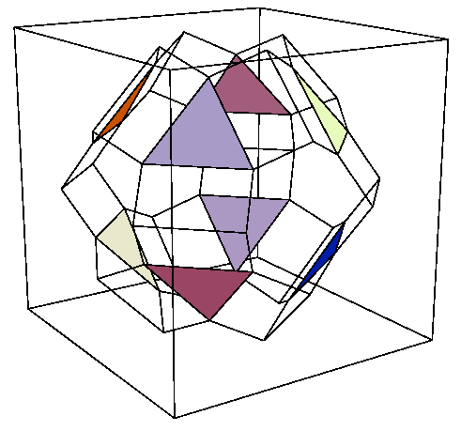
Protocol Complex: Round One

Slide 68
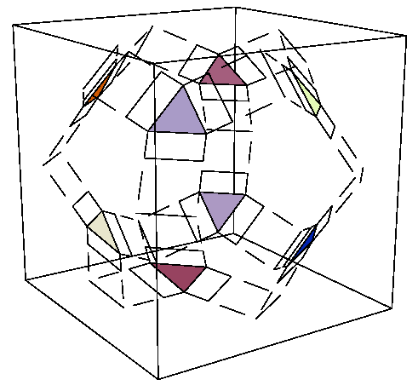
Protocol Complex: Round Two

Slide 69
Protocol Complex Evolution
zero
one
two

Slide 70
Summary
protocol complex
Ξ
δ
input complex
output complex
Δ

Slide 71
Decision Map
δ
Simplicial map, sending simplexes to simplexes
Protocol complex
Output complex

Slide 72
Lower Bound Strategy
δ
Find topological “obstruction” to this simplicial map
Protocol complex
Output complex

Slide 73
Consensus Example
Subcomplex of all-0 inputs
Must map here
0
0
δ
1
1
Protocol
Output

Slide 74
Consensus Example
0
0
δ
1
1
Protocol
Subcomplex of all-1 inputs
Must map here
Output

Slide 75
Consensus Example
Image under δ must start here ..
0
0
δ
1
1
Protocol
Path from
“all-0” to “all-1”
Output
and end here

Slide 76
Consensus Example
path
0
0
δ
?
1
1
Output

Slide 77
Consensus Example
Image under δ must start here ..
But this “hole” is an obstruction
δ
Protocol
Path from
“all-0” to “all-1”
Output
and end here

Slide 78
Conjecture
A protocol cannot solve consensus if its complex is path-connected
Model-independent!

Slide 79
If Adversary keeps Protocol Complex path-connected …
Forever …
Consensus is impossible
For r rounds …
A round-complexity lower bound
For time t …
A time-complexity lower bound

Slide 80
Barycentric Subdivision
Each vertex of Bary ¾ is a face of ¾
Simplex = set of faces ordered by inclusion
¾
Notes:
For our purposes, the most useful subdivision is the \emph{standard chromatic subdivision} defined as follows. Let $\cC$ be a chromatic complex.

Slide 81
Barycentric Agreement
I
Bary I
Distributed Computing through Combinatorial Topology
Notes:
Informally, the processes start out on vertexes of a single simplex $\sigma$ of $\cI$, and they eventually halt on vertexes of a single simplex of $\Delta(\sigma) \subseteq \cI$.

Slide 82
Barycentric Agreement
(I, bary I, bary(¢))
arbitrary input complex
subdivided output complex
subdivision as carrier map
Distributed Computing through Combinatorial Topology
Notes:
Informally, the processes start out on vertexes of a single simplex $\sigma$ of $\cI$, and they eventually halt on vertexes of a single simplex of $\Delta(\sigma) \subseteq \cI$.

Slide 83
If There are n Processes
(I, bary skel^{n} I, bary skel^{n})
Inputs only from n-skeleton of input complex
Distributed Computing through Combinatorial Topology
Notes:
Informally, the processes start out on vertexes of a single simplex $\sigma$ of $\cI$, and they eventually halt on vertexes of a single simplex of $\Delta(\sigma) \subseteq \cI$.

Slide 84
Theorem
A one-layer immediate snapshot protocol solves the n-process barycentric agreement task
(I, bary skel^{n} I, bary skel^{n})
Proof
All input simplices belong to skel^{n} I
Immediate snapshot returns
Set of input vertices (face of input simplex)
Faces ordered wrt one another

Slide 85
Barycentric Agreement Protocol
{v₀, v₂}
{v₀}
{v₀,v₁,v₂}
v₀
v₁
v₂
Snapshots are ordered
Notes:
When process $P_i$ is scheduled to run, it writes its state to $m[i]$, and then
atomically reads the entire array. (We call such an atomic read a
\emph{snapshot}, and its result a \emph{view}.)

Slide 86
Barycentric Agreement Protocol
{v₀,v₁,v₂}
{v₀}
{v₀, v₂}
Each view is a face of ¾
Notes:
When process $P_i$ is scheduled to run, it writes its state to $m[i]$, and then
atomically reads the entire array. (We call such an atomic read a
\emph{snapshot}, and its result a \emph{view}.)

Slide 87
Barycentric Agreement Protocol
{v₀,v₁,v₂}
{v₀}
{v₀, v₂}
Each view is a face of ¾
Notes:
When process $P_i$ is scheduled to run, it writes its state to $m[i]$, and then
atomically reads the entire array. (We call such an atomic read a
\emph{snapshot}, and its result a \emph{view}.)

Slide 88
Barycentric Agreement Protocol
{v₀,v₁,v₂}
{v₀}
{v₀, v₂}
Each face of ¾ is a vertex of Bary ¾
Notes:
When process $P_i$ is scheduled to run, it writes its state to $m[i]$, and then
atomically reads the entire array. (We call such an atomic read a
\emph{snapshot}, and its result a \emph{view}.)

Slide 89
Barycentric Agreement Protocol
Ordered faces ) simplex of Bary ¾
Notes:
When process $P_i$ is scheduled to run, it writes its state to $m[i]$, and then
atomically reads the entire array. (We call such an atomic read a
\emph{snapshot}, and its result a \emph{view}.)

Slide 90
Iterated Barycentric Agreement
skel^{n} I
bary^{N} skel^{n} I
Notes:
Informally, the processes start out on vertexes of a single simplex $\sigma$ of $\cI$, and they eventually halt on vertexes of a single simplex of $\Delta(\sigma) \subseteq \cI$.

Slide 91
Iterated Barycentric Agreement
(I, bary^{N} skel^{n} I, bary^{N} skel^{n})
Distributed Computing through Combinatorial Topology
Notes:
Informally, the processes start out on vertexes of a single simplex $\sigma$ of $\cI$, and they eventually halt on vertexes of a single simplex of $\Delta(\sigma) \subseteq \cI$.

Slide 92
{p},q,r
Q
{p},{p,q},r
R
{p},{p,q},{p,q,r}
One-round IS executions
R
{p},q,{p,r}
Q
{p},{p,q,r},{p,r}
QR
{p},{p,q,r}
P
R
p,{q},r
{p,q},{q},r
{p,q},{q},{p,q,r}
P
R
P
Q
p,{q},{q,r}
{p,q,r},{q},{q,r}
PR
R
{p,q,r},{q}
p,q,r
P
Q
p,q,{r}
{p,r},q,{r}
{p,r},{p,q,r},{r}
Q
P
PQ
p,{q,r},{r}
{p,q,r},{q,r},{r}
PR
PQ
QR
{p,q},r
{p,q,r},{r}
R
PQR
{p,r},q
{p,q},{p,q,r}
Q
p,{q,r}
P
{p,r},{p,q,r}
{p,q,r}
{q,r},{p,q,r}
Notes:
Fig4-2.pdf

Slide 93
One-Layer Immediate Snapshot Protocol Complex
{p}{pq}{pqr}
{p}{pqr}{pqr}
{pqr}{pqr}{pqr}
{pqr}{qr}{qr}
Notes:
93
subdivision

Slide 94
Compare Views
{p},q,r
Q
{p},{p,q},r
R
{p},{p,q},{p,q,r}
R
Q
{p},q,{p,r}
{p},{p,q,r},{p,r}
QR
{p},{p,q,r}
{p}{pq}{pqr}
p,{q},r
P
{p,q},{q},r
R
{p,q},{q},{p,q,r}
P
R
P
Q
PR
p,{q},{q,r}
{p,q,r},{q},{q,r}
{p}{pqr}{pqr}
R
{p,q,r},{q}
p,q,r
p,q,{r}
P
{p,r},q,{r}
Q
{p,r},{p,q,r},{r}
{pqr}{pqr}{pqr}
PQ
Q
P
PR
PQ
p,{q,r},{r}
{p,q,r},{q,r},{r}
QR
{p,q},r
R
{p,q,r},{r}
PQR
{p,r},q
Q
{p,q},{p,q,r}
{pqr}{qr}{qr}
p,{q,r}
P
{p,r},{p,q,r}
{p,q,r}
{q,r},{p,q,r}
Combinatorial view
Operational view
Notes:
94
subdivision

Slide 95
Compositions
Given protocols
(I,P,¥)
(I’,P’,¥’)
where P µ I’
their composition is
(I,P’’,¥’’)
where ¥’’ = ¥’°¥ and P’’ = ¥’’(I)

Slide 96
Theorem
The protocol complex for a single-layer IS protocol (I,P,¥) is
Bary I

Slide 97
Theorem
The protocol complex for an N-layer IS protocol (I,P,¥) is
Bary^{N} I

Slide 98
Corollary
The protocol complex for an N-layer IS protocol (I,P,¥) is
n-connected

Slide 99
Road Map
Operational Model
Combinatorial Model
Main Theorem

Slide 100
Fundamental Theorem
Theorem
(I,O,¢) has a wait-free (n+1)-process layered IS protocol iff there is a continuous map
f: |skel^{n} I| → |O|...
carried by ¢
Notes:
We will prove a simple theorem that completely characterizes when it is possible to solve a colorless task in wait-free read-write memory.
The theorem states that a colorless task $(\cI^*,\cO^*,\Delta^*)$ has a wait-free read-write protocol if and only if there is a continuous map between their polyhedrons,

Slide 101
Proof Outline
Lemma
If …
there is a WF layered protocol for (I,O,¢) …
then …
there is a continuous
f: |skel^{n} I| ! |O| carried by ¢.
Distributed Computing through Combinatorial Topology

Slide 102
Map ) Protocol
Hypothesis
f
Continuous
Bary^{n} I
O
Distributed Computing through Combinatorial Topology

Slide 103
Map ) Protocol
Á
f
Simplicial
approximation
Bary^{n} I
O
Distributed Computing through Combinatorial Topology

Slide 104
Map ) Protocol
Á
Apply Á
Run barycentric Agreement
Bary^{n} I
O
QED
Distributed Computing through Combinatorial Topology

Slide 105
Protocol ) Map
Lemma
Theorem
If …
there is a WF-RW protocol for (I,O,¢) …
if and only if …
then …
there is a continuous
f: |skel^{n} I| ! |O| carried by ¢.
Distributed Computing through Combinatorial Topology

Slide 106
Protocol ) Map
Proof strategy
Inductive construction
g_{d}: |skel^{d} I| ! |¥(I)|.
Base d = 0
Define g₀: |skel⁰ I| ! |¥(I)| …
Let g₀(v) be any vertex in ¥({v})
Distributed Computing through Combinatorial Topology

Slide 107
Protocol ) Map
Induction Hypothesis
g_{d-1}: |skel^{d-1} I| ! |¥(I)|
For all ¾ in skel^{d-1} I
g_{d-1} sends |skel^{d-1} ¾|  |¥(¾)|
But ¥(¾) is (d-1)-connected (earlier theorem)
Can extend to g_{d}: |¾|  |¥(¾)|
Yielding g_{d}: |skel^{d} I| ! |¥(I)|
Distributed Computing through Combinatorial Topology

Slide 108
Protocol ) Map
Constructed
g: |skel^{n} I| → |¥(I)|
Simplicial decision map
δ: ¥(skel^{n} I) → O
|δ|: |¥(skel^{n} I)| → |O|
Composition f = | δ | ¢ g yields
f: | skel^{n} I| ! |O| carried by ¢.
QED
Distributed Computing through Combinatorial Topology

Slide 109
This work is licensed under a Creative Commons Attribution-ShareAlike 2.5 License.
You are free:
  to Share — to copy, distribute and transmit the work
  to Remix — to adapt the work
Under the following conditions:
  Attribution. You must attribute the work to “Distributed Computing through Combinatorial Topology” (but not in any way that suggests that the authors endorse you or your use of the work).
  Share Alike. If you alter, transform, or build upon this work, you may distribute the resulting work only under the same, similar or a compatible license.
For any reuse or distribution, you must make clear to others the license terms of this work. The best way to do this is with a link to
  http://creativecommons.org/licenses/by-sa/3.0/.
Any of the above conditions can be waived if you get permission from the copyright holder.
Nothing in this license impairs or restricts the author's moral rights.

