Slide 1

Elements of Combinatorial Topology
Companion slides for
Distributed Computing
Through Combinatorial Topology
Maurice Herlihy & Dmitry Kozlov & Sergio Rajsbaum
TexPoint fonts used in EMF.
Read the TexPoint manual before you delete this box.: AAAA
Notes:
1

Slide 2
Road Map
Simplicial Complexes
Standard Constructions
Carrier Maps
Connectivity
Subdivisions
Simplicial & Continuous Approximations

Slide 3
Road Map
Simplicial Complexes
Standard Constructions
Carrier Maps
Connectivity
Subdivisions
Simplicial & Continuous Approximations

Slide 4
A Vertex
Notes:
We will build our constructions out of vertices (sing. vertex). From a geometric view, we can think of a vertex as being a point in a sufficiently high-dimensional Euclidean space. From an abstract combinatorial view, a vertex is just an element taken from some domain of elements.

Slide 5
A Vertex
Combinatorial: an element of a set.
Notes:
We will build our constructions out of vertices (sing. vertex). From a geometric view, we can think of a vertex as being a point in a sufficiently high-dimensional Euclidean space. From an abstract combinatorial view, a vertex is just an element taken from some domain of elements.

Slide 6
A Vertex
Combinatorial: an element of a set.
Geometric: a point in high-dimensional Euclidean Space
Notes:
We will build our constructions out of vertices (sing. vertex). From a geometric view, we can think of a vertex as being a point in a sufficiently high-dimensional Euclidean space. From an abstract combinatorial view, a vertex is just an element taken from some domain of elements.

Slide 7
Simplexes
0-simplex
1-simplex
2-simplex
3-simplex
Notes:
A simplex is a set of vertices. Geometrically, we draw simplexes as the convex hull of affinely-independent points. The dimension of a simplex is one less than its number of edges.

Slide 8
Simplexes
Combinatorial: a set of vertexes.
0-simplex
1-simplex
2-simplex
3-simplex
Notes:
A simplex is a set of vertices. Geometrically, we draw simplexes as the convex hull of affinely-independent points. The dimension of a simplex is one less than its number of edges.

Slide 9
Simplexes
Combinatorial: a set of vertexes.
Geometric: convex hull of points in general position
0-simplex
1-simplex
2-simplex
3-simplex
Notes:
A simplex is a set of vertices. Geometrically, we draw simplexes as the convex hull of affinely-independent points. The dimension of a simplex is one less than its number of edges.

Slide 10
Simplexes
Combinatorial: a set of vertexes.
Geometric: convex hull of points in general position
0-simplex
1-simplex
dimension
2-simplex
3-simplex
Notes:
A simplex is a set of vertices. Geometrically, we draw simplexes as the convex hull of affinely-independent points. The dimension of a simplex is one less than its number of edges.

Slide 11
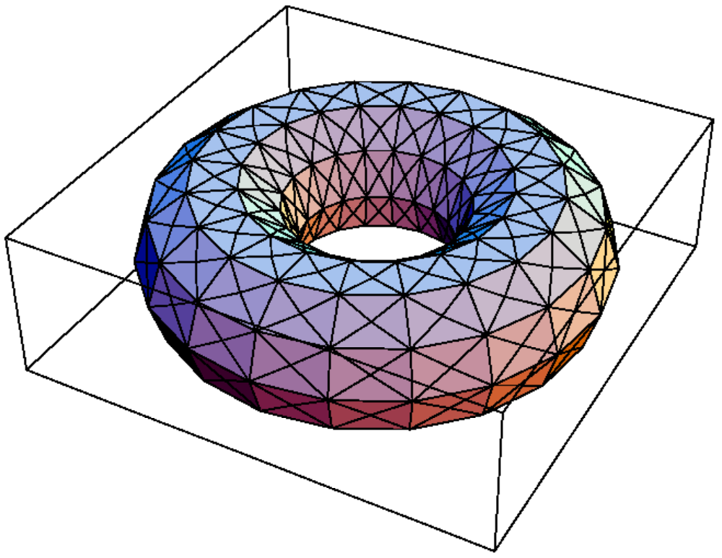
Simplicial Complex
Notes:
A simplicial complex is a set of simplexes closed under inclusion. Geometrically, any two simplices intersect in a common face, which can be empty.

Slide 12
Simplicial Complex
Combinatorial: a set of simplexes close under inclusion.
Notes:
A simplicial complex is a set of simplexes closed under inclusion. Geometrically, any two simplices intersect in a common face, which can be empty.

Slide 13
Simplicial Complex
Combinatorial: a set of simplexes close under inclusion.
Geometric: simplexes “glued together” along faces …
Notes:
A simplicial complex is a set of simplexes closed under inclusion. Geometrically, any two simplices intersect in a common face, which can be empty.

Slide 14
Graphs vs Complexes
Notes:
A simplicial complex is a set of simplexes closed under inclusion. Geometrically, any two simplices intersect in a common face, which can be empty.

Slide 15
Graphs vs Complexes
dimension 0 or 1
Notes:
A simplicial complex is a set of simplexes closed under inclusion. Geometrically, any two simplices intersect in a common face, which can be empty.

Slide 16
Graphs vs Complexes
dimension 0 or 1
arbitrary dimension
Notes:
A simplicial complex is a set of simplexes closed under inclusion. Geometrically, any two simplices intersect in a common face, which can be empty.

Slide 17
Graphs vs Complexes
dimension 0 or 1
arbitrary dimension
complexes are a natural generalization of graphs
Notes:
A simplicial complex is a set of simplexes closed under inclusion. Geometrically, any two simplices intersect in a common face, which can be empty.

Slide 18
Abstract Simplicial Complex
finite set V with a collection K of subsets of V, such that …
Notes:
The singleton set containing each vertex is in the graph. Usually we will be casual about the distinction between a vertex and its singleton set.

Slide 19
Abstract Simplicial Complex
finite set V with a collection K of subsets of V, such that …
for all s 2 S, {s} 2 K
Notes:
The singleton set containing each vertex is in the complex. Usually we will be casual about the distinction between a vertex and its singleton set.

Slide 20
Abstract Simplicial Complex
finite set S with a collection K of subsets of S, such that …
for all s 2 S, {s} 2 K
for all X 2 K, and Y ½ X, Y 2 K
Notes:
Graphs are closed under inclusion. If X is a simplex in \cK, and Y is a subset of X, then X is also in \cG. For graphs, this just says that if an edge is in the graph, so are its two vertices.

Slide 21
Geometric Simplicial Complex
A collection of geometric simplices in R^{d} such that
Notes:
With geometric simplicial complexes, we are talking about subspaces of Euclidean space.

Slide 22
Geometric Simplicial Complex
A collection of geometric simplices in R^{d} such that
any face of a ¾2K is also in K
Notes:
First, geometric complexes are also closed under inclusion.

Slide 23
Geometric Simplicial Complex
A collection of geometric simplices in R^{d} such that
any face of a ¾2K is also in K
for all ¾,¿ 2 K, their intersection
¾ Å ¿ is a face of each of them.
Notes:
Second, we require that geometric simplices in complex fit together nicely. For any two simplices, there intersection must be a face of both (possibly empty).

Slide 24
Abstract vs Geometric Complexes

Slide 25
Abstract vs Geometric Complexes
Abstract: A

Slide 26
Abstract vs Geometric Complexes
Abstract: A
Geometric: |A|

Slide 27
Simplicial Maps
Vertex-to-vertex map …
A
Á
B

Slide 28
Simplicial Map
Vertex-to-vertex map …
A
that sends simplexes to simplexes
Á
B
Á: A ! B

Slide 29
Road Map
Simplicial Complexes
Standard Constructions
Carrier Maps
Connectivity
Subdivisions
Simplicial & Continuous Approximations

Slide 30
Skeleton
C
(solid tetrahedron)
skel² C
(hollow tetrahedron)
skel¹ C
skel⁰ C

Slide 31
Facet
A facet of K is a simplex of maximal dimension

Slide 32
Star
Star(¾,K) is the complex of facets of K containing ¾
Complex

Slide 33
Open Star
Starº(¾,K) union of interiors of simplexes containing ¾
Point Set

Slide 34
Link
Link(¾,K) is the complex of simplices of Star(¾,K) not containing ¾
Complex

Slide 35
More Links
v
v
C
Link(v,C)
Notes:
Examples f the link of a vertex

Slide 36
More Links
e
e
C
Link(e,C)
Notes:
Examples f the link of a vertex

Slide 37
Join
Let A and B be complexes with disjoint sets of vertices
their join A*B is the complex
with vertices V(A) [ V(B)
and simplices ® [ ¯, where ® 2 A, and ¯ 2 B.

Slide 38
Join
A
B
A*B
Notes:
The join of two edges is a tetrahedron

Slide 39
Road Map
Simplicial Complexes
Standard Constructions
Carrier Maps
Connectivity
Subdivisions
Simplicial & Continuous Approximations

Slide 40
Carrier Map
©
A
B
Maps simplex of A
to subcomplex of B
©: A ! 2^{B}

Slide 41
Carrier Maps are Monotonic
©
A
B
If ¿ µ ¾ then ©(¿) µ ©(¾)
or
for ¾,¿ 2 A, ©(¾Å¿) µ ©(¾)Å©(¿)

Slide 42
Example
©
Notes:
42
simplicialVScarrierMap.eps

Slide 43
Example
©
on vertices
Notes:
43
simplicialVScarrierMap.eps

Slide 44
Example
©
on edges
There is no simplicial map carried by ©
Notes:
44
simplicialVScarrierMap.eps

Slide 45
Strict Carrier Maps
©
A
B
for all ¾,¿ 2 A, ©(¾Å¿) = ©(¾)Å©(¿)

Slide 46
Strict Carrier Maps
©
A
B
for all ¾,¿ 2 A, ©(¾Å¿) = ©(¾)Å©(¿)
replace µ with =

Slide 47
Rigid Carrier Maps
©
A
B
for ¾ 2 A, ©(¾) is pure of dimension dim ¾

Slide 48
Carrier of a Simplex
©
A
B
given strict ©: A ! 2^{B}

Slide 49
Carrier of a Simplex
©
A
B
given strict ©: A ! 2^{B}
for each ¿ 2 B,
9 unique smallest ¾ 2 A such that ¿ 2 ©(¾).

Slide 50
Carrier of a Simplex
©
A
B
given strict ©: A ! 2^{B}
for each ¿ 2 B,
9 unique smallest ¾ 2 A such that ¿ 2 ©(¾).
¾ = Car(¿, ©(¾))
sometimes
omitted

Slide 51
Carrier of a Simplex
©
A
B
given strict ©: A ! 2^{B}
for each ¿ 2 B,
9 unique smallest ¾ 2 A such that ¿ 2 ©(¾).
¾ = Car(¿, ©(¾))
sometimes
omitted

Slide 52
Carrier Map Carried By Carrier Map
Given carrier maps
©: A ! 2^{B}
ª: A ! 2^{B}

Slide 53
Carrier Map Carried By Carrier Map
Given carrier maps
©: A ! 2^{B}
ª: A ! 2^{B}
© is carried by ª if
for all ¾ 2 A, ©(¾) µ ª(¾)

Slide 54
Carrier Map Carried By Carrier Map
Given carrier maps
©: A ! 2^{B}
ª: A ! 2^{B}
© is carried by ª if
for all ¾ 2 A, ©(¾) µ ª(¾)
written: © µ ª

Slide 55
Simplicial Map Carried By Carrier Map
Given carrier and simplicial maps
©: A ! 2^{B}
ϕ: A ! B

Slide 56
Simplicial Map Carried By Carrier Map
Given carrier and simplicial maps
©: A ! 2^{B}
ϕ: A ! B
ϕ is carried by © if

Slide 57
Simplicial Map Carried By Carrier Map
Given carrier and simplicial maps
©: A ! 2^{B}
ϕ: A ! B
ϕ is carried by © if
for all ¾ 2 A, ϕ(¾) µ ©(¾)

Slide 58
Simplicial Map Carried By Carrier Map
Given carrier and simplicial maps
©: A ! 2^{B}
ϕ: A ! B
ϕ is carried by © if
for all ¾ 2 A, ϕ(¾) µ ©(¾)
written: ϕ µ ©

Slide 59
Continuous Map Carried By Carrier Map
Given carrier and continuous maps
©: A ! 2^{B}
f: |A| ! |B|

Slide 60
Continuous Map Carried By Carrier Map
Given carrier and continuous maps
©: A ! 2^{B}
f: |A| ! |B|
f is carried by © if

Slide 61
Continuous Map Carried By Carrier Map
Given carrier and continuous maps
©: A ! 2^{B}
f: |A| ! |B|
f is carried by © if
for all ¾ 2 A, f(¾) µ |©(¾)|

Slide 62
Compositions
Given carrier maps
©: A ! 2^{B}
ª: B ! 2^{C}
their composition is
(ª ° ©)(¾) := [_{¿ 2 ©(¾)} ª(¿)

Slide 63
Theorem
If ©, ª are both
strict
so is © ° ª
rigid
so is © ° ª

Slide 64
Compositions
Given carrier and simplicial maps
©: A ! 2^{B}
ϕ: C ! A

Slide 65
Compositions
Given carrier and simplicial maps
©: A ! 2^{B}
ϕ: C ! A
their composition is the carrier map
(© ° ϕ): C ! 2^{B}

Slide 66
Compositions
Given carrier and simplicial maps
©: A ! 2^{B}
ϕ: C ! A
their composition is the carrier map
(© ° ϕ): C ! 2^{B}
defined by
(© ° ϕ)(¾) := © (ϕ(¾))

Slide 67
Compositions
Given carrier and simplicial maps
©: A ! 2^{B}
ϕ: B ! C

Slide 68
Compositions
Given carrier and simplicial maps
©: A ! 2^{B}
ϕ: B ! C
their composition is the carrier map
(ϕ ° ©): A ! 2^{C}

Slide 69
Compositions
Given carrier and simplicial maps
©: A ! 2^{B}
ϕ: B ! C
their composition is the carrier map
(ϕ ° ©): A ! 2^{C}
defined by
(© ° ϕ)(¾) := [_{¿ 2 ©(¾)} ϕ(¿)

Slide 70
Colorings
¢^{n} :=

Slide 71
Chromatic Complex
Â
A
¢^{n}
rigid simplicial map

Slide 72
Color-Preserving Simplicial Map
ϕ
A
¢^{n}
color of v = color of ϕ(v)

Slide 73
Road Map
Simplicial Complexes
Standard Constructions
Carrier Maps
Connectivity
Subdivisions
Simplicial & Continuous Approximations

Slide 74
A Path
simplicial
complex
vertex
edge
edge
edge
edge
vertex
vertex
vertex
vertex

Slide 75
Path Connected
Any two vertexes can be linked by a path

Slide 76
Rethinking Path Connectivity
0-sphere
Let’s call this complex 0-connected
1-disc

Slide 77
1-Connectivity
1-sphere
2-disc

Slide 78
This Complex is not 1-Connected
?

Slide 79


2-Connectivity
2-sphere
3-disk

Slide 80


n-connectivity
C is n-connected, if, for m · n, every continuous map of the m-sphere
can be extended to a continuous map of the (m+1)-disk

Slide 81
n-connectivity
C is n-connected, if, for m · n, every continuous map of the m-sphere
can be extended to a continuous map of the (m+1)-disk
(-1)-connected is non-empty

Slide 82
Road Map
Simplicial Complexes
Standard Constructions
Carrier Maps
Connectivity
Subdivisions
Simplicial & Continuous Approximations

Slide 83
Subdivisions
Notes:
A geometric complex is subdivided by partitioning each of its simplexes into smaller simplexes without changing the complex's polyhedron.

Slide 84
Subdivisions
Notes:
A geometric complex is subdivided by partitioning each of its simplexes into smaller simplexes without changing the complex's polyhedron.

Slide 85
B is a subdivision of A if …
¯
For each simplex ¯ of B there is a simplex ® of A such that |¯| µ |®|.
®
Notes:
A geometric complex is subdivided by partitioning each of its simplexes into smaller simplexes without changing the complex's polyhedron.

Slide 86
B is a subdivision of A if …
¯
For each simplex ¯ of B there is a simplex ® of A such that |¯| µ |®|.
®
For each simplex ® of A, |®| is the union of a finite set of geometric simplexes of B.
Notes:
A geometric complex is subdivided by partitioning each of its simplexes into smaller simplexes without changing the complex's polyhedron.

Slide 87
Stellar Subdivision
¾
Notes:
For our purposes, the most useful subdivision is the \emph{standard chromatic subdivision} defined as follows. Let $\cC$ be a chromatic complex.

Slide 88
Stellar Subdivision
¾
Stel ¾
Notes:
For our purposes, the most useful subdivision is the \emph{standard chromatic subdivision} defined as follows. Let $\cC$ be a chromatic complex.

Slide 89
Stellar Subdivision
Any subdivision is the composition of stellar subdivisions
¾
Stel ¾
Notes:
For our purposes, the most useful subdivision is the \emph{standard chromatic subdivision} defined as follows. Let $\cC$ be a chromatic complex.

Slide 90
Barycentric Subdivision
¾
Notes:
For our purposes, the most useful subdivision is the \emph{standard chromatic subdivision} defined as follows. Let $\cC$ be a chromatic complex.

Slide 91
Barycentric Subdivision
¾
Bary ¾
Notes:
For our purposes, the most useful subdivision is the \emph{standard chromatic subdivision} defined as follows. Let $\cC$ be a chromatic complex.

Slide 92
Barycentric Subdivision
¾
Notes:
For our purposes, the most useful subdivision is the \emph{standard chromatic subdivision} defined as follows. Let $\cC$ be a chromatic complex.

Slide 93
Barycentric Subdivision
Each vertex of Bary ¾ is a face of ¾
¾
Notes:
For our purposes, the most useful subdivision is the \emph{standard chromatic subdivision} defined as follows. Let $\cC$ be a chromatic complex.

Slide 94
Barycentric Subdivision
Each vertex of Bary ¾ is a face of ¾
¾
Notes:
For our purposes, the most useful subdivision is the \emph{standard chromatic subdivision} defined as follows. Let $\cC$ be a chromatic complex.

Slide 95
Barycentric Subdivision
Each vertex of Bary ¾ is a face of ¾
Simplex = faces ordered by inclusion
¾
Notes:
For our purposes, the most useful subdivision is the \emph{standard chromatic subdivision} defined as follows. Let $\cC$ be a chromatic complex.

Slide 96
Barycentric Coordinates
v₀
x = t₀ v₀ + t₁ v₁ + t₂ v₂
0 · t₀,t₁,t₂ · 1
x
∑ t_{i} = 1
v₂
v₁
Every point of |C| has a unique representation using barycentric coordinates

Slide 97
Standard Chromatic Subdivision
Notes:
subdivisions
97

Slide 98
Standard Chromatic Subdivision
Ch ¾
Notes:
subdivisions
98

Slide 99
Standard Chromatic Subdivision
Ch ¾
Chromatic form of Barycentric
Notes:
subdivisions
99

Slide 100
Road Map
Simplicial Complexes
Standard Constructions
Carrier Maps
Connectivity
Subdivisions
Simplicial & Continuous Approximations

Slide 101

From Simplicial to Continuous
simplicial
continuous
Notes:
One direction is easy. Any simplicial map $\phi:\cA~\to~\cB$ can be turned into a piece-wise linear map $|\phi|:|\cA|~\to~|\cB|$ by extending over barycentric coordinates.

Slide 102
From Simplicial to Continuous
simplicial
continuous
Notes:
One direction is easy. Any simplicial map $\phi:\cA~\to~\cB$ can be turned into a piece-wise linear map $|\phi|:|\cA|~\to~|\cB|$ by extending over barycentric coordinates.

Slide 103
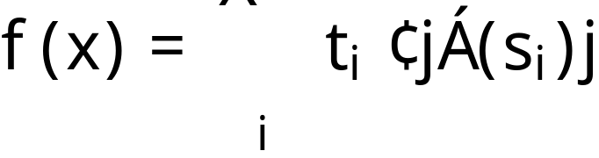
From Simplicial to Continuous
simplicial
continuous
extend over barycentric coordinates
(piece-wise linear map)
Notes:
One direction is easy. Any simplicial map $\phi:\cA~\to~\cB$ can be turned into a piece-wise linear map $|\phi|:|\cA|~\to~|\cB|$ by extending over barycentric coordinates.

Slide 104
Maps
simplicial
continuous

Slide 105
Maps
simplicial
Simplicial Approximation Theorem
continuous

Slide 106




Simplicial Approximation
simplicial
continuous

Slide 107



Simplicial Approximation

Slide 108


Simplicial Approximation

Slide 109


Simplicial Approximation

Slide 110
Simplicial Approximation

Slide 111

Simplicial Approximation

Slide 112
Simplicial Approximation

Slide 113

Simplicial Approximation

Slide 114
Simplicial Approximation

Slide 115
Simplicial Approximation
Á is a simplicial approximation of f if …

Slide 116

Simplicial Approximation
Á is a simplicial approximation of f if …
for every v in A …

Slide 117

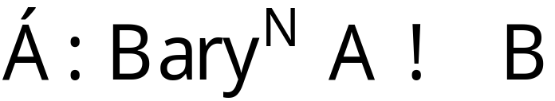
Simplicial Approximation Theorem
Given a continuous map
there is an N such that f has a simplicial approximation
Notes:
Not every continuous map $f:|\cA|~\to~|\cB|$ has a simplicial
approximation mapping $\cA$ to $\cB$.
The following theorem, however,
states we can always find a simplicial approximation defined over a
sufficiently refined subdivision of $\cA$.
We won’t prove this theorem here, since the proof can be found in any elementary Topology textbook.

Slide 118
Simplicial Approximation Theorem
Given a continuous map
there is an N such that f has a simplicial approximation
Actually holds for most other subdivisions….
Notes:
Not every continuous map $f:|\cA|~\to~|\cB|$ has a simplicial
approximation mapping $\cA$ to $\cB$.
The following theorem, however,
states we can always find a simplicial approximation defined over a
sufficiently refined subdivision of $\cA$.
We won’t prove this theorem here, since the proof can be found in any elementary Topology textbook.

Slide 119
This work is licensed under a Creative Commons Attribution-ShareAlike 2.5 License.
You are free:
  to Share — to copy, distribute and transmit the work
  to Remix — to adapt the work
Under the following conditions:
  Attribution. You must attribute the work to “Distributed Computing through Combinatorial Topology” (but not in any way that suggests that the authors endorse you or your use of the work).
  Share Alike. If you alter, transform, or build upon this work, you may distribute the resulting work only under the same, similar or a compatible license.
For any reuse or distribution, you must make clear to others the license terms of this work. The best way to do this is with a link to
  http://creativecommons.org/licenses/by-sa/3.0/.
Any of the above conditions can be waived if you get permission from the copyright holder.
Nothing in this license impairs or restricts the author's moral rights.

