Slide 1
CSCI-1680
Wrap-up Lecture
Rodrigo Fonseca
With some material from Jen Rexford

Slide 2
Administrivia
Today is the last class!
Two more things to go:
  Final project, due this Sunday, May 6th
  Final Exam, May 10th, 9AM, CIT 219
How do you study?
  Any covered topic is fair game, but more emphasis on content given after midterm (TCP on)
  Lecture slides, homeworks, plus relevant sections of the book (will update website)
  If in doubt, no topic not covered in class will be on the exam

Slide 3
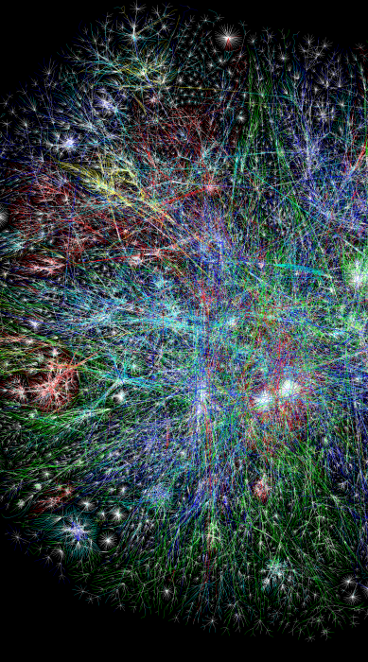
What you (hopefully) learned from this course
Skill: Network programming
  C programming (most of you)
  Socket programming
  Server programming
  Implementing protocols
Knowledge: How the Internet Works
  IP Protocol suite
  Internet Architecture
  Applications (Web, DNS, P2P, …)
Insight: key concepts
  Protocols
  Layering
  Naming

Slide 4
Today
Cut across protocols, identify principles
Internet Architecture
  Virtues and challenges going forward!

Slide 5
Networking Principles
We saw many layers and protocols, but some principles are comon to many
Some are general CS concepts
  Hierarchy
  Indirection
  Caching
  Randomization
Some are somewhat networing-specific
  Layering
  Multiplexing
  End-to-end argument
  Soft-state

Slide 6
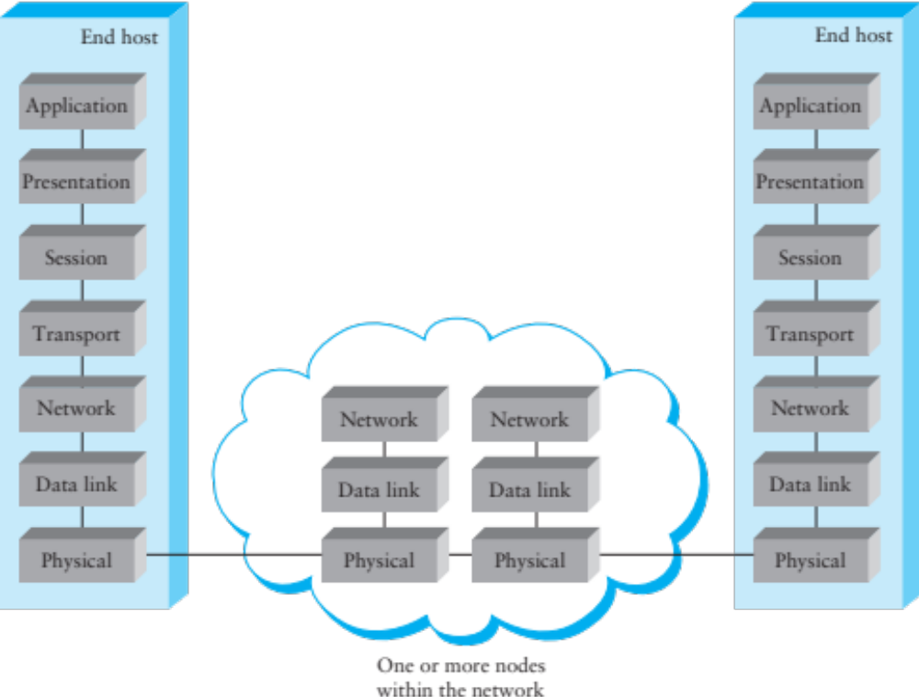
Layering

Slide 7
Layering
Strong form of encapsulation, abstraction
Each layer has three interfaces:
  Services provided to upper layer
  Protocol to communicate with peer at the same layer
  Using the services of the lower layer
Provided interface hides all details of internal interface and lower layers
Can be highly recursive
  E.g., IP over DNS, File system over Gmail!

Slide 8
Layering on the Internet
HTTP message
HTTP
HTTP
TCP segment
TCP
TCP
router
router
IP
IP packet
IP packet
IP packet
IP
IP
IP
Ethernet
interface
Ethernet
interface
SONET
interface
SONET
interface
Ethernet
interface
Ethernet
interface
Ethernet frame
SONET frame
Ethernet frame

Slide 9
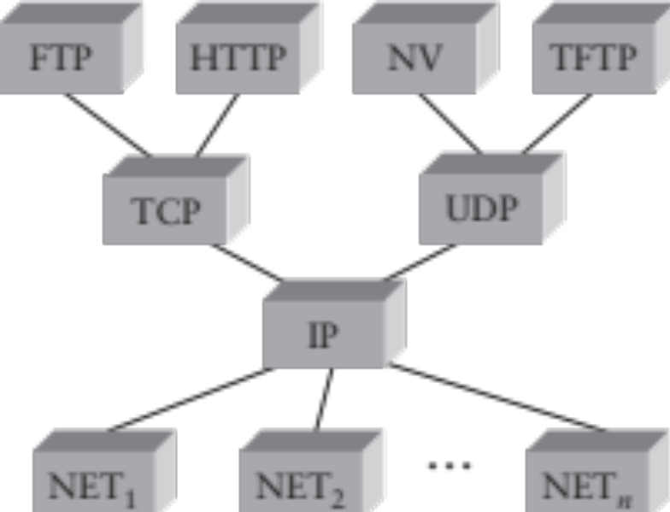
Layering: IP as a Narrow Waist
Many applications protocols on top of UDP & TCP
IP works over many types of networks
This is the “Hourglass” architecture of the Internet.
  If every network supports IP, applications run over many different networks (e.g., cellular network)

Slide 10
Layering: Data Encapsulation
One layer’s data is the (opaque) payload of the next
  Stream (Application)
  Segments (TCP)
  Packets (IP)
  Frames (Ethernet)
  Encoding: bits -> chips
  Modulation: chips -> signal variations
Ethernet Frame
IP Packet
TCP Segment
Application data

Slide 11
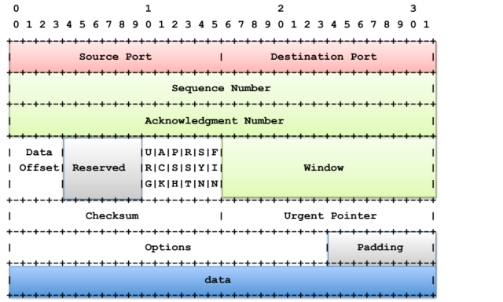
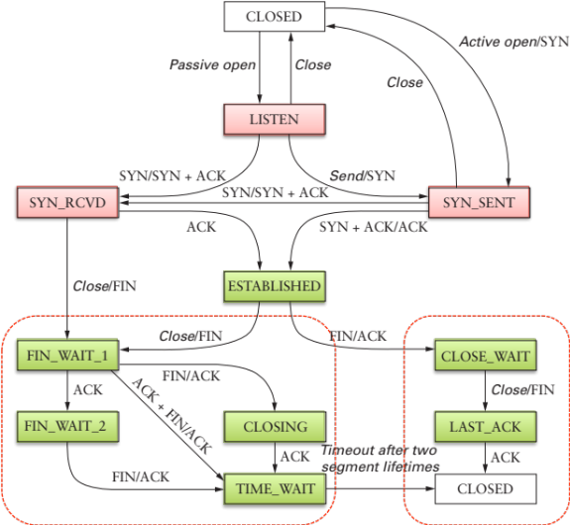
Protocols
Specifications for communication
  Data formats
  Behaviors (FSMs)
Allow
  Interoperability
  Independent implementations
  Don’t need to specify everything
    E.g., TCP Congestion Control
Postel’s Robustness Principle
  "Be liberal in what you accept, and conservative in what you send” (RFC 1122)

Slide 12
Multiplexing
Multiple streams/flows can share at different levels
  Important to be able to de-multiplex: need naming
Sharing
  Cost: infrastructure sharing
  Access: single channel sharing
  Reuse: Implementation sharing

Slide 13
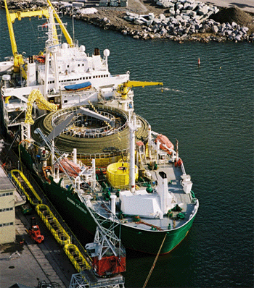
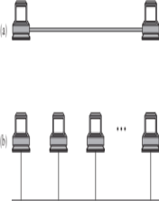
Multiplexing: Cost
Multiple flows/streams can share a link/path
  Packet switching
  Circuit switching
Issues
  Coordinate access
    In time, in space, in frequency
  De-multiplexing (name, id)

Slide 14
Multiplexing: Access
Sharing a single channel
E.g.,
  NAT: multiple nodes share a single IP address
    De-multiplexing: NAT uses 5-tuple to disambiguate
  SSH port forwarding
    Only port 22 is open, can tunnel other ports
    ssh other.host.com –L 5900:other.host.com:5900
  VPN

Slide 15
Multiplexing: Reuse
No need to re-implement functionality
  Several streams/flows can use the services of a protocol
E.g.:
  IP/ARP/AppleTalk on Ethernet: demux EtherType
  TCP/UDP/DCCP/… on IP: demux Protocol ID
  HTTP/SIP/SMTP/… on TCP/UDP: demux on Port
  Multiple hosts on one HTTP server: demux on Host: field

Slide 16
End-to-End Argument
“The end knows best”
“The function in question can completely and correctly be implemented only with the knowledge and help of the application standing at the end points of the communication system. Therefore, providing that questioned function as a feature of the communication system itself is not possible. (Sometimes an incomplete version of the function provided by the communication system may be useful as a performance enhancement.)”
End-to-end arguments in system design. Saltzer, Reed, and Clark. Technology (100), 1984

Slide 17
End-to-end argument
Reliability:
  File transfer application: even through TCP, has to check for file correctness (e.g., BitTorrent hashes)
  So reliability by the transport layer is redundant
  Would work even on top of UDP
Multihop wireless:
  10 hops, 10% chance of packet loss per hop:
  Chance of success: 0.9¹⁰ ~ 35%
  If you do up to 3 retransmissions per hop, loss drops to 0.1³ = 0.001 per hop => chance of success 0.999¹⁰ ~ 99% !
    But can’t make it 0 => still require end-to-end check!

Slide 18
End-to-end argument: examples
Encryption: need assurance of no tampering, can only prove if the end point encrypted the message
  Doesn’t matter if the network automatically encrypts
Duplicate suppression
  “Don’t click submit twice”: even though TCP is underneath, two requests will be different data for the network, application must enforce at-most-once
Automatic recovery
  Airline reservation: rather than guaranteeing that every request can survive system crashes, rely on operators to retry.

Slide 19
End-to-end argument
Instinctively we like modularity and clean interfaces
  Which means putting functionality in low-level abstractions
Examples: reliability, in-order delivery, security
But some applications won’t be able to rely on this
  Low level functionality might be redundant
  Or might be insufficient
  Or might be useless for some applications
  Or might be harmful – e.g., real-time audio over a reliable, in-order delivery channel
Use as a guiding principle or where to place functionality

Slide 20
Hierarchy
Scalability of large systems
  Cannot store all information everywhere
  Cannot centrally control every component
Hierarchy as a way to manage scale
  Divide large system in smaller pieces
  Summarize information about each piece
Hierarchy as a way to divide control
  Decentralized management of pieces
Many examples of hierarchy in the Internet

Slide 21
Hierarchy Examples: IP Routing
IP Addressing
  Hierarchical assignment of address blocks
  IANA -> Regional Internet Registries -> ISPs
  Decentralized control
Topology
  (Roughly) correlated with addressing
  Allows aggregation (CIDR)
    Brown owns 128.148.0.0/16
  Decreases size of routing tables!

Slide 22
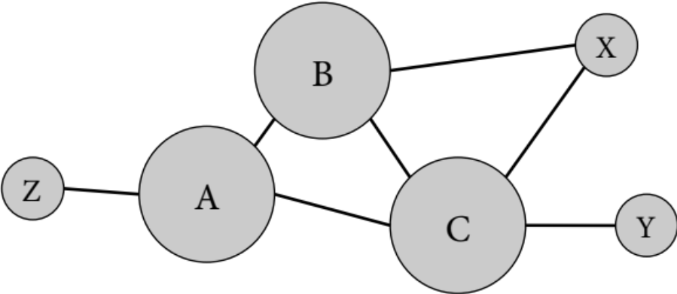
Hierarchy Examples: IP Routing
AS-level Topology
  Separates intra and inter-domain routing
  ASs have own economic interests
  Delegation of control
    Policy in inter-domain routing
    Complete control of intra-domain routing
Hierarchical Topology
  Transit, Multi-homed, Stub ASs

Slide 23
Hierarchy Examples: DNS
Hierarchical name database
Allows delegation of control
  Each organization controls a sub-tree
  May delegate control
Allows scaling of the infrastructure
  A DNS server only needs to know about its sub-domains

Slide 24
Hierarchy Example: MAC Addresses
Ethernet MAC addresses are globally unique identifiers
  First 3 bytes: manufacturer, allocated by consortium
  Last 3 bytes: allocated by manufacturer

Slide 25
Indirection
Referencing by name
“Any problem in computer science can be solved with another level of indirection... Except for the problem of too many layers of indirection” David Wheeler
Goes hand in hand with the layering abstractions
Benefits
  Human convenience
  Makes underlying changes transparent
Examples
  Host names versus IP addresses

Slide 26
Names versus addresses
Names are easier to remember
Addresses can change underneath
Name could map to multiple IP addresses
  E.g. load balancing, or geographically closer server
Multiple names for the same address
Need a way to map one to the other
  DNS hierarchy

Slide 27
Many Translations
DHCP: Given a MAC Address, assign an IP address
  Uses IP broadcast to find server
ARP: Given an IP address, find Ethernet MAC Addresses
  Uses Link Layer broadcast to find node
DNS: Given a Name, find an IP address
  Uses IP unicast/anycast to well known roots, to bootstrap
  Relies on IP routing infrastructure, DNS hierarchy
DHT: Given a key, find a node
  Uses IP unicast plus efficient flat namespace routing

Slide 28
Caching
Duplicate data stored elsewhere
  Reduce latency for accessing the data
  Reduce the load on other parts of the system
Often quite effective
  Locality of reference: temporal locality and small set of popular items
Examples:
  Web caching
  DNS caching
  ARP caching
  Learning bridges

Slide 29
DNS Caching
What is cached?
  Mapping of names to IP addresses
  Lookups that failed
  IP addresses of name servers
Reduces latency
Reduces load on hierarchy
Why is it effective?
  Mostly read database
  Doesn’t change very often
  Popular sites are visited often

Slide 30
HTTP Caching
What is cached?
  Web objects
Where is it cached?
  Browser, proxy-cache, main memory on server
Reduces latency, load
What contributes to high hit rates?
  Cacheable content (mostly static)
  Sharing the cache among multiple users
  Small amount of popular content

Slide 31
Randomization
Distributed adaptive algorithms
Risk of synchronization
  Many parties respond to the same conditions in the same way
  May lead to bad aggregate behavior
Randomization can de-synchronize
  Example: Ethernet backoff mechanism
  Example: Random Early Drop

Slide 32
Soft State
State is stored in nodes by network protocols
  E.g., a mapping, routing entry, cached object
Key issue: how to deal with changes?
Hard state: “valid unless told otherwise”
  “Managed” by originator of state
  Kept consistent, explicit invalidation
Soft state: “valid if fresh”
  Removed by storing node on timeout
  Periodically refreshed as needed
    May need extra cost (on-demand revalidation or check)
  Can be seen as a hint
Soft state reduces complexity

Slide 33
Soft state examples
DNS Caching
  TTL
  Can be wrong, check with origin on error
Alternative
  Origin keeps track of copies
  Refresh copies on change in mapping
Cache coherence is hard
  And expensive at scale!
Others
  DHCP lease

Slide 34
Internet Architecture
A Radical Idea
  Dumb network
  Lowest common denominator (best-effort service)
  No reservations: statistical multiplexing, packets
Amazingly successful
  Architecture has scaled in size…
  Many orders of magnitude difference in bandwidth, latency, jitter, reliability, …

Slide 35
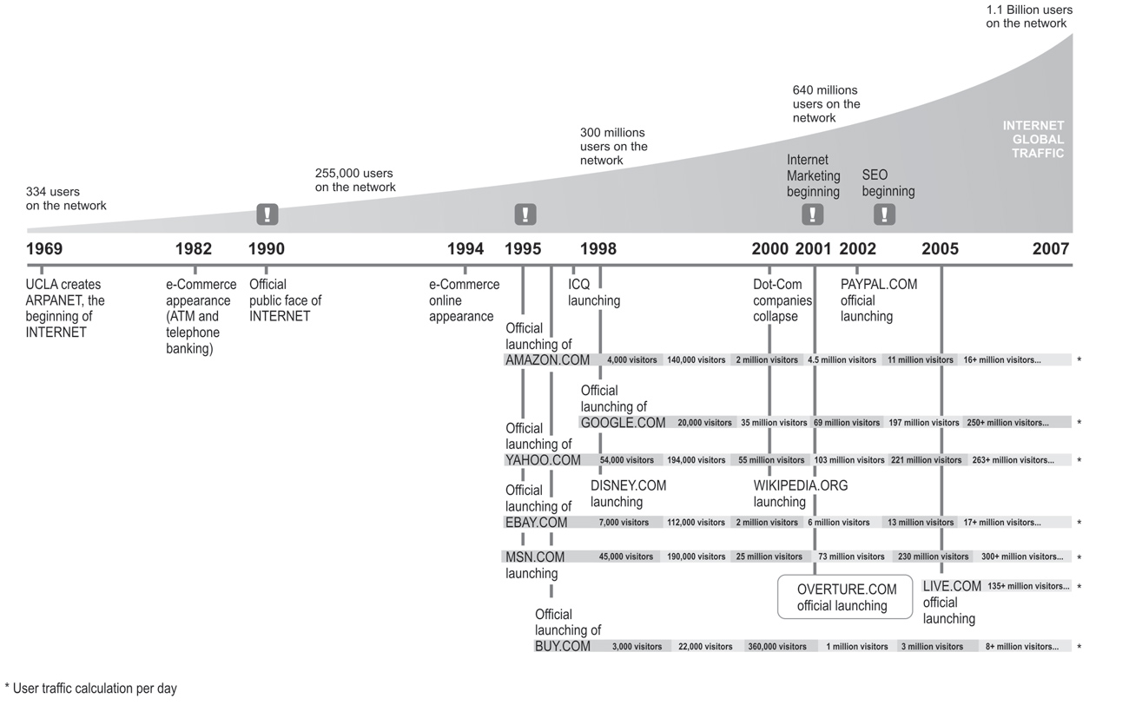
Growth of the Internet
Source: Miguel Angel Todaro

Slide 36
Original Design Principles of the Internet
David Clark, 1988 “The Design Philosophy of the DARPA Internet Protocols”
Fundamental Goal:
  Effective technique for multiplexed utilization of existing interconnected networks
Secondary Goals:
  Communication should continue despite loss of nodes
  Multiple types of service
  Variety of networks
  Distributed management of resources
  Cost effective
  Low-effort host attachment
  Resources must be accountable

Slide 37
But… There are BIG Challenges
Designed in a different environment, with different uses
  Identity / Accountability
  Access model
  Security
  Challenges to openness

Slide 38
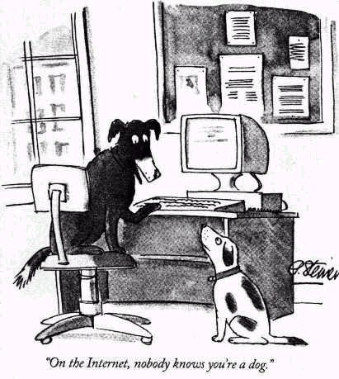
Identity
Leads to
  Spoofing
  Spam
  Denial of service
    Amplification attacks
  Route hijacking
  DNS cache poisoning

Slide 39
Protocols designed based on trust
That you don’t spoof your address
  MAC spoofing, IP spoofing, email spoofing
That you are who you say you are
  BGP announcements, Websites, DNS servers
That you adhere to the protocol
  Ethernet exponential backoff after a collision
  TCP-friendliness
That protocol specifications are public
  So that others can build interoperable implementations

Slide 40
Nobody in charge
Traffic traverses many Ass
  Who’s at fault when things go wrong?
  How do you upgrade functionality?
Anyone can add any application
  Whether it is legal, moral, good, well-behaved, etc.
Nobody knows how big the Internet is
Spans many countries
  So no government can be in charge

Slide 41
Access Models
“On by default”
  Any node can talk to any node (IP, email, web)
  Allows for Denial of Service Attacks!
  Can use a firewall…
    But won’t stop attackers from saturating the paths to you!

Slide 42
Host versus Data centric
IP is host-to-host protocol
  telnet myhost.mycompany.com
Today
  Users want content, not servers
  Web: many redirections, lots of URLs are not “human readable”
  http://a7.sphotos.ak.fbcdn.net/hphotos-ak-ash1/167898_788691982781_7555_40937029_2012165_n.jpg
  “Lookup” through search engines
  BitTorrent: torrent file describes content, specific peers are irrelevant
Can the architecture support this better?

Slide 43
Security
Last class
Huge challenges
  Public Key Infrastructure
  S-BGP, DNSSEC, IPSec
Spoofing, Poisoning, Phishing
Denial of Service attacks
Cyber-security
  Cyber-war (talk to John Savage)

Slide 44
Challenges to Openness
Walled Gardens
  E.g., Facebook, Google
  Convenient, easy to use, network effects
  Intrusive data collection
  No control of own data, hard to migrate
  Centralization of trust
  Proprietary protocols
Network Neutrality
  Should all packets be treated equally?
  ISPs are commoditized, want to make money
  Can prioritize own traffic, charge to carry other traffic
  Very hot debate topic

Slide 45
Other Challenges
Extreme mobility
  Mobile with no fixed attachment point
  How to maintain efficient routing?
Large number of nodes
  Billions of small networked devices (e.g., sensors)
  “Internet of Things”
Sometimes-connected nodes
  Developing regions with intermittent connectivity
Real-time applications
  VoIP, gaming, IPTV

Slide 46
Future of the Internet
Can we fix these problems
  Security
  Performance
  Upgradability
  Manageability
  … your favorite ailment here …
Without disrupting a critical infrastructure?
Open technical and policy question…

Slide 47
Thank you!

