Slide 1
CSCI-1680
Security
Rodrigo Fonseca
Based on lecture notes by Scott Shenker and Mike Freedman

Slide 2
Today’s Lecture
Classes of attacks
Basic security requirements
Simple cryptographic methods
Cryptographic toolkit (Hash, Digital Signature, …)
DNSSec
Certificate Authorities
SSL / HTTPS

Slide 3
Basic Requirements for Secure Communication
Availability: Will the network deliver data?
  Infrastructure compromise, DDoS
Authentication: Who is this actor?
  Spoofing, phishing
Integrity: Do messages arrive in original form?
Confidentiality: Can adversary read the data?
  Sniffing, man-in-the-middle
Provenance: Who is responsible for this data?
  Forging responses, denying responsibility
  Not who sent the data, but who created it

Slide 4
Other Desirable Security Properties
Authorization: is actor allowed to do this action?
  Access controls
Accountability/Attribution: who did this activity?
Audit/Forensics: what occurred in the past?
  A broader notion of accountability/attribution
Appropriate use: is action consistent with policy?
  E.g., no spam; no games during business hours; etc.
Freedom from traffic analysis: can someone tell when I am sending and to whom?
Anonymity: can someone tell I sent this packet?

Slide 5
Internet’s Design: Insecure
Designed for simplicity in a naïve era
“On by default” design
Readily available zombie machines
Attacks look like normal traffic
Internet’s federated operation obstructs cooperation for diagnosis/mitigation

Slide 6
Eavesdropping - Message Interception (Attack on Confidentiality)
Unauthorized access to information
Packet sniffers and wiretappers
Illicit copying of files and programs
A
B
Eavesdropper

Slide 7
Eavesdropping Attack: Example
tcpdump with promiscuous network interface
  On a switched network, what can you see?
What might the following traffic types reveal about communications?
  DNS lookups (and replies)
  IP packets without payloads (headers only)
  Payloads
Notes:
Remember the ARP flooding attack?

Slide 8
Integrity Attack - Tampering
Stop the flow of the message
Delay and optionally modify the message
Release the message again
A
B
Perpetrator

Slide 9
Authenticity Attack - Fabrication
Unauthorized assumption of other’s identity
Generate and distribute objects under this identity
A
B
Masquerader: from A

Slide 10
Attack on Availability
Destroy hardware (cutting fiber) or software
Modify software in a subtle way
Corrupt packets in transit
Blatant denial of service (DoS):
  Crashing the server
  Overwhelm the server (use up its resource)
A
B

Slide 11
Basic Forms of Cryptography

Slide 12
Confidentiality through Cryptography
Cryptography: communication over insecure channel in the presence of adversaries
Studied for thousands of years
Central goal: how to encode information so that an adversary can’t extract it …but a friend can
General premise: a key is required for decoding
  Give it to friends, keep it away from attackers
Two different categories of encryption
  Symmetric: efficient, requires key distribution
  Asymmetric (Public Key): computationally expensive, but no key distribution problem

Slide 13
Symmetric Key Encryption
Same key for encryption and decryption
  Both sender and receiver know key
  But adversary does not know key
For communication, problem is key distribution
  How do the parties (secretly) agree on the key?
What can you do with a huge key? One-time pad
  Huge key of random bits
To encrypt/decrypt: just XOR with the key!
  Provably secure! …. provided:
    You never reuse the key … and it really is random/unpredictable
  Spies actually use these

Slide 14
Using Symmetric Keys
Both the sender and the receiver use the same secret keys
Plaintext
Plaintext
Internet
Encrypt with
secret key
Decrypt with
secret key
Ciphertext

Slide 15
Asymmetric Encryption (Public Key)
Idea: use two different keys, one to encrypt (e) and one to decrypt (d)
  A key pair
Crucial property: knowing e does not give away d
Therefore e can be public: everyone knows it!
If Alice wants to send to Bob, she fetches Bob’s public key (say from Bob’s home page) and encrypts with it
  Alice can’t decrypt what she’s sending to Bob …
  … but then, neither can anyone else (except Bob)

Slide 16
Public Key / Asymmetric Encryption
Sender uses receiver’s public key
  Advertised to everyone
Receiver uses complementary private key
  Must be kept secret
Plaintext
Plaintext
Internet
Encrypt with
public key
Decrypt with
private key
Ciphertext

Slide 17
Works in Reverse Direction Too!
Sender uses his own private key
Receiver uses complementary public key
Allows sender to prove he knows private key
Plaintext
Plaintext
Internet
Decrypt with
public key
Encrypt with
private key
Ciphertext

Slide 18
Realizing Public Key Cryptography
Invented in the 1970s
  Revolutionized cryptography
  (Was actually invented earlier by British intelligence)
How can we construct an encryption/decryption algorithm with public/private properties?
  Answer: Number Theory
Most fully developed approach: RSA
  Rivest / Shamir / Adleman, 1977; RFC 3447
  Based on modular multiplication of very large integers
  Very widely used (e.g., SSL/TLS for https)

Slide 19
Cryptographic Toolkit

Slide 20
Cryptographic Toolkit
Confidentiality: Encryption
Integrity: ?
Authentication: ?
Provenance: ?

Slide 21
Integrity: Cryptographic Hashes
Sender computes a digest of message m, i.e., H(m)
  H() is a publicly known hash function
Send m in any manner
Send digest d = H(m) to receiver in a secure way:
  Using another physical channel
  Using encryption (why does this help?)
Upon receiving m and d, receiver re-computes H(m) to see whether result agrees with d

Slide 22
Operation of Hashing for Integrity
Plaintext
corrupted msg
Plaintext
NO
=
digest’
Internet
Digest
(MD5)
Digest
(MD5)
digest

Slide 23
Cryptographically Strong Hashes
Hard to find collisions
  Adversary can’t find two inputs that produce same hash
  Someone cannot alter message without modifying digest
  Can succinctly refer to large objects
Hard to invert
  Given hash, adversary can’t find input that produces it
  Can refer obliquely to private objects (e.g., passwords)
    Send hash of object rather than object itself
Notes:
Properties

Slide 24
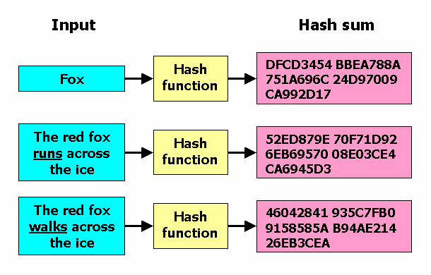
Effects of Cryptographic Hashing

Slide 25
Cryptographic Toolkit
Confidentiality: Encryption
Integrity: Cryptographic Hash
Authentication: ?
Provenance: ?

Slide 26
Public Key Authentication
Each side need only to know the other side’s public key
  No secret key need be shared
A encrypts a nonce (random number) x using B’s public key
B proves it can recover x
A can authenticate itself to B in the same way
A
B
E(x, Public_{B})
x

Slide 27
Cryptographic Toolkit
Confidentiality: Encryption
Integrity: Cryptographic Hash
Authentication: Decrypting nonce
Provenance: ?

Slide 28
Digital Signatures
Suppose Alice has published public key K_{E}
If she wishes to prove who she is, she can send a message x encrypted with her private key K_{D}
  Therefore: anyone w/ public key K_{E} can recover x, verify that Alice must have sent the message
  It provides a digital signature
  Alice can’t deny later deny it ⇒ non-repudiation

Slide 29
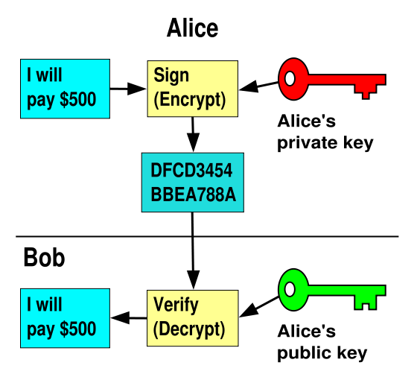
RSA Crypto & Signatures, con’t

Slide 30
Summary of Our Crypto Toolkit
If we can securely distribute a key, then
  Symmetric ciphers (e.g., AES) offer fast, presumably strong confidentiality
Public key cryptography does away with problem of secure key distribution
  But not as computationally efficient
  Often addressed by using public key crypto to exchange a session key
  And not guaranteed secure
    but major result if not
Notes:
No efficient algorithm to factor large numbers.

Slide 31
Summary of Our Crypto Toolkit, con’t
Cryptographically strong hash functions provide major building block for integrity (e.g., SHA-1)
  As well as providing concise digests
  And providing a way to prove you know something (e.g., passwords) without revealing it (non-invertibility)
  But: worrisome recent results regarding their strength
Public key also gives us signatures
  Including sender non-repudiation
Turns out there’s a crypto trick based on similar algorithms that allows two parties who don’t know each other’s public key to securely negotiate a secret key even in the presence of eavesdroppers

Slide 32
PKIs and HTTPS

Slide 33
Public Key Infrastructure (PKI)
Public key crypto is very powerful …
… but the realities of tying public keys to real world identities turn out to be quite hard
PKI: Trust distribution mechanism
  Authentication via Digital Certificates
Trust doesn’t mean someone is honest, just that they are who they say they are…

Slide 34
Managing Trust
The most solid level of trust is rooted in our direct personal experience
  E.g., Alice’s trust that Bob is who they say they are
  Clearly doesn’t scale to a global network!
In its absence, we rely on delegation
  Alice trusts Bob’s identity because Charlie attests to it ….
  …. and Alice trusts Charlie

Slide 35
Managing Trust, con’t
Trust is not particularly transitive
  Should Alice trust Bob because she trusts Charlie …
  … and Charlie vouches for Donna …
  … and Donna says Eve is trustworthy …
  … and Eve vouches for Bob’s identity?
Two models of delegating trust
  Rely on your set of friends and their friends
    “Web of trust” -- e.g., PGP
  Rely on trusted, well-known authorities (and their minions)
    “Trusted root” -- e.g., HTTPS

Slide 36
PKI Conceptual Framework
Trusted-Root PKI:
  Basis: well-known public key serves as root of a hierarchy
  Managed by a Certificate Authority (CA)
To publish a public key, ask the CA to digitally sign a statement indicating that they agree (“certify”) that it is indeed your key
  This is a certificate for your key (certificate = bunch of bits)
    Includes both your public key and the signed statement
  Anyone can verify the signature
Delegation of trust to the CA
  They’d better not screw up (duped into signing bogus key)
  They’d better have procedures for dealing with stolen keys
  Note: can build up a hierarchy of signing

Slide 37
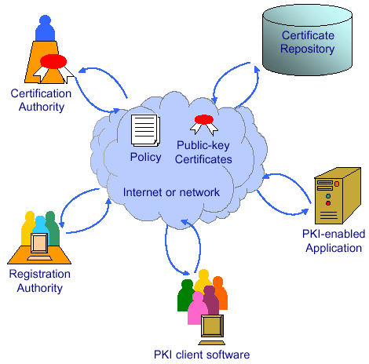
Components of a PKI

Slide 38

Digital Certificate
Signed data structure that binds an entity with its corresponding public key
  Signed by a recognized and trusted authority, i.e., Certification Authority (CA)
  Provide assurance that a particular public key belongs to a specific entity
Example: certificate of entity Y
Cert = E({name_{Y}, KY_{public}}, KCA_{private})
  KCA_{private}: private key of Certificate Authority
  name_{Y}: name of entity Y
  KY_{public}: public key of entity Y
    In fact, they may sign whatever glob of bits you give them
Your browser has a bunch of CAs wired into it

Slide 39

Certification Authority
People, processes responsible for creation, delivery and management of digital certificates
Organized in an hierarchy
  To verify signature chain, follow hierarchy up to root
Root CA
CA-1
CA-2

Slide 40

Registration Authority
People & processes responsible for:
  Authenticating the identity of new entities (users or computing devices), e.g.,
    By phone, or physical presence + ID
  Issuing requests to CA for certificates
The CA must trust the Registration Authority
  This trust can be misplaced

Slide 41
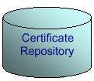
Certificate Repository
A database accessible to all users of a PKI
Contains:
  Digital certificates
  Policy information associated with certs
  Certificate revocation information
    Vital to be able to identify certs that have been compromised
    Usually done via a revocation list

Slide 42
Putting It All Together: HTTPS
Steps after clicking on https://www.amazon.com
https = “Use HTTP over SSL/TLS”
  SSL = Secure Socket Layer
  TLS = Transport Layer Security
    Successor to SSL, and compatible with it
  RFC 4346
Provides security layer (authentication, encryption) on top of TCP
  Fairly transparent to the app

Slide 43
HTTPS Connection (SSL/TLS), con’t
Browser (client) connects via TCP to Amazon’s HTTPS server
Client sends over list of crypto protocols it supports
Server picks protocols to use for this session
Server sends over its certificate
(all of this is in the clear)
Browser
Amazon
SYN
SYN ACK
ACK
Hello. I support
(TLS+RSA+AES128+SHA1) or
(SSL+RSA+3DES+MD5) or …
Let’s use
TLS+RSA+AES128+SHA1
Here’s my cert
~1 KB of data

Slide 44
Inside the Server’s Certificate
Name associated with cert (e.g., Amazon)
Amazon’s public key
A bunch of auxiliary info (physical address, type of cert, expiration time)
URL to revocation center to check for revoked keys
Name of certificate’s signatory (who signed it)
A public-key signature of a hash (MD5) of all this
  Constructed using the signatory’s private RSA key

Slide 45
Validating Amazon’s Identity
Browser retrieves cert belonging to the signatory
  These are hardwired into the browser
If it can’t find the cert, then warns the user that site has not been verified
  And may ask whether to continue
  Note, can still proceed, just without authentication
Browser uses public key in signatory’s cert to decrypt signature
  Compares with its own MD5 hash of Amazon’s cert
Assuming signature matches, now have high confidence it’s indeed Amazon …
  … assuming signatory is trustworthy

Slide 46
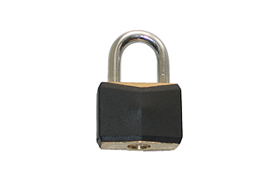
HTTPS Connection (SSL/TLS), con’t
Browser constructs a random session key K
Browser encrypts K using Amazon’s public key
Browser sends E(K, KA_{public}) to server
Browser displays
All subsequent communication encrypted w/ symmetric cipher using key K
  E.g., client can authenticate using a password
Browser
Amazon
Here’s my cert
~1 KB of data
K
E(K, KA_{public})
Agreed
K
E(password …, K)
E(response …, K)

Slide 47
DNS Security
Notes:
Case study of security problems, build to a solution employing our cryptographic toolkit

Slide 48
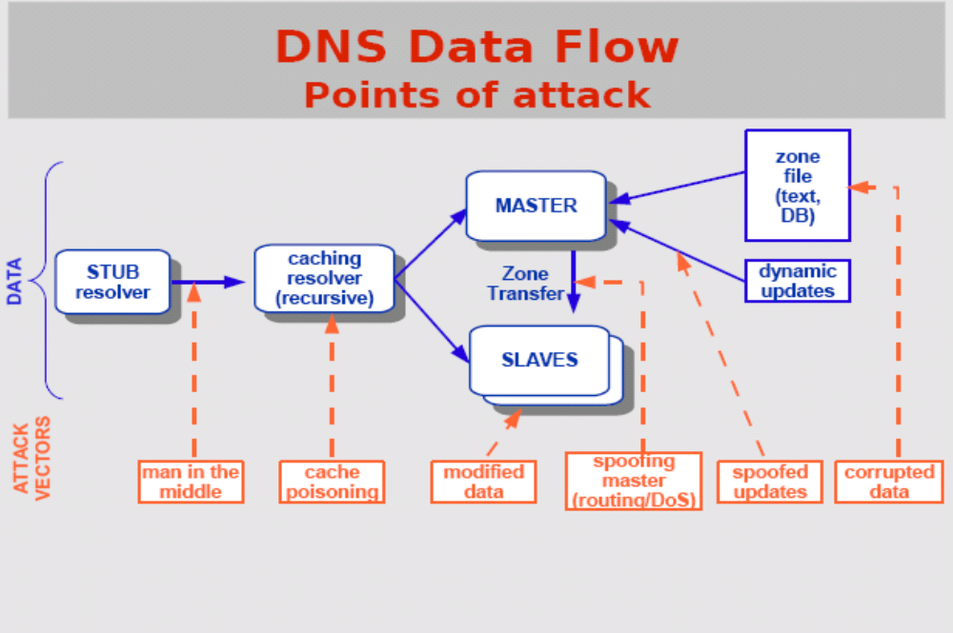
Source: http://nsrc.org/tutorials/2009/apricot/dnssec/dnssec-tutorial.pdf

Slide 49
Root level DNS attacks
Feb. 6, 2007:
  Botnet attack on the 13 Internet DNS root servers
  Lasted 2.5 hours
  None crashed, but two performed badly:
    g-root (DoD), l-root (ICANN)
    Most other root servers use anycast

Slide 50
Do you trust the TLD operators?
Wildcard DNS record for all .com and .net domain names not yet registered by others
  September 15 – October 4, 2003
  February 2004: Verisign sues ICANN
Redirection for these domain names to Verisign web portal: “to help you search”
  and serve you ads…and get “sponsored” search

Slide 51
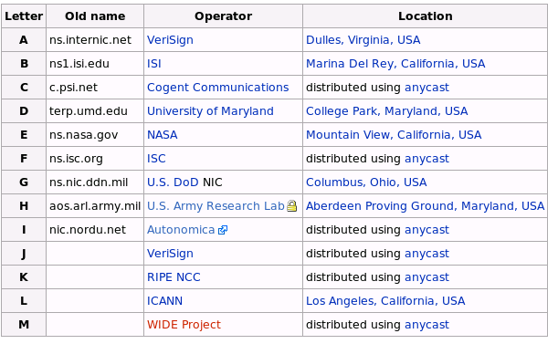
Defense: Replication and Caching
source: wikipedia

Slide 52

DNS Amplification Attack
DNS Amplification attack: ( ×40 amplification )
DNS Query
SrcIP: DoS Target
(60 bytes)
EDNS Reponse
(3000 bytes)
DNS
Server
DoS
Source
DoS
Target
580,000 open resolvers on Internet (Kaminsky-Shiffman’06)

Slide 53

Solutions
attacker
ip spoofed packets
open
amplifier
replies
prevent
ip spoofing
disable
open amplifiers
victim
Notes:
Authentication, provenance … holistic approach to security

Slide 54
But should we believe it?
Enter DNSSEC
DNSSEC protects against data spoofing and corruption
DNSSEC also provides mechanisms to authenticate servers and requests
DNSSEC provides mechanisms to establish authenticity and integrity

Slide 55
PK-DNSSEC (Public Key)
The DNS servers sign the hash of resource record set with its private (signature) keys
Public keys can be used to verify the SIGs
Leverages hierarchy:
  Authenticity of nameserver’s public keys is established by a signature over the keys by the parent’s private key
  In ideal case, only roots’ public keys need to be distributed out-of-band

Slide 56
Verifying the tree
Question: www.cnn.com ?
.(root)
dns.cs.brown.edu
www.cnn.com A ?
Src.cs.brown.edu
ask .com server
SIG (ip addr and PK of .com server)
resolver
stub
resolver
www.cnn.com A ?
xxx.xxx.xxx.xxx
www.cnn.com A ?
.com
transaction
signatures
ask cnn.com server
SIG (ip addr and PK of cnn.com server)
add to cache
www.cnn.com A ?
slave servers
SIG (xxx.xxx.xxx.xxx)
transaction
signatures
cnn.com

Slide 57
Next Class
Final Class! Wrap up, review how concepts fit together
Final exam: Thursday May 10th, 9-12, CIT 219

