Slide 1
CSCI-1680
Network Programming II
Rodrigo Fonseca

Slide 2
Today
Network programming
  Programming Paradigms
  Programming libraries
Final project

Slide 3
Low-level Sockets
Address Family AF_PACKET
  Socket type: SOCK_RAW
    See link-layer (Ethernet) headers. Can send broadcast on a LAN. Can get/create non-IP packets
  Socket type: SOCK_DGRAM
    See IP headers. Can get protocols other than TCP/UDP: ICMP, SCTP, DCCP, your own…
    Can cook your own IP packets
  Must have root privileges to play with these

Slide 4
Building High Performance Servers

Slide 5
The need for concurrency
How to improve throughput?
  Decrease latency (throughput α 1/latency)
  Hard to do!
    Optimize code (this you should try!)
    Faster processor (no luck here, recently)
    Speed of light isn’t changing anytime soon…
    Disks have to deal with things like inertia!
  Do multiple things at once
Concurrency
  Allows overlapping of computation and I/O
  Allows use of multiple cores, machines

Slide 6
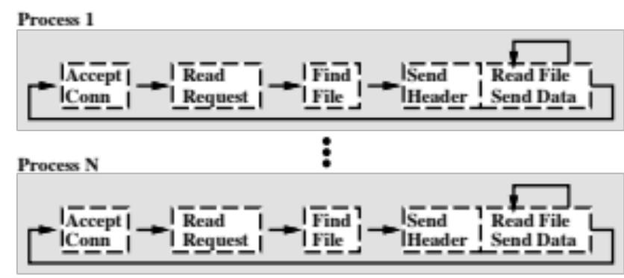
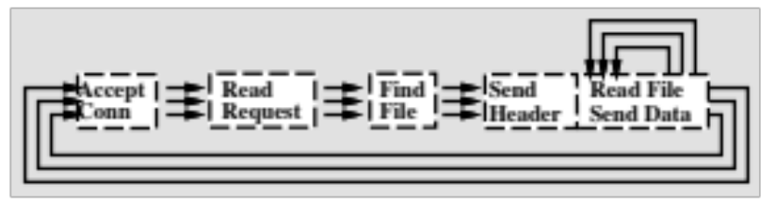
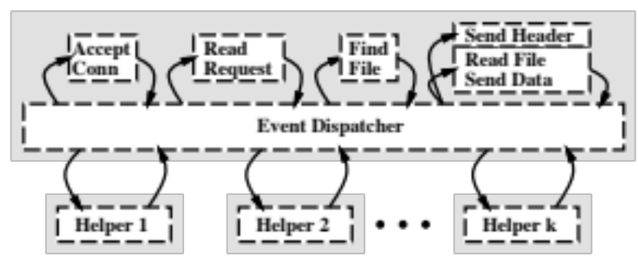
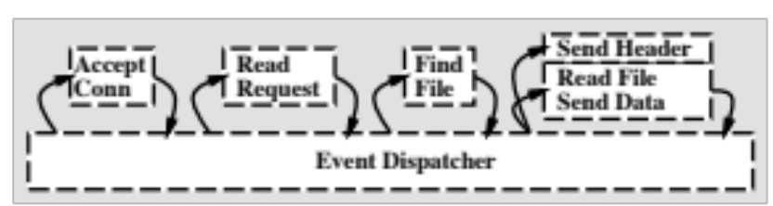
High-performance Servers
Common Patterns
Multiple processes
Multiple Threads
Single Process Event Driven with Helpers
Single Process Event Driven
Figures from Pai, et al., 1999 “Flash: An efficient and portable Web server”
Notes:
Process-based, Thread-based, Event-based, Event-based with helpers

Slide 7
Threads
Usual model for achieving concurrency
Uniform abstraction for single and multiple cores
Concurrency with locks/mutexes
  Threads may block, hold locks for long time
Easy to reason about
  Each thread has own stack
Strong support from OS, libraries, debuggers
Traditionally, problems with more than a few 100 threads
  Memory overhead, O(n) operations

Slide 8
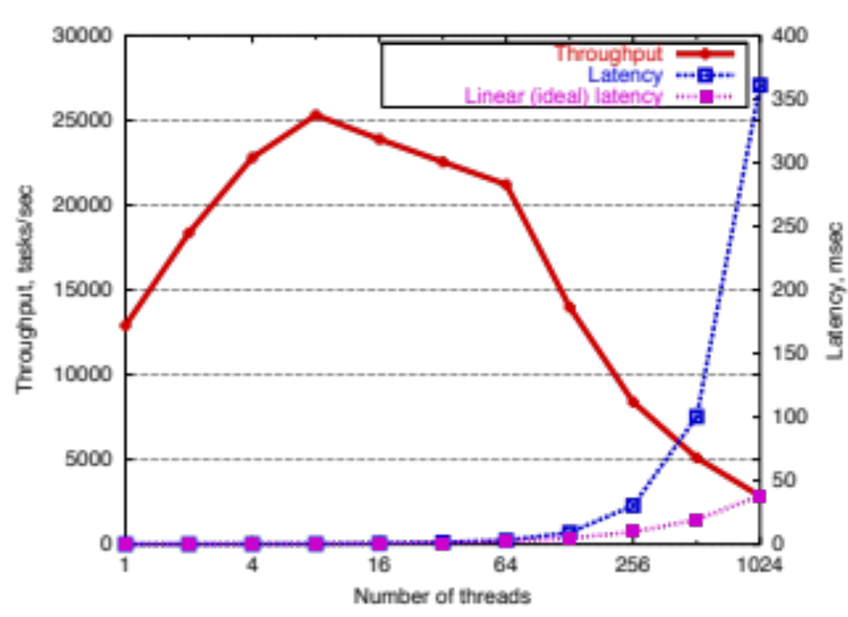
Performance, Thread-based server
From Welsh, et al., SOSP 2001 “SEDA: An Architecture for Well-Conditioned, Scalable Internet Services
Notes:
Threaded server throughput degradation: This benchmark mea- sures a simple threaded server which creates a single thread for each task in the pipeline. After receiving a task, each thread performs an 8 KB read from a disk file; all threads read from the same file, so the data is always in the buffer cache. Threads are pre-allocated in the server to eliminate thread startup overhead from the measurements, and tasks are generated internally to negate network effects. The server is implemented in C and is running on a 4-way 500 MHz Pentium III with 2 GB of memory under Linux 2.2.14. As the number of con- current tasks increases, throughput increases until the number of threads grows large, after which throughput degrades substantially. Response time becomes unbounded as task queue lengths increase; for comparison, we have shown the ideal linear response time curve (note the log scale on the x axis).

Slide 9
Events
Small number of threads, one per CPU
Threads do one thing:
  while(1) {
    get event from queue
    Handle event to completion
  }
Events are network, I/O readiness and completion, timers, signals
  Remember select()?
Assume event handlers never block
  Helper threads handle blocking calls, like disk I/O

Slide 10
Events
Many works in the early 2000’s claimed that events are needed for high performance servers
  E.g., Flash, thttpd, Zeus, JAWS web servers
Indeed, many of today’s fastest servers are event-driven
  E.g., OKCupid, lighttpd, nginx, tornado
  Lighttpd: “Its event-driven architecture is optimized for a large number of parallel connections”
  Tornado: “Because it is non-blocking and uses epoll, it can handle thousands of simultaneous standing connections”

Slide 11
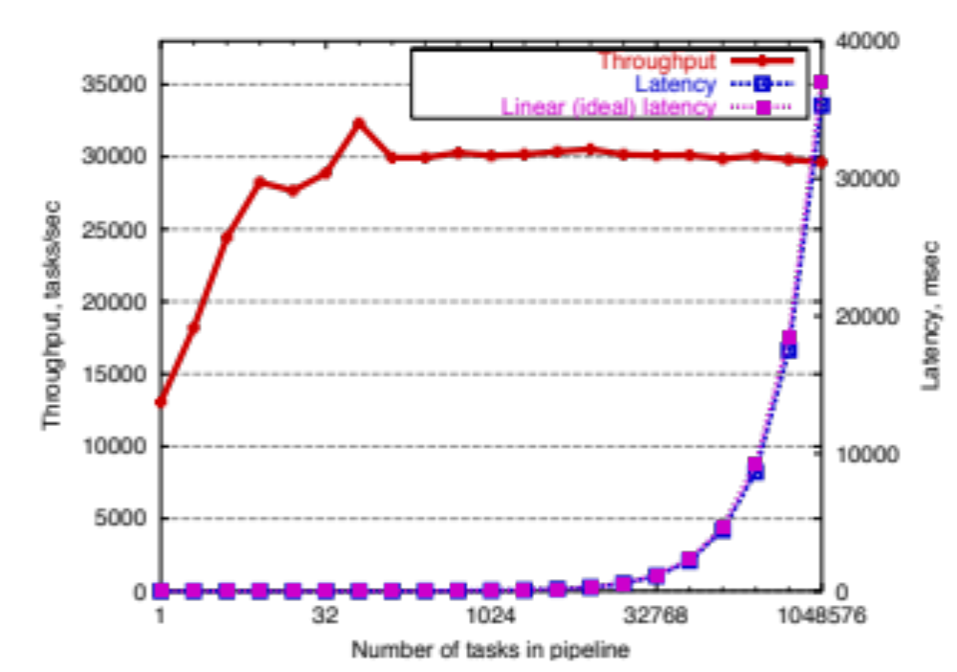
Performance, Event-Driven Web server
From Welsh, et al., SOSP 2001 “SEDA: An Architecture for Well-Conditioned, Scalable Internet Services
Notes:
Event-driven server throughput: This benchmark measures an event-driven version of the server from Figure 2. In this case, the server uses a single thread to process tasks, where each task reads 8 KB from a single disk file. Although the filesystem interface provided by the operating system used here (Linux 2.2.14) is blocking, because the disk data is always in the cache, this benchmark estimates the best possible performance from a nonblocking disk I/O layer. As the figure shows, throughput remains constant as the load is increased to a very large number of tasks (note the change in the horizontal axis scale from Figure 2), and response time is linear (note the log scale on the x axis).

Slide 12
Flash Web Server
Pai, Drushel, Zwaenepoel, 1999
Influential work
Compared four architectures
  Multi-process servers
  Multi-threaded servers
  Single-process event-driven
  Asymmetric Multi-process event driven
AMPED was the fastest

Slide 13
Events (cont)
Highly efficient code
  Little or no switching overhead
  Easy concurrency control
Common complaint: hard to program and reason about
  For people and tools
Main reason: stack ripping

Slide 14
Events criticism: control flow
Events obscure control flow
  For programmers and tools
Web Server
Accept
Conn.
Threads | Events
thread_main(int sock) { struct session s; accept_conn(sock, &s); read_request(&s); pin_cache(&s); write_response(&s); unpin(&s); } pin_cache(struct session *s) { pin(&s); if( !in_cache(&s) ) read_file(&s); } | CacheHandler(struct session *s) { pin(s); if( !in_cache(s) ) ReadFileHandler.enqueue(s); else ResponseHandler.enqueue(s); } RequestHandler(struct session *s) { …; CacheHandler.enqueue(s); } . . . ExitHandlerr(struct session *s) { …; unpin(&s); free_session(s); } AcceptHandler(event e) { struct session *s = new_session(e); RequestHandler.enqueue(s); }
Read
Request
Pin
Cache
Read
File
Write
Response
Exit

Slide 15
Events criticism: Exceptions
Exceptions complicate control flow
  Harder to understand program flow
  Cause bugs in cleanup code
Web Server
Accept
Conn.
Threads | Events
thread_main(int sock) { struct session s; accept_conn(sock, &s); if( !read_request(&s) ) return; pin_cache(&s); write_response(&s); unpin(&s); } pin_cache(struct session *s) { pin(&s); if( !in_cache(&s) ) read_file(&s); } | CacheHandler(struct session *s) { pin(s); if( !in_cache(s) ) ReadFileHandler.enqueue(s); else ResponseHandler.enqueue(s); } RequestHandler(struct session *s) { …; if( error ) return; CacheHandler.enqueue(s); } . . . ExitHandlerr(struct session *s) { …; unpin(&s); free_session(s); } AcceptHandler(event e) { struct session *s = new_session(e); RequestHandler.enqueue(s); }
Read
Request
Pin
Cache
Read
File
Write
Response
Exit

Slide 16
Events criticism: State Management
Events require manual state management
Hard to know when to free
  Use GC or risk bugs
Web Server
Accept
Conn.
Threads | Events
thread_main(int sock) { struct session s; accept_conn(sock, &s); if( !read_request(&s) ) return; pin_cache(&s); write_response(&s); unpin(&s); } pin_cache(struct session *s) { pin(&s); if( !in_cache(&s) ) read_file(&s); } | CacheHandler(struct session *s) { pin(s); if( !in_cache(s) ) ReadFileHandler.enqueue(s); else ResponseHandler.enqueue(s); } RequestHandler(struct session *s) { …; if( error ) return; CacheHandler.enqueue(s); } . . . ExitHandlerr(struct session *s) { …; unpin(&s); free_session(s); } AcceptHandler(event e) { struct session *s = new_session(e); RequestHandler.enqueue(s); }
Read
Request
Pin
Cache
Read
File
Write
Response
Exit

Slide 17
Usual Arguments
Events:
  Hard to program (stack ripping)
  Easy to deal with concurrency (cooperative task management)
    Shared state is more explicit
  High performance (low overhead, no switching, no blocking)
Threads
  Easy to reason about flow, state (automatic stack management)
  Hard to deal with concurrency (preemptive task management)
    Everything is shared
  Lower performance (thread switching cost, memory overhead)

Slide 18
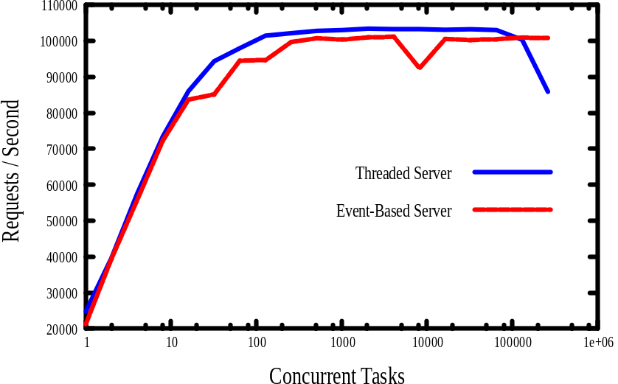
Capriccio (2003)
Showed threads can perform as well as events
  Avoid O(n) operations
  Cooperative lightweight user-level threads
    (still one kernel thread per core)
  Asynchronous I/O
    Handled by the library
  Variable-length stacks
  The thread library runs an event-based system underneath!

Slide 19
Artificial Dichotomy!
Old debate! Lauer and Needham, 78
  Duality between process-based and message-passing
  Updated by the Capriccio folks, 2003
Performance should be similar
  No inherent reason for threads to be worse
  Implementation is key
Threads | Events
Monitors Exported functions Call/return and fork/join Wait on condition variable | Event handler & queue Events accepted Send message / await reply Wait for new messages

Slide 20
Artificial Dichotomy
Threads
  Preemptive multitasking
  Automatic stack management
Events
  Cooperative multitasking
  Manual stack management (stack ripping)
Adya, 2002: you can choose your features!
  They show that you can have cooperative multitasking with automatic stack managment
Adya, A. et al., 2002. “Cooperative Task Management without Manual Stack Managementor, Event-driven Programming is Not the Opposite of Threaded Programming

Slide 21
Threads vs. Events
Today you still have to mostly choose either style (complete packages)
  Thread-based servers very dependent on OS, threading libraries
Some promising directions!
  TAME allows you to write sequential C++ code (with some annotations), converts it into event-based
  Scala (oo/functional language that runs on the JVM) makes threaded and event-based code look almost identical

Slide 22
Popular Event-Based Frameworks
libevent
libasync (SFS, SFS-light)
Javascript
  All browser code
  Node.js at the server side
GUI programming

Slide 23
Some available libraries
With material from Igor Ganichev

Slide 24
Python
Rich standard library
  url/http/ftp/pop/imap/smtp/telnet
  SocketServer, HTTPServer, DocXMLRPCServer, etc
Twisted
  Very popular
  Has a lot of stuff, but quite modular
  Event-driven, many design patterns. Steep learning curve…
  Well maintained and documented

Slide 25
Java
Mature RPC library: RMI
River: RMI + service discovery, mobile code
Java.NIO
  High-level wrapping of OS primitives
    Select -> Selector . Socket -> Channel
  Good, efficient buffer abstraction
Jetty
  Extensible, event-driven framework
  High-performance
  Avoid unnecessary copies
  Other side doesn’t have to be in Java

Slide 26
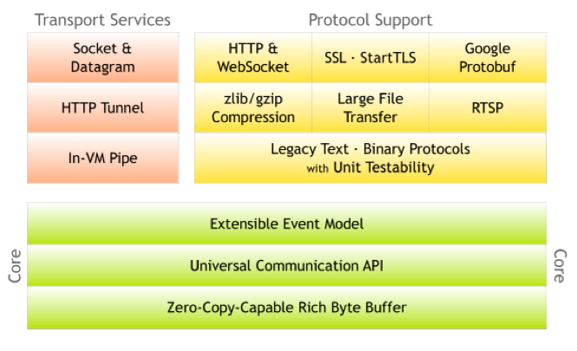

Slide 27
C
Sockets!
Direct access to what the OS provides
Libevent
  Simple, somewhat portable abstraction of select() with uniform access to events: I/O, timers, signals
  Supports /dev/poll, kqueue(2), event ports, select(2), poll(2) and epoll(4).
  Well maintained, actively developed
  Behind many very high-performance servers
    Memcached

Slide 28
C++
Boost.ASIO
  Clean, lightweight, portable abstraction of sockets and other features
  Not a lot of higher-level protocol support
  Has support for both synchronous and asynchronous operations, threads (from other parts of Boost)
Others: ACE, POCO

Slide 29
ICE
Cross-language middleware + framework
  Think twisted + protocol buffers
Open source but owned by a company
SSL, sync/async, threads, resource allocation, firewall traversal, event distribution, fault tolerance
Supports many languages
  C++, Java, .NET-languages (such as C# or Visual Basic), Objective-C, Python, PHP, and Ruby

Slide 30
Other “cool” approaches
Erlang, Scala, Objective C
  Support the Actor model: program is a bunch of actors sending messages to each other
  Naturally extends to multi-core and multiple machines, as sending messages is the same
Go
  Built for concurrency, uses ‘Goroutines’, no shared state
  “Don’t share memory to communicate, communicate to share memory”

Slide 31
Node.js
Javascript server framework
Leverages highly efficient Chrome V8 Javascript JIT runtime
Completely event-based
Many high-level libraries
var http = require('http');
http.createServer(function (req, res) {
res.writeHead(200, {'Content-Type': 'text/plain'});
res.end('Hello World\n');
}).listen(8124, "127.0.0.1");
console.log('Server running at http://127.0.0.1:8124/');

Slide 32
Final Assignment

Slide 33
Final Project
Tethering IP over 3G
Problem: Laptop in need of internet, no Wi-Fi available.
On hand: Smartphone with 3G connection.
Native applications don’t always allow custom network programming.
  iOS App Store guidelines.

Slide 34
Custom Tethering Solution
Websockets to the rescue!
  Implemented in browsers.
  Bi-directional, full-duplex connection over a single TCP socket.
  Modern smartphone browsers have implemented websockets.

Slide 35
Implementation

Slide 36
Some questions
How to connect phone to laptop?
How to encode data?
Virtual interfaces: TUN or TAP?
Client: setting up routes
Server: what to do with the packets you receive?

Slide 37
Some Resources
TUN/TAP Interfaces
  TunTap package for Mac OSX
Websocket Server
  Twisted
NAT
  Scapy
Base64 Encoding
  http://www.ietf.org/rfc/rfc3548.txt

