Slide 1
CSCI-1680
Transport Layer III
Congestion Control Strikes Back
Rodrigo Fonseca
Based partly on lecture notes by David Mazières, Phil Levis, John Jannotti, Ion Stoica

Slide 2
Last Time
Flow Control
Congestion Control

Slide 3
Today
More TCP Fun!
Congestion Control Continued
  Quick Review
  RTT Estimation
TCP Friendliness
  Equation Based Rate Control
TCP on Lossy Links
Congestion Control versus Avoidance
  Getting help from the network
Cheating TCP

Slide 4
Quick Review
Flow Control:
  Receiver sets Advertised Window
Congestion Control
  Two states: Slow Start (SS) and Congestion Avoidance (CA)
  A window size threshold governs the state transition
    Window <= ssthresh: SS
    Window > ssthresh: Congestion Avoidance
  States differ in how they respond to ACKs
    Slow start: +1 w per RTT (Exponential increase)
    Congestion Avoidance: +1 MSS per RTT (Additive increase)
  On loss event: set ssthresh = w/2, w = 1, slow start

Slide 5
AIMD
Fair: A = B
AI
MD
Flow Rate B
Efficient: A+B = C
Flow Rate A
Notes:
Fair, efficient, distributed

Slide 6
States differ in how they respond to acks
Slow start: double w in one RTT
  There are w/MSS segments (and acks) per RTT
  Increase w per RTT → how much to increase per ack?
    w / (w/MSS) = MSS
AIMD: Add 1 MSS per RTT
  MSS/(w/MSS) = MSS²/w per received ACK

Slide 7
Putting it all together
cwnd
Timeout
Timeout
AIMD
AIMD
ssthresh
Slow
Start
Slow
Start
Slow
Start
Time

Slide 8
Fast Recovery and Fast Retransmit
cwnd
AI/MD
Slow Start
Fast retransmit
Time

Slide 9
RTT Estimation
We want an estimate of RTT so we can know a packet was likely lost, and not just delayed
Key for correct operation
Challenge: RTT can be highly variable
  Both at long and short time scales!
Both average and variance increase a lot with load
Solution
  Use exponentially weighted moving average (EWMA)
  Estimate deviation as well as expected value
  Assume packet is lost when time is well beyond reasonable deviation

Slide 10
Originally
EstRTT = (1 – α) × EstRTT + α × SampleRTT
Timeout = 2 × EstRTT
Problem 1:
  in case of retransmission, ACK corresponds to which send?
  Solution: only sample for segments with no retransmission
Problem 2:
  does not take variance into account: too aggressive when there is more load!

Slide 11
Jacobson/Karels Algorithm (Tahoe)
EstRTT = (1 – α) × EstRTT + α × SampleRTT
  Recommended α is 0.125
DevRTT = (1 – β) × DevRTT + β | SampleRTT – EstRTT |
  Recommended β is 0.25
Timeout = EstRTT + 4 DevRTT
For successive retransmissions: use exponential backoff

Slide 12
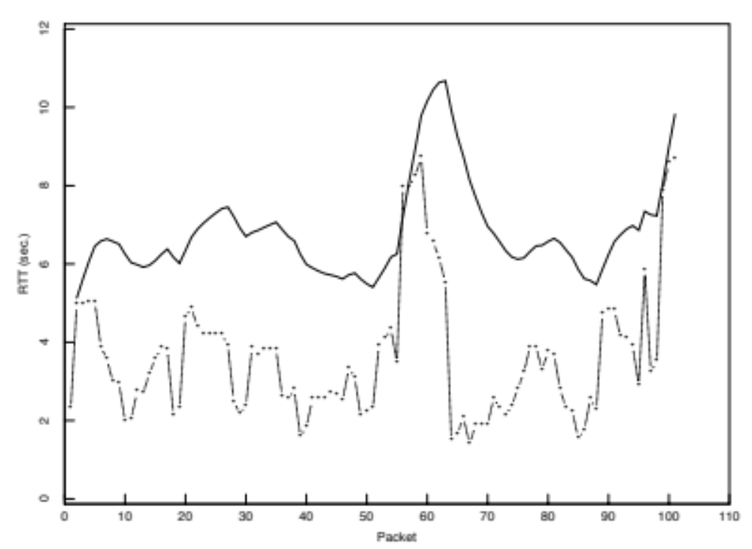
Old RTT Estimation

Slide 13
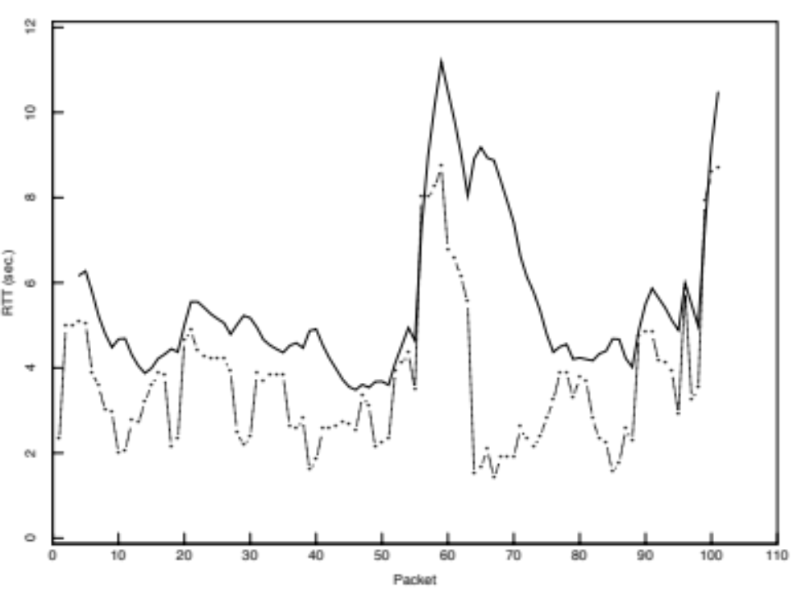
Tahoe RTT Estimation

Slide 14
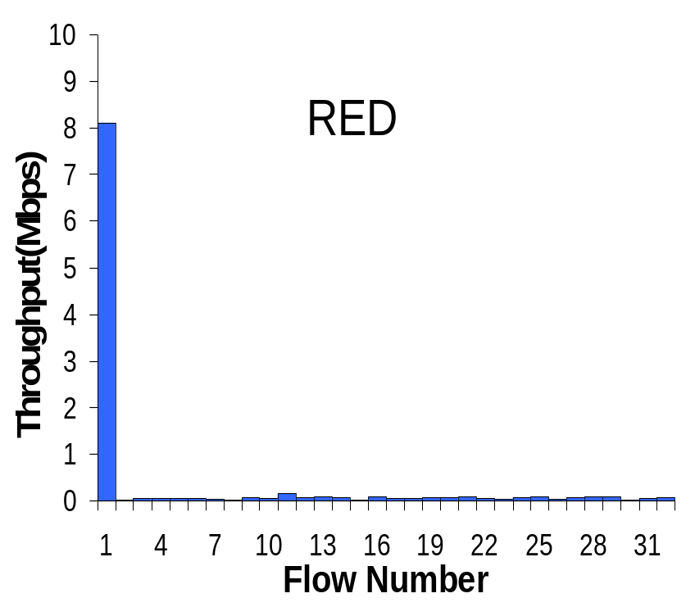
TCP Friendliness
Can other protocols co-exist with TCP?
  E.g., if you want to write a video streaming app using UDP, how to do congestion control?
1 UDP Flow at 10MBps
31 TCP Flows
Sharing a 10MBps link

Slide 15
TCP Friendliness
Can other protocols co-exist with TCP?
  E.g., if you want to write a video streaming app using UDP, how to do congestion control?
Equation-based Congestion Control
  Instead of implementing TCP’s CC, estimate the rate at which TCP would send. Function of what?
  RTT, MSS, Loss
Measure RTT, Loss, send at that rate!

Slide 16
TCP Throughput
Assume a TCP congestion of window W (segments), round-trip time of RTT, segment size MSS
  Sending Rate S = W x MSS / RTT (1)
Drop: W = W/2
  grows by MSS for W/2 RTTs, until another drop at W ≈ W
Average window then 0.75xS
  From (1), S = 0.75 W MSS / RTT (2)
Loss rate is 1 in number of packets between losses:
  Loss = 1 / ( 1 + (W/2 + W/2+1 + W/2 + 2 + … + W)
  = 1 / (3/8 W²) (3)

Slide 17
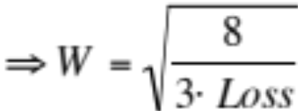
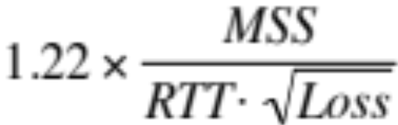
TCP Throughput (cont)
  Loss = 8/(3W²) (4)
  Substituting (4) in (2), S = 0.75 W MSS / RTT ,
  Throughput ≈
Equation-based rate control can be TCP friendly and have better properties, e.g., small jitter, fast ramp-up…

Slide 18
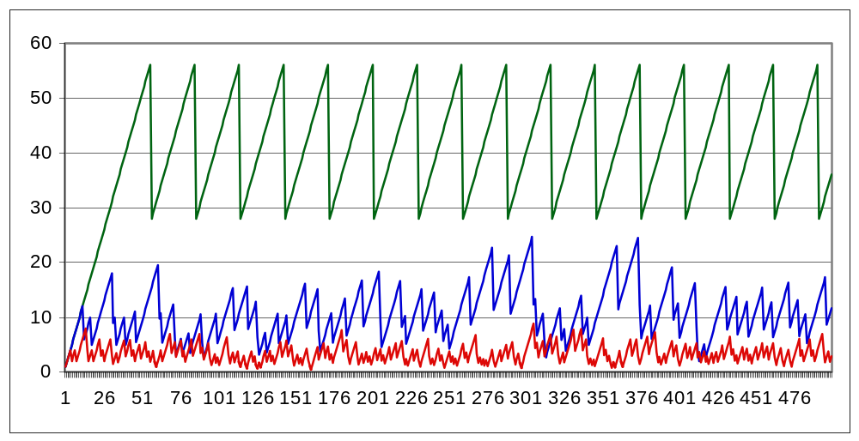
What Happens When Link is Lossy?
Throughput ≈ 1 / sqrt(Loss)
p = 0
p = 1%
p = 10%

Slide 19
What can we do about it?
Two types of losses: congestion and corruption
One option: mask corruption losses from TCP
  Retransmissions at the link layer
  E.g. Snoop TCP: intercept duplicate acknowledgments, retransmit locally, filter them from the sender
Another option:
  Tell the sender about the cause for the drop
  Requires modification to the TCP endpoints

Slide 20
Congestion Avoidance
TCP creates congestion to then back off
  Queues at bottleneck link are often full: increased delay
  Sawtooth pattern: jitter
Alternative strategy
  Predict when congestion is about to happen
  Reduce rate early
Two approaches
  Host centric: TCP Vegas (won’t cover)
  Router-centric: RED, DECBit

Slide 21
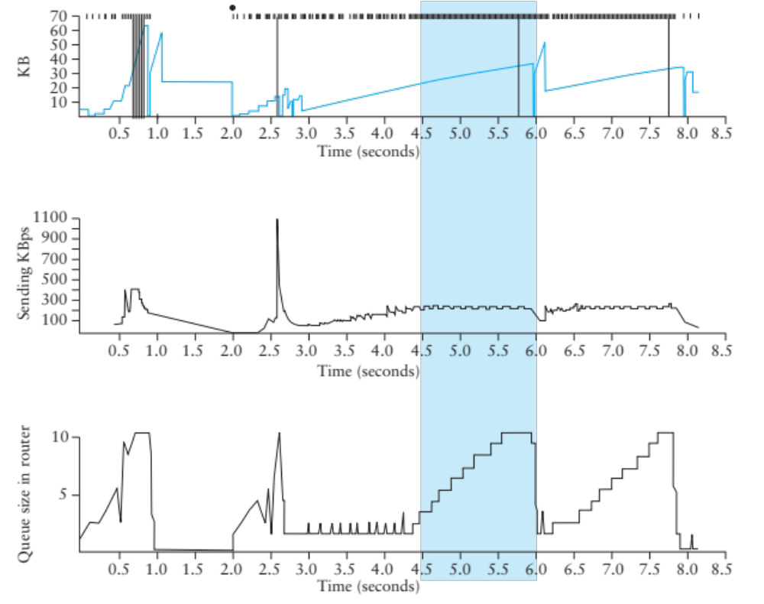
TCP Vegas
Idea: source watches for sign that router’s queue is building up (e.g., sending rate flattens)

Slide 22
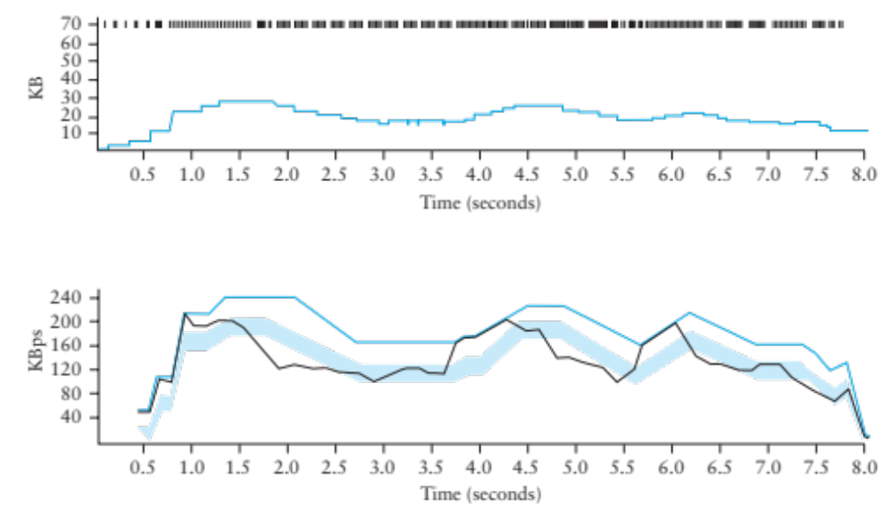
TCP Vegas
Compare Actual Rate (A) with Expected Rate (E)
  If E-A > β, decrease cwnd linearly : A isn’t responding
  If E-A < α, increase cwnd linearly : Room for A to grow

Slide 23
Vegas
Shorter router queues
Lower jitter
Problem:
  Doesn’t compete well with Reno. Why?
  Reacts earlier, Reno is more aggressive, ends up with higher bandwidth…

Slide 24
Help from the network
What if routers could tell TCP that congestion is happening?
  Congestion causes queues to grow: rate mismatch
TCP responds to drops
Idea: Random Early Drop (RED)
  Rather than wait for queue to become full, drop packet with some probability that increases with queue length
  TCP will react by reducing cwnd
  Could also mark instead of dropping: ECN

Slide 25
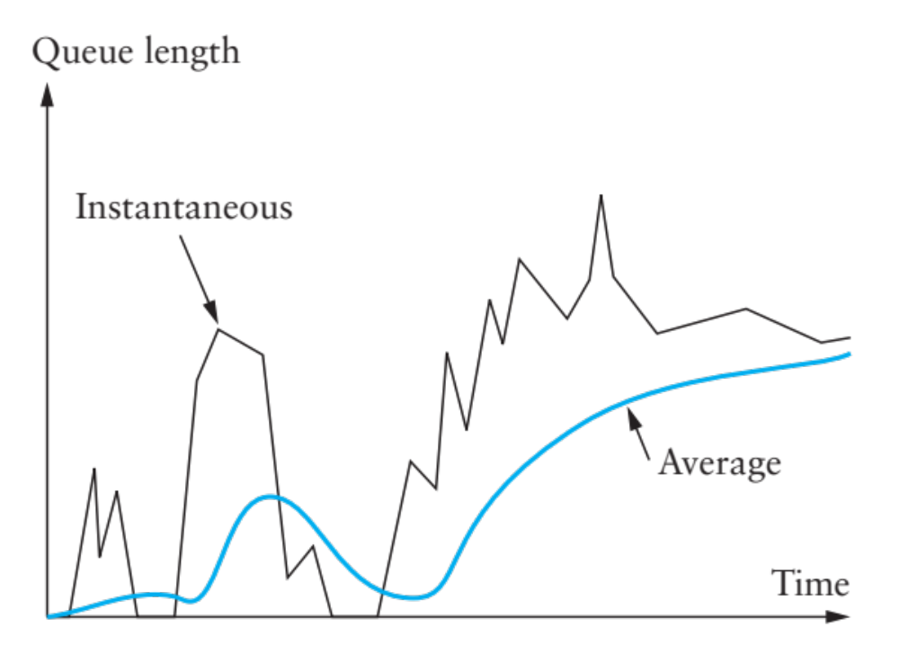
RED Details
Compute average queue length (EWMA)
  Don’t want to react to very quick fluctuations

Slide 26
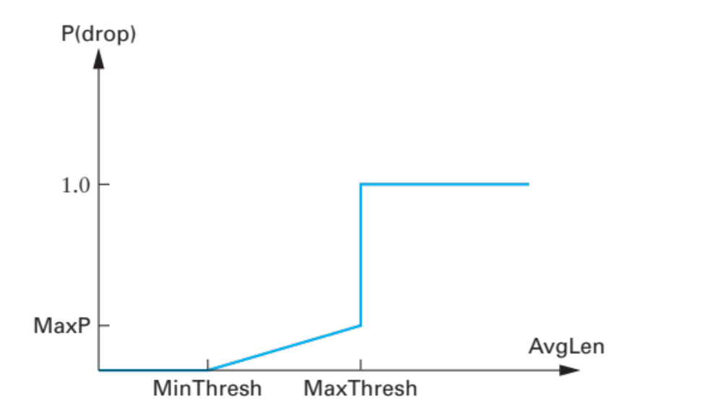
RED Drop Probability
Define two thresholds: MinThresh, MaxThresh
Drop probability:
Improvements to spread drops (see book)

Slide 27
RED Advantages
Probability of dropping a packet of a particular flow is roughly proportional to the share of the bandwidth that flow is currently getting
Higher network utilization with low delays
Average queue length small, but can absorb bursts
ECN
  Similar to RED, but router sets bit in the packet
  Must be supported by both ends
  Avoids retransmissions optionally dropped packets

Slide 28
What happens if not everyone cooperates?
TCP works extremely well when its assumptions are valid
  All flows correctly implement congestion control
  Losses are due to congestion

Slide 29
Cheating TCP
Three possible ways to cheat
  Increasing cwnd faster
  Large initial cwnd
  Opening many connections
  Ack Division Attack

Slide 30
Increasing cwnd Faster
y
C
x increases by 2 per RTT
y increases by 1 per RTT
Limit rates:
x = 2y
x
Figure from Walrand, Berkeley EECS 122, 2003

Slide 31
Larger Initial Window
x
A
B
y
D
E
x starts SS with cwnd = 4
y starts SS with cwnd = 1
Figure from Walrand, Berkeley EECS 122, 2003

Slide 32
Open Many Connections
Web Browser: has to download k objects for a page
  Open many connections or download sequentially?
x
A
B
y
D
E
Assume:
  A opens 10 connections to B
  B opens 1 connection to E
TCP is fair among connections
  A gets 10 times more bandwidth than B
Figure from Walrand, Berkeley EECS 122, 2003

Slide 33
Exploiting Implicit Assumptions
Savage, et al., CCR 1999:
  “TCP Congestion Control with a Misbehaving Receiver”
Exploits ambiguity in meaning of ACK
  ACKs can specify any byte range for error control
  Congestion control assumes ACKs cover entire sent segments
What if you send multiple ACKs per segment?

Slide 34
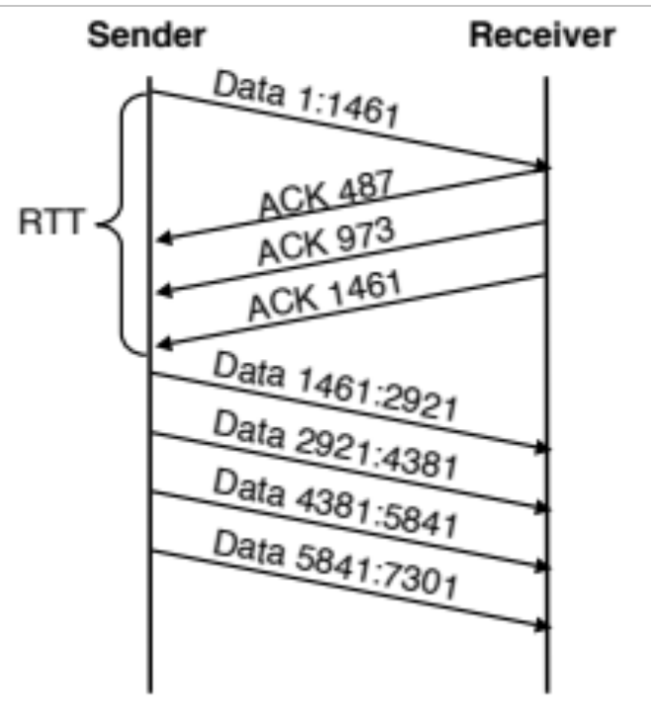
ACK Division Attack
Receiver: “upon receiving a segment with N bytes, divide the bytes in M groups and acknowledge each group separately”
Sender will grow window M times faster
Could cause growth to 4GB in 4 RTTs!
  M = N = 1460

Slide 35
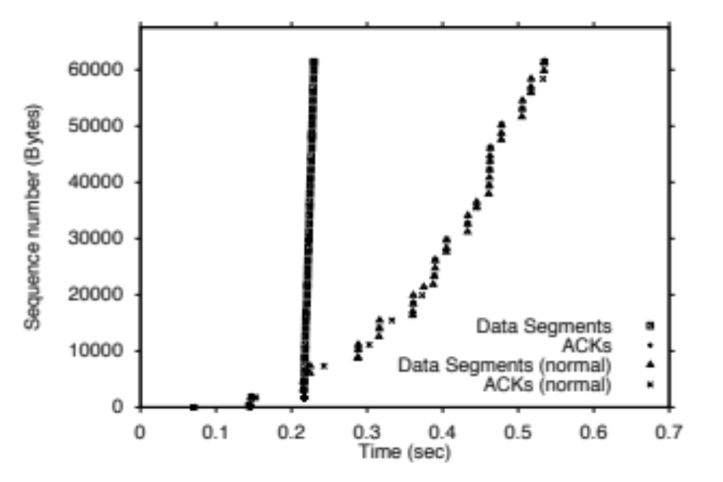
TCP Daytona!

Slide 36
Defense
Appropriate Byte Counting
  [RFC3465 (2003), RFC 5681 (2009)]
  In slow start, cwnd += min (N, MSS)
  where N is the number of newly acknowledged bytes in the received ACK

Slide 37
Cheating TCP and Game Theory
x
A
B
y
D
E
D → Increases by 1 Increases by 5
A
Increases by 1
Increases by 5
(x, y)
22, 22 | 10, 35
35, 10 | 15, 15
Too aggressive
Losses
Throughput falls
Individual incentives: cheating pays
Social incentives: better off without cheating
Classic PD: resolution depends on accountability

Slide 38

Next time
We’ll move into the application layer after Spring Break
  DNS, Web, Security, and more…
Have a nice break!

Slide 39
Backup slides
We didn’t cover these in lecture: won’t be in the exam, but you might be interested ☺

Slide 40
More help from the network
Problem: still vulnerable to malicious flows!
  RED will drop packets from large flows preferentially, but they don’t have to respond appropriately
Idea: Multiple Queues (one per flow)
  Serve queues in Round-Robin
  Nagle (1987)
  Good: protects against misbehaving flows
  Disadvantage?
  Flows with larger packets get higher bandwidth

Slide 41
Solution
Bit-by-bit round robing
Can we do this?
  No, packets cannot be preempted!
We can only approximate it…

Slide 42
Fair Queueing
Define a fluid flow system as one where flows are served bit-by-bit
Simulate ff, and serve packets in the order in which they would finish in the ff system
Each flow will receive exactly its fair share

Slide 43
Example
Flow 1
(arrival traffic)
1
2
3
4
5
6
time
Flow 2
(arrival traffic)
1
2
3
4
5
time
Service
in fluid flow
system
1
2
1
2
3
4
5
6
3
4
5
time
Packet
system
1
2
1
3
2
3
4
4
5
5
6
time

Slide 44
Implementing FQ
Suppose clock ticks with each bit transmitted
  (RR, among all active flows)
P_{i} is the length of the packet
S_{i} is packet i’s start of transmission time
F_{i} is packet i’s end of transmission time
F_{i} = S_{i} + P_{i}
When does router start transmitting packet i?
  If arrived before F_{i-1}, S_{i} = F_{i-1}
  If no current packet for this flow, start when packet arrives (call this A_{i}): S_{i} = A_{i}
Thus, F_{i} = max(F_{i-1},A_{i}) + P_{i}

Slide 45
Fair Queueing
Across all flows
  Calculate F_{i} for each packet that arrives on each flow
  Next packet to transmit is that with the lowest F_{i}
  Clock rate depends on the number of flows
Advantages
  Achieves max-min fairness, independent of sources
  Work conserving
Disadvantages
  Requires non-trivial support from routers
  Requires reliable identification of flows
  Not perfect: can’t preempt packets
Notes:
Example of max-min fairness: 10: 8, 6, 2 => 10/3 = 3.33; 2 gets 2; 8 remaining: 8/2 = 4, others get 8, 6.

Slide 46
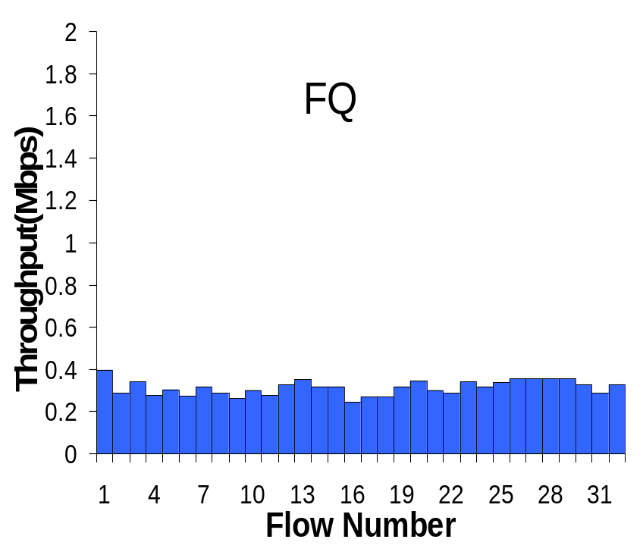
Fair Queueing Example
10Mbps link, 1 10Mbps UDP, 31 TCPs

Slide 47
Big Picture
Fair Queuing doesn’t eliminate congestion: just manages it
You need both, ideally:
  End-host congestion control to adapt
  Router congestion control to provide isolation

