Slide 1
CSCI-1680
Network Layer:
Intra-domain Routing
Rodrigo Fonseca
Based partly on lecture notes by David Mazières, Phil Levis, John Jannotti

Slide 2
Today
Intra-Domain Routing
Next class: Inter-Domain Routing

Slide 3
Routing
Routing is the process of updating forwarding tables
  Routers exchange messages about routers or networks they can reach
  Goal: find optimal route for every destination
  … or maybe a good route, or any route (depending on scale)
Challenges
  Dynamic topology
  Decentralized
  Scale

Slide 4
Scaling Issues
Every router must be able to forward based on any destination IP address
  Given address, it needs to know next hop
  Naïve: one entry per address
  There would be 10⁸ entries!
Solutions
  Hierarchy (many examples)
  Address aggregation
    Address allocation is very important (should mirror topology)
  Default routes

Slide 5
IP Connectivity
For each destination address, must either:
  Have prefix mapped to next hop in forwarding table
  Know “smarter router” – default for unknown prefixes
Route using longest prefix match, default is prefix 0.0.0.0/0
Core routers know everything – no default
Manage using notion of Autonomous System (AS)

Slide 6
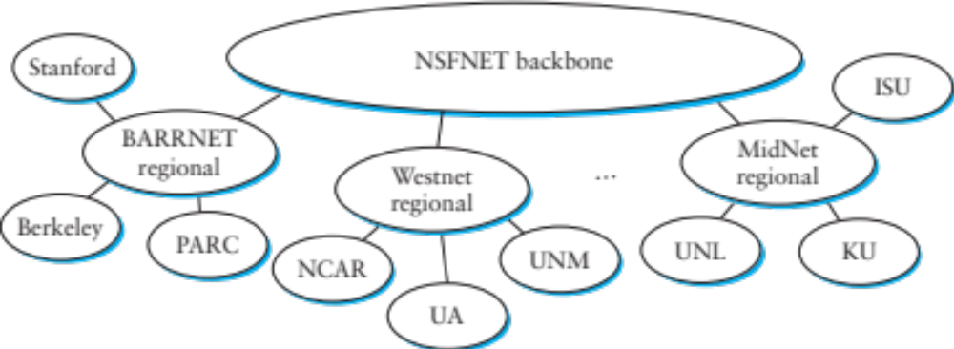
Internet structure, 1990
Several independent organizations
Hierarchical structure with single backbone

Slide 7
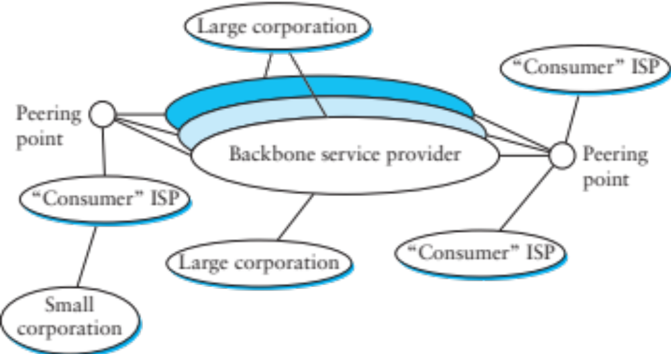
Internet structure, today
Multiple backbones, more arbitrary structure

Slide 8
Autonomous Systems
Correspond to an administrative domain
  AS’s reflect organization of the Internet
  E.g., Brown, large company, etc.
  Identified by a 16-bit number
Goals
  AS’s choose their own local routing algorithm
  AS’s want to set policies about non-local routing
  AS’s need not reveal internal topology of their network

Slide 10
Inter and Intra-domain routing
Routing organized in two levels
Intra-domain routing
  Complete knowledge, strive for optimal paths
  Scale to ~100 networks
  Today
Inter-domain routing
  Aggregated knowledge, scale to Internet
  Dominated by policy
    E.g., route through X, unless X is unavailable, then route through Y. Never route traffic from X to Y.
  Policies reflect business agreements, can get complex
  Next lecture

Slide 11
Intra-Domain Routing

Slide 12
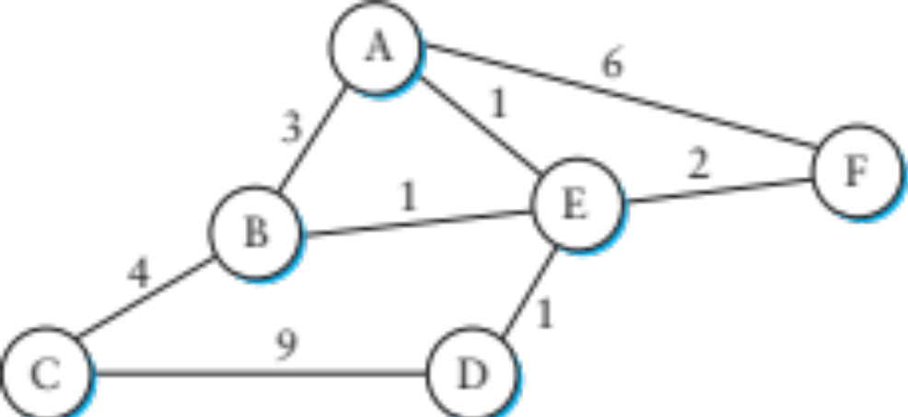
Network as a graph
Nodes are routers
Assign cost to each edge
  Can be based on latency, b/w, queue length, …
Problem: find lowest-cost path between nodes
  Each node individually computes routes

Slide 13
Basic Algorithms
Two classes of intra-domain routing algorithms
Distance Vector
  Requires only local state
  Harder to debug
  Can suffer from loops
Link State
  Each node has global view of the network
  Simpler to debug
  Requires global state

Slide 14
Distance Vector
Local routing algorithm
Each node maintains a set of triples
  <Destination, Cost, NextHop>
Exchange updates with neighbors
  Periodically (seconds to minutes)
  Whenever table changes (triggered update)
Each update is a list of pairs
  <Destination, Cost>
Update local table if receive a “better” route
  Smaller cost
Refresh existing routes, delete if time out

Slide 15
Calculating the best path
Bellman-Ford equation
Let:
  D_{a}(b) denote the current best distance from a to b
  c(a,b) denote the cost of a link from a to b
Then D_{x}(y) = min_{z}(c(x,z) + D_{z}(y))
Routing messages contain D
D is any additive metric
  e.g, number of hops, queue length, delay
  log can convert multiplicative metric into an additive one (e.g., probability of failure)

Slide 16
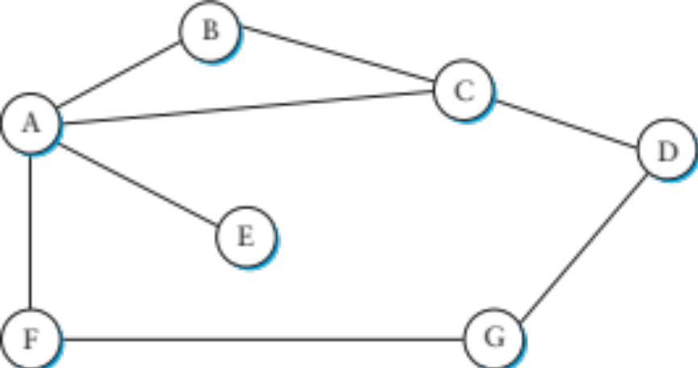
DV Example
B’s routing table
Destination | Cost | Next Hop
A | 1 | A
C | 1 | C
D | 2 | C
E | 2 | A
F | 2 | A
G | 3 | A

Slide 17
Adapting to Failures
G, 3, D
G, 2, D
G, 3,C
G, ∞,-
G, 2, F
G, 1, G
G, 4, A
G, 3, A
G, 1, G
G, ∞, -
G, 4, A
F-G fails
F sets distance to G to infinity, propagates
A sets distance to G to infinity
A receives periodic update from C with 2-hop path to G
A sets distance to G to 3 and propagates
F sets distance to G to 4, through A
Notes:
Does the order matter here?

Slide 18
Count-to-Infinity
Link from A to E fails
A advertises distance of infinity to E
B and C advertise a distance of 2 to E
B decides it can reach E in 3 hops through C
A decides it can reach E in 4 hops through B
C decides it can reach E in 5 hops through A, …
When does this stop?

Slide 19
Good news travels fast
B
1
4
1
A
C
10
A decrease in link cost has to be fresh information
Network converges at most in O(diameter) steps
Notes:
Note routes to A.

Slide 20
Bad news travels slowly
B
12
4
1
A
C
10
An increase in cost may cause confusion with old information, may form loops
Consider routes to A
Initially, B:A,4,A; C:A,5,B
Then B:A,12,A, selects C as next hop -> B:A,6,C
C -> A,7,B; B -> A,8,C; C -> A,9,B; B -> A,10,C;
C finally chooses C:A,10,A, and B -> A,11,C!
Notes:
Note routes to A.

Slide 21
How to avoid loops
IP TTL field prevents a packet from living forever
  Does not repair a loop
Simple approach: consider a small cost n (e.g., 16) to be infinity
  After n rounds decide node is unavailable
  But rounds can be long, this takes time
Problem: distance vector based only on local information

Slide 22
Better loop avoidance
Split Horizon
  When sending updates to node A, don’t include routes you learned from A
  Prevents B and C from sending cost 2 to A
Split Horizon with Poison Reverse
  Rather than not advertising routes learned from A, explicitly include cost of ∞.
  Faster to break out of loops, but increases advertisement sizes

Slide 23
Warning
Split horizon/split horizon with poison reverse only help between two nodes
  Can still get loop with three nodes involved
  Might need to delay advertising routes after changes, but affects convergence time

Slide 24
Other approaches
DSDV: destination sequenced distance vector
  Uses a ‘version’ number per destination message
  Avoids loops by preventing nodes from using old information from descendents
  But, you can only update when new version comes from root
Path Vector: (BGP)
  Replace ‘distance’ with ‘path’
  Avoids loops with extra cost

Slide 25
Link State Routing
Strategy:
  send to all nodes information about directly connected neighbors
Link State Packet (LSP)
  ID of the node that created the LSP
  Cost of link to each directly connected neighbor
  Sequence number (SEQNO)
  TTL

Slide 26
Reliable Flooding
Store most recent LSP from each node
  Ignore earlier versions of the same LSP
Forward LSP to all nodes but the one that sent it
Generate new LSP periodically
  Increment SEQNO
Start at SEQNO=0 when reboot
  If you hear your own packet with SEQNO=n, set your next SEQNO to n+1
Decrement TTL of each stored LSP
  Discard when TTL=0

Slide 27
Calculating best path
Djikstra’s single-source shortest path algorithm
  Each node computes shortest paths from itself
Let:
  N denote set of nodes in the graph
  l(i,j) denote the non-negative link between i,j
    ∞ if there is no direct link between i and j
  C(n) denote the cost of path from s to n
  s denotes yourself (node computing paths)
Initialize variables
  M = {s} (set of nodes incorporated thus far)
  For each n in N-{s}, C(n) = l(s,n)
  Next(n) = s if l(s,n) < ∞, – otherwise

Slide 28
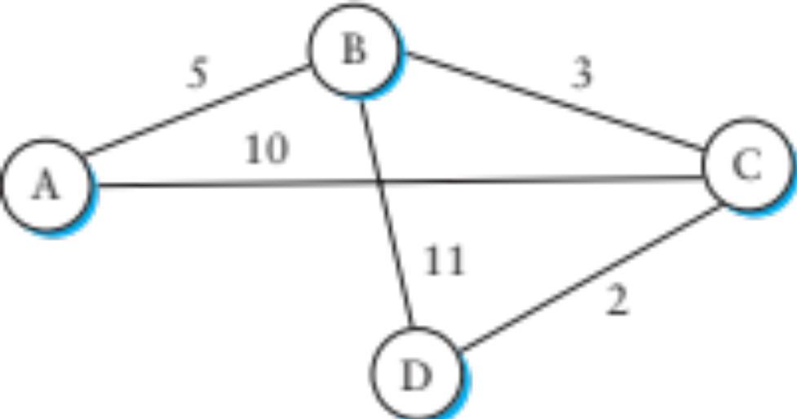
Djikstra’s Algorithm
While N≠M
  Let w ∈(N-M) be the node with lowest C(w)
  M = M ∪ {w}
  Foreach n ∈ (N-M), if C(w) + l(w,n) < C(n)
  then C(n) = C(w) + l(w,n), Next(n) = w
Example: D: (D,0,-) (C,2,D) (B,5,C) (A,10,B)

Slide 29
Distance Vector vs. Link State
# of messages (per node)
  DV: O(d), where d is degree of node
  LS: O(nd) for n nodes in system
Computation
  DV: convergence time varies (e.g., count-to-infinity)
  LS: O(n²) with O(nd) messages
Robustness: what happens with malfunctioning router?
  DV: Nodes can advertise incorrect path cost
  DV: Others can use the cost, propagates through network
  LS: Nodes can advertise incorrect link cost

Slide 30
Metrics
Original ARPANET metric
  measures number of packets enqueued in each link
  neither latency nor bandwidth in consideration
New ARPANET metric
  Stamp arrival time (AT) and departure time (DT)
  When link-level ACK arrives, compute
    Delay = (DT – AT) + Transmit + Latency
  If timeout, reset DT to departure time for retransmission
  Link cost = average delay over some time period
Fine Tuning
  Compressed dynamic range
  Replaced Delay with link utilization
Today: commonly set manually to achieve specific goals

Slide 31
Examples
RIPv2
  Fairly simple implementation of DV
  RFC 2453 (38 pages)
OSPF (Open Shortest Path First)
  More complex link-state protocol
  Adds notion of areas for scalability
  RFC 2328 (244 pages)

Slide 32
RIPv2
Runs on UDP port 520
Link cost = 1
Periodic updates every 30s, plus triggered updates
Relies on count-to-infinity to resolve loops
  Maximum diameter 15 (∞ = 16)
  Supports split horizon, poison reverse
Deletion
  If you receive an entry with metric = 16 OR
  If a route times out

Slide 33
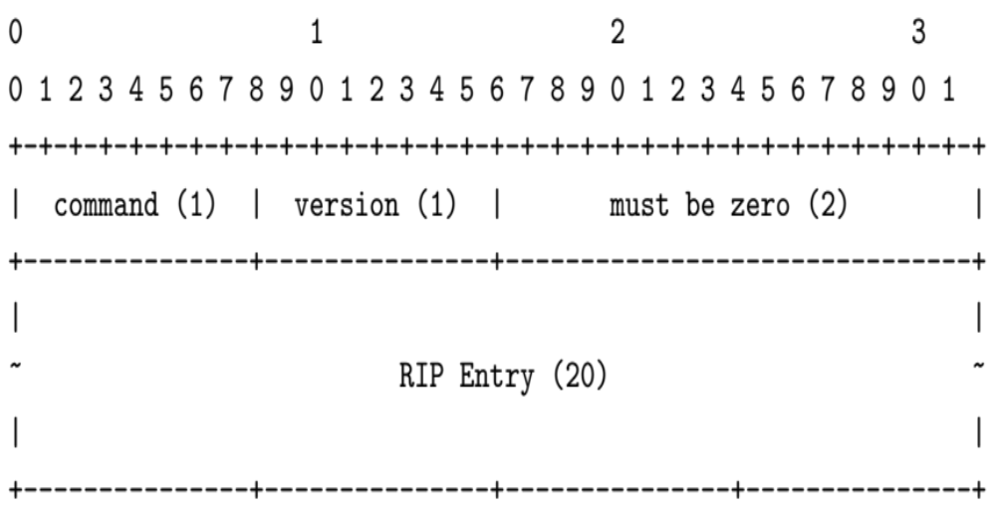
Packet format

Slide 34
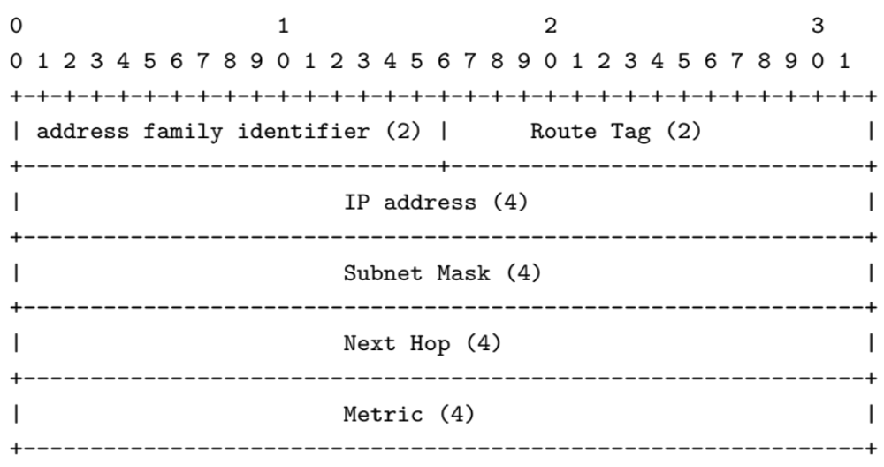
RIPv2 Entry

Slide 35
Route Tag field
Allows RIP nodes to distinguish internal and external routes
Must persist across announcements
E.g., encode AS

Slide 36
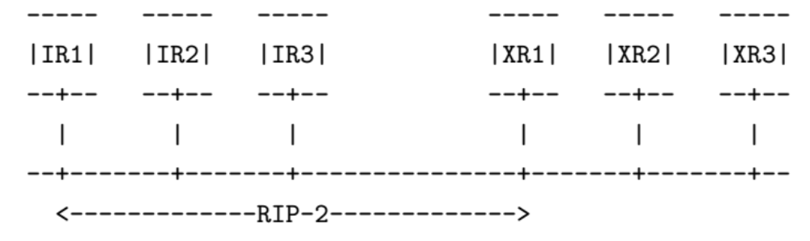
Next Hop field
Allows one router to advertise routes for multiple routers on the same subnet
Suppose only XR1 talks RIPv2:

Slide 37
OSPFv2
Link state protocol
Runs directly over IP (protocol 89)
  Has to provide its own reliability
All exchanges are authenticated
Adds notion of areas for scalability

Slide 38
OSPF Areas
Area 0 is “backbone” area (includes all boundary routers)
Traffic between two areas must always go through area 0
Only need to know how to route exactly within area
Otherwise, just route to the appropriate area
Tradeoff: scalability versus optimal routes

Slide 39
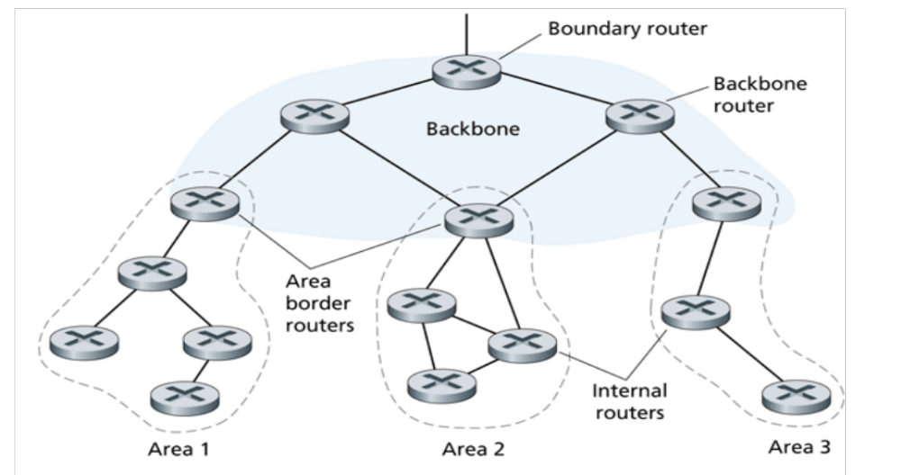
OSPF Areas

Slide 40
Next Class
Inter-domain routing: how scale routing to the entire Internet

