Slide 1
CSCI-1680
Network Layer:
IP & Forwarding
Rodrigo Fonseca
Based partly on lecture notes by David Mazières, Phil Levis, John Jannotti

Slide 2
Administrivia
IP out today. Your job:
  Find partners and tell us
  Implement IP forwarding and DV routing
  Get started NOW (ok, after class)
HW1 due tomorrow
My next office hours:
  Today, 12:30-1:30; Wednesday 11:00-12:00
No class next Tuesday (Brown holiday)
No class next Thursday (Rodrigo out of town)

Slide 3
Today
Network layer: Internet Protocol (v4)
Forwarding
  Addressing
  Fragmentation
  ARP
  DHCP
  NATs
Next 2 classes: Routing

Slide 4
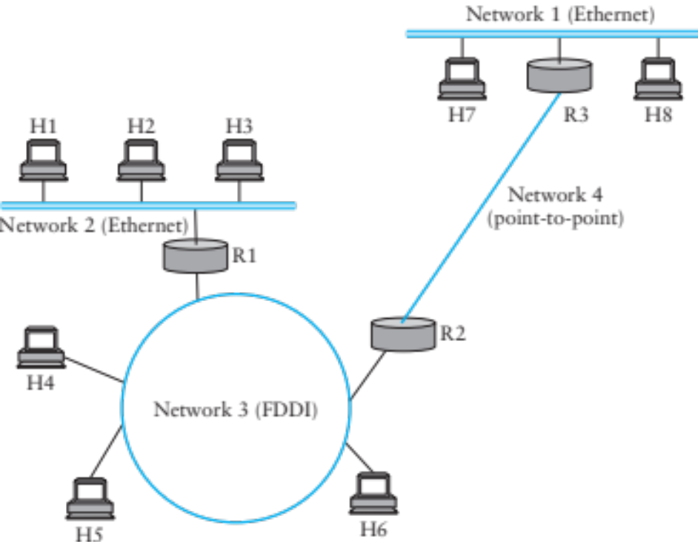
Internet Protocol Goal
How to connect everybody?
  New global network or connect existing networks?
Glue lower-level networks together:
  allow packets to be sent between any pair or hosts
Wasn’t this the goal of switching?

Slide 5
Internetworking Challenges
Heterogeneity
  Different addresses
  Different service models
  Different allowable packet sizes
Scaling
Congestion control

Slide 6
How would you design such a protocol?
Circuits or packets?
  Predictability
Service model
  Reliability, timing, bandwidth guarantees
Any-to-any
  Finding nodes: naming, routing
  Maintenance (join, leave, add/remove links,…)
  Forwarding: message formats

Slide 7
IP’s Decisions
Packet switched
  Unpredictability
Service model
  Lowest common denominator: best effort, connectionless datagram
Any-to-any
  Common message format
  Separated routing from forwarding
  Naming: uniform addresses, hierarchical organization
  Routing: hierarchical, prefix-based (longest prefix matching)
  Maintenance: delegated, hierarchical

Slide 8
A Bit of History
Packet switched networks: Arpanet’s IMPs
  Late 1960’s
  RFC 1, 1969!
  Segmentation, framing, routing, reliability, reassembly, flow control
Network Control Program (NCP)
  Provided connections, flow control
  Assumed reliable network: IMPs
  Used by programs like telnet, mail, file transfer
Wanted to connect multiple networks
  Not all reliable, different formats, etc…

Slide 9
TCP/IP Introduced
Vint Cerf, Robert Kahn
Replace NCP
Initial design: single protocol providing a unified reliable pipe
  Could support any application
Different requirements soon emerged, and the two were separated
  IP: basic datagram service among hosts
  TCP: reliable transport
  UDP: unreliable multiplexed datagram service

Slide 10
An excellent read
David D. Clark, “The design Philosophy of the DARPA Internet Protocols”, 1988
Primary goal: multiplexed utilization of existing interconnected networks
Other goals:
  Communication continues despite loss of networks or gateways
  Support a variety of communication services
  Accommodate a variety of networks
  Permit distributed management of its resources
  Be cost effective
  Low effort for host attachment
  Resources must be accountable

Slide 11
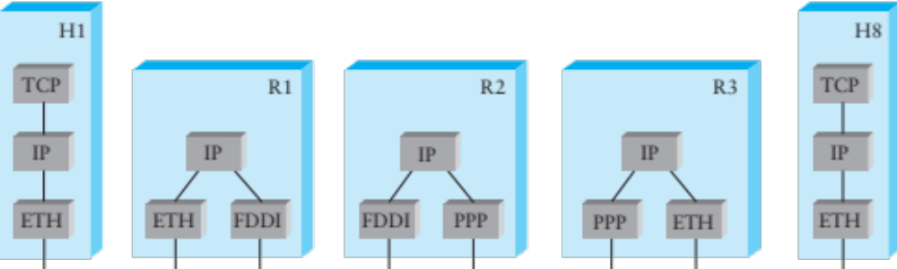
Internet Protocol
IP Protocol running on all hosts and routers
Routers are present in all networks they join
Uniform addressing
Forwarding/Fragmentation
Complementary:
  Routing, Error Reporting, Address Translation

Slide 12
IP Protocol
Provides addressing and forwarding
  Addressing is a set of conventions for naming nodes in an IP network
  Forwarding is a local action by a router: passing a packet from input to output port
IP forwarding finds output port based on destination address
  Also defines certain conventions on how to handle packets (e.g., fragmentation, time to live)
Contrast with routing
  Routing is the process of determining how to map packets to output ports (topic of next two lectures)

Slide 13
Service Model
Connectionless (datagram-based)
Best-effort delivery (unreliable service)
  packets may be lost
  packets may be delivered out of order
  duplicate copies of packets may be delivered
  packets may be delayed for a long time
It’s the lowest common denominator
  A network that delivers no packets fits the bill!
  All these can be dealt with above IP (if probability of delivery is non-zero…)

Slide 14
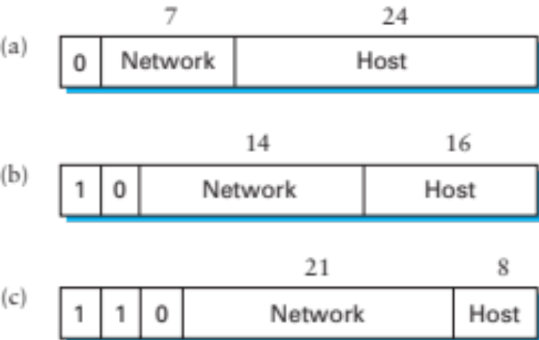
Format of IP addresses
Globally unique (or made seem that way)
  32-bit integers, read in groups of 8-bits: 128.148.32.110
Hierarchical: network + host
Originally, routing prefix embedded in address
  Class A (8-bit prefix), B (16-bit), C (24-bit)
  Routers need only know route for each network

Slide 15
Forwarding Tables
Exploit hierarchical structure of addresses: need to know how to reach networks, not hosts
Keyed by network portion, not entire address
Next address should be local
Network | Next Address
212.31.32.* | 0.0.0.0
18.*.*.* | 212.31.32.5
128.148.*.* | 212.31.32.4
Default | 212.31.32.1

Slide 16
Classed Addresses
Hierarchical: network + host
  Saves memory in backbone routers (no default routes)
  Originally, routing prefix embedded in address
  Routers in same network must share network part
Inefficient use of address space
  Class C with 2 hosts (2/255 = 0.78% efficient)
  Class B with 256 hosts (256/65535 = 0.39% efficient)
  Shortage of IP addresses
  Makes address authorities reluctant to give out class B’s
Still too many networks
  Routing tables do not scale
Routing protocols do not scale

Slide 17
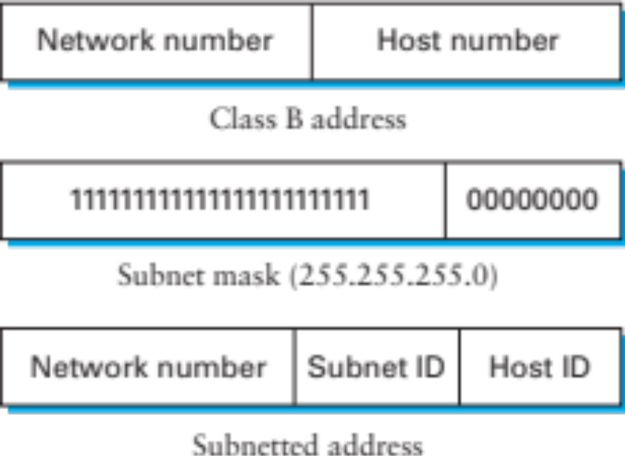
Subnetting
Add another level to address/routing hierarchy
Subnet mask defines variable portion of host part
Subnets visible only within site
Better use of address space
Notes:
Much better efficiency: can break large networks without increasing global routing table size

Slide 18
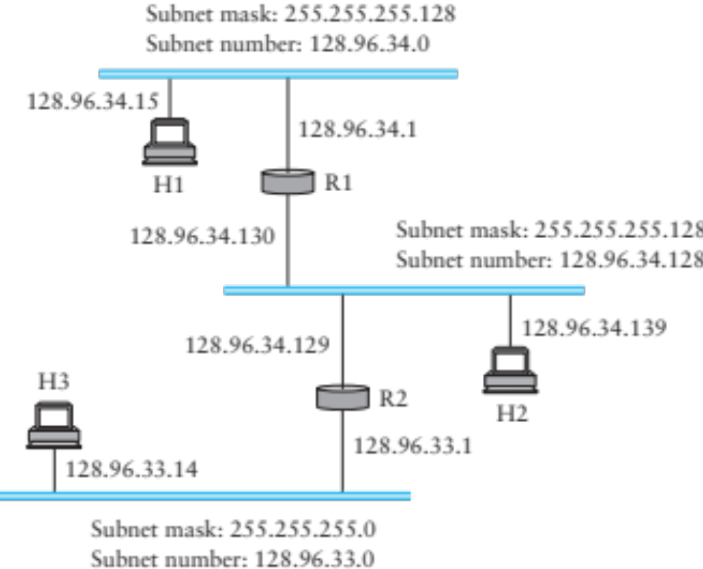
Example
H1-> H2: H2.ip & H1.mask != H1.subnet => no direct path
Notes:
128.96.34.139 = 10000000 01100000 00100010 10001011
Mask: 11111111 11111111 11111111 10000000

Slide 19
R1’s Forwarding Table
Network | Subnet Mask | Next Address
128.96.34.0 | 255.255.255.128 | 128.96.34.1
128.96.34.128 | 255.255.255.128 | 128.96.34.130
128.96.33.0 | 255.255.255.0 | 128.96.34.129

Slide 20
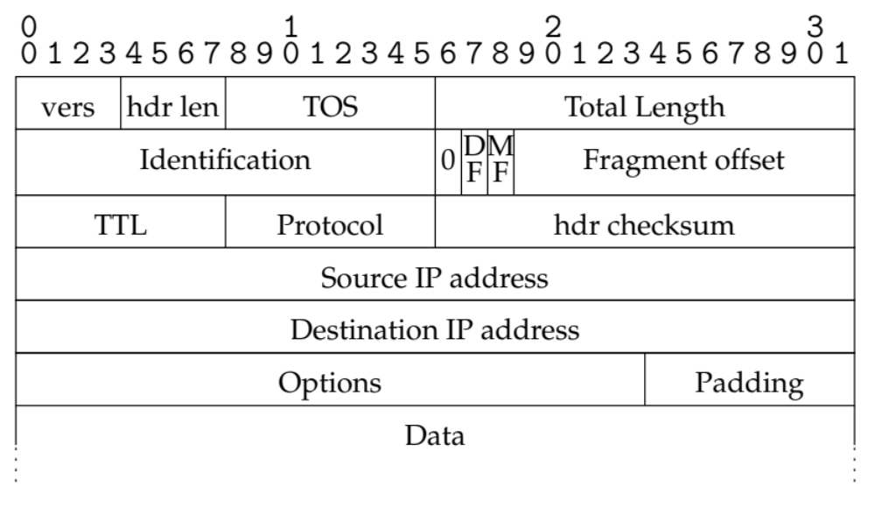
IP v4 packet format

Slide 21
IP header details
Forwarding based on destination address
TTL (time-to-live) decremented at each hop
  Originally was in seconds (no longer)
  Mostly prevents forwarding loops
  Other cool uses…
Fragmentation possible for large packets
  Fragmented in network if crossing link w/ small frame
  MF: more fragments for this IP packet
  DF: don’t fragment (returns error to sender)
Following IP header is “payload” data
  Typically beginning with TCP or UDP header

Slide 22
Other fields
Version: 4 (IPv4) for most packets, there’s also 6
Header length: in 32-bit units (>5 implies options)
Type of service (won’t go into this)
Protocol identifier (TCP: 6, UDP: 17, ICMP: 1, …)
Checksum over the header

Slide 23
Fragmentation & Reassembly
Each network has maximum transmission unit (MTU)
Strategy
  Fragment when necessary (MTU < size of datagram)
  Source tries to avoid fragmentation (why?)
  Re-fragmentation is possible
  Fragments are self-contained datagrams
  Delay reassembly until destination host
  No recovery of lost fragments
Notes:
Fragmentation: loss of one fragment implies all fragments discarded
Delay of entire packet is worst case delay over all fragments

Slide 24
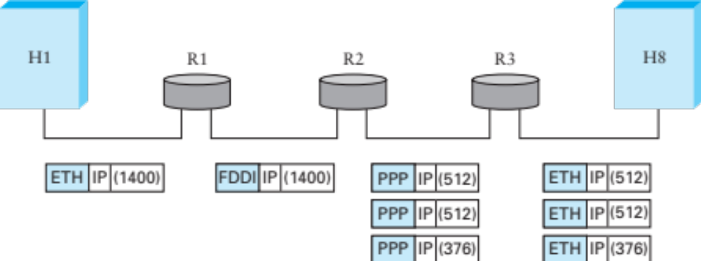
Fragmentation Example
Ethernet MTU is 1,500 bytes
PPP MTU is 576 bytes
  R2 must fragment IP packets to forward them

Slide 25
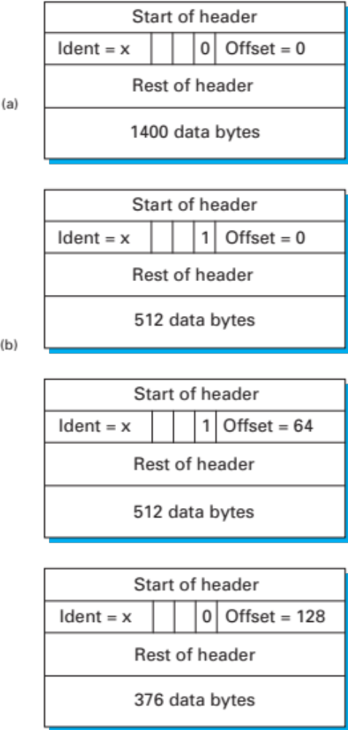
Fragmentation Example (cont)
IP addresses plus ident field identify fragments of same packet
MF (more fragments bit) is 1 in all but last fragment
Fragment offset multiple of 8 bytes
  Multiply offset by 8 for fragment position original packet

Slide 26
Translating IP to lower level addresses
Map IP addresses into physical addresses
  E.g., Ethernet address of destination host
  or Ethernet address of next hop router
Techniques
  Encode physical address in host part of IP address (IPv6)
  Each network node maintains lookup table (IP->phys)

Slide 27
ARP – address resolution protocol
Dynamically builds table of IP to physical address bindings for a local network
Broadcast request if IP address not in table
All learn IP address of requesting node (broadcast)
Target machine responds with its physical address
Table entries are discarded if not refreshed

Slide 28
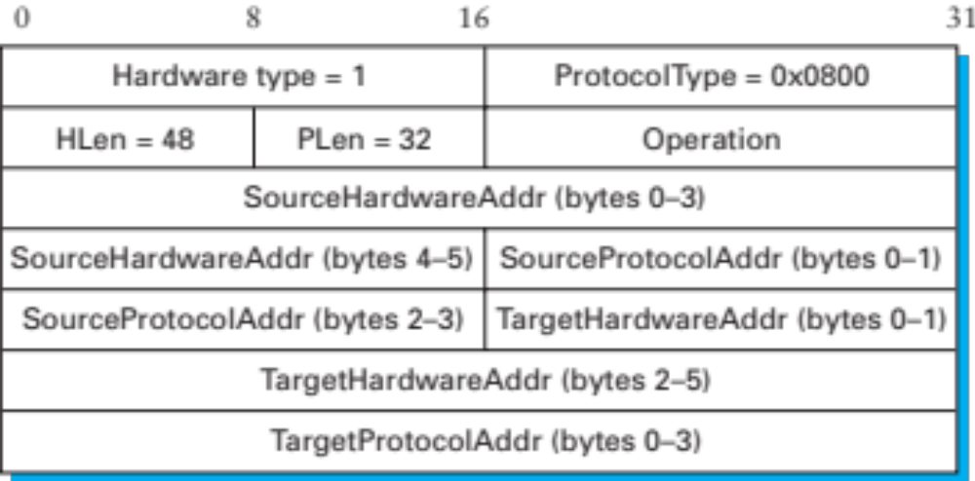
ARP Ethernet frame format
Why include source hardware address? Why not?

Slide 29
Obtaining Host IP Addresses - DHCP
Networks are free to assign addresses within block to hosts
Tedious and error-prone: e.g., laptop going from CIT to library to coffee shop
Solution: Dynamic Host Configuration Protocol
  Client: DHCP Discover to 255.255.255.255 (broadcast)
  Server(s): DHCP Offer to 255.255.255.255 (why broadcast?)
  Client: choose offer, DHCP Request (broadcast, why?)
  Server: DHCP ACK (again broadcast)
Result: address, gateway, netmask, DNS server

Slide 30
Scaling: Supernetting
Problem: routing table growth
Idea: assign blocks of contiguous networks to nearby networks
Called CIDR: Classless Inter-Domain Routing
Represent blocks with a single pair
  (first network address, count)
Restrict block sizes to powers of 2
Use a bit mask (CIDR mask) to identify block size
Address aggregation: reduce routing tables

Slide 31
CIDR Forwarding Table
Network | Next Address
212.31.32/24 | 0.0.0.0
18/8 | 212.31.32.5
128.148/16 | 212.31.32.4
128.148.128/17 | 212.31.32.8
0/0 | 212.31.32.1

Slide 32
Obtaining IP Addresses
Blocks of IP addresses allocated hierarchically
  ISP obtains an address block, may subdivide
  ISP: 128.35.16/20 10000000 00100011 00010000 00000000
  Client 1: 128.35.16/22 10000000 00100011 00010000 00000000
  Client 2: 128.35.20/22 10000000 00100011 00010100 00000000
  Client 3: 128.35.24/21 10000000 00100011 00011000 00000000
Global allocation: ICANN, /8’s (ran out!)
Regional registries: ARIN, RIPE, APNIC, LACNIC, AFRINIC

Slide 33
Network Address Translation (NAT)
Despite CIDR, it’s still difficult to allocate addresses (2³² is only 4 billion)
We’ll talk about IPv6 later
NAT “hides” entire network behind one address
Hosts are given private addresses
Routers map outgoing packets to a free address/port
Router reverse maps incoming packets
Problems?
Notes:
Incoming flows
Shared ports
Breaks assumptions

Slide 34
Internet Control Message Protocol (ICMP)
Echo (ping)
Redirect
Destination unreachable (protocol, port, or host)
TTL exceeded
Checksum failed
Reassembly failed
Can’t fragment
Many ICMP messages include part of packet that triggered them
See http://www.iana.org/assignments/icmp-parameters

Slide 35
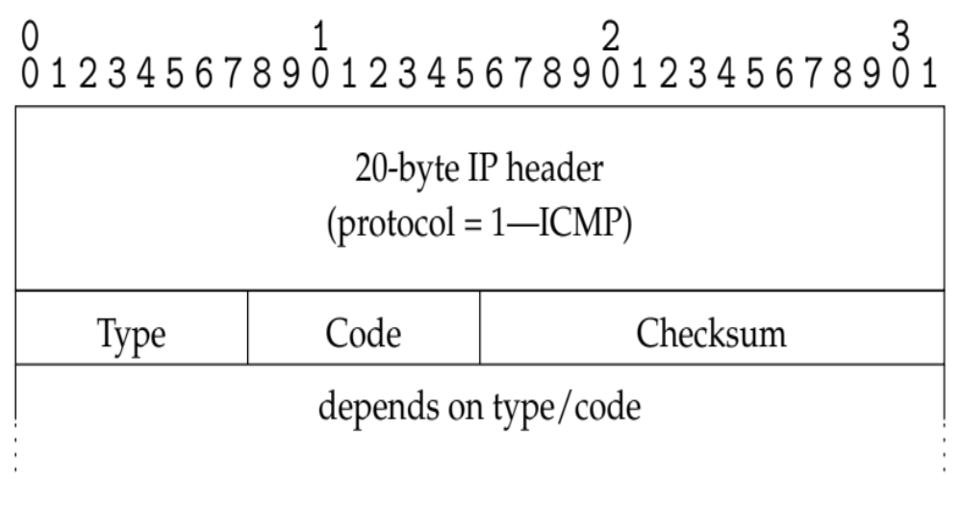
ICMP message format

Slide 36
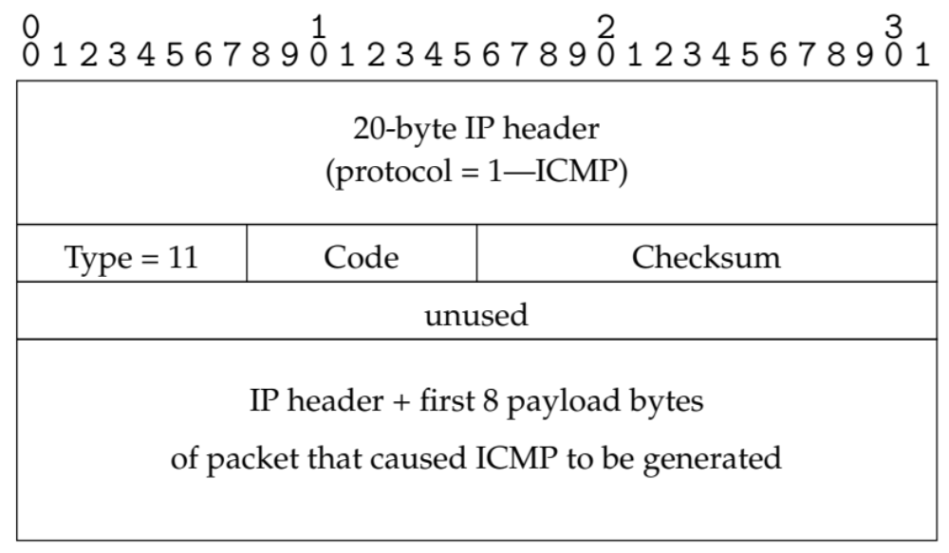
Example: Time Exceeded
Code usually 0 (TTL exceeded in transit)
Discussion: traceroute

Slide 37
Example: Can’t Fragment
Sent if DF=1 and packet length > MTU
What can you use this for?
Path MTU Discovery
  Can do binary search on packet sizes
  But better: base algorithm on most common MTUs
Notes:
Path MTU discovery

Slide 38
Coming Up
Routing: how do we fill the routing tables?
  Intra-domain routing: Tuesday 2/28
  Inter-domain routing: Thursday, 3/1

