Slide 1
CSCI-1680
Link Layer Reliability
Rodrigo Fonseca
Based partly on lecture notes by David Mazières, Phil Levis, John Jannotti

Slide 2
Administrivia
Snowcast due on Friday
Homework I out on Thursday
GitHub
  We have free GitHub private accounts for the course!
    You can use it for the other projects
    Create a GH account, send your login
    Private repositories for each group

Slide 3
Last time…
  Physical Layer
    Encoding
    Modulation
  Link Layer Framing
Today: Link Layer Reliability
  Basic Error Detection
  Reliability

Slide 4
Error Detection
Idea: have some codes be invalid
  Must add bits to catch errors in packet
Sometimes can also correct errors
  If enough redundancy
  Might have to retransmit
Used in multiple layers
Three examples today:
  Parity
  Internet Checksum
  CRC

Slide 5
Simplest Schemes
Repeat frame n times
  Can we detect errors?
  Can we correct errors?
    Voting
  Problem: high redundancy : n !
Example: send each bit 3 times
  Valid codes: 000 111
  Invalid codes : 001 010 011 100 101 110
  Corrections : 0 0 1 0 1 1

Slide 6
Parity
Add a parity bit to the end of a word
Example with 2 bits:
  Valid: 000 011 011 110
  Invalid: 001 010 010 111
  Can we correct?
Can detect odd number of bit errors
  No correction

Slide 7
In general
Hamming distance: number of bits that are different
  E.g.: HD (00001010, 01000110) = 3
If min HD between valid codewords is d:
  Can detect d-1 bit error
  Can correct ⌊(d-1)/2⌋ bit errors
What is d for parity and 3-voting?
Notes:
Parity: d=2
3-Voting: d=3

Slide 8
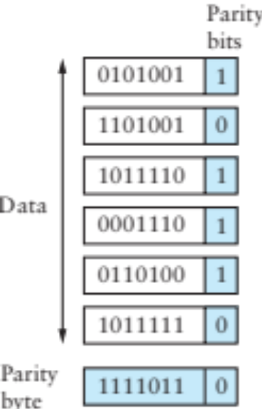
2-D Parity
Add 1 parity bit for each 7 bits
Add 1 parity bit for each bit position across the frame)
  Can correct single-bit errors
  Can detect 2- and 3-bit errors, most 4-bit errors
Find a 4-bit error that can’t be corrected

Slide 9
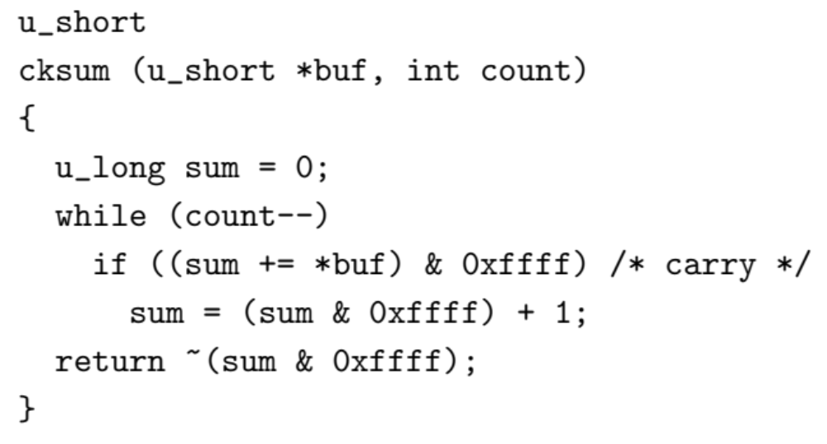
IP Checksum
Fixed-length code
  n-bit code should capture all but 2^{-n} fraction of errors
    Why?
  Trick is to make sure that includes all common errors
IP Checksum is an example
  1’s complement of 1’s complement sum of every 2 bytes

Slide 10
How good is it?
16 bits not very long: misses how many errors?
  1 in 2¹⁶, or 1 in 64K errors
Checksum does catch all 1-bit errors
But not all 2-bit errors
  E.g., increment word ending in 0, decrement one ending in 1
Checksum also optional in UDP
  All 0s means no checksums calculated
  If checksum word gets wiped to 0 as part of error, bad news

Slide 11
From rfc791 (IP)
“This is a simple to compute checksum and experimental evidence indicates it is adequate, but it is provisional and may be replaced by a CRC procedure, depending on further experience.”

Slide 12
CRC – Error Detection with Polynomials
Goal: maximize protection, minimize bits
Consider message to be a polynomial in Z₂[x]
  Each bit is one coefficient
  E.g., message 10101001 -> m(x) = x⁷ + x⁵+ x³ + 1
Can reduce one polynomial modulo another
  Let n(x) = m(x)x³. Let C(x) = x³ + x² + 1.
  n(x) “mod” C(x) : r(x)
  Find q(x) and r(x) s.t. n(x) = q(x)C(x) + r(x) and degree of r(x) < degree of C(x)
  Analogous to taking 11 mod 5 = 1

Slide 13
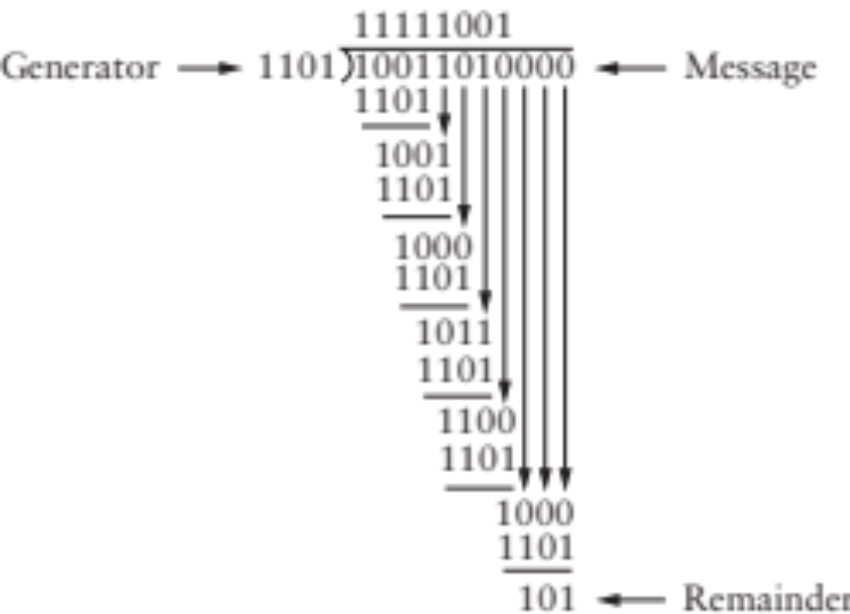
Polynomial Division Example
Just long division, but addition/subtraction is XOR

Slide 14
CRC
Select a divisor polynomial C(x), degree k
  C(x) should be irreducible – not expressible as a product of two lower-degree polynomials in Z₂[x]
Add k bits to message
  Let n(x) = m(x)x^{k} (add k 0’s to m)
  Compute r(x) = n(x) mod C(x)
  Compute n(x) = n(x) – r(x) (will be divisible by C(x)) (subtraction is XOR, just set k lowest bits to r(x)!)
Checking CRC is easy
  Reduce message by C(x), make sure remainder is 0
Notes:
Irreducible analogous to prime

Slide 15
Why is this good?
Suppose you send m(x), recipient gets m’(x)
  E(x) = m’(x) – m(x) (all the incorrect bits)
  If CRC passes, C(x) divides m’(x)
  Therefore, C(x) must divide E(x)
Choose C(x) that doesn’t divide any common errors!
  All single-bit errors caught if x^{k}, x⁰ coefficients in C(x) are 1
  All 2-bit errors caught if at least 3 terms in C(x)
  Any odd number of errors if last two terms (x + 1)
  Any error burst less than length k caught

Slide 16
Common CRC Polynomials
Polynomials not trivial to find
  Some studies used (almost) exhaustive search
CRC-8: x⁸ + x² + x¹ + 1
CRC-16: x¹⁶ + x¹⁵ + x² + 1
CRC-32: x³² + x²⁶ + x²³ + x²² + x¹⁶ + x¹² + x¹¹ + x¹⁰ + x⁸ + x⁷ + x⁵ + x⁴ + x² + x¹ + 1
CRC easily computable in hardware
Notes:
Not tri

Slide 17
Reliable Delivery
Error detection can discard bad packets
Problem: if bad packets are lost, how can we ensure reliable delivery?
  Exactly-once semantics = at least once + at most once

Slide 18
At Least Once Semantics
How can the sender know packet arrived at least once?
  Acknowledgments + Timeout
Stop and Wait Protocol
  S: Send packet, wait
  R: Receive packet, send ACK
  S: Receive ACK, send next packet
  S: No ACK, timeout and retransmit

Slide 19
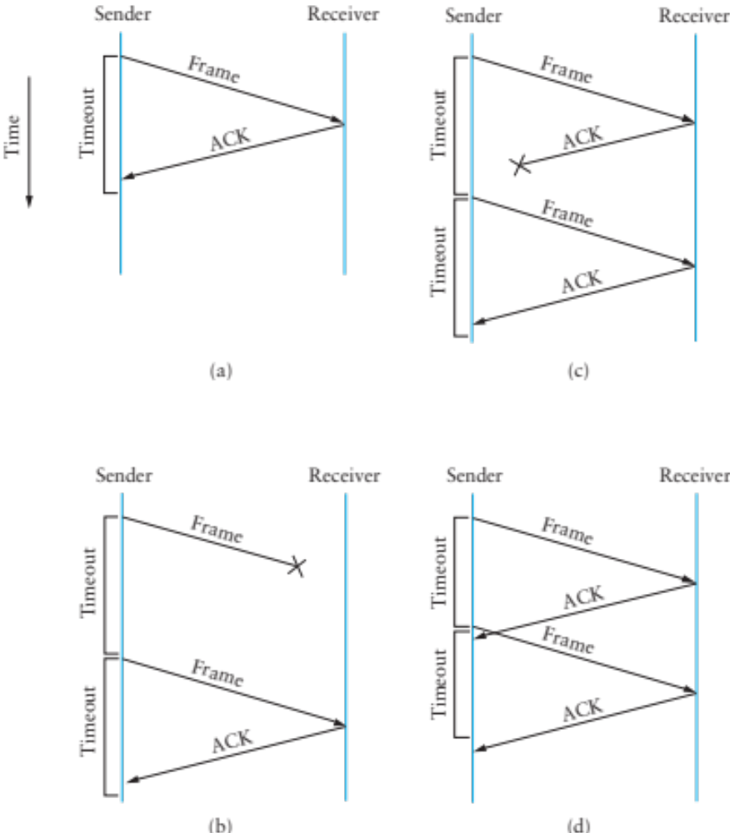

Slide 20
Stop and Wait Problems
Duplicate data
Duplicate acks
Can’t fill pipe (remember bandwitdh-delay product)
Difficult to set the timeout value

Slide 21
At Most Once Semantics
How to avoid duplicates?
  Uniquely identify each packet
  Have receiver and sender remember
Stop and Wait: add 1 bit to the header
  Why is it enough?

Slide 22
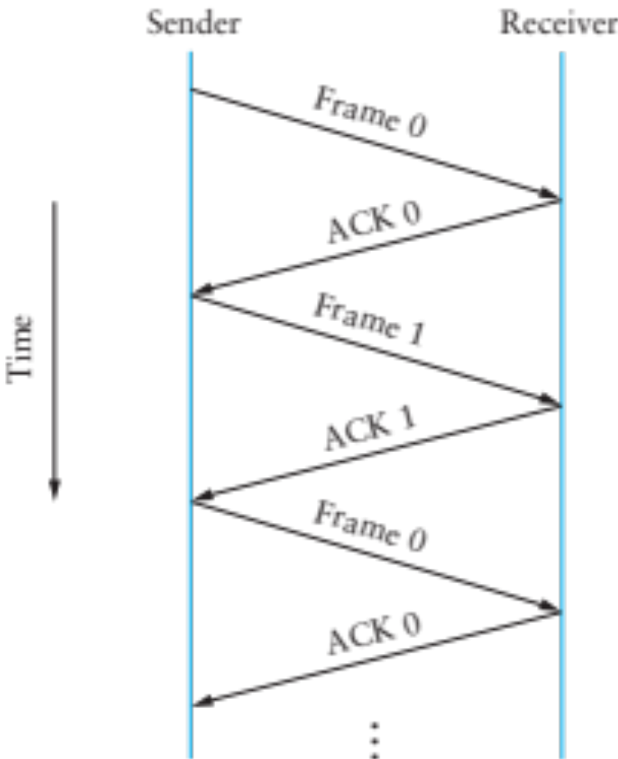

Slide 23
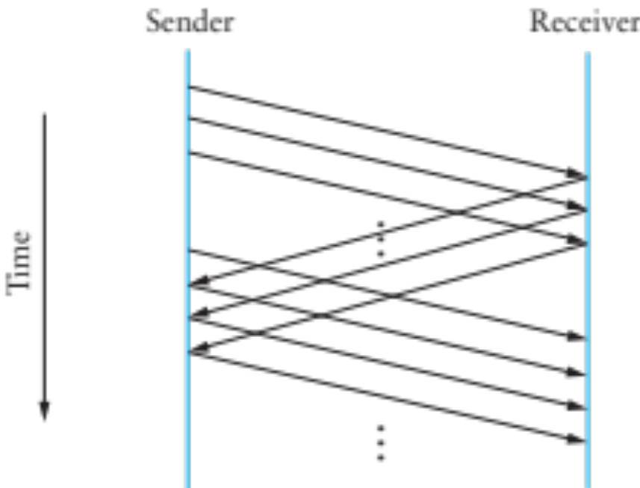
Sliding Window Protocol
Still have the problem of keeping pipe full
  Generalize approach with > 1-bit counter
  Allow multiple outstanding (unACKed) frames
  Upper bound on unACKed frames, called window

Slide 24
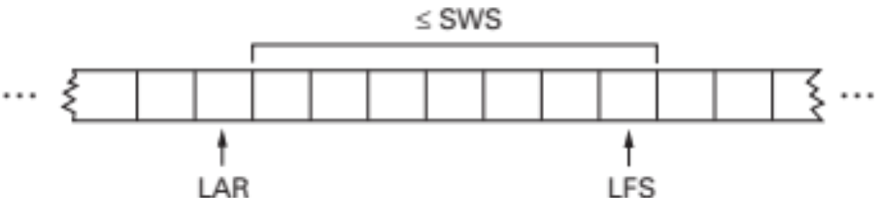
Sliding Window Sender
Assign sequence number (SeqNum) to each frame
Maintain three state variables
  send window size (SWS)
  last acknowledgment received (LAR)
  last frame send (LFS)
Maintain invariant: LFS – LAR ≤ SWS
Advance LAR when ACK arrives
Buffer up to SWS frames

Slide 25
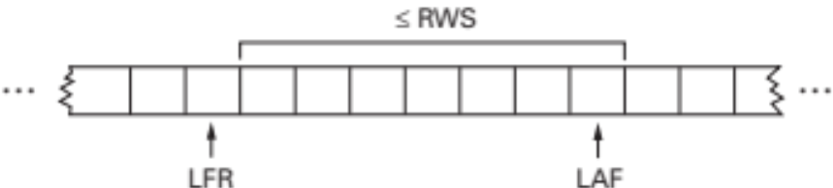
Sliding Window Receiver
Maintain three state variables:
  receive window size (RWS)
  largest acceptable frame (LAF)
  last frame received (LFR)
Maintain invariant: LAF – LFR ≤ RWS
Frame SeqNum arrives:
  if LFR < SeqNum ≤ LAF, accept
  if SeqNum ≤ LFR or SeqNum > LAF, discard
Send cumulative ACKs
Notes:
How to set SWS?
How to set RWS?
What is this accomplishing? Reliability, Ordering, Flow Control

Slide 26
Tuning Send Window
How big should SWS be?
  “Fill the pipe”
How big should RWS be?
  1 ≤ RWS ≤ SWS
How many distinct sequence numbers needed?
  If RWS = 1, need at least SWS+1
  If RWS = SWS, SWS < (#seqs + 1)/2
SWS can’t be more more than half of the space of valid seq#s.

Slide 27
An alternative for reliability
Erasure coding
  Assume you can detect errors
  Code is designed to tolerate entire missing frames
    Collisions, noise, drops because of bit errors
  Forward error correction
Examples: Reed-Solomon codes, LT Codes, Raptor Codes
Property:
  From K source frames, produce B > K encoded frames
  Receiver can reconstruct source with any K’ frames, with K’ slightly larger than K
  Some codes can make B as large as needed, on the fly

Slide 28
LT Codes
Luby Transform Codes
  Michael Luby, circa 1998
Encoder: repeat B times
  Pick a degree d
  Randomly select d source blocks. Encoded block t_{n}= XOR or selected blocks

Slide 29
LT Decoder
Find an encoded block t_{n} with d=1
Set s_{n} = t_{n}
For all other blocks t_{n’} that include s_{n} ,
set t_{n’}=t_{n’} XOR s_{n}
Delete s_{n} from all encoding lists
Finish if
  You decode all source blocks, or
  You run out out blocks of degree 1

Slide 30
Next class
Link Layer II
  Ethernet: dominant link layer technology
    Framing, MAC, Addressing
  Switching

