Slide 1
CSCI-1680
Application Interface
Rodrigo Fonseca
Based partly on lecture notes by David Mazières, Phil Levis, John Jannotti

Slide 2
Administrivia
Today: Network Programming mini-course! 368, 8-10pm
Signup for Snowcast milestone
  Must sign up for a slot by Fri 3pm
  http://bit.ly/snowcast12

Slide 3
Review
Multiplexing
Layering and Encapsulation
IP, TCP, UDP
Today:
  Performance Metrics
  Socket API
  Concurrent servers

Slide 4
Circuit Switching
Guaranteed allocation
  Time division / Frequency division multiplexing
Low space overhead
Easy to reason about
Failures: must re-establish connection
  For any failures along path
Overload: all or nothing
  No graceful degradation
Waste: allocate for peak, waste for less than peak
Set up time

Slide 5
Packet Switching
Break information in small chunks: packets
Each packet forwarded independently
  Must add metadata to each packet
Allows statistical multiplexing
  High utilization
  Very flexible
  Fairness not automatic
  Highly variable queueing delays
  Different paths for each packet

Slide 6
A Taxonomy of networks
Communication Network
Switched
Communication Network
Broadcast
Communication Network
Point-to-point network
Circuit-Switched
Communication Network
Packet-Switched
Communication Network
A hybrid of circuits and packets; headers include a “circuit identifier” established during a setup phase
Datagram
Network
Virtual Circuit Network

Slide 7
Layers, Services, Protocols
Last class: layering, separation of concerns
Application
Service: user-facing application.
Application-defined messages
Service: multiplexing applications
Reliable byte stream to other node (TCP),
Unreliable datagram (UDP)
Transport
Network
Service: move packets to any other node in the network
IP: Unreliable, best-effort service model
Link
Service: move frames to other node across link.
May add reliability, medium access control
Physical
Service: move bits to other node across link

Slide 8
Layers, Services, Protocols
Layer N+1
Service: abstraction provided to layer above
API: concrete way of using the service
Layer N
Protocol: rules for communication
within same layer
Layer N uses the services provided by N-1 to
implement its protocol and provide its own services
Layer N-1

Slide 9
Challenge
Decide on how to factor the problem
  What services at which layer?
  What to leave out?
  Balance demands,
For example:
  IP offers pretty crappy service, even on top of reliable links… why?
  TCP: offers reliable, in-order, no-duplicates service. Why would you want UDP?

Slide 10
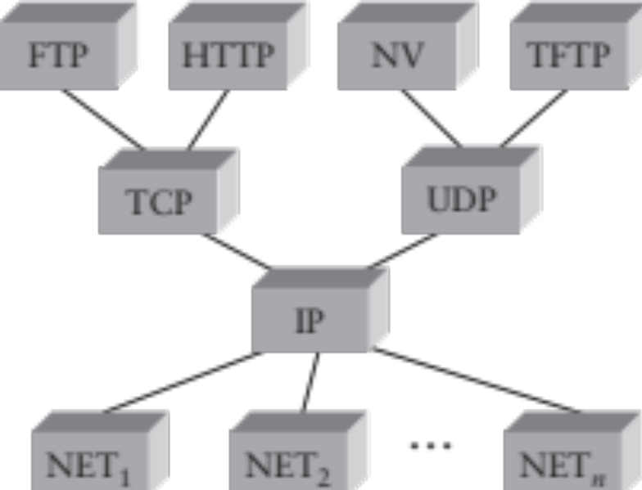
IP as the Narrow Waist
Many applications protocols on top of UDP & TCP
IP works over many types of networks
This is the “Hourglass” architecture of the Internet.
  If every network supports IP, applications run over many different networks (e.g., cellular network)

Slide 11
Network Layer: Internet Protocol (IP)
Used by most computer networks today
  Runs over a variety of physical networks, can connect Ethernet, wireless, modem lines, etc.
Every host has a unique 4-byte IP address (IPv4)
  E.g., www.cs.brown.edu →128.148.32.110
  The network knows how to route a packet to any address
Need more to build something like the Web
  Need naming (DNS)
  Interface for browser and server software (next lecture)
  Need demultiplexing within a host: which packets are for web browser, Skype, or the mail program?

Slide 12
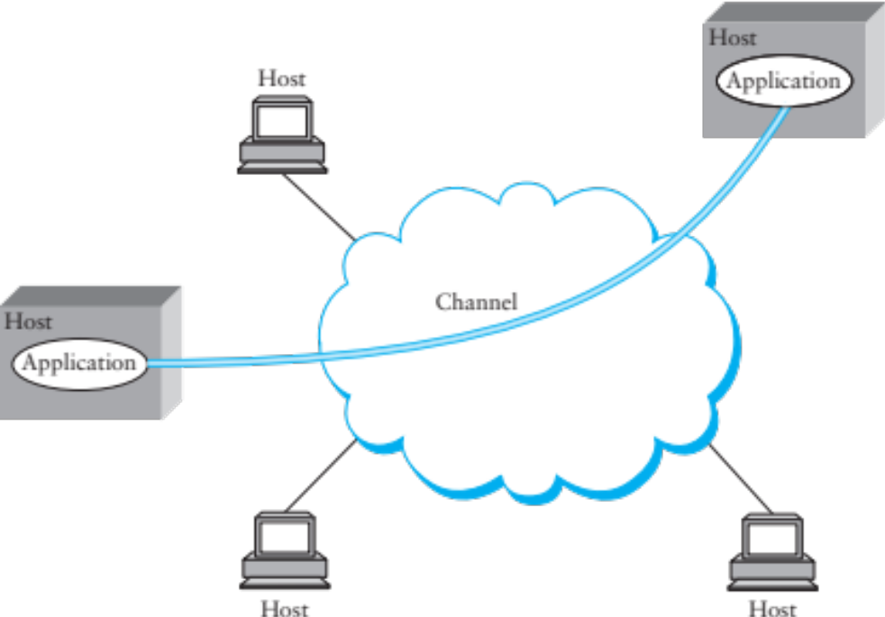
Inter-process Communication
Talking from host to host is great, but we want abstraction of inter-process communication
Solution: encapsulate another protocol within IP

Slide 13
Transport: UDP and TCP
UDP and TCP most popular protocols on IP
  Both use 16-bit port number & 32-bit IP address
  Applications bind a port & receive traffic on that port
UDP – User (unreliable) Datagram Protocol
  Exposes packet-switched nature of Internet
  Sent packets may be dropped, reordered, even duplicated (but there is corruption protection)
TCP – Transmission Control Protocol
  Provides illusion of reliable ‘pipe’ or ‘stream’ between two processes anywhere on the network
  Handles congestion and flow control

Slide 14
Performance Metrics
Throughput - Number of bits received/unit of time
  e.g. 10Mbps
Goodput - Useful bits received per unit of time
Latency – How long for message to cross network
  Process + Queue + Transmit + Propagation
Jitter – Variation in latency

Slide 15
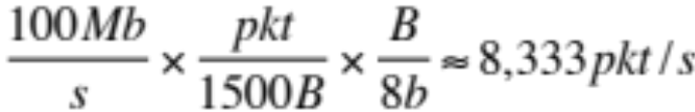
Latency
Processing
  Per message, small, limits throughput
  e.g. or 120μs/pkt
Queue
  Highly variable, offered load vs outgoing b/w
Transmission
  Size/Bandwidth
Propagation
  Distance/Speed of Light

Slide 16
Bandwidth and Delay
How much data can we send during one RTT?
E.g., send request, receive file
Request
Response
Time
For small transfers, latency more important, for bulk, throughput more important

Slide 17
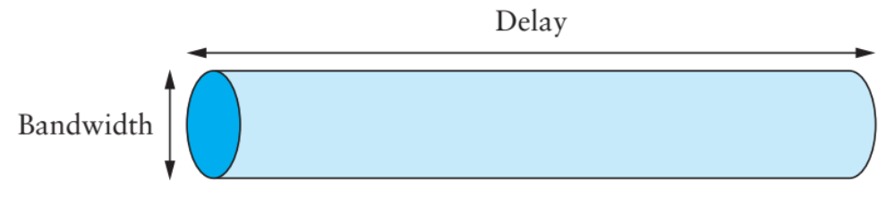
Maximizing Throughput
Can view network as a pipe
  For full utilization want bytes in flight ≥ bandwidth × delay
  But don’t want to overload the network (future lectures)
What if protocol doesn’t involve bulk transfer?
  Get throughput through concurrency – service multiple clients simultaneously

Slide 18
Using TCP/IP
How can applications use the network?
Sockets API.
  Originally from BSD, widely implemented (*BSD, Linux, Mac OS X, Windows, …)
  Important do know and do once
  Higher-level APIs build on them
After basic setup, much like files

Slide 19
System Calls
Problem: how to access resources other then CPU
  Disk, network, terminal, other processes
  CPU prohibits instructions that would access devices
  Only privileged OS kernel can access devices
Kernel supplies well-defined system call interface
  Applications request I/O operations through syscalls
  Set up syscall arguments and trap to kernel
  Kernel performs operation and returns results
Higher-level functions built on syscall interface
  printf, scanf, gets, all user-level code

Slide 20
File Descriptors
Most I/O in Unix done through file descriptors
  Integer handles to per-process table in kernel
int open(char *path, int flags, ...);
Returns file descriptor, used for all I/O to file

Slide 21
Sockets: Communication Between Machines
Network sockets are file descriptors too
Datagram sockets: unreliable message delivery
  With IP, gives you UDP
  Send atomic messages, which may be reordered or lost
  Special system calls to read/write: send/recv
Stream sockets: bi-directional pipes
  With IP, gives you TCP
  Bytes written on one end read on another
  Reads may not return full amount requested, must re-read

Slide 22
Error Returns
What if open fails? Returns -1 (invalid fd)
Most system calls return -1 on failure
  Specific type of error in global int errno
#include <sys/errno.h> for possible values
  2 = ENOENT “No such file or directory”
  13 = EACCES “Permission denied”
perror function prints human-readable message
  perror(“initfile”);
  initfile: No such file or directory

Slide 23
Some operations on File Descriptors
ssize_t read (int fd, void *buf, int nbytes);
  Returns number of bytes read
  Returns 0 bytes at end of file, or -1 on error
ssize_t write (int fd, void* buf, int nbytes);
  Returns number of bytes written, -1 on error
off_t lseek (int fd, off_t offset, int whence);
  whence: SEEK_SET, SEEK_CUR, SEEK_END
  returns new offset, or -1 on error
int close (int fd);
int fsync (int fd);
  Guarantees that file contents is stably on disk
See type.c

Slide 24
/* type.c */
#include <stdio.h>
#include <stdlib.h>
#include <unistd.h>
#include <fcntl.h>
void typefile (char *filename) {
int fd, nread;
char buf[1024];
fd = open (filename, O_RDONLY);
if (fd == -1) {
perror (filename);
return;
}
while ((nread = read (fd, buf, sizeof (buf))) > 0)
write (1, buf, nread);
close (fd);
}
int main (int argc, char **argv) {
int argno;
for (argno = 1; argno < argc; argno++)
typefile (argv[argno]);
exit (0);
}

Slide 25
System calls for using TCP
Client Server
socket – make socket
bind – assign address, port
listen – listen for clients
socket – make socket
bind* – assign address
connect – connect to listening socket
accept – accept connection
This call to bind is optional, connect can choose address & port.

Slide 26
Socket Naming
Recall how TCP & UDP name communication endpoints
  IP address specifies host (128.148.32.110)
  16-bit port number demultiplexes within host
  Well-known services listen on standard ports (e.g. ssh – 22, http – 80, mail – 25, see /etc/services for list)
  Clients connect from arbitrary ports to well known ports
A connection is named by 5 components
  Protocol, local IP, local port, remote IP, remote port
  TCP requires connected sockets, but not UDP

Slide 27
Socket Address Structures
Socket interface supports multiple network types
Most calls take a generic sockaddr:
struct sockaddr {
uint16_t sa_family; /* address family */
char sa_data[14]; /* protocol-specific addr */
};
E.g. int connect(int s, struct sockaddr* srv,
socklen_t addrlen);
Cast sockaddr * from protocol-specific struct, e.g.,
struct sockaddr_in {
short sin_family; /* = AF_INET */
u_short sin_port; /* = htons (PORT) */
struct in_addr sin_addr; /*32-bit IPv4 addr */
chars in_zero[8];
};

Slide 28
Dealing with Address Types
All values in network byte order (Big Endian)
  htonl(), htons(): host to network, 32 and 16 bits
  ntohl(), ntohs(): network to host, 32 and 16 bits
  Remember to always convert!
All address types begin with family
  sa_family in sockaddr tells you actual type
Not all addresses are the same size
  e.g., struct sockaddr_in6 is typically 28 bytes, yet generic struct sockaddr is only 16 bytes
  So most calls require passing around socket length
  New sockaddr_storage is big enough

Slide 29
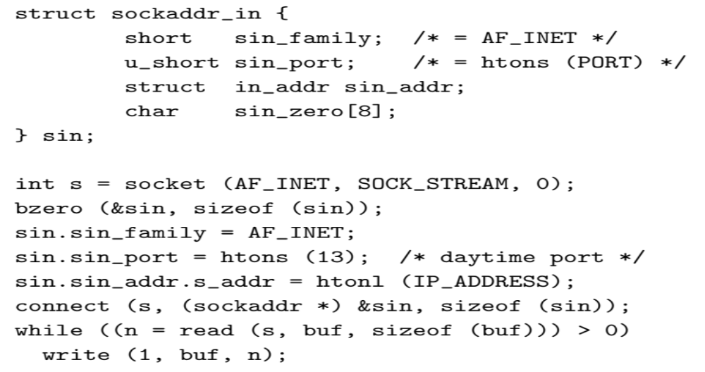
Client Skeleton (IPv4)

Slide 30
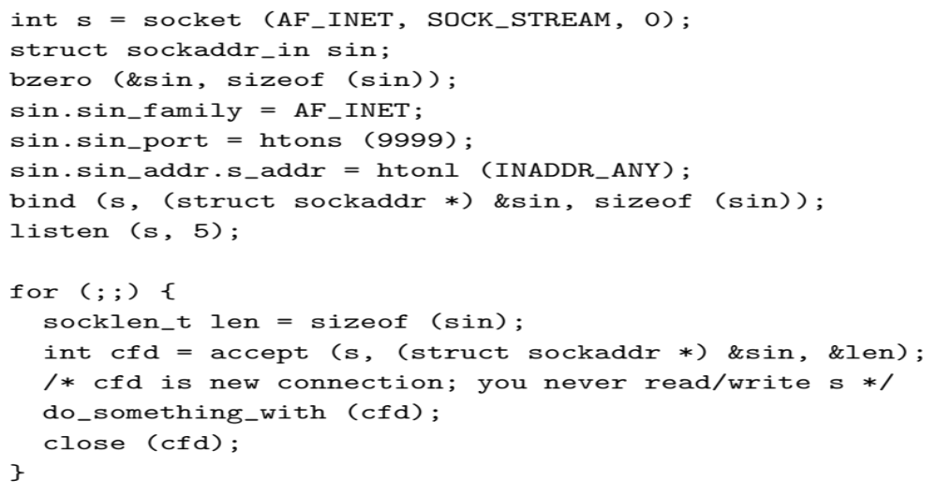
Server Skeleton (IPv4)

Slide 31
Looking up a socket address with getaddrinfo
struct addrinfo hints, *ai;
int err;
memset (&hints, 0, sizeof (hints));
hints.ai_family = AF_UNSPEC; /* or AF_INET or AF_INET6 */
hints.ai_socktype = SOCK_STREAM;/* or SOCK_DGRAM for UDP */
err = getaddrinfo ("www.brown.edu", "http", &hints, &ai);
if (err)
fprintf (stderr, "%s\n", gia_strerror (err));
else {
/* ai->ai_family = address type (AF_INET or AF_INET6) */
/* ai->ai_addr = actual address cast to (sockaddr *) */
/* ai->ai_addrlen = length of actual address */
freeaddrinfo (ai); /* must free when done! */
}

Slide 32
getaddrinfo() [RFC3493]
Protocol-independent node name to address translation
  Can specify port as a service name or number
  May return multiple addresses
  You must free the structure with freeaddrinfo
Other useful functions to know about
  getnameinfo – Lookup hostname based on address
  inet_ntop – Convert IPv4 or 6 address to printable
  Inet_pton – Convert string to IPv4 or 6 address

Slide 33
A Fetch-Store Server
Client sends command, gets response over TCP
Fetch command (“fetch\n”):
  Response has contents of last stored file
Store command (“store\n”):
  Server stores what it reads in file
  Returns OK or ERROR
What if server or network goes down during store?
  Don’t say “OK” until data is safely on disk
See fetch_store.c

Slide 34
EOF in more detail
What happens at end of store?
  Server receives EOF, renames file, responds OK
  Client reads OK, after sending EOF: didn’t close fd
int shutdown(int fd, int how);
  Shuts down a socket w/o closing file descriptor
  how: 0 = read, 1 = write, 2 = both
  Note: applies to socket, not descriptor, so copies of descriptor (through fork or dup affected)
  Note 2: with TCP, can’t detect if other side shuts for reading

Slide 35
Using UDP
Call socket with SOCK_DGRAM, bind as before
New calls for sending/receiving individual packets
  sendto(int s, const void *msg, int len, int flags, const struct sockaddr *to, socklen t tolen);
  recvfrom(int s, void *buf, int len, int flags, struct sockaddr *from, socklen t *fromlen);
  Must send/get peer address with each packet
Example: udpecho.c
Can use UDP in connected mode (Why?)
  connect assigns remote address
  send/recv syscalls, like sendto/recvfrom w/o last two arguments

Slide 36
Uses of UDP Connected Sockets
Kernel demultiplexes packets based on port
  Can have different processes getting UDP packets from different peers
Feedback based on ICMP messages (future lecture)
  Say no process has bound UDP port you sent packet to
  Server sends port unreachable message, but you will only receive it when using connected socket

Slide 37
Creating/Monitoring Processes
pid_t fork(void);
  Create new process that is exact copy of current one
  Returns twice!
  In parent: process ID of new process
  In child: 0
pid_t waitpid(pid_t pid, int *stat, int opt);
  pid – process to wait for, or -1 if any
  stat – will contain status of child
  opt – usually 0 or WNOHANG

Slide 38
Fork example
switch (pid = fork ()) {
case -1:
perror ("fork");
break;
case 0:
doexec ();
break;
default:
waitpid (pid, NULL, 0);
break;

Slide 39
Deleting Processes
void exit(int status);
  Current process ceases to exist
  Status shows up on waitpid (shifted)
  By convention, status of 0 is success, non-zero error
int kill (int pid, int sig);
  Sends signal sig to process pid
  SIGTERM most common sig, kills process by default (but application can catch it for “cleanup”)
  SIGKILL stronger, always kills

Slide 40
Serving Multiple Clients
A server may block when talking to a client
  Read or write of a socket connected to a slow client can block
  Server may be busy with CPU
  Server might be blocked waiting for disk I/O
Concurrency through multiple processes
  Accept, fork, close in parent; child services request
Advantages of one process per client
  Don’t block on slow clients
  May use multiple cores
  Can keep disk queues full for disk-heavy workloads

Slide 41
Threads
One process per client has disadvantages:
  High overhead – fork + exit ~100μsec
  Hard to share state across clients
  Maximum number of processes limited
Can use threads for concurrency
  Data races and deadlocks make programming tricky
  Must allocate one stack per request
  Many thread implementations block on some I/O or have heavy thread-switch overhead
Rough equivalents to fork(), waitpid(), exit(), kill(), plus locking primitives.

Slide 42
Non-blocking I/O
fcntl sets O_NONBLOCK flag on descriptor
int n;
if ((n = fcntl(s, F_GETFL)) >= 0)
fcntl(s, F_SETFL, n|O_NONBLOCK);
Non-blocking semantics of system calls:
  read immediately returns -1 with errno EAGAIN if no data
  write may not write all data, or may return EAGAIN
  connect may fail with EINPROGRESS (or may succeed, or may fail with a real error like ECONNREFUSED)
  accept may fail with EAGAIN or EWOULDBLOCK if no connections present to be accepted

Slide 43
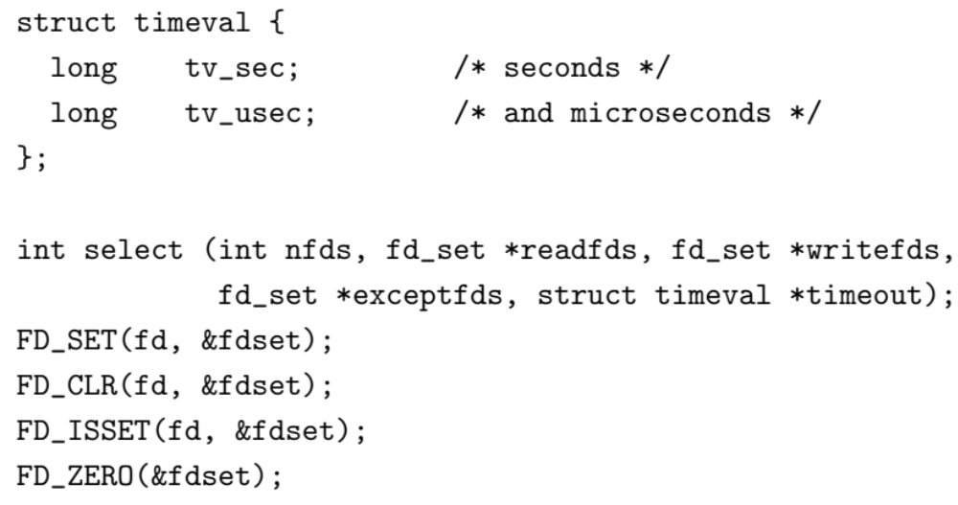
How do you know when to read/write?
Entire program runs in an event loop

Slide 44
Event-driven servers
Quite different from processes/threads
  Race conditions, deadlocks rare
  Often more efficient
But…
  Unusual programming model
  Sometimes difficult to avoid blocking
  Scaling to more CPUs is more complex

Slide 45
Coming Up
Next class: Physical Layer
Fri 03: Snowcast milestones

