Slide 1
CSCI-1680 - Computer Networks
Rodrigo Fonseca (rfonseca)
http://www.cs.brown.edu/courses/cs168
cs168tas@cs.brown.edu
Based partly on lecture notes by David Mazières, Phil Levis, John Jannotti, Peterson & Davie

Slide 2
Cast
Instructor: Rodrigo Fonseca (rfonseca)
GTA: Justin DeBrabant(debrabant)
HTA: Stephen Poletto (spoletto)
UTA: Sam Helman (shelman)
UTA: SeungJi Lee (sl136)
Email: cs168tas@cs.brown.edu (all of us)

Slide 3
Overview
Goal: learn concepts underlying networks
  How do networks work? What can one do with them?
  Gain a basic understanding of the Internet
  Gain experience writing protocols
  Tools to understand new protocols and applications

Slide 4
Prerequisites
CSCI-0320/CSCI-0360 (or equivalent).
  We assume basic OS concepts (kernel/user, threads/processes, I/O, scheduling)
Low-level programming or be willing to learn quickly
  threads, locking, explicit memory management, …
We allow any* language, but really support only C
  You will be bit twiddling and byte packing…

Slide 5
Administrivia
All assignments will be on the course page
http://www.cs.brown.edu/courses/cs168/s12
Text: Peterson and Davie, Computer Networks - A Systems Approach, 4th or 5th Editions
You are responsible to check the web page!
  All announcements will be there
  Textbook chapters corresponding to lectures: read them before class
  Handouts, due dates, programming resources, etc…
  Subject to change (reload before checking assignments)

Slide 6
Grading
“Written” component
  Exams: Midterm (15%) and Final (25%)
  Homework: 3 written assignments (15%)
    Short answer and design questions
4 Programming Projects (45%)
  Snowcast: streaming music server
  IP, as an overlay, on top of UDP
  TCP, on top of your IP
  Final (TBD)
Must pass two components individually

Slide 7
Networks
What is a network?
  System of lines/channels that interconnect
  E.g., railroad, highway, plumbing, postal, telephone, social, computer
Computer Network
  Moves information
  Nodes: general-purpose computers (most nodes)
  Links: wires, fiber optics, EM spectrum, composite…

Slide 8
Why Study Computer Networks?
Many nodes are general-purpose computers
Very easy to innovate and develop new uses of the network: you can program the nodes
Contrast with the ossified Telephone network:
  Can’t program most phones
  Intelligence in the network, control by parties vested in the status quo, …

Slide 9
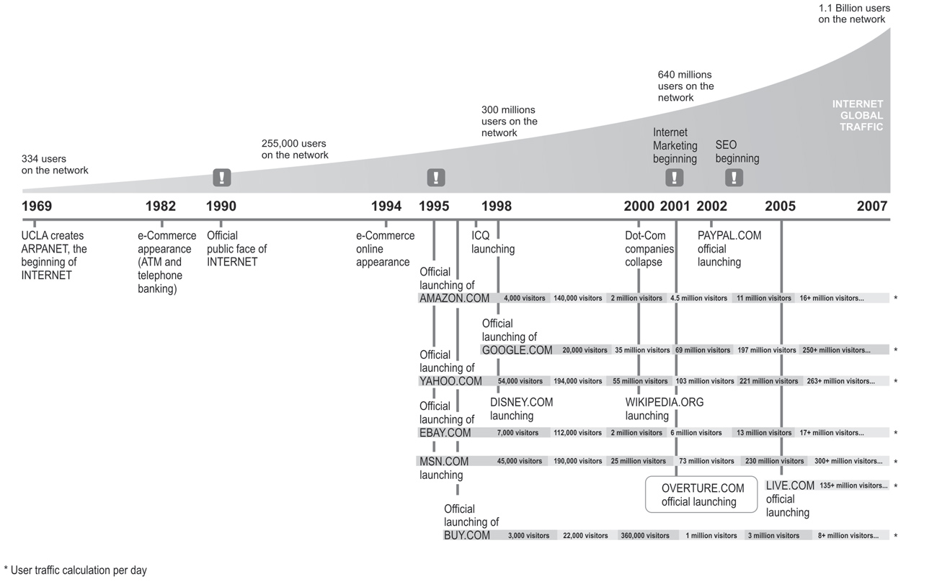
Growth of the Internet
Source: Miguel Angel Todaro

Slide 10
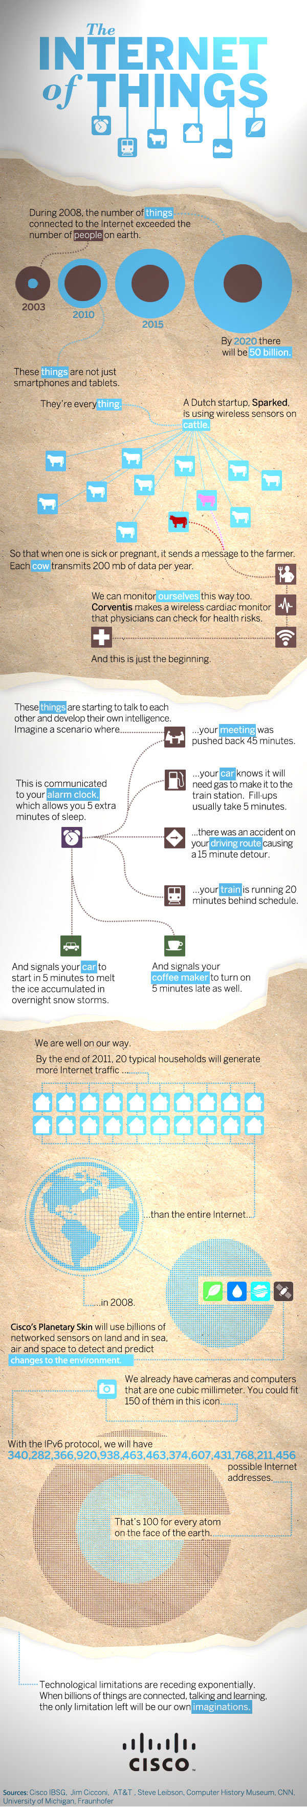
Source: Cisco

Slide 11
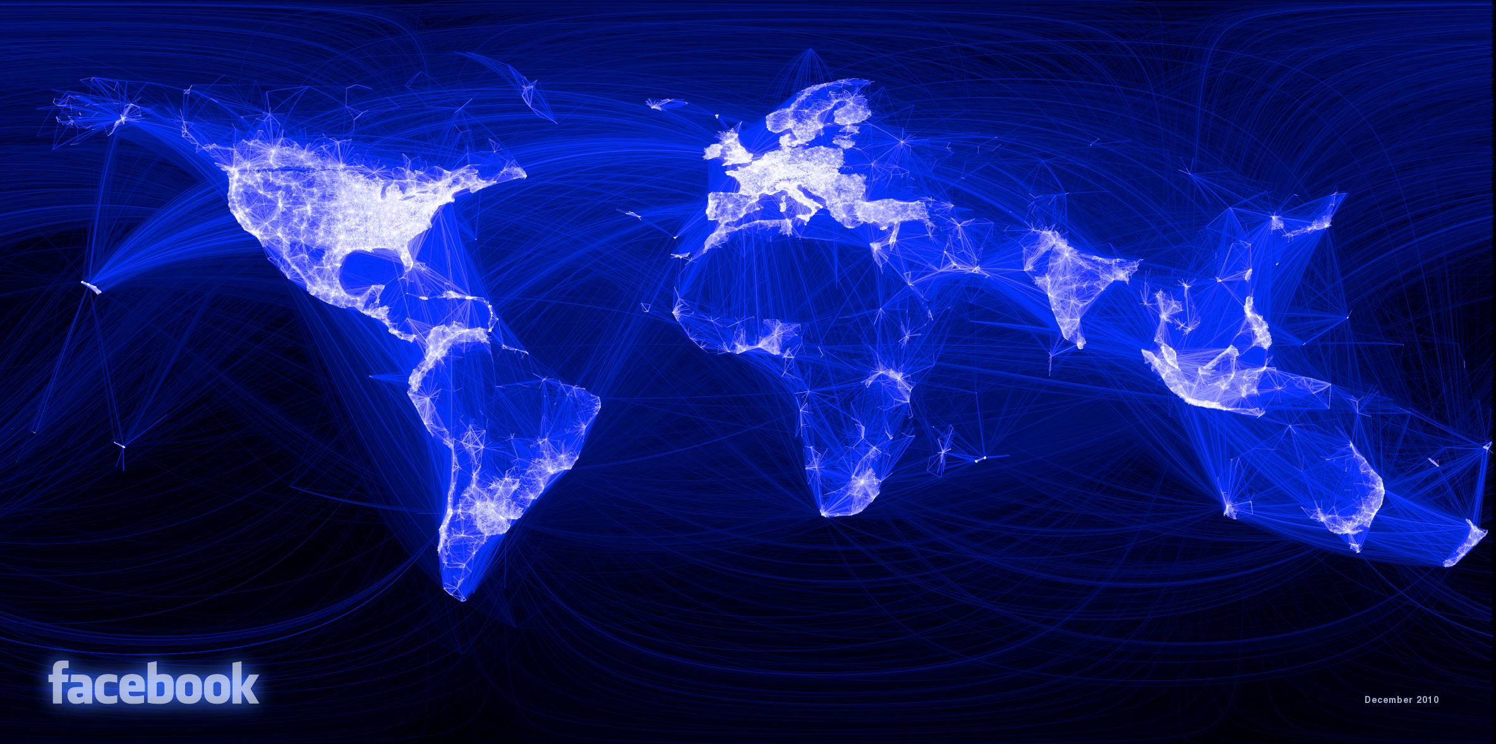
Source: Facebook

Slide 12
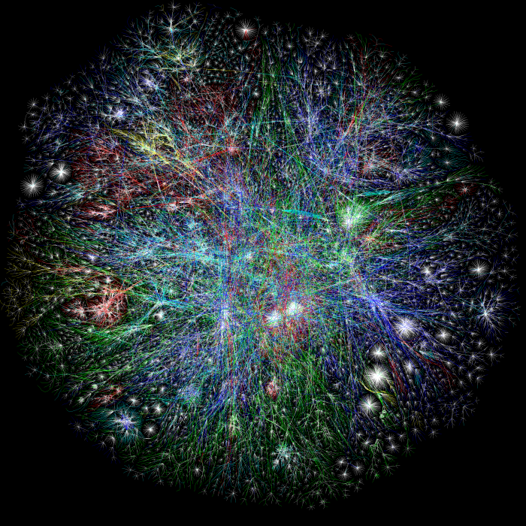
Traceroute map of the Internet, ~5 million edges, circa 2003. opte.org

Slide 13
Why should you take this course?
Impact
  Social, economic, political, educational, …
  Why would SOPA never work?
  What does it mean to run out of IP addresses?
  How could Egypt shut down the Internet internally
  How could Pakistan shut down Youtube globally
Continuously changing and evolving
  Incredible complexity
  Any fact you learn will be inevitably out of date
  Learn general underlying principles
Learn to program the network
Networks are cool!

Slide 14
Roadmap
Assignments: learn by implementing
  Warm up: Snowcast, a networked music server
    Get a feel for how applications use the network
Build knowledge from the ground up
  Link individual nodes
  Local networks with multiple nodes
  IP: Connect hosts across several networks
  Transport: Connect processes on different hosts
  Applications
A few cross-cutting issues
  Security, multimedia, overlay networks, P2P…

Slide 15

Two-minutes for stretching…
(and an opportunity to sneak out if you are shopping)

Slide 16
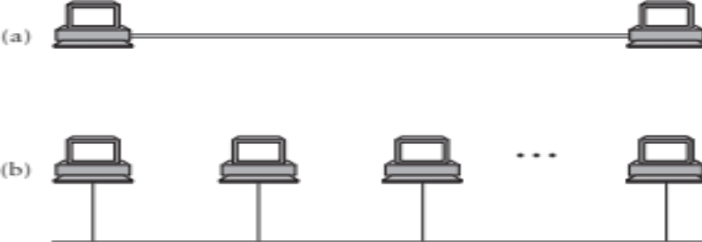
Building Blocks
Nodes: Computers (hosts), dedicated routers, …
Links: Coax, twisted pair, fiber, radio, …

Slide 17
How to connect more nodes?
Multiple wires
Shared medium

Slide 18
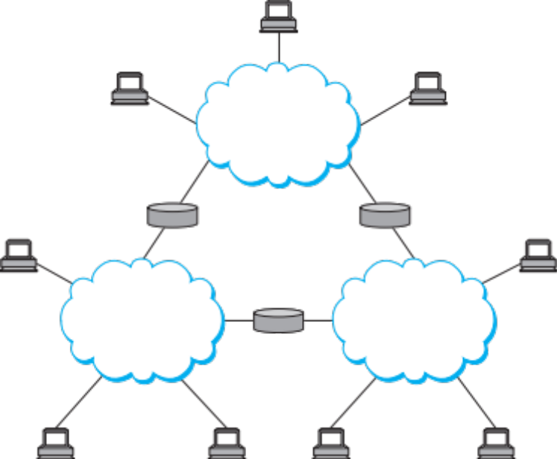
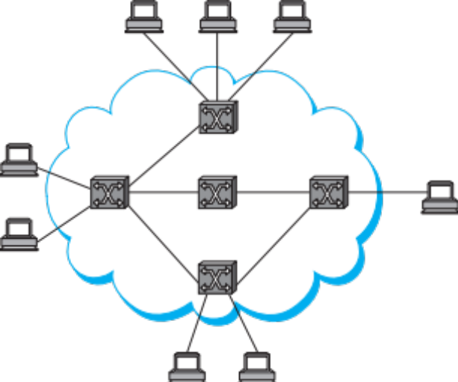
From Links to Networks
To scale to more nodes, use switching
  Nodes can connect to multiple other nodes
  Recursively, one node can connect to multiple networks
Notes:
Notice how we have some central elements connecting the hosts: switches
We want to create the illusion that the nodes are all connected to each other

Slide 19
Switching Strategies
Circuit Switching – virtual link between two nodes
  Set up circuit (e.g. dialing, signaling) – may fail: busy
  Transfer data at known rate
  Tear down circuit
Packet Switching
  Forward bounded-size messages.
  Each message can have different senders/receivers
  Focus of this course
Analogy: circuit switching reserves the highway for a cross-country trip. Packet switching interleaves everyone’s cars.

Slide 20
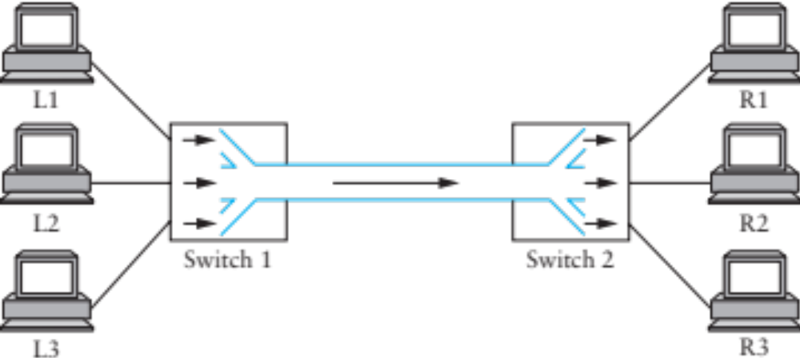
Multiplexing
What to do when multiple flows must share a link?

Slide 21
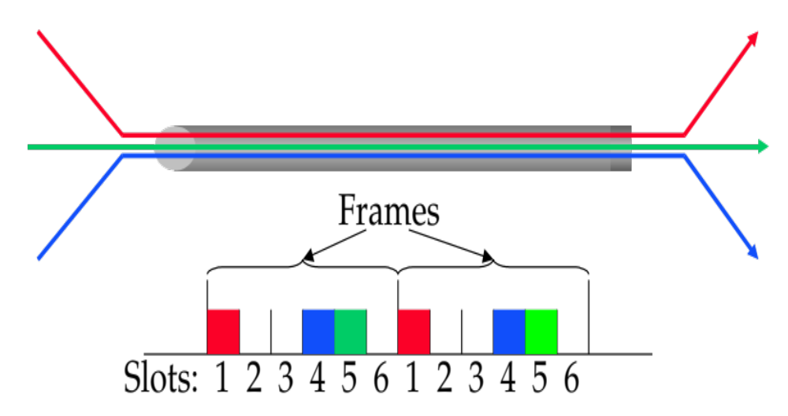
STDM
Synchronous time-division multiplexing
  Divide time into equal-sized quanta, round robin
  Illusion of direct link for switched circuit net
  But wastes capacity if not enough flows
  Also doesn’t degrade gracefully when more flows than slots

Slide 22
FDM
Frequency-division multiplexing: allocates a frequency band for each flow
  Same TV channels and radio stations
Similar drawbacks to STDM
  Wastes bandwidth if someone not sending
  Can run out of spectrum

Slide 23
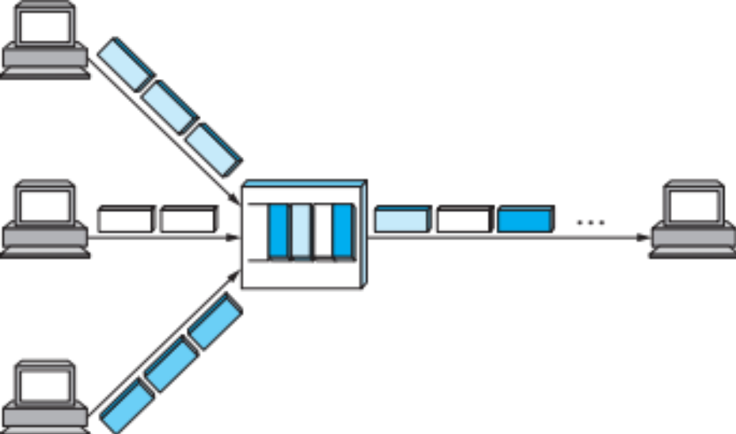
Statistical Multiplexing
Idea: like STDM but with no pre-determined time slots (or order!)
Maximizes link utilization
  Link is never idle if there are packets to send

Slide 24
Statistical Multiplexing
Cons:
  Hard to guarantee fairness
  Unpredictable queuing delays
  Packets may take different paths
Yet…
  This is the main model used on the Internet

Slide 25
Traceroute map of the Internet, ~5 million edges, circa 2003. opte.org

Slide 26
Managing Complexity
Very large number of computers
Incredible variety of technologies
  Each with very different constraints
No single administrative entity
Evolving demands, protocols, applications
  Each with very different requirements!
How do we make sense of all this?

Slide 27
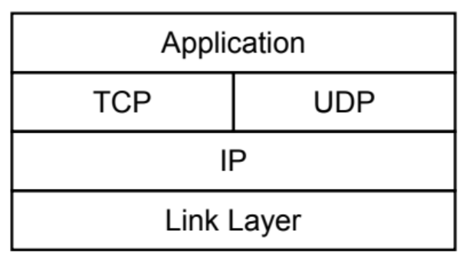
Layering
Separation of concerns
  Break problem into separate parts
  Solve each one independently
  Tie together through common interfaces: abstraction
  Encapsulate data from the layer above inside data from the layer below
  Allow independent evolution
Example
  A network layer packet from A to D is put in link layer packets A to B, B, to C, C to D

Slide 28
Single Link Communication
Physical Layer: Several questions:
  Encoding: voltage, frequency, phase,…
  Medium: copper, fiber, radio, light,…
Link Layer: how to send data?
  When to talk
  What to say (format, “language”)
Examples: Ethernet, USB
  Stay tuned for lectures 3 and 4…

Slide 29
Layers
Application – what the users sees, e.g., HTTP
Presentation – crypto, conversion between representations
Session – can tie together multiple streams (e.g., audio & video)
Transport – demultiplexes, provides reliability, flow and congestion control
Network – sends packets, using routing
Data Link – sends frames, handles media access
Physical – sends individual bits

Slide 30
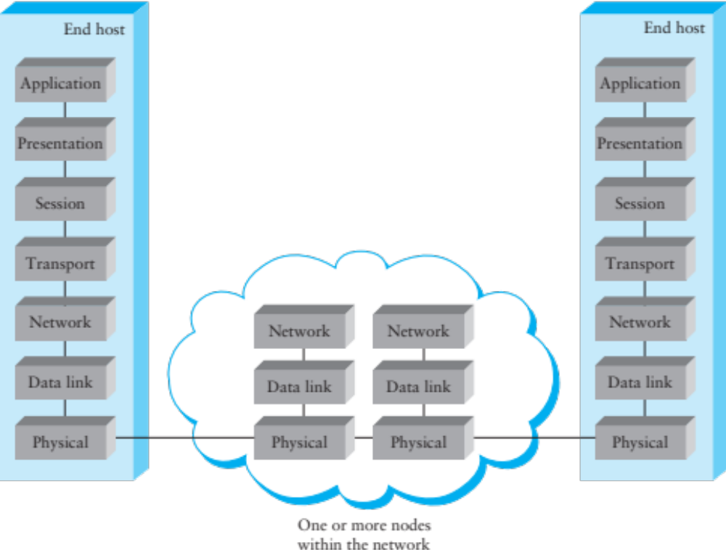
OSI Reference Model
Application Protocol
Transport Protocol
Network Protocol
Link-Layer Protocol
Notes:
Open Systems Interconnect, ISO

Slide 31
Protocols
What do you need to communicate?
  Definition of message formats
  Definition of the semantics of messages
  Definition of valid sequences of messages
    Including valid timings

Slide 32
Addressing
Each node typically has a unique* name
  When that name also tells you how to get to the node, it is called an address
Each layer can have its own naming/addressing
Routing is the process of finding a path to the destination
  In packet switched networks, each packet must have a destination address
  For circuit switched, use address to set up circuit
Special addresses can exist for broadcast/multicast/anycast
* or thinks it does, in case there is a shortage

Slide 33
Network Layer: Internet Protocol (IP)
Used by most computer networks today
  Runs over a variety of physical networks, can connect Ethernet, wireless, modem lines, etc.
Every host has a unique 4-byte IP address (IPv4)
  E.g., www.cs.brown.edu →128.148.32.110
  The network knows how to route a packet to any address
Need more to build something like the Web
  Need naming (DNS)
  Interface for browser and server software (next lecture)
  Need demultiplexing within a host: which packets are for web browser, Skype, or the mail program?

Slide 34
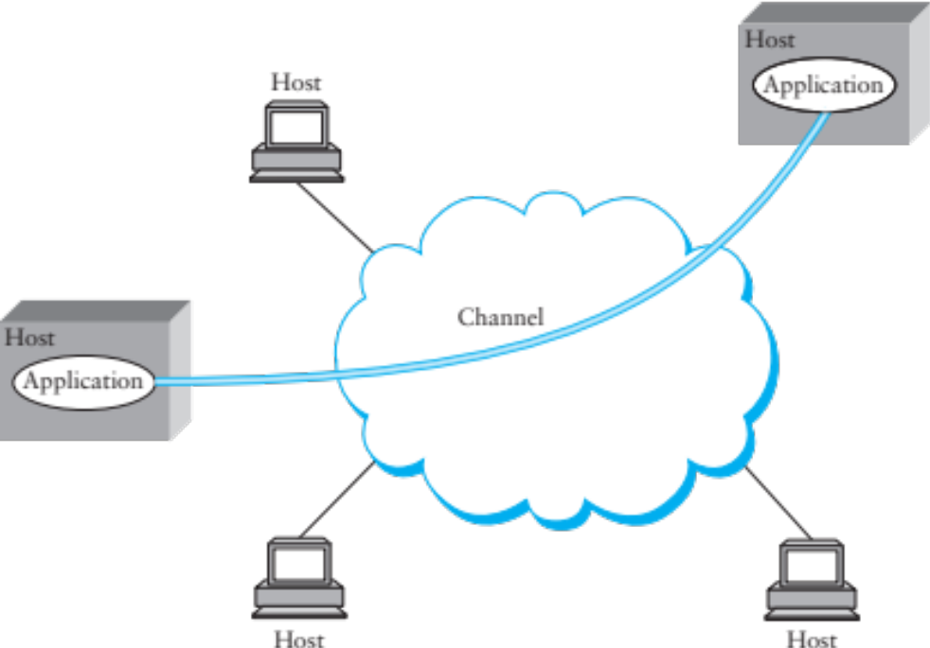
Inter-process Communication
Talking from host to host is great, but we want abstraction of inter-process communication
Solution: encapsulate another protocol within IP

Slide 35
Transport: UDP and TCP
UDP and TCP most popular protocols on IP
  Both use 16-bit port number & 32-bit IP address
  Applications bind a port & receive traffic on that port
UDP – User (unreliable) Datagram Protocol
  Exposes packet-switched nature of Internet
  Sent packets may be dropped, reordered, even duplicated (but there is corruption protection)
TCP – Transmission Control Protocol
  Provides illusion of reliable ‘pipe’ or ‘stream’ between two processes anywhere on the network
  Handles congestion and flow control

Slide 36
Uses of TCP
Most applications use TCP
  Easier to program (reliability is convenient)
  Automatically avoids congestion (don’t need to worry about taking down the network
Servers typically listen on well-know ports:
  SSH: 22
  SMTP (email): 25
  Finger: 79
  HTTP (web): 80

Slide 37
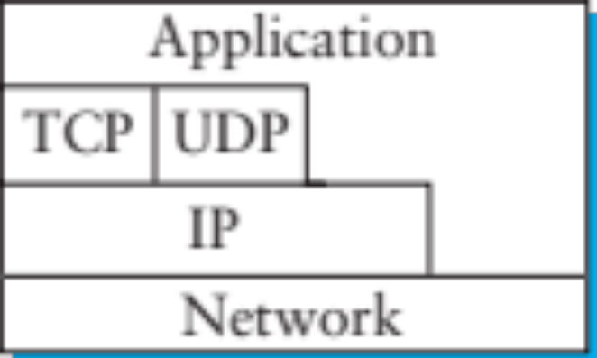
Internet Layering
Strict layering not required
  TCP/UDP “cheat” to detect certain errors in IP-level information like address
  Overall, allows evolution, experimentation

Slide 38
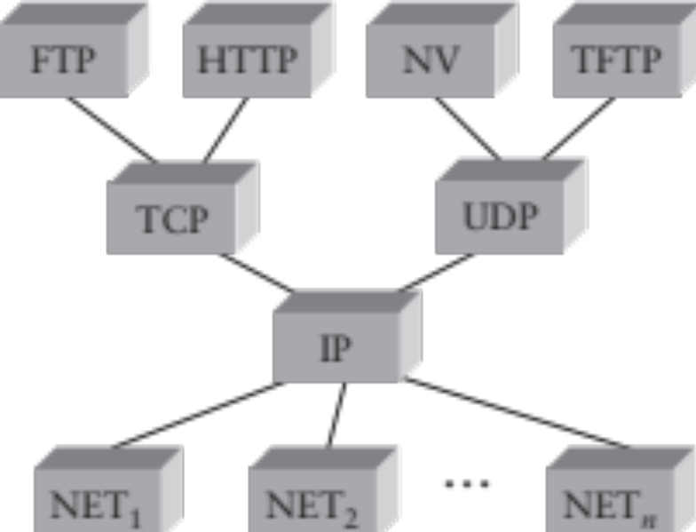
IP as the Narrow Waist
Many applications protocols on top of UDP & TCP
IP works over many types of networks
This is the “Hourglass” architecture of the Internet.
  If every network supports IP, applications run over many different networks (e.g., cellular network)

Slide 39
Roadmap
Assignments: learn by implementing
  Warm up: Snowcast, a networked music server
    Get a feel for how applications use the network
Build knowledge from the ground up
  Link individual nodes
  Local networks with multiple nodes
  IP: Connect hosts across several networks
  Transport: Connect processes on different hosts
  Applications
A few cross-cutting issues
  Security, multimedia, overlay networks, P2P…

Slide 40
Coming Up
Next class: how do applications use the network?
  Introduction to programming with Sockets
  Peterson & Davie 1.4
  Beej’s Guide to Network Programming (link on the course website)
Then…
  We start moving up the network stack, starting from how two computers can talk to each other.
Remember: start your projects TODAY!

