Slide 1
CSCI-1680
RPC and Data Representation
Rodrigo Fonseca

Slide 2
Administrivia
TCP: talk to the TAs if you still have questions!
Thursday: HW3 out
Final Project (out 4/21)
  Implement a WebSockets server
  … an efficient server
  Evaluation:
    Correctness (should work with a simple chat application)
    Efficiency: response time as number of clients increases
    Minimum performance level
    Little contest: most scalable server wins extra credit
  More information soon…

Slide 3
Today
Defining Protocols
  RPC
  IDL

Slide 4
Problem
Two programs want to communicate: must define the protocol
  We have seen many of these, across all layers
  E.g., Snowcast packet formats, protocol headers
Key Problems
  Semantics of the communication
    APIs, how to cope with failure
  Data Representation
  Scope: should the scheme work across
    Architectures
    Languages
    Compilers…?

Slide 5
RPC – Remote Procedure Call
Procedure calls are a well understood mechanism
  Transfer control and data on a single computer
Idea: make distributed programming look the same
  Have servers export interfaces that are accessible through local APIs
  Perform the illusion behind the scenes
2 Major Components
  Protocol to manage messages sent between client and server
  Language and compiler support
    Packing, unpacking, calling function, returning value

Slide 6
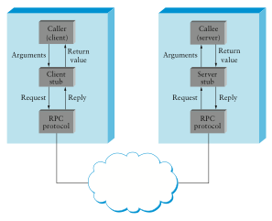

Slide 7
Can we maintain the same semantics?
Mostly…
Why not?
  New failure modes: nodes, network
Possible outcomes of failure
  Procedure did not execute
  Procedure executed once
  Procedure executed multiple times
  Procedure partially executed
Desired: at-most-once semantics

Slide 8
Implementing at-most-once semantics
Problem: request message lost
  Client must retransmit requests when it gets no reply
Problem: reply message lost
  Client may retransmit previously executed request
  OK if operation is idempotent
  Server must keep “replay cache” to reply to already executed requests
Problem: server takes too long executing
  Client will retransmit request already in progress
  Server must recognize duplicate – could reply “in progress”

Slide 9
Server Crashes
Problem: server crashes and reply lost
  Can make replay cache persistend – slow
  Can hope reboot takes long enough for all clients to fail
Problem: server crashes during execution
  Can log enough to restart partial execution – slow and hard
  Can hope reboot takes long enough for all clients to fail
Can use “cookies” to inform clients of crashes
  Server gives client cookie, which is f(time of boot)
  Client includes cookie with RPC
  After server crash, server will reject invalid cookie

Slide 10
RPC Components
Stub Compiler
  Creates stub methods
  Creates functions for marshalling and unmarshalling
Dispatcher
  Demultiplexes programs running on a machine
  Calls the stub server function
Protocol
  At-most-once semantics (or not)
  Reliability, replay caching, version matching
  Fragmentation, Framing (depending on underlying protocols)

Slide 11
Examples of RPC Systems
SunRPC (now ONC RPC)
  The first popular system
  Used by NSF
  Not popular for the wide area (security, convenience)
Java RMI
  Popular with Java
  Only works among JVMs
DCE
  Used in ActiveX and DCOM, CORBA
  Stronger semantics than SunRPC, much more complex

Slide 12
More examples
XML-RPC, SOAP
Json-RPC
Apache Thrift

Slide 13
Presentation Formatting
How to represent data?
Several questions:
  Which data types do you want to support?
    Base types, Flat types, Complex types
  How to encode data into the wire
  How to decode the data?
    Self-describing (tags)
    Implicit description (the ends know)
Several answers:
  Many frameworks do these things automatically

Slide 14
Which data types?
Basic types
  Integers, floating point, characters
  Some issues: endianness (ntohs, htons), character encoding, IEEE 754
Flat types
  Strings, structures, arrays
  Some issues: packing of structures, order, variable length
Complex types
  Pointers! Must flatten, or serialize data structures

Slide 15
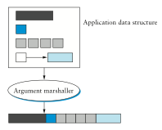

Slide 16
Schema
How to parse the encoded data?
Self-describing data: tags
  Additional information added to message to help in decoding
  Examples: field name, type, length
Implicit: the code at both ends “knows” how to decode the message
  E.g., your Snowcast implementation
  Interoperability depends on well defined protocol specification!

Slide 17
Stub Generation
Many systems generate stub code from independent specification: IDL
Separates logical description of data from
  Dispatching code
  Marshalling/unmarshalling code
  Data wire format

Slide 18
Sun XDR (RFC 4506)
External Data Representation for SunRPC
Types: most of C types
No tags (except for array lengths)
  Code needs to know structure of message
Usage:
  Create a program description file (.x)
  Run rpcgen program
  Include generated .h files, use stub functions
Very C/C++ oriented
  Although encoders/decoders exist for other languages

Slide 19
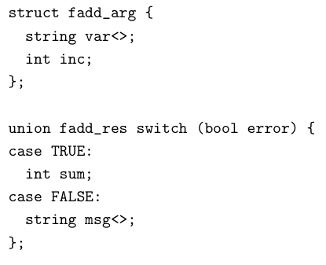
Example: fetch and add server
In fadd_prot.x:

Slide 20
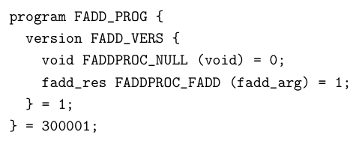
RPC Program Definition
Rpcgen generates marshalling/unmarshalling code, stub functions, you fill out the actual code

Slide 21
XML
Other extreme
Markup language
  Text based, semi-human readable
  Heavily tagged (field names)
  Depends on external schema for parsing
  Hard to parse efficiently
<person>
<name>John Doe</name>
<email>jdoe@example.com</email>
</person>

Slide 22
Google Protocol Buffers
Defined by Google, released to the public
  Widely used internally and externally
  Supports common types, service definitions
  Natively generates C++/Java/Python code
    Over 20 other supported by third parties
  Not a full RPC system, only does marshalling
    Many third party RPC implementations
  Efficient binary encoding, readable text encoding
Performance
  3 to 10 times smaller than XML
  20 to 100 times faster to process

Slide 23
Binary Encoding
Integers: varints
  7 bits out of 8 to encode integers
  Msb: more bits to come
  Multi-byte integers: least significant group first
Signed integers: zig-zag encoding, then varint
  0:0, -1:1, 1:2, -2:3, 2:4, …
  Advantage: smaller when encoded with varint
General:
  Field number, field type (tag), value
Strings:
  Varint length, unicode representation

Slide 24
Apache Thrift
Originally developed by Facebook
Used heavily internally
Full RPC system
  Support for C++, Java, Python, PHP, Ruby, Erlang, Perl, Haskell, C#, Cocoa, Smalltalk, and Ocaml
Many types
  Base types, list, set, map, exceptions
Versioning support
Many encodings (protocols) supported
  Efficient binary, json encodings

Slide 25
Apache Avro
Yet another newcomer
Likely to be used for Hadoop data representation
Encoding:
  Compact binary with schema included in file
  Amortized self-descriptive
Why not just create a new encoding for Thrift?
  I don’t know…

Slide 26
Conclusions
RPC is good way to structure many distributed programs
  Have to pay attention to different semantics, though!
Data: tradeoff between self-description, portability, and efficiency
Unless you really want to bit pack your protocol, and it won’t change much, use one of the IDLs
Parsing code is easy to get (slightly) wrong, hard to get fast
  Should only do this once, for all protocols
Which one should you use?

